Slide 1
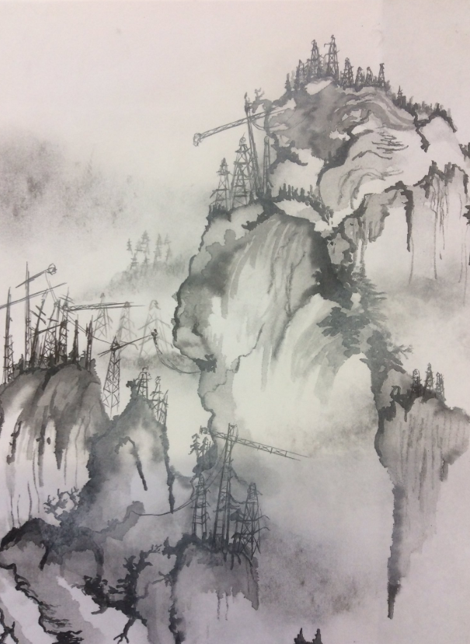
Task description
Photograph and print out (A4) your Chinese ink landscape study.
Find some images that link to the idea of urban sprawl, e.g. cranes, pylons, high rise buildings.
Add multiples of such features to the hillsides on your copy using biro or fine liner (this should link to Yang Yongliang's work).
For my example I have used black pen and white chalk.

