Slide 1
Final piece design
Please note that the final piece, once completed, will be levelled.
You will be assessed on the following:
-pattern creation skills.
-use of colour.
-collage skills.
-drawing and painting skills.
-complexity and effectiveness of overall design.

Slide 2
Thank you for all your fantastic patterns you’ve been submitting. I have started marking them and will send individual feedback asap. If you are still to submit, please do so!
These patterns will be used later to form the hair/clothing of your final piece Japanese portrait.
Today I would like you to do the actual layout drawn design for your final piece portrait.
To do this use a double page in your sketchbook (so that it is A3 size). If you don’t have your sketchbook use a thick type of paper, as you will be painting onto it. If you don’t like having the middle seam of the sketchbook use an A4 page or A3 heavy loose paper. My examples are A3 size done on loose cartridge paper.
I have attached my designs on slide 3 and 4 (today you are just drawing the outline, lightly with a pencil). In later lessons you will be collaging parts of your pattern and painting the face.
You are just doing one design, so pick either a ‘kabuki portrait’ or a ‘manga/anime portrait’. Both will bring up lots of options on google images.
Note: for a more complex design pick to do a design with folds of clothing, for a simpler one look for one that has a simple hair and outfit shape.

Slide 3
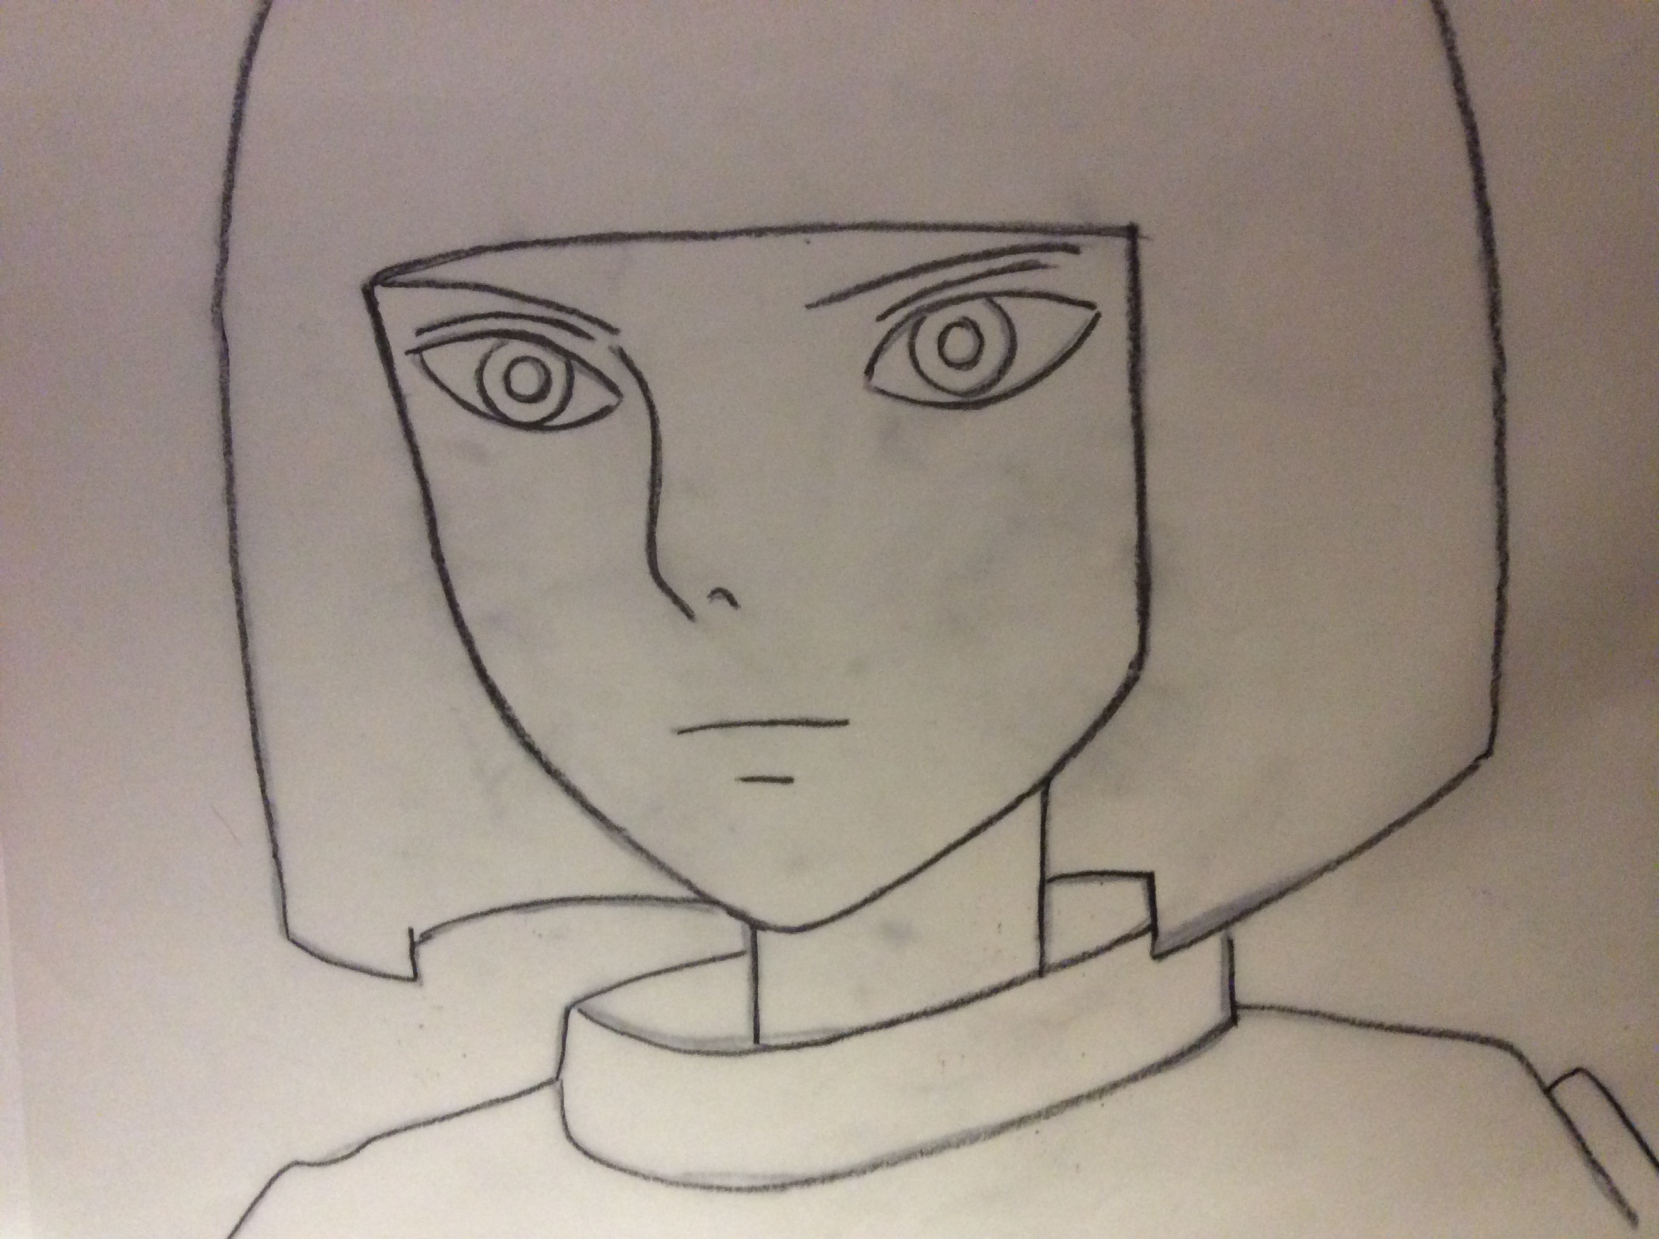
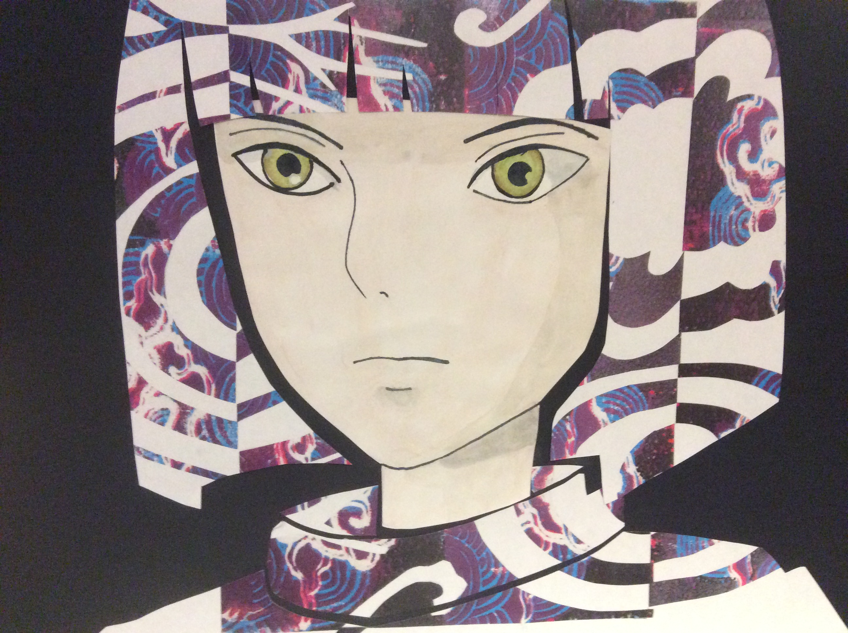
Example 1 – simple shapes
Image on the top is my example for the task today, image below shows what you will end up doing with it. Please note that I have only done heavy lines because it would not show up in the photo, you are to do light outlines (we don’t want them showing through when we paint it next lesson). Fill the page, as smaller shapes will be harder to cut in later lessons.

Slide 4
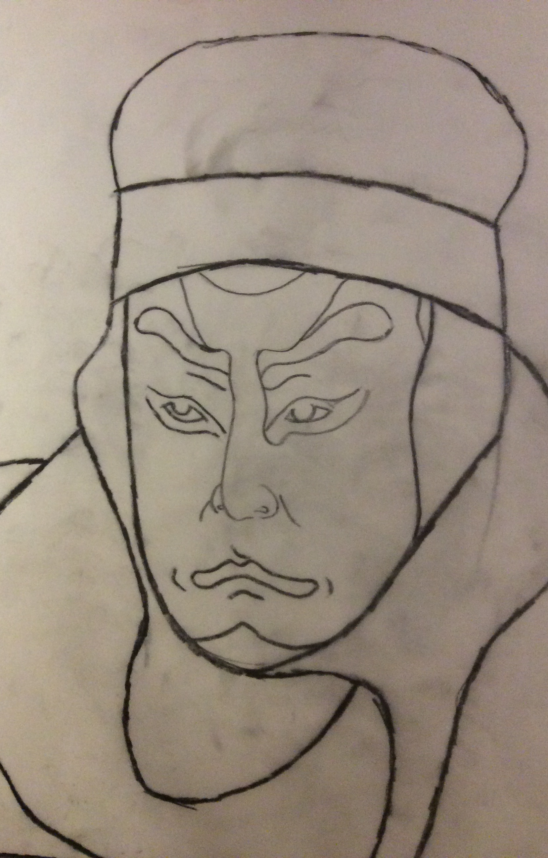
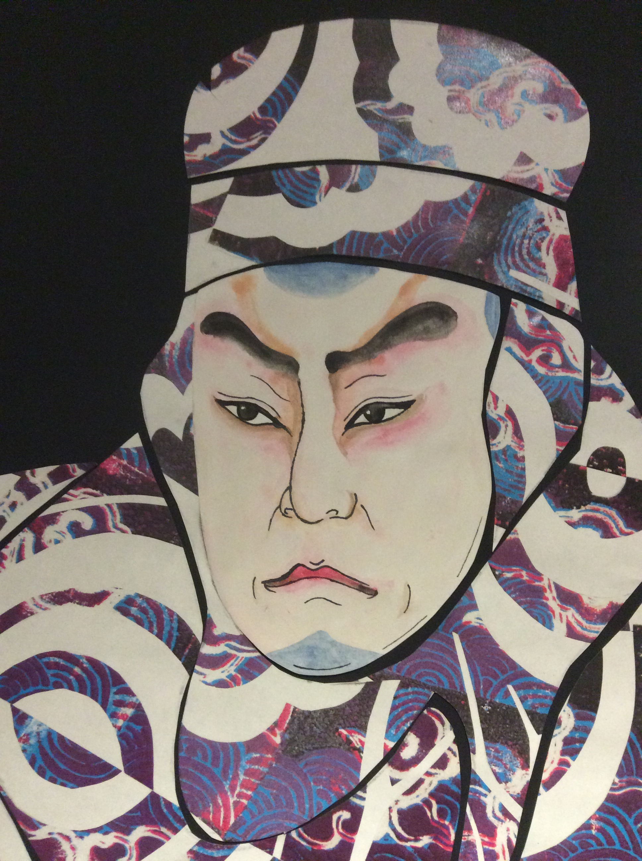
Example 2 – a more complex design
Image on the left is my example for the task today, righthand image shows what you will end up doing with it. Please note that I have only done heavy lines because it would not show up in the photo, you are to do light outlines (we don’t want them showing through when we paint it next lesson). Fill the page, as smaller shapes will be harder to cut in later lessons.

