Slide 1
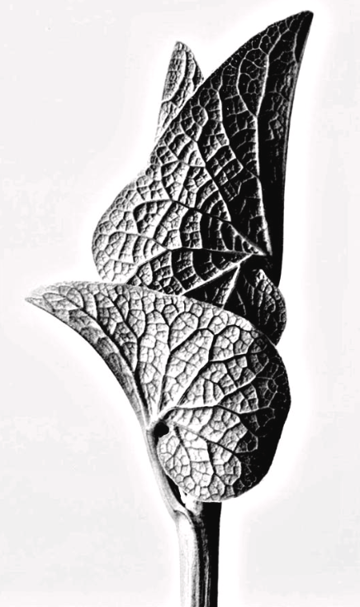
Karl Blossfeldt
First visit
https://artsandculture.google.com/entity/karl-blossfeldt/m03n0pf
Study the compositions achieved by Blossfeldt; the blankness of the background, the focus on textural organic forms, the overall shape and tones within his black and white photographs.
Task: Take a set of at least 12 (it could be more) close up black and white photos of organic/natural forms in response to Blossfeldt's images.
Ideas: if you have access to a garden or you have not yet been for the one walk you're allowed a day, then you could do this at the same time. If you can't go outside you could use house plants, or even fruit and veg out of the fridge (he did a number of famous close up photos of peppers, mushrooms and cabbage leaves).
Don't worry if you don't have a DSLR, just use your phone.
If you can take a blank piece of paper to hold behind the organic form so that there isn't anything visible in the background. Or set up the photos to do inside.
Use lighting in a creative way if you wish, you could get some nice shadows if you're setting it up inside.
Edit your best 12 using a simple app... play with the contrast so that you get a range of tones. Save the full size images as you will be using some of them for future lessons.
Then present them as a grid on a word doc or PowerPoint slide.... any programme that allows you to easily submit them in one go.

