Slide 1
LATIN STORIES
by John Taylor
PART I: 1-30

Slide 2
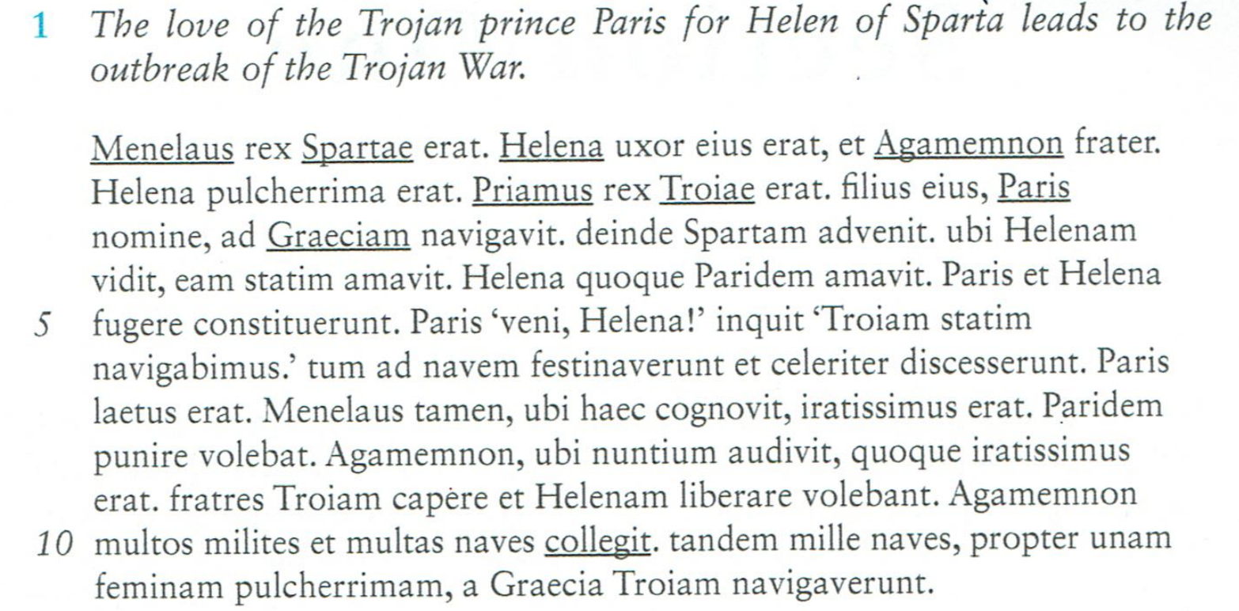
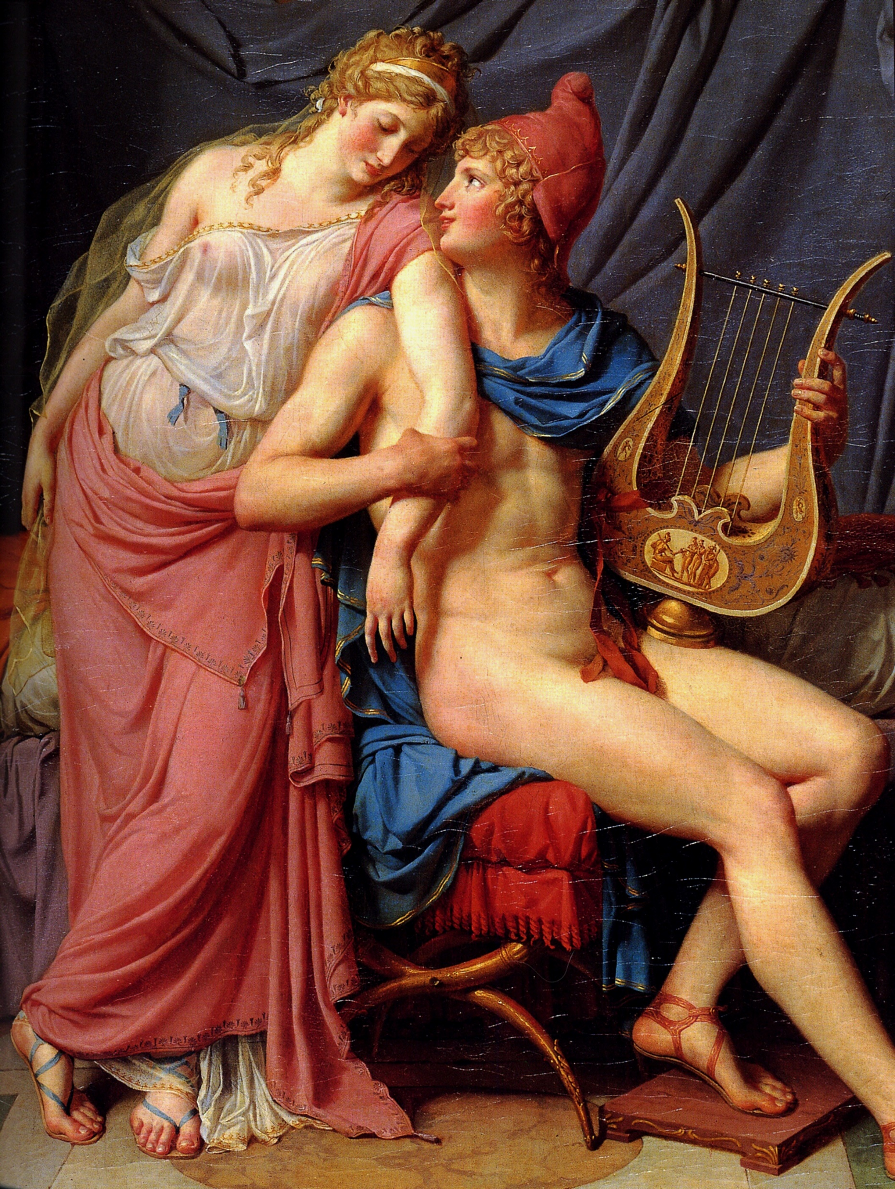
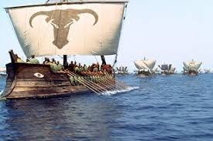
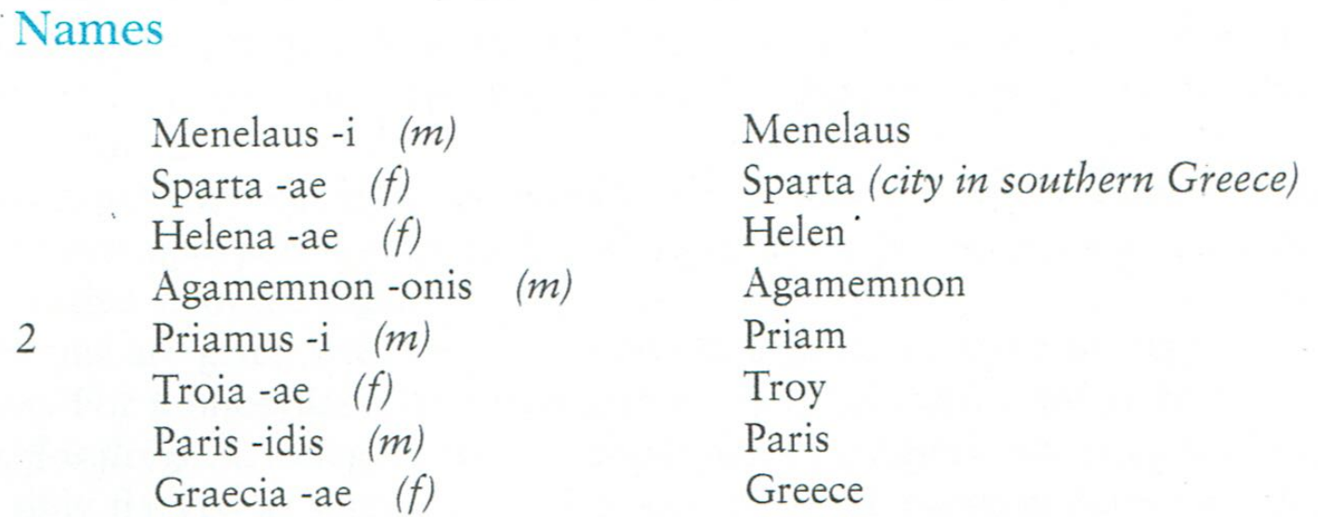

Slide 3
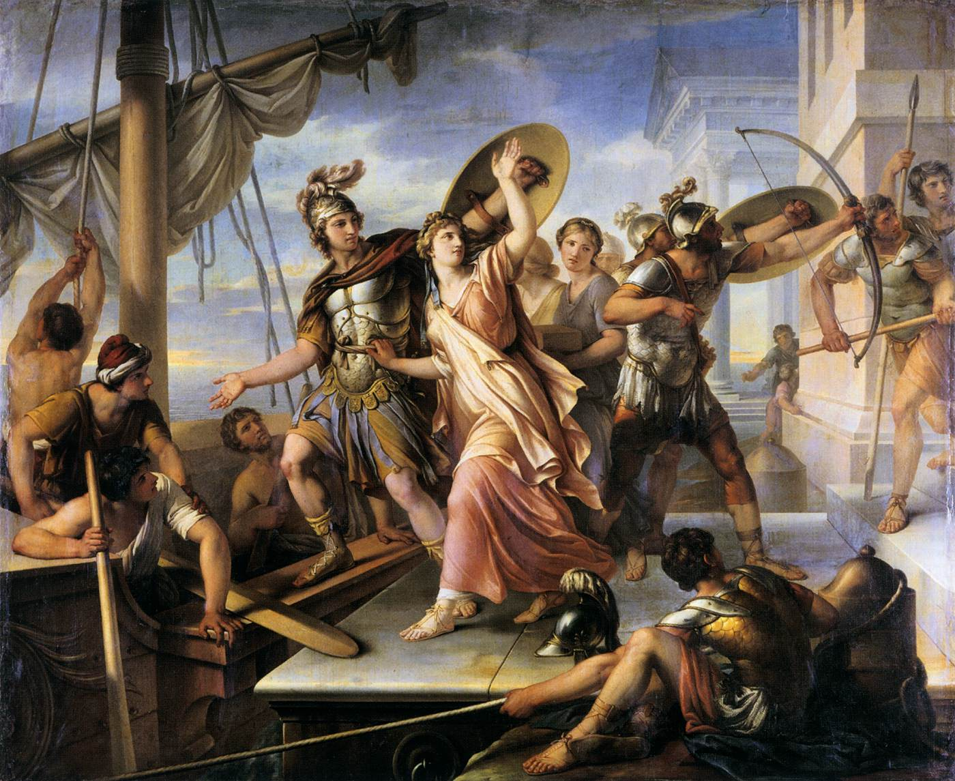

Slide 4
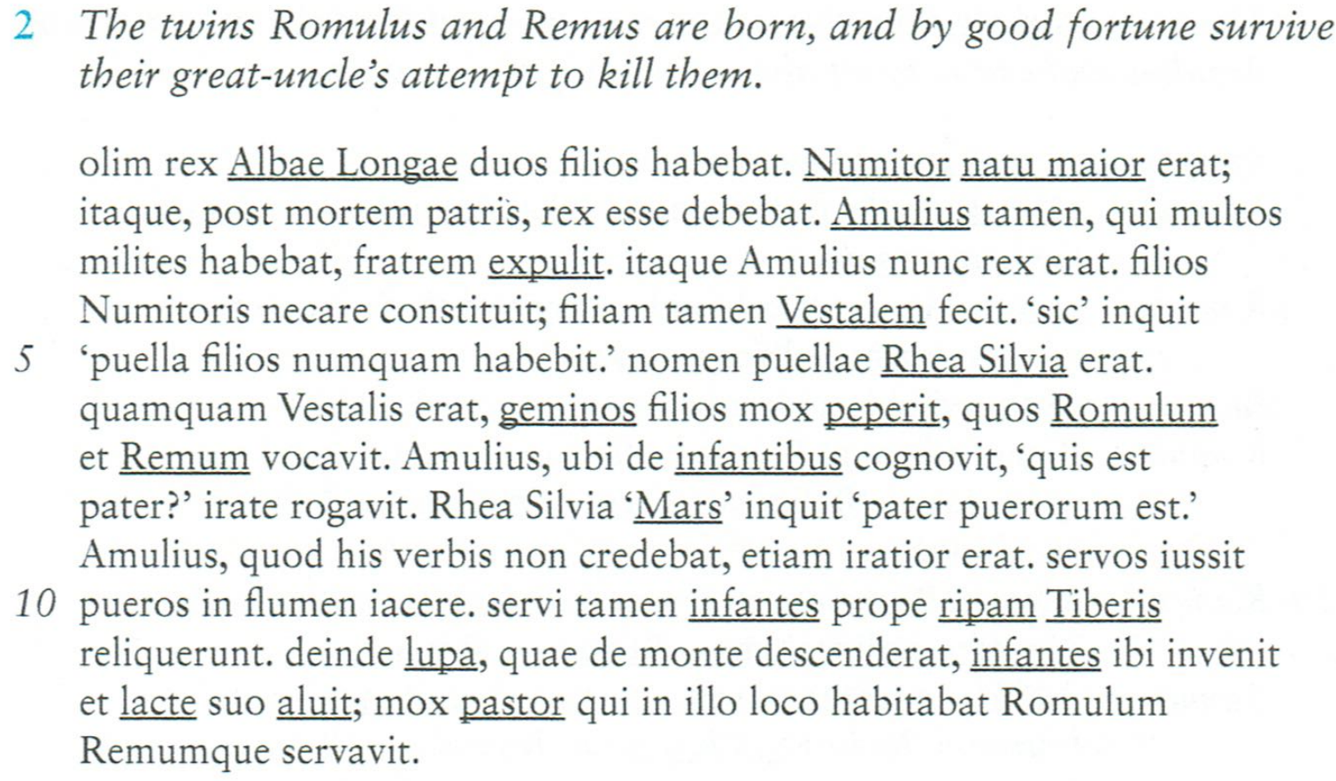
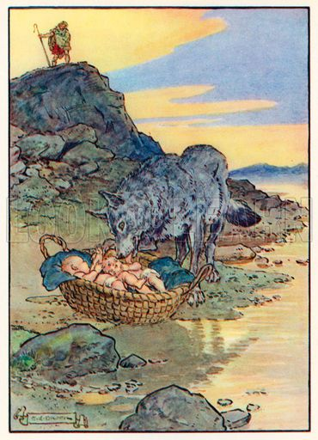
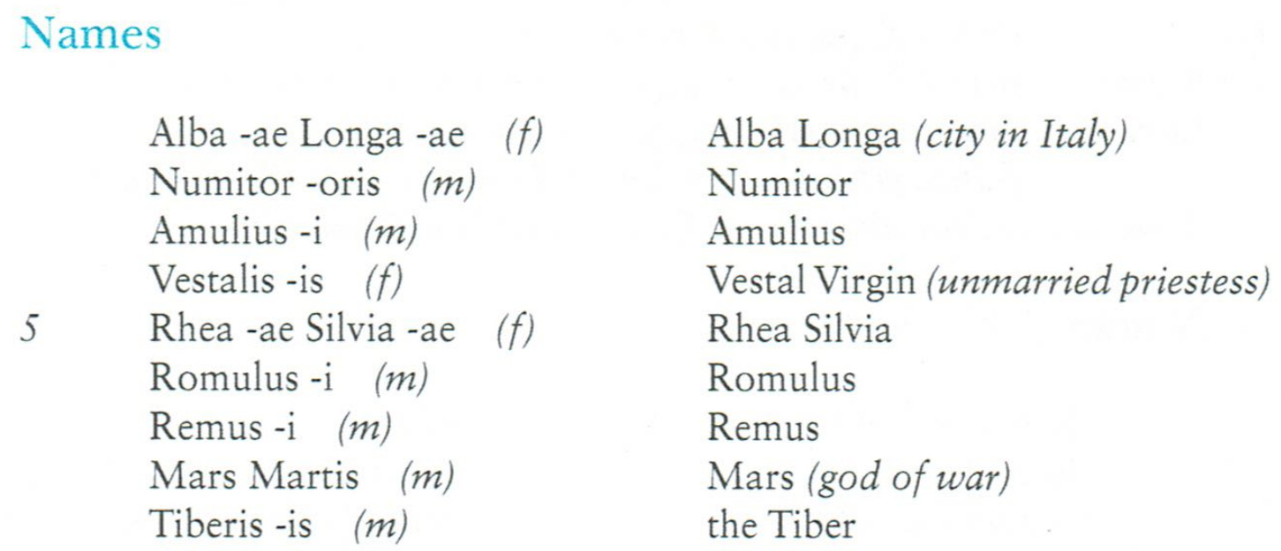
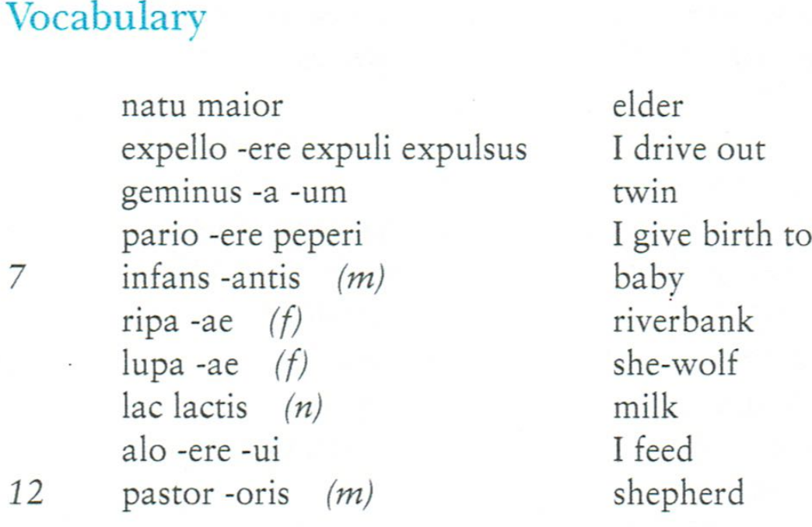

Slide 5
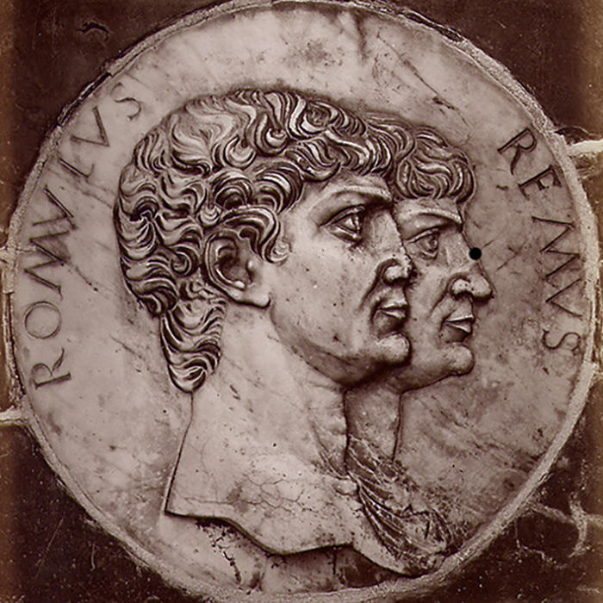
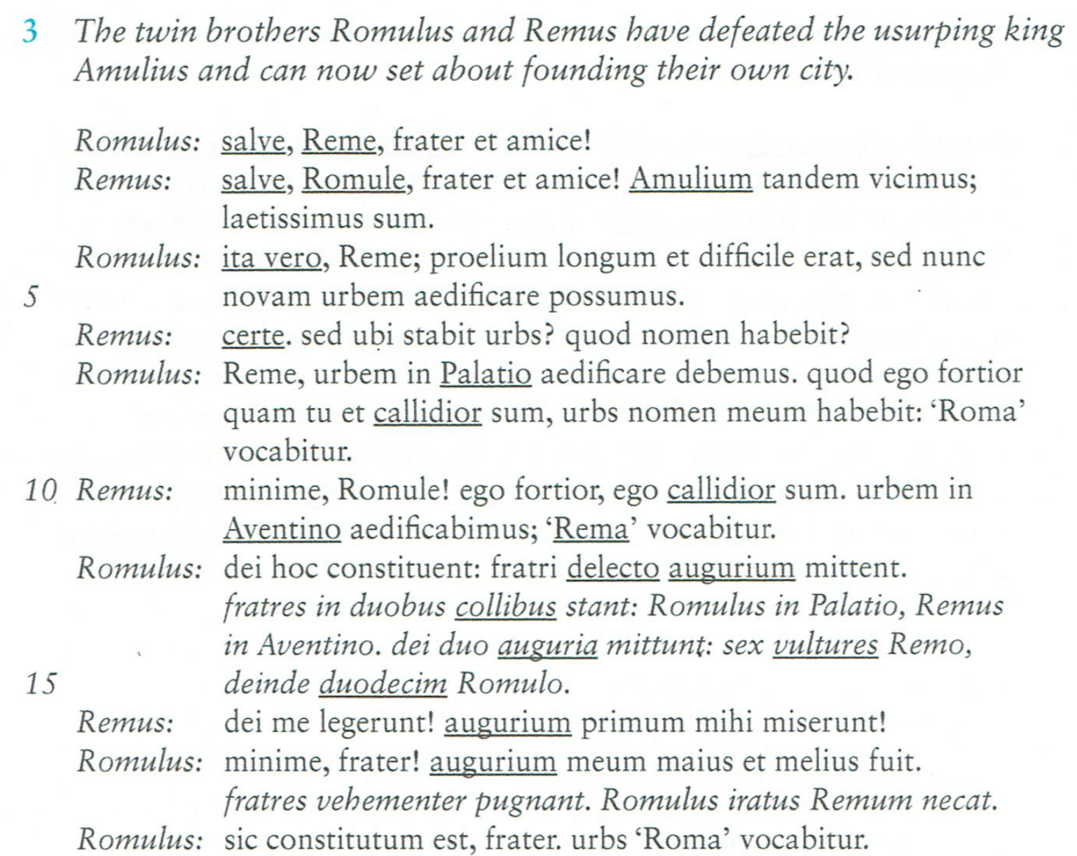
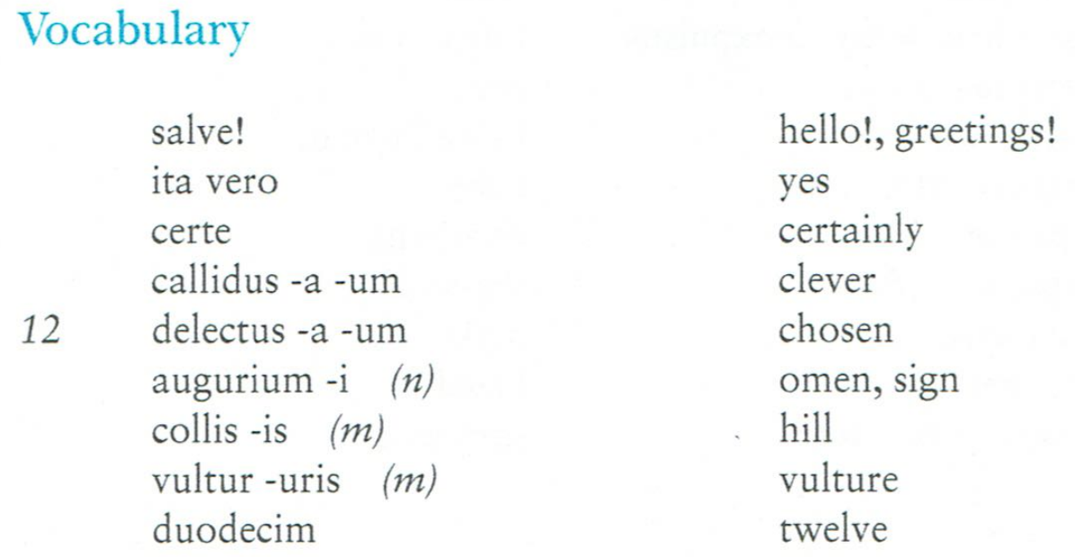

Slide 6
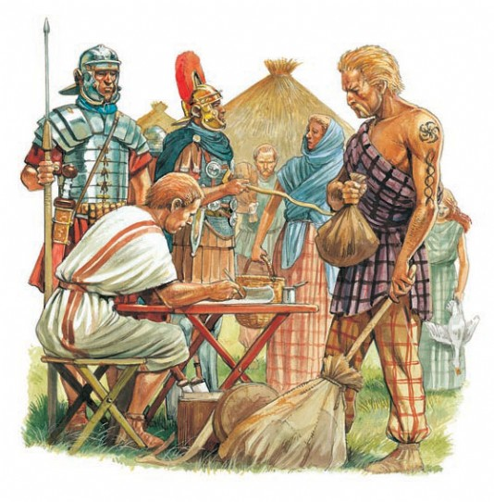
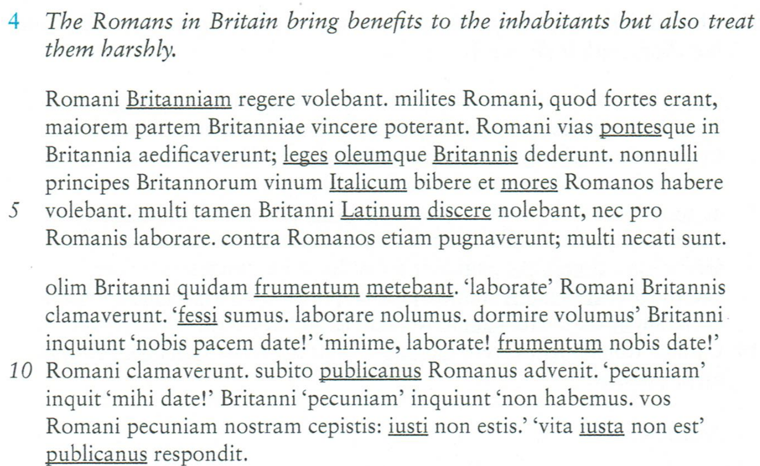
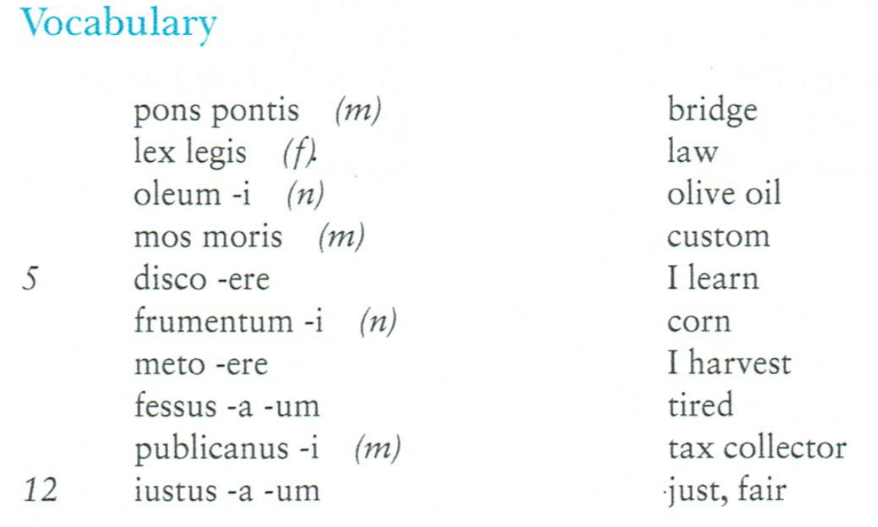

Slide 7
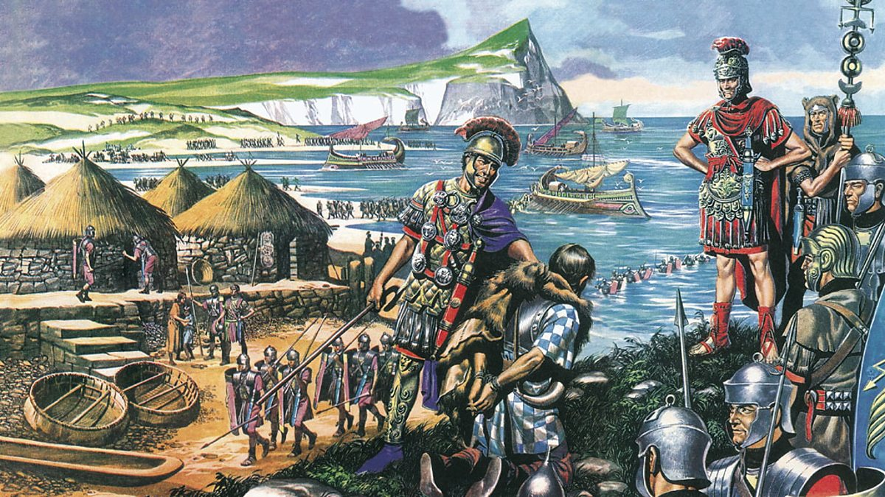

Slide 8
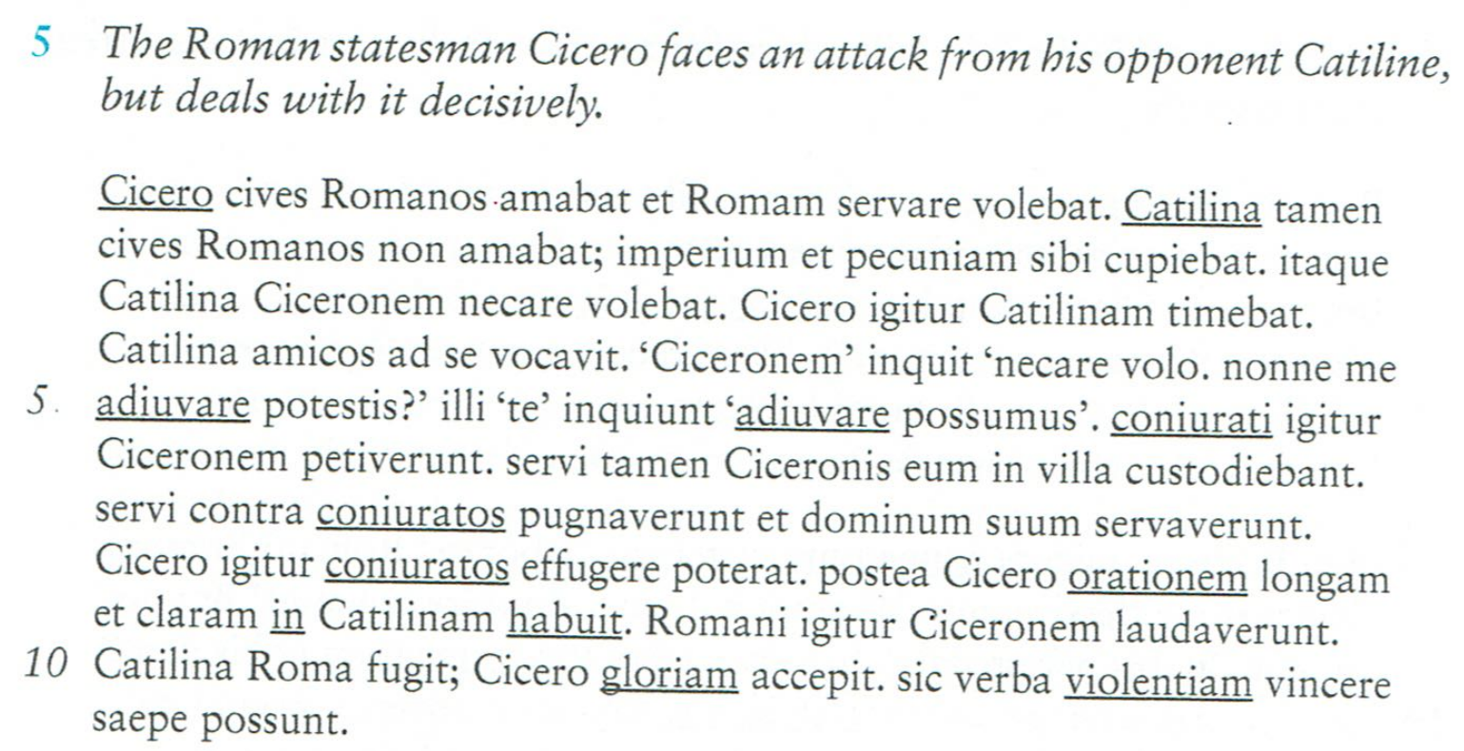
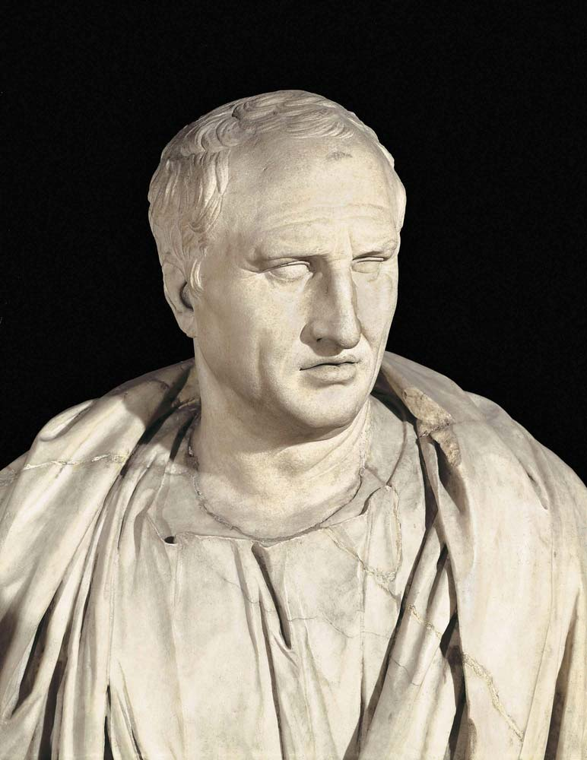
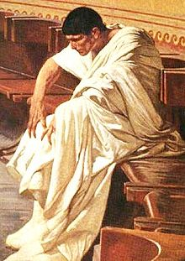
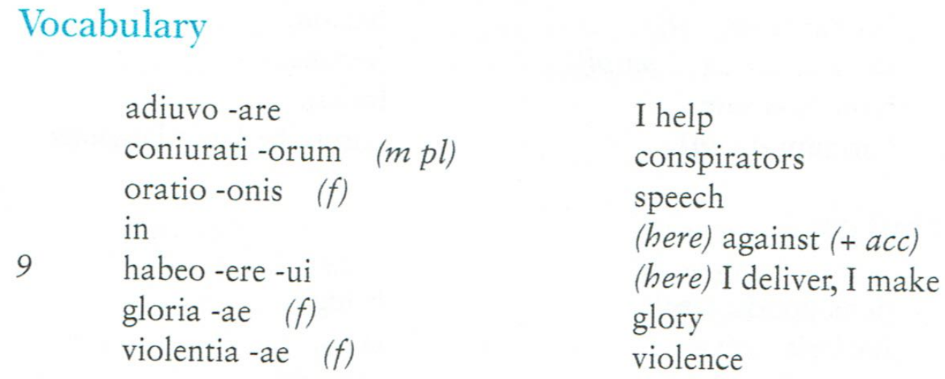

Slide 9
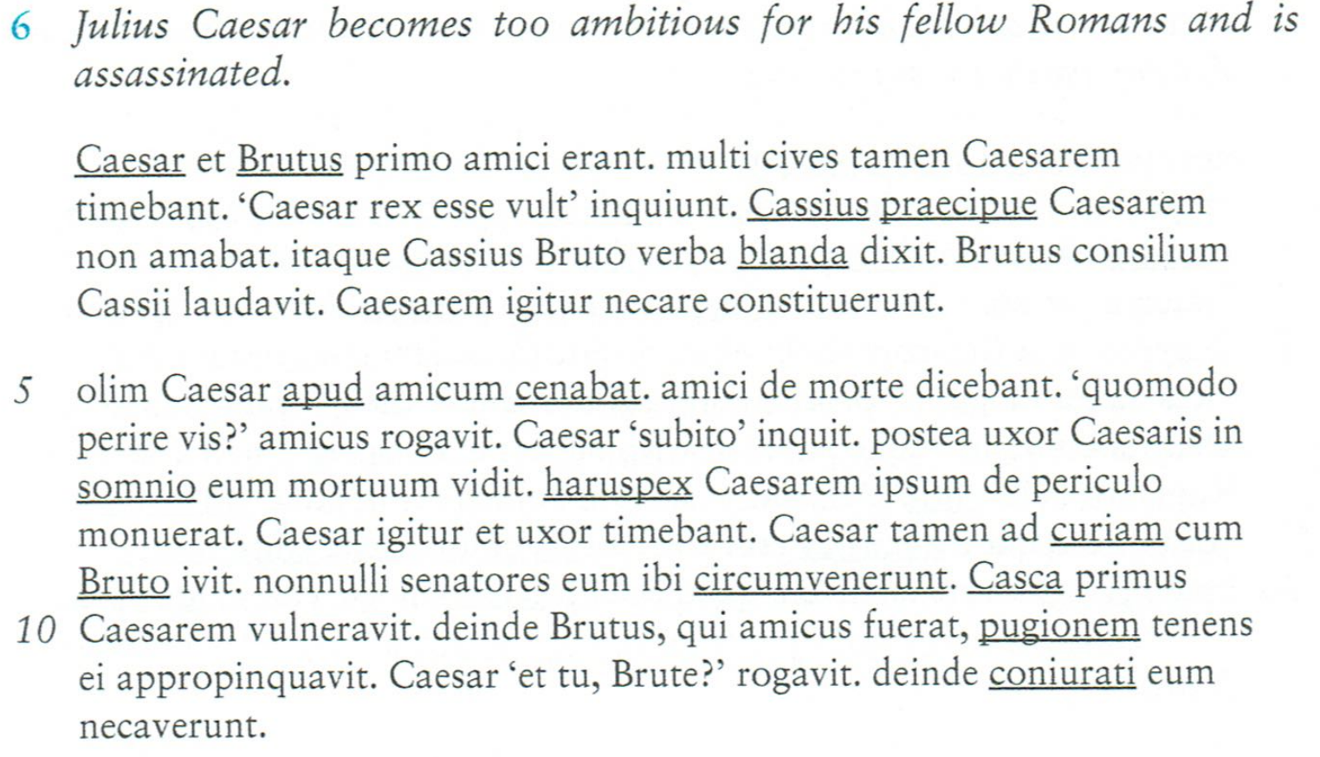
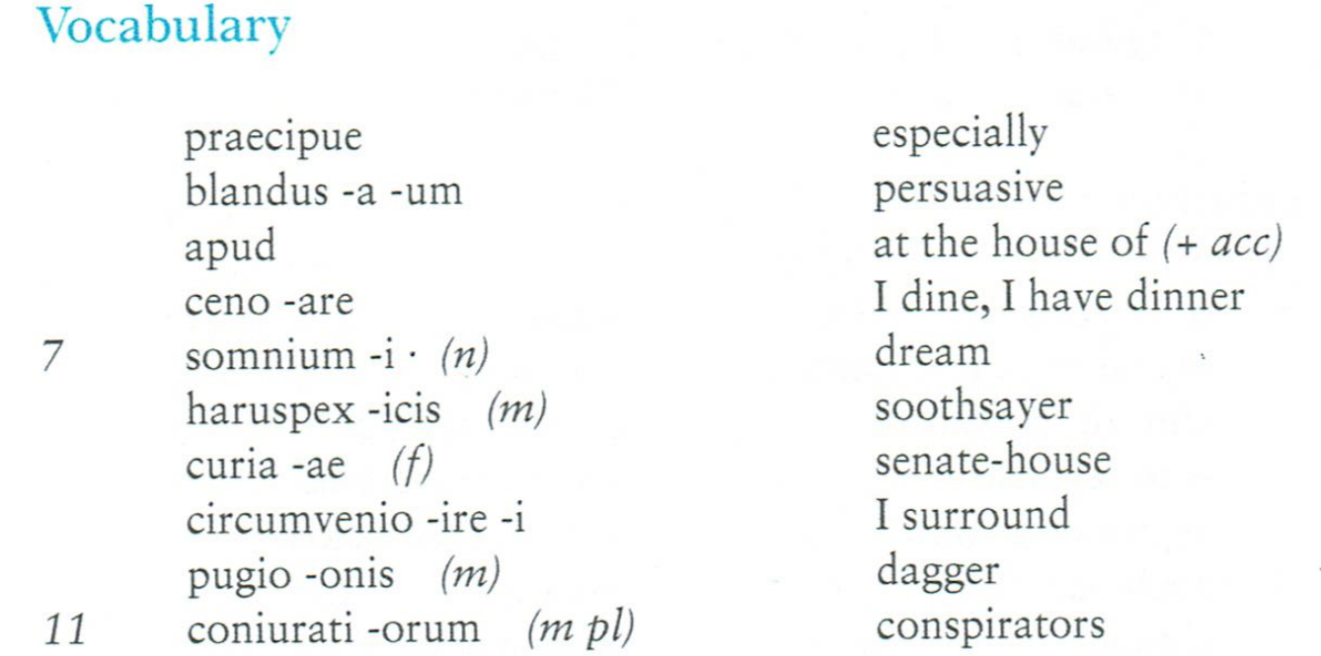
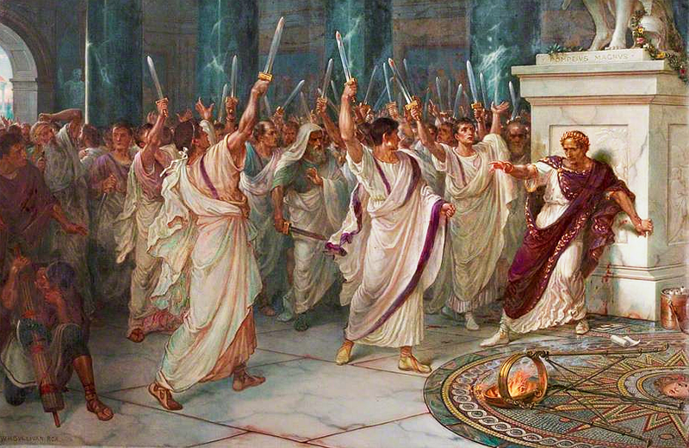
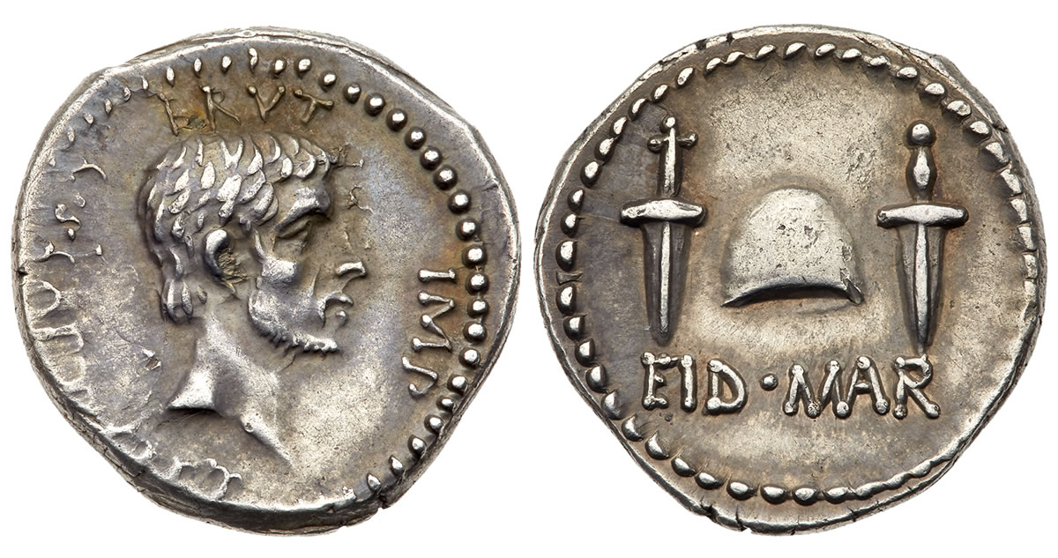

Slide 10
Click here to see a film version of the assassination of Julius Caesar

Slide 11
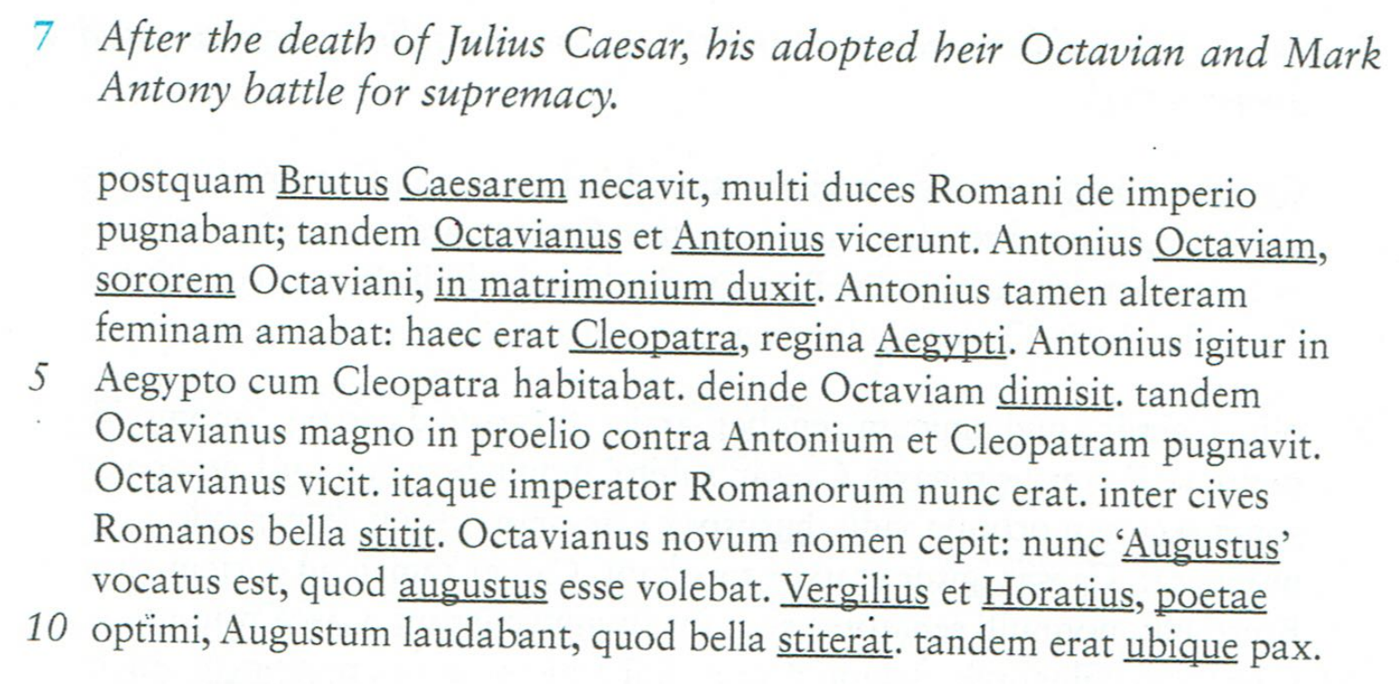
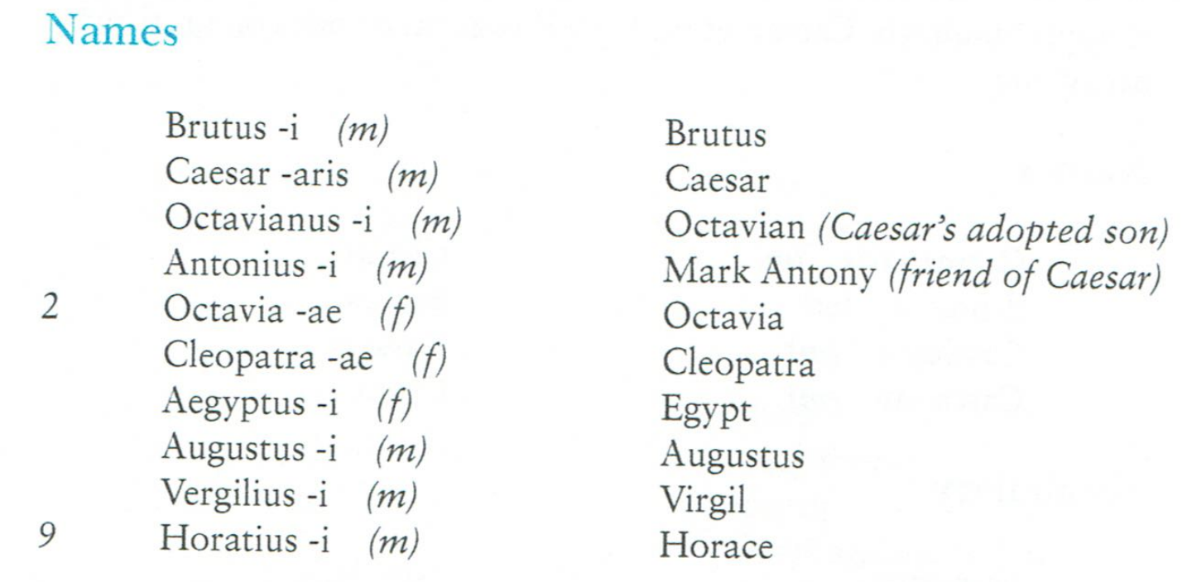
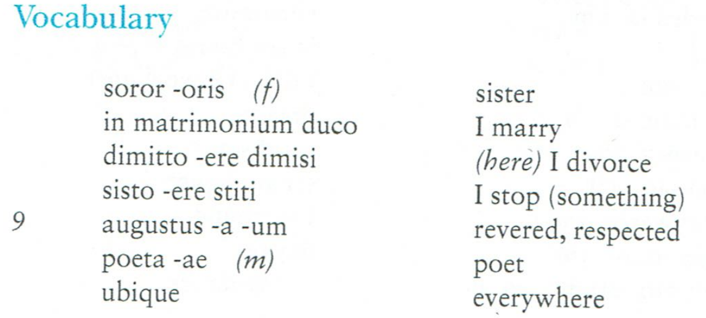
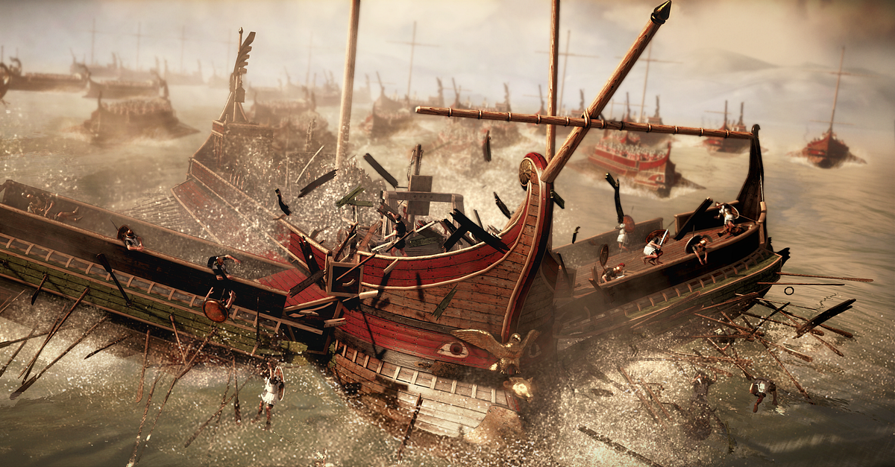
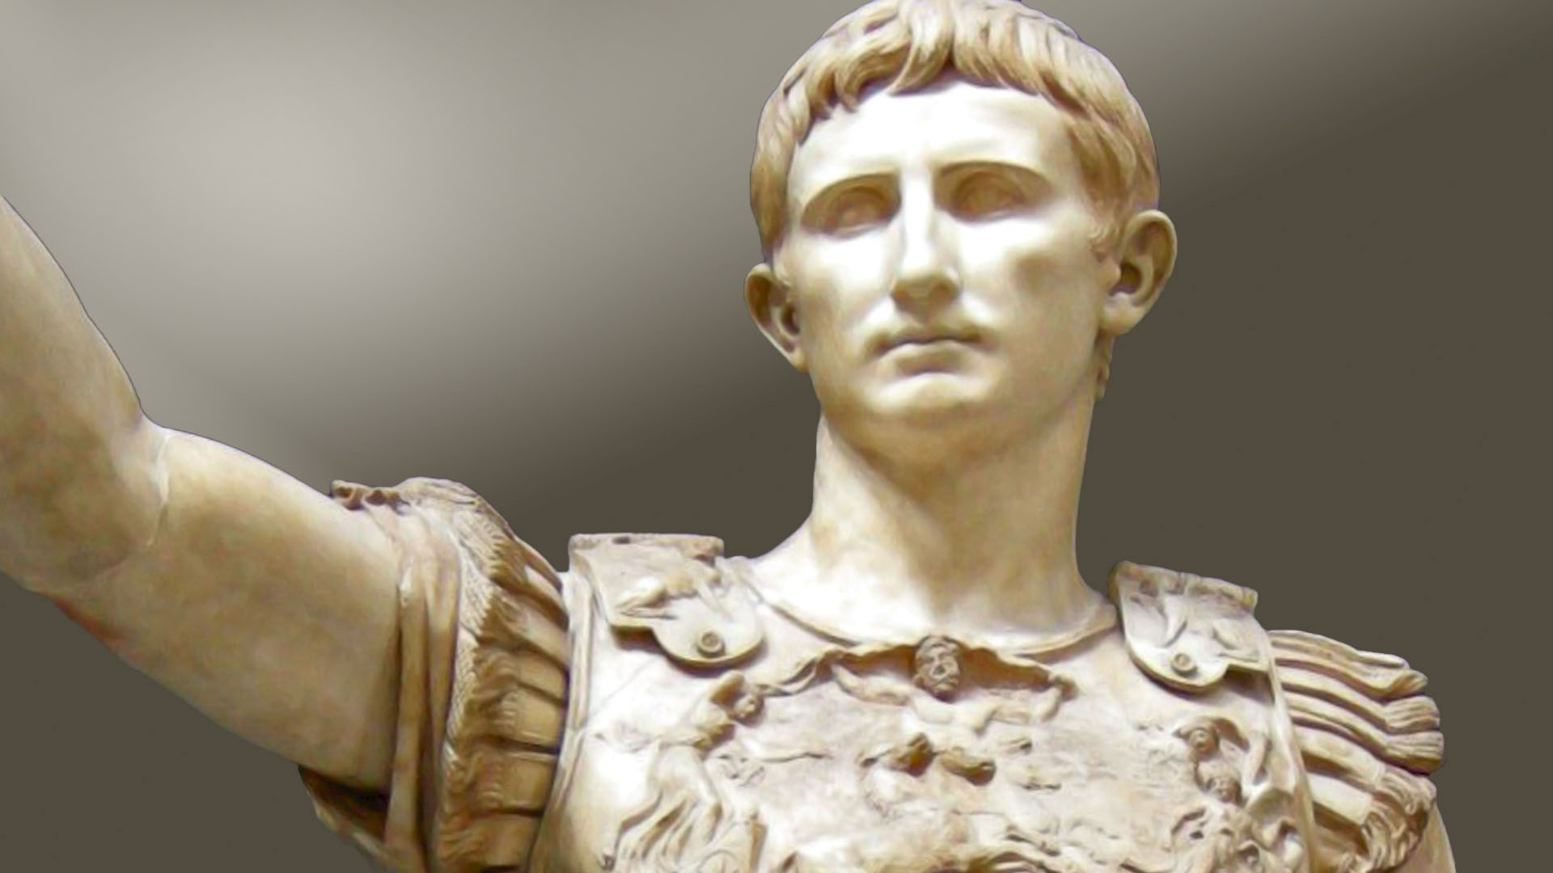

Slide 12
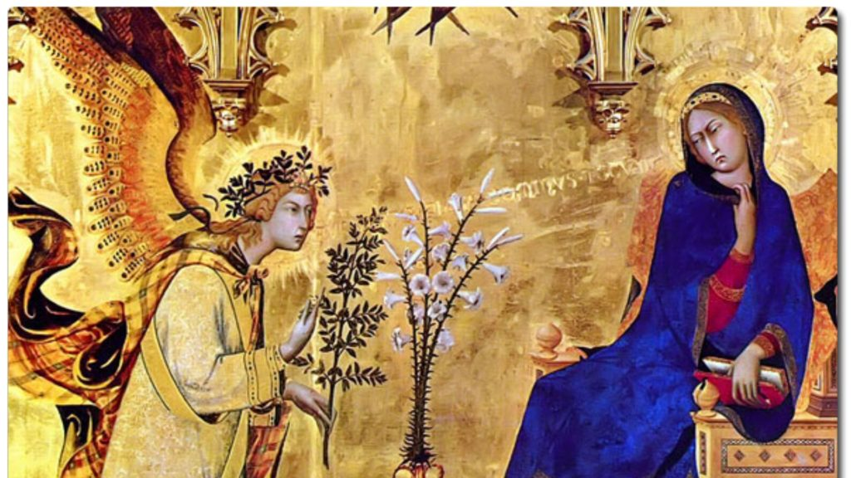
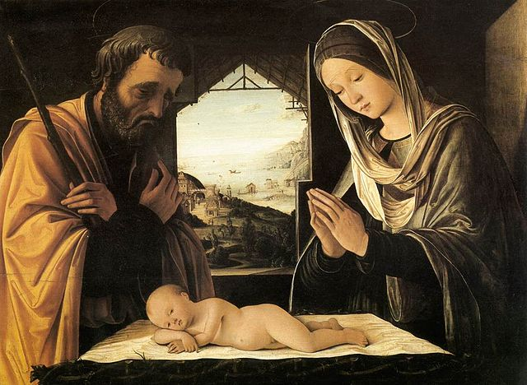
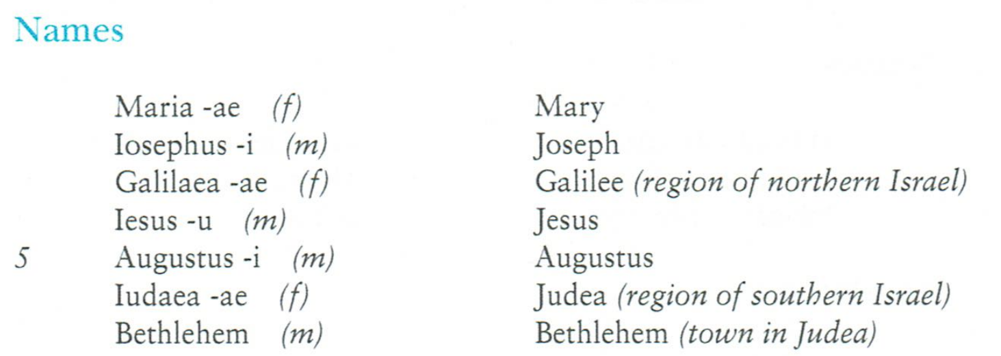
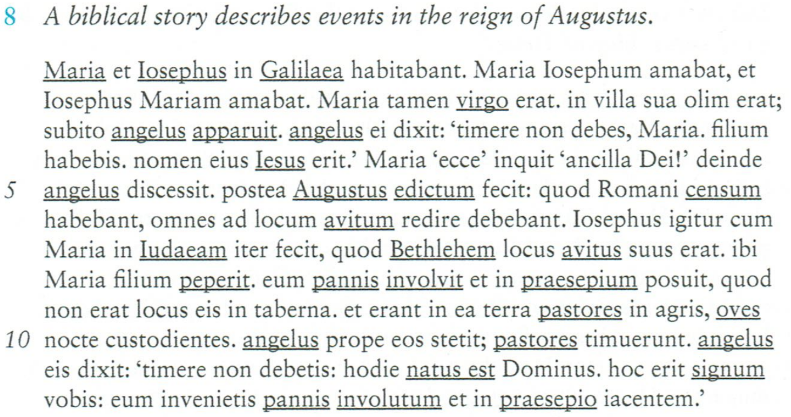
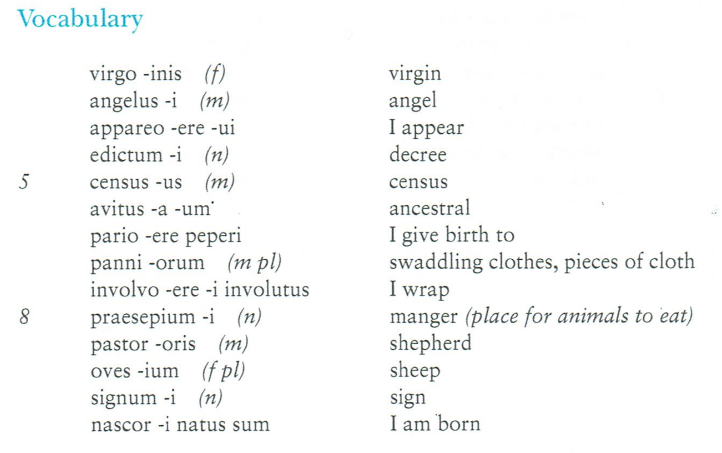
Simone Martini – The Annunciation c.1333
Lorenzo Costa The Nativity c.1490

Slide 13
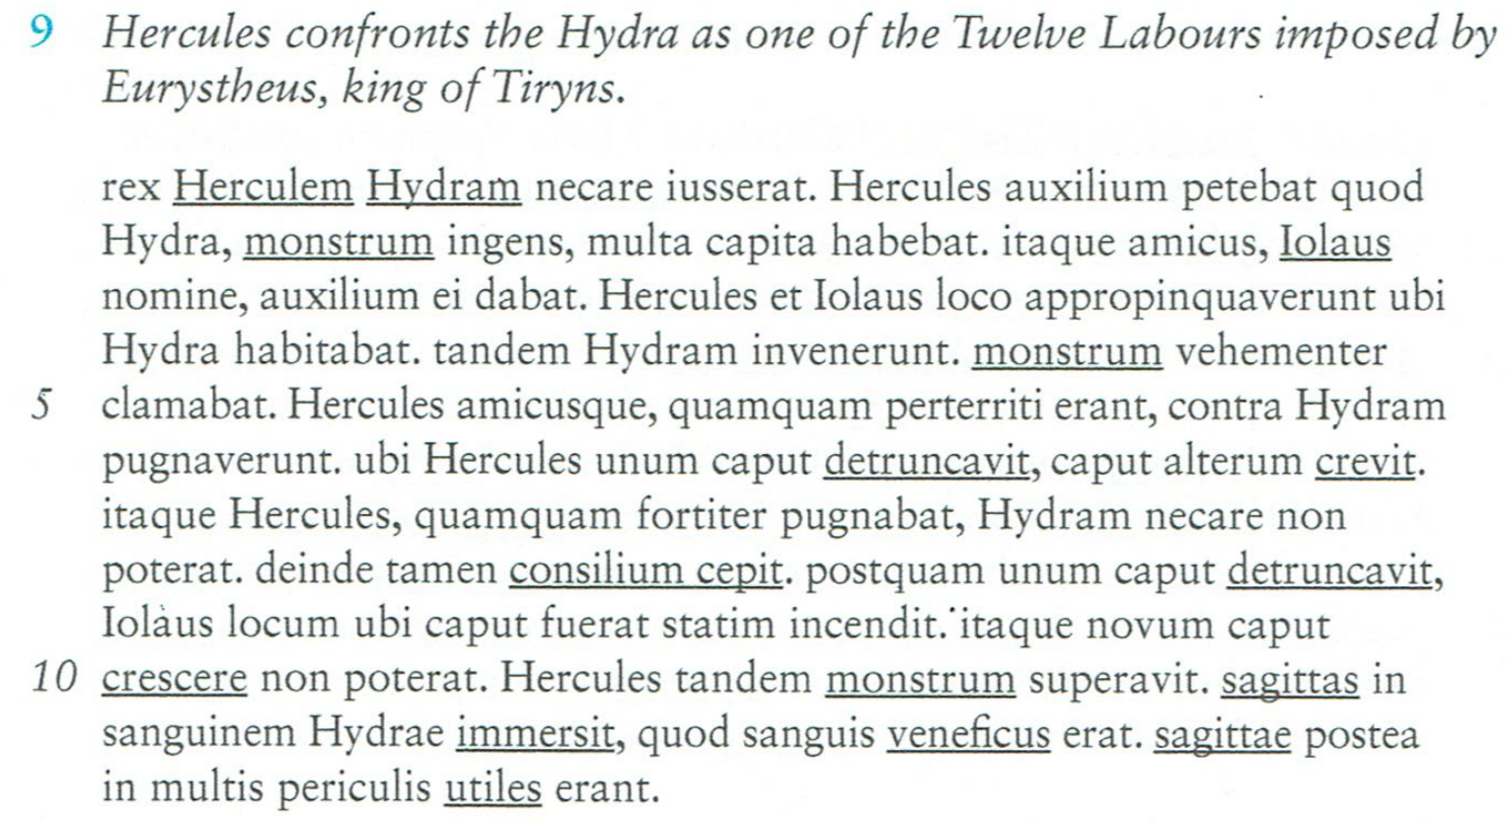
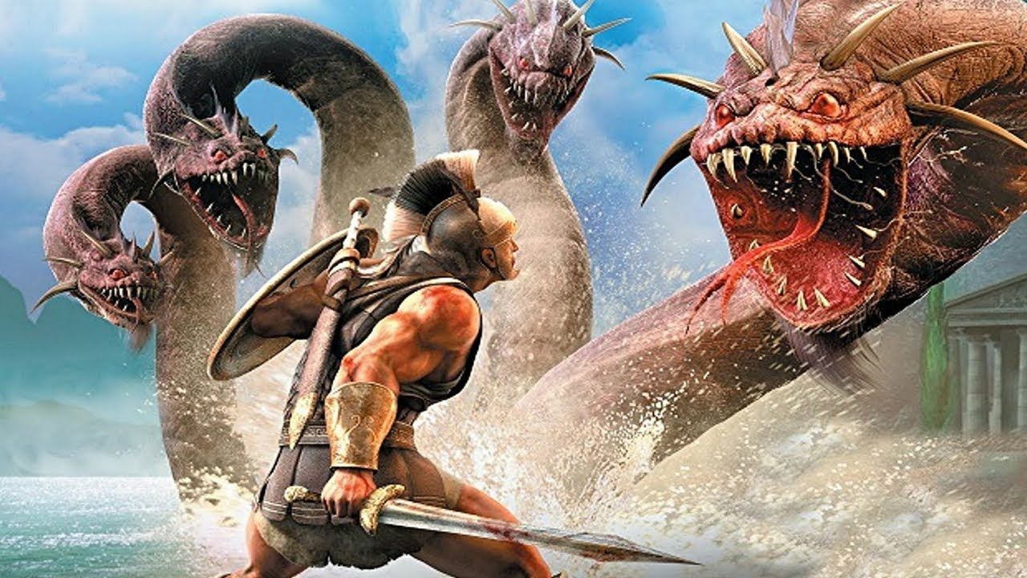
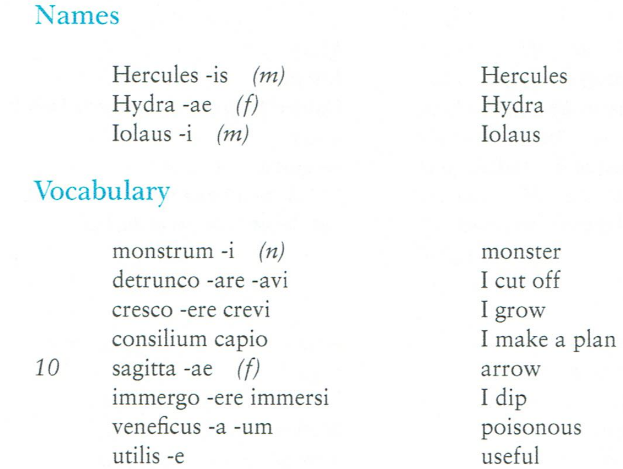
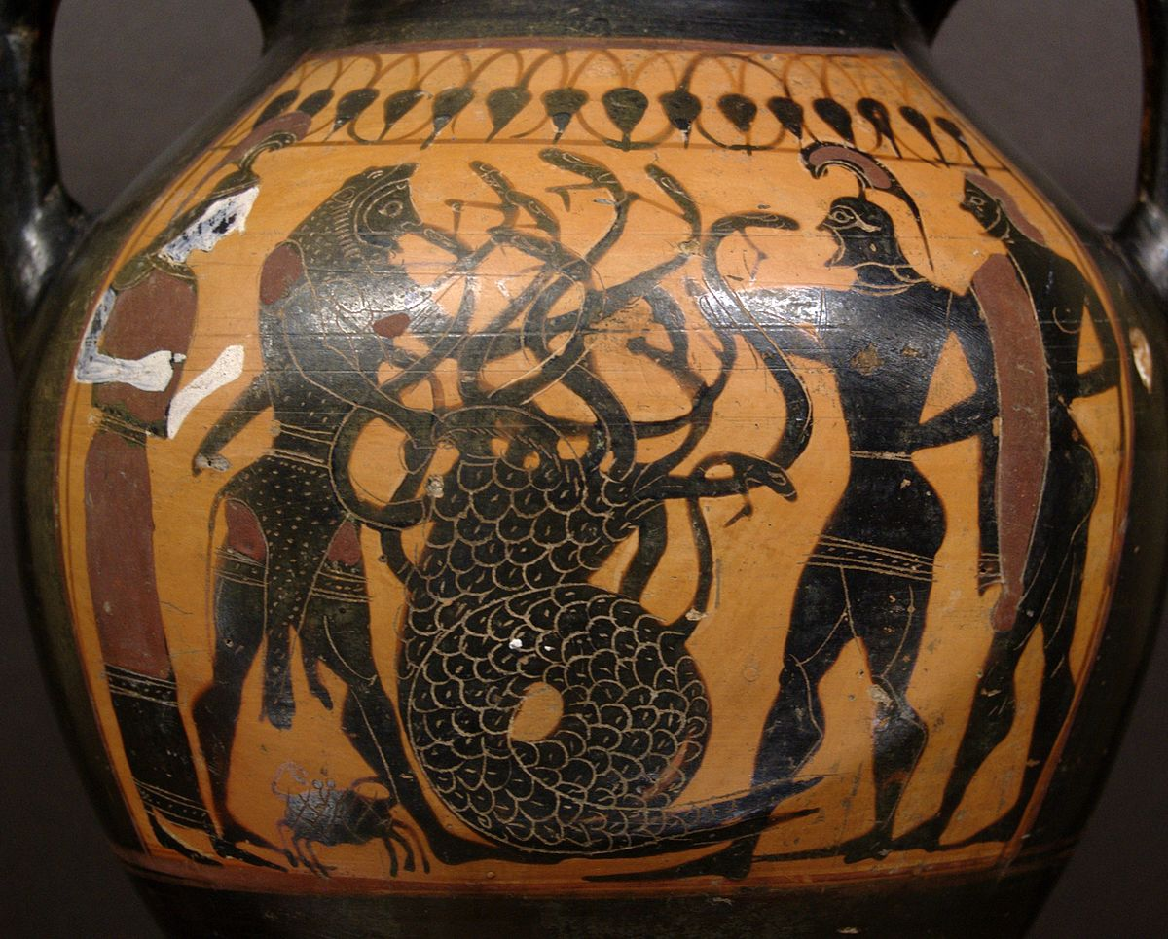
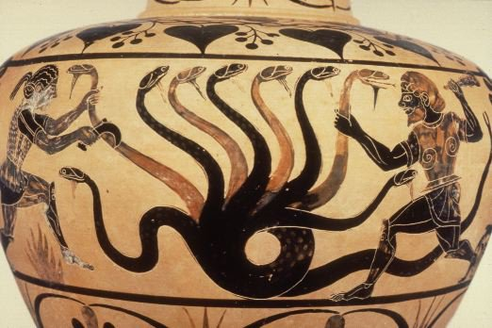

Slide 14
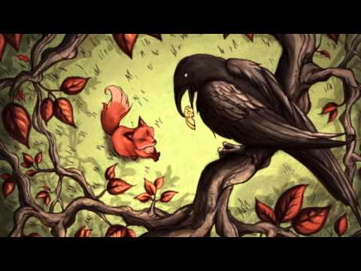
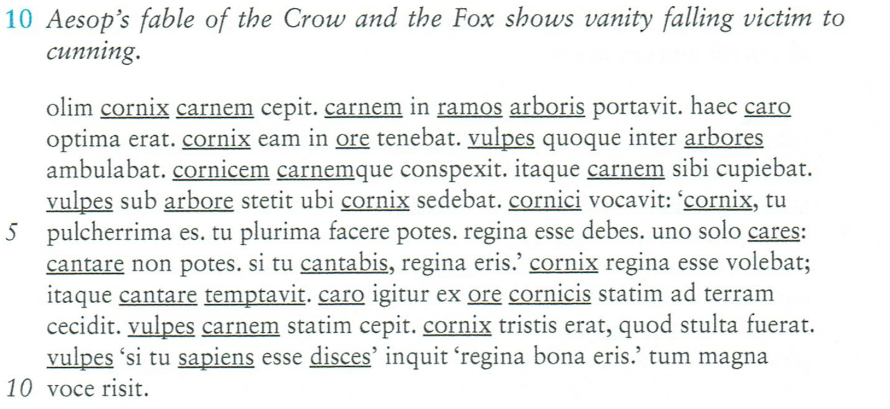
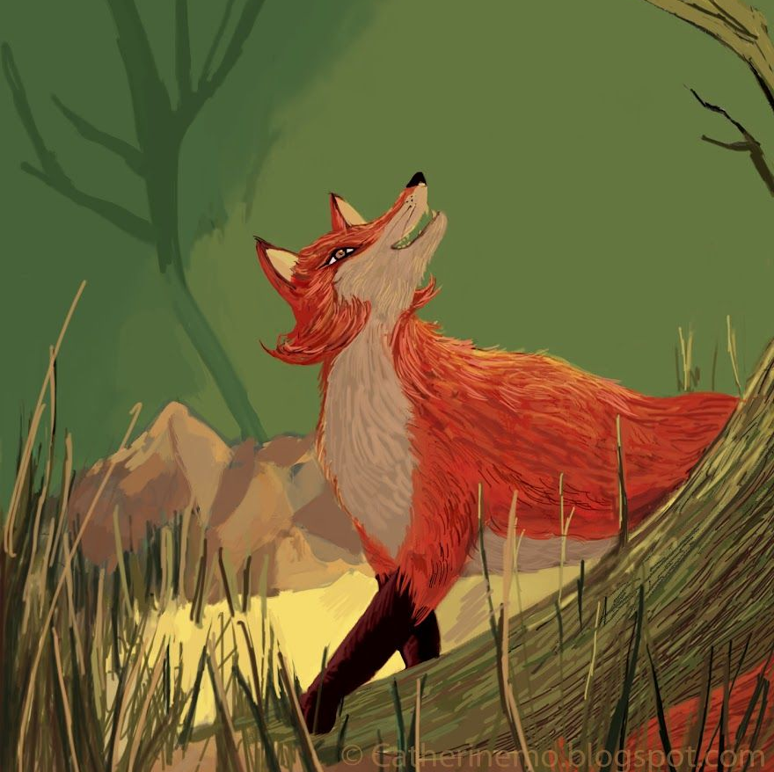
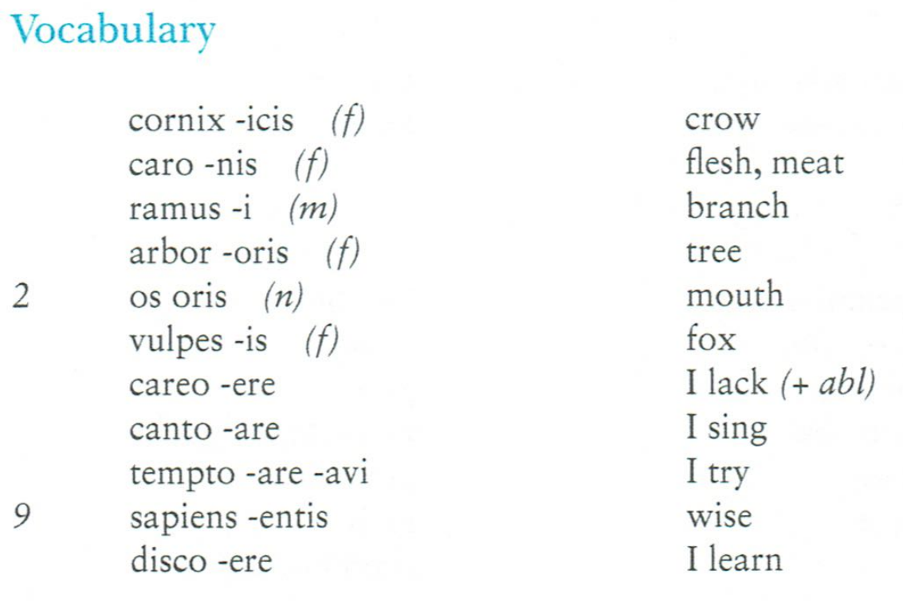
https://www.youtube.com/watch?v=hACpLj0_EiA

Slide 15
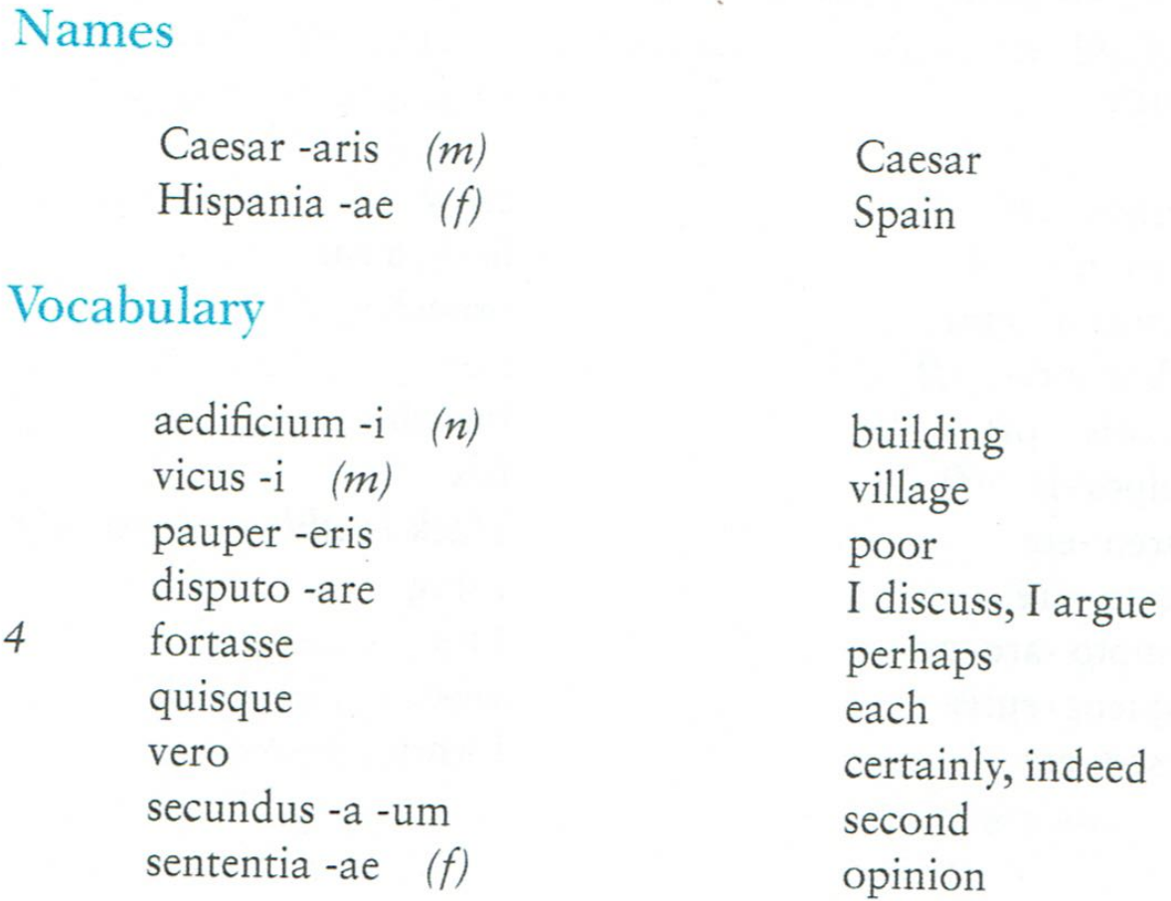
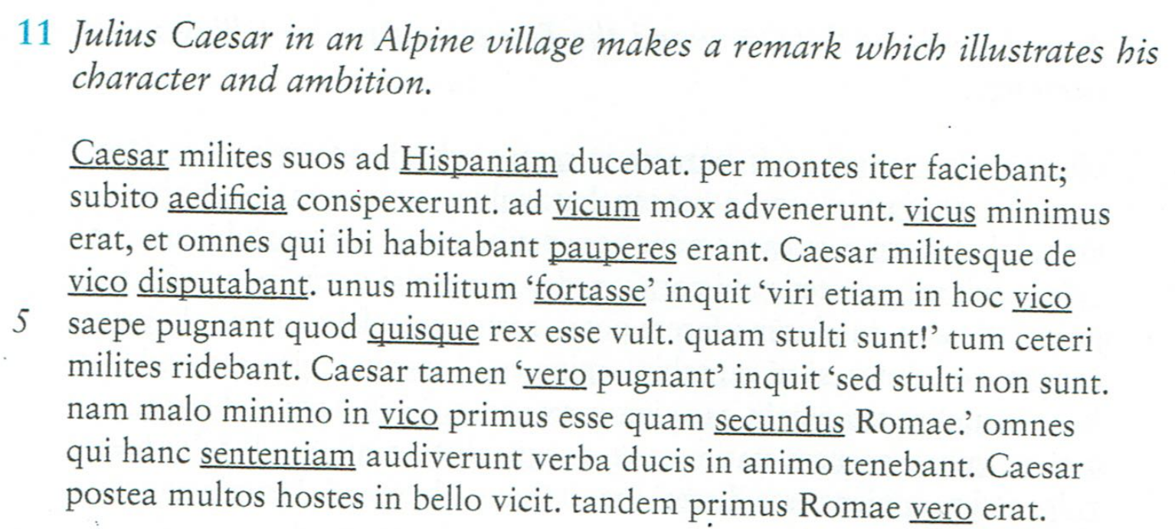
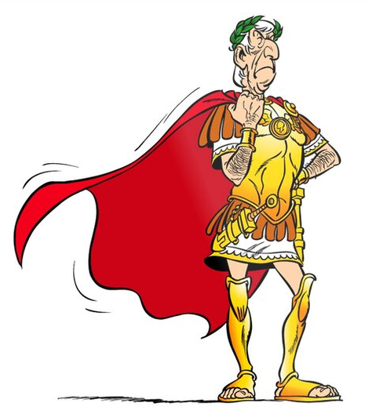
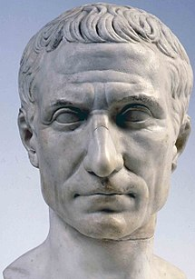
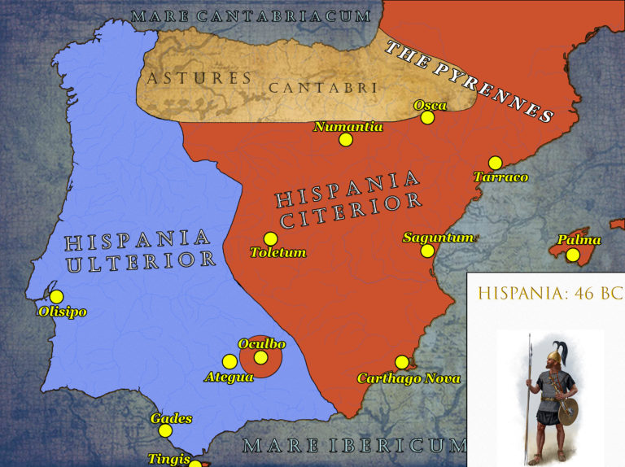

Slide 16
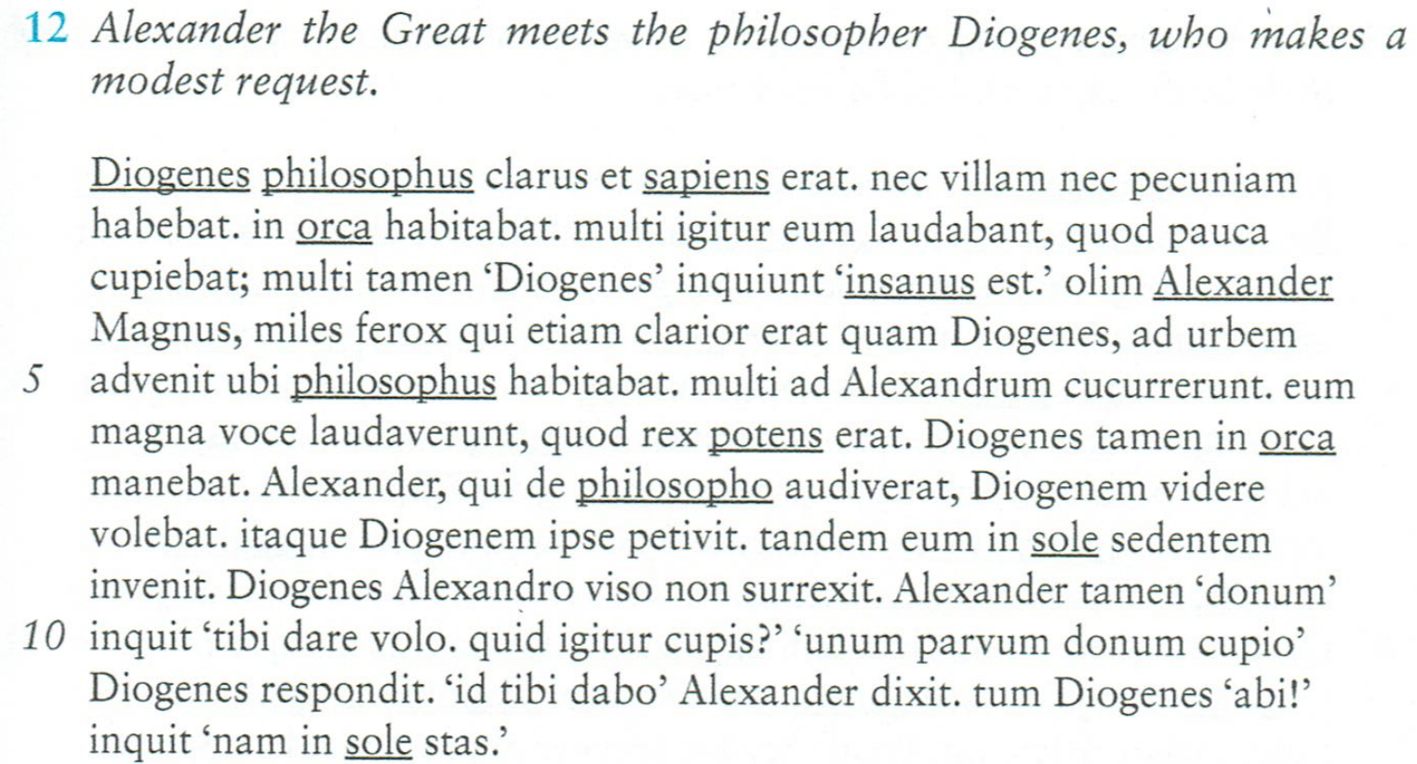
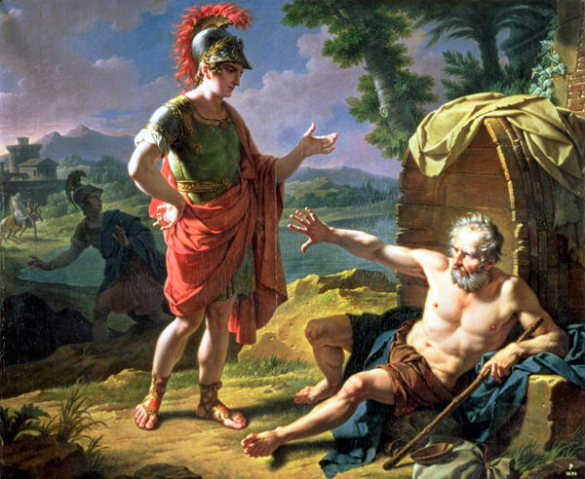
https://kosmossociety.chs.harvard.edu/

Slide 19
In Augustine’s
Confessions, he hears a boy chanting
tolle, lege, tolle, lege
("take and read," "take and read").
He opens the Bible to Romans 13:14,
"Put ye on the Lord Jesus Christ, and make not provision for the flesh, to fulfil the lusts thereof."
This led him to his final decision to become a Christian.
St Augustine by Benozzo Gozzoli

Slide 20
Troy 2004 Starring Brad Pitt and Eric Bana

Slide 21
Small vessels for hemlock found in excavations in the Athenian Agora.

Slide 23
The ‘cave of Philoctetes; on Lemnos.

Slide 26
Picasso's series The Rape of the Sabines was executed at the height of the Cuban Missile Crisis in the autumn of 1962. The works capture the showdown between East and West and the very real threat of the annihilation of humanity in a Third World War and nuclear Armageddon.
https://www.pablopicasso.org/the-rape-of-the-sabine-women.jsp

Slide 27
The Intervention of the Sabine women. 1799 Jacques-Louis David

Slide 30
Azrael, Angel of Death
Thanatos, god of Death by Evelyn de Morgan

Slide 31
The Siege of Naxos (499 BC) was a failed attempt by the Aristagoras, tyrant of Miletus to conquer the island of Naxos, with the support of the Persians. It turned out to be a disaster and paved the way for the Ionian revolt and the start of the Greco-Persian Wars.
Coin of Miletus at the time of Aristagoras c.500BC

Slide 32
The death of Seneca AD65 by Peter Paul Rubens, painted in 1612-15 (Museo del Prado).
Left: an idealised image of Seneca and a contemporary bust of the emperor Nero, who reigned from AD54-68.

Slide 33
‘Sulla immediately proscribed eighty persons without communicating with any magistrate. As this caused a general murmur, he let one day pass, and then proscribed two hundred and twenty more, and again on the third day as many. In an harangue to the people, he said, with reference to these measures, that he had proscribed all he could think of, and as to those who now escaped his memory, he would proscribe them at some future time.’ Plutarch, Life of Sulla (XXXI)
Sulla came into conflict with the consul Scipio in 83BC and his Second March on Rome.

Slide 34
Statue of Arminius, erected in the Teutoburg Forest, Westphalia, site of his greatest triumph against Rome in AD9 when he destroyed three Roman legions.
Segestes and his daughter

Slide 35
Nero was rumoured to have sung while Rome burned in AD64.

