Slide 1
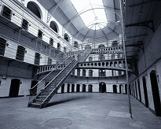
Title: Institutional aggression
Why do people behave aggressively towards other members of an institution?
Is it the personality and previous experiences of prison inmates that predict their violent behaviour in prison?
Do the stresses of being imprisoned, such as loss of freedom, cause violence in prison?
Aggression also happens at an institutional level and social psychologists try to explain why this happens through two models: ‘deprivation model’ and the ‘importation model’.
Starter: Decide whether each of the statements are true or false?
Learning objectives:
To DESCRIBE and EVALAUTE the ‘importation model’ and ‘deprivation model’ of institutional aggression within groups.
To KNOW and EVALUATE supporting research and each theory.

Slide 2
What do we mean by the term institution?
Institutions are simply groups of people held together by a common factor. There is often a hierarchical structure.
In pairs, think of as many types of ‘institution’ as possible (2 minutes)
Examples of institutions include the armed forces, boarding schools, prisons, mental institutions, and the work place. These are places with a strict rule set up that gives little free choice to its members.
Can also refer to religions, or a political group.
Learning objectives:
To DESCRIBE and EVALAUTE the ‘importation model’ and ‘deprivation model’ of institutional aggression within groups.
To KNOW and EVALUATE supporting research and each theory.

Slide 3
A focus on prisons….
Prison facts
Life in prison
Makes notes, or mind maps, on the documentary in order to be able to answer the questions below.
Describe aggressive relationships between guards and inmates in prisons.
Describe examples and frequency of assault and violence between inmates in prisons.
Describe any personality features and/or backgrounds of many inmates that may lead them to be aggressive.
Describe the key features of ‘gang membership’ in prisons (ethnicities, key behaviours, hierarchy, fear etc).
Describe why prisons could be considered ‘stressful’ places for inmates.
Describe specific ‘deprivations’ that prisoners experience that could be linked to a rebellion against these in the form of increased violence
Learning objectives:
To DESCRIBE and EVALAUTE the ‘importation model’ and ‘deprivation model’ of institutional aggression within groups.
To KNOW and EVALUATE supporting research and each theory.
Notes:
stephen fry american prison facts and Louis Theroux on prisons

Slide 4
Explaining aggression in institutions such as prisons
Situational explanation Situation causes increased levels (Deprivation model)
Dispositional explanation
Individuals are the cause for increased levels (Importation model)
Learning objectives:
To DESCRIBE and EVALAUTE the ‘importation model’ and ‘deprivation model’ of institutional aggression within groups.
To KNOW and EVALUATE supporting research and each theory.

Slide 5
Importation model (Irwin & Cressey 1962)
Dispositional explanation
Prisoners are often the product of a difficult background and experiences.
They bring their own social histories and personality traits with them to prison (due to genetics, hormone levels SLT etc.).
Prisoners ‘import’ their personalities, difficulties and histories with them from the outside into the prison.
The people inside are not ‘blank slates’.
Violence and aggression is not a product of the institution itself but rather the characteristics of individuals who enter it.
Learning objectives:
To DESCRIBE and EVALAUTE the ‘importation model’ and ‘deprivation model’ of institutional aggression within groups.
To KNOW and EVALUATE supporting research and each theory.

Slide 6
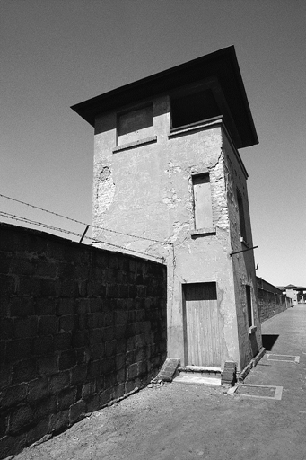
Importation model (Irwin & Cressey 1962) Supporting research??
Dispositional explanation
Keller and Wang (2005) found that prison violence, and assaults on staff are more likely to occur in high-security prisons (inmates had committed more violent crimes on ‘the outside’), than those with lower security inmates, supporting the idea that the inmates had brought violent behaviour into the institution with them.
Learning objectives:
To DESCRIBE and EVALAUTE the ‘importation model’ and ‘deprivation model’ of institutional aggression within groups.
To KNOW and EVALUATE supporting research and each theory.

Slide 7
Importation model (Irwin & Cressey 1962)
Dispositional explanation
Pre-prison gang membership tends to be exacerbated in prison.
Research has found that gangs leads to increased levels of aggression and violence due to deindividuation, conformity and obedience (Allender and Marcell 2003).
Learning objectives:
To DESCRIBE and EVALAUTE the ‘importation model’ and ‘deprivation model’ of institutional aggression within groups.
To KNOW and EVALUATE supporting research and each theory.

Slide 8
Importation model (A02) - Evaluation
However……A study of over 800 male inmates found litte evidence of a relationship between previous gang membership and misconduct within prison – found deprivation factors to play an equally important role (DeLisi, 2004)
Mc Corkle et al (1995) criticised the model as it gives no practical suggestions for how to decrease violence (unlike deprivation model).
Implications for rehabilitation – consider the home environment and the individual.
Learning objectives:
To DESCRIBE and EVALAUTE the ‘importation model’ and ‘deprivation model’ of institutional aggression within groups.
To KNOW and EVALUATE supporting research and each theory.

Slide 9
Deprivation model (Paterline and Peterson 1999)
The ‘deprivation’ inmates experience in terms of losses of freedom, personal space, heterosexual relationships, home comforts, personal security etc. increase levels of anxiety and stress in inmates.
This is turn may lead to increased levels of aggression.
A desire to rebel against the frustrations of the ‘deprivation’ may also by expressed as aggression towards staff and other inmates.
Violence and aggression are a product of the institution itself.
Situational explanation
Learning objectives:
To DESCRIBE and EVALAUTE the ‘importation model’ and ‘deprivation model’ of institutional aggression within groups.
To KNOW and EVALUATE supporting research and a practical application IDA.

Slide 10
Deprivation model Evidence??
Situational explanation
Megargee (1977) studied US young offender prisons over 3 years. Levels of overcrowding correlated significantly with levels of disruptive and aggressive behaviour.
Mc Corkle et al (1995) found that the following factors significantly increased peer aggression levels:
Overcrowding
Lack of privacy
Lack of activity
Learning objectives:
To DESCRIBE and EVALAUTE the ‘importation model’ and ‘deprivation model’ of institutional aggression within groups.
To KNOW and EVALUATE supporting research and each theory.

Slide 11
Deprivation model Evaluation (A02)
Inconsistent research findings e.g. research in psychiatric institutions found that increased personal space did not have any impact on reducing levels of aggression against staff and other patients (Njiman et al, 1999).
Lack of strong empirical evidence.
Does have practical applications.
Changing prisons environments based on the theory can lower aggression levels. E.g. In HMP Woodhill overcrowding was reduced, temperature was regulated and music was played. This led to a vast reduction in aggression levels.
Learning objectives:
To DESCRIBE and EVALAUTE the ‘importation model’ and ‘deprivation model’ of institutional aggression within groups.
To KNOW and EVALUATE supporting research and each theory.

Slide 12
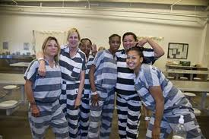
Gender bias
Deprivation model Evaluation (A02)
Studies concentrate mainly on male prisoners, ignoring the fact that female offenders often develop strong bonds in prison.
Learning objectives:
To DESCRIBE and EVALAUTE the ‘importation model’ and ‘deprivation model’ of institutional aggression within groups.
To KNOW and EVALUATE supporting research and each theory.

Slide 13
Deprivation model Evaluation (A02)
Supported theoretically by Maslow’s hierarchy of needs.
Prison riots not necessarily correlated with deprivation of privileges, freedoms, food etc.
Learning objectives:
To DESCRIBE and EVALAUTE the ‘importation model’ and ‘deprivation model’ of institutional aggression within groups.
To KNOW and EVALUATE supporting research and each theory.

Slide 14
Research suggests BOTH explanations probably play a role…
Importation model best suited to explaining aggression towards other inmates. Whereas the deprivation mode best explained aggression towards prison staff.
Learning objectives:
To DESCRIBE and EVALAUTE the ‘importation model’ and ‘deprivation model’ of institutional aggression within groups.
To KNOW and EVALUATE supporting research and each theory.

Slide 15
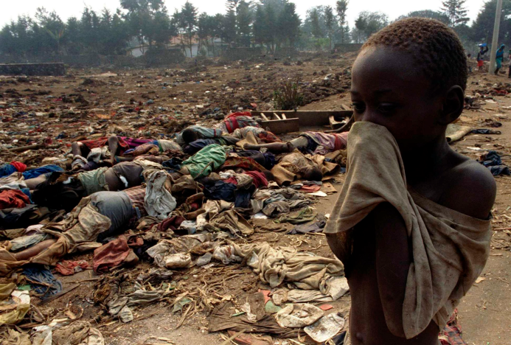
Institutional aggression can also occur between groups
E.g. political institutions, religious institutions and even ethnic groups can be aggressive towards one another.
This usually happens when one institution’s relationship with the other is characterised by hatred and violence. E.g. Attempted Hutu genocide of Tutsi in Rwanda 1994.
Key social factors in institutional aggression escalating include: Dehumanisation, obedience to authority and a lack of bystander intervention.
Learning objectives:
To DESCRIBE and EVALAUTE the ‘importation model’ and ‘deprivation model’ of institutional aggression within groups.
To KNOW and EVALUATE supporting research and each theory.

Slide 16
Films worth watching in relation to institutional aggression:
Shawshank redemption
American History X
Hotel Rwanda
Learning objectives:
To DESCRIBE and EVALAUTE the ‘importation model’ and ‘deprivation model’ of institutional aggression within groups.
To KNOW and EVALUATE supporting research and a practical application IDA.

