Slide 1
Intro to Relationships
Resources: Complete Companion books

Slide 2
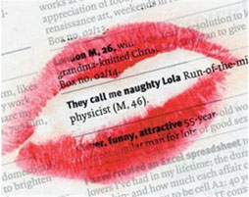
What do we look for in a partner?
Write down 5 things that you would look for in a boyfriend/girlfriend
Write a dating advert for yourself. Include what you are looking for in a partner. You have 30 words maximum.
Do you think males and females will look for different things?

Slide 3
What makes people start a relationship?
He’s just so dreamy…

Slide 4
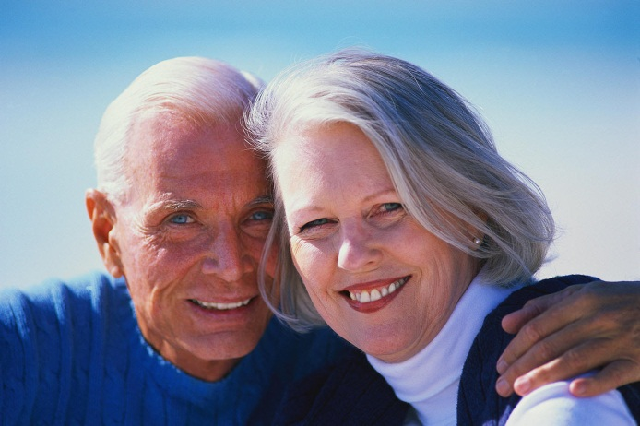
Why do some relationships last?

Slide 5
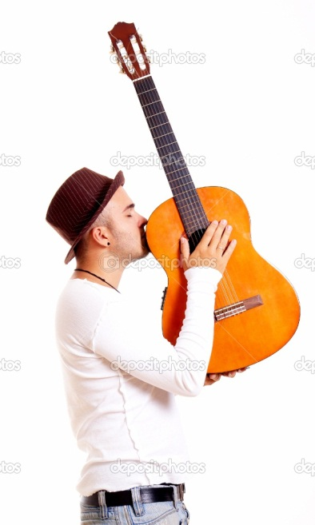
Why do some relationships break down?
She came between me and my guitar…

Slide 6
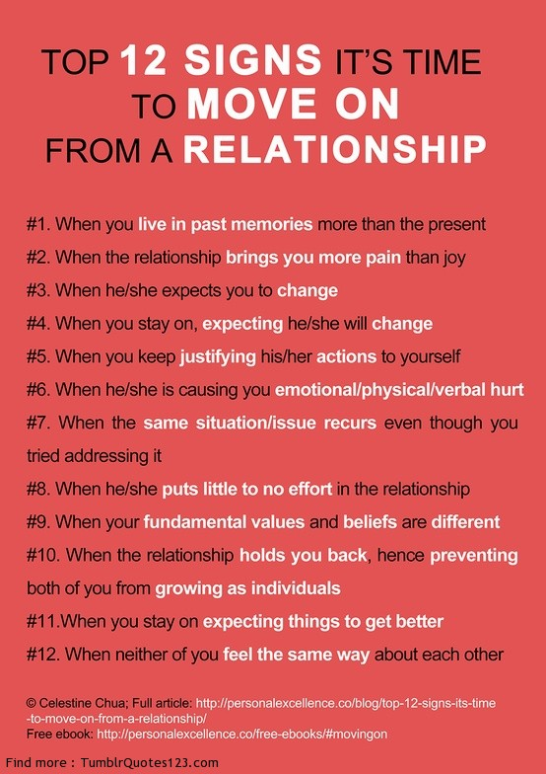

Slide 7
Love is in the air…or is it?
We would like to think that the formation of relationships is something magical, based on deep emotions and feelings.
Social psychologists, however, argue it’s more about self interest, reinforcement, and similarities between people.

Slide 8
Byrne and Clore (1970)
Most things in our lives are usually either rewarding or punishing. Example?
When we have our needs met, we experience it as reward. Example?
Mutual attraction occurs when each partner meets the other person’s needs.

Slide 9
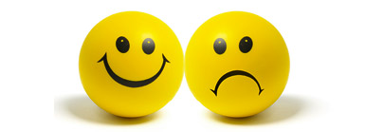
Byrne and Clore (1970)
Rewarding stimuli make us happy/produce positive feelings
Punishing stimuli produce negative feelings/make us feel bad
People can be classed as stimuli and some people make us happy, whilst some do not.
How can OPERANT CONDITIONING be applied to relationship formation?

Slide 10
Can you remember the difference between CLASSICAL and OPERANT conditioning?

Slide 11
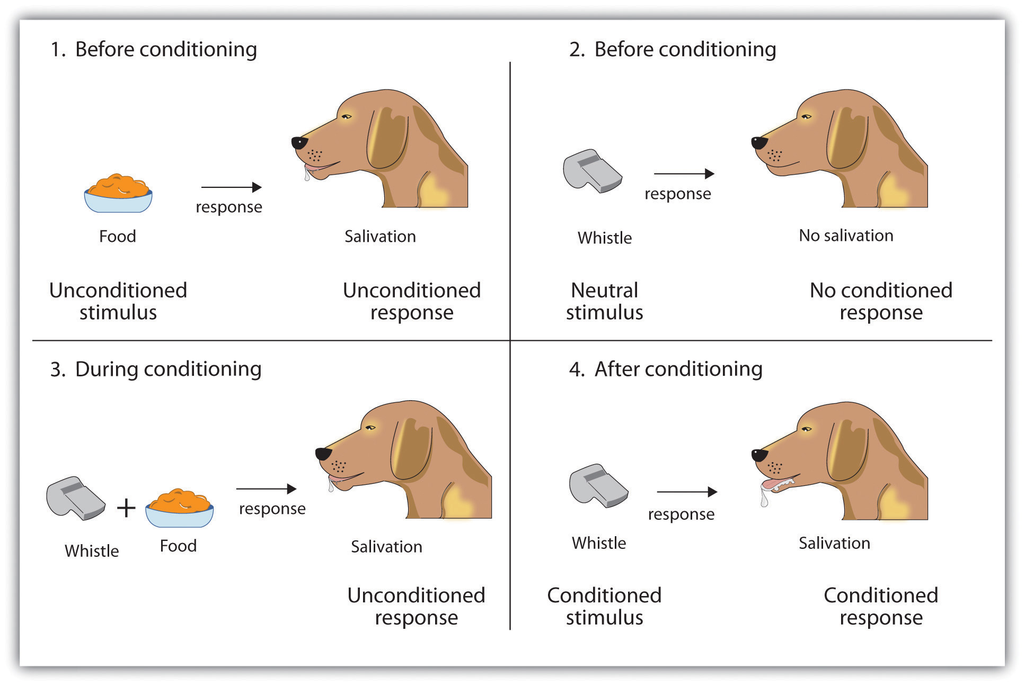
Classical conditioning: learning through association

Slide 12
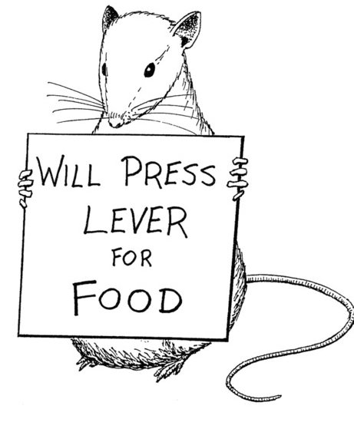
Operant Conditioning
Learning through the consequences that follow a behaviour.
Press a lever…get some food…do it again
= Positive reinforcement
Negative reinforcement is when you take something away that makes the person sad, uncomfortable, anxious etc.
Eg somebody who is agoraphobic stops leaving the house and feels better because the anxiety has been removed.

Slide 13
Byrne and Clore (1970)
As well as forming relationships with people who invoke positive feelings in us, we are also likely to form relationships with people who are ASSOCIATED with positive feelings.
Can you think of an example of this in your own life?
A previously neutral person can become positively/negatively valued because of an association with a particular event.
Discussion…Holiday romances…

Slide 14
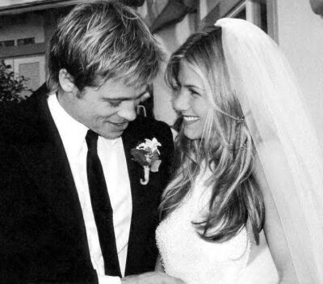
Will it last?
What do you think Byrne and Clore (1970) said about the longevity/durability of relationships?
Where positive feelings outweigh negative feelings, the relationship will usually last.
Where there is more negative feelings than positive, it will probably fail.

Slide 15
Evaluation Any ideas?
Read page 49 in Complete Companion and jot your ideas down…
+
-

Slide 16
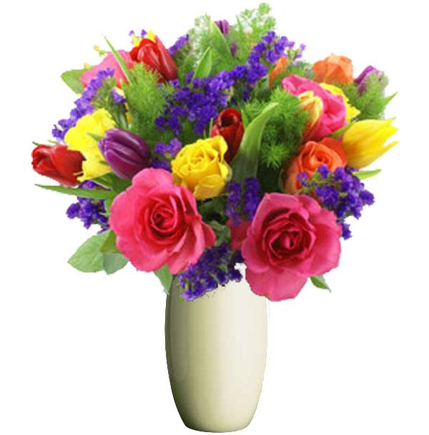
Evaluation Any ideas?
Read page 49 in Complete Companion and jot your ideas down…
+
-
Support from Griffit and Guay (1969) Creative task evaluation
Facebook use-Sheldon et al (2011)
Physiological support-Aron et al (2005) Early-stage, intense romantic love ‘shows up’ in dopamine levels; it is ‘satisfying’ to fall in love.
Face validity
Hays (1985) It is satisfying to give AND receive rewards (so self-interest is not the only motivator)
Lott (1994) Byrne and Clore show a culture bias; not all cultures are as self-interested as Western cultures and in many, women are more concerned with the interests of others.

Slide 17
Face Validity
Face validity is a simple form of validity in which researchers determine if the test seems to measure what is intended to measure . This only means that the test looks like it works. It does not mean that the test has been proven to work
The theory has face validity: is supported by everyday experiences i.e. happy, warm people with a good sense of humour have more friends.

