Slide 1
PROJECT 2: our environment

Slide 2
Purpose: to model a gcse style project
How to find relevant inspiration from historical and contemporary artists, including how to thematically contextualise your work (AO1).
How to showcase a range of different materials and techniques effectively (AO2).
How to show the visual development of an emerging idea and create meaningful outcomes (AO2 and AO4).
It will also allow clear development of recording skills (AO3).

Slide 3
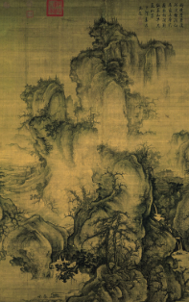
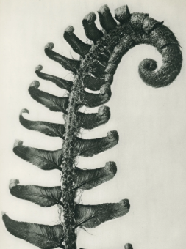
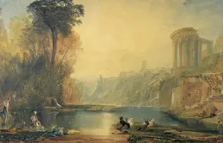
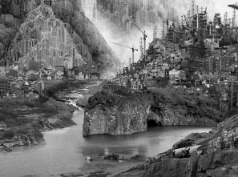
Artists that you will be introduced to…
Turner (British 1800s), Guo Xi ( Chinese 11th Centruy), Yang Yongliang (Chinese current), Karl Blossfeldt (German 1880s).

Slide 4
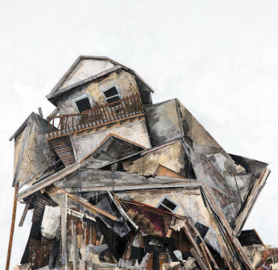
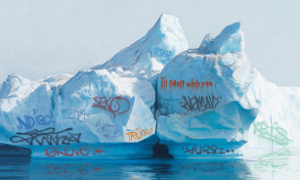
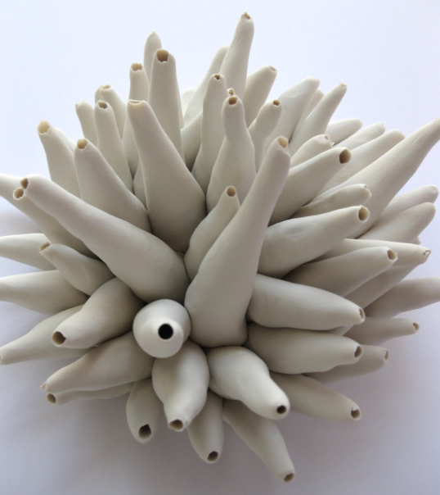
Josh Keyes (American current), clay artists, Seth Clarke (American current).

Slide 5
‘SUBLIME’
What does this word mean to you?
What could it mean to artists of the 18 and 19th Century?
Notes:
https://www.theguardian.com/books/2000/aug/19/scienceandnature
In the past, the Alps, the Grand Canyon, Manhattan, the Book of Job, Paradise Lost, and the paintings of Turner have all been called "sublime". Until the 20th century, it was the accepted word for the fascination of all that dwarfs and overwhelms us.

Slide 6
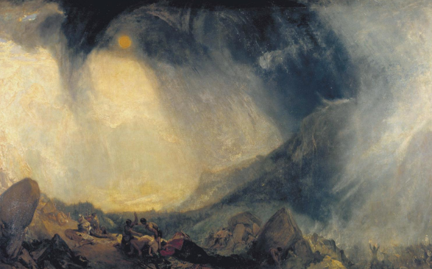
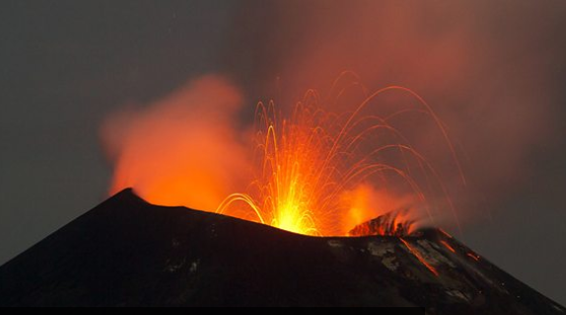
Snow Storm: Hannibal and His Army Crossing the Alps BBC2 KRAKATOA REVEALED

Slide 7
A new cult of the sublime was capped with Edmund Burke's Philosophical Enquiry into the Origin of our Ideas of the Sublime and Beautiful (1757). For Burke, the sublime always belongs opposite the "beautiful". Beauty is what we can comprehend; sublimity is what we cannot grasp. Beauty is in proportion; sublimity is in vastness. The beautiful is satisfying; the sublime is stupefying. Primarily, the sublime was to be found in nature.

Slide 8
For the Romantic poets, the sublime was an encounter with the almost infinite powers of the human imagination. In The Prelude, Wordsworth sees Mont Blanc and regrets that the real mountain has taken the place of what he more sublimely imagined. Now the sublime is not in nature, it is in faculties of the individual.
This is also Turner's sublime - the greatest stretch and test of the figurative imagination. Ever since, even if it has faded from literature, it has stayed as an idea in art, especially in American art. 19th-century American painting was dominated by huge landscapes.

Slide 9
J.M.W. Turner RA (1775 - 1851)

Slide 10
J.M.W. Turner RA (1775 - 1851) A child prodigy who went on to become one of the stars of British art
Began his formal training at the Royal Academy Schools aged just 14.
At this time the Royal Academy promoted history painting as the height of artistic accomplishment. Turner set out to change this outlook by elevating the status of landscape painting by demonstrating landscape’s potential to address historical, religious and literary subjects.
While Turner enjoyed great success as an oil painter and continued to explore the potential of watercolour. As a portable and quick-drying medium, it proved indispensable as a means of recording scenery and fleeting effects of light and shade observed during his extensive travels around the UK and Europe and it was in watercolour that he achieved some of his most creative and innovative results.

Slide 11
PRACTICAL TASK
LESSON OBJECTIVE: TO BE ABLE TO UNDERSTAND HOW TURNER CAPTURED THE BEAUTY OF NATURE IN HIS FLUID USE OF LAYERED WATERCOLOUR.
SKILL OBJECTIVE: TO MIX A RANGE OF APPROPRIATE SHADES AND BUILD UP LAYERS OF WATERCOLOUR, TO SCRATCH THROUGH LAYERS TO ADD TEXTURE AND TO BUILD UP AREAS OF DARKER DETAIL.
LESSON OUTCOME: AN A3 WATERCOLOUR TURNER STUDY.
AO1 – responding to the work of other artists/designers.

