Slide 1
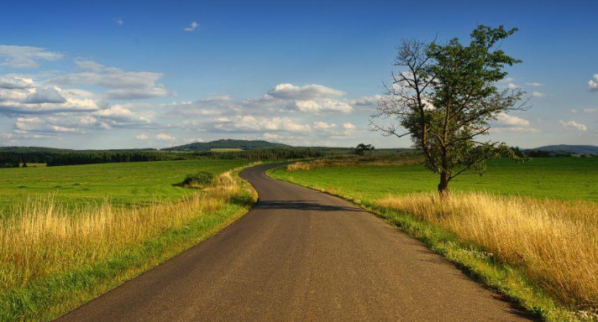
Landscape photography
Task description
To link to the current work that you have been doing I would like you to take a set of photos (approx. 20 in total, then pick the best ten for your sketchbook).
The photos should be of landscapes or trees or woodland and convey a sense of natural beauty (you may wish to use certain filters or editing software to alter/enhance the colour scheme. Also consider the time of day and explore different camera angles (close up, wide angle shot, looking up etc). I was hoping most of you would be able to get out over the weekend to do this. If you are having to stay in the house to self isolate could you let me know please.
You will need to print out your best 8-10 to mount into your book. In a future lesson (Monday) we will be using some of them for image transfer (so keep them saved digitally somewhere), and then working into them. Therefore you need some that are straight long shots so that we can add industrial elements over the top.
For those of you that wish to enhance your photographic skills, this is a useful set of tips:
https://improvephotography.com/45474/15-helpful-landscape-photography-tips-beginners/

