Slide 1
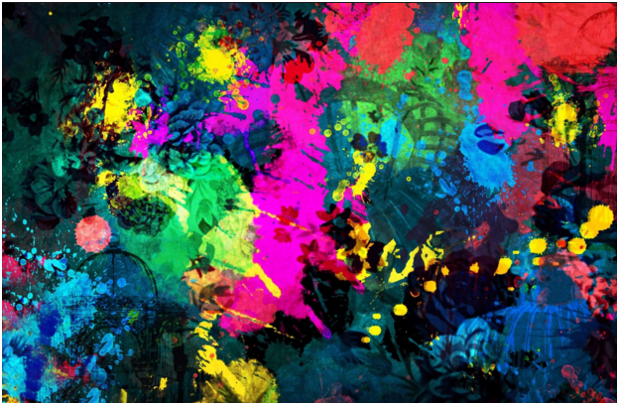
GCSE art study skills
This pack contains sources of guidance to help you to improve your skills and approach to your art coursework. Select tasks that you feel will benefit you and help you to create the best project possible.

Slide 2
contents
Slide 3 – dealing with a lack of motivation
Slides 4 – 9 approaches to help you to improve your drawing skills
Slide s10 -11 approaches to help you to improve your painting skills
Slides 12 -1 3 getting started with photography
Slide 14 finding inspiration
Slide 15 sketchbook examples

Slide 3
Motivation
Without self motivation it is easy to fall behind with art projects, and as a result low motivation can become a barrier to success. If this sounds like you take a moment to follow the links to several articles that reference some worthwhile strategies.
http://www.studentartguide.com/articles/motivation

Slide 4
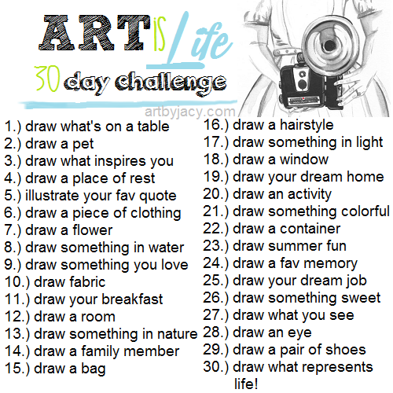
Improving your Drawing
1. Create a routine
A drawing everyday challenge (this simply encourages you to pick up a pen or pencil), some could be quick timed 2 minute drawings, others longer when you have time to properly sit down.
The 30 day challenge to the right is just one example, you could create your own tasks based on your project theme or simply google ‘30 day drawing challenge ‘ for more ideas. It doesn’t necessarily matter when you are drawing, it simply encourages you to gain confidence.

Slide 5
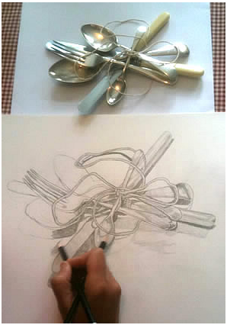
2. Tips to improve your accuracy when drawing from observation
This article provides excellent advice
http://www.studentartguide.com/articles/realistic-observational-drawings
IT EXPANDS ON THE FOLLOWING TIPS WITH VISUAL EXAMPLES:
Tip 1: Look at what you are drawing
Tip 2: Draw from real objects whenever possible
Tip 3: Don’t trace
Tip 4: Understand perspective
Tip 5. Use grids, guidelines or rough forms to get the proportions
right before you add details
Tip 6: Be wary of ellipses
Tip 7: Keep the outlines light
Tip 8: Have a Good Range of Tone
Tip 9: Use mark-making to convey surface quality and texture
Tip 10: Include / omit detail as necessary

Slide 6
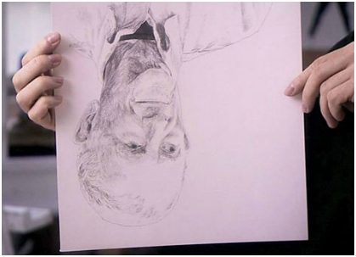
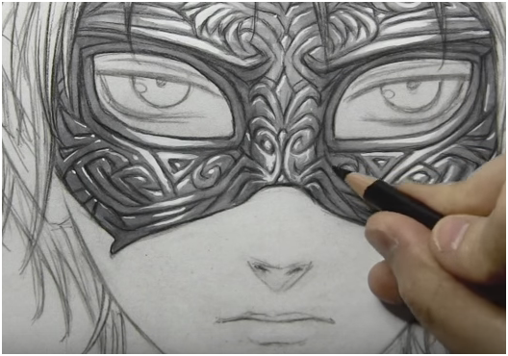
3. VIDEOS TO GUIDE YOU
http://www.bbc.co.uk/schools/gcsebitesize/art/video/drawing/
has six drawing videos that help you to focus on improving certain skills:
1. selecting the right pencil for the job
2. The use of an eraser in drawing
3. How to improve your shading
4. Working on a ground
5. Drawing upside down
6. Using charcoal.
Youtube has lots of useful drawing videos, if you are interested in more stylised drawing, for example manga, it would be worth you looking at Mark crilley:
https://www.youtube.com/watch?v=UBCfioB4axk&t=1033s
In the above video he talks you through how he got better at drawing whilst working on a current piece.

Slide 7
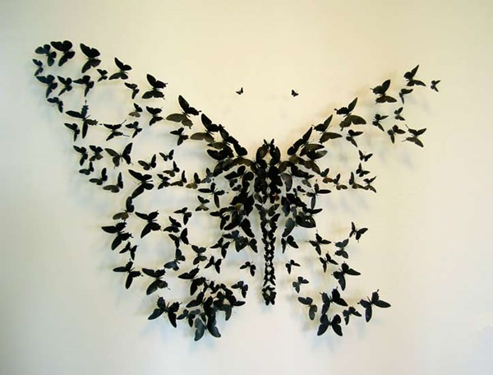
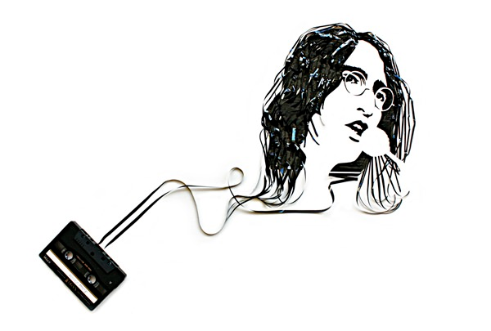
2. Explore Drawing with different media
Biro, ink, charcoal and pencils are all useful, but you could also try the following:
-shading a background and drawing with a rubber
-using black paper and white pencils
-drawing with random materials (string, toothpaste, sweets, wax, wheels, anything really but it would be best if it is relevant to your project theme).
Erika Iris Simmons uses old cassette tape to create popular celebrity portraits.
Paul Villinski is a visual artist that uses discarded materials such as beer cans to bring out his artwork in meaningful poetic ways.

Slide 8
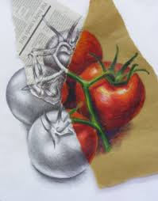
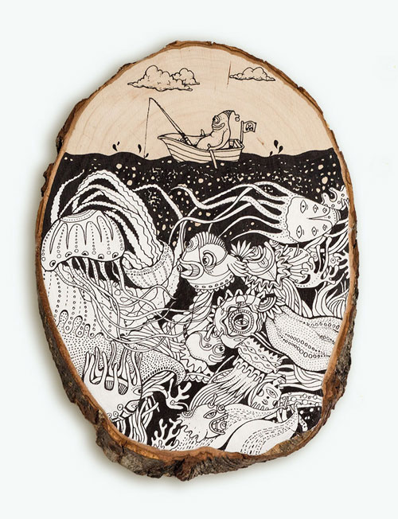
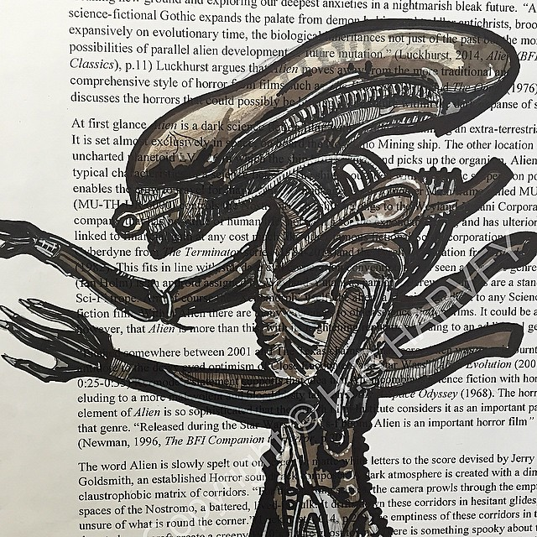
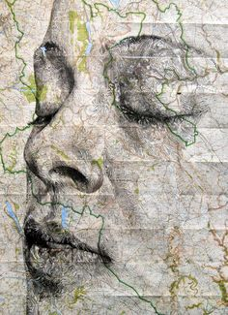
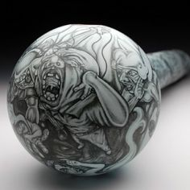
3. Explore drawing on different materials.
Here are just a few ideas
draw on an ink spattered background
Draw on a collaged background
Draw over pages of text/newspaper
Draw over photographs
Create a textured background and work on top
Draw on a wooden surface
Draw onto an object

Slide 9
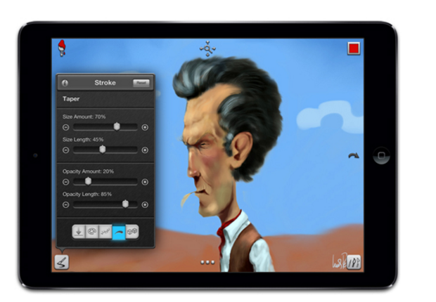
4. DRAWING DIGITALLY
There are numerous apps for ipads to help you to master the art of digital drawing, look at this article for ideas:
http://www.creativebloq.com/digital-art/art-on-the-ipad-1232669
Procreate and sketchbook pro are also good choices.

Slide 10
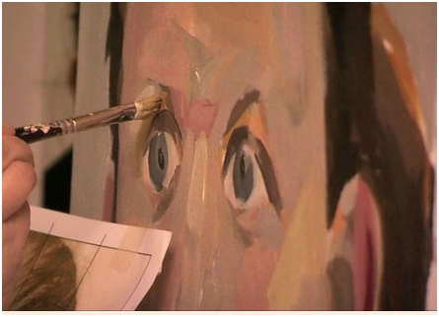
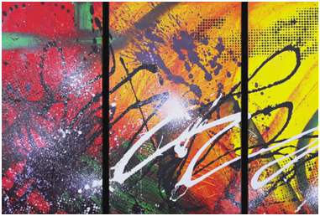
PAINTING
1. VIDEOS TO GUIDE YOU
http://www.bbc.co.uk/schools/gcsebitesize/art/video/painting/
has six painting videos that help you to focus on improving certain skills:
1. selecting a colour palette
2. Colour mixing
3. Mixing skin tones
4. Using the correct brush
5. Preparing surfaces
6. Painting portraits
Youtube has lots of useful painting videos, if you are interested in contemporary abstract styles using lots of different messy techniques look at John Beckley’s channel, e.g. this video
https://www.youtube.com/watch?v=dQ8GXj1TsVY

Slide 11
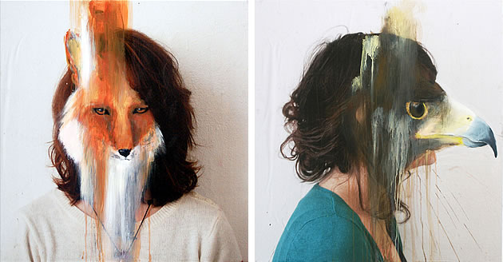
2.painting is time consuming but there are ways that you can get faster
The following article is ideal for those of your who wish to really challenge yourself as the examples are of an extremely high standard.
http://www.studentartguide.com/articles/how-to-draw-and-paint-faster
The above link provides a really useful article that expands on the following tips:
Use a ground
Incorporate mixed media /patterned surfaces / textural elements
Work on several pieces at once
Paint things in the right order – background areas first
Use masking tape to create straight edges
Leave artwork purposefully incomplete
Selectively flatten tone
Focus on Line
Include photographs
These artworks by Charlotte Caron show animal faces painted on top of photographic portraits. Note the clever unity of the colours in each image.

Slide 12
PHOTOGRAPHY
VIDEOS TO GUIDE YOU
The basics are covered in the following link:
http://www.bbc.co.uk/schools/gcsebitesize/art/video/photography/
CAMERA TYPES, FOCUS, APERTURE, DEPTH OF FIELD, EXPOSURE AND SHUTTER SPEED.
Further tutorials will be added to moodle.

Slide 13
TRY COMBINING Photographic SKILLS WITH OTHER ART SKILLS, LOOK AT THE FOLLOWING FOR 100+ IDEAS ON HOW TO DO THIS
http://www.studentartguide.com/articles/creative-photography-ideas
For further research:
Masters of Photography - a superb resource, including articles, photographs and resources on a wide variety of famous photographers
A History of Photography - an excellent one-stop history of photography with information about processes, individual artists and movements in handy hypertext format.
Get inspired by looking at the work of other gcse photography students:
http://www.photopedagogy.com/gcse-gallery.html

Slide 14
HOW TO DEVELOP YOUR IDEAS
WHERE TO LOOK FOR ARTIST INSPIRATION:
For possible contemporary artist links look at:
www.thisiscolosal.com
www.art2day.co.uk
For a broad range of artist links:
http://www.tate.org.uk/art/
http://www.moma.org/learn/moma_learning/themes
Further artist links will be posted on department Twitter account: @kes_artdept
Don’t forget all the art books we have in the art room!

Slide 15
SKETCHBOOK INSPIRATION
THERE ARE NUMEROUS EXAMPLES ONLINE, I HAVE SELECTED SOME OF THE BEST ONES WHICH CAN BE FOUND ON MY PINTEREST LINK BELOW:
https://uk.pinterest.com/Mswestmore/gcse-project-examples/
ALSO CHECK OUT VIDEOS SUCH AS:
https://www.youtube.com/watch?v=dKIu7t_WiFc
I WILL ALSO BE PUTTING TOGETHER EXAMPLES OF work from last year, this will appear on moodle as additional files.

