Slide 1
Ian Murphy
Ian Murphy is a living artist whose work often focuses on the architecture seen during his travels. For your mock exam you are to respond to his work. I advise you do it in the following way:
Have a look at his featured work over the following four slides. Pay attention to how detailed and textural they are. You will need to pick your own close up to do in response.
Think about where you could take a close up photo of interesting architectural details (a range of tones and textures will make the image more interesting to study and draw from). See example right.
Take your photo, edit it into black and white and play with the contrast and cropping if necessary.
Print your image a suitable size to work from in the exam. Please note you will NOT be able to have your phones in the exam.
Decide on the materials you will use to complete a high quality detailed drawing of your chosen image (stick to monochrome, any of the following materials would be suitable: shading pencils, biro, fine liner, chalk and charcoal). Tip: pick a material you feel confident in using to get the best result. Select an appropriate size to work based on your material choice and the fact you have 5 hours!
Decide what technique you will use to draw, e.g. freehand or gridding. If the latter you may grid your photo out in advance.
On the day of the exam (Thursday 20th June) you will need to come over straight after registration with your image already printed out and any specific materials you might need. You will have normal breaks.
Good luck!
Purpose of exam: to assess your recording skills and for you to see how much you can do in 5hours, this will help you to plan for the final GSCE exam.

Slide 2
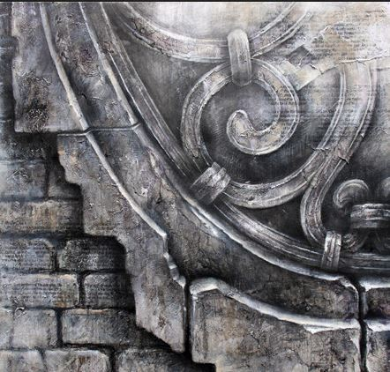
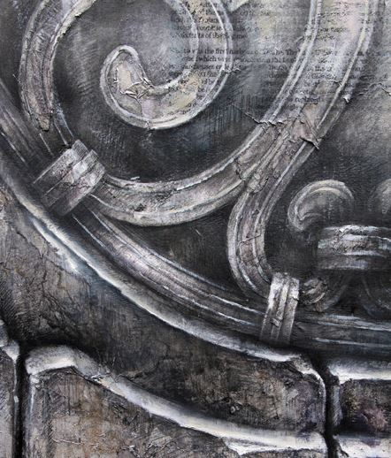

Slide 3
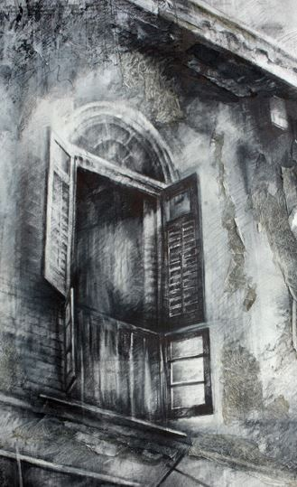
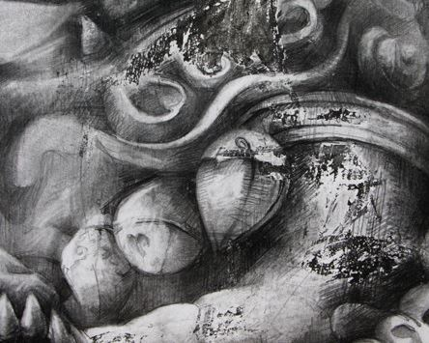

Slide 4
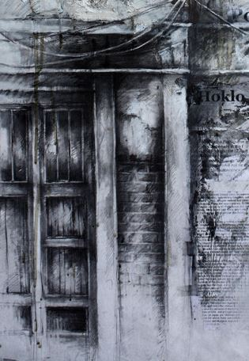
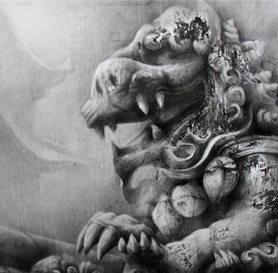

Slide 5
