Slide 1
Schizophrenia –
Hangman
Come up with key words linked to schizophrenia and play hang man.
Keywords
Atypical antipsychotics
Chlorpromazine
Clozapine
Learning objectives:
To be able DESCRIBE and EXPLAIN how biological therapies for SZ (antipsychotics and ECT) work.
To EVALUTE how effective and appropriate the treatments are.

Slide 2
Home learning
Listen to the BBC radio 4 ‘all in the mind’ podcast on drug trials and SZ:
http://www.bbc.co.uk/programmes/b00bz73j
Also on moodle.
Keywords
Atypical antipsychotics
Chlorpromazine
Clozapine
Learning objectives:
To be able DESCRIBE and EXPLAIN how biological therapies for SZ (antipsychotics and ECT) work.
To EVALUTE how effective and appropriate the treatments are.

Slide 3
How do biological treatments work? And are they effective?
Keywords
Atypical antipsychotics
Chlorpromazine
Clozapine
Learning objectives:
To be able DESCRIBE and EXPLAIN how biological therapies for SZ (antipsychotics and ECT) work.
To EVALUTE how effective and appropriate the treatments are.

Slide 4
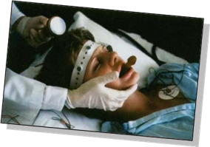
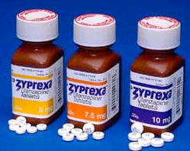
SZ treated from a medical (biological) perspective through:
On very rare occasions for severe catatonic schizophrenia in the US WITH…
Antipsychotic drugs
ECT
Keywords
Atypical antipsychotics
Chlorpromazine
Clozapine
Learning objectives:
To be able DESCRIBE and EXPLAIN how biological therapies for SZ (antipsychotics and ECT) work.
To EVALUTE how effective and appropriate the treatments are.

Slide 5
How do they work?
Are they effective?
Watch the video
Keywords
Atypical antipsychotics
Chlorpromazine
Clozapine
Learning objectives:
To be able DESCRIBE and EXPLAIN how biological therapies for SZ (antipsychotics and ECT) work.
To EVALUTE how effective and appropriate the treatments are.

Slide 6
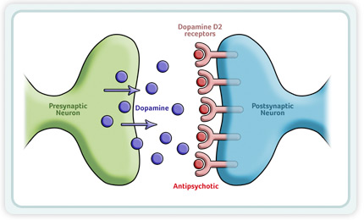
(A01) How do antipsychotics work?
Antipsychotics work by binding to and then therefore blocking d2 (dopamine) receptors.
This reduces dopamine level, and thus the symptoms of SZ.
Learning objectives:
To be able DESCRIBE and EXPLAIN how biological therapies for SZ (antipsychotics and ECT) work.
To EVALUTE how effective and appropriate the treatments are.

Slide 7
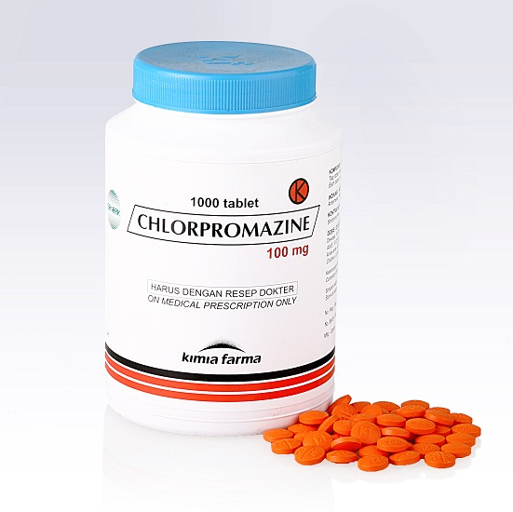
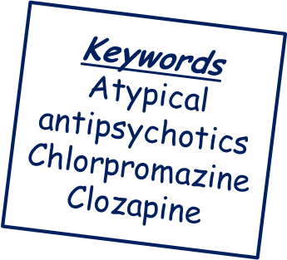
(A01) There are different generations of antipsychotics…
Typical antipsychotics – e.g. Chlorpromazine© is a commonly prescribed typical antipsychotic that reduces symptoms for approx. 60-70% of patients.
These are ‘dopamine antagonists’ that relieve positive symptoms of SZ by binding to, and blocking, d2 receptors in several brain areas.
Learning objectives:
To be able DESCRIBE and EXPLAIN how biological therapies for SZ (antipsychotics and ECT) work.
To EVALUTE how effective and appropriate the treatments are.

Slide 8
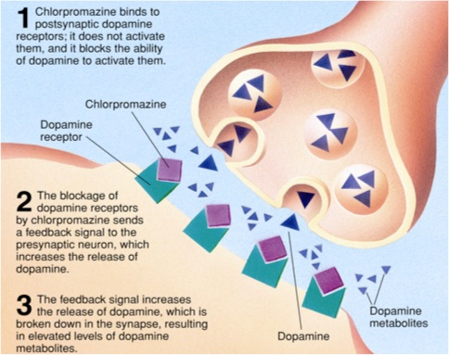
Learning objectives:
To be able DESCRIBE and EXPLAIN how biological therapies for SZ (antipsychotics and ECT) work.
To EVALUTE how effective and appropriate the treatments are.

Slide 9
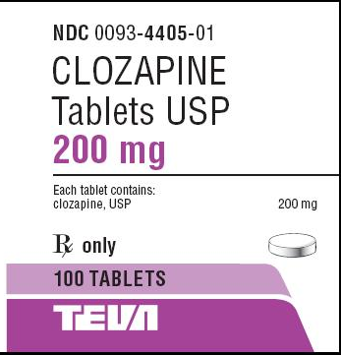
(A01) There are different generations of antipsychotics…
Atypical antipsychotics – Newer drugs.
E.g. Clozapine© is a commonly prescribed atypical antipsychotic.
These do block d2 receptors, but more temporarily (results in less side effects), and ALSO block serotonin receptors.
Learning objectives:
To be able DESCRIBE and EXPLAIN how biological therapies for SZ (antipsychotics and ECT) work.
To EVALUTE how effective and appropriate the treatments are.

Slide 10
So, are antipsychotics effective?? (I.e. do they work?)…………….
Learning objectives:
To be able DESCRIBE and EXPLAIN how biological therapies for SZ (antipsychotics and ECT) work.
To EVALUTE how effective and appropriate the treatments are.

Slide 11
Antipsychotics have long been established as a relatively cheap, effective treatment, which rapidly reduce symptoms and enable many people to live relatively normal lives - allow patients to be treated outside of hospital. (May 1981).
Especially effective for some forms of SZ where regularly attending therapy sessions may be challenging.
Learning objectives:
To be able DESCRIBE and EXPLAIN how biological therapies for SZ (antipsychotics and ECT) work.
To EVALUTE how effective and appropriate the treatments are.

Slide 12
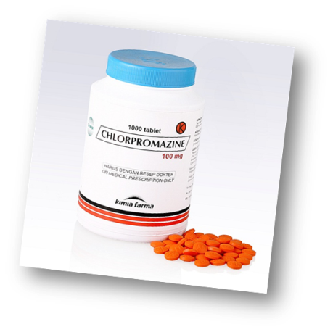
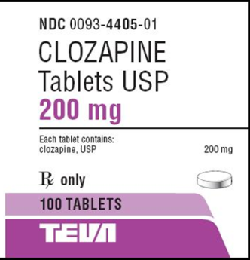
Typical
Vs.
Atypical
Works only on positive symptoms.
Do help alleviate the disorder. For example, Davis et al. (1980) did a meta-analysis of drug trials – 3519 participants. Found that 55% of placebo patients relapsed, whereas only 19% of patients on typical antipsychotics relapsed. (However, this study may be unfair, as possible the placebo patients are in a state of withdrawal – this leads to flooding of the dopamine system – therefore making relapse more likely).
Research has also found antipsychotics make much less of a difference in SZ living in supportive home environments.
Marginally more effective than typical.
Works on positive symptoms AND some negative symptoms some of the time such as apathy.
Fewest side effects .
Enables treatment of some patients who are drug resistant with typical antipsychotics (though some people remain drug resistant to both types!)

Slide 13
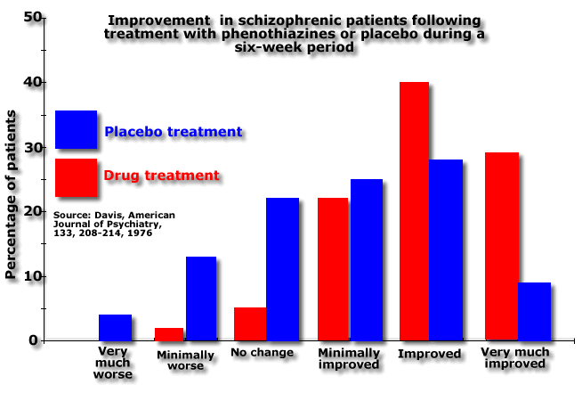
Learning objectives:
To be able DESCRIBE and EXPLAIN how biological therapies for SZ (antipsychotics and ECT) work.
To EVALUTE how effective and appropriate the treatments are.

Slide 14
Are they appropriate?? (I.e. are there issues with prescribing them as a method of treatment)
Learning objectives:
To be able DESCRIBE and EXPLAIN how biological therapies for SZ (antipsychotics and ECT) work.
To EVALUTE how effective and appropriate the treatments are.

Slide 15
A problem with antipsychotics as a treatments is that there are often significant side effects.
Watch the video.
Pick out as many key side effects as you can.
The problem with side effects is that they lead to a proportion of patients wanting to discontinue treatment. Key side effects of antipsychotics include:
Weight gain
Tremors
Long-term tardive dyskinesia
Myocarditis (inflammation of heart muscle)
Keywords
Atypical antipsychotics
Chlorpromazine
Clozapine
Sexual dysfunction
Learning objectives:
To be able DESCRIBE and EXPLAIN how biological therapies for SZ (antipsychotics and ECT) work.
To EVALUTE how effective and appropriate the treatments are.

Slide 16
A further issue with appropriateness is that drugs treat symptoms NOT the underlying cause.
SZ reappears as soon as drugs cease to be taken. Means many patients are on drugs (with side effects!) for life.
Learning objectives:
To be able DESCRIBE and EXPLAIN how biological therapies for SZ (antipsychotics and ECT) work.
To EVALUTE how effective and appropriate the treatments are.

Slide 17
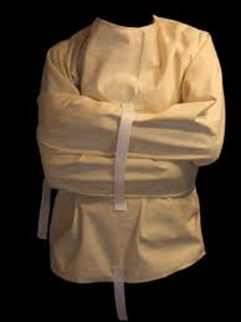
A final issue with appropriateness is that antipsychotics can potentially have dehumanizing effects as take away a sense of personal responsibility, and can be viewed as a form of ‘chemical ‘straight-jacket’.
Learning objectives:
To be able DESCRIBE and EXPLAIN how biological therapies for SZ (antipsychotics and ECT) work.
To EVALUTE how effective and appropriate the treatments are.

Slide 18
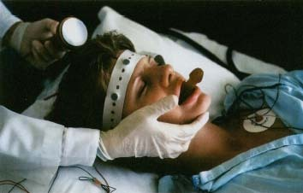
What is ECT?
ECT was used historically to treat SZ.
Research has shown ECT to be only slightly more effective that a placebo (sham ECT), and for the improvements to be minimal in the long-term (Tharyan and Adams 2005).
ECT is therefore no longer used in the UK.
The small benefit has, however, meant it has been reintroduced in the US to use WITH antipsychotics in very severe cases where rapid reduction in symptoms is necessary.
Learning objectives:
To be able DESCRIBE and EXPLAIN how biological therapies for SZ (antipsychotics and ECT) work.
To EVALUTE how effective and appropriate the treatments are.

Slide 19
Effectiveness?
Sarita et al (1998) found no difference in symptom reduction between ECT and ‘sham ECT’ (placebo). Therefore shows it is not an effective treatment.
More effective for catatonic symptoms.
Appropriateness?
Risky procedure with potentially serious side effects e.g. memory dysfunction, brain damage, persistent head aches, heart problems.
Learning objectives:
To be able DESCRIBE and EXPLAIN how biological therapies for SZ (antipsychotics and ECT) work.
To EVALUTE how effective and appropriate the treatments are.

Slide 20
A scene at the doctors…
In groups of 4 or so, create a doctor-patient dialogue script that another group can act out.
The scene must include at minimum:
A patient and/or family member describing their SZ symptoms to a psychiatrist.
A psychiatrist diagnosing the illness and explaining to the patient how she/he intends to treat the illness and why.
The patients thoughts on the diagnosis and prescribed treatment (e.g. Might explain to the doctor that prefers solely psychological based treatments? Why? Might enquire as to possible side effects/issues surrounding a drug prescription? Might ask if antipsychotics will work? And how?).
Learning objectives:
To be able DESCRIBE and EXPLAIN how biological therapies for SZ (antipsychotics and ECT) work.
To EVALUTE how effective and appropriate the treatments are.

