Slide 1
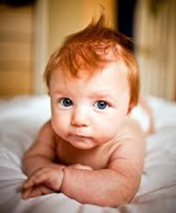
Explanations of attachment: Learning theory
These babies used their mother as a safe base and were happy to explore the room when she was present.
They showed distress by crying when she left, and welcomed her back on her return, settling back down to play fairly quickly.
They were wary of the stranger and treated them very differently.
70% of babies fell into this category
Starter: What sort of attachment are each of the descriptions describing?
These babies were very upset at separation but were not easily comforted when the mother returned.
They appeared to be angry and rejected her attempts to comfort them.
These babies seemed to expect the relationship to be difficult and they alternated between seeking closeness and wanting distance.
15% of babies fell into this category
Learning objectives:
To EXPLAIN the ‘learning theory’ of how attachments are formed.
To KNOW and EVALUATE research supporting the theory.
To be able to EVALUATE the accuracy of the theory.

Slide 2
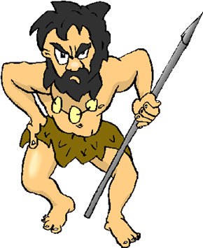
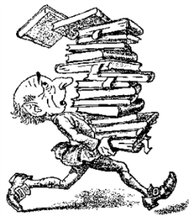
There are two competing theories of ‘how’ attachments form…
Keywords
Conditioning
Drives
Reinforcement
Evolutionary theory (Bowlby)
Learning theory (Dollard & Miller)
The tendency to form attachments is INNATE
This tendency is present in both infants and mothers.
Infants have no innate tendency to form attachments
They LEARN attachments due to satisfying DRIVES.
Learning objectives:
To EXPLAIN the ‘learning theory’ of how attachments are formed.
To KNOW and EVALUATE research supporting the theory.
To be able to EVALUATE the accuracy of the theory.

Slide 3
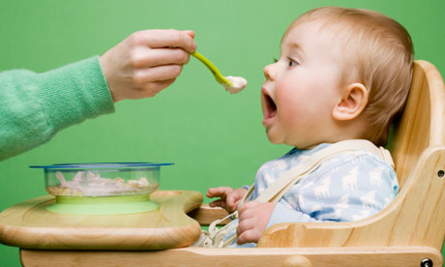
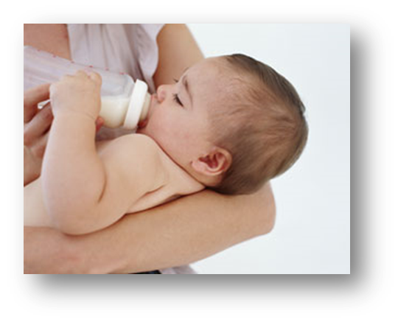
What is the learning theory of attachment formation?
Attachments are learned behaviours, rather than innate.
The learning takes place due to drives. E.g. for food and water.
Mother becomes associated with the satisfying the baby’s drives, as she tends to be the primary provider of food, comfort, etc. (all things the baby wants).
Keywords
Conditioning
Drives
Reinforcement
Learning objectives:
To EXPLAIN the ‘learning theory’ of how attachments are formed.
To KNOW and EVALUATE research supporting the theory.
To be able to EVALUATE the accuracy of the theory.

Slide 4
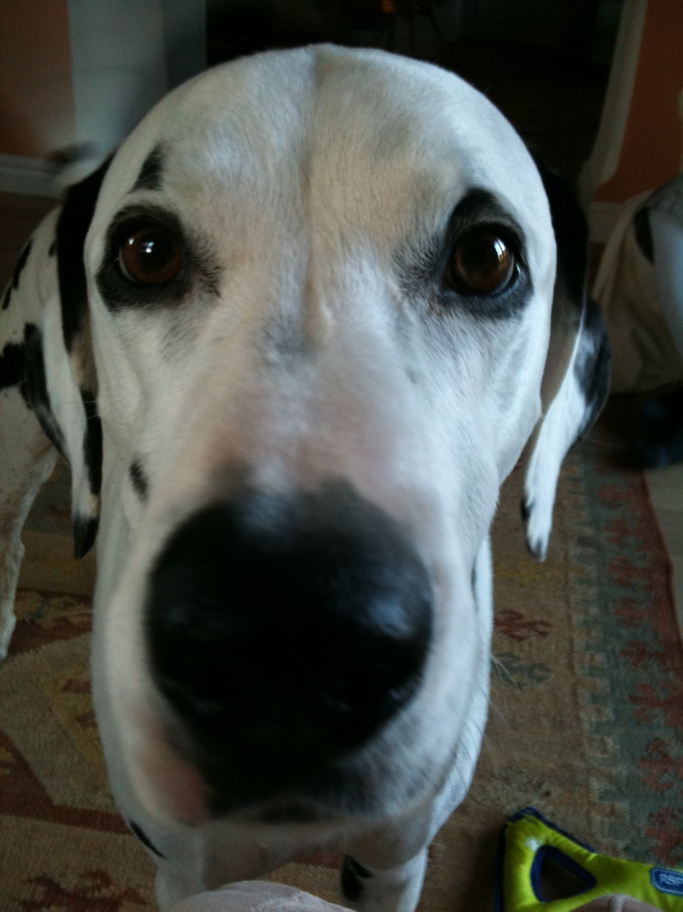
This is Mr. Biggles. Mr. Biggles likes tea. If the kettle is put on and his bowl is picked up he starts to drool (a lot). Why?
How do the babies learn?
Keywords
Conditioning
Drives
Reinforcement
Learning objectives:
To EXPLAIN the ‘learning theory’ of how attachments are formed.
To KNOW and EVALUATE research supporting the theory.
To be able to EVALUATE the accuracy of the theory.

Slide 5
How do they learn the association?
+
Classical conditioning
Operant conditioning
Watch the introduction to these two processes.
Make appropriate notes.
Learning theory is a behavioural approach theory. C + O conditioning are key ides of the approach.
Keywords
Conditioning
Drives
Reinforcement
Learning objectives:
To EXPLAIN the ‘learning theory’ of how attachments are formed.
To KNOW and EVALUATE research supporting the theory.
To be able to EVALUATE the accuracy of the theory.

Slide 6
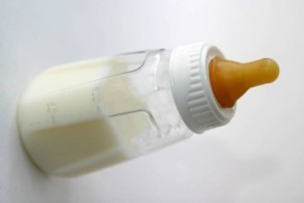
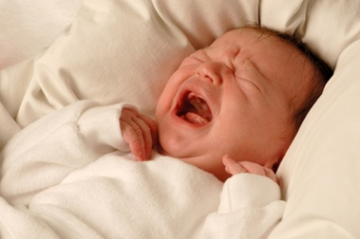
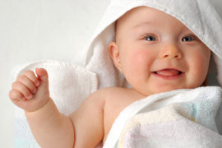
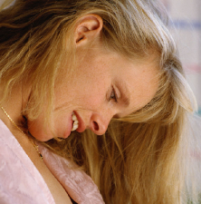
BEFORE CLASSICAL CONDITIONING:
Food = UCS
(unconditioned stimulus)
Baby feels pleasure = UCR
(unconditioned response to food)
Mother = NS
(neutral stimulus)
Baby does not respond
(no innate response to the mother)
Learning objectives:
To EXPLAIN the ‘learning theory’ of how attachments are formed.
To KNOW and EVALUATE research supporting the theory.
To be able to EVALUATE the accuracy of the theory.

Slide 7
Classical conditioning: a learning theory of attachments
THE PROCESS OF CONDITIONING:
STEP
1
Food = UCS
(unconditioned stimulus)
Baby feels pleasure = UCR
(unconditioned response to food)
STEP
2
+
Mother = NS
(neutral stimulus)
Food = UCS
(unconditioned stimulus)
Baby feels pleasure = UCR
(unconditioned response to food)
STEP
3
Mother = CS
(conditioned stimulus)
Baby feels pleasure = CR
(conditioned response to mother)

Slide 8
Activity – fill in the blanks
According to learning theory, the baby has to ……. to form an attachment with his mother.
By the process of ……. conditioning, the baby forms an ……. between the mother (a …… stimulus) and the feeling of pleasure that comes from being fed (an ……, unconditioned response).
At first, the baby simply feels comforted by ……. However each time he is fed, the …… is there too. He quickly associates the mother with the …… of being fed.
Before long, the mother …… a feeling of …… on her own, even without food.
This means the baby feels …… when the mother is near. It is the beginning of …….
ASSOCIATION * ATTACHMENT * CLASSICAL * PLEASURE * FOOD HAPPIER * INNATE * LEARN * MOTHER * NEUTRAL * STIMULATES

Slide 9
How does operant conditioning contribute to babies learning an attachment?
Watch the video. Add ideas to the mini-mind maps so that you can apply ‘operant conditioning’ to attachment.
How does operant differ from classical conditioning
What are key terms used in operant conditioning and what do they mean?
Keywords
Conditioning
Drives
Reinforcement
Learning objectives:
To EXPLAIN the ‘learning theory’ of how attachments are formed.
To KNOW and EVALUATE research supporting the theory.
To be able to EVALUATE the accuracy of the theory.

Slide 10
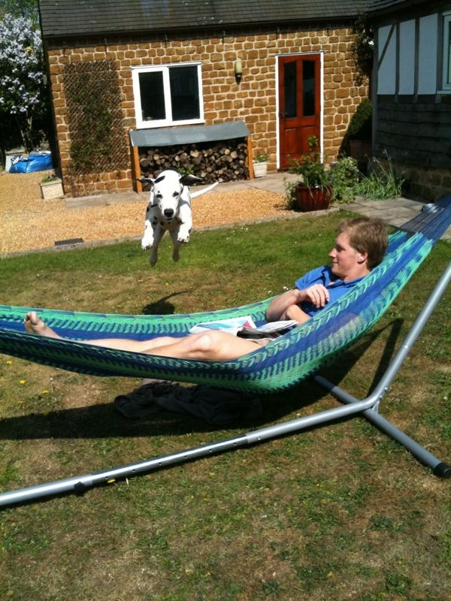
If I want him to learn to do random things like jump over people in hammocks. How do I do it using operant conditioning?
So back to Mr. Biggles…
Keywords
Conditioning
Drives
Reinforcement
Learning objectives:
To EXPLAIN the ‘learning theory’ of how attachments are formed.
To KNOW and EVALUATE research supporting the theory.
To be able to EVALUATE the accuracy of the theory.

Slide 11
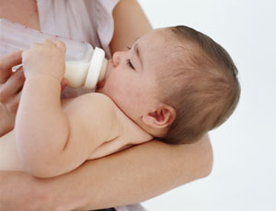
OPERANT CONDITIONING and ATTACHMENTS:
Baby performs action:
cries
Baby receives reward:
food relieves hunger
The reward REINFORCES the action, so the baby REPEATS it
Learning objectives:
To EXPLAIN the ‘learning theory’ of how attachments are formed.
To KNOW and EVALUATE research supporting the theory.
To be able to EVALUATE the accuracy of the theory.

Slide 12
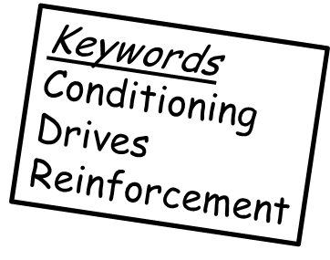
Learning theory of attachment
Classical Conditioning
Operant conditioning
Learning by association
Learning occurs through reward or punishment
The mother becomes associated with pleasure and satisfying the infants drives and thus becomes a CS.
Babies are rewarded by the mother e.g. food etc. (food becomes primary reinforcer, and thus the mother a secondary reinforcer).
They also protect their ‘food source’ through reciprocal pleasant behaviours e.g. smiling.
Learning objectives:
To EXPLAIN the ‘learning theory’ of how attachments are formed.
To KNOW and EVALUATE research supporting the theory.
To be able to EVALUATE the accuracy of the theory.

Slide 13
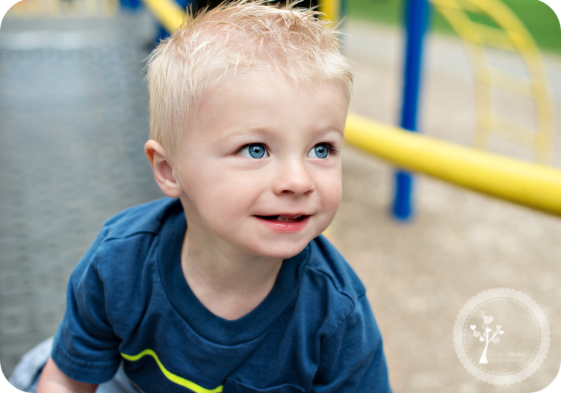
Apply your knowledge: T-P-S
Ollie is 2 years old and is learning to use the toilet! Every time he remembers to use the toilet he gets a sticker. After getting 5 stickers he gets a chocolate bar. He has very quickly learnt to use the toilet.
How has this happened?
Learning objectives:
To EXPLAIN the ‘learning theory’ of how attachments are formed.
To KNOW and EVALUATE research supporting the theory.
To be able to EVALUATE the accuracy of the theory.

Slide 14
Activity
Use the blanks card sort sheet to create a card sort for your partner.
One person to create a card sort about classical conditioning.
The second person to create a card sort about operant conditioning.
You will then do each others!!! (So don’t tell the person what you’re doing).
Learning objectives:
To EXPLAIN the ‘learning theory’ of how attachments are formed.
To KNOW and EVALUATE research supporting the theory.
To be able to EVALUATE the accuracy of the theory.

Slide 15
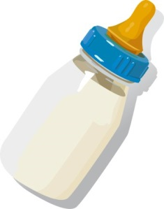
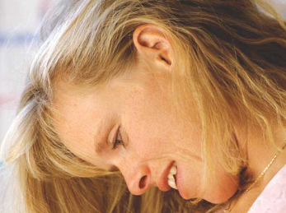
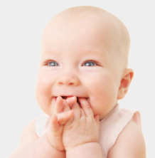
For example…
Food = UCS
UCS = unconditioned stimulus
Mother = NS
NS = neutral stimulus
+
Food = UCS
UCS = unconditioned stimulus
Mother = CS
CS = conditioned response
Baby is happy = UCR
UCR = unconditioned response
Baby is happy = UCR
UCR = unconditioned response
Baby is happy = CR
CR = conditioned response

Slide 16
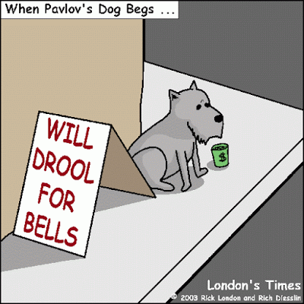
Evaluating the ‘ Learning Theory’ of Attachment
Strengths
Can you think of a something you have come to associate with something else?
+Can provide an adequate explanation of why attachments form: scientific evidence that we do learn through association and reinforcement.
Learning objectives:
To EXPLAIN the ‘learning theory’ of how attachments are formed.
To KNOW and EVALUATE research supporting the theory.
To be able to EVALUATE the accuracy of the theory.

Slide 17
Problems with theory…
Contact and comfort is more important than food: Harlow’s monkeys.
Watch the videos….
video
Learning objectives:
To EXPLAIN the ‘learning theory’ of how attachments are formed.
To KNOW and EVALUATE research supporting the theory.
To be able to EVALUATE the accuracy of the theory.

Slide 18
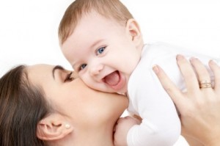
Schaffer and Emerson (1964)
Problems with theory…
Studied 60 babies at monthly intervals for the first 18 months of life (this is known as a longitudinal study). The children were all studied in their own home.
The babies interactions with their carers were observed, and carers were interviewed.
The results indicated that attachments were most likely to form with those who responded accurately to the baby's signals e.g. crying, NOT the person they spent most time with or who necessarily fed them (Schaffer and Emerson called this sensitive responsiveness). Babies were also found to have multiple attachments.
Evaluation?
+ Strength - longitudinal study means that it eliminates individual differences as a possible cause of the findings.
+ Strength – High ecological validity because the study was conducted on real children in the real world.
- Weakness - the parents collected the data which means it could be biased and potentially subjective.
Learning objectives:
To EXPLAIN the ‘learning theory’ of how attachments are formed.
To KNOW and EVALUATE research supporting the theory.
To be able to EVALUATE the accuracy of the theory.

Slide 19
Problems with theory…
.
Learning objectives:
To EXPLAIN the ‘learning theory’ of how attachments are formed.
To KNOW and EVALUATE research supporting the theory.
To be able to EVALUATE the accuracy of the theory.

