Slide 1
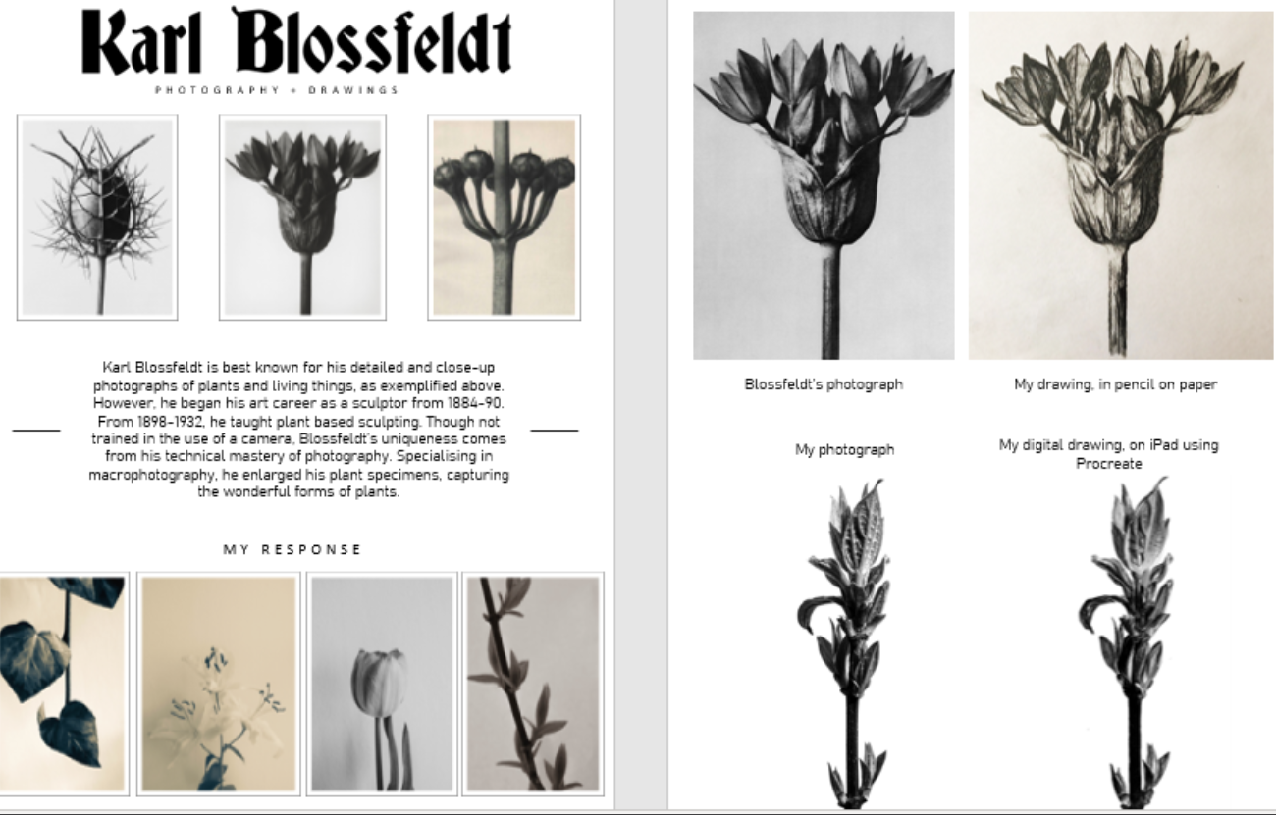
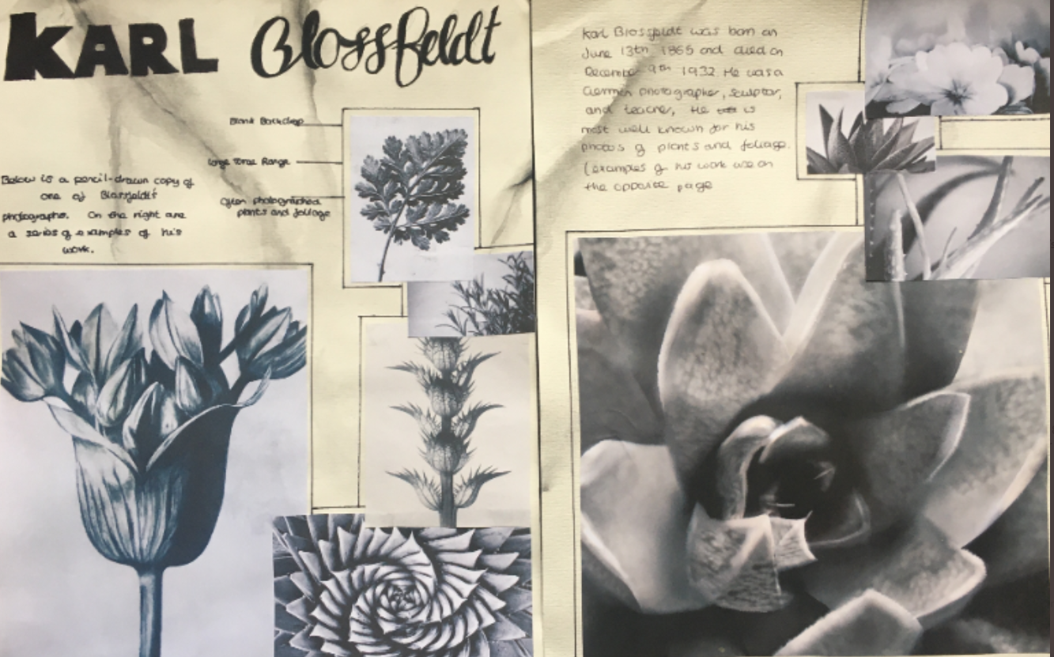
Karl Blossfeldt
Lesson tasks:
1. Complete a drawing from one of your own black and white Karl Blossfeldt style photos. You are welcome to use any material to do this.
Ideas: acrylic, chalk, digital painting using apps such as Procreate or Krita, ink, tea, coffee, biro..... anything that you can create a range of tones with. You could focus on smooth blending or maybe hatching or pointillism. Begin to develop your own drawing style, this could mean working small or going bigger. Just be mindful that this piece of work will need presenting alongside your Blossfeldt style photos and your drawn copy across a double page in your sketchbook.
There is no need to submit this yet, I will look at it once you have presented the whole double page.
2. Present a double sketchbook page of your Karl Blossfeldt related work. It should include the following:
- a clear title using the artist name.
-a brief paragraph explaining what type of work he was famous for and the period (dates) he worked between.
- a couple of small images of his work.
- your best own black and white photos in response.
- your detailed drawn copy of his work.
-your drawing of one of your own photos.
Presentation style:
-consider what you have available. Some of you may have collage materials to hand, such as magazines and newspapers. Others of you may just need to opt for simplicity with sharp headings.
Above: digital presentation
Below: hand collaged presentation

