Slide 1
Evolutionary explanations of human reproductive behaviour
One of the big decisions which people make in life is choosing a mate or sexual partner
This is an important decision because it can mean a lifelong commitment as well as choosing your children’s other parent

Slide 2
Summary
Charles Darwin (1871) argued that the way we make these choices is the result of evolution. He proposed two main mechanisms which determine the evolution of an animal’s characteristics:
• Natural selection
Sexual selection

Slide 3
Natural selection

Slide 4
Natural selection
(survival of the fittest)
This is the process by which animals that are best adapted to their environment (the fittest) are more likely to survive.

Slide 5
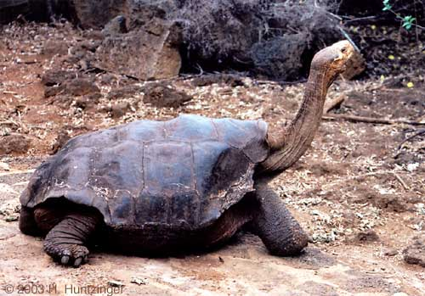
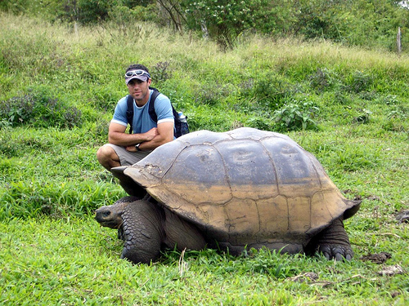

Slide 6
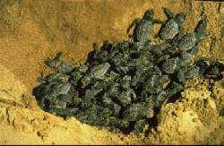
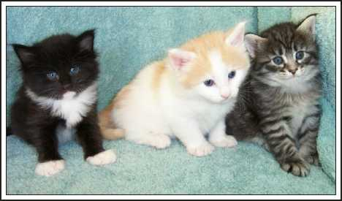
Key Elements of Evolution: Natural Selection
FERTILITY
Individuals can produce more offspring than the environment can support
VARIATION
Individuals vary in inherited characteristics e.g. body size & shape, colour, behaviour

Slide 7
Key Elements of Evolution: Natural Selection
COMPETITION
Those possessing characteristics which aid survival or reproduction are more likely to succeed
These characteristics will be passed on to future generations
Successful characteristics will spread through the population
Competition between individuals

Slide 8
Sexual selection

Slide 9
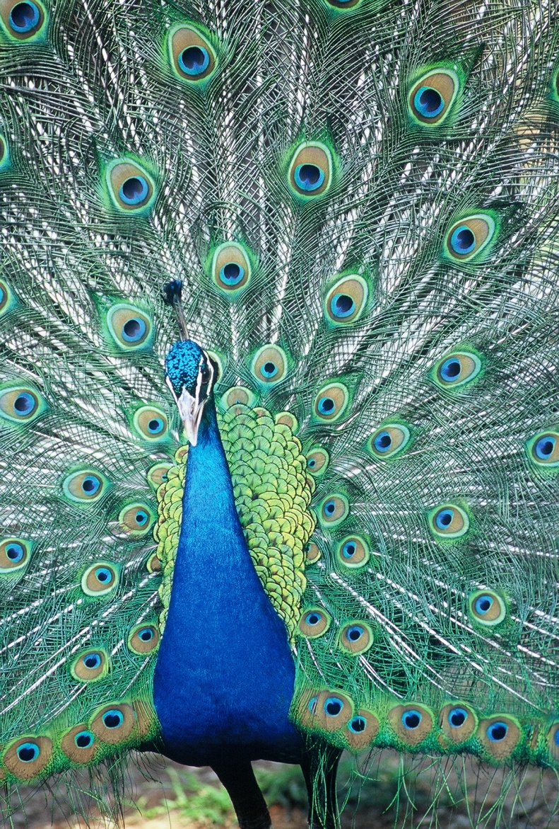
Sexual selection
HOWEVER, a peacock’s tail appears to have no purpose to aiding survival (it doesn’t help it fly better or faster)
In fact it would be likely to be a bit of a hindrance to survival.
The process of natural selection can’t provide a full explanation.

Slide 10
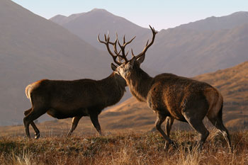
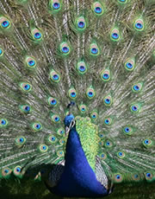
Sexual Selection
Darwin (1871)
Sexual selection had a similar effect to natural selection in driving evolution
Competition between males for mates
Males evolve characteristics which increase chances of being selected by females
Such as the spectacular tails of peacocks

Slide 11
Sexual selection
Individuals who possess features that make them attractive to the opposite sex or help them compete with members of the same sex for access to mates mean that the possessor breeds successfully whereas those individuals without the features are less successful.

Slide 12
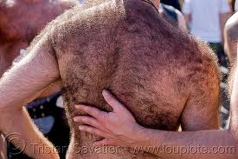
Example of human sexual selection:
Relative hairlessness – Pagel & Bodmer believed that this came about because it is clear whether or not the individual has parasites – if the individual doesn’t have parasites, the clear skin would advertise it, and therefore the person would be more likely to get a sexual partner.

Slide 13
Sexual selection: 2 main processes involved
Intra-sexual selection
Members of one sex (usually male) must compete with each other for access to members of the other sex.
Traits which lead to success will be passed on.
Inter-sexual selection
The preferences of one sex determine the areas in which the other sex must compete

Slide 14
Summary
Evolutionary theory suggests that there are two main mechanisms for the evolution of an animal’s characteristics:
• Natural selection (survival of the fittest). This is the process by which animals that are best adapted to their environment (fitness) are more likely to survive.

Slide 15
Summary
Sexual selection - survival of the sexiest-ensures reproductive success.
This is the process by which animals that are most successful at attracting the opposite sex & mating and having offspring are more likely to pass on their genes to the next generation.

Slide 16
Preferences in mate selection & evolution

Slide 17
Choosing a Mate
Parental investment suggests differences between males and females in strategies of mate selection
Males: mating = relatively small investment – soon able to mate again
Females: mating = relatively large investment + resources needed to nourish eggs or embryos
Choosing a mate is therefore a more important decision for females than for males
So females will be more choosy in picking a mate than males

Slide 18
Preferences in mate selection and evolution
Thornhill & Thornhill (1983)
propose that individuals who are lacking in preferred characteristics will not be selected to mate and therefore will not be able to pass on their genes.
However these preferred characteristics are not easy to define and are thought to be related to a number of factors:
Reproductive value
Paternity probability
Parental investment

Slide 19
1. rank them on their desirability in someone you might want to marry.
Sociability
Good financial prospects
Good looks
Chastity: No previous sexual intercourse
Dependable character
Intelligence
Ambition and industriousness

Slide 20
Rank them on their desirability in someone you might want to marry. 3 (indispensable) to 0 (irrelevant/unimportant)
Sociability
Good financial prospects
Good looks
Chastity: No previous sexual intercourse
Dependable character
Intelligence
Ambition and industriousness

Slide 21
Sexual Selection
In some species both sexes contribute to rearing offspring, as in humans (sometimes).
According to evolutionary theory there would be adaptive differences in male and females choice of mates.
See grid p.94 Holt & Lewis
Females choose:
Health and fitness: “good genes”
Potential parental investment from male (ie resources)
Males choose:
Fertility (linked closely with youth and attractiveness)
Faithfulness – to avoid risk of investing in another male’s children

Slide 22
Buss (1989): Sex differences in human mate preferences
Aim:
To test whether there are differences between males and females in how they choose mates
To test whether these differences are universal: common to humans all over the world
If they are, this would support the evolutionary theory, that these differences are inborn, and are the result of evolution

Slide 23
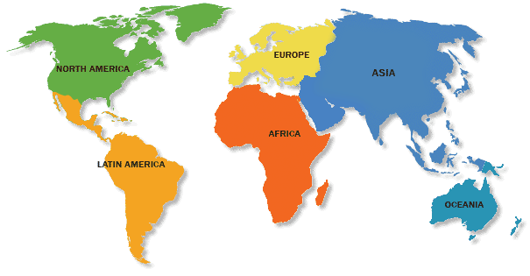
Method: participants
37 samples of participants were selected from 33 different countries all over the world
The total number of participants was 10,047 (4601 males, 5446 females)
Samples were mostly young adults, chosen by opportunity sampling
The mean age of the participants was 23 years

Slide 24
Procedure: data collection
Data was mainly collected by native researchers in each country and mailed to the USA. They were not aware of the central hypotheses of the research.
Translation: English- native language & back again.
All terms to be ‘gender neutral’
Some cultural differences reflected eg Nigeria - polygyny

Slide 25
Procedure – questionnaire 1
Each participant was given 2 questionnaires in their native language
Questionnaire 1 – rating:
Part 1 – age, sex, religion, marital status, no. of siblings
Part 2- mate preferences eg preferred age of marriage, preferred age difference with spouse, , no. Of children desired etc
Part 3: Listed 18 characteristics which they might take into account when choosing a mate. Participants rated the importance of each factor on a scale from 0 to 3
Where 0 = unimportant
And 3 = indispensible

Slide 26
Characteristics in mate selection
Good looks
Good financial prospects
Chastity
Ambition& Industriousness

Slide 27
Characteristics in mate selection
Good cook and housekeeper
Pleasing disposition
Sociability
Similar educational background
Refinement, neatness
Dependable character
Emotional stability & maturity
Desire for home and children
Favourable social status
Similar religious background
Similar political background
Mutual attraction-love
Good health
Education and intelligence

Slide 28
Procedure – questionnaire 2
The second questionnaire asked participants to rank 13 of the characteristics based on their desirability in someone they might want to marry
These factors included “good earning capacity” and “physical attractiveness”

Slide 29
RESULTS

Slide 30
Age differences
MALES
FEMALES
In all 37 samples males preferred mates who were younger.
The mean age difference preferred by males was 2.66 years younger.
Males preferred age to get married at was 27 app
Across all countries females preferred males who were older.
The mean age difference preferred by females was 3.42 years older.
Females preferred age to get married at was 25 app

Slide 31
Bar Chart showing the mean ideal age given by men and women for their chosen partner
Results:
Ideal Age
(mean)

Slide 32
Results
Good financial prospects
Ambition & industriousness
In 97% of the samples females valued ‘good financial prospects more highly in a mate than males did.
In 92% of the samples females expressed a higher valuation than men did
In 78% of the samples this was statistically significant.

Slide 33
Results
Good looks
In 100% of samples males rated this more highly than females did
92% of these samples found a significant difference in this aspect.

Slide 34
Validity check
Independent demographic data obtained in 27 countries.
Mean age difference was 3 yrs - Very close to male & female reported preferences.
Mean age at actual marriage was very close to the reported ideal age (M=28, F=25)

Slide 35
Conclusions:
Sex differences in mate preferences are in line with those predicted by evolutionary theory.
Women tend to choose men who provide more parental investment & resources: older, ambitious and industrious, earning capacity;
Men tend to choose women who provide greater reproductive capacity : younger, healthy and fertile (good looks) and who are less likely to let him support another man’s child (chastity)
Both men and women tend to prefer partners who would increase their chances of reproductive success

Slide 36
Strengths of the Study
Large scale sample: over 10000 people from 37 different cultures
Means that findings can be generalised to all humans
Use of two different questionnaires showed that results were consistent (or reliable)

Slide 37
Weaknesses of the Study
Sampling methods may not have been representative
Opportunity sampling and the use of volunteers may lead to bias in the sample
Responses to questionnaires may not reflect how people actually do make choices
People may tend to give what they see as socially acceptable responses.
Difficult to be sure that people’s preferences are due to evolution rather than influence of society

Slide 38
Content analysis: Singles ads

Slide 39
Content analysis of singles ads
Practical task: Develop a coding system to compare male and female preferences for desirable qualities in a potential mate.
E.g.
Age differences
Good looks / image
Ambition/ financial prospects

Slide 40
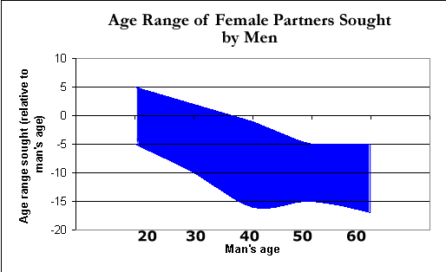
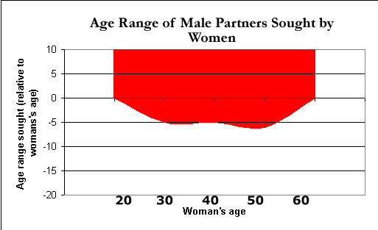
Choosing partners: the ideal age
This implies that males seek younger fertile females
Females seek older, better-off males
Kenrick & Keefe (1992)
Newspaper advertisements from people seeking romantic partners supported these predictions
Men, in the ads, also tended to emphasise their wealth, while women emphasised their beauty

Slide 41
Waynforth & Dunbar (1995)
Analysed nearly 900 ‘lonely hearts’ ads from 4 American newspapers. Certain key terms identified & themes sought.
Results:
More men than women sought a youthful mate
More men sought a physically attractive mate
More women used ‘physically attractive’ terms to described themselves.
More men reported their economic status / earning power when describing themselves.

Slide 42
Reproductive value and fertility

Slide 43
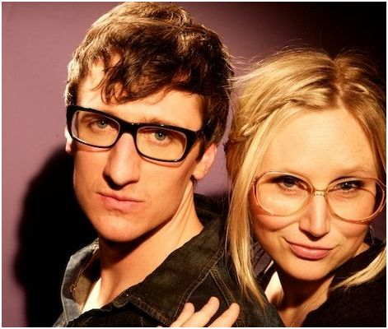
Reproductive value & fertility
Although mammalian females contribute more in terms of parental investment than males, females have greater limitations in their fertility; it is heavily affected by the age of the female.
Therefore the pressure on males to be able to identify a potentially fertile female is significantly attached to external cues which relate to the age and general health of the female.

Slide 44
Reproductive value & fertility
Symons (1979) cites that features of physical appearance associated with youth such as smooth skin, good muscle tone, lustrous hair and full lips and behavioural indicators of youth such as high energy levels and a sprightly gait give cues to males concerning the age and therefore the reproductive capacity of females.
This suggests that males more than females will value youth and physical attractiveness in potential mates.

Slide 45
Reproductive value & fertility
Symmetry:
It takes a great deal of physiological precision to engineer a symmetrical body. Stress or poor genetic endowment detracts from the ability to produce symmetrical features.
In 1883 Galton noticed that he could merge the faces of many women to produce an ‘average face’ which tended to be more attractive than most of the individual faces.
(You can make your own average faces at faceresearch.org)
This could be because the average face is highly symmetrical; there is also evidence that animals use symmetry as evidence for fitness in a prospective partner.

Slide 46
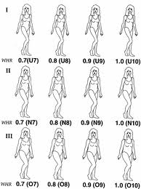
Reproductive value & fertility
Waist to hip ratio:
Devendra Singh (1993) at Texas University:
The ratio of the waist to hips (WHR) has been found to be an important factor in perceptions of attractiveness. Studying statistics over the last 40 years of Playboy centrefolds and miss America models etc found that despite a reduction overall in the body weight of models, the WHR remained relatively consistent to the 0.7 figure.

Slide 47
Summary
In some species both sexes contribute to rearing offspring, as in humans (sometimes) Both males and females are highly selective to maximise the opportunity to have healthy offspring.
However since parental investment is different in each case males and females would choose different characteristics in their mate.
Females tend to choose: Health and fitness: “good genes” and potential parental investment
Males tend to choose: Fertility and faithfulness – to avoid risk of investing in another male’s children

Slide 48
Evaluation of evolutionary explanations of human reproductive behaviour
AO2

Slide 49
Testability
It is very difficult to test out evolutionary theories as forces operate so slowly over time.
It is difficult to separate out various factors as social and cultural influences are always at play.

Slide 50
Falsifiability
Evolutionary theory could be said to lack falsifiability.
By this we mean that no matter what the behaviour evolutionary theory could account for it e.g. Males who act promiscuously are regarded as maximising their reproductive chances. Whilst those who opt for a monogamous relationship are viewed as acting to improve the chances of their offspring surviving by being in 2 parent family and investing resources into it.

Slide 51
Reproduction??
Evolutionary theory prioritises the drive for reproduction and passing on of genes.
However this would not satisfactorily account for homosexual relationships and also heterosexual couples who choose not to have children.

Slide 53
Attractiveness & fertility link
Evolutionary theory assumes that attractiveness is associated with fertility levels, but is this actually the case?
A plain woman can breed as well as an attractive woman.
It may well be that there is a correlation between attractiveness and healthiness but this does not indicate causality

Slide 54
Short and long term mate preferences
A much documented difference between males and females is the tendency to engage in casual sex (Buss & schmidt 1993)
On balance men tend to be much more likely to have short term relationships or one night stands than women.

Slide 55
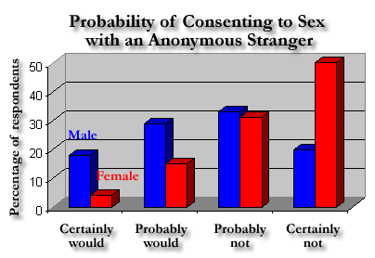
Choosing a Mate
Symons & Ellis (1989)
Aim: to compare males and females willingness to have sex with a stranger
Method: male & female students were asked whether they would be willing to have sex with an attractive stranger
Conclusions: some overlap between the sexes, but differences supported predictions that females would be more selective
Results:
However, responses reflect what people say they would do rather than actual behaviour

Slide 56
Choosing a Mate
Clark & Hatfield (1989)
Aim: to compare males’ and females’ willingness to have sex with a stranger, in a real life situation
Method: male & female students were approached by an attractive stranger of the opposite sex, who asked one of 3 questions:
Responses supported predictions from evolutionary perspective
Percentage saying “Yes”
Question | Male | Female
Would you go out with me tonight?
Would you come to my apartment tonight?
Would you go to bed with me tonight?

Slide 57
Choosing a Mate
Aim: to compare males’ and females’ willingness to have sex with a stranger, in a real life situation
Method: male & female students were approached by an attractive stranger of the opposite sex, who asked one of 3 questions:
Responses supported predictions from evolutionary perspective
Percentage saying “Yes”
Question | Male | Female
Would you go out with me tonight? | 50%
Would you come to my apartment tonight?
Would you go to bed with me tonight?

Slide 58
Choosing a Mate
Aim: to compare males’ and females’ willingness to have sex with a stranger, in a real life situation
Method: male & female students were approached by an attractive stranger of the opposite sex, who asked one of 3 questions:
Responses supported predictions from evolutionary perspective
Percentage saying “Yes”
Question | Male | Female
Would you go out with me tonight? | 50% | 50%
Would you come to my apartment tonight?
Would you go to bed with me tonight?

Slide 59
Choosing a Mate
Aim: to compare males’ and females’ willingness to have sex with a stranger, in a real life situation
Method: male & female students were approached by an attractive stranger of the opposite sex, who asked one of 3 questions:
Responses supported predictions from evolutionary perspective
Percentage saying “Yes”
Question | Male | Female
Would you go out with me tonight? | 50% | 50%
Would you come to my apartment tonight? | 69%
Would you go to bed with me tonight?

Slide 60
Choosing a Mate
Aim: to compare males’ and females’ willingness to have sex with a stranger, in a real life situation
Method: male & female students were approached by an attractive stranger of the opposite sex, who asked one of 3 questions:
Responses supported predictions from evolutionary perspective
Percentage saying “Yes”
Question | Male | Female
Would you go out with me tonight? | 50% | 50%
Would you come to my apartment tonight? | 69% | 6%
Would you go to bed with me tonight?

Slide 61
Choosing a Mate
Aim: to compare males’ and females’ willingness to have sex with a stranger, in a real life situation
Method: male & female students were approached by an attractive stranger of the opposite sex, who asked one of 3 questions:
Responses supported predictions from evolutionary perspective
Percentage saying “Yes”
Question | Male | Female
Would you go out with me tonight? | 50% | 50%
Would you come to my apartment tonight? | 69% | 6%
Would you go to bed with me tonight? | 75%

Slide 62
Choosing a Mate
Aim: to compare males’ and females’ willingness to have sex with a stranger, in a real life situation
Method: male & female students were approached by an attractive stranger of the opposite sex, who asked one of 3 questions:
Responses supported predictions from evolutionary perspective
Percentage saying “Yes”
Question | Male | Female
Would you go out with me tonight? | 50% | 50%
Would you come to my apartment tonight? | 69% | 6%
Would you go to bed with me tonight? | 75% | 0%

Slide 63
Criticisms
HOWEVER, Greiling & Buss (2000) suggest that blind acceptance of sexual selection theory ignores the possible benefits of short term mating for the female.
These include the possibility of producing more genetically diverse or better quality off spring or even using short term mating as a way of exiting a poor quality relationship.

Slide 64
IDA
Issues, debates and approaches

Slide 65
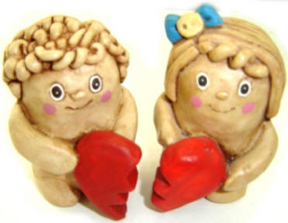
Alternative explanations
Social factors such as similarity, proximity & familiarity all play an important part in relationships.
Attraction has been found to be linked with how similar individual’s are. Especially if there is knowledge of shared interests or activities (Byrne, 1970).

Slide 66
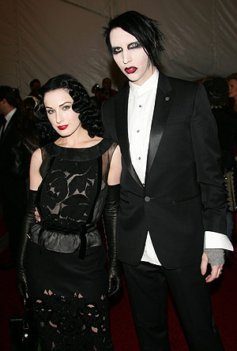
Alternative explanations
Physical attractiveness is also important in our culture.
We are continually shown beauty linked to health & happiness and this may be the reason for attraction.
In reality people tend to be attracted to those whom they see as similar to themselves on an attractiveness scale.

Slide 67
Determinism
Evolutionary theory is largely deterministic in nature, in that it suggests our behaviour is largely pre determined by evolutionary forces and processes.
In this sense it suggests that we don’t have totally free will over our choice of partner and even our own reproductive behaviours.

