Slide 1
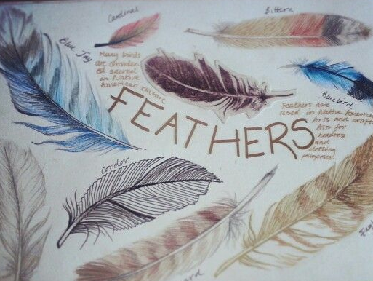
Art challenge
Please note: there is a lot here, don’t feel that you should do all of it, do the bits that appeal. Work in whatever size you like and come at lunchtimes for tips and guidance.
To create a GCSE style project that explores the initial theme of BIRDS.
Do an initial mind map and collect imagery to work from, think about what themes are associated with birds too e.g. migration.
Take your own photographs of birds if possible… in flight and close up, collect feathers.
Create a series of drawings that explore birds ‘close up’ (use a variety of media:
Pencil
Pen/biro
Coloured pencil
Mono print
Paint
-charcoal and chalk

Slide 2
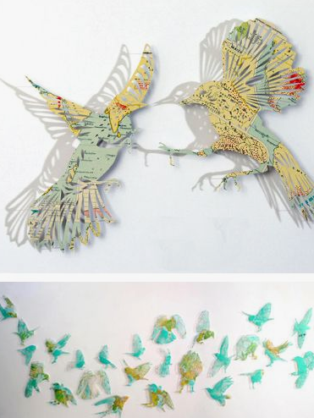
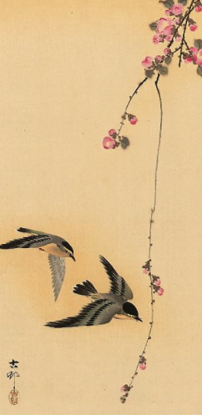
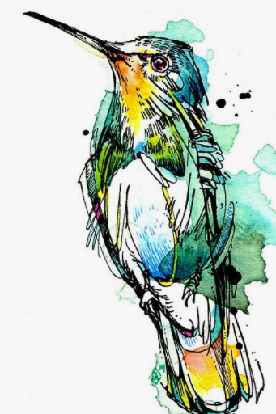
4. Explore the shape and form of birds and the idea of migration by looking up Claire Brewster’s work. Now create careful cut out responses from collected maps and your own chosen bird silhouettes.
5. Look at the work of Abby Diamond and explore creating your own responses in inks, watercolour and fine liner.
You may also want to look at the work of Ohara Koson, who is a Japanese artist

Slide 3
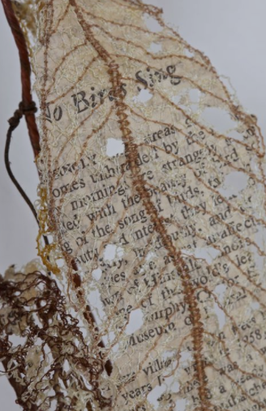
Extension
Stitching into artwork can be an interesting way of creating texture.
Try stitching feather or leaf shapes into photocopies of your existing studies.

Slide 4
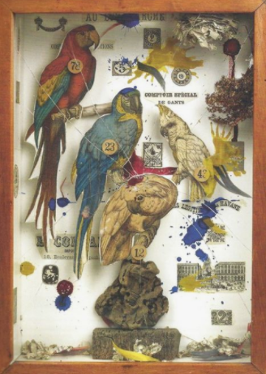
Development
6. Explore Joseph Cornell’s work, where he uses boxes to create his layered compositions.
7. Think about how you could bring elements of your work so far to create a final piece. Firstly, decide what the focus of the final piece will be and then design a composition that will convey this and use a combination of the best techniques learnt through exploring the previous artists.
(Obviously I can discuss this with you when I get to this stage).

Slide 5
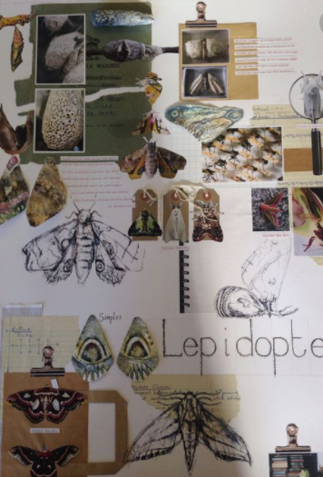
Display
Decide how you want to creatively display all of your samples and work – e.g. collaged onto mount board with relevant photos and titles.

