Slide 1
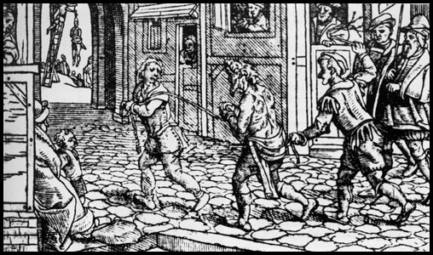
Woodcut from 1536. Those caught begging were whipped through the streets. Repeated offenders would be mutilated and could even be hanged. Why do you think the Tudors were so tough on this type of crime?
 Are we more tolerant of begging today?

Slide 2
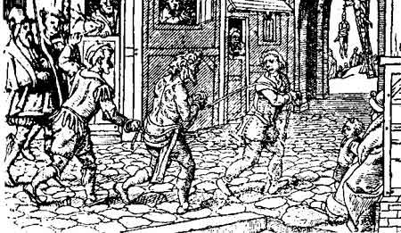
Why was it a crime to be homeless in the 1500s?
 Key words: vagabond / vagrancy sturdy beggars canting House of Correction
Learning objectives:
Describe different types of vagabond and how they were punished.
Assess why they were thought to be a problem
Discuss point for and against the 1494 & 1547 vagrancy acts.

Slide 3
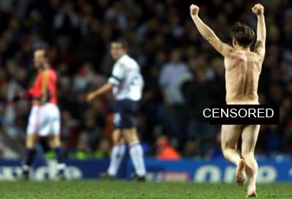
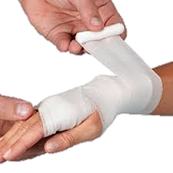
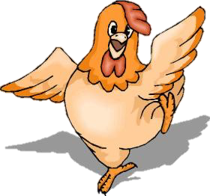
What have all these pictures got to do with ‘sturdy beggars’?
Notes:
Come back to this at the end as a plenary activity. Write guesses on the board so as to return to them.

Slide 4
Types of sturdy beggar (‘professional’ begging)
Bristler – specially weighted dice or ‘bristles’
Counterfeit Crank – pretended to be sick, often using soap in mouth
Clapper Dudgeon – cut himself & cover himself with bandages to feign injuries
Baretop Trickster – lure men in and rob them
Tom O’Bedlam – feign madness

Slide 5
Who were the vagabonds?
Beggars, tramps and vagrants who wandered the country without a settled job, occasionally soldiers who had been demobilised or criminals, but most were unemployed people moving to a new town looking for work.
What’s the difference between a vagrant and a vagabond?
Vagabond is a synonym of vagrant. A vagrant is a person without a home or job while a vagabond is a person on a trip of indeterminate destination or length of time.

Slide 6
Why were there so many beggars in Tudor England?
Notes:
During Eliz reign the population rose from three million to four million owing to greater life expectancy and rise in fertility.
Henry VIII had debased the coinage which meant the proportion of gold and silver in coins was reduced.
The country was hit by a number of poor harvests particularly in the 1590s which led to a rise in food prices.
1563 set upper wage limits for skilled workers so wages fell as living cost rose.
Towns grew in size as changes in agriculture led to people leaving the countryside.
Land enclosure meant the traditional open field system was ended for larger farm units with fewer people working on them.
Far more units were dedicated to raising sheep for the expanding wool trade.

Slide 7
Reasons for so many vagabonds
Unemployment – Henry VII banned private armies, lots of soldiers without work
Enclosure – large sheep farms needing fewer workers
Reformation – closure of monasteries
Vulnerable people – widows, orphans, sick, elderly

Slide 8
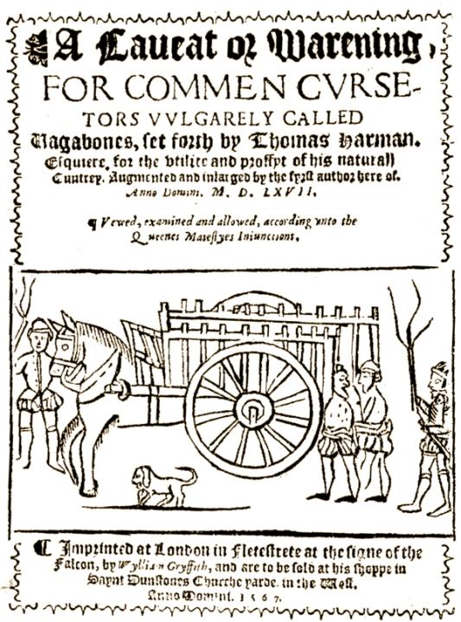
In 1567 Thomas Harman wrote a best-selling book about vagabonds in Tudor England. Why do you think his book was so popular?
Read p.72-73 of Dawson and note as many ideas.
Answer question 3 on page 73

Slide 9
Reasons for fear of vagabonds
Idleness for considered a sin – especially Puritans
Fear of crimes – beggars often blamed for other crimes, e.g. theft
Cost – people didn’t want to pay more taxes especially to support beggars from other places
Lack of welfare state – no state support for vulnerable people

Slide 10
Punishments
1494 – Henry VII – beggars in stocks 3 days
1531 – Henry VIII – licence to beg for worthy poor, others whipped & sent back to their town of origin
1547 – Edward VI – whipped, branded with V and made slave for 2 years, with threat of execution for escaping
1601 – Elizabeth I – local taxes to support poor, poor made to work in House of Correction, beggars whipped out of town

Slide 11
 Group task
Produce a public information film warning your community about the perils of sturdy beggars. You film should include:
References to at least 3 types of beggars
Explanations of why they are such a danger to society
Punishments typical of one particular time, e.g. 1547 or 1601

Slide 12
What have all these pictures got to do with ‘sturdy beggars’?
Notes:
Come back to this at the end as a plenary activity. Write guesses on the board so as to return to them.

