Slide 1
Battle of Pinkie Cleugh

Slide 2
Context
Henry VIII had launched a ‘War of Rough Wooing’ against the Scots
He had failed to secure an alliance through marriage between Edward and the young Mary (future Mary, Queen of Scots)
Somerset decided to continue this policy of forcible alliance
Additionally, Somerset wanted to impose Protestant reforms on Scotland

Slide 3
Preparation
Soon after becoming Protector, Somerset begins to prepare for a major assault on Scotland in September
Somerset moved into Scotland and advanced along the east coast with a fleet to keep his army supplied
Meanwhile, a group of 5000 men led by Thomas Wharton invaded Annandale as a distraction, taking Castlemilk and burning Annan
The Earl of Arran levied an army to defend against the English south of Edinburgh, occupying the sloping west bank of the River Esk

Slide 4
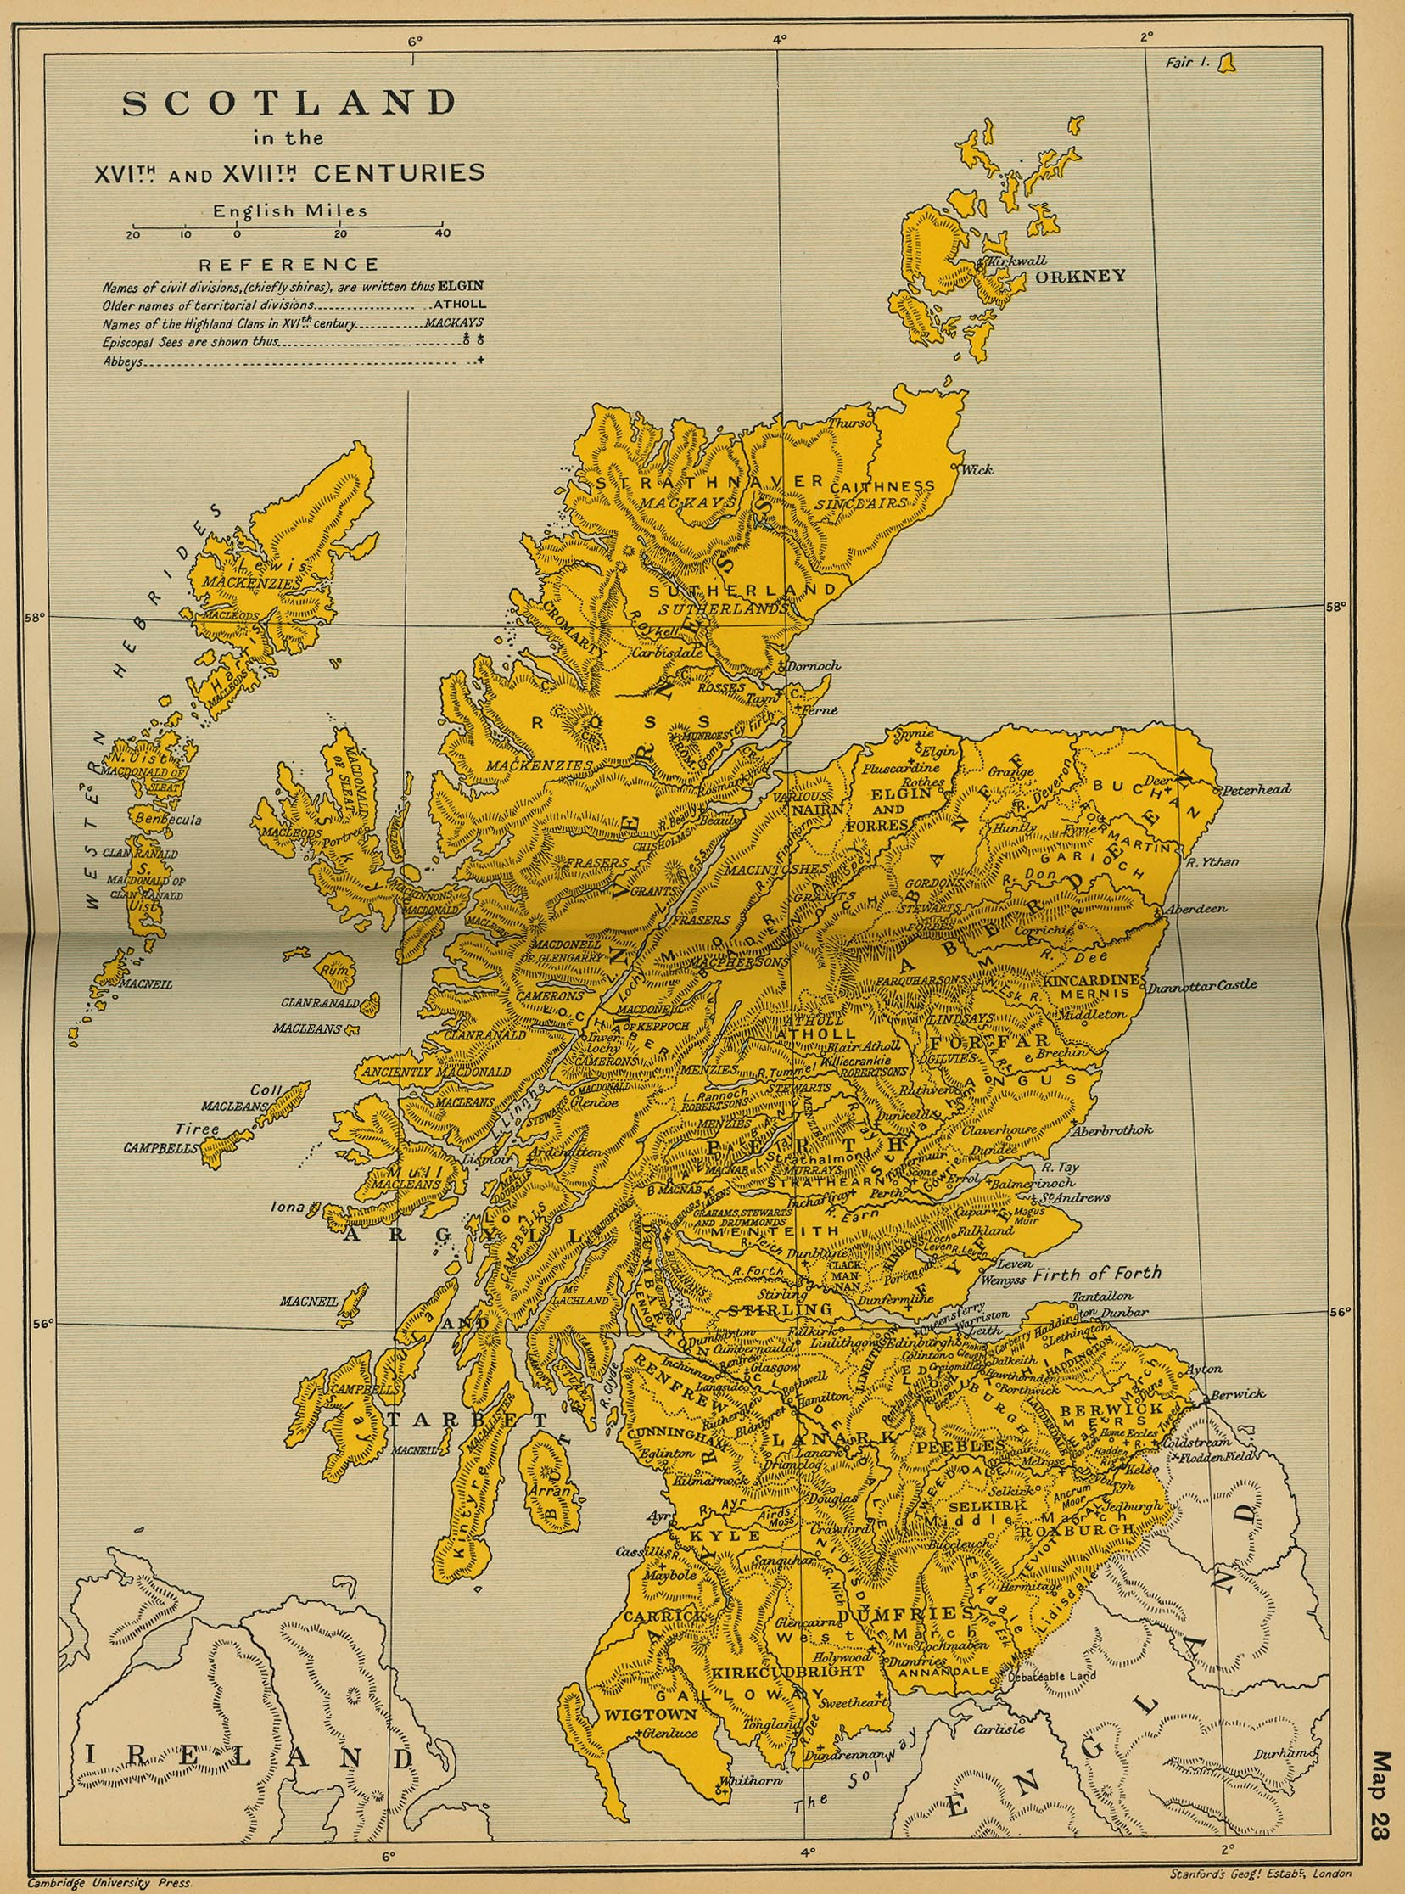

Slide 5
Pre-Battle
On 9th September, Somerset’s forces occupied Falside Hill, 3 miles from Arran’s main site
The Earl of Home led 1,500 horsemen to the English encampment and challenged the English cavalry
The Scottish cavalry are demonised by the English, and flee back to the main Scottish encampment
Arran sends 2 more requests to Somerset
To dual personally
For 20 champions from each side to settle the dispute
Somerset declines both

Slide 6
Battle
Arran’s forces cross the river Esk to try to create close-combat fighting, as his troops are outmatched in artillery, but were disrupted by fire from English ships The English cavalry attack the Scottish forces but are repelled by pikemen (Lord Grey himself is wounded)
However, the Scottish arm is now under fire from English ships, bowmen and artillery, and thus cannot advance: the Scots retreat, and many are slaughtered by English cavalry and Sir John Luttrell’s advance

Slide 7
Comparison of forces
England
Scotland
Duke of Somerset
16,800+ strong
Also 30 warships
200-500 killed
Consisted of archers and pikemen
But had more cavalry, artillery and some foreign mercenaries
German mercs used an early form of handgun called the arquebus
Earl of Arran and Earl of Angus
22,000-36,000 strong
6,000-15,000 killed
2000 taken prisoner
Consisted mostly of archers and pikemen

Slide 8
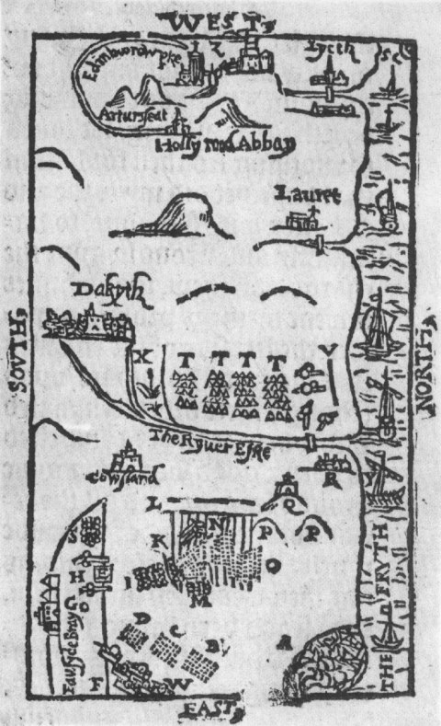
http://www.historic-uk.com/assets/Images/battleofpinkie.jpg?1390902374

Slide 9
http://www.battlefieldstrust.com/media/682.pdf

Slide 10
Implications
Scotland suffer a crushing defeat
However, they refuse to marry Mary to Edward and smuggle her to France
Somerset now occupies several Scottish forts

Slide 11
Analysis
Political implications are negligible in the long run
Scotland don’t give up Mary
The forts taken are surrounded by hostile Scots, and so aren’t maintainable
Can be seen as the first “modern” battle in Britain
Cooperation between artillery and troops
Use of naval bombardment to support ground troops
William Patten, secretary to the English commanders, commented that the battle was remarkably different to previous medieval battles
Some interpret the result as a medieval Scottish army being defeated by a more advanced, “Renaissance” English army

Slide 12
Analysis cont
Others have defended the Scottish tactics
Merriman saw the Scottish encampment as extremely sophisticated, though let down by a lack of cavalry
Merriman commented that Somerset’s failure to continue his charge to take Edinburgh as a massive loss of opportunity
In 1548, Lord Methven, the Scottish master of artillery, commentated that the battle was lost due to growing support for English policy and the Scottish army’s haste on the day

Slide 13
Some refs
Detailed summary of the fighting itself
http://www.battleofprestonpans1745.org/heritagetrust/html/documents/ELL65_TheBattleofPinkieCleugh.pdf
Detailed summary of the buildup and initial advancements
http://www.thesonsofscotland.co.uk/thebattleofpinkie1547.htm
Wiki was actually quite good for once ngl

