Slide 1
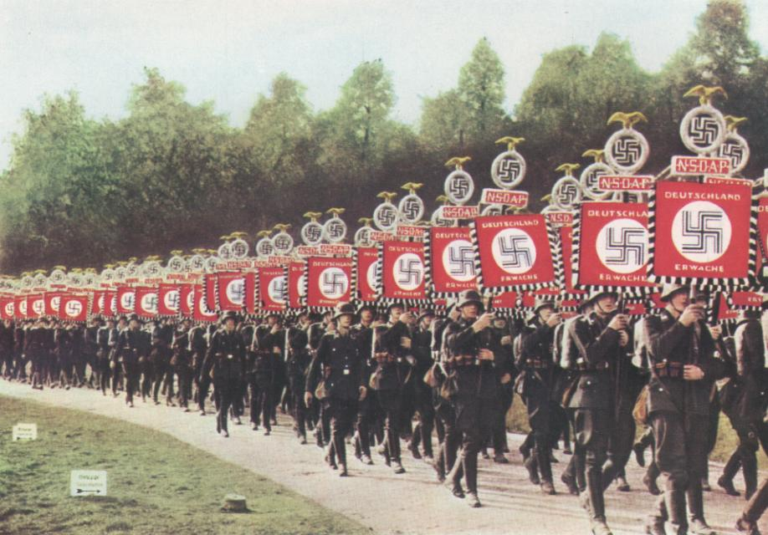
Would you be part of the minority who resist the pressure to conform and/or obey? (independent behaviour)
Starter: Complete the odd one out.
Learning objectives:
To UNDERSTAND explanations why people resist pressure to conform including personality( internal locus of control, confident), social support of ally, reactance
To KNOW and EVALUATE research relating to people who remain independent.

Slide 2
Without exception
Due:
Friday 5th
Home learning
1.Watch the video at: https://www.youtube.com/watch?v=UGxGDdQnC1Y&index=38&list=PLNo419yvwUDDuGEekLWgdlJPUA3WOVeig
This will recap on some areas we have covered so far….
Make any notes you feel are necessary.
2. Listen to the podcasts on the moodle course (All in the mind episodes on ‘locus of control’, and ‘the bystander effect’).
3.Answer the following two 4 mark previous questions:
• ‘Using your knowledge of psychology, explain why some people might resist pressures to conform’ (4 marks).
•‘When you are a passenger on a train, you are much more likely to move to another seat if the ticket collector tells you to move than if another passenger tells you to do so. Use your knowledge of why people obey to explain this behaviour.’ (4 marks).
4. Complete the worksheet
Learning objectives:
To UNDERSTAND explanations why people resist pressure to conform including personality( internal locus of control, confident), social support of ally, reactance
To KNOW and EVALUATE research relating to people who remain independent.

Slide 3
Not all people conform and obey. Some people resist social influence. For example, not all people went to 450 V on Milgram’s experiment. There are also examples from real life….
Read the article.
Learning objectives:
To UNDERSTAND explanations why people resist pressure to conform including personality( internal locus of control, confident), social support of ally, reactance
To KNOW and EVALUATE research relating to people who remain independent.
Notes:
Photocopy page 2 of the black book ‘Edelweiss pirates’.

Slide 4
How can we resist conformity or obedience?
Although averages were high, NOT ALL participants conformed in Asch’s experiment, and NOT ALL participants obeyed in Milgram’s experiment. What made these people remain independent?
In pairs, think about the research we have looked in social influence. What factors might enable someone to RESIST social influence?
Learning objectives:
To UNDERSTAND explanations why people resist pressure to conform including personality( internal locus of control, confident), social support of ally, reactance
To KNOW and EVALUATE research relating to people who remain independent.

Slide 5
People are more likely to resist pressures to CONFORM, and maintain their independence if….
Learning objectives:
To UNDERSTAND explanations why people resist pressure to conform including personality( internal locus of control, confident), social support of ally, reactance
To KNOW and EVALUATE research relating to people who remain independent.

Slide 6
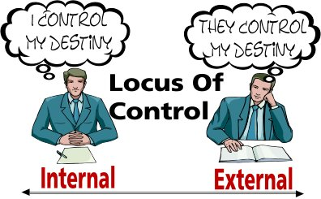
….. Have an INTERNAL locus of control (Rotter 1966).
Do you have an ‘internal’ or ‘external’ locus of control?
Complete the questionnaire to find out.
Learning objectives:
To UNDERSTAND explanations why people resist pressure to conform including personality( internal locus of control, confident), social support of ally, reactance
To KNOW and EVALUATE research relating to people who remain independent.

Slide 7
Score one point for each of the following:
2.a, 3.b, 4.b, 5.b, 6.a, 7.a, 9.a, 10.b, 11.b, 12.b, 13.b, 15.b, 16.a, 17.a, 18.a, 20.a,
If you didn’t get these answers for these questions, you shouldn’t give yourself a point.
If an answer for the question isn’t listed, don’t give yourself a point.
A high score (9 or more) = External Locus of Control
A low score (8 or less) = Internal Locus of Control
Learning objectives:
To UNDERSTAND explanations why people resist pressure to conform including personality( internal locus of control, confident), social support of ally, reactance
To KNOW and EVALUATE research relating to people who remain independent.

Slide 8
Locus of control…
A02 commentary:
Twenge et al. (2004) used a meta-analysis and found a significant historical increase in external locus of control in Americans since 1960!
‘Locus of control’ is how much a person believes that they have control over their own behaviour.
This is usually measured along a scale with internal control at one end and external control at the other.
Internal control refers to those people who see that they have a great deal of control over their own behaviour and will take responsibility for their actions.
External control refers to those who believe that their behaviour is controlled by other forces such as luck fate.
A02: People with a high INTERNAL locus of control are likely to resist because:
Seek more practical information (less likely to rely on opinions of others).
Tend to be ‘leaders’.
Have high self-control. (Rotter 1966).
Learning objectives:
To UNDERSTAND explanations why people resist pressure to conform including personality( internal locus of control, confident), social support of ally, reactance
To KNOW and EVALUATE research relating to people who remain independent.

Slide 9
Locus of control…different ways of seeing the same events…
Internal locus of control – I really should have studied more. I know that I didn’t put as much effort into revision as I could have. It’s my fault I got a bad grade.
External locus of control – I had a rubbish teacher. My little brother kept interrupting me when I tried to revise. The exam was on a really bad day. It’s not my fault.
Learning objectives:
To UNDERSTAND explanations why people resist pressure to conform including personality( internal locus of control, confident), social support of ally, reactance
To KNOW and EVALUATE research relating to people who remain independent.

Slide 10
For each of the examples below, say whether the person has an Internal or an External L.O.C.
Amanda doesn’t bother applying to be her class representative because she feels she is not popular enough to win.
Sarah checks her horoscope every day to see if she is going to have a good or a bad day.
Harry feels confident that he will get the job he applied for because he has good exam results and prepared well for the interview.
Learning objectives:
To UNDERSTAND explanations why people resist pressure to conform including personality( internal locus of control, confident), social support of ally, reactance
To KNOW and EVALUATE research relating to people who remain independent.

Slide 11
Evidence for L.O.C….
Oliner and Oliner (1988) interviewed two groups of non-Jewish people who had lived through the Holocaust and Nazi Germany. They compared 406 people who had protected and rescued Jews from the Nazis and 126 people who had not done this.
Oliner and Oliner found that the group that rescued the Jews had scores demonstrating an internal locus of control.
Learning objectives:
To UNDERSTAND explanations why people resist pressure to conform including personality( internal locus of control, confident), social support of ally, reactance
To KNOW and EVALUATE research relating to people who remain independent.

Slide 12
People are more likely to resist pressures to CONFORM, and maintain their independence if….
Learning objectives:
To UNDERSTAND explanations why people resist pressure to conform including personality( internal locus of control, confident), social support of ally, reactance
To KNOW and EVALUATE research relating to people who remain independent.

Slide 13
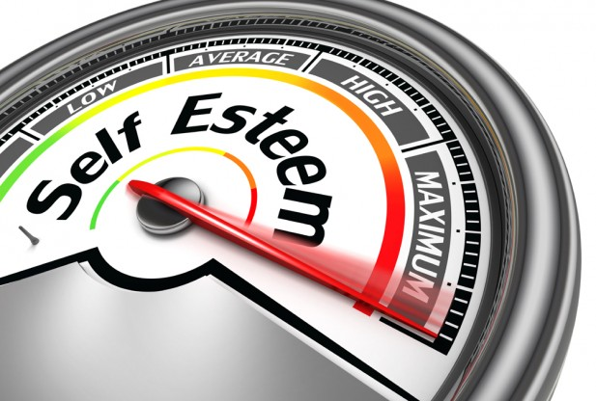
… they have high levels of self-esteem.
Use the Rosenberg scale to assess your level of self-esteem.
Learning objectives:
To UNDERSTAND explanations why people resist pressure to conform including personality( internal locus of control, confident), social support of ally, reactance
To KNOW and EVALUATE research relating to people who remain independent.

Slide 14
People are more likely to resist pressures to CONFORM, and maintain their independence if….
Learning objectives:
To UNDERSTAND explanations why people resist pressure to conform including personality( internal locus of control, confident), social support of ally, reactance
To KNOW and EVALUATE research relating to people who remain independent.

Slide 15
….have social support.
Presence of an ally in both Milgram and Asch research reduced the effects of social influence.
Learning objectives:
To UNDERSTAND explanations why people resist pressure to conform including personality( internal locus of control, confident), social support of ally, reactance
To KNOW and EVALUATE research relating to people who remain independent.

Slide 16
People are more likely to resist pressures to CONFORM, and maintain their independence if….
Learning objectives:
To UNDERSTAND explanations why people resist pressure to conform including personality( internal locus of control, confident), social support of ally, reactance
To KNOW and EVALUATE research relating to people who remain independent.

Slide 17
Insights from Milgram’s studies
…. they are in a place of low-status.
Milgram found that when the experiment was moved away from the prestigious setting of Yale University to a downtown office, more people felt able to resist authority. This tells us that STATUS is a key factor in obedience/resistance.
Learning objectives:
To UNDERSTAND explanations why people resist pressure to conform including personality( internal locus of control, confident), social support of ally, reactance
To KNOW and EVALUATE research relating to people who remain independent.

Slide 18
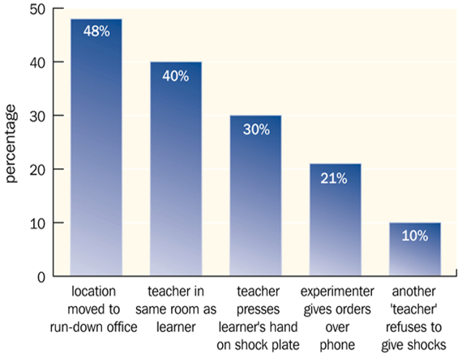
Insights from Milgram’s studies
Other factors found to influence ability to resist from Milgram (recap).
Learning objectives:
To UNDERSTAND explanations why people resist pressure to conform including personality( internal locus of control, confident), social support of ally, reactance
To KNOW and EVALUATE research relating to people who remain independent.

Slide 19
People are more likely to resist pressures to CONFORM, and maintain their independence if….
Learning objectives:
To UNDERSTAND explanations why people resist pressure to conform including personality( internal locus of control, confident), social support of ally, reactance
To KNOW and EVALUATE research relating to people who remain independent.

Slide 20
….. They are men!
Research has shown women are more likely to conform to what they think others want when seeking a partner (e.g. what kind of clothes a man finds attractive). – fits with evolutionary theory of relationships and investment.
Research has also found that women are more likely to exhibit an external locus of control!
Learning objectives:
To UNDERSTAND explanations why people resist pressure to conform including personality( internal locus of control, confident), social support of ally, reactance
To KNOW and EVALUATE research relating to people who remain independent.

Slide 21
What are the advantages to society of having people who remain independent?
In silence, read through the article written by Zimbardo about ‘Social Heroism’.
When you are finished:
Discuss your thoughts with a partner on: What ‘social heroism’ is? And what Zimbardo suggests are the advantages to society of having ‘social heroes’ (people who remain independent)?
Summarise the article into what you think are the 5 most important key points.
Learning objectives:
To UNDERSTAND explanations why people resist pressure to conform including personality( internal locus of control, confident), social support of ally, reactance
To KNOW and EVALUATE research relating to people who remain independent.

Slide 22
Social Heroism
Zimbardo’s concept of ‘social heroism’ - A02.
In his book, The Lucifer Effect (2007) Zimbardo suggests that while the majority of humanity is bowing to an unjust authority, the few who resist are really heroes.
In this context, heroes are those people who are willing to make sacrifices for the good of others in society.
Social heroism involves putting oneself at risk in pursuit of an important principle.
It may be very costly in terms of lowered social status, loss of credibility and in some cases, even arrest, torture and even death.
Learning objectives:
To UNDERSTAND explanations why people resist pressure to conform including personality( internal locus of control, confident), social support of ally, reactance
To KNOW and EVALUATE research relating to people who remain independent.

