Slide 1
https://www.youtube.com/watch?v=XoTx7Rt4dig Crash course – aggression

Slide 2
What is Aggression?
Starter:
The following is a list of statements. For each one you need to decide whether you think it is aggressive or not aggressive
A shopper elbows aside another shopper in order to reach a bargain.
A driver opens his car door without looking and knocks a cyclist off his bike.
A pedestrian sees someone lying bleeding on the pavement but does not stop.
A child pushes another off a swing so that she can play on it.
An abandoned wife writes to her husband’s employer with details of false expense claims he has submitted in the past.
Based on this activity:
Write a definition for ‘Aggression’

Slide 3
What is “Aggression”?
Aggression can be defined as actions or intentions to harm or gain advantage over someone else. However, these actions or intentions might not involve physical harm.
Violence, on the other hand, does involve physical harm.
Proactive aggression – ‘cold blooded’ aggression. This type of aggression is planned and calculated. Aggression is a method used to get what you want.
Retroactive aggression – ‘hot blooded’ aggression. Aggression as a result of anger or impulse. Retroactive aggression can be seen to be the cause of many social problems in society today.

Slide 4
There are both biological and psychological contributing factors to aggressive behaviour.
Some psychologists explain aggression from:
A social psychological perspective (the behaviour is learnt from others –SLT- or arises as a result from interactions with others – deindividuation).
An evolutionary perspective (jealously and infidelity).
A biological perspective (the result of genes – and/or imbalances in hormones and neural mechanisms).
Of course, research suggests it’s realistically an interactionist approach!
https://www.youtube.com/watch?v=uJ0Q_s3glCs
Notes:
Aggression, Anger, and the Origins of Violence in Children video

Slide 5
Neural and hormonal influences
Literacy Objective:
Limbic system
Serotonin
testosterone
L.O to outline and evaluate the neural influences (limbic system and serotonin) in aggression.
The Biological Approach

Slide 6
Biological explanations of aggression
Neural and hormonal
Genetic
The limbic system *
(Amygdala, hippocampus)
Serotonin *
Testosterone*
Research on genetic factors
MAOA gene *
* You can be directly questioned on these
Notes:
Print

Slide 7
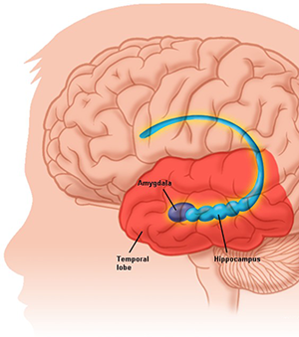
Neural influences
The limbic system
A complex system of nerves and networks in the brain. It controls the basic emotions (fear, pleasure, anger) and drives (hunger, sex, dominance, care of offspring).

Slide 10
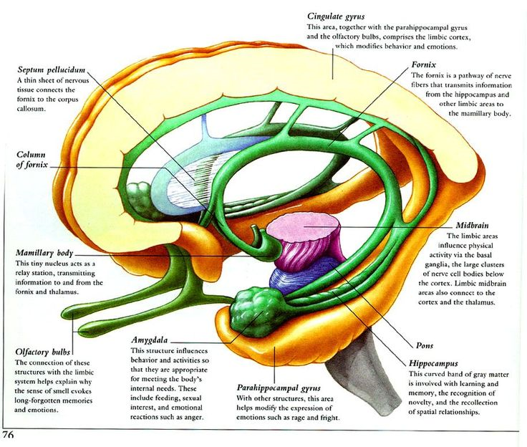

Slide 11
The amygdala AO1
Assess and responds to the environment (threats and challenges)
Quickly evaluates the emotional importance of sensory information
In animals, electrical stimulation of the amygdala results in an aggressive response (e.g snarling)
If removed, no aggression is demonstrated
Removing the amygdala of the dominant monkey within a social group leads to a loss of dominance within that group
Notes:
Other brain areas: thalamus plays a significant role in arousal, wakefulness and alertness. Also in the processing of memory. It acts as a regulator (sleep wake cycle)
Hypothalamus – hormonal and bodily rhythms

Slide 12
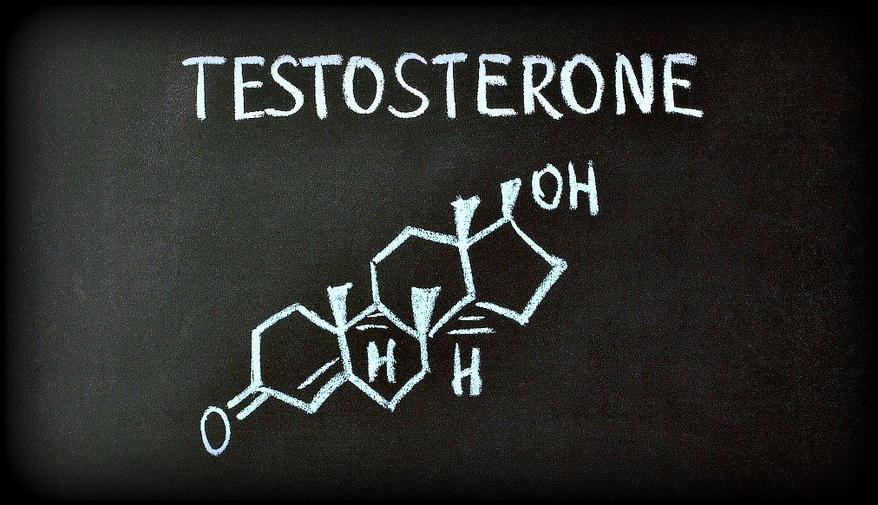
Task
Gospic et al:
Aim:
Method:
Results:
Conclusion
https://www.youtube.com/watch?v=vHQcblt8WNo
Research using the ultimatum game has found when participants reject what they deem to be unfair offers, areas of the amygdala were activated.
https://www.youtube.com/watch?v=xpkxLKV_3d0

Slide 13
The hippocampus AO1
Involved with the formation of LTM
Animals can compare current threats with similar past experiences and respond appropriately. For example if an animal has been attacked by a previous animal and they see them again they know to either respond in aggression or fear.
If damaged, the nervous system fails to put situations into a meaningful context, leading the amygdala to respond inappropriately (aggression)
Impaired hippocampal functioning has been found in violent offenders

Slide 14
Biological explanations of aggression
Neural and hormonal
Genetic
The limbic system *
(Amygdala, hippocampus)
Serotonin *
Testosterone*
Research on genetic factors
MAOA gene *
* You can be directly questioned on these
Notes:
Print

Slide 15
Serotonin deficiency hypothesis AO1
Serotonin is an inhibitory neurotransmitter (reducing firing in the brain and dampens neural activity)
Serotonin inhibits the firing of the amygdala and is associated with greater self control.
Therefore, low levels of serotonin remove this inhibitory effect, consequently people act on impulsion, leading to more aggressive behaviour.
Serotonin is thought to reduce aggression by inhibiting responses to emotional stimuli.

Slide 16
Research into Serotonin – Mann et al
Procedure - gave 35 healthy patients a serotonin depleting drug (dexfenflouromine (typically used in weight loss)). Pps filled in questionnaires (self report methods) which assessed hostility and aggression.
Findings - they found the drug was associated with increased aggression in males. (Interestingly this was not found in females).
Suggests…..

Slide 17
Evaluation of Neural explanations AO3
Neural Explanations FAMDA
AO3 – Other brain structures (Alternative explanation)
AO3 – Drugs and serotonin (optional)
AO3 – Raleigh monkeys (further research)
AO3 – Methodological problems with research (method) AO3 – Correlation and Causation/ Biological reductionist (Debate)
AO3 – Implication? Can we be held accountable? (Applications)
Discuss the neural explanations for aggression, include the limbic system (8 marks)

Slide 18
Methodological evaluations
A strength of much supporting research into aggression is that it is highly controlled using scientific methods. For example Gospic used FMRIs – spot patterns and trends.
However, a weakness of Gospic’s research, similar to other research into aggression, is that it lacks mundane realism – the ultimatum game isn’t representative of real life aggression, which may have consequences etc.
However ethically we cannot induce aggression therefore these studies tell us little about aggression in the real world and maybe limited in understanding the biological role of aggression.

Slide 19
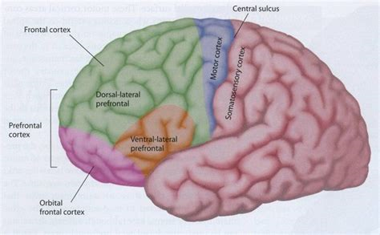
Evaluation of the Limbic System
Other brain structures involved in the role of aggression.
The Prefrontal cortext is responsible for the executive functions, which include mediating conflicting thoughts, making choices between right and wrong or good and bad, predicting future events, and governing social control — such as suppressing emotional or sexual urges.
The orbital frontal cortex (OFC) in particular is thought to be involved in self control and the inhibition of aggression. Research by Coccaro found that patients with psychiatric disorders with common featured aggression had reduced activity in the OFC. Therefore they were unable to control impulsive behaviour leading to aggression. Therefore the regulation of aggression is more complex and involves the OFC as well as the limbic system.

Slide 20
Supporting evidence from non-human research
Raleigh et al found supporting evidence from Vervet monkeys.
Using experimental diets, they gave one group of monkeys a high in tryptophan (which increases serotonin levels).
The other group were given a diet low in tryptophan.
They found those fed on a diet high in tryptophan were less aggressive and vice versa for the other condition.
This suggests serotonin does have a role in aggression.
However what is a problem with animal research?

Slide 21
IDA – Debate
Although the relationship between neurotransmitters and aggression can be tested using animals, this has limited application to humans due to complexity of human behaviour. Due to obvious ethical issues we can not induce aggressive behaviour in humans and although we can’t deny there is a link, and research has identified correlations, we cannot assume cause and effect. Therefore the findings into the biological explanations is reductionist and in trying to reduce aggressive behaviour to neurotransmitters and hormones; instead we must also consider the wider social influences. For example it can be an interaction between neural mechanism and our environment.
Further AO3 points - Research only looks at certain types of aggression (violent, verbal) – can this be generalised to all form of aggression?
*Implications – can we be held to account if our behaviour is determined by our biology. Can and should it be used as a legal defence?

Slide 22
Optional AO3 Berman - Support from Drug research for serotonin.
Drugs that increase serotonin have also been seen to reduce aggressive behaviour.
Berman gave participants either a placebo or paroxetine (a drug increasing serotonin activity).
Participants then took part in a game where they had to administer and receive varying levels of electric shocks.
They found that the participants receiving paroxetine gave fewer and lower level shocks than those given the placebo. (Although this was only found in participants who had a background of aggressive behaviour).
From these findings, we can conclude that serotonin does play a role in aggression.
Notes:
Don’t learn

Slide 23
Wider research
Does Dr. Fallon, a leading neurobiologist at the University of California think that violence and aggression are genetic?
Make notes to back up your answer.
http://brainposts.blogspot.co.uk/2010/08/neuroscience-of-murder-and-aggression.html#!/2010/08/neuroscience-of-murder-and-aggression.html

