Slide 1
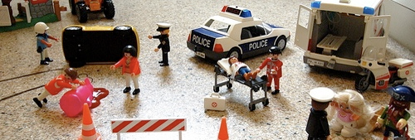
How accurate is an eye witness testimony really?
Starter: Complete the odd one out
Notes:
5 mins including feedback

Slide 2
Home Learning Task
Task: Listen to the podcast at - https://www.youtube.com/watch?v=0FcEDiSc0_g
Add as many ideas as you can to the mini mind-maps.
2. Watch part two of the CBS documentary on EWT at: http://www.youtube.com/watch?v=I4V6aoYuDcg&feature=related and make notes.
Learning objectives:
•To UNDERSTAND how misleading information, including leading questions and post-event discussion, and anxiety all affect the accuracy of EWT.
•To KNOW and EVALAUTE key research into the accuracy of EWT.

Slide 3
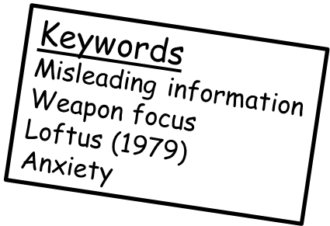
Do we notice as much as we think?
As we know our memory is not full proof. We do not remember everything we see. We only remember things that we give ATTENTION to. Why?
In a scenario where a witness needs to give a statement they may remember very little of the scene, as their attention was likely focused elsewhere.
Watch the video to demonstrate this…
Learning objectives:
•To UNDERSTAND how misleading information, including leading questions and post-event discussion, and anxiety all affect the accuracy of EWT.
•To KNOW and EVALAUTE key research into the accuracy of EWT.
Notes:
5 minute discussion around demonstration of student’s change blindness.

Slide 4
Do we notice as much as we think we do? Simons (1999) famously investigated change blindness, and found people do not notice as much as they assume they do. Watch the video and answer the questions: - What are the potential consequences of attention issues in human memory in real life? - Challenge: Are there individual differences in levels of attention and change blindness? Why is this important?
Learning objectives:
•To UNDERSTAND how misleading information, including leading questions and post-event discussion, and anxiety all affect the accuracy of EWT.
•To KNOW and EVALAUTE key research into the accuracy of EWT.
Notes:
10 mins video on inattentional blindness, including interactive demonstration of face recognition. Students answer two questions from video (one question ‘challenge question’ for more able).

Slide 5
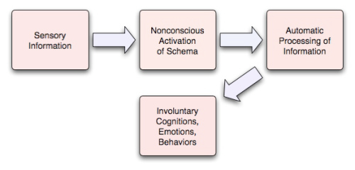
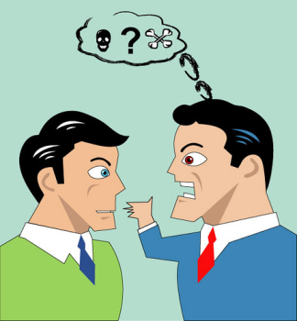
Based on his ‘war of ghosts’ research, Bartlett (1932) suggested that memories can be affected by thoughts you already have about day to day experiences. You MAY begin to base expectations on observations we have made in previous experiences. These are known as SCHEMAS. Schemas can affect the reliability of EWT, as witnesses are not necessarily recalling facts, but reconstructing memories biased by previous experiences, moods, knowledge, attitudes, stereotypes etc.
Learning objectives:
•To UNDERSTAND how misleading information, including leading questions and post-event discussion, and anxiety all affect the accuracy of EWT.
•To KNOW and EVALAUTE key research into the accuracy of EWT.

Slide 6
How accurate are ‘line-ups’?
Imagine you are at a gas station buying milk. A man walks in, threatens the employee at the counter, robs the cash register, and runs out. The entire ordeal lasts about five seconds. This is the man you saw…
Next lesson we will see how many of you can accurately pick this perpetrator out from a line-up…
Learning objectives:
•To UNDERSTAND how misleading information, including leading questions and post-event discussion, and anxiety all affect the accuracy of EWT.
•To KNOW and EVALAUTE key research into the accuracy of EWT.

Slide 7
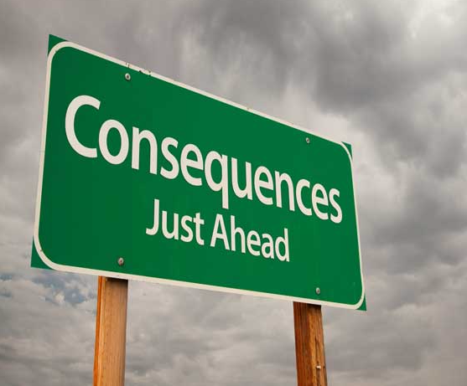
What problems are there with the inaccuracy of eyewitness testimonies?
Since inaccurate EWT can lead to the conviction of innocent people, any research that helps to improve EWT, or increase our understanding of it is very important and beneficial.
Watch the video and come up with answers for the two following questions:
What can the real world consequences be of inaccurate EWTs?
What type of evidence is more accurate?
Fact: It is estimated that 75% of wrongly convicted defendants, later cleared by DNA evidence, were convicted based largely on eyewitness testimony.
Learning objectives:
•To UNDERSTAND how misleading information, including leading questions and post-event discussion, and anxiety all affect the accuracy of EWT.
•To KNOW and EVALAUTE key research into the accuracy of EWT.
Notes:
15 mins real life case study video of wrongly convicted rapist based on EWT. Students introduced to what type of evidence is more accurate than EWT and why.

Slide 8
Age of witness
Anxiety
What key factors affect the accuracy of EWT?
Misleading information
Learning objectives:
•To UNDERSTAND how misleading information, including leading questions and post-event discussion, and anxiety all affect the accuracy of EWT.
•To KNOW and EVALAUTE key research into the accuracy of EWT.

Slide 9
Factors affecting accuracy of EWT: Anxiety
5 mins
Keyword: Anxiety
This is an unpleasant emotional state where we are anticipating something negative about to happen. Anxiety leads to physiological arousal (e.g. rapid heart rate and shallow breathing).
What effect has research shown anxiety has on the accuracy of EWT?
Task:
Left side of the room read ‘Christianson and Hubinette’s (1993)’ research and ‘Yuille and Cutshall (1986)’ research. Be prepared to feed back to the group:
- What they did? (methodology)
- What they found and concluded from their results?
Right side of the room read ‘Deffenbacher et al. (2004)’ research and ‘Clifford and Scott (1978)’ research. Be prepared to feed back to the group:
- What they did? (methodology)
- What they found and concluded from their results?
Much research has found that heightened levels of anxiety have been found to negatively impact on the accuracy of EWT. The more stressed (anxious) a person is in a situation, the more inaccurate their testimony is likely to be.
HOWEVER….
Some studies have found the opposite: that increased arousal enhances the accuracy of memory.
Learning objectives:
•To UNDERSTAND how misleading information, including leading questions and post-event discussion, and anxiety all affect the accuracy of EWT.
•To KNOW and EVALAUTE key research into the accuracy of EWT.

Slide 10
Factors affecting accuracy of EWT: Anxiety
5 mins
What is the ecological validity of this research like?
What does this mean for the generalisability of the results?
‘Christianson and Hubinette’s (1993)’ research and ‘Yuille and Cutshall (1986)’ research.
‘Deffenbacher et al. (2004)’ research and ‘Clifford and Scott (1978)’ research.
Learning objectives:
•To UNDERSTAND how misleading information, including leading questions and post-event discussion, and anxiety all affect the accuracy of EWT.
•To KNOW and EVALAUTE key research into the accuracy of EWT.

Slide 11
Factors affecting accuracy of EWT: Anxiety
Deffenbacher suggests that the apparent contradiction in findings could best be explained with reference to the Yerkes-Dodson law…
What do you think this graph should look like based on Deffenbacher’s findings?
Learning objectives:
•To UNDERSTAND how misleading information, including leading questions and post-event discussion, and anxiety all affect the accuracy of EWT.
•To KNOW and EVALAUTE key research into the accuracy of EWT.

Slide 12
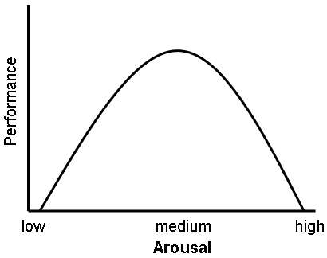
Anxiety – The Yerkes-Dodson Law (1908)
The Yerkes-Dodson Law helps us to explain how anxiety effects our recall. It shows…
That as arousal of anxiety increases, performance (accurate recall of an event) also increases up until a certain level of anxiety.
If a person feels a higher level of anxiety, performance (accuracy of recall) significantly decreases.
Therefore those studies which had found improved memory accuracy were most likely dealing with increased arousal within the first part of the Yerkes-Dodson curve, whereas studies which showed that accuracy decreases with increased arousal were most likely operating in the second part of the curve.
Evaluation (A02)
An alternative idea proposed by Freud is that memories which are traumatic (likely when anxious) are repressed to protect the individual from the emotional distress they would cause………….. HOWEVER, very little empirical evidence for this idea!!
The accuracy of recall is best in moderately arousing conditions.
Task: Draw this graph. Then annotate it to explain the Yerkes Dodson law in your own words.
5 mins
Learning objectives:
•To UNDERSTAND how misleading information, anxiety and age of witness all affect the accuracy of EWT.
•To KNOW and EVALAUTE key research into the accuracy of EWT.

Slide 13
Look at each of the following pictures you are going to be shown...

Slide 14
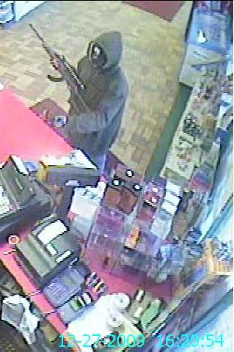
1

Slide 15
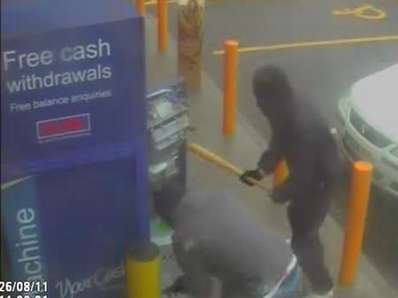
2

Slide 16
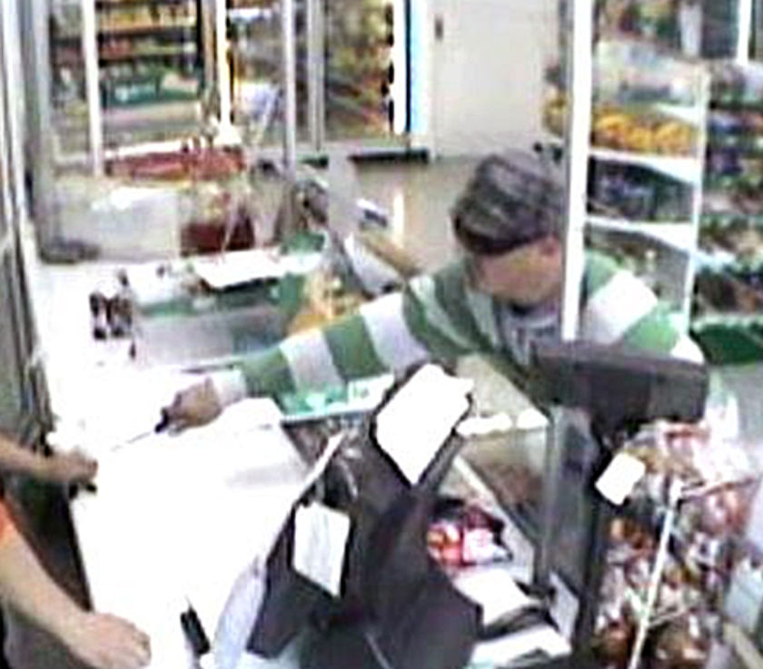
3

Slide 17
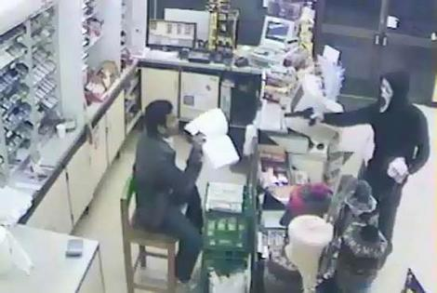
4

Slide 18
What were your eyes drawn to in each picture?
Without talking to the person sitting near you, write down an answer to the following questions:
Q1 - Describe the clothing of the person in picture 1, and describe what they were carrying.
Q2 – How many people were at the cash point in picture 2?
Q3 – Was the person robbing the shop in picture 3 displaying threatening behaviour of any sort? What colour clothing was the person wearing in the picture?
Q4 - What was the person in picture 4 wearing? Did the person disguise their identity? Can you describe the weapon?
Learning objectives:
•To UNDERSTAND how misleading information, including leading questions and post-event discussion, and anxiety all affect the accuracy of EWT.
•To KNOW and EVALAUTE key research into the accuracy of EWT.

Slide 19
Grey hoody
Black cap
Gun
Blue Jeans
Who correctly recalled any aspects of this scene asked?
1

Slide 20
Who correctly recalled any aspects of this scene asked?
You were likely focused on the baseball bat.
Person 2
Person 1
2

Slide 21
Threatening shop keeper with a knife
Cap, and green and white stripy jumper.
Who correctly recalled the weapon over clothing?
3

Slide 22
Scream mask to hide identity.
Gun
Who noticed the threatening scream mask, when they hadn’t noticed clothing in other photos? Gun?
4

Slide 23
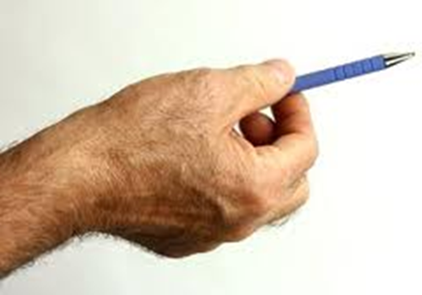
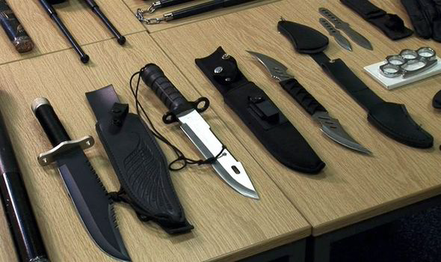
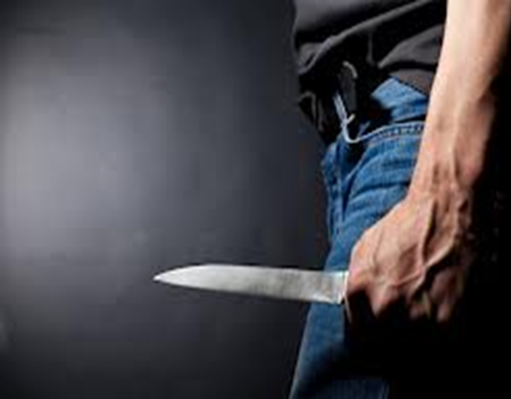
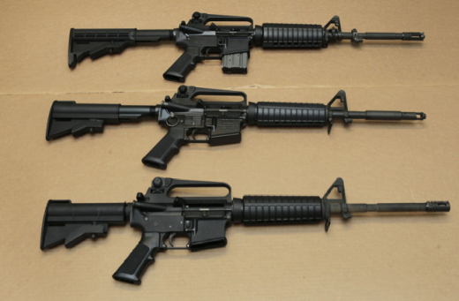
Loftus et al. (1987) - Weapon Focus Effect
In Loftus’s (1987) experiment, volunteer participants arrived at a room to take part in an experiment in an adjoining laboratory (deception). In both experimental conditions participants then heard a discussion in an adjoining room.
In condition 1 a man emerged holding a pen and with grease on his hands.
In condition 2 the discussion was rather more heated, and the participants heard breaking glass and then saw man emerge holding a paperknife covered in blood. When asked to identify the man from 50 photos, participants in condition 1 were 49% accurate, compared with 33% accuracy in condition 2.
What did Loftus conclude?
Why does this happen?
Loftus et al. (1987) had monitored eyewitnesses’ eye movements and found that the presence of a
weapon causes attention to be physically drawn towards the weapon itself and away from other
things such as the person’s face.
Not ‘noticing’ and remembering things from a scene is exacerbated when a weapon is involved, because the witness is experiencing a high level of anxiety.
Witness’s eyes are naturally drawn to the weapon due to the danger it poses. Their focus and attention on this aspect of the scene means that they miss a great deal else that is going on.
Learning objectives:
•To UNDERSTAND how misleading information, including leading questions and post-event discussion, and anxiety all affect the accuracy of EWT.
•To KNOW and EVALAUTE key research into the accuracy of EWT.

Slide 24
Key research into ‘anxiety’ as a factor that affects accuracy of EWT: Loftus et al. (1987)
Evaluation of this study?
High ecological validity
Supports Y-D but no low arousal condition
Ethical considerations
Was poor recall due to anxiety or something else? I.e. were extraneous variables controlled?
Task: Create an advert for recruiting participants to Loftus’s (1979) study. (The best will go on the wall). Include:
A description of what the study will entail.
Why is the research important? Why should volunteers sign up?
What you expect to find (based on the actual results)
Inform potential participants of any ethical issues they may experience as part of the research.
Weapon focus effect
Learning objectives:
•To UNDERSTAND how misleading information, including leading questions and post-event discussion, and anxiety all affect the accuracy of EWT.
•To KNOW and EVALAUTE key research into the accuracy of EWT.

Slide 25
The Rules
You have 2 cards – labelled “TRUE” or “FALSE”
Answer each question by holding up the appropriate card
Those who hold up the incorrect card are eliminated from the game
The last person(s) in the game wins!
8
9
7
10
1
6
2
5
3
4

Slide 26
8
Question 1
Anxiety and age do not have an affect on the accuracy of EWT.
FALSE
TRUE
9
FALSE
TRUE
7
10
1
6
2
5
3
4
Notes:
He looked into restrained eating. Found dieters ate more after preload.

Slide 27
8
TRUE
TRUE
Question 2
Yuille and Cutshall (1986) found that increased anxiety lowers correct recall.
FALSE
9
FALSE
7
10
1
6
2
5
3
4

Slide 28
8
TRUE
TRUE
Question 3
Loftus used three conditions in her experiment.
FALSE
9
FALSE
7
10
1
6
2
5
3
4
Notes:
Humans have evolved taste preferences for sweet and salty foods.

Slide 29
8
TRUE
TRUE
Question 4
Memory can be reconstructive.
FALSE
9
FALSE
7
10
1
6
2
5
3
4

Slide 30
8
TRUE
TRUE
Question 5
In a scenario where a witness needs to give a statement they may remember very little of the scene, as their attention was likely focused elsewhere.
FALSE
9
FALSE
7
10
1
6
2
5
3
4

Slide 31
8
TRUE
TRUE
Question 6
Anxiety is an unpleasant emotional state where we are anticipating something negative about to happen.
FALSE
9
FALSE
7
10
1
6
2
5
3
4

Slide 32
8
TRUE
TRUE
Question 7
The Yerkes-Dodson Law helps us to explain how anxiety effects our recall.
FALSE
9
FALSE
7
10
1
6
2
5
3
4

Slide 33
8
TRUE
TRUE
Question 8
Inattentional blindness is where a change in a visual stimulus is introduced and the observer does not notice it.
FALSE
9
FALSE
7
10
1
6
2
5
3
4
Notes:
Was Wegner

Slide 34
8
TRUE
TRUE
FALSE
Question 9
Loftus et al. (1987) used a experimental ‘repeated measures’ methodology.
FALSE
9
7
10
1
6
2
5
3
4
Notes:
Effects were minimal.

Slide 35
8
TRUE
TRUE
Question 10
Loftus’s study into ‘weapon focus’ has low ecological validity.
FALSE
9
FALSE
7
10
1
6
2
5
3
4
Notes:
It’s the psychodynamic approach, not cognitive.

Slide 36
8
Well done!
You have survived the ‘Eliminator Game!’
9
7
10
1
6
2
5
3
4

Slide 37
TRUE
FALSE
answer
answer

Slide 38
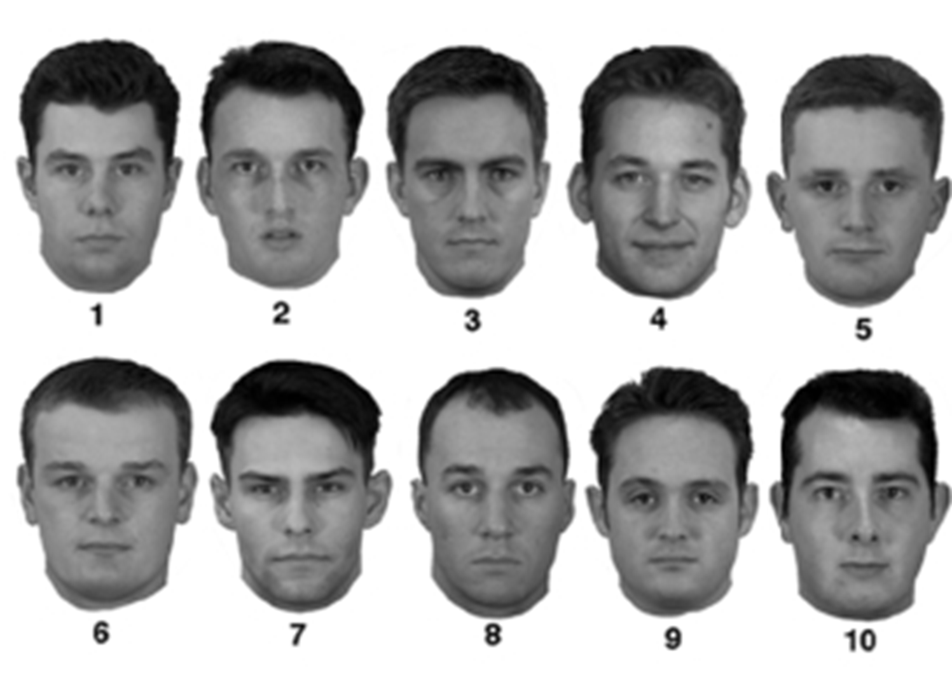
The police have asked you to help them identify the perpetrator. They will show you a set of pictures, and ask you if you can select the picture of the man you saw rob the gas station…

