Slide 1
What are the different types of attachment?
And what is Ainsworth’s (1973) ‘Strange Situation’ Experiment?

Slide 2
Home learning
Listen to the mind changers podcast on Ainsworth.
Keywords
Attachment
Caregiver
Strange situation
Learning objectives:
To be able to DEFINE attachment.
To KNOW the three key types: avoidant, secure, resistant
TO KNOW and EVALUATE Ainsworth’s ‘strange situation’ research.

Slide 3
Mary Ainsworth designed the ‘strange situation’ to investigate attachments in infants.
Watch the videos and make notes on
Separation anxiety stranger anxiety
The procedure of Ainsworth’s ‘strange situation’ ….
The types of attachment

Slide 4
What you should have: The Strange Situation
Controlled observation
12-18-month olds and their mothers were observed using a video camera in a purpose built laboratory playroom to assess:
secure-base behaviour
separation anxiety
reunion behaviour
stranger anxiety
Learning objectives:
To be able to DEFINE attachment.
To KNOW the three key types: avoidant, secure, resistant
TO KNOW and EVALUATE Ainsworth’s ‘strange situation’ research.
Notes:
Explain a,b,c,d. Ask if anyone can see any ethical problems. Discuss: is a laboratory playroom the same as a real life situation? Do they think children would react the same here as in the home? Or are children used to going to different places and situations, e.g., a playgroup, etc. Is the situation ecologically valid?

Slide 5
Observations were recorded every 15 seconds and placed into behavioural categories
Intensity | Proximity and contact seeking | Contact maintaining | Proximity and interaction avoiding | Proximity and interaction resisting | Searching
1
2 |  | 
3 |  |  |  |  | 
4 |  
5 |  |  |  |  | 
6 | 
7 |  | 
Notes:
Included to demonstrate behavioural categories for AQA research methods.

Slide 6
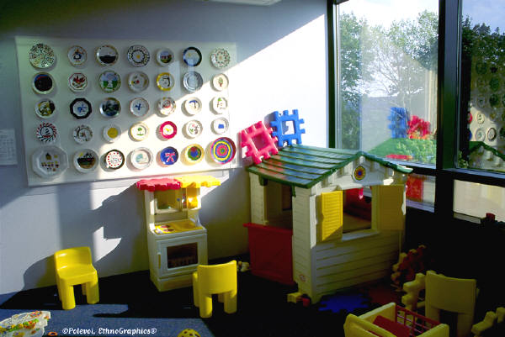
Procedure for the Strange Situation

Slide 7
1 | Mother and infant enter the room. Mother sits in one of the chairs and reads a magazine. Child is placed on the floor and is free to explore the toys.
2 | After about three minutes, a stranger enters, sits on the second chair and talks briefly with the mother
3 | The stranger approaches the infant and attempts to interact and play with them
4 | Mother leaves the room so the infant is alone with the stranger. The stranger comforts the baby if they are upset and offers to play with them
5 | After around three minutes mother returns and the stranger leaves
6 | Three minutes later mother departs again leaving the baby briefly alone in the room
7 | The stranger re-enters and offers to comfort and play with the baby
8 | Mother returns and the stranger leaves

Slide 8
Task: Find out what Ainsworth’s findings were by completing the sheet using the textbook.

Slide 9
Primary Carer’s Behaviour Towards Child
Child’s ‘Working Model’ of Itself
Positive & Loved
Unloved & Rejected
Angry & Confused
Secure
Avoidant
Resistant
www.psychlotron.org.uk

Slide 10
Task: In pairs, diagnose each of the children in the examples as either securely attached, insecure-avoidant or insecure – resistant.
Then create your own scenario…

Slide 11
Is the SS a valid test?
Could there be any observer bias or subjectivity in the procedure?
Do all cultures raise children in the same way?
Notes:
Discuss: cultural issues plus whether attachment type is dependent upon the person with them on the day of the test. Could they be insecurely attached to that carer but securely attached to someone else? Also talk about observer bias and subjectivity within the observations. Researchers aware of hypothesis – record behaviour in line with expectations.

Slide 12
Is the SS a reliable test?
I don’t like this place or that horrid lady. This isn’t home. If she makes me go in that playroom again I’m going to stamp my feet and scream until I’m sick!
I’m bored of doing this over and over again.
Notes:
Discuss: Do they think children can change categories over time? What family factors/life events might cause a child to be secure then insecure? Test is only reliable if children are in same category when tested again – how long should we leave it? 4-6 weeks is a long time in the life of an infant. Much can change.

Slide 13
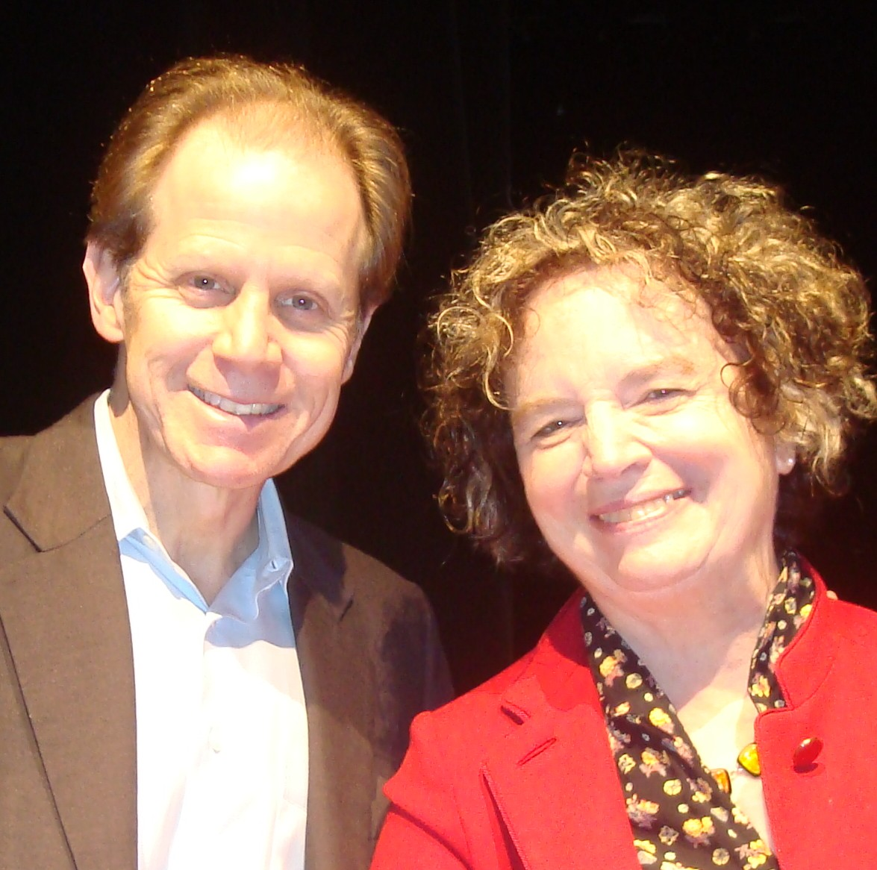
What about other attachment types?
We found a further attachment type: disorganised attachment. This is where there are no set patterns of behaviour at separation of reunion?
Ainsworth never found this as she had a poor population sample size.
Notes:
Discuss: Do they think children can change categories over time? What family factors/life events might cause a child to be secure then insecure? Test is only reliable if children are in same category when tested again – how long should we leave it? 4-6 weeks is a long time in the life of an infant. Much can change.

Slide 14
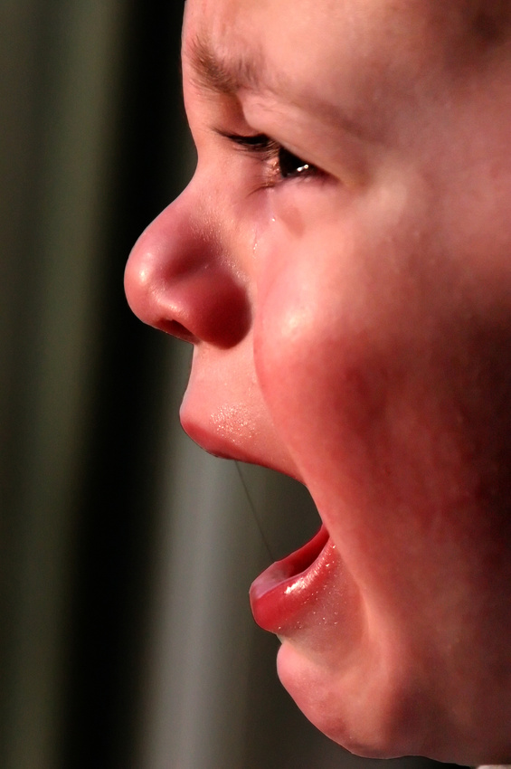
Ethics – can we justify this?
Notes:
Discuss: harm to child, distress for carer. Can we justify causing stress? How could we do an observation involving mother/baby/stranger interaction in a real world? Baby clinic/hospitals etc. Issue of socially sensitive research. If child is not type B, assumption is A and C must have bad mothers.

Slide 16
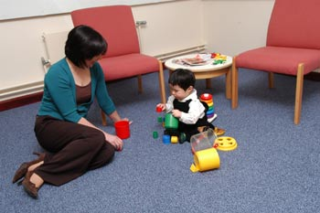
Activity – Research re-enactment
In groups of 5 - 7 create a sketch staging the ‘strange situation’. Your scene must include the following information:
Researchers using the observation technique.
Every stage of the procedure. (stranger/care-giver entering/leaving the room in correct sequence).
The reactions of the children of the different types of attachment e.g. insecure avoidant.
Evaluative comments about the ‘strange situation’. E.g. from a critical mother worried about the ethics.
Keywords
Attachment
Caregiver
Strange situation
Learning objectives:
To be able to DEFINE attachment.
To KNOW the three key types: avoidant, secure, resistant
TO KNOW and EVALUATE Ainsworth’s ‘strange situation’ research.

