Slide 1
Lesson objective: I will investigate what crime was committed in Tudor Stuart times and analyse the punishments given.
Date
Starter Activity:
Why do people commit crimes?
Notes:
At the start of the lessons student to copy the Learning objective into their books. Either: I will learn… or I will develop/be able to
Key words as part of the objective: express, evaluate, organise, define, solve, write, plan, apply, produce, select, reflect on, implement, compile, incorporate, construct, explain, practise, draw, identify, classify, decide, list calculate, present, assemble, describe, conclude
Starter: Think about how are you going to engage the students that they can do independently that look back on the previous lesson or look forward

Slide 2
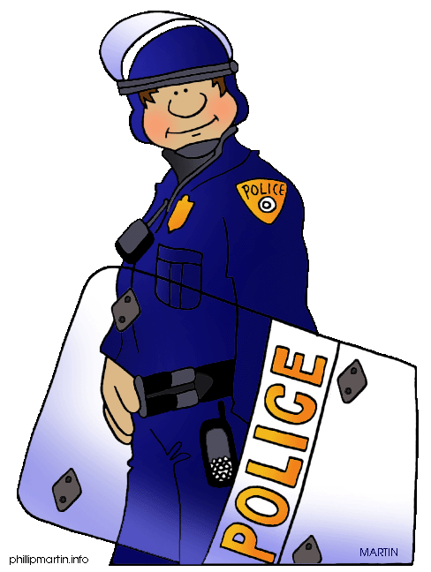
Lesson objective: I will investigate what crime was committed in Tudor Stuart times and analyse the punishments given.
Lesson Activity:
During Tudor Stuart times there was no organised police force. Each village had an organised militia where men from the village would protect it from outside invaders. However law were harsh and wrongdoing was severely punished. To deter people from committing crime, the punishments were very cruel. People believed if a criminal’s punishment was sever and painful enough, the act would not be repeated and it would put other people off the committing crime as well. Torture was used as a way of gaining information.

Slide 3
Lesson objective: I will investigate what crime was committed in Tudor Stuart times and analyse the punishments given.
Lesson Activity:
Each village had a Justice of the Peace to sort out any problems. If you were a Justice of the Peace you would have the power to:
Stop riots, using the militia
Look after the building of roads, bridges, jails and poor houses
Decide how much local people should be paid
Report people who didn’t go to church
Be in charge of whipping beggars
Check on the local alehouses

Slide 4
Lesson objective: I will investigate what crime was committed in Tudor Stuart times and analyse the punishments given.
Lesson Activity:
Match the law with the crime on part A.
Match the crime with the punishment on Part B
Read the sheet about the three types of torture.
P.E.E paragraph - How do Tudor punishments compare to punishments today?
P – Punishments are different today because…
E – Evidence to support this is…
E – This means that…
.

Slide 5
Part A – match the law with the crime
Law | Crime
1. Unlawful games | a. More than 3 people making trouble together
2. Rescue | b. Quarrelling
3. Barratry | c. Playing bowls, cards or dice on a holy day
4. Inmate | d. Stirring up trouble for the king or queen
5. Riot | e. Refusing to go to church
6. Recusance | f. Not going to regular weapons practice
7. Sedition | g. Taking a person or animal by force
8. Archery | h. Letting part of your house to someone without a job
Part B – match the crime with the punishment
Crime | Punishment
1. A women poisons her husband | a. Burned alive
2. A man poisons another man – even if the victim does not die | b. Having the letter ‘F’ branded on the cheek. Ears cut off, nostrils slit and hands cut off
3. Being a tramp | c. Whipped and having a hole burned through the right ear
4. Lying in court “perjury” | d. Death by hanging
5. Helping or sheltering someone who is a murderer | e. To be boiled in water or lead
6. Stealing | f. Branded on the forehead with the letter ‘P’ using a hot iron

Slide 6
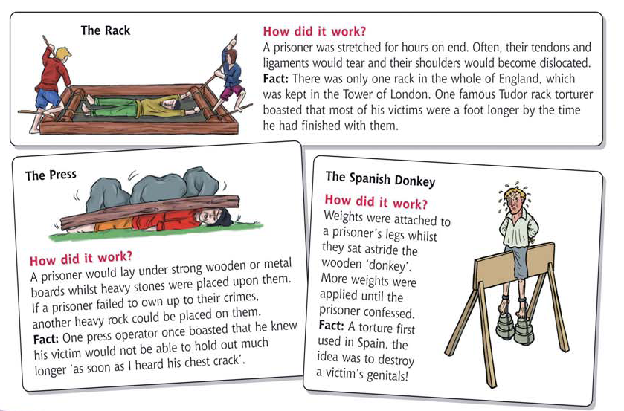
Types of torture

Slide 7
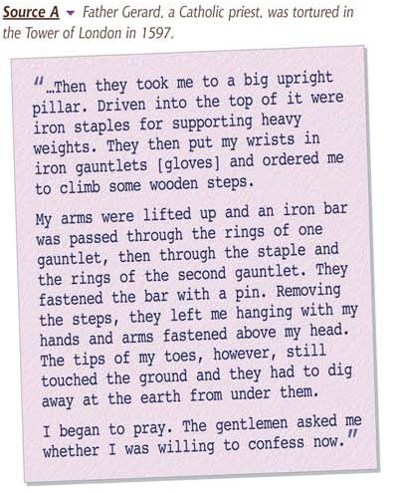
Extension task
Describe what is happening to Father Gerard
Why did the earth have to be dug away from under his feet?
Looking at the provenance of the source, come up with a reason why he may have been a prisoner

Slide 8
Answers
Crime
Law
More than 3 people making trouble together
Quarrelling
Playing bowls, cards or dice on a holy day
Stirring up trouble for the king or queen
Refusing to go to church
Not going to regular weapons practice
Taking a person or animal by force
Letting part of your house to someone without a job
Unlawful games
Rescue
Barratry
Inmate
Riot
Recusance
Sedition
Archery

Slide 9
Answers
Crime
Punishment
A women poisons her husband
A man poisons another man – even if the victim does not die
Being a tramp
Lying in court “perjury”
Helping or sheltering someone who is a murderer
stealing
Burned alive
Having the letter ‘F’ branded on the cheek. Ears cut off, nostrils slit and hands cut off
Whipped and having a hole burned through the right ear
Death by hanging
To be boiled in water or lead
Branded on the forehead with the letter ‘P’ using a hot iron

Slide 10
Lesson objective: I will investigate what crime was committed in Tudor Stuart times and analyse the punishments given.
Lesson Activity: Plenary
Torture is now illegal in our country but it is still used throughout the world.
Why do you think other countries still use it?
Do you think it is a reliable way to get information?

