Slide 1
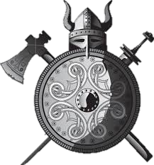
Viking Shields

Slide 2
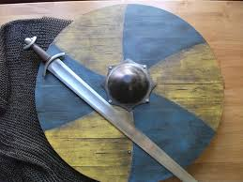
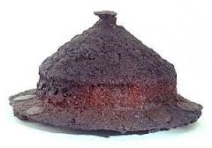
Archaeologists have not found much evidence for complete shields, although parts of the fittings have been found, like the central boss.

Slide 3
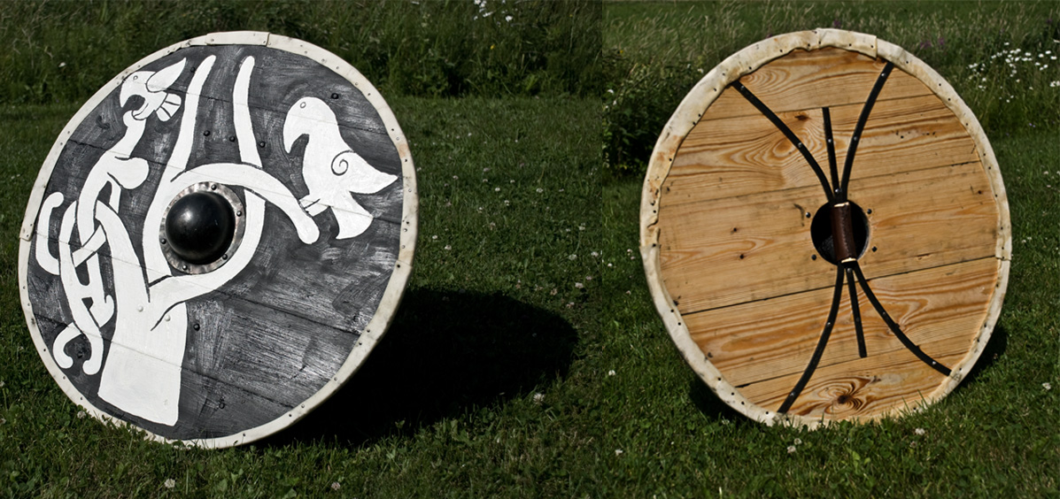
Circular shields were up to a metre across and made of a single layer of planks fitted together. There was a central hollow iron boss to protect the hand, a handle (grip) riveted to the back, and bindings on the rim, sometimes made from leather.

Slide 4
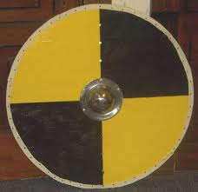
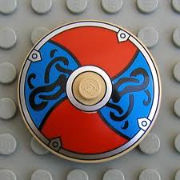
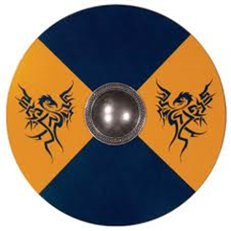
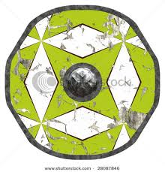
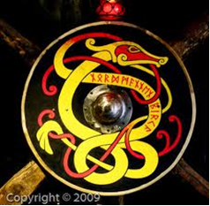
Some of the pictures of shields in Viking art show simple pinwheel and spiral designs.

Slide 5
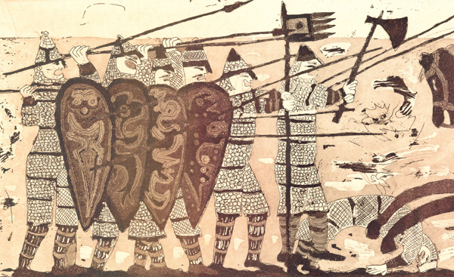
The kite-shaped shield was introduced from around 1000 AD. You can see this represented on the bayeux tapestry, which records the events of 1066. The designs on the shields on the tapestry include crosses, patterns made up of dots, and quite a few strange looking creatures.

Slide 6
SAXON Shields Design your own saxon shield suitable for use in the shield wall. Make sure you include your personal story, the metal boss and the strap for your hand.

