Slide 2
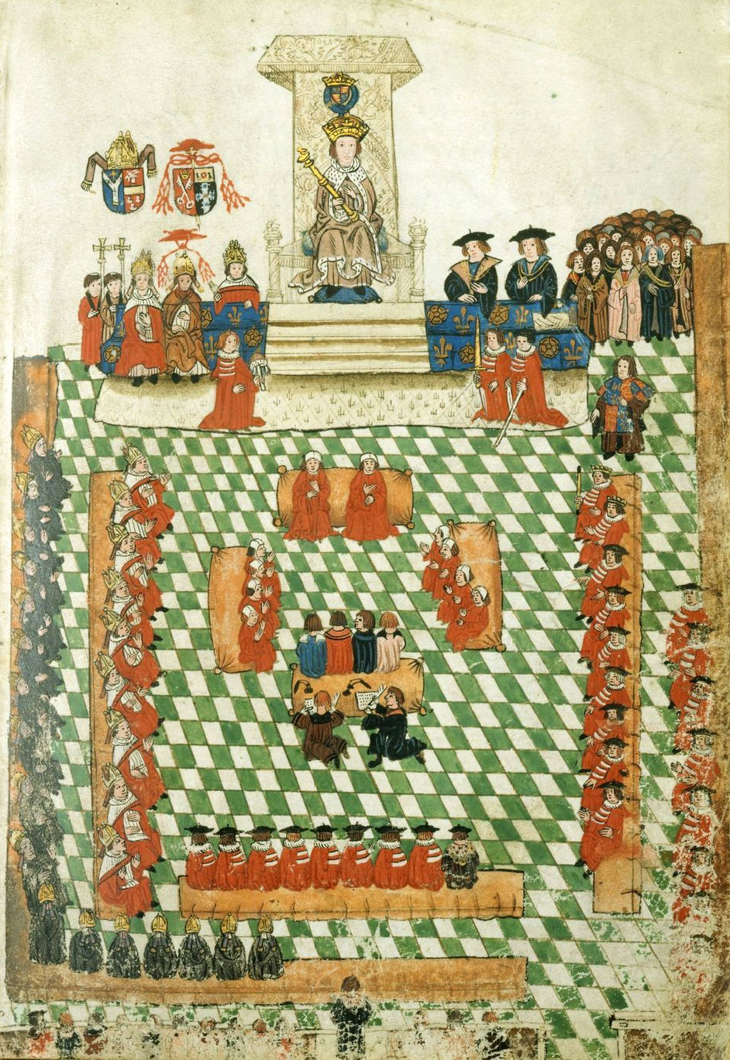
Starter: Identify the people in this picture. What do you think is happening in this picture? Have you seen anything like this else where in our times?
Notes:
1523 opening ceremony of Parliament
A contemporary illustration of the 1523 State Opening shows a remarkable visual similarity between State Openings of the 16th and 21st centuries. In both cases, the monarch sits on a throne before the Cloth of Estate, crowned and wearing a crimson robe of state; the Cap of Maintenance and Sword of State are borne by peers standing before the monarch on the left and right respectively; the Lord Great Chamberlain stands alongside, bearing his white wand of office. Members of the Royal retinue are arrayed behind the King (top right). In the main body of the Chamber, the Bishops are seated on benches to the King's right wearing their parliamentary robes, and the Lords Temporal are seated on the other benches (among them the Duke of Norfolk, carrying his baton as Earl Marshal of England). The judges (red-robed and coifed) are on the woolsacks in the centre, and behind them are the clerks (with quills and inkpots). At the bottom of the picture members of the House of Commons can be seen at the Bar to the House, with the Speaker in the centre, wearing his black and gold robe of state.

Slide 3
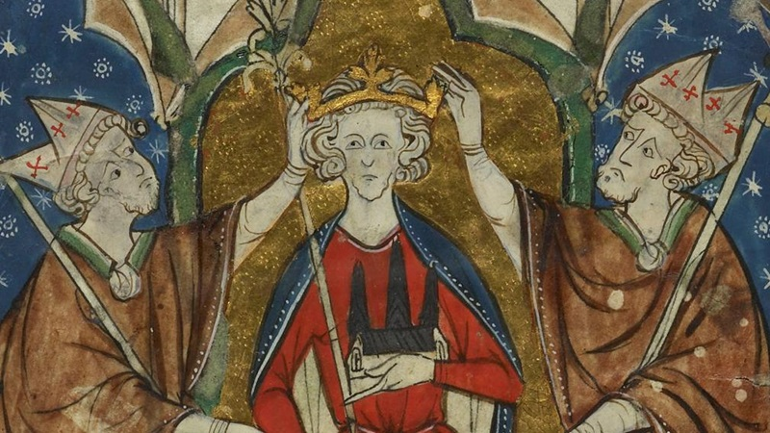
Enquiry Question: Why did Simon de Montfort rebel against Henry III?

Slide 4
Learning Outcomes
To describe problems between King Henry III and his barons
To identify and describe the roles of Simon, Eleanor and the Henry III

Slide 5
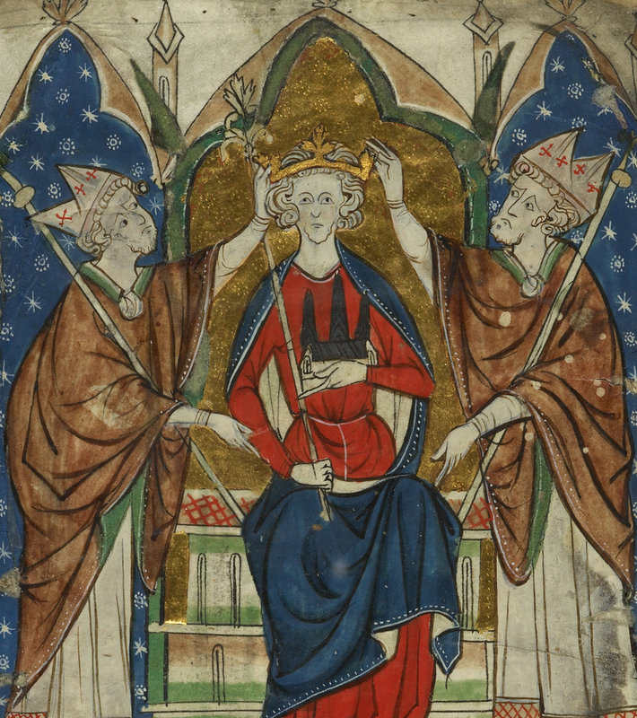
A King is crowned…
Asking questions…
King John died in the middle of a war with his barons. His son Henry III was crowned king when he was just 9 years old.
Is he ready to rule?
What might make ruling especially challenging?
What should happen?
Who should help him?
For how long?
Notes:
[Teachers Notes Document saved on S drive for extra subject knowledge]
Teacher to explain the key issues of Henry’s minority – council ruling on his behalf and Henry only formally takes control in 1227. Despite having taken control, he is heavily influenced by his advisors that helped him and advised him. Many accusations of various advisers abusing their power, squandering royal money, responsible for failed invasions of France, taking land off other barons and nobles who they did not like, leaving some to complain that Henry was not protecting the rights of his subjects, during which time there was a brief civil war between rival groups of barons. After settling a peace, for the next 24 years, Henry ruled the kingdom personally, rather than through senior advisers. A small royal council was formed. Everything that happened after this could only be blamed on Henry himself.

Slide 6
Asking questions…
What goes so wrong?
Henry takes control of his government in 1227.
By 1258 he is facing a crisis that threatens his powers as king.
What could Henry have done to upset people?
What parts of the Magna Carta (and his reissued and confirmed charters) could he have ignored?

Slide 7
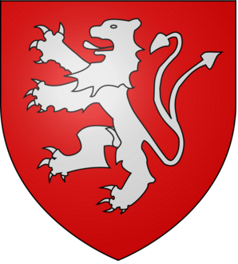
Asking questions…
How do the barons react?
Simon de Montfort led a rebellion against Henry III – and briefly captured him.
Simon then called a Parliament to decide the new constitution.
Why is this significant?
Coat of Arms of Simon De Montfort
Notes:
This was the first Parliament to which representatives from counties and towns were summoned to give advice.
For the first time, it was not just the great barons who were being consulted, but representatives of a much wider section of the community.

Slide 8
Conflict between the king and barons
1
2
3
4
From 1234 onward, King Henry III took over governing the kingdom, having been under the control of the ministers that had run the country while he was a child.
Henry III lacked money and placed continued pressure on the people of England by collecting taxes. The government officials who collected these taxes were accused of abusing their positions.
Henry III was criticised for being too generous to his close friends and family, handing out important jobs to them and protecting them from the law at the expense of everyone else.
In particular people did not like the influence of two groups of ‘foreigners’: Henry’s wife’s family from Provence and Savoy (in modern southeast France, northern Italy and Switzerland) on the one hand, and his half-brothers from Poitou in western France, on the other. Each of these groups were also suspicious of each other.

Slide 9
The role and nature of Parliament and the Council of Fifteen
5
7
During Henry III’s reign Parliament became increasingly important. Parliament was the name given to the occasions when all the barons met with the king and each other, usually at Westminster but also elsewhere.
In April 1258, the barons were attending Parliament at Westminster and confronted Henry III with demands that he make reforms. They agreed to meet at Oxford in June where the Provisions of Oxford were agreed. The king and everyone present swore an oath to uphold these provisions which set out a series of changes in the way England was governed.
6
After Magna Carta that the king could only gain extra taxes by asking the barons first. As the king needed money he called the barons to Parliament much more frequently than ever before. In return for giving taxes the barons asked for reforms in government. They particularly wanted to be able to choose the king’s ministers for him and they wanted him to follow their advice which he did not do.
8
The king agreed that he would accept the advice of a council of fifteen barons who could appoint and dismiss ministers, that parliament would be held three times a year. Henry III was forced to do this and effectively lost power over the government to the council of fifteen. One of the fifteen was Simon de Montfort.

Slide 10
Increasing tensions and civil war
9
11
12
In 1261, Henry III asked the Pope to cancel the Provisions of Oxford and he regained power over the government. Most of the more powerful barons accepted this, but Simon de Montfort refused to break the oath he had made to the Provisions of Oxford, and left the country for France.
In 1263, Henry III lost the support of some barons who then invited Simon de Montfort back to England. He arrived in April 1263 and began fighting against Henry III and his royalist supporters. Simon de Montfort had a lot of popular support from people across England who thought that foreigners had too much influence.
The two sides agreed to let King Louis IX of France decide between them. The king of France decided that the Provisions of Oxford should indeed be condemned and Henry III should have full powers over the government. Simon de Montfort and his supporters refused to accept this and civil war broke out.
The following year, in October 1259, the Council of Fifteen carried out further reform, this time of local government, and introduced laws popular among the less powerful and wealthy members of society including knights, people who lived in towns, and peasants.
10

Slide 11
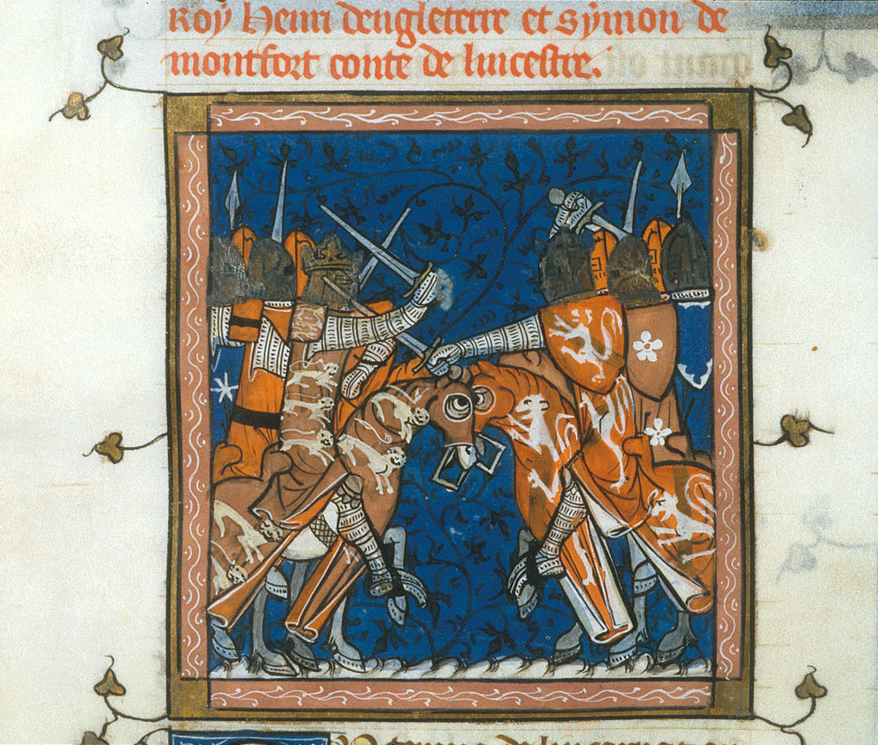
Asking questions…
Who won the civil war?
On 14 May 1264, Simon de Montfort captured Henry III, his brother Richard, Earl of Cornwall, and the king’s son, Edward, at the Battle of Lewes.
Having done this, Simon took control of the government himself, appointing a council of nine, mostly made up of his own friends and allies.
He confirmed Magna Carta and the Provisions of Oxford.

Slide 12
Asking questions…
What happens next?
Unlike in 1258, Simon de Montfort did not have the support of many powerful barons.
Most of his supporters were less powerful barons and knights.
He was also popular among the wider population.
In order to strengthen his position, he summoned to parliament representatives of minor landowners in the counties, and of the people of the towns.
Two knights were to be chosen in each county, along with two representatives of each city and borough (called burgesses), and they were to come to Parliament at Westminster.
Before this, only barons had attended Parliament, though knights had occasionally been called.

Slide 13
Asking questions…
What was Simon’s fate?
On 4 August 1265, Simon de Montfort was defeated at the Battle of Evesham.
He was killed and his body was horribly mutilated. Henry III, together with his brother, Richard and son, Edward, regained power over the government.
They continued with the local reforms that had been popular with the less wealthy and powerful people, but not the reforms that restricted the king’s power.

Slide 14
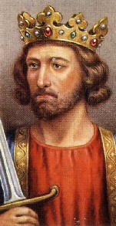
Asking questions…
How did Edward rule?
When Edward became king after Henry III died in 1272, he once again began to call representatives of the counties and towns to Parliament.
This happened more and more frequently, and these representatives eventually formed the House of Commons in the fourteenth century.

Slide 15
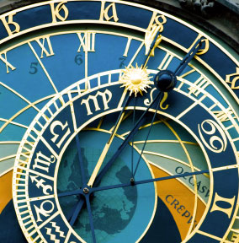
Chronological Understanding
Reign of Henry III
1265 Edward escapes captivity. Simon de Montfort is defeated and killed at Evesham. Edward takes control of the government from his father. | 19 Oct 1216 King John dies at Newark, most likely of dysentery.
1237 Henry III reconfirms the 1225 charters. | 1264 Civil War. Simon de Montfort is victorious at Lewes and set up a new government. Henry III’s son, Edward was taken hostage to ensure peace.
1265 The charter is published in the counties. | Sep 1217 The Treaty of Lambeth ends the civil war. Prince Louis is given a generous pay-off and returns to France.
28 Oct 1216 King Henry III is crowned at Gloucester. He is just nine years old. The charter is reissued for the first time by loyal barons in Henry’s government in an effort to win support from the rebel barons. | 1258 Henry III faces crisis at home and abroad. A bungled deal with the Papacy results in Henry being threatened with excommunication. He faces a rebellion in Wales and discontent from English barons. The Provisions of Oxford create a Privy Council to advise the king. It also establishes that Parliament is to be held three times a year.
1225 Henry III issues his own version of Magna Carta. He says he does so of his own free choice. | 1272 Henry III dies while Edward is on crusade. Edward becomes King Edward I.
Nov 1217 The second reissue of the charter. A ‘Charter of the Forest’ is also issued as a supplement. | 1253 The charter is confirmed at Westminster. Witnesses include not just barons, but representatives of the church and town leaders.
Notes:
Students to place events into chronological order. (number)

Slide 16
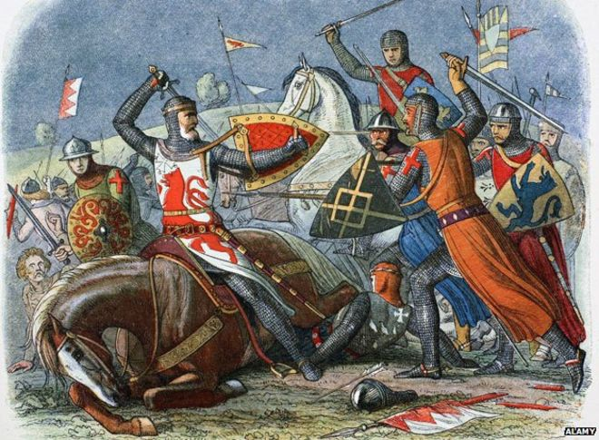
Independent Close Reading
1259 – The Father of Parliaments
Read the hand out “1259 – The Father of Parliaments”
Create a colour coded key to show:
Causes of rebellion
Actions of Simon de Montfort
Consequences of rebellion

Slide 17
INSTRUCTIONS
You will be shown a statement that describes either Simon de Montfort, Eleanor de Montfort, or King Henry III.
If it describes Simon…
If it describes Eleanor…
If it describes King Henry III…
Notes:
Add actions/movements for each individual – the sillier the better!

Slide 18
I am a French nobleman granted land in England by King Henry III
Simon de Montfort

Slide 19
I am the king’s sister
Eleanor de Montfort

Slide 20
I am a skilled politician and military leader given great responsibility by Henry III
Simon de Montfort

Slide 21
I supported my husband in his fight against my brother, the King
Eleanor de Montfort

Slide 22
I was convinced that, with support people, he could defeat the barons’ rebel army
King Henry III

Slide 23
I was captured by Simon de Montfort at the battle of Lewes
King Henry III

Slide 24
I am a powerful and influential woman at a time when women’s involvement in big issues was limited
Eleanor de Montfort

Slide 25
I am the son of King John who had agreed to Magna Carta
King Henry III

Slide 26
I became leader of a rebellion against the king
Simon de Montfort

Slide 27
I called representatives of all shire and towns to Parliament
Simon de Montfort

Slide 28
I married Simon de Montfort
Eleanor de Montfort

Slide 29
I made and broke agreements, raised taxes but increasingly needed Parliament’s say to do so
King Henry III

Slide 31
During Henry III’s reign Parliament became increasingly important. Parliament was the name given to the occasions when all the barons met with the king and each other, usually at Westminster but also elsewhere. | From 1234 onward, King Henry III took over governing the kingdom, having been under the control of the ministers that had run the country while he was a child. | In April 1258, the barons were attending Parliament at Westminster and confronted Henry III with demands that he make reforms. They agreed to meet at Oxford in June where the Provisions of Oxford were agreed. The king and everyone present swore an oath to uphold these provisions which set out a series of changes in the way England was governed. | In 1261, Henry III asked the Pope to cancel the Provisions of Oxford and he regained power over the government. Most of the more powerful barons accepted this, but Simon de Montfort refused to break the oath he had made to the Provisions of Oxford, and left the country for France.
After Magna Carta that the king could only gain extra taxes by asking the barons first. As the king needed money he called the barons to Parliament much more frequently than ever before. In return for giving taxes the barons asked for reforms in government. They particularly wanted to be able to choose the king’s ministers for him and they wanted him to follow their advice which he did not do. | The king agreed that he would accept the advice of a council of fifteen barons who could appoint and dismiss ministers, that parliament would be held three times a year. Henry III was forced to do this and effectively lost power over the government to the council of fifteen. One of the fifteen was Simon de Montfort. | Henry III was criticised for being too generous to his close friends and family, handing out important jobs to them and protecting them from the law at the expense of everyone else. | The two sides agreed to let King Louis IX of France decide between them. The king of France decided that the Provisions of Oxford should indeed be condemned and Henry III should have full powers over the government. Simon de Montfort and his supporters refused to accept this and civil war broke out.
The following year, in October 1259, the Council of Fifteen carried out further reform, this time of local government, and introduced laws popular among the less powerful and wealthy members of society including knights, people who lived in towns, and peasants. | Henry III lacked money and placed continued pressure on the people of England by collecting taxes. The government officials who collected these taxes were accused of abusing their positions. | In 1263, Henry III lost the support of some barons who then invited Simon de Montfort back to England. He arrived in April 1263 and began fighting against Henry III and his royalist supporters. Simon de Montfort had a lot of popular support from people across England who thought that foreigners had too much influence. | In particular people did not like the influence of two groups of ‘foreigners’: Henry’s wife’s family from Provence and Savoy (in modern southeast France, northern Italy and Switzerland) on the one hand, and his half-brothers from Poitou in western France, on the other. Each of these groups were also suspicious of each other.

