Slide 1
Henry VIII

Slide 2
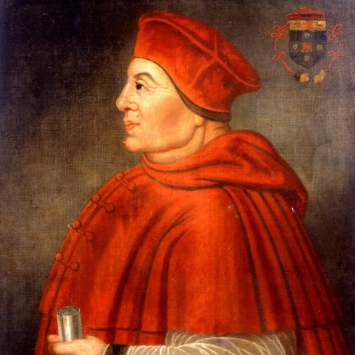
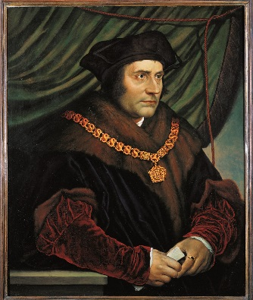
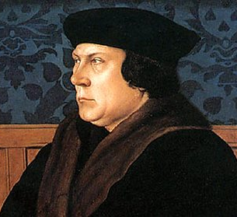
Henry VIII (April 1509 - January 1547)
Wolsey
More
Cromwell
Factions
1509
1515
1529
1532
1540
1547
Notes:
Rules for 38 years

Slide 3
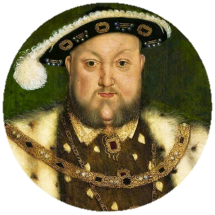
Key Individuals
Power of the Monarchy
Foreign Relations and Succession
Government
What to consider as we go:
Change/continuity
Success/failure
Significance/importance
Causation/consequence
Society and Economy
Religion

Slide 4
Key Individuals: Overview
1515-1529 (Thomas Wolsey, Catherine of Aragon, Anne Boleyn)
1529-1532 (Thomas More, Thomas Cromwell)
1532-1540 (Thomas Cromwell, Thomas Cranmer, Anne of Cleves)
1540-1547 (Duke of Norfolk, Stephen Gardiner, Catherine Howard, Edward Seymour, Catherine Parr, Anthony Denny)
These will crop up as we go through the other key questions

Slide 5
Key People: Wolsey and Cromwell
THOMAS WOLSEY
Son of a butcher from Ipswich
Won a scholarship for Oxford (15 years old)
Gained patronage under Bishop Fox
Royal Almoner
1513: Dean of York & Bishop of Tournai
1514: Bishop of Lincoln & Archbishop of York
1515: Cardinal and Lord Chancellor
1518: Papal legate
Wolsey is ostentatious! Also known as ‘alter rex’.
THOMAS CROMWELL
Also humble origins (dad ale-house keeper)
Travelled at young age (Netherlands, Italy)
1516: found employment in the household of Wolsey
1524: developed a successful legal practice
1529 elected as an MP
1531: member of the royal household
1532: Master of King’s Jewels
1533: Chancellor of the Exchequer
1535: Vicar General (HVIII made up to institute church reform
1536: Principle Secretary on Royal Council
1540: Lord Great Chamberlain and Earl of Essex

Slide 6
Key People: The Wives
NAME | APPROX. LENGTH OF MARRIAGE (YEARS) | OUTCOME
Catherine of Aragon | 28 | Divorced
Anne Boleyn | 3 | Beheaded
Jane Seymour | 1 | Died
Anne of Cleves | >1 | Divorced
Catherine Howard | 2 | Beheaded
Catherine Parr | 4 | Survived

Slide 7
Government: Overview
1509-1515: Council Learned in Law, Court, Nobility, Style of Government
1515-1529: Wolsey (legal, economics, finance reform; Parliament; divorce)
1529-1532: More (divorce)
1532-1540: Cromwell (divorce, Revolution in Government debate)
1540-1547: Factions and what this means for Henry’s power

Slide 8
Government: 1509-1515
Within days of his accession, HVIII ordered the arrest of Empson and Dudley
Henry abolished the unpopular Council Learned in the Law
Henry’s Court is dedicated to pleasure and refinement. But, he also enjoyed the company of scholars steeped in the new learning of the Renaissance.
Henry’s attitude towards the nobility was different to that of his father. Early gestures of good will include cancelling 175 bonds. There is no doubt that Henry regarded the nobility as his friends and associates.
Henry shared his suspicion of possible rivals amongst the nobility. In 1513, Henry had Edmund de la Pole executed for treason.
Henry’s style of government in this period was personal. He took major decisions himself, without the aid of a Chief Minister.
Henry continued to use Justices of the Peace rather than relying on nobles in the localities.

Slide 9
Government: 1515-1529
Legal Reforms
Aim was to tackle slowness and unfairness
Promoted civil law (evidence) over common law
Strengthened Star Chamber (12 →120 cases)
Reputation as a ‘friend to the poor’
Economic Reforms
No coherent economic policy
1517 – national enquiry into enclosure
Then, legal cases were drawn up against landlords who had enclosed without proper permission
1523-26 suspended cases due to opposition from landlords in Parliament
Financial Reforms
Shortage of money was a problem for HVIII
National survey (1522): into who could pay tax (first of its type since Doomsday Book), gained £200,000.
Subsidy (1523): based on income not property, did not raise as much money as hoped.
1525 Amicable Grant: tax for church/ordinary payers based on their property value. Provoked rebellion.
Parliament
Wolsey could be accused of trying to rule without Parliament (called Parliament twice)
1515: Hunne’s Case – Bishop Scandal
1523: Taxation as a result of foreign policy

Slide 10
Government: 1515-1529
Scriptural argument Diplomatic manoeuvres Legal Efforts
Wolsey used Leviticus 20:16 along with the fact there was no proof that Catherine and Arthur’s marriage had not been consummated. Henry was convinced the his lack of a male heir was God punishing him.
However, theologians disagree on this biblical extract. Some said that it only counted is Arthur was alive, and because he was dead, Henry actually had a duty to marry Catherine!
Charles V was unlikely to support the divorce (Catherine’s nephew) and Charles was in control of Italy, holding the Pope hostage… Wolsey tried to free the Pope by using an alliance with France and the renewal of warfare in Italy to distract Charles.
However, Charles was too entrenched in the Italian peninsula for this plan to be successful.
Wolsey decided to hold the divorce hearings in England (as Papal Legate he could then make the call). Pope Clement VII sent Campeggio to England with strict instructions to delay the hearing and ensure no decision was reached. Campeggio genuinely took months to arrive…
When the court final met in 1529, Catherine refused to recognise it and appealed to the Pope to move the hearing to Rome. The Pope agreed. At this point Wolsey had run out of options…

Slide 11
Government: 1529-1532
Thomas More was a able scholar, but poor replacement as Lord Chancellor.
More had a reputation for putting his principles before anything else.
He held strong Humanist beliefs (wrote Utopia in 1516).
More was deeply sympathetic to Catherine of Aragon
Whilst he criticised the Catholic church, he was convinced that reform could be achieved
Henry applied a number of measure to pressurise the clergy and Pope:
 | Pressure of the Clergy | Pressure on the Pope
1529 | Parliament encouraged to voice anti-Clerical feelings (Cromwell started collecting evidence of abuses)
1530 | Revival of Praemunire (Medieval law) – it found 15 of the upper clergy guilty of supporting Wolsey’s abuse of power | Scholars from Oxbridge were sent to European universities to find support for the divorce
1531 | Henry pardoned the clergy of crimes against him, but demanded that they recognise him as ‘supreme head’ of the church
1532 | Jan: Cromwell introduced the ‘Supplication Against the Ordinances’ (petition calling HVIII to deal with corrupt clergy). Cromwell is invited into HVIII’s Royal Council May: ‘Submission of the Clergy’ – church had to agree to this, a document giving HVIII power to veto church laws and choose his own Bishops | Jan: Act of Parliament passed preventing the payment of annates to Rome. Fierce opposition! Aug: Archbishop of Canterbury dies, and is replaced with Thomas Cranmer (reformer with some Protestant views)
Notes:
Notice that the information in the table is more the doing of Cromwell than More.

Slide 12
Government: 1532-1540
Ultimately, the divorce and Break with Rome was accomplished through statue law (Parliament), whose Supremacy over canon law (Church) was established.
Acts of Parliament (1533-34)
Broken with Rome
Act | Details
1536 Ten Articles | 3 sacraments were necessary for salvation. Eucharist was ambiguous. Confession was praised. Praying to the saints was rejected
1537 Bishops Book | Restored the 4 sacraments omitted from the 10 Articles (given lower status)
1539 Six Articles | Reasserted Catholic Doctrine. Denying transubstantiation was heretical
1543 King’s Book | Revised Bishops book
1. Act in Restraint of Appeal (1533)
The Monarch possessed imperial jurisdiction
and was not subject to any foreign power.
Appeals could not be made to Rome.
2. Act of Supremacy (1534)………
‘The King’s majesty , justly and rightly is.... and oweth to be the Supreme Head of the Catholic Church’.
3. Succession Act (1534)
Henry’s marriage to Catherine was void;
succession should be vested in the children
of Anne Boleyn; treason to deny the
validity of the marriage to Anne Boleyn.
4. Treason Act (1534)……..
Treason could be committed by spoken... words and by deeds or writing.

Slide 13
 | Was a Revolution in Government | Was not a Revolution in Government
Council | Royal Council (large group - nobles, clergy and King’s household) transformed into the Privy Council. This was a much smaller group of around 20 members. Privy Council contained mainly trained lawyers and administrators, rather than the traditional noble families. | Arguably Wolsey’s idea, as early as 1526- and not Cromwell’s. Other historians argue that these changes did not really begin until after Cromwell’s death in 1540.
Finance | Cromwell created new financial institutions, including: -Court of: Augmentations, First Fruits and Tenths, Wards | Cromwell continued HVIII’s approach (managing finances from the Privy Chamber.) Henry VII = Master of the King’s Wards.
Power of the Monarchy | Power increased (Act of Supremacy and Cromwell wrote that everyone owed the King (who was chosen by God) total obedience. The Act of Union with Wales (1536) reorganised local government in Wales and the Marches, giving the monarch greater control. An Act against Liberties and Franchises restricted the special powers of regional nobles, such as the Prince Bishop of Durham. | The power of the monarch was immense even before Cromwell’s changes. These powers included significant influence over appointments to church positions and emergency taxation.
Parliament | Began to play a central role - Henry needed it to agree to the various Acts. It met for an unbroken period (1529-1536) By the end of this period, statute law (law made by Parliament with the King’s consent) represented ultimate authority in England. The dissolution of the monasteries meant that clergy were in a minority in the House of Lords for the first time. | Parliament could not call or prorogue itself. When parliament was not sitting the King could still govern by Proclamation. 1540s - King did not call Parliament frequently The increase in the power of Parliament was only temporary: During Liz’s reign, Parliament’s role was limited. The Church, still had its own finance system/ courts
Notes:
Augmentation: administer monastic properties and revenues confiscated by the crown at the dissolution of the monasteries.
First Fruits and Tenths: Clergy had to pay a portion of their first year's income (known as annates) and a tenth of their revenue annually thereafter.
Court of Wards

Slide 14
Factions: 1540-7
CONSERVATIVE FACTION (1540-1546)
Accept the break with Rome but oppose doctrinal change
Key members: Duke of Norfolk, Stephen Gardiner
Success: Six Articles of Religion; fall of Cromwell; marriage to Catherine Howard
Failures: Catherine Howard was beheaded, Plot against Cranmer (in charge of his own investigation), plot against Catherine Parr (Henry took his wife’s side).
REFORM FACTION (1546-1546)
Accept break with Rome, and see it as an opportunity for further reform
Key members: Edward Seymour, Archbishop Cranmer
Success: Fall of Catherine Howard, Catherine Parr marriage, plot against Gardiner and arrest of Norfolk, Anthony Denny (Chief Gentlemen) gets access to the dry stamp.

Slide 15
Religion: Overview
Renaissance ideas
Reform of the Church
English Protestantism
Dissolution of the Monasteries
Situation by 1547

Slide 16
Religion: Key Terms
TERM | DEFINITION
Renaissance | The cultural rebirth that occurred in Europe from roughly the fourteenth through the middle of the seventeenth centuries, based on the rediscovery of the literature of Greece and Rome
Humanism | The belief that you can improve mankind through education (emphasis on mankind). Renaissance humanism links this process with the renaissance.

Slide 17
Religion: Renaissance ideas
Renaissance ideas existed during the reign of Henry VII. During Henry VIII;s reign renaissance ideas continued to flourish. This, in part, was because Henry encouraged it!
Humanism and Education
Renaissance and English Culture
John Colet founded St. Pauls school London. Governors were from the city guild rather than clergy; curriculum was influenced by Erasmus and humanist principles; humanist William Lily was the Headteacher.
Education reforms were not limited to St Pauls. E.g. Corpus Christi and Cardinal College Oxford. Wolsey started his own school in Ipswich. Humanism had an impact on University curricula.
Erasmus (Dutch humanist scholar) was received with enthusiasm amongst English intellectual circles. He was friends with Thomas More.
Examples of humanism influencing culture:
Writer = Thomas More
Sculpture = Italian Pietro Torrigiano (tombs of HVII and Elizabeth)
However, gothic culture remained dominant
Artist = Hans Holbein (medieval chivalry imagry)
Henry seemed more conservative than Wolsey (Nonsuch Palace vs. Hampton Court
It is important not to exaggerate the importance of Renaissance ideas. The scope was limited and much change was down to new religious thinking > Renaissance Humanism

Slide 18
Religion: Reform of the Church
Anti-Clericalism
Anticlericalism means opposition to the political/social importance of the clergy.
Common lawyers objected to the influence of canon (church) law, and the clergy’s legal privileges.
The worst example of misconduct was the death of Richard Hunnes.
Corruption
Corruption was associated with the church
Pluralism (receiving profits for more than one post)
Simony (purchase of office)
Absenteeism (receiving profits for a post, but not being present to perform duties associated with that post)
Wolsey is the best example!
WEAKNESSES OF THE CHURCH
Hunnes Case
Richard Hunnes (merchant) was found dead in the Bishop of London’s prison (refused to pay the mortuary fee when his child died). He apparently hanged himself, but the coroner ruled he could not have, and it was a murder! Parliament took up the case and Wolsey had to kneel and beg for forgiveness (senior representative of the church).
Decline of monasticism
The idea of dissolving monasteries existed before the 1530s
Wolsey had dissolved around 20 houses in the 1520s to fund Cardinal College
Some think monasticism had lost its sense of direction
Large monasteries had become huge businesses with huge resources
Some monasteries were flourishing e.g. Observant Franciscans and Bridgettines

Slide 19
Religion: Evidence of English Protestantism
Lollards
Religious movement that existed from the mid-14th century to the English Reformation. It was initially led by John Wycliffe, a Roman Catholic theologian who was dismissed from the University of Oxford in 1381 for criticism of the Roman Catholic Church. The Lollards' demands were primarily for reform of Western Christianity.
Their beliefs survived in this period
Intellectuals
At an intellectual level there were a nucleus of reformers based in Cambridge in the 1520’s who met for discussions at the White Horse. A leader figure in this group was Robert Barned, who had been converted to Protestantism by Thomas Bilney. They would both be burnt as heretics later in HVIII’s reign. The most influential in this group was Thomas Cranmer.
German reformers
German reformers had influence. They were based in London and the east-coast ports in the 1520’s.

Slide 20
Religion: Dissolution of the Monasteries
CAUSES | EVENTS | CONSEQUENCES
High regard monasteries had been held in had almost vanished (number of regular clergy dropped by 10,000) | 1534: Act of First Fruits and Tenths allowed HVIII to tax the church. Act of Supremacy gave HVIII the power to reform all religious establishments in England. | Main beneficiaries were HVIII and nobility (land seizure and assets gained). It is estimated that the value of dissolution = 10% of national wealth.
Monasteries had become more business like, with servants, luxuries and renting out land | 1535: Cromwell’s commission Valor Ecclesiasticus and second survey to investigate corruption. | Benefitted Protestants with the dissolution dealing a great blow to Catholic ritual
Cromwell’s inspection in 1535 found corruption in smaller monasteries (on the hunt to find corruption!) | 1536: Based on the commission, Parliament passed the Act for Dissolution of Smaller Monasteries. (all valued under £200 per year). New commissioners sent out to supervise. Provoked the Pilgrimage of Grace. | Much of the property was bought by nobility or lesser gentry. Lesser gentry buying land is important because it illustrates a societal shift.
Monasteries were wealthy. In 1535 Cromwell commissioned a survey (Valor Ecclesiasticus) which revealed these monasteries could double the Crown’s annual income. |  | Finance funded foreign policy. In the long term it did little to help financial independence (land was sold off to raise money). 1543-7 half of the land was sold off!
Seizure of monastic land would give the crown additional property which they could distribute for support. | 1537-8: Closures continued (some religious houses bribed officials to overlook them temporarily). Cathusian monks were executed for their opposition. | Main losers were inhabitants of the monasteries and their local community.
Monasteries were permanent reminder of the Catholic Church. | 1539: Parliament passed the Act for the Dissolution of Larger Monasteries, extending closures to all houses except chantries. | Monks/nuns lost their accommodation (most got compensation). Government was least generous to nuns/friars.
The primary role of monasteries (to pray for the souls of the dead) was out of line with Protestant theology. | 1540: Court of Augmentations was established, with Richard Rich as Chancellor, to handle property and income from the monasteries. | Had a negative impact on education. Great libraries were broken up and books burnt. However, education continued.

Slide 21
Religion: Religion by 1547
Change
Continuity
Jurisdiction of the Pope had been destroyed (King had more authority)
Monasteries had been dissolved (transfer of resources from church to crown)
Parish churches had to have a bible in English
Religious culture had been influenced by Humanism
Church hierarchy
Interior of the churches
Services were largely traditional
Six Articles 1539 and the fall of Cromwell weakened the case for religious reform
Services were still held in Latin
Music continued to play in services

Slide 22
Foreign Policy: Overview
1509-1515: France and Scotland
1515-1529: Wolsey (Treaty of London, Support for the Habsburg/France)
1532-1547: Europe; Scotland; Ireland

Slide 23
Foreign Policy: 1509-1515
FRANCE
Henry relieved hostilities with France 1512: Henry held an army there. But, with expenditure increasing, and the wellbeing of the soldiers deteriorating, the army returned to England. 1513: Wolsey organised a second expedition to France. The campaign was a success. The English drove the French in the ‘Battle of Spurs’ and went onto capture Tournai. 1514: Treaty of Saint Germaine-en-Laye left England in possession of Tournai and Therouanne and an annual payment to Henry.
SCOTLAND
Scotland allied with France in 1512 James IV led an army to invade NE England (trying to divert English troops from going into France) Catherine of Aragon was acting as Regent because Henry was in France. The Earl of Surrey was given title of Lieutenant-General of the North with instruction to take the army north to repel the invasion. The Battle of Flodden (1513) = last large scale medieval-style battle. English lost 1,500. Scots lost 10,000, inc James IV! A committee was set to rule in the name of James’ wife Margaret, and her son.
Notes:
p.45

Slide 24
Foreign Policy: 1515-1529
COUNTRY | RULER IN 1500 | WHAT HAPPENED TO THE RULER | NEW RULER
ENGLAND | Henry VII | Died in 1509 | Henry VIII
BURGUNDY | Philip | Died in 1506 | Charles V (son of Phillip)
FRANCE | Louis XII | Died in 1515 | Francis I
SPAIN | Ferdinand | Died in 1516 | Charles V (grandson of Ferdinand)
HRE | Maximilian | Died in 1519 | Charles V (grandson of Maximilian)
Notes:
p.45

Slide 25
Foreign Policy: 1515-1529
Treaty of London
Pope Leo X called for a crusade to halt the spread of Ottoman power
Little chance of this happening, but Wolsey used this to place England at the centre of European affairs
2 dozen countries signed the treaty– which called for ‘universal peace’. Each country signed separately with England
1519 Charles was elected HRE, who in turn geographically encircled France. Charles inherited his fathers commitment to Milan, which France controlled. Francis and Charles are now in direct opposition, and Wolsey needed to choose a side…
Henry meets Charles
1520: Henry met Francis at the Field of the Cloth of Gold
Henry meets Charles
1522: Henry declares was on France (Spain is the more attractive alliance, married to Catherine of Aragon, and Henry wants to make territorial gains in France). Amounts to nothings and costs a fortune!
1525: Imperial forces capture Francis I at the Battle of Pavia. Henry hoped to exploit this and asked Charles for help, but he refused!
1526: Wolsey joined negotiations with France, Pope, Venice and Florence for an anti-Habsburg alliance (League of Cognac).
England is dragged into war with Charles. At this point Henry sought a divorce, and Charles had got the Pope hostage! England were ineffectual…
1529: Treaty of Cambrai (Wolsey fell from power two weeks later ☹)
Notes:
p.45

Slide 26
Foreign Policy: 1529-1540
Search for Protestant Allies
1529-1539
Context: (1) European powers were focused on the Ottoman Turks (Suleiman the Magnificent) who had taken over most of the eastern Mediterranean. (2) English attention to Europe had been in dealings with the Pope.
Cromwell tried to ally with Schmalkadic League but nothing was agreed; Cromwell tried to ally with France, but again nothing was agreed.
Turning point: Treaty of Nice (1538) between Charles V and Francis I
Cromwell’s reaction: (6 articles) and marriage to Anne of Cleves…
Europe 1540-47
1541 Charles and Francis at war again…
Henry allied with the Habsburgs and sent an army of 48,000 to Calais.
They were meant to march on Paris - but both followed their own priorities (and then blamed each other)
Henry captured Boulogne
Charles and Francis sign the Treaty of Crepy and France threaten to invade
South coast put on full alert
1545 invasion attempt fails
Treaty of Andres 1546: HVIII kept Boulogne and renewed payments of pension money. Agreed that if France payed, Boulogne would be given back to France in 1554.
War cost £2 million
Scotland 1540-47
Context: James V pursuing a pro-French policy (1538 Mary of Guise marriage)
Henry attempted to negotiate, but James refused, humiliating Henry
1542: Duke of Norfolk sent – campaign was a military success e.g. Soloway Moss and 1000 Scottish prisoners taken
James V died within a weak of defeat of fever, leaving the crown to Mary Queen of Scots
Treaty of Greenwich collapsed (marriage between Edward and MQoS)
Border raids between 1544-45 by Somerset
Finance!
Ireland
HVIII regarded Ireland as rebellious (like the North)
1536 Thomas Fitzgerald (Irish leading family member) rebelled (break with Rome)
Rebellion was brutally put down and a more solid base of government established
1540: Kingdom of Ireland declared (St. Leger the governor). All lands in Ireland had to surrender to the crown, which would be returned after pledging loyalty oaths.
In practice the new governor only properly controlled the Pale (around Dublin).
Notes:
p.45

Slide 27
Society and Economy: Overview
Society: Elites and Commoners; Regional issues; Rebellion
Economy: Trade; exploration; prosperity and depression

Slide 28
Society: Elites and Commoners
Peerage grew in size during HVIII’s reign (by the end there are only 9 more though!)
Most achieves peerage through successful royal service
Sometimes was linked to close family ties (Edward Seymour = Earl of Hertford)
England had one duke when HVIII became King, and Henry only promoted two (Norfolk and Suffolk)
HVIII sometimes bestowed property on nobles and enabled them to exert royal authority in particular areas
E.g. Suffolk was given property in Lincolnshire after the Pilgrimage of Grace
Nobles were expected to have households and offer hospitality to their neighbours
Bastard feudalism has not died out
NOBILITY
1540 = 5000 gentry families (John Guy)
The number of gentry increased during HVIII’s reign
There was also an increase in the number of JPs
GENTRY
Little change in the standard of living in the first half of HVIII’s reign
However, rise in inflation did lead to a drop in real income
The social structure went unchanged
COMMONERS

Slide 29
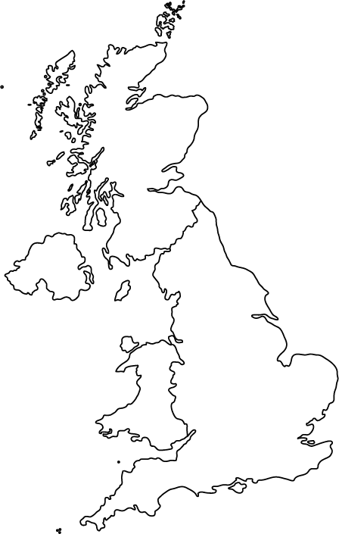
Society: Regional Issues
SCOTTISH BORDER
Hard to police (remote, inhospitable, lawless)
Border was split into three marches, with a warden for each
Henry had little time for border magnate families e.g. Percies and Dacres
Other option was to appoint outsiders
DURHAM
Durham was an English palatine (under separate jurisdiction), exercised by the bishop.
Act Resuming Liberties to the Crown (1536) reduced the level of independence enjoyed by the bishop, but did not destroy it completely.
COUNCIL OF THE NORTH
Problem to govern (Pilgrimage of Grace)
After the rebellion, HVIII and Cromwell re-established the council as a permanent body based in York with professional staff
Had administrative and legal functions
WALES
<1536 Wales was a separate territory, under English control
1536 Laws in Wales Act
Divided Wales into shire counties
Gave welsh shires direct representation in the Commons
Brough Wales into the same legal framework as England

Slide 30
Society: Rebellion (Pilgrimage of Grace)
Religious:
Dissolution of smaller monasteries (less of charitable/education functions; loss of parish churches; fear northern land would fall into the hands of southern; leader Robert Aske was a convinced supporter of monasteries).
1536 Injunctions were seen as an attack (discouraged celebration of Saints such as St. Wilfred; discouraged pilgrimages; rumours that church plate and jewels would be confiscated)
Secular
Resentment of taxation
Attempts to impose the Duke of Suffolk upon Lincolnshire
(Elton) courtly conspiracy prompted by councillors who supported Catherine of Aragon, who wanted Mary restoring as heir
CAUSES

Slide 31
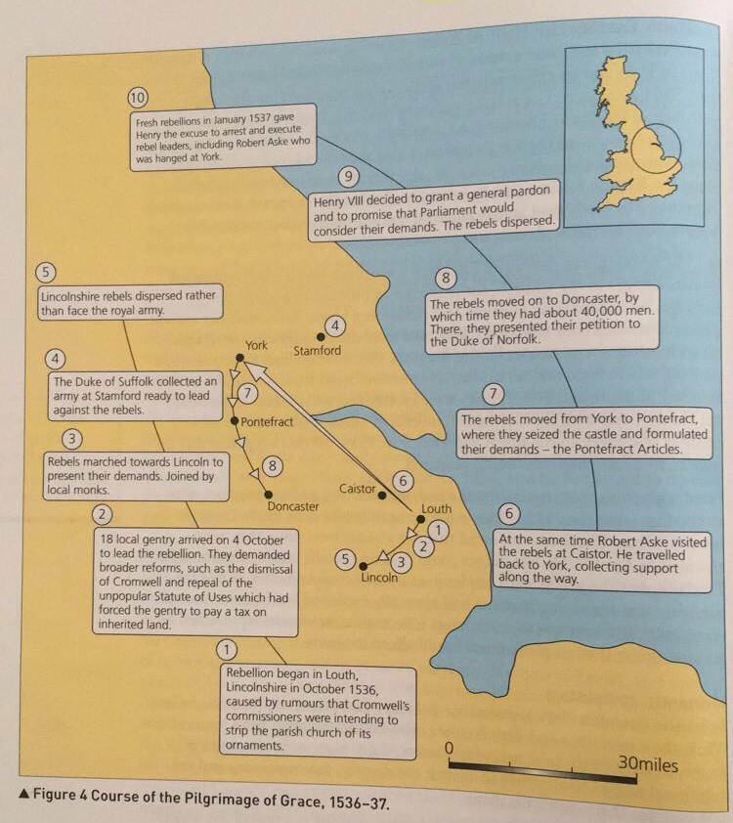
CONSEQUENCES
Most geographically wide-spread of the Tudor rebellions
Most popular in terms of participation
Henry was poor in how he handled the rebellion.
He was luck that the Duke of Norfolk showed common sense and was flexible.
CHRONOLOGY

Slide 32
Economy: Trade
Growth
Volume of English trade increased in the first half of the Sixteenth Century
Where
Leading route for exports were London to Antwerp. (Then cent to customers in Central Europe and the Baltic)
Profits
Profits did not always find their way to England (70% of cloth exports were transported by English merchants but much trade was in foreign hands before).
Cloth exports doubled; increased in export of hides and tins (esp. Cornish tin); mining industries grew
Market for raw wool declined
Increase in the importation of wine
This had a negative impact on other ports (e.g. Bristol, Hull and Boston)
Southampton boomed, especially because of trade with Venice (but this was short lived)
West riding of Yorkshire, East Anglia and West Country saw the greatest growth of the cloth industry.
Those who did make big profits also enhanced their social status. E.g. William Stumpe of Malmesbury became MP, and high sheriff for the county.

Slide 33
Economy: Exploration
Henry was uninterested in exploration and made no attempt to build on the earlier achievement of Cabot and the Bristol Merchants.
Robert Thorne (Bristol trader) continued his involvement in an Iceland and Newfoundland fishery, other merchants were unable to win royal support for the Venture.
Cabot remained in Spain for most of Henry’s reign apart from two short visits to England.

Slide 34
Economy: Prosperity and Depression
PROSPERITY
Population growth from 1525 Agricultural prices rose from the 1520s, which led to an increase in farming incomes. Debasement led to a short term artificial boom
DEPRESSION
Bad harvests (1520-1 and 1527-9), led to a temporary increase in food prices Food prices doubled across Henry’s reign Real wages declined for many (debasement impacted this) Assessment for subsidies led to urban poverty e.g. half of Coventry’s population had no personal wealth Growing unemployment amongst rural labourers Some were made homeless on account of engrossing (joining together 2+ farms) Population increase: Strain food supply + wages stagnated (cheap labour)
ENCLOSURE
Wolsey launched an enclosure commission Regional practice in this period (east Midlands) 1534: law to limit sheep ownership and engrossing

Slide 35
Power of the Monarchy
Break with Rome
Pilgrimage of Grace
Revolution in Government?
Foreign Policy
Economy
Smooth succession
Government
Foreign Policy
Sickly bystander?
Still in control?
Foreign Policy
Attempts to get the divorce
Wolsey
More
Cromwell
Factions
1509
1515
1529
1532
1540
1547

Slide 36
Tudor Exam Tips

Slide 37
Extract Questions
This is how the extract question will look in your exam

Slide 38
Extract Questions
Paragraph 1: The historians argument
Paragraph 2: Convincing argument 1
Paragraph 3: Convincing argument 2
Paragraph 4: Unconvincing argument 1
Paragraph 5: Unconvincing argument 2
Paragraph 6: Conclusion
1 hour = 3 sources
20 minutes per source

Slide 39
Extract Questions
Getting the high-grades!
Make sure your first paragraph outlines ALL arguments
Make sure you write down the full argument
Make sure your knowledge links to the argument you quote
Make sure you do not contradict yourself across the sources
Make sure you cover the years in the question

Slide 40
Essay Questions
This is how the essay questions will look in your exams

Slide 41
Essay Questions
Essays that have a reason in the question
E.g. ‘Foreign policy was the key reason for the consolidation of Henry VII’s authority’ Assess the validity of this view.
Introduction (define, criteria, judgement)
3 x paragraphs about the reason
3x paragraphs about other reasons
Conclusion
Essays that don’t have a reason in the question
E.g. ‘By 1509, Henry VII had successfully established his monarchical authority’ Assess the validity of this view
Introduction (define, criteria, judgement)
3 x paragraphs ‘for’
3x paragraphs ‘against’
Conclusion

Slide 42
Essay Questions
Getting the high-grades!
Cover all the years in the question (E grade if not!)
Make sure your knowledge is detailed (names, numbers)
Show that you understand key terms (e.g. Attainders)
In your explanation (PEEL), link back to your criteria!
Keep your argument consistent!
In your conclusion, acknowledge the problem at the heart of the debate/why this question is being asked
BE CONFIDENT! ☺ You are trying to give the impression that you are a Tudor expert, who knows the content and knows the answer – never write sentences that make you sound unsure!

Slide 43
General Revision Tips
Test yourself – if you just read your notes/copy them out, you will convince yourself you can remember it when you can’t
Look at past paper – use them to work on what you find hardest (evidence? Argument? Timing?)
Don’t cram all your revision the night before… It. Will. Not. Work.
Keep in mind that in the exam you will have to think, even if your dream topic comes up, you need to really read the question and what it is asking you to do with the information you know! (Long story short, you cannot memorise answers…)
Remember that whilst these few months will be super intense… it is short term! Make sure you keep in mind what you have lined up after college! ☺

Slide 44
Any Questions?

