Slide 1
Data presentation
Learning Aims:
To understand how to gain high marks in the data presentation section

Slide 2
Guidance
A variety of appropriate data presentation techniques have been employed, including at least two more complex techniques
There is evidence of ICT based techniques
Map representation is accurate (title, key, direction and scale)
Graph representation is accurate (title, units and labels on axes)
Photographs are fully annotated
Tables/graphs/maps/diagrams/statistics are integrated into the text

Slide 3
Types of data presentation
Simple
Satellite images
Word tables
Excel pie charts and bar graphs
Scanned field sketch
Imported information from the web
Complex
Annotated photos or satellite images
Overlays and base maps
Located proportional symbols or pie charts
Scatter graphs with line of best fit
Choropleth maps
Isolines

Slide 4
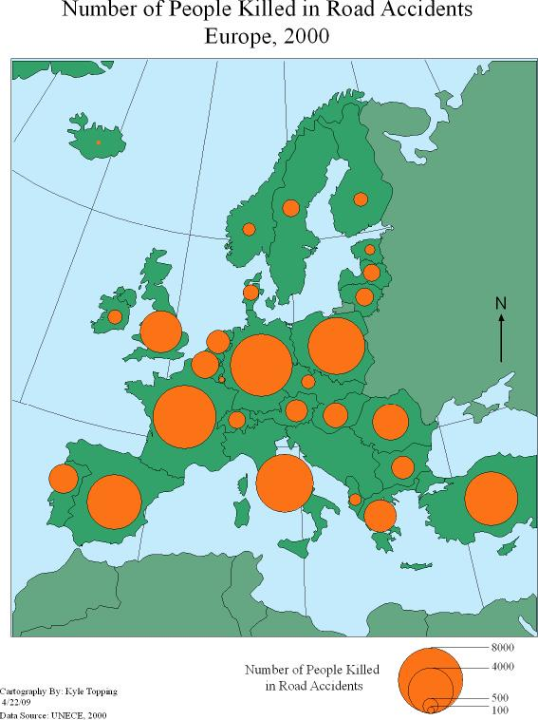

Slide 5
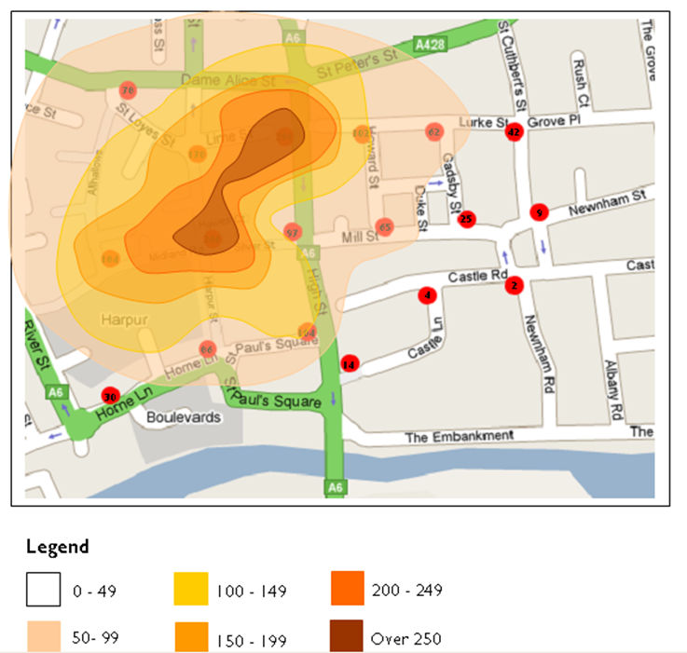

Slide 6
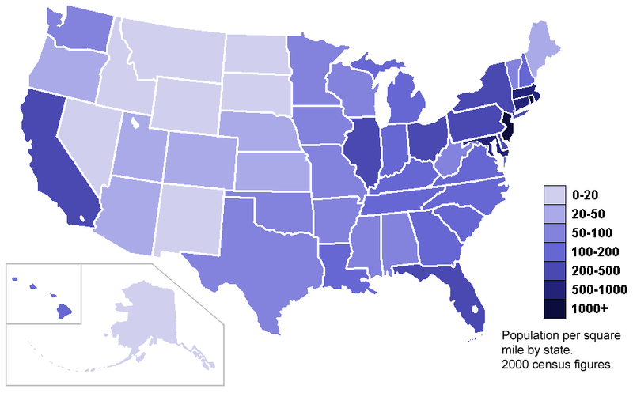

Slide 7
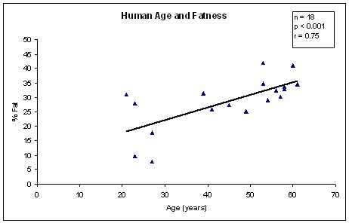

Slide 8
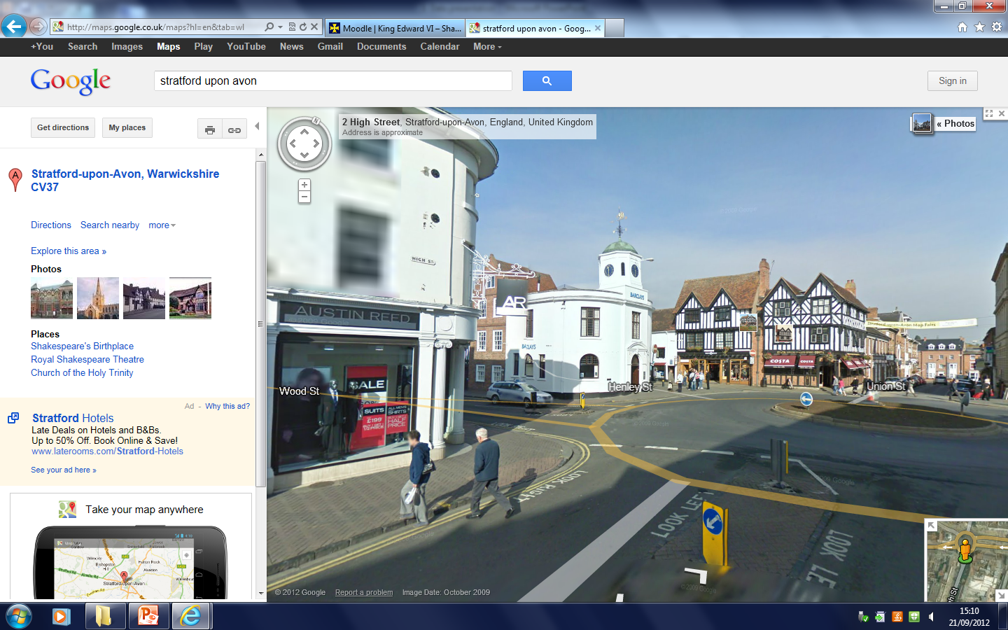

Slide 10
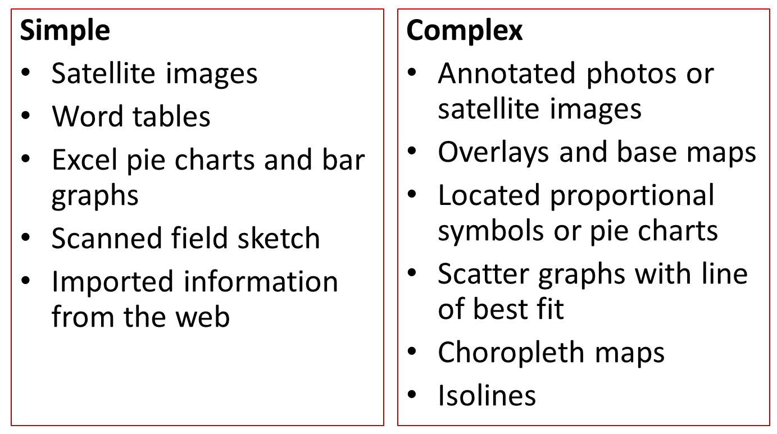
Complete the following table
Data | Presentation technique

