Slide 1
Starter: What if everyone heard voices?
Keywords
Delusions
Hallucinations
Avolition
Disordered thinking
Learning objectives:
To UNDERSTAND the clinical characteristics of schizophrenia (including being able to distinguish between positive and negative symptoms).
To KNOW there are debated different types of schizophrenia.

Slide 2
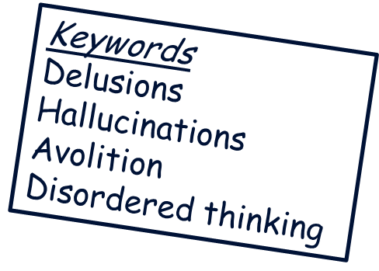
Some SZ myths…
Schizophrenics have multiple personalities (No that is MPD – possibly not even a disorder!)
Schizophrenics are all violent and dangerous. (A very small correlation between the disorder and violence).
Alcohol abuse makes you schizophrenic.
Learning objectives:
To UNDERSTAND the clinical characteristics of schizophrenia (including being able to distinguish between positive and negative symptoms).
To KNOW there are debated different types of schizophrenia.

Slide 3
What is it?
Watch the video.
“A profound disruption of cognition and emotion, which affects a person’s language, thought, perception of reality and sense of self.”
Learning objectives:
To UNDERSTAND the clinical characteristics of schizophrenia (including being able to distinguish between positive and negative symptoms).
To KNOW there are debated different types of schizophrenia.

Slide 4
Some SZ facts…
Affects about 1% of the population worldwide (but differences in prevalence rates in different countries).
Onset between 15 and 45.
Affects both men and women reasonably equally.
After 10 years, of the people diagnosed with schizophrenia:
- 25% Completely recover
-25% Much improved, relatively independent
-25% Improved, but require extensive support
- 15% Hospitalized, unimproved
- 10% Dead (suicide)
Learning objectives:
To UNDERSTAND the clinical characteristics of schizophrenia (including being able to distinguish between positive and negative symptoms).
To KNOW there are debated different types of schizophrenia.

Slide 5
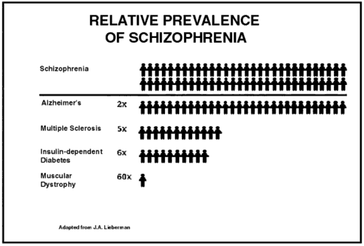
Some SZ facts…
Keywords
Delusions
Hallucinations
Avolition
Disordered thinking
Learning objectives:
To UNDERSTAND the clinical characteristics of schizophrenia (including being able to distinguish between positive and negative symptoms).
To KNOW there are debated different types of schizophrenia.

Slide 6
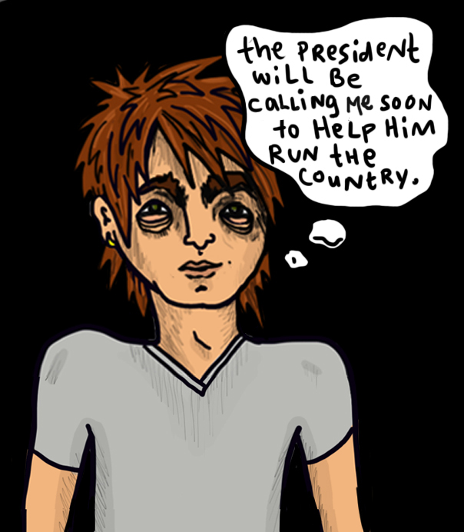
What are the key symptoms?
Watch the video.
Pick out:
The symptoms of SZ
The difference between positive and negative symptoms
How these impact on patients
Learning objectives:
To UNDERSTAND the clinical characteristics of schizophrenia (including being able to distinguish between positive and negative symptoms).
To KNOW there are debated different types of schizophrenia.
Notes:
What is schizophrenia video

Slide 7
What are the symptoms?
Positive symptoms
Negative symptoms
Excess of normal function.
(Behaviours additional to expected behaviour, and tend to concern loss of touch with reality).
Deficits of normal emotional responses or of other thought processes. (Behaviours missing from ‘normal’ expected behaviour . Tend to be more chronic).
Learning objectives:
To UNDERSTAND the clinical characteristics of schizophrenia (including being able to distinguish between positive and negative symptoms).
To KNOW there are debated different types of schizophrenia.

Slide 8
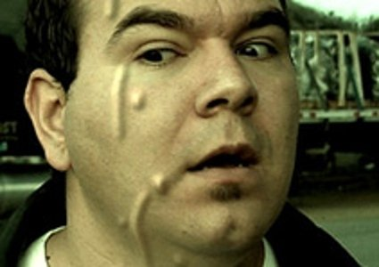
Positive Symptoms
Hallucinations
Bizarre, unreal perceptions of the environment
Auditory (hearing voices)
Visual (seeing lights, objects or faces)
Olfactory (smelling things)
Feeling things (e.g. bugs crawling under skin)
I hate you
Learning objectives:
To UNDERSTAND the clinical characteristics of schizophrenia (including being able to distinguish between positive and negative symptoms).
To KNOW there are debated different types of schizophrenia.

Slide 9
Positive Symptoms
Delusions
Beliefs which seem real to the person but are not
Paranoid delusions
Delusions of grandeur
Learning objectives:
To UNDERSTAND the clinical characteristics of schizophrenia (including being able to distinguish between positive and negative symptoms).
To KNOW there are debated different types of schizophrenia.

Slide 10
Positive Symptoms
Disordered thinking – belief that:
Thoughts inserted/withdrawn in mind
Thoughts being broadcast (to others in room, or via tv etc.)
You…
Learning objectives:
To UNDERSTAND the clinical characteristics of schizophrenia (including being able to distinguish between positive and negative symptoms).
To KNOW there are debated different types of schizophrenia.

Slide 11
Positive Symptoms
Experiences of being controlled– genuine belief that you are being controlled by something else. E.g. alien, computer etc.
Learning objectives:
To UNDERSTAND the clinical characteristics of schizophrenia (including being able to distinguish between positive and negative symptoms).
To KNOW there are debated different types of schizophrenia.

Slide 12
Negative Symptoms
Affective flattening
Reduction in range and intensity of emotional expression
Apparent in
Facial expressions
Voice tone
Eye contact
Body language
Learning objectives:
To UNDERSTAND the clinical characteristics of schizophrenia (including positive and negative symptoms..
To KNOW there are different types of schizophrenia.

Slide 13
Negative Symptoms
Speech poverty (alogia)
Loss of speech abilities
Speech lacks fluency
Lack of speech productivity
Excessively brief replies to questions
Reflects slow or blocking thoughts
Other issues with speech e.g.
Loose associations – Rapidly shifting from topic to topic, with no connection between one thought and the next.
Neologisms – Made-up words or phrases that only have meaning to the patient.
Perseveration – Repetition of words and statements; saying the same thing over and over.
Clang – Meaningless use of rhyming words (“I said the bread and read the shed and fed Ned at the head").
Learning objectives:
To UNDERSTAND the clinical characteristics of schizophrenia (including positive and negative symptoms..
To KNOW there are different types of schizophrenia.

Slide 14
Negative Symptoms
Avolition
Lack of goal-directed behaviour, enthusiasm and energy.
E.g. sitting in house for hours everyday doing nothing.
Learning objectives:
To UNDERSTAND the clinical characteristics of schizophrenia (including being able to distinguish between positive and negative symptoms).
To KNOW there are debated different types of schizophrenia.

Slide 15
To be diagnosed with SZ:
Two or more symptoms must be apparent for more than a month.
Need to have an impact on functioning e.g. social functioning.
Learning objectives:
To UNDERSTAND the clinical characteristics of schizophrenia (including being able to distinguish between positive and negative symptoms).
To KNOW there are debated different types of schizophrenia.
Notes:
https://www.youtube.com/watch?v=LB84Cf6nmbo - SZ case study

Slide 16
Type 1 = Acute SZ characterised by majority positive symptoms and improved likelihood of recovery.
Type 2 = Chronic SZ characterised by equal, or predominant negative symptoms and poorer likelihood of recovery.
Learning objectives:
To UNDERSTAND the clinical characteristics of schizophrenia (including being able to distinguish between positive and negative symptoms).
To KNOW there are debated different types of schizophrenia.
Notes:
https://www.youtube.com/watch?v=LB84Cf6nmbo - SZ case study

Slide 17
Task
Identify which clinical symptoms this patient is exhibiting.
Learning objectives:
To UNDERSTAND the clinical characteristics of schizophrenia (including being able to distinguish between positive and negative symptoms).
To KNOW there are debated different types of schizophrenia.
Notes:
https://www.youtube.com/watch?v=LB84Cf6nmbo - SZ case study

Slide 18
Different subtypes…
Paranoid schizophrenia
Disorganised schizophrenia
Catatonic schizophrenia
Undifferentiated schizophrenia
However, DSM-V-TR has recommended that the subtypes not be included in the new edition.
Why do you think this is?
Learning objectives:
To UNDERSTAND the clinical characteristics of schizophrenia (including being able to distinguish between positive and negative symptoms).
To KNOW there are debated different types of schizophrenia.

Slide 19
Watch the TED talks by a schizophrenic patient, now training as a psychiatrist.
Learning objectives:
To UNDERSTAND the clinical characteristics of schizophrenia (including being able to distinguish between positive and negative symptoms).
To KNOW there are debated different types of schizophrenia.

Slide 20
Clinical characteristics charades…
You will be split into two teams.
Each team must nominate one person to come to the front to pick up a card and act out the clinical characteristic on the card. Their team must try to guess as many characteristics as they can in 1 minute.
There will be three rounds…
(Rule: you can’t use the same charade twice, and you can’t say anything like ‘the one that Dave did last …’)
Learning objectives:
To UNDERSTAND the clinical characteristics of schizophrenia (including being able to distinguish between positive and negative symptoms).
To KNOW there are debated different types of schizophrenia.

Slide 21
Home learning
1. Watch the video at:
http://www.learner.org/vod/vod_window.html?pid=788 (on the moodle), and answer the following questions.
What is the role of dopamine in causing SZ (the ‘dopamine hypothesis’)?
What evidence is there for this?
What evidence is there for a genetic factor in causing SZ?
What sort of factors sometimes ‘trigger’ the onset of SZ in people with a genetic predisposition for it?
What is the ‘schizophrenergic mother’ and ‘schizophrenergic family’? How is this theorised to contribute to explaining SZ?
What evidence is there for the effectiveness of anti-psychotics in treating SZ? What strengths and limitations are there of antipsychotics?
What psychological therapies are there for SZ?
2. Listen to the two following podcasts at a time when you’re not doing much else e.g. driving/walking:
http://www.stuffyoushouldknow.com/podcasts/how-schizophrenia-works/
‘All in the mind’ podcast on SZ (on the moodle course).
Learning objectives:
To UNDERSTAND the clinical characteristics of schizophrenia (including being able to distinguish between positive and negative symptoms).
To KNOW there are debated different types of schizophrenia.

