Slide 1
A Level D&T: Product Design
Design styles and movements

Slide 2
What do you need to know?
Students should be aware of, and be able to discuss, key design styles and movements and their principles of design, including:
Arts and craft movement
Art Deco
Modernism, eg Bauhaus
Post modernism, eg Memphis.

Slide 3
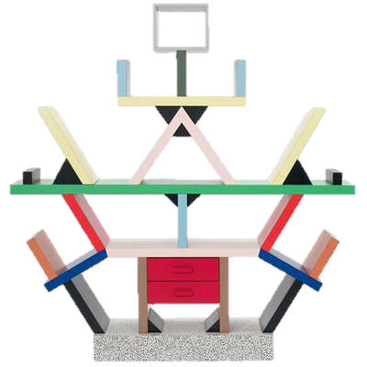
Arts and Crafts / 1885- 1900 / William Morris
Art Nouveau / 1890- 1910 / Charles Rennie Mckintosh
Bauhaus / 1917- 1933 / Walter Gropius
Art Deco / 1920 – 1930 / William Van Alen
American Streamlining/ 1928 – 1955 / Raymond Lowey
Modernism/ 1930 – 1970 / Harry Beck
Postmodernism/ 1970 – 1990 / Ron Arrad

Slide 4
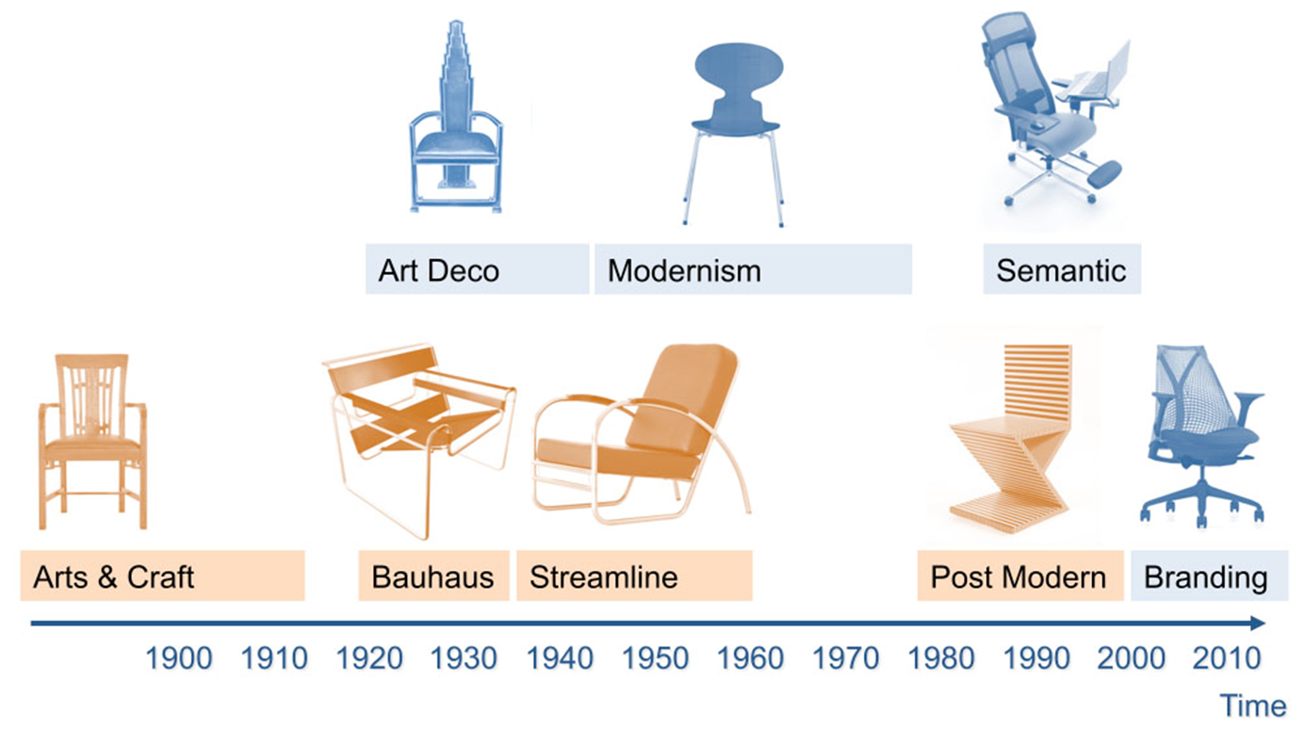

Slide 5
Arts and craft movement
The Arts and Crafts Movement began in Britain around 1880 and quickly spread to America, Europe and Japan.
Inspired by the ideas of John Ruskin and William Morris
It advocated a revival of traditional handicrafts, a return to a simpler way of life and an improvement in the design of ordinary domestic objects.

Slide 7
Art Deco
Art Deco, also called style moderne, movement in the decorative arts and architecture that originated in the 1920s and developed into a major style in western Europe and the United States during the 1930s.
William Van Alen, Clarice Cliff
It is a style of drawing, that relies on bold designs, clear lines, vibrant colours and patterns.
Geometric shapes and intense colour schemes are prominent.

Slide 8
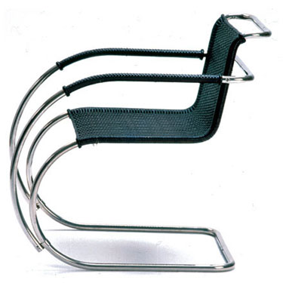
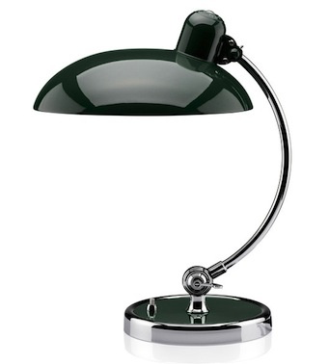
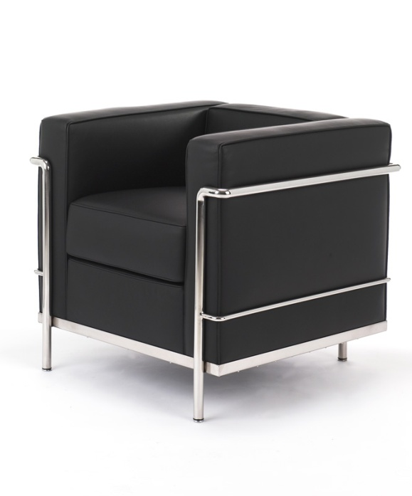
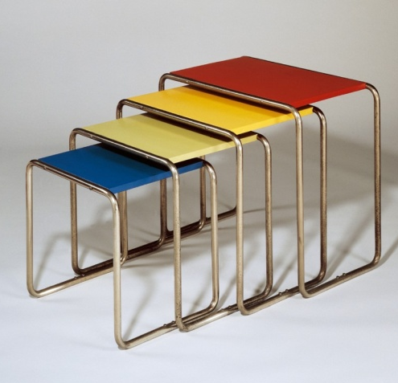
Task
Modernism
BAUHAUS (1919 – 1933)
Modernist movement was influenced by industrial designs and made use of geometric shapes.
• It produced the first design for mass production.
• It was the origin of many ‘design classics’
Famous Designer: Marcel Breuer – Wassily Chair
In 1919 a new Art, Design and Architecture School was formed, called the Bauhaus. Even today its name is synonymous with quality design. The School moved to the distinctive ‘Bauhaus’ building in 1926 (Dessau, Germany) where it influenced the design of everyday products, developing into an international art movement.

Slide 9
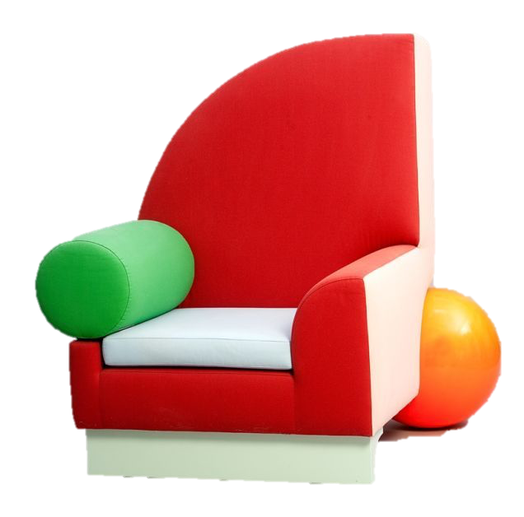
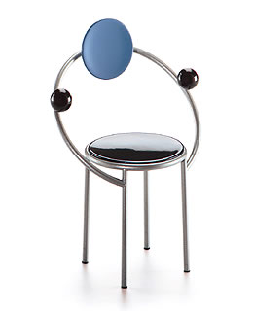
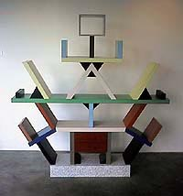
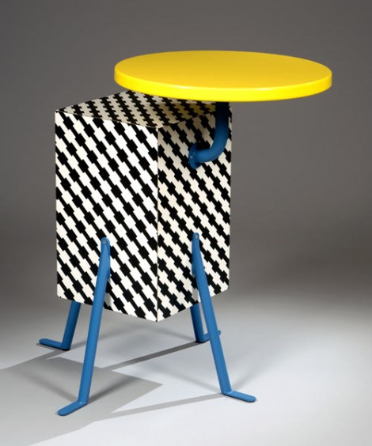
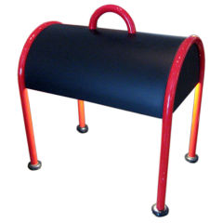
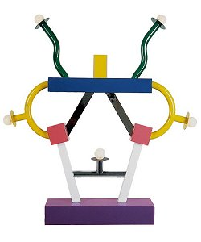
Post Moderism
Memphis 1980's
The Memphis group comprised of Italian designers and architects who created a series of highly influential products in the 1980's. They disagreed with the conformist approach at the time and challenged the idea that products had to follow conventional shapes, colours, textures and patterns.
Famous Designer: Ettore Sottsass

Slide 10
Designers and their work
Students should be aware of, and be able to discuss, the work of influential designers and how their work represents the principles of different design movements, including:
Phillipe Starck
James Dyson
Margaret Calvert
Dieter Rams
Charles and Ray Eames
Marianne Brandt

Slide 11
Activity
Produce a 5 minute presentation on a specific designer
Include background info about the designer
Where possible link the designers work to a specific ‘movement’
Include images of key work the designer produced
Discuss how their work continues to be an influence today

Slide 12
Useful Resources
BBC The Genius of Design
https://designmuseum.org/

