Slide 1
Which is your favourite shade of blue?

Slide 2
Simultaneous Contrast - Two colours, side by side, interact with one another and change our perception accordingly.

Slide 3
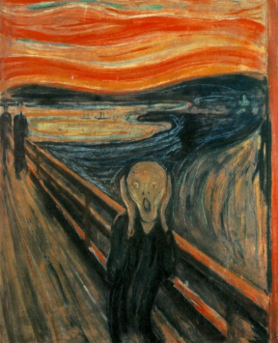
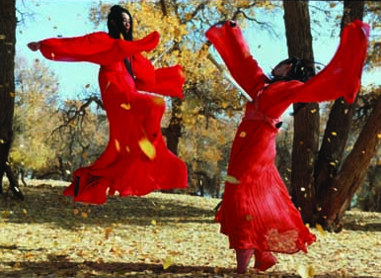
Colour Theory

Slide 4
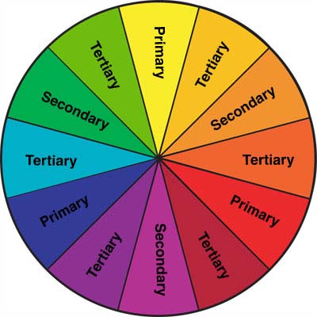

Slide 5
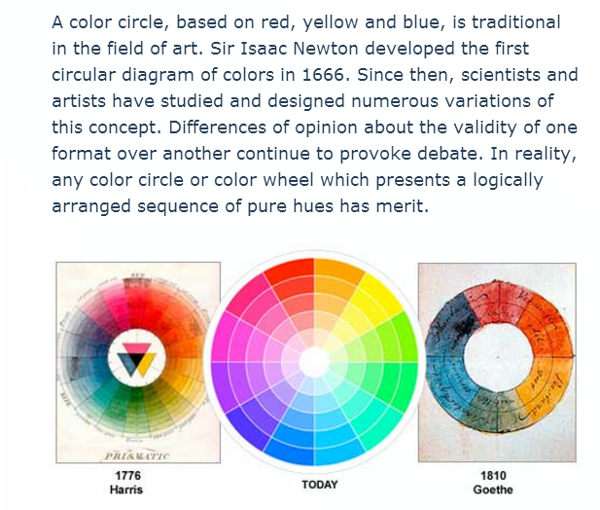
The whole colour wheel

Slide 6
Enquiry question: How can I create the other colours on the colour wheel using combinations of the three primary colours?
Lesson objective: to explore colour mixing to create samples that can be used to make a double page that shows your understanding of colour theory.
Rules:
Work on your A3 sheet with control leaving space around each experiment so that they don’t merge together.
Only use 2 colours at any one time (one of these may be a secondary colour you have mixed).
In pencil note down under each experiment which colours you mixed + amounts and what instrument you used to mix them.

Slide 7
Challenge 1
Mix green, orange and purple.
Extension challenge: How can you make brown?

Slide 8
Challenge 2
Make as many colours off the colour wheel as possible, just from primary watercolours.
Combine them in them is the most interesting and unique way you can think of!
Extension challenge: How can you make brown?

Slide 9
Reflecting on what we have discovered
What colours have we created when mixing two primary colours together? Why is ratio important here?
What is a tertiary colour?
Using your knowledge of colour mixing how is the colour wheel designed to be used?
PRIMARY SECONDARY TERTIARY TINT HUE SHADE TONE

Slide 10
COMPLETE THE FOLLOWING DEFINITIONS
A PRIMARY COLOUR IS….
A SECONDARY COLOUR IS….
A TERTIARY COLOUR IS….
A TINT IS….
A HUE IS….
A SHADE IS….
A TONE IS…..

