Slide 1
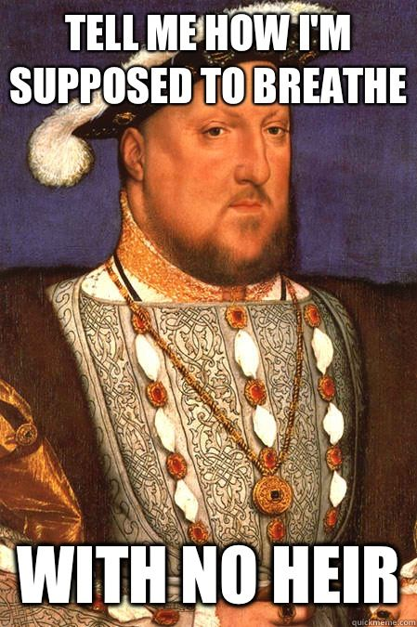
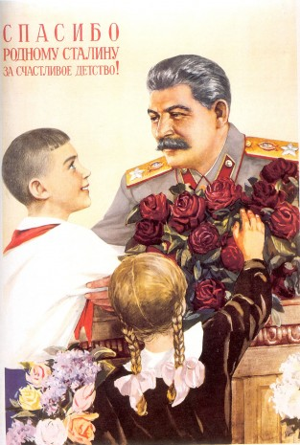
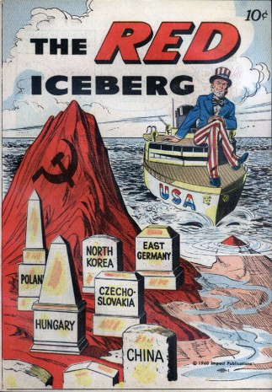
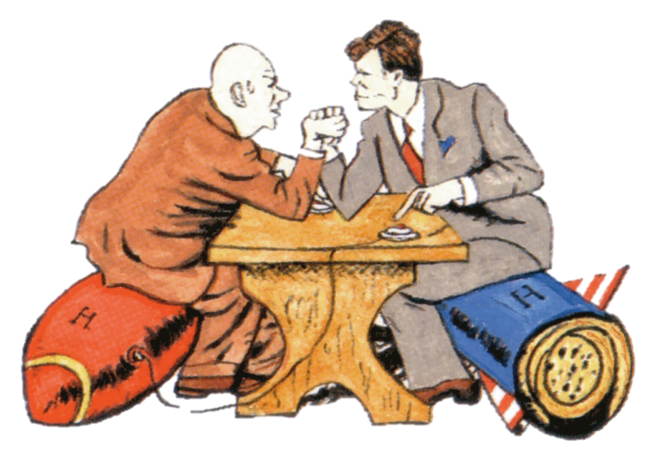
Welcome to
A level History
Notes:
Lesson One

Slide 2
Why do we study History?
It teaches you how ideas, beliefs, decisions and actions have shaped events in the past.
History deals with big issues e.g. racism, power, war, politics, discrimination & terrorism
To develop the TRANSFERABLE SKILLS employers want
Because it is enjoyable, interesting and thought provoking!

Slide 3
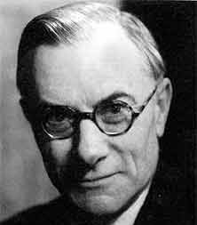
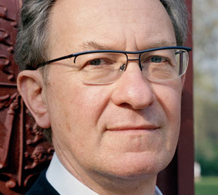
What is the purpose?
“…detect when a man is talking rot.” John Alexander Smith
“…the facts of history are nothing, interpretation is everything.” E.H. Carr
“Our history binds us together as a distinctive community in an otherwise generically globalized culture”
Simon Schama

Slide 4
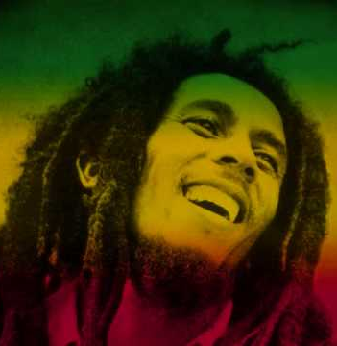
What is the purpose?
If you know your history, Then you would know where you coming from …
Bob Marley

Slide 5
What skills will you develop?
Research skills
Excellent Communication & writing skills
How to handle & analyse data
How to construct an argument
How to organise information
Problem-solving
How to select evidence
The ability to question how useful sources are

Slide 6
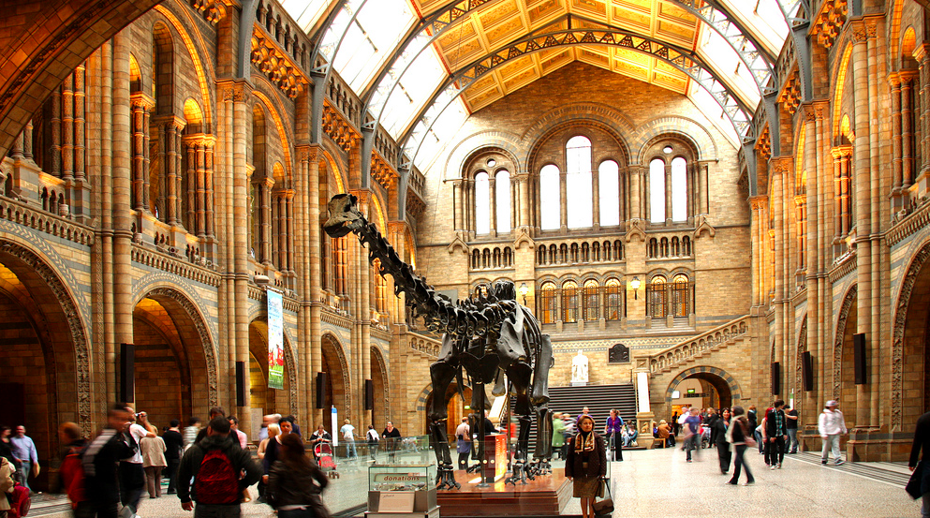
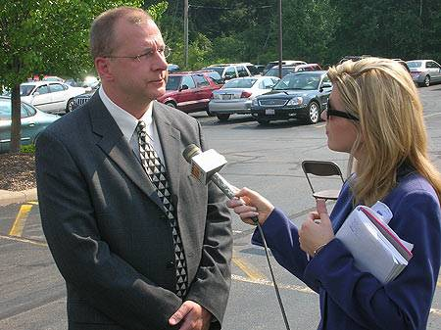
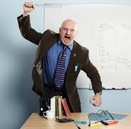
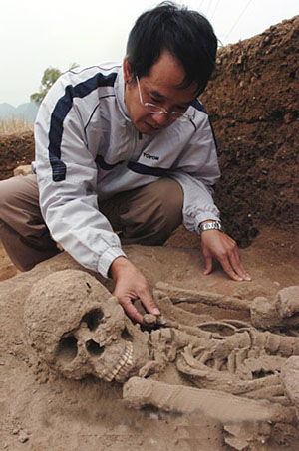
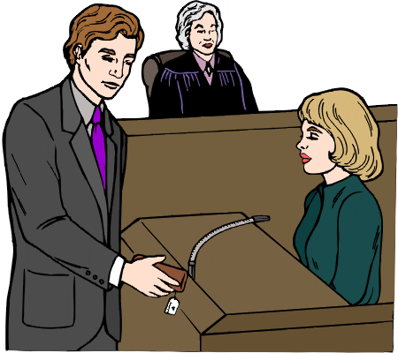
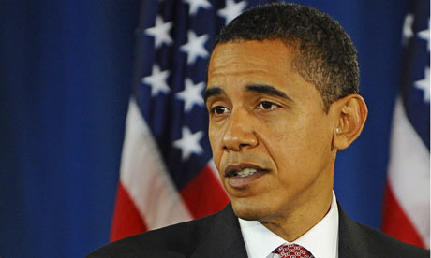
History related jobs
Journalist/reporter
Museum/gallery worker
Archivist
Teacher
Lawyer/
barrister
Historian/ lecturer
Politician
Archaeologist

Slide 7
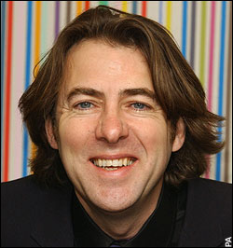
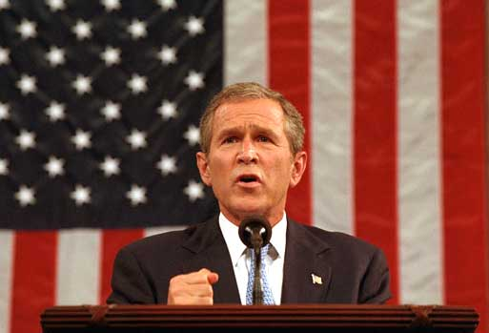
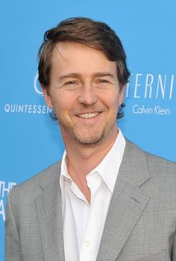
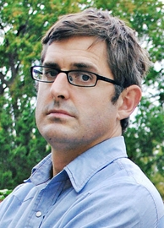
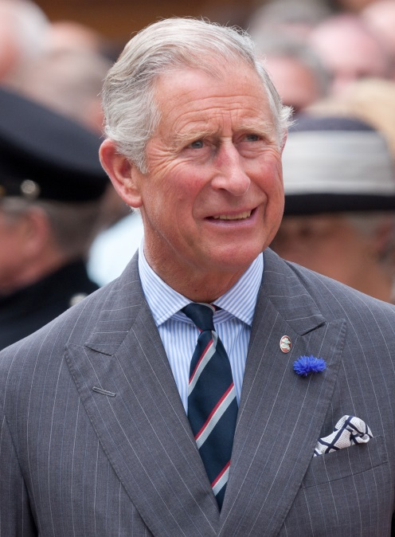
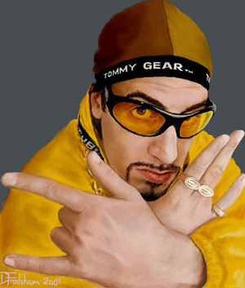
Famous History graduates
Notes:
Jonathon Ross, Prince Charles, George Bush, Sacha Baron-Cohen, Gordon Brown, Louis Theroux, Edward Norton

Slide 8
What will you need to do to be successful at A level?

Slide 9
Takes an active role in the class.
Completes homework on time to the highest standard.
Ask questions and revises topics at home.
Does EXTRA READING
Meets deadlines, gets organised.
Could have put that bit more work in.
A* | 90%
A | 80%
B | 70%
C | 60%
D | 50%
E | 40%
F | 30%
Wastes time in lessons and after school and during free periods.
Waits until two weeks before the exam before considering there might be work to do and leaves worrying about revision until the night before.

Slide 10
Be disciplined!
Keep well-organised notes
Be prepared to do much of the reading for lessons outside the class
As you move ever close to undergraduate work, be prepared to go that extra mile and use resources in the department, school or local public libraries
Look out for relevant news items or documentaries that discuss the Cold War and its aftermath
Visit museums (Imperial War Museum, which has an excellent Cold War section, the Science Museum – good on the Space Race)
Meet homework deadlines.

Slide 11
Keep your folders organised!
It will help you to categorise the following in your folders:
a section for your class notes
a section for your homework/additional note taking
a glossary of keywords that you come across during the course.
a ‘who’s who’ of key figures
a map of key events of the Cold War
a timeline of key events

Slide 12
Course outline
Breadth Study The Tudors: England 1485-1603
Assessed Written exam: 1 hour 30 minutes Two questions (one compulsory) 50 marks 50% of AS
Questions Two sections Section A – one compulsory question linked to interpretations (25 marks) Section B – one question from two (25 marks)
Depth Study The Cold War, c.1945-1991
Assessed Written exam: 1 hour 30 minutes Two questions (one compulsory) 50 marks 50% of AS
Questions Two sections Section A – one compulsory question linked to primary sources contemporary to the period (25 marks) Section B – one question from two (25 marks)

Slide 13
To the brink of Nuclear War: international relations c.1945-1963

Slide 14
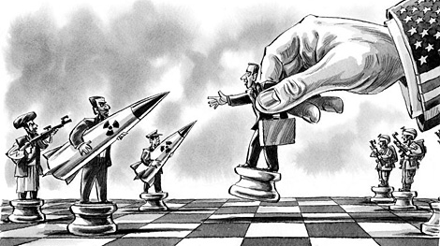
To the brink of Nuclear War
Introduction to the Cold War
Learning objectives
State what I will be covering during year 12.
Recall key events of the Cold War.
Consider why the Cold War begun.

Slide 15
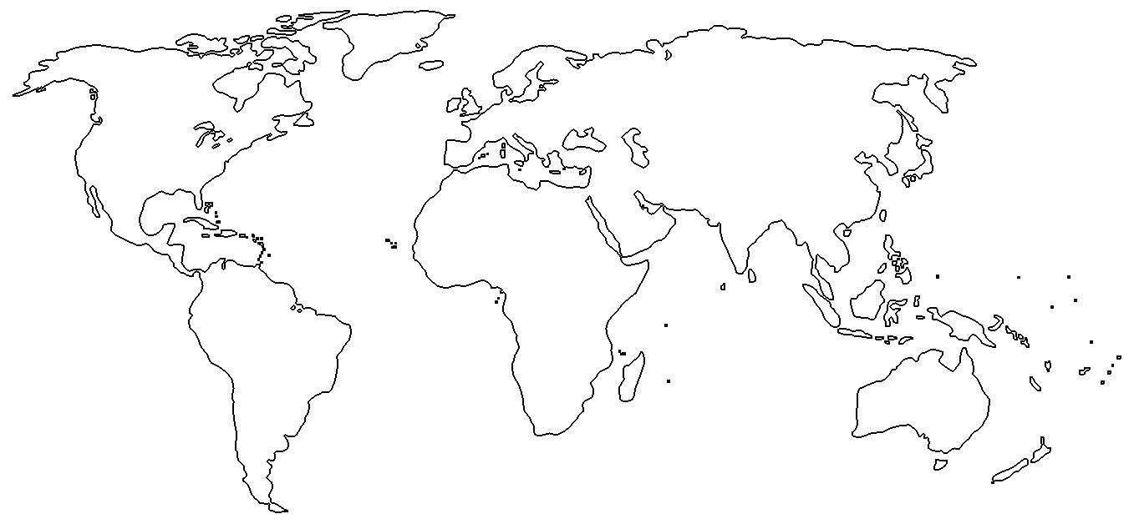
Starter
Brainstorm nations around the world that have been hot spots of tension in the late 20th and early 21st centuries.
 Why do you think this has been the case?

Slide 16
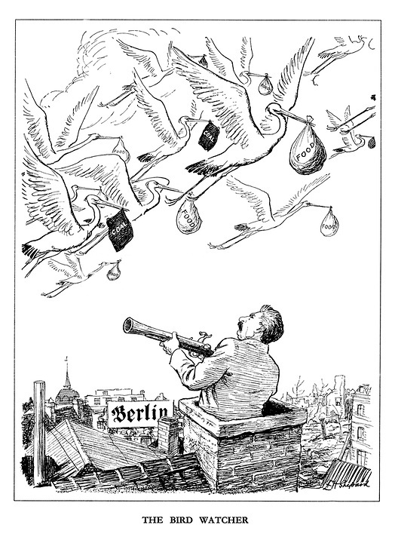
Your task: Examine the primary and secondary source, dates and documents relating to the Cold War. Consider what the sources show and what chronological order you would place them in.

Slide 17
Plenary 
A new facts about the Cold War.
A key words you have learned
Is the Cold War too recent to be studied in depth by historians?

