Slide 1
Recap: Ideological differences between East and West
 | Communism (Soviet Union) | Capitalism (USA and Britain)
Politics
Economics
Social structure
Rights
Communism
Capitalism

Slide 2
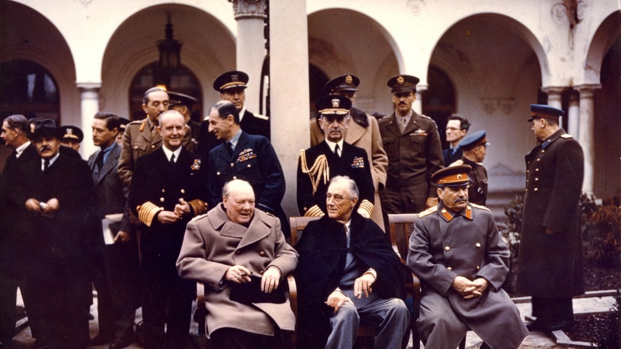
How far did conflicting ideologies impact the conferences (1943-45)?

Slide 3
- Identify evidence of rising tensions at the wartime conferences - Recall what contributed to worsening tensions in the years 1943-45 - Judge how far conflicting ideologies created tensions within the Grand Alliance

Slide 4
‘The tensions that existed within the Grand Alliance by the end of 1946 were the result of conflicting ideologies.’ Explain why you agree or disagree with this view.

Slide 5
Key words
Grand Alliance:
A strategic war alliance between America, the USSR and the UK to defeat Germany. Created in 1941 and ended by 1946.
Sphere of influence:
An area seen as under the control or political or economic influence of a nation
Ideology:
A system of ideas/beliefs that form the bases of economic and/or political theory and policy

Slide 6
“Thus the story of the Cold War was the story of boundaries, establishing the outer limits of each sphere of influence and competing for those who had not yet pitched their tents in one camp or another.” Engerman p.33

Slide 7
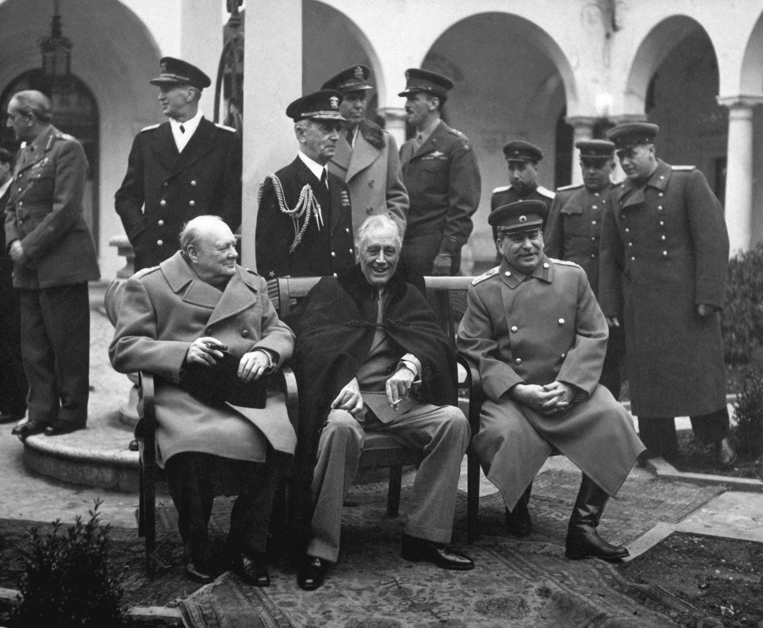

Slide 8
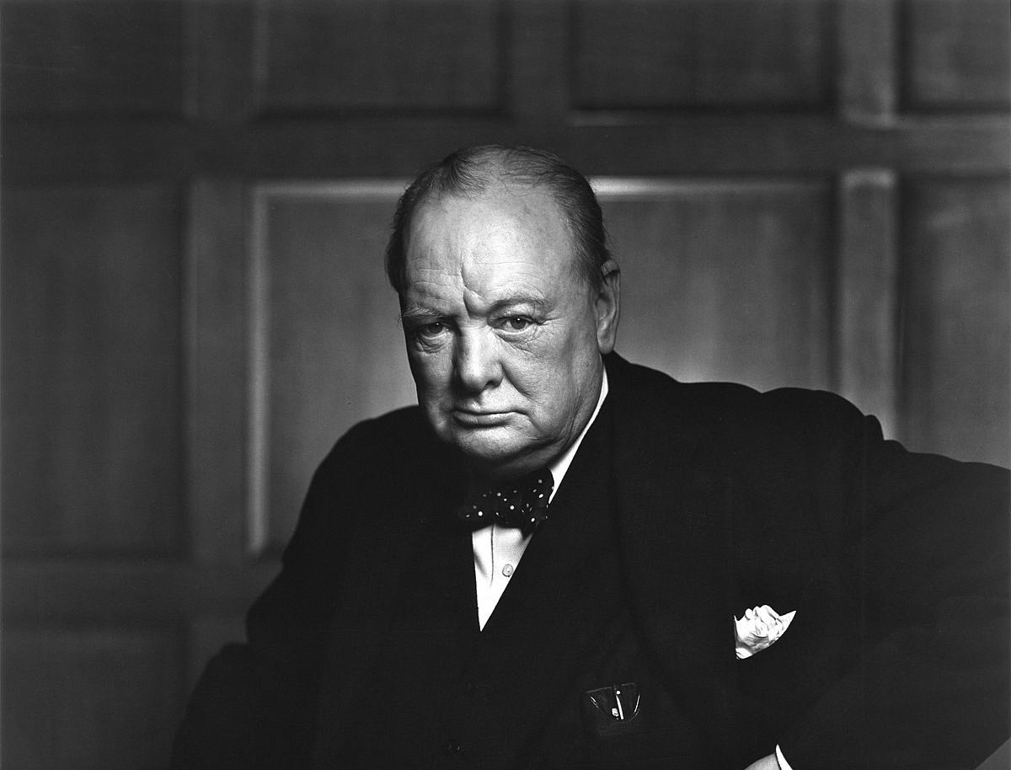
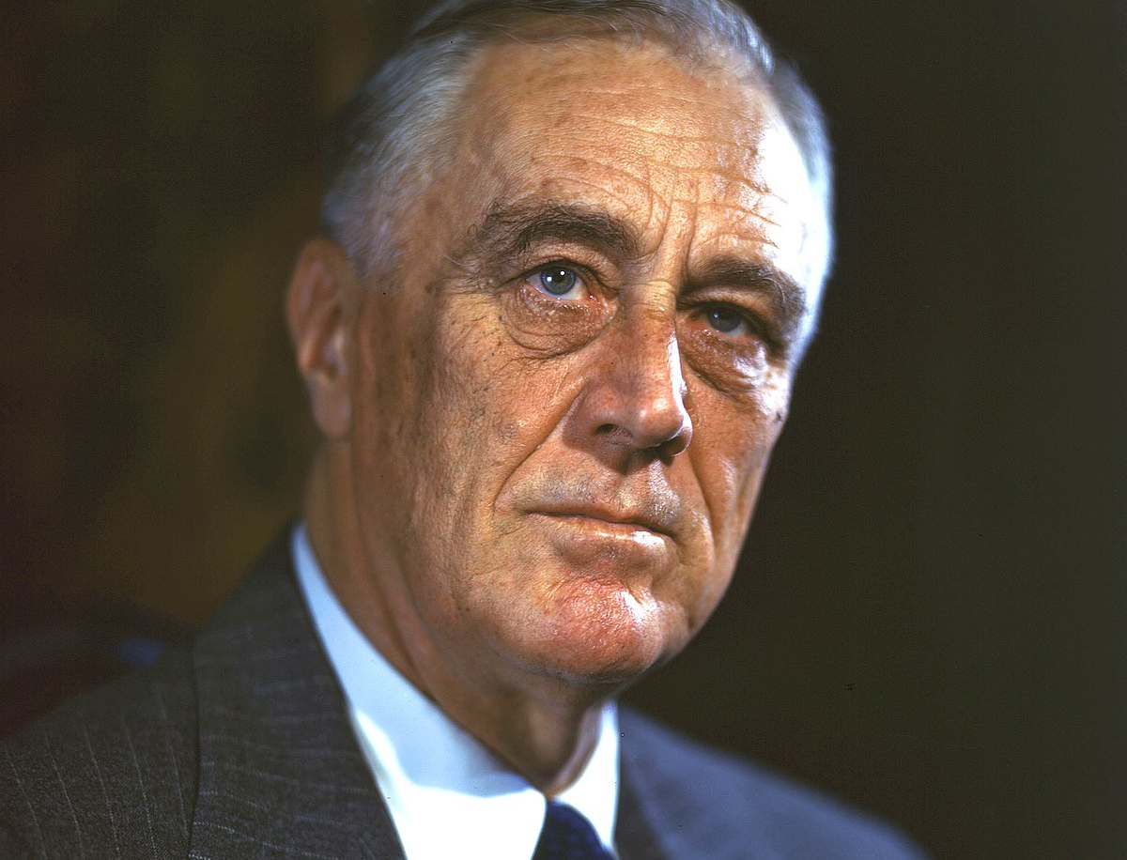
What did the ‘Big Three’ want?
Churchill wanted to preserve the British Empire.
The USSR wanted compensation for their losses, land, the elimination of German dominance and a security buffer.
American goals focused on ending authoritarian regimes and keeping the UK & USSR in the war against Japan.

Slide 9
Why might they disagree??

Slide 10
The Atlantic Charter (1941)
In August 1941, Roosevelt and Churchill met to consider the dangers arising from Nazism and considered goals for the post-war world.
It stated that signatories would not seek territorial gain from any war.

Slide 11
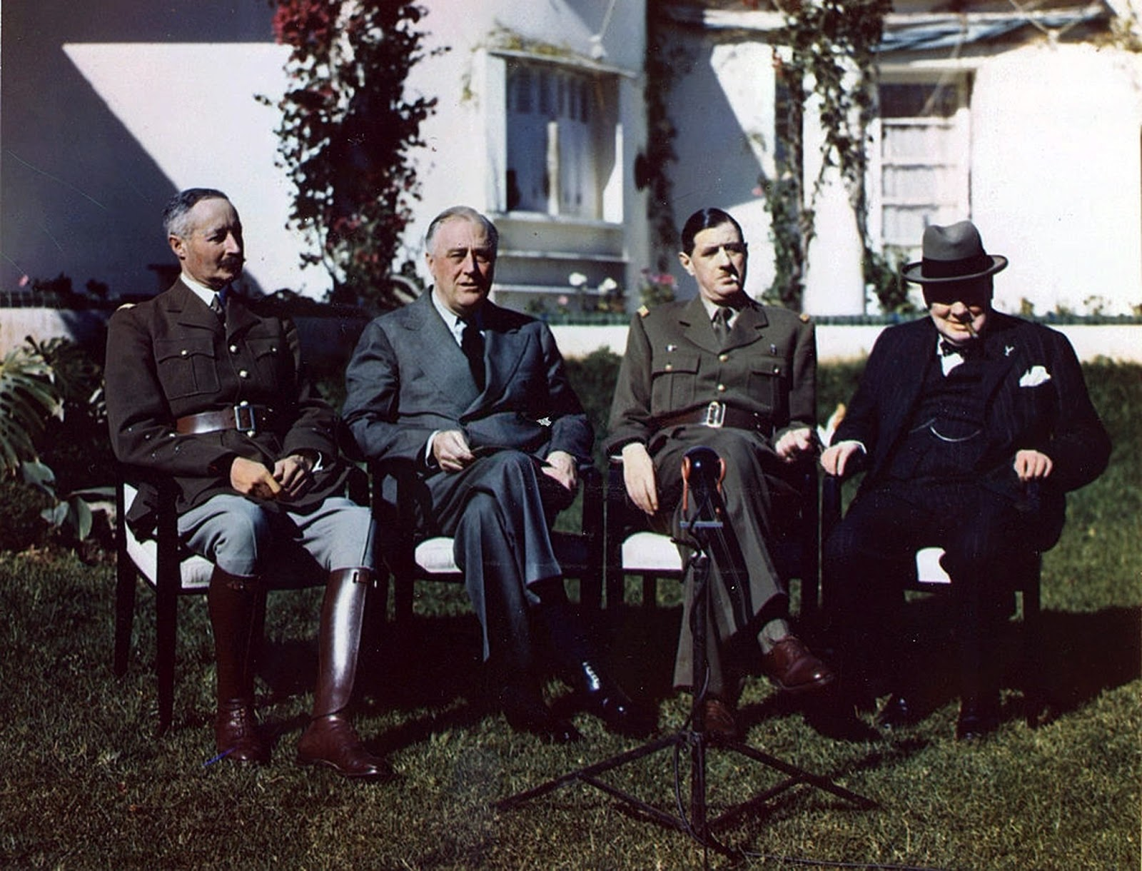
Casablanca (January 1943)
A key outcome was the unconditional surrender of the Axis powers.
A bone of contention was the location of the second front.
In the year after, Stalin was convinced the allies were deliberately slowing to weaken the Red Army.

Slide 12
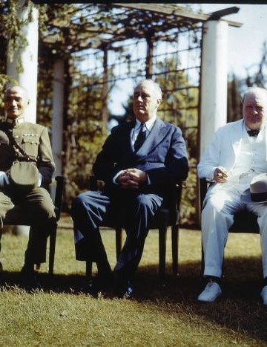
Cairo (22-26 November 1943)
Churchill and Roosevelt met with Chinese leader Jiang Jieshi to discuss war against Japan.
They identified China as one of the four major post-war powers.
The Cairo declaration ended with an agreement on the following goals:
Continue the war against Japan
Insist upon unconditional surrender
Remove Japan from the lands it conquered
Restore Japan to its 1894 frontiers before the Sino-Japanese war
Agree to no allied acquisition of land on mainland Asia or in the Pacific Islands.

Slide 13
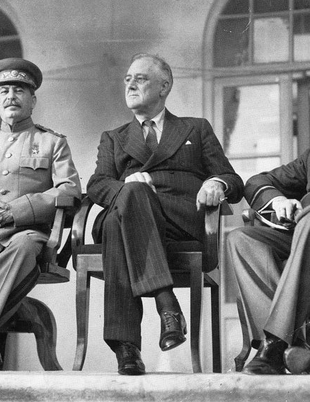
Tehran Conference (28 Nov-1 Dec 1943)
Discussions were dominated by coordinating the next phase of the war.
Stalin agreed he would declare war on Japan after German defeat but wanted compensation (Kurile Islands, Sakhalin Island, access to Dairen and Port Arthur).
Stalin insisted the USSR be restored to its 1941 borders (moving Poland’s borders West).
The powers agreed to compensate Poland with German territory. The Oder and Neisse rivers were chosen as new Polish frontiers, ratified at Potsdam.

Slide 14
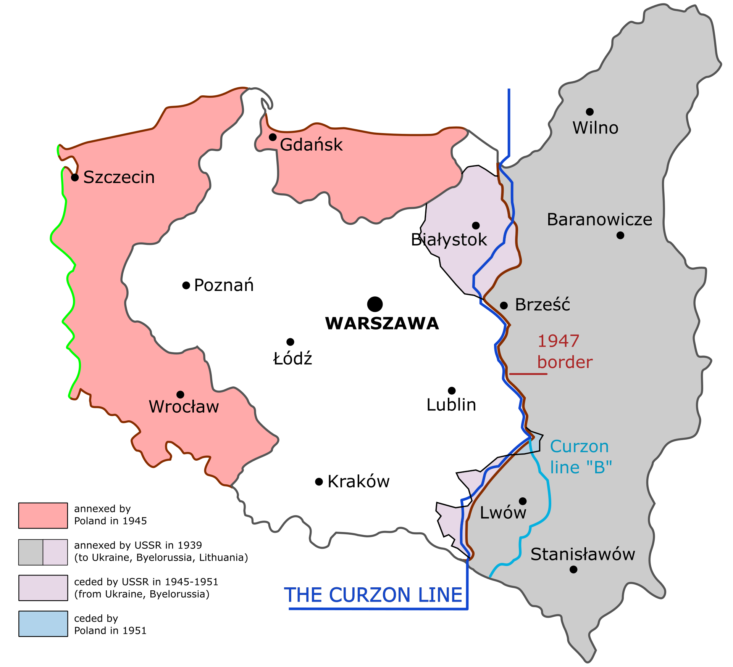

Slide 15
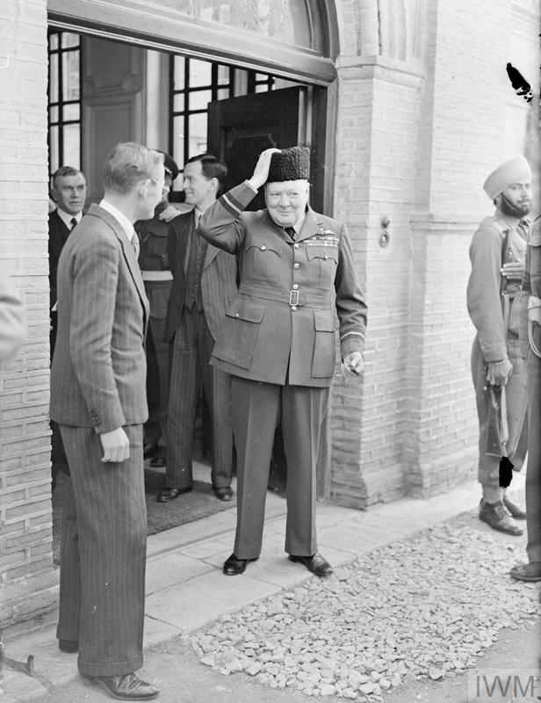
Tehran Conference
The Baltic states Estonia, Latvia and Lithuania would become part of the USSR if they agreed in a referenda (Stalin wanted this to be without international oversight!)
There would be an advisory commission to consider dividing Germany.
The idea of a new international organisation was forwarded.

Slide 16
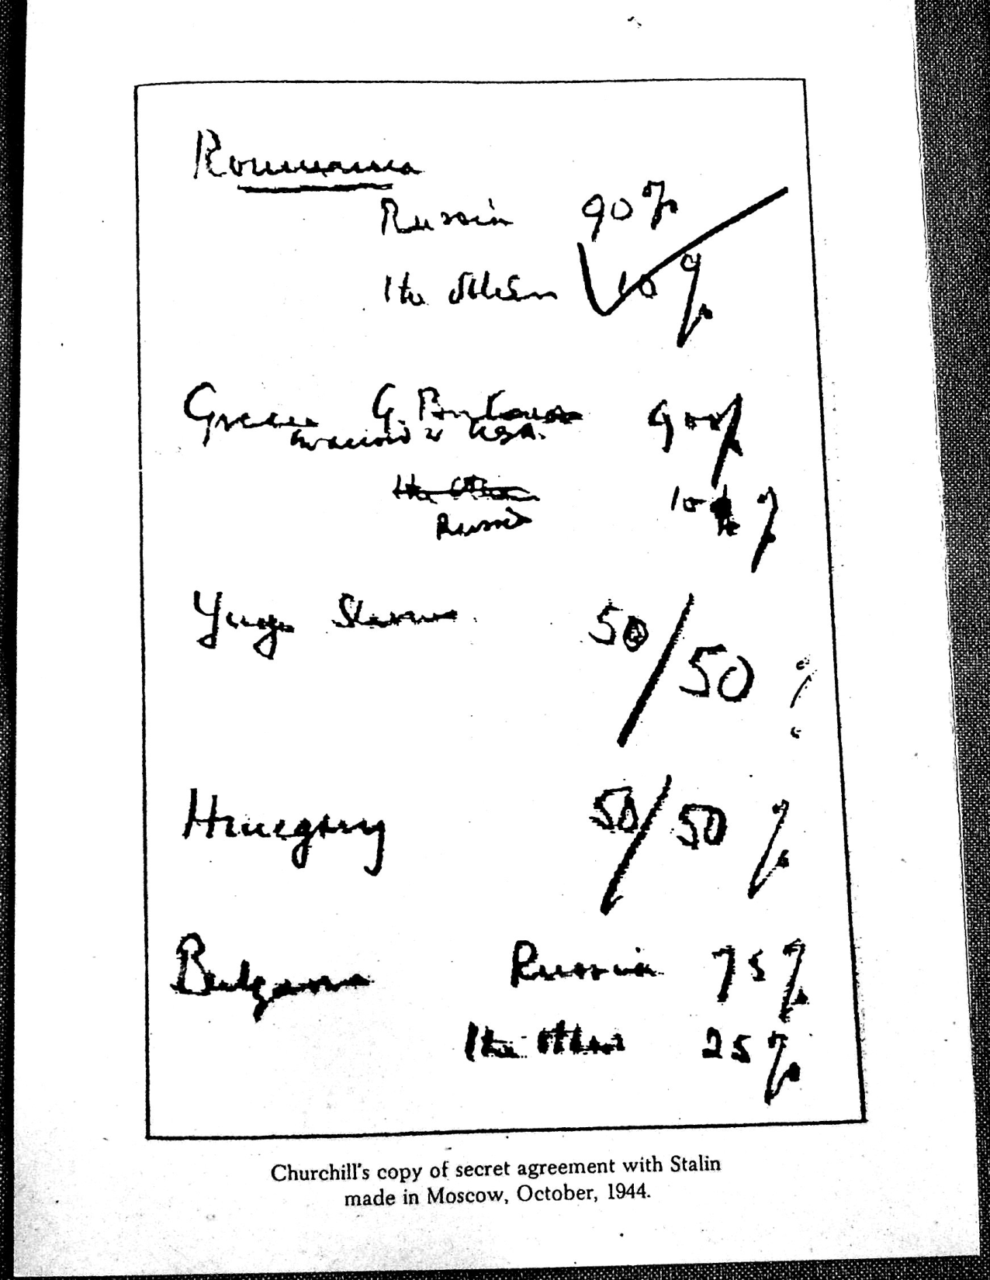
The Percentages Agreement (1944)
In private conversations, Churchill and Stalin arrived at an arrangement regarding ‘spheres of influence’ in south-eastern Europe.
This was penned by Churchill on a napkin and checked off my Stalin in a sign of agreement.
The US ambassador was not included in the conversation and was only informed of its contents later.

Slide 17
Task
Working in groups of 3 (wherever possible) you will each be given a leader to consider.
You will need to familiarise yourselves with their standpoint.
Complete the tasks outlined
If anyone is feeling brave, we could conduct a role play at the end!

Slide 18
Establishing the UN
The mandate and composition was discussed repeatedly at Tehran and Moscow.
All agreed It should be an international peacekeeping body.
The principle bodies established were:
General Assembly, which could discuss any issue of international importance
Security Council, charged with preventing war and limiting international conflict
International Court of Justice to mediate disputes
Economic and Social Council.

Slide 19
Establishing the UN
The Security Council was made up of the UK, USSR, USA, China and France.
These five permanent members were given the power of veto in matters of security.
Member states agreed to place some of their armed forces at the disposal of the SC.
The UN represented 80% of the world’s population.
The Charter was ratified when the UN opening in NY on 24th October 1945.

Slide 20
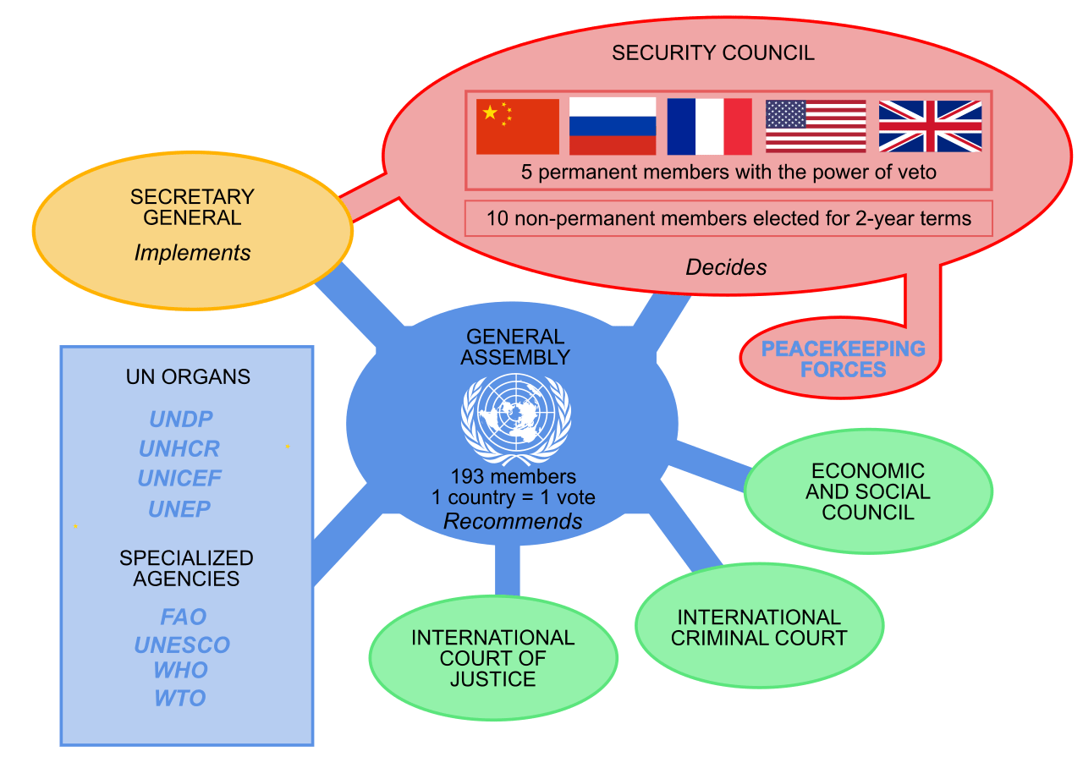

Slide 21
Yalta Conference (Feb 1945)
The Declaration of Liberated Europe committed the Big Three to adhering to:
democratic processes
promoting economic recovery in Europe
pursuing anti-Nazi policies and
helping liberated countries in establishing provisional governments.
Germany was to be divided into four zones (France was included but their zone would come out of the British and American zones).
Agreed Germany had to pay reparations in kind and the German leadership would be put on trial for war crimes.

Slide 22
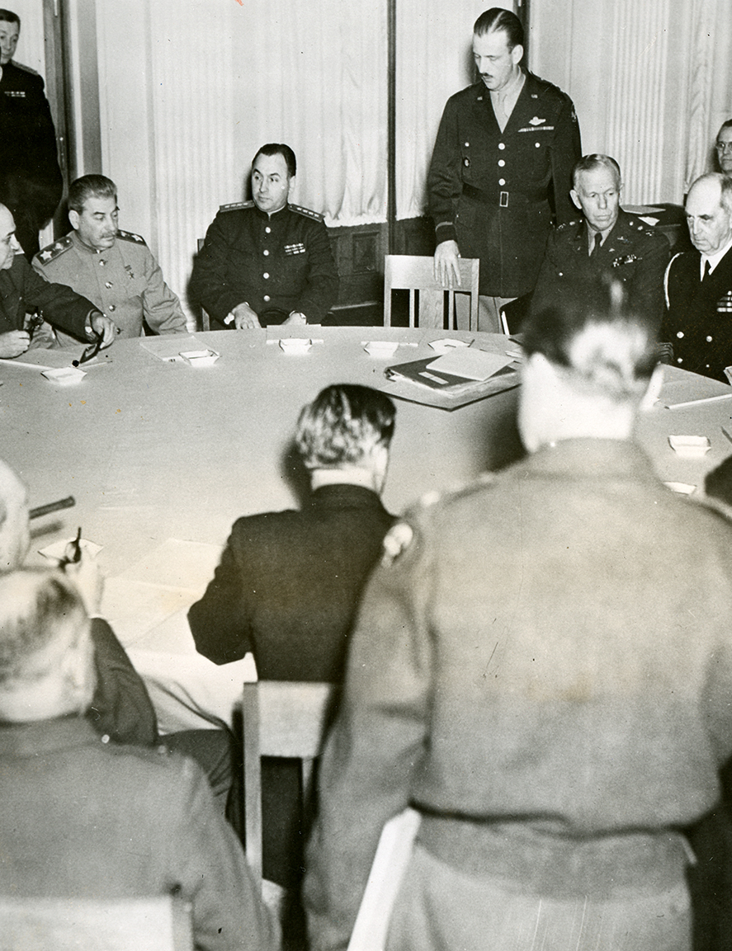
Yalta Conference
Non-German territories in central Europe were to be restored as independent countries and hold free elections.
Poland was to form a temporary coalition government; the government would be reorganised to include the London Poles and he Lublin Poles.
The USSR agreed to join the war against Japan 2-3 months after German surrender in exchange for dominance over Mongolia, the Kurile Islands, the port of Sakhalin Island and control over Port Arthur and the Manchurian Railway.

Slide 23
Were there disagreements?
Of course!!

Slide 24
A different picture by Potsdam!
12th April 1945 Roosevelt died leaving VP Harry S Truman as new POTUS.
A successful detonation of the atom bomb took place in New Mexico desert in July 1945.
May 1945, Germany surrender unconditionally to the allies. The USA were insistent on continued war with Japan and confirmation of Soviet assistance.
Churchill was replaced by Clement Attlee in the middle of the Potsdam Conference. This was a change in party and a shift in focus to domestic affairs.

Slide 25
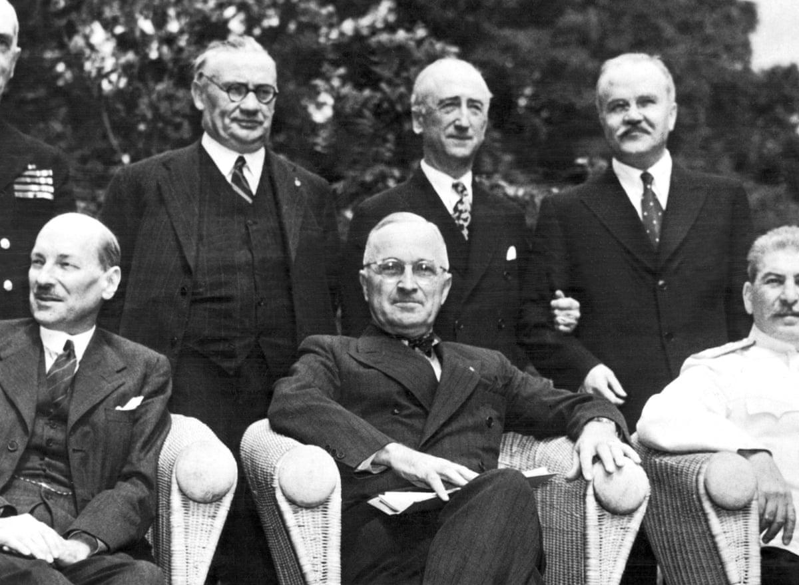
Potsdam (August 1945)
Stalin was the only person present in all previous meetings.
The conference expanded and clarified policies agreed upon at Yalta, but the strain of the wartime alliance was showing.
The US and UK wanted guarantee from Stalin that Poland would be granted free elections … but the Red Army occupied the Baltic countries and most of eastern and southern Europe.

Slide 26
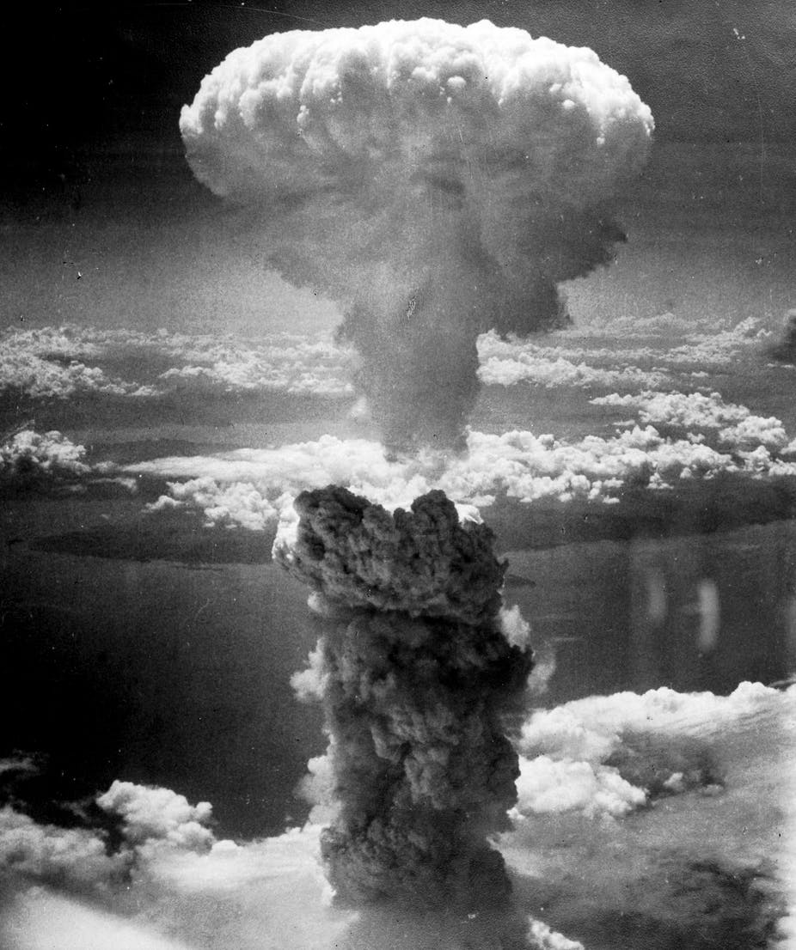
Potsdam (August 1945)
The Polish government was being challenged by the faction that took its orders from Moscow – the Lublin Poles.
Only Czechoslovakia resisted communism
6th August 1945 (four days after Potsdam concluded) the US dropped the A-bomb on Hiroshima; on 9th August they dropped another on Nagasaki.

Slide 27
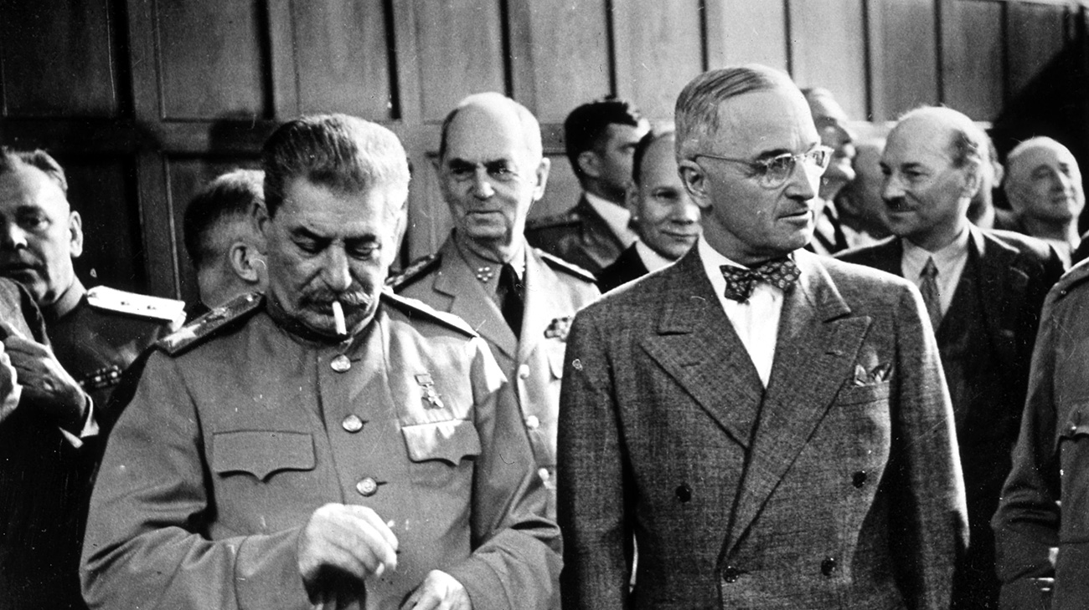
Disagreement

Slide 28
Post-war European treaties
 | Reparations (US$) | Territorial adjustments
Bulgaria | 70 million: 45 million to Greece, 25 million to Yugoslavia | Vardar Macedonia to Yugoslavia Eastern Macedonia and Thrace to Greece regained Sothern Dobrudja
Finland | 300 million: all to USSR | Accepted loss of territory from the Winter War (1939-40) with USSR and also lost Petsamo
Hungary | 300 million: 200 million to USSR, 100 million to Czechoslovakia and Yugoslavia | Three villages to Czechoslovakia
Italy | 360 million: 125 million to Yugoslavia, 105 million to Greece, 100 million to USSR, 25 million to Ethiopia, 5,000,000 to Albania | All colonies under trusteeship of UN, Istria to Yugoslavia, Trieste an international city under UN, who islands in eastern Adriatic to Yugoslavia, Dodecanese islands to Greece, Western Alps to France
Romania | 300 million: all to USSR | Bessarabia and Bukovina to USSR Southern Dobrudja to Bulgaria

Slide 29
Task: Match and the places, dates, decisions.
The Decisions
After Germany’s defeat, the Allies continued to debate post-war plans for Germany and Poland; Truman told Stalin that the US had a “powerful new weapon” but did not tell him that it was an atomic bomb
Allies agreed that Germany would be divided and occupied after the war by the four major powers: US, UK, France and USSR; further discussions took place on the creation of the United Nations
US & UK will seek the unconditional surrender of the Axis Powers, call upon the aid of the Soviet Union, and begin making plans to invade Sicily & Italy
US, UK and China developed plans for defeating Japan, declared that Japan would be stripped of all conquered territories, and guaranteed the post-war independence of Korea
In a secret meeting before the US had entered the war, the US & UK declare that they seek no territorial gains in war and that self-determination & freedom should be guaranteed to all people.
Allied powers planned the opening of a “second front” in western Europe in the spring of 1944 and agreed to the creation of the United Nations; the Soviet Union agreed to join the war against Japan six months after the defeat of Germany.
Places & Names
Yalta Conference
Atlantic Charter
Potsdam Conference
Casablanca Conference
Cairo Conference
Tehran Conference
Dates
November 1943
August 1941
July-August 1945
January 1943
November-December 1943
February 1945

Slide 30
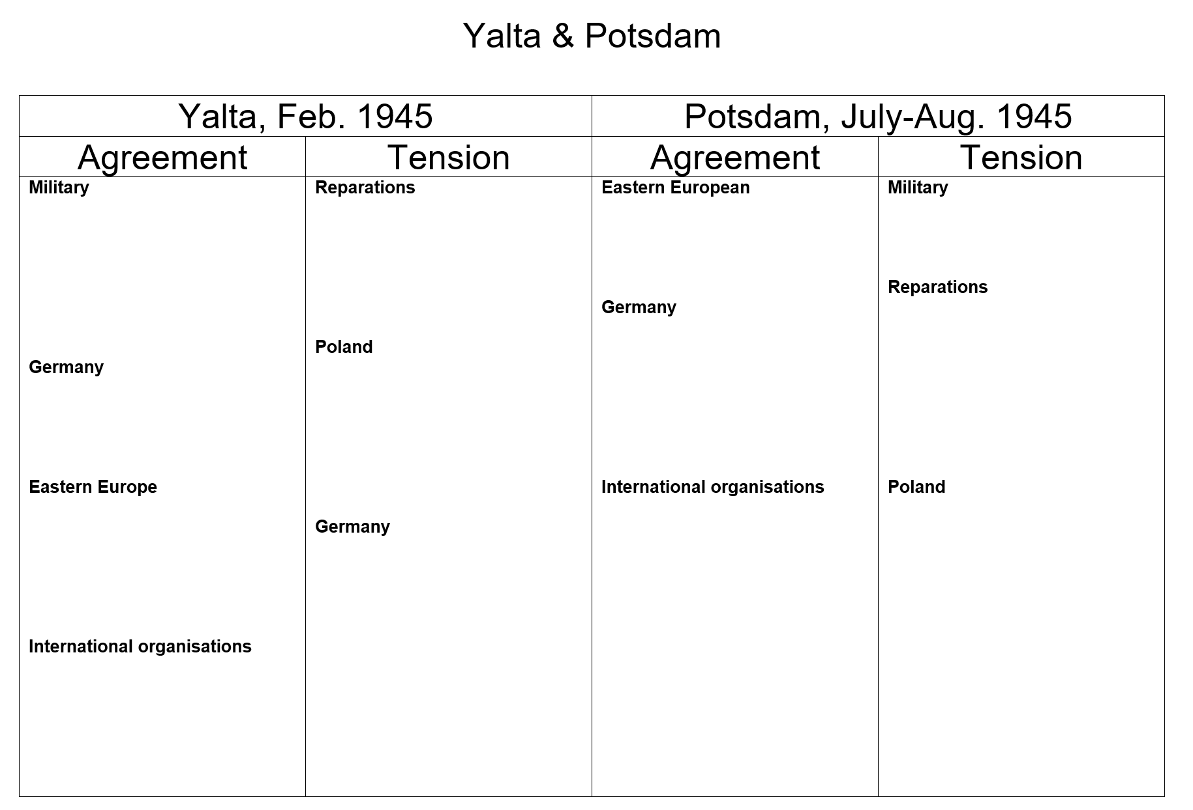

Slide 31
‘The tensions that existed within the Grand Alliance by the end of 1946 were the result of conflicting ideologies.’ Explain why you agree or disagree with this view.

