Slide 1
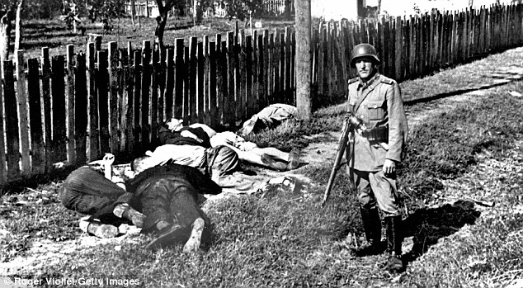
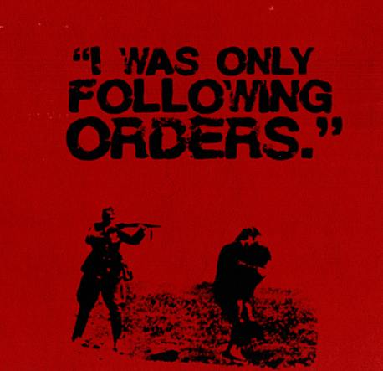

Starter: Read the Eichman transcript
Why do people obey?
Would you have followed Nazi orders?

Slide 2

Would you obey?
Why?
We are going to go through a series of examples. Write down whether you would or would not obey, and try to identify key factors that are influencing your decision….
Learning objectives:
To DEFINE ‘obedience’ and explain how it differs from others forms of social influence.
To DESCRIBE Milgram’s (1963) research and EXPLAIN the results.
To EVALUATE Milgram’s (1963) methodology and ethics.

Slide 3
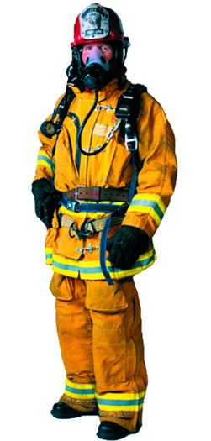
Would you obey?
Why?
A fireman in uniform approaches you in the street and tells you to cross to the other side of the street immediately.
Learning objectives:
To DEFINE ‘obedience’ and explain how it differs from others forms of social influence.
To DESCRIBE Milgram’s (1963) research and EXPLAIN the results.
To EVALUATE Milgram’s (1963) methodology and ethics.

Slide 4

Would you obey?
Why?
A policeman in uniform tells you to cross to the other side of the road.
Learning objectives:
To DEFINE ‘obedience’ and explain how it differs from others forms of social influence.
To DESCRIBE Milgram’s (1963) research and EXPLAIN the results.
To EVALUATE Milgram’s (1963) methodology and ethics.

Slide 5

Would you obey?
Why?
A milk man tells you to cross to the other side of the road.
Learning objectives:
To DEFINE ‘obedience’ and explain how it differs from others forms of social influence.
To DESCRIBE Milgram’s (1963) research and EXPLAIN the results.
To EVALUATE Milgram’s (1963) methodology and ethics.

Slide 6
Would you obey?
Why?
While on holiday in a country, a hotel sign tells you that you must write in a book where you are going every time you leave the hotel.
Learning objectives:
To DEFINE ‘obedience’ and explain how it differs from others forms of social influence.
To DESCRIBE Milgram’s (1963) research and EXPLAIN the results.
To EVALUATE Milgram’s (1963) methodology and ethics.

Slide 7
Would you obey?
Why?
You are at an Oxford University college on an interview. You walk through the quad and a sign says ‘Keep off the grass’.
Learning objectives:
To DEFINE ‘obedience’ and explain how it differs from others forms of social influence.
To DESCRIBE Milgram’s (1963) research and EXPLAIN the results.
To EVALUATE Milgram’s (1963) methodology and ethics.

Slide 8
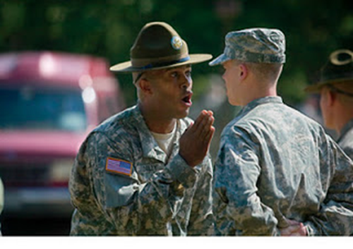
Would you obey?
Why?
You are a soldier, and your commanding officer tells you to run towards the enemy even though you know they will be firing directly at you.
Learning objectives:
To DEFINE ‘obedience’ and explain how it differs from others forms of social influence.
To DESCRIBE Milgram’s (1963) research and EXPLAIN the results.
To EVALUATE Milgram’s (1963) methodology and ethics.

Slide 9

Would you obey?
Why?
At work, your boss tells you that if you steal money out of your colleague’s locker, which they always leave open, it will teach them a valuable lesson about taking care of their property.
Learning objectives:
To DEFINE ‘obedience’ and explain how it differs from others forms of social influence.
To DESCRIBE Milgram’s (1963) research and EXPLAIN the results.
To EVALUATE Milgram’s (1963) methodology and ethics.

Slide 10
Would you obey?
Why?
You have volunteered to take part in an experiment at a very prestigious university. The experimenter, a professor at the university, and medical doctor, is telling you to deliver electric shocks to another volunteer to see whether punishment affects their ability to learn.
Learning objectives:
To DEFINE ‘obedience’ and explain how it differs from others forms of social influence.
To DESCRIBE Milgram’s (1963) research and EXPLAIN the results.
To EVALUATE Milgram’s (1963) methodology and ethics.

Slide 11

Obedience is a form of social influence where the source of influence comes from a direct order from someone of perceived authority. E.g. Doctor, higher management, sergeant.
Motivation to obey comes from fear of punishment, and/or belief in the legitimacy of authority.
Learning objectives:
To DEFINE ‘obedience’ and explain how it differs from others forms of social influence.
To DESCRIBE Milgram’s (1963) research and EXPLAIN the results.
To EVALUATE Milgram’s (1963) methodology and ethics.

Slide 12
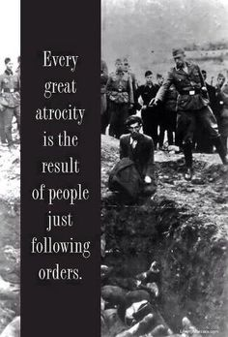
So far we have looked at types of indirect social influence. (NSI and ISI etc.)
Obedience is a direct form of social influence (a person has only a choice to comply or defer).

Slide 13
Differences between conformity and obedience…
 | Conformity | Obedience
What is it? | Going along with the crowd/yielding to group pressure. | Changing our behaviour to follow the direct demands of an authority figure.
Motivation? | Nobody actually has to ask! We act to please peers, friends, social group, or to resolve ambiguity in our own minds. | Authority figures: parents, police, government etc.
Why do we do it? | To be accepted, liked or just to fit in, to avoid feeling silly or in a situation when we don’t know what to do. | To avoid punishment or unpleasant consequences
Extension activity- think of real life examples that can be applied to obedience to support the ideas presented in the table
Learning objectives:
To DEFINE ‘obedience’ and explain how it differs from others forms of social influence.
To DESCRIBE Milgram’s (1963) research and EXPLAIN the results.
To EVALUATE Milgram’s (1963) methodology and ethics.

Slide 14
There are constant examples from history, and across culture, of people being influenced to obey authority figures against their ‘normal moral judgement’. For example….
Learning objectives:
To DEFINE ‘obedience’ and explain how it differs from others forms of social influence.
To DESCRIBE Milgram’s (1963) research and EXPLAIN the results.
To EVALUATE Milgram’s (1963) methodology and ethics.

Slide 15

Mai Lai Massacre – During Vietnam War US platoon followed
Lieutenant Calley orders to kill 500 unarmed civilians.

Slide 16
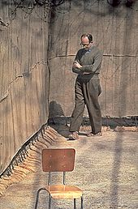
A very famous study into obedience to authority was undertaken by Milgram (1963).
He wanted to investigate why people suspend their own moral judgement and follow authority orders, even to extreme consequences.
His research was particularly pertinent at the time, due to many WWII Nazi war criminals being tried and giving the defence “I was only following orders”.
Social Psychology
KEY STUDY
Adolf Eichmann in the yard of his cell at Ayalon Prison in Israel, 1961.
Learning objectives:
To DEFINE ‘obedience’ and explain how it differs from others forms of social influence.
To DESCRIBE Milgram’s (1963) research and EXPLAIN the results.
To EVALUATE Milgram’s (1963) methodology and ethics.

Slide 17
Add ideas to the mind-maps below as you watch the video.
Social Psychology
KEY STUDY
What did Milgram do? (procedures) And what did he find? (Results)
What ethical issues are there with his experiment?
Learning objectives:
To DEFINE ‘obedience’ and explain how it differs from others forms of social influence.
To DESCRIBE Milgram’s (1963) research and EXPLAIN the results.
To EVALUATE Milgram’s (1963) methodology and ethics.

Slide 18
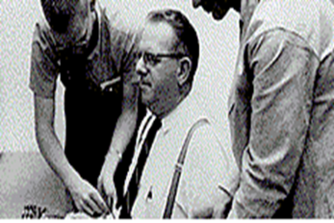
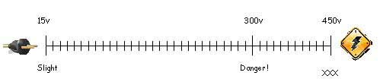
Capacity for moral decision-making suspended when within a powerful social hierarchy. We obey authority figures, even when asked to behave in ‘inhumane manner’.
What did Milgram do? (procedures) And what did he find? (Results)
Subsequent replications of the study in different countries found variations in obedience to 450V:
Germany 85%(!)
UK 50%
Aussies 40%
100%
65%
Suggests many crimes against humanity, including holocaust, result of situational factors (strong social hierarchy and ‘legitimacy’), rather than personality factors (the Germans were not ‘evil’.
Learning objectives:
To DEFINE ‘obedience’ and explain how it differs from others forms of social influence.
To DESCRIBE Milgram’s (1963) research and EXPLAIN the results.
To EVALUATE Milgram’s (1963) methodology and ethics.

Slide 19
Harm – some participants suffered extreme stress reactions, e.g. sweating and shaking, as well as embarrassment and the feelings of being used.
However, after the experiment 2/3 said they had learned something of ‘personal importance’ and 85% were pleased to have taken part.
Lack of informed consent – because they were deceived participants could not give their full informed consent.
What ethical issues are there with his experiment? (A02)
True right to withdraw– due to the ‘prods’ did not have a true right to withdraw.
However, they were informed of their RTW and some did.
Deception – participants were deceived in many ways, the initial advert, the selection of teacher and learner, the fake shocks etc.
Needed? Worth it?
Learning objectives:
To DEFINE ‘obedience’ and explain how it differs from others forms of social influence.
To DESCRIBE Milgram’s (1963) research and EXPLAIN the results.
To EVALUATE Milgram’s (1963) methodology and ethics.

Slide 20
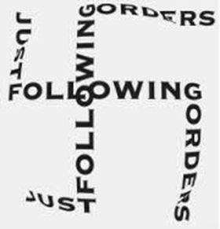
Task: Use notes from the video and the textbook to create a detailed ‘outline of Milgram’s research’
Your outline must include:
What he set out to investigate (his aim).
A detailed description of the procedures used (including sample size and method of sampling, the role of confederates and a description of the ‘prods’ used and situations the participants were put into).
Details of the results (including percentage of people who went all the way to 450 volts).
The conclusions that were drawn from the study.
Learning objectives:
To DEFINE ‘obedience’ and explain how it differs from others forms of social influence.
To DESCRIBE Milgram’s (1963) research and EXPLAIN the results.
To EVALUATE Milgram’s (1963) methodology and ethics.

Slide 21
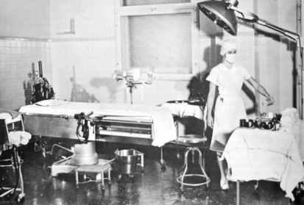
Can determine whether the IV does cause the DV to change, causal conclusions can be drawn.
Can easily be replicated, therefore reliability can be assessed and checked.
Orne and Holland (1968) claimed that Milgram’s participants would have worked out the deception in the experiment, since they claimed it was obvious that ‘the teacher’ could have just pressed the button himself in order to deliver the shocks if the experiment was about ‘learning and punishment’.
They argued therefore that the experiment lacked internal validity.
High control of variables as laboratory experiment.
As it is a laboratory experiment, the situation is generally artificial. Therefore there is a lack of ecological validity.
Howerver, Hofling et al (1966) showed blind obedience just as likely in a more ‘real-life’ setting
Evaluation of methodology
A02
Investigator effects may have caused participants to have behaved differently..
Original experiment only men. So lacks population validity and difficult to generalise to women.
Learning objectives:
To DEFINE ‘obedience’ and explain how it differs from others forms of social influence.
To DESCRIBE Milgram’s (1963) research and EXPLAIN the results.
To EVALUATE Milgram’s (1963) methodology and ethics.

Slide 22
Do Milgram’s results have historical validity?
Watch a modern replication of Milgram’s (1963) research undertaken at Kings University.
Were the results similar?
Derren Brown has also replicated the research on one of his shows. On the moodle if you would like to watch.
Learning objectives:
To DEFINE ‘obedience’ and explain how it differs from others forms of social influence.
To DESCRIBE Milgram’s (1963) research and EXPLAIN the results.
To EVALUATE Milgram’s (1963) methodology and ethics.

Slide 23
Variations of Milgram’s original experiment……
18 variations of the original investigation were undertaken by Milgram and his team.
Variations of Milgram’s original experiment……
If you were Milgram, how would you have varied the conditions of your study to check that your situational explanation for obedience was accurate?
What would you manipulate in order to test obedience under different conditions?
Learning objectives:
To DEFINE ‘obedience’ and explain how it differs from others forms of social influence.
To DESCRIBE Milgram’s (1963) research and EXPLAIN the results.
To EVALUATE Milgram’s (1963) methodology and ethics.

Slide 24
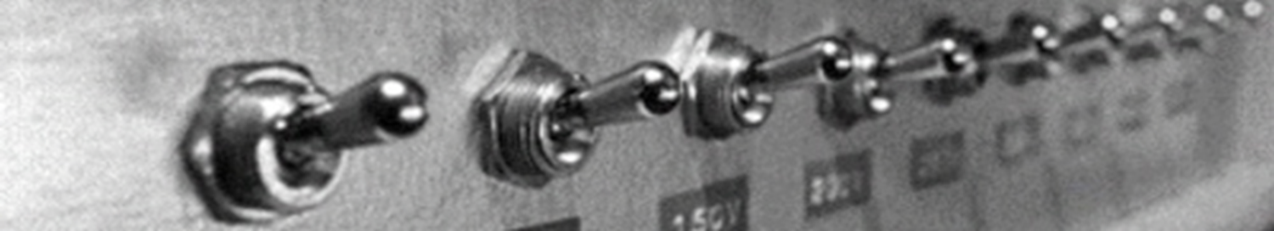
Task
10 mins
Get into groups of 3 or 4.
You will be given a set of six cards with some of the key variations on Milgram’s basic study.
As a group, you must place them in order from which you think would have had the highest levels of obedience, to the lowest levels. You must write down a rationale for your choices, and estimate the % of people who obeyed up to 450v, which we will hear as a group in a discussion in 10 mins.
Learning objectives:
To DEFINE ‘obedience’ and explain how it differs from others forms of social influence.
To DESCRIBE Milgram’s (1963) research and EXPLAIN the results.
To EVALUATE Milgram’s (1963) methodology and ethics.
Notes:
Cards to be found in handout 152 (in the psychology teacher handbook from Kim)

Slide 25
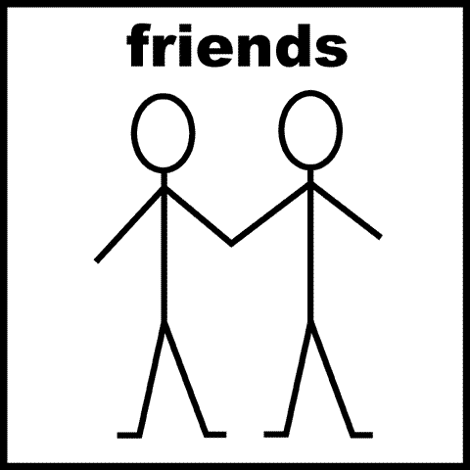
Presence of allies
Teacher given support from two other ‘teachers’ (confederates) who refused to continue at 210 volts.
Learning objectives:
To DEFINE ‘obedience’ and explain how it differs from others forms of social influence.
To DESCRIBE Milgram’s (1963) research and EXPLAIN the results.
To EVALUATE Milgram’s (1963) methodology and ethics.

Slide 26
Lower
Lower
10%

Slide 27

Proximity of authority figure
Experimenter left the room and gave instructions to ‘teacher’ by telephone.
Learning objectives:
To DEFINE ‘obedience’ and explain how it differs from others forms of social influence.
To DESCRIBE Milgram’s (1963) research and EXPLAIN the results.
To EVALUATE Milgram’s (1963) methodology and ethics.

Slide 28
Lower
Lower 21%

Slide 29
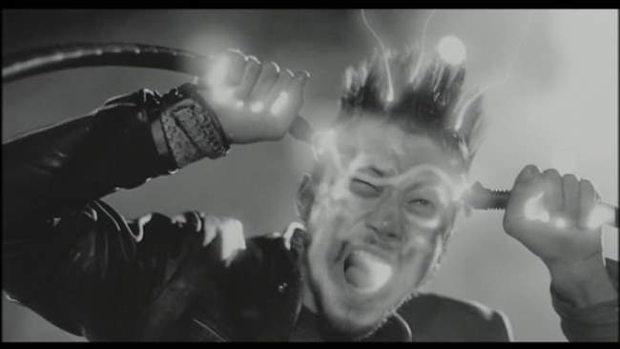
Peer administers shock
Assistant (confederate) gave shocks whilst teacher read out word pairs.
Learning objectives:
To DEFINE ‘obedience’ and explain how it differs from others forms of social influence.
To DESCRIBE Milgram’s (1963) research and EXPLAIN the results.
To EVALUATE Milgram’s (1963) methodology and ethics.

Slide 30
Lower
Higher
92%

Slide 31
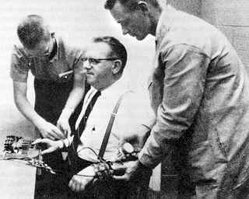
Physical touch proximity
Teacher had to force learner’s hand onto the plate to receive electric shock.
Learning objectives:
To DEFINE ‘obedience’ and explain how it differs from others forms of social influence.
To DESCRIBE Milgram’s (1963) research and EXPLAIN the results.
To EVALUATE Milgram’s (1963) methodology and ethics.

Slide 32
Lower
30%
30%

Slide 33

Proximity of learner
Teacher and learner in same room (1.5 feet from each other). Teacher – participant- can see aguish rather than just hear it.
Learning objectives:
To DEFINE ‘obedience’ and explain how it differs from others forms of social influence.
To DESCRIBE Milgram’s (1963) research and EXPLAIN the results.
To EVALUATE Milgram’s (1963) methodology and ethics.

Slide 34
Lower
40%
40%

Slide 35
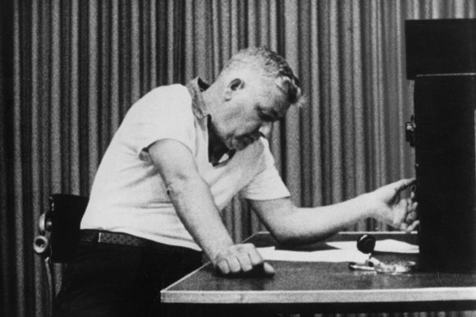
Teacher discretion
Teacher has control of the amount of shock delivered to the ‘learner’.
Learning objectives:
To DEFINE ‘obedience’ and explain how it differs from others forms of social influence.
To DESCRIBE Milgram’s (1963) research and EXPLAIN the results.
To EVALUATE Milgram’s (1963) methodology and ethics.

Slide 36
Lower
2.5%
40%

Slide 37
Home learning
Task: Complete the questions on the sheet from memory to test your knowledge on Milgram’s experiment. Check your answers with your notes and textbooks afterwards.
Learning objectives:
To DEFINE ‘obedience’ and explain how it differs from others forms of social influence.
To DESCRIBE Milgram’s (1963) research and EXPLAIN the results.
To EVALUATE Milgram’s (1963) methodology and ethics.

