Slide 1
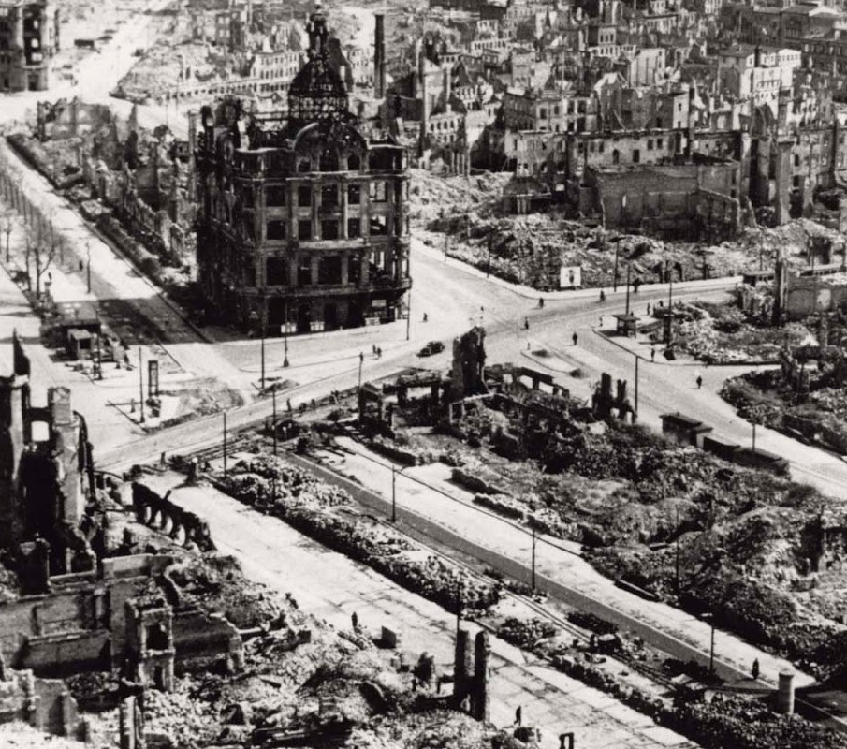
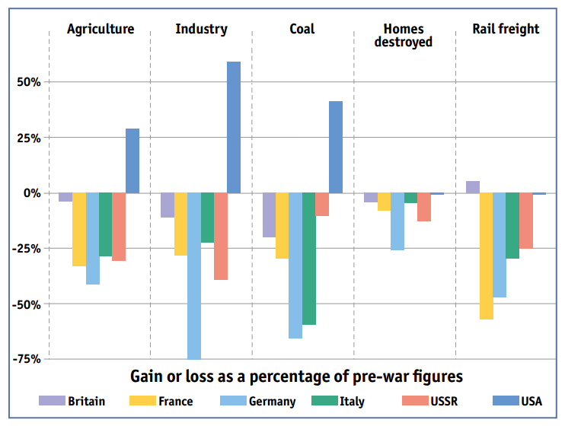

Slide 2
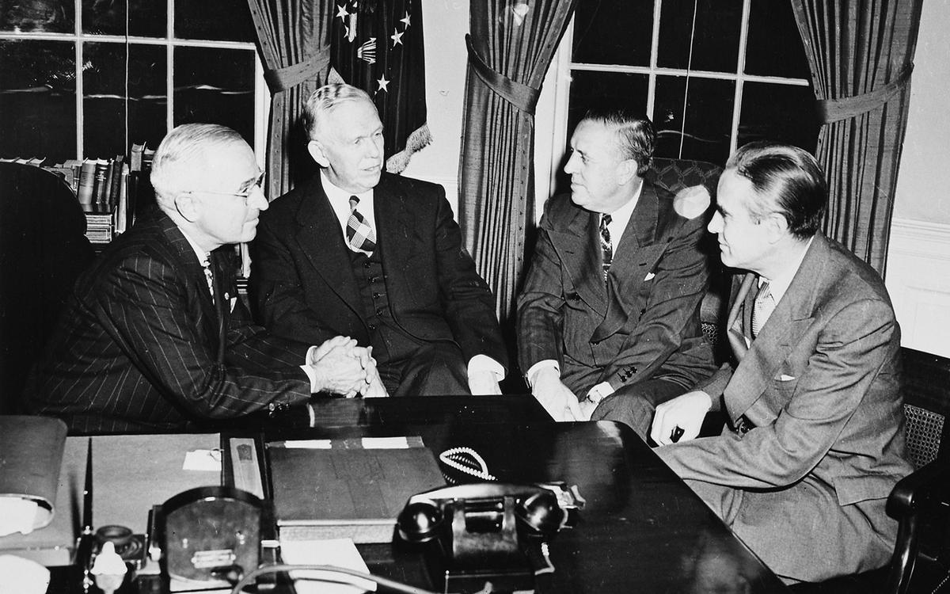
How far did US economic assistance cause superpower rivalry?
The Truman Doctrine (March 1947) and Marshall Plan (June 1947)

Slide 3
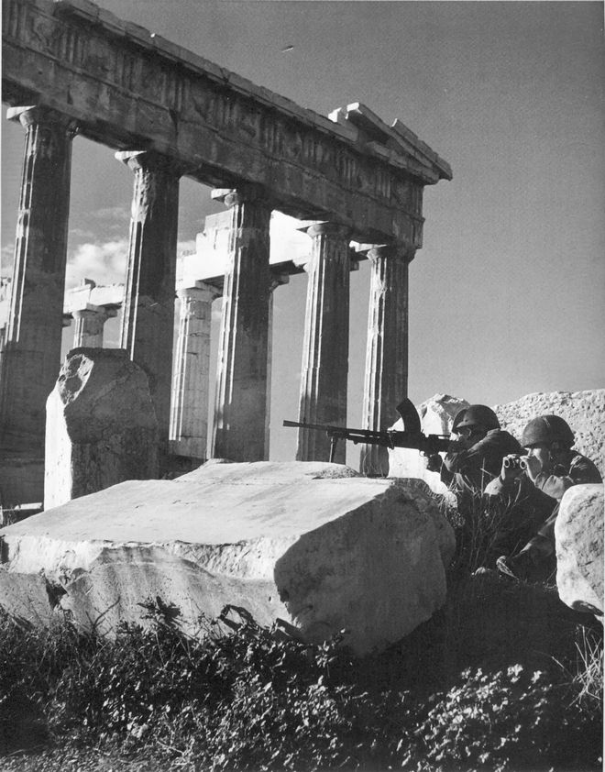
Greek Civil War
The post war situation in Greece attracted US attention, where it was estimated $3.1 million would be needed to reconstruction.
The British supported the restoration of a constitutional monarchy.
An ensuing Civil War against the Greek communists drained the economically wrecked British government.
It informed the US it could not continue its support of the royalist government.

Slide 4
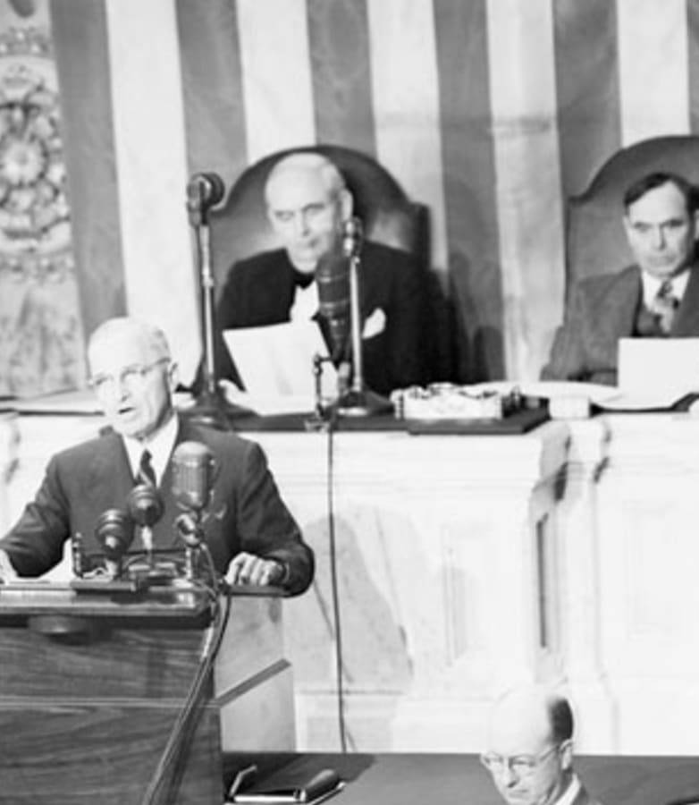
Truman Doctrine
Turkey was also seen as an area of concern regarding Soviet expansion.
This forced the US to take a stance and the concrete result was the Truman Doctrine.
In his speech to congress (12th March 1947) he outlined the dangers of Greece and Turkey falling to Communism.
He requested $400 million to assist the two countries.

Slide 5
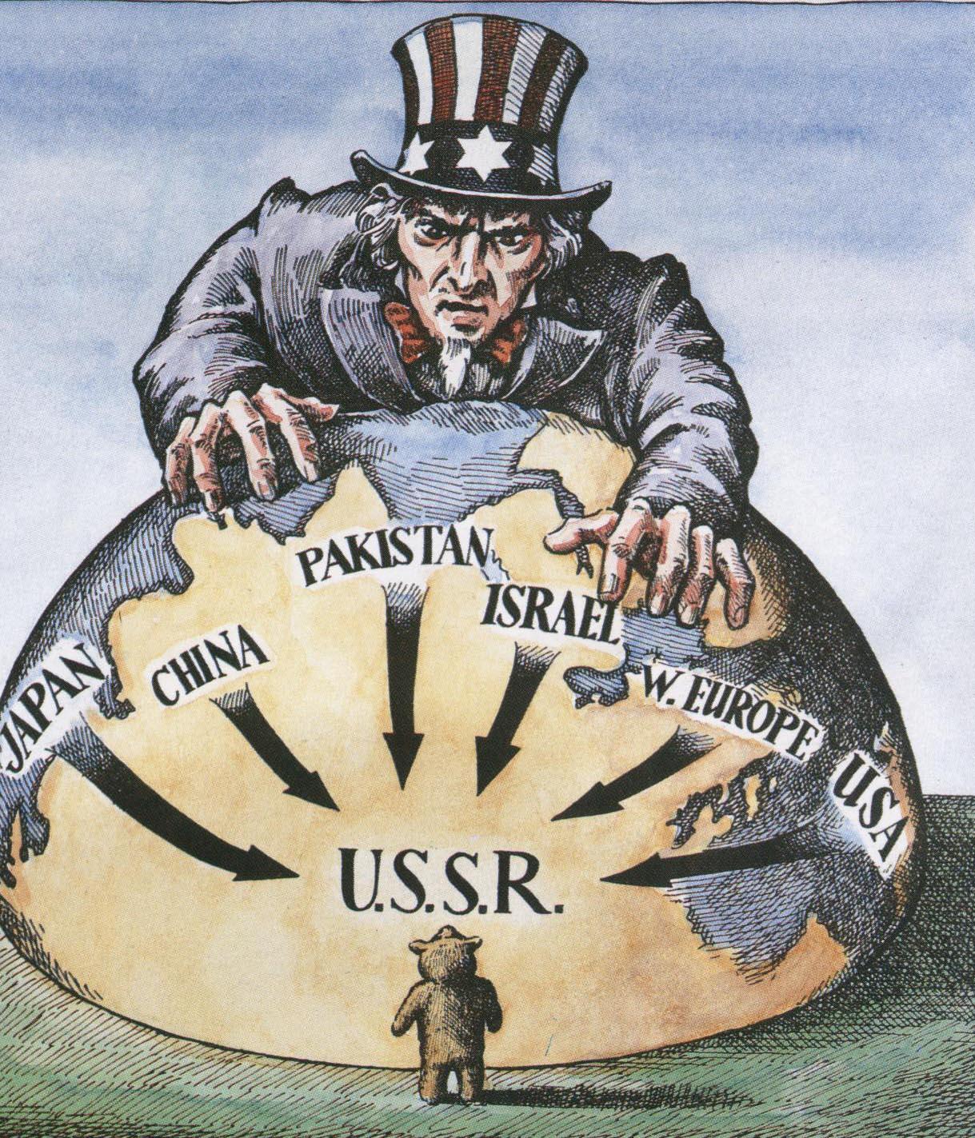
Containment
The moral imperative of the USA was now to prevent the spread of communism to other countries.
This policy of containment was to be conducted through military and financial assistance.
By 1948, the Greek Army reached 200,000 men and with US assistance the balance of civil war tilted towards the monarchists.

Slide 6
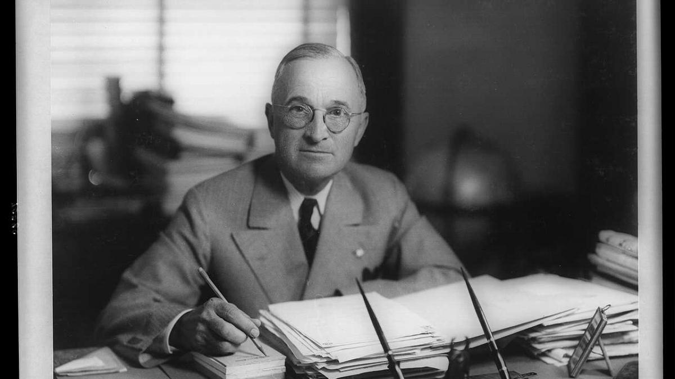
Task: Truman Doctrine analysis

Slide 7
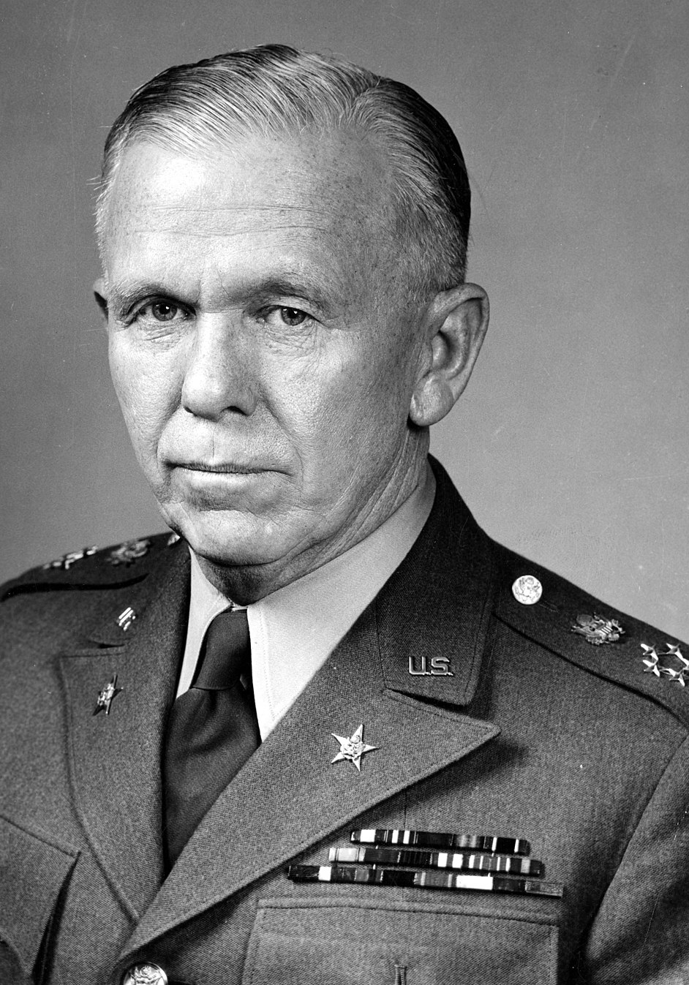
Marshall Plan
Marshall was Supreme Allied Commander in Europe during the Second World War and was appointed Secretary of State in January 1947.
He proposed providing economic assistance to European countries.
Through the European Recovery Programme (ERP) counties would receive grants and loans for the USA to help them rebuild.
Although it was offered to all countries in Europe, the Soviets refused aid and pressured their satellites to decline the offer too.

Slide 8
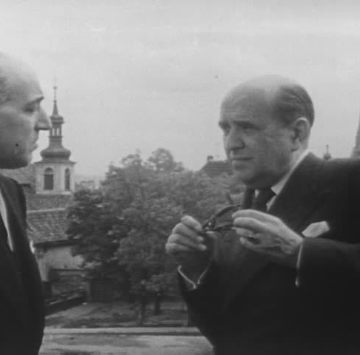
Soviet concern
To Stalin, Marshall Plan was a serious blow indicating there would be a continued US presence in Europe.
His fears were confirmed when Czechoslovakia expressed interest in taking up the aid.
As we know, Czechoslovak officials were summoned to Moscow and instructed to reject Marshall Aid.

Slide 9
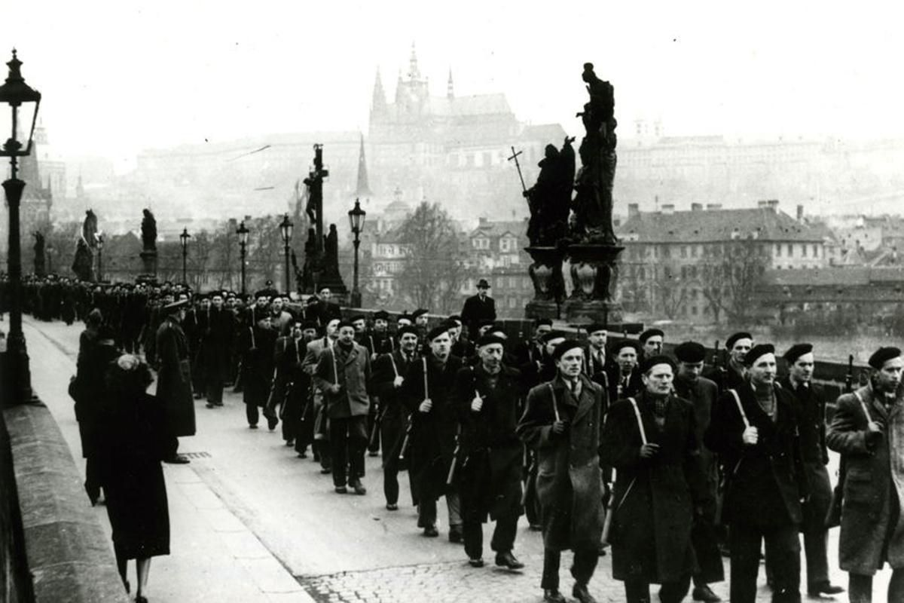
Coup in Czechoslovakia
In February 1948, the Czechoslovakian communists with the backing of the Soviets, overthrew the government.
This stunned western Europe. It led hesitant US politicians to grant aid and implement the Marshall Plan.

Slide 10
European Recovery Program (passed into law 3rd April 1948)
1948-51 the USA provided $13.2 billion to 17 countries.
The aim was to:
Meet immediate need for food, medicine, and housing
Increase industrial and agricultural production by rapidly rebuilding factories, railroad, bridges…
Combat inflation and establish financial stability
Create a common market free of national trade barriers.

Slide 11
European Recovery Program
Aid expanded to include funding for economic development
It was scheduled to last until 1953 but the Korean War halted assistance in 1951.
Some Europeans (namely the French) were sceptical of US intentions, but this dropped off as the program proceeded.

Slide 12
ERP assistance received by country | 1950 population | Total Marshall Plan assistance (millions of dollars)
Austria | 6,935,000 | 677.8
Belgium | 8,628,000 | 364.3
Denmark | 4,271,000 | 273.0
Federal Republic of Germany (named from 1949) | 49,986,000 | 1390.6
France | 41,829,000 | 2,713.6
Greece | 7,566,000 | 706.7
Iceland | 143,000 | 29.3
Ireland | 2,963,000 | 147.5
Italy | 47,105,000 | 1,508.8
Luxembourg | 295,587 | 195
Netherlands | 10,114,000 | 1,083.5
Norway | 3,265,000 | 255.3
Portugal | 8,443,000 | 51.2
Sweden | 7,014,000 | 107.3
United Kingdom | 50,127,000 | 3,189.8

Slide 13
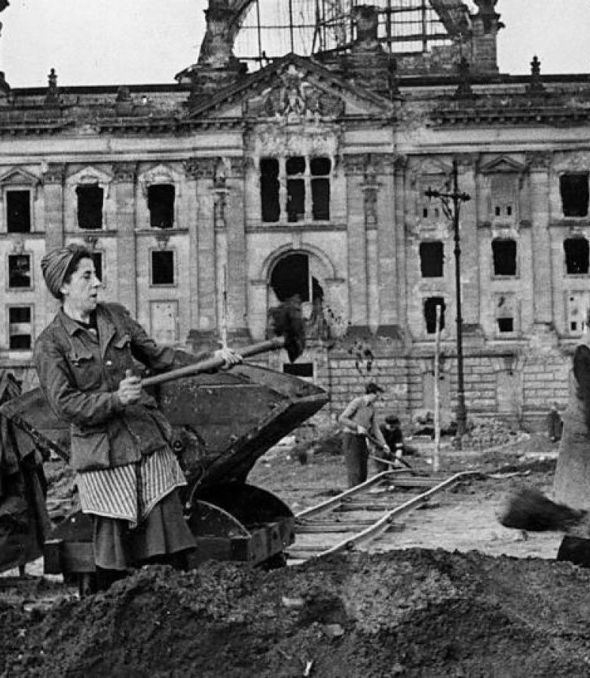
Results
Economic growth was rapid and created close trade relations.
It contributed to the end of austerity measures and a reduction of the influence of communist parties, especially in France and Italy.
National trade barriers did still block the free flow of goods and services and inflation remained a problem in some countries.
The US had officially turned from traditional isolationism.

Slide 14
Soviet response
COMECON members
Initially: USSR, Poland, Bulgaria, Romania, Hungary, Czechoslovakia.
Later: Albania, East Germany, Mongolia, Cuba, Vietnam, China, Yugoslavia.
In 1949 the Soviets initiated their own economic programme – COMECON (Council for Economic Assistance).
It aimed to provide economic stability to eastern European countries struggling with the loss of markets in southern and western Europe.
Policies were largely dictated by the USSR but was coordinated in a mutually beneficial manner.

Slide 15
Truman Doctrine (March 1947)
Purpose: to oppose aggressive behaviour by communists in Greece and Turkey (and further into Europe) through using American resources (military assistance, hardware, money)
Action: aid ($400 million) was given to Greece and Turkey to prevent them ‘falling’ to Communism.
Aim: to stop the spread of communism ‘policy of containment’
Impact: started a new foreign policy for America
Many communists felt it was a declaration of ‘war’ and regard this as the start of the Cold War.
Marshall Plan (June 1947)
A development on the principles set out by the Truman Doctrine.
Purpose: to help fix the ruined economies of Europe and rescue the economies of the West. $13.2 million was given in aid to 17 countries.
Trigger: Czechoslovakia fell to communism and Jan Masaryk, a minister who supported the West, mysteriously died.
Impact: Marshal plan was seen as ‘dollar imperialism’ to the USSR - USA was using money to influence countries to support them against the USSR

Slide 16
The year is 1948 and you are part of a US delegation sent to a country of your choice to provide Marshall Aid to that country. Refer to the table for the overall amount of aid that you can distribute. Each of you is responsible for one component of assistance that you need to consider when allocating money:
loans for economic development
cash for economic development
humanitarian aid (food, clothing, fuel, medicine)
civilian advisors to help with economic and humanitarian assistance
publicity for gaining support of the host country for Marshall Plan aid
You do not have to provide precise monetary amounts, but should consider the context of the country that you have chosen. What should the priorities be, given the needs of your country? How important are US interests in the allocation of aid?
Your group should write up a five point action plan that explains how Marshall aid will be spent and why. You will then present this to the class for discussion.
Once we've heard from all the groups consider why different countries might have different priorities, take into account the local situation and the level of importance of US interests.

