Slide 1
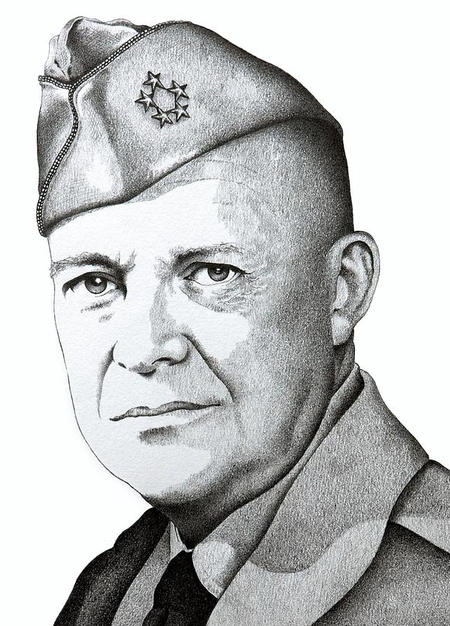
How did he increase involvement in Vietnam?
Reason two
Eisenhower
1953-61
Define the following terms:
Pacification
ARVN
PLAF
PAVN
Limited war
Guerrilla warfare
Reason one

Slide 2
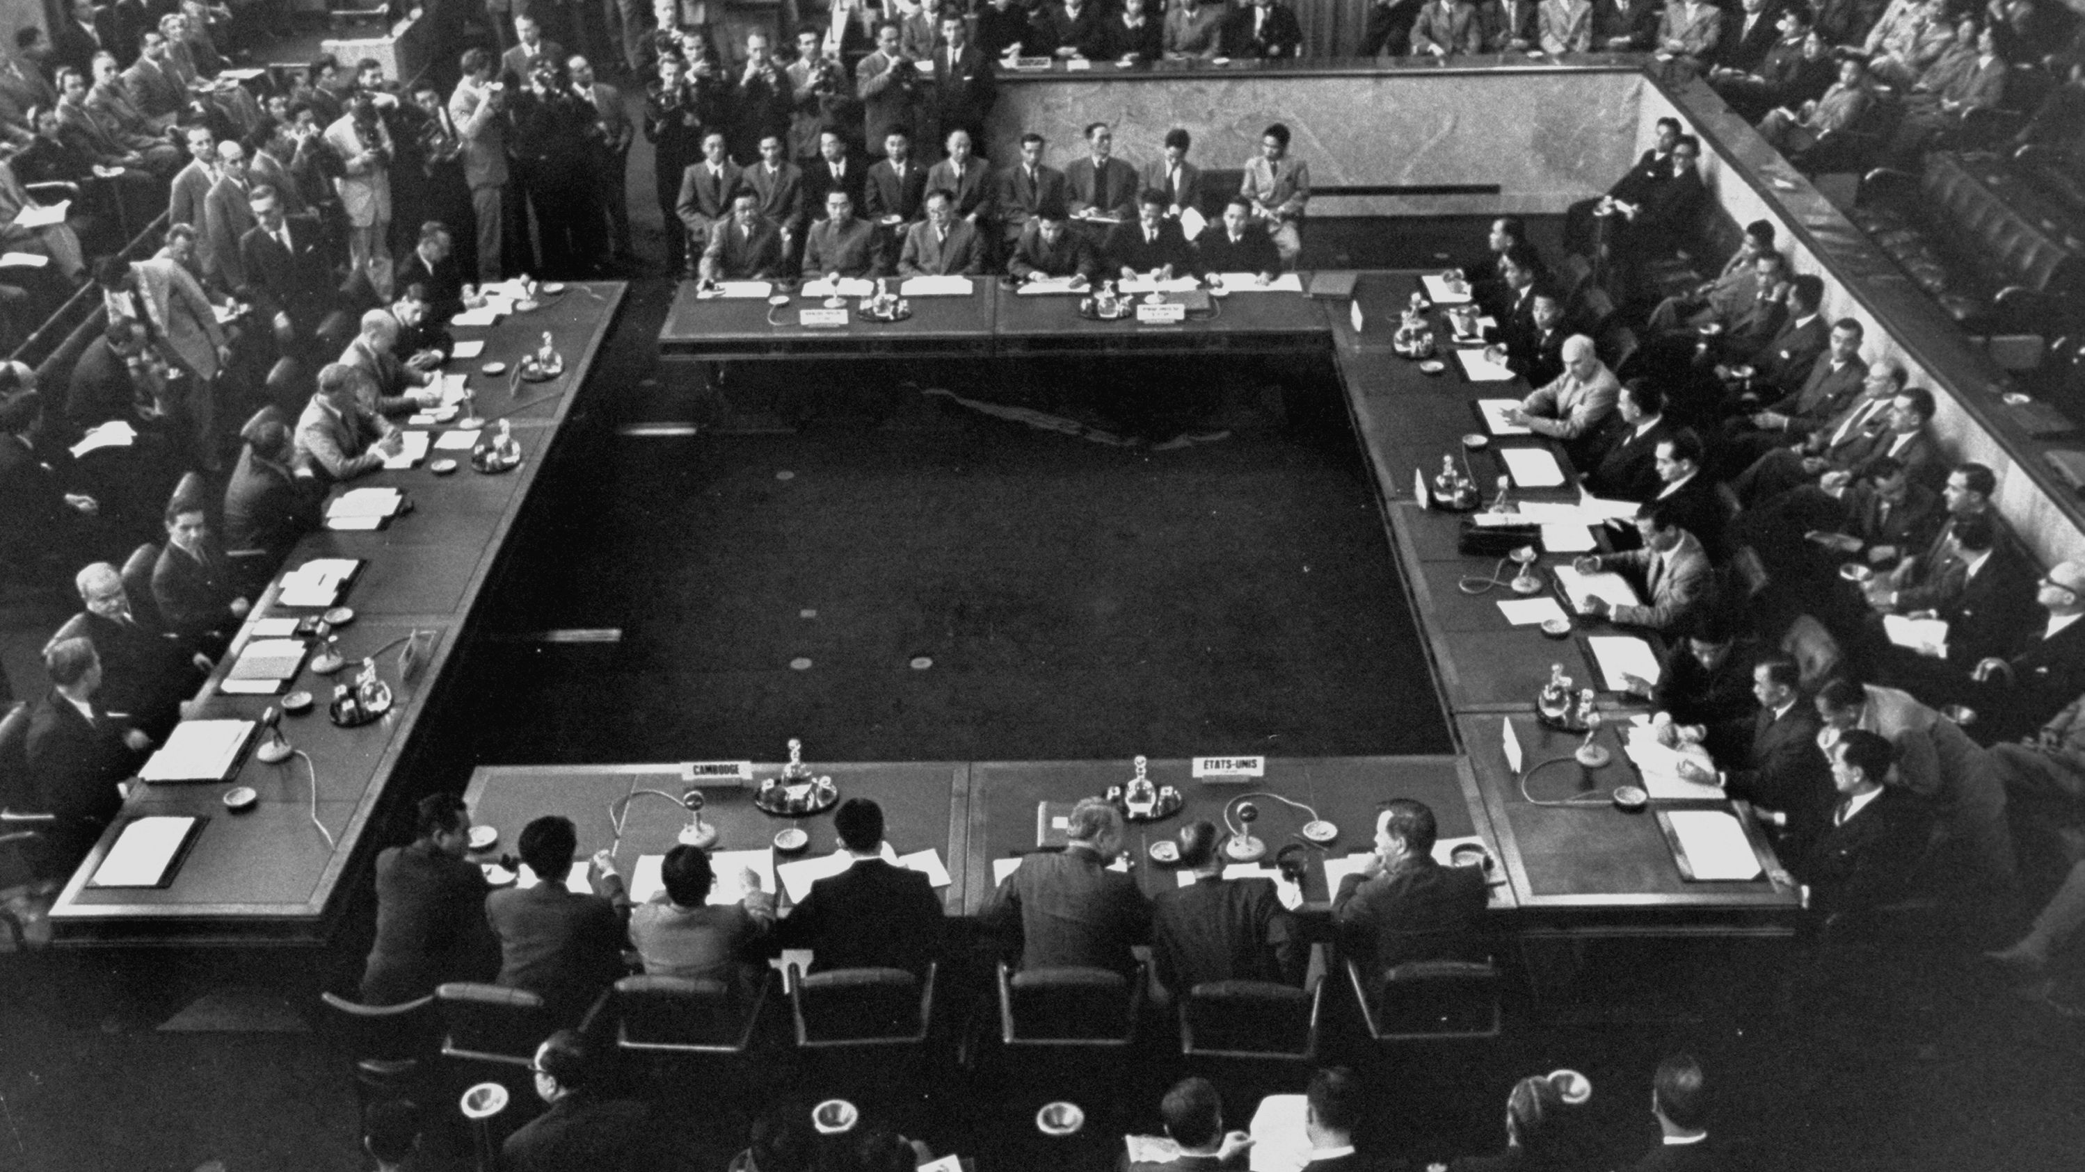
What views did the various participants of this conference hold?
Geneva Conference
26 Apr 1954 – 20 Jul 1954

Slide 3
 | What did they want? | What did they get?
USA | No Communist gains. | Half of Vietnam was not Communist, half was.
USSR | Decreased Cold War tension. | Settlement that did not last.
China | Keep US out. Gain international recognition. | Recognition, but US stayed in Southeast Asia.
France | Respite. Retain some influence in Indochina. | Got out. Hardly retained any influence.
Ho Chi Minh | Control over as much of Vietnam was possible. | Got half of Vietnam.
Diem | Control over as much of Vietnam was possible. | Got half of Vietnam, but soon lost it.
UK | Peace in Southeast Asia. Halt spread of Communism. | Uneasy, temporary peace. Communism not halted.

Slide 4
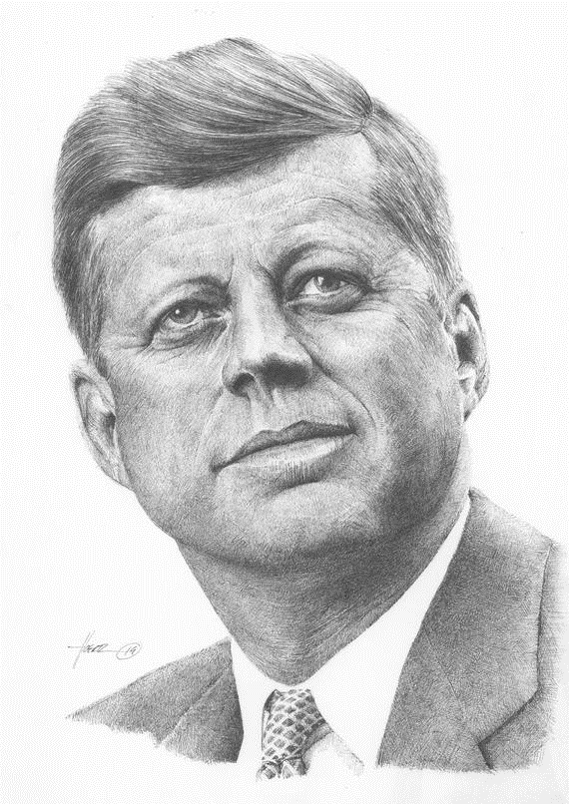
Kennedy continued Eisenhower’s ‘limited war’ approach:
He sent 16,000 more US advisers to train the ARVN.
He focused on pacification – winning over local people so that they wouldn’t support communism
He sent in US Special Forces (‘Green Berets’), who trained villagers to protect themselves from the VC.
He agreed the use of chemical spraying to kill crops and jungle areas where the VC could be hiding.
About 5,000 ‘strategic hamlets’ had been built by September 1962.
Kennedy
1961-63
By 1963 the US had lost faith in Diem:
He was increasingly harsh to Buddhists. His troops killed Buddhists and raided their temples. In June 1963 a Buddhist monk called Quang Duc famously burned himself to death in protest.
In January 1963 the ARVN lost the Battle of Ap Bac, despite having more troops and US air support.
It was impossible for the ARVN to win over villagers, who simply saw the army as part of Diem’s corrupt government.
In November 1963 Diem was assassinated in a coup by ARVN generals

Slide 5
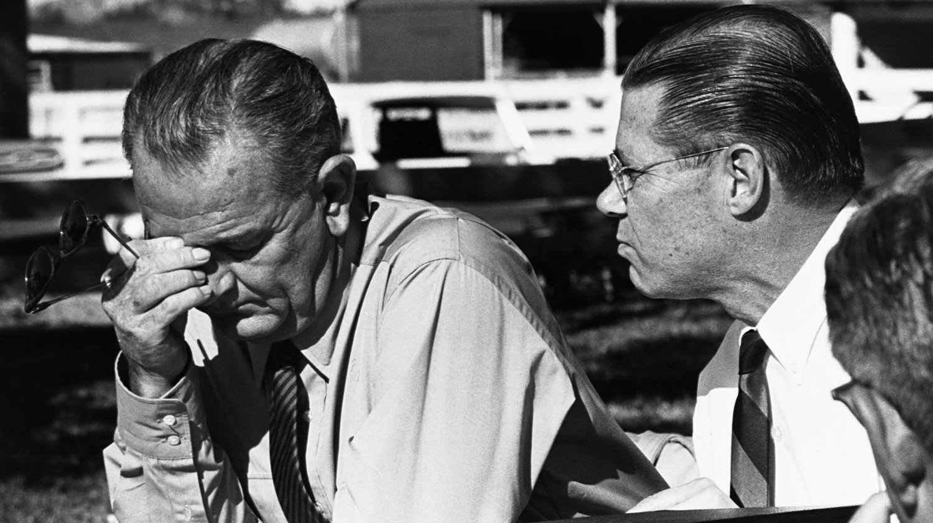
How was Johnson able to escalate the war in Vietnam?
What was Johnson’s view on the conflict and how did the Gulf of Tonkin crisis impact on US involvement in Vietnam?

Slide 6
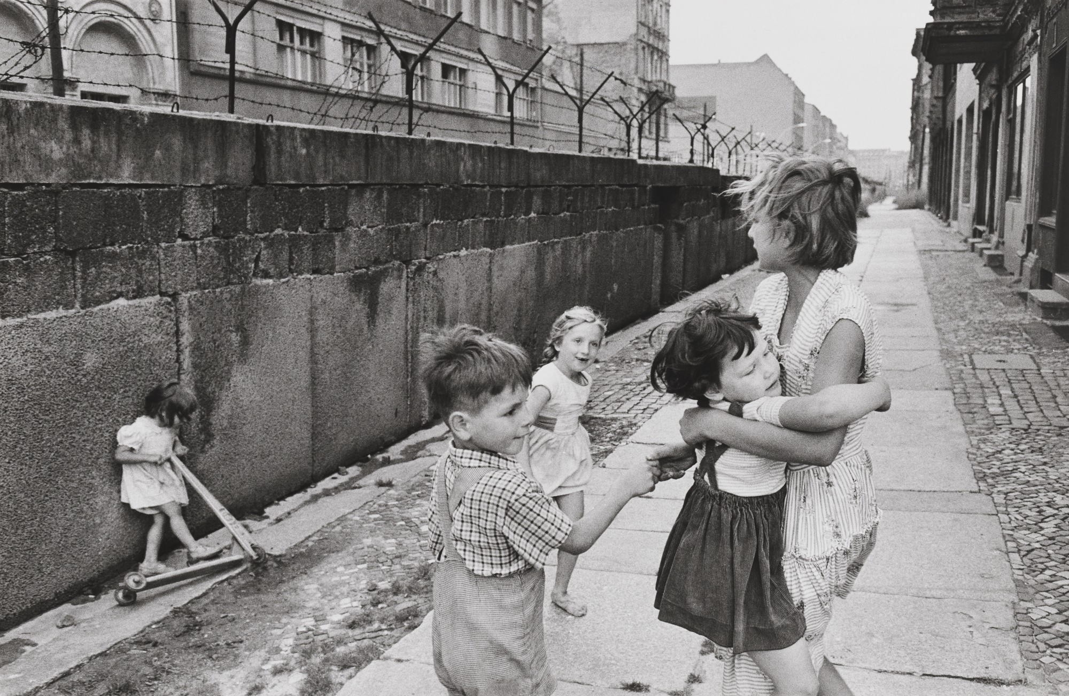
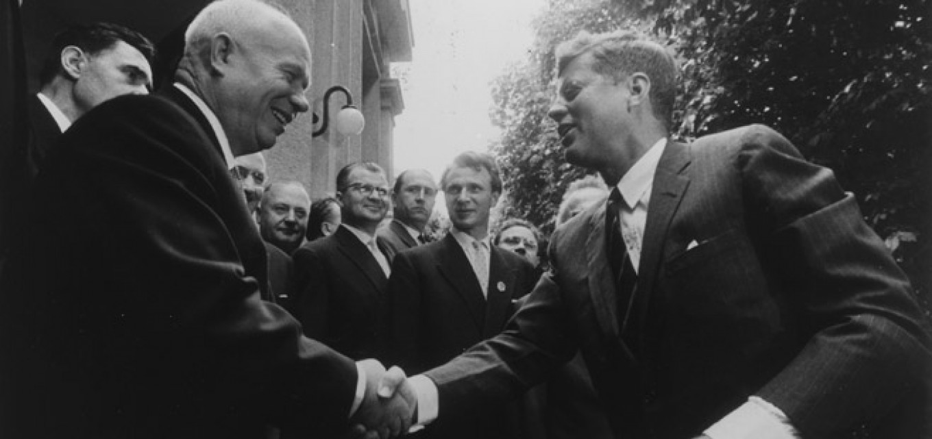
What was the situation at the point Johnson becomes President?
The Johnson administration were able to improved relations, focus foreign policy on the Vietnam War and embark on his ‘Great Society’ project.
He left Lyndon Johnson a US military force in Vietnam of 16,000 and a commitment to the growing Vietnamese war.
He was intensely patriotic, a believer in Domino Theory but was also tied to Kennedy’s legacy and a fear of backing out of Vietnam.

Slide 7
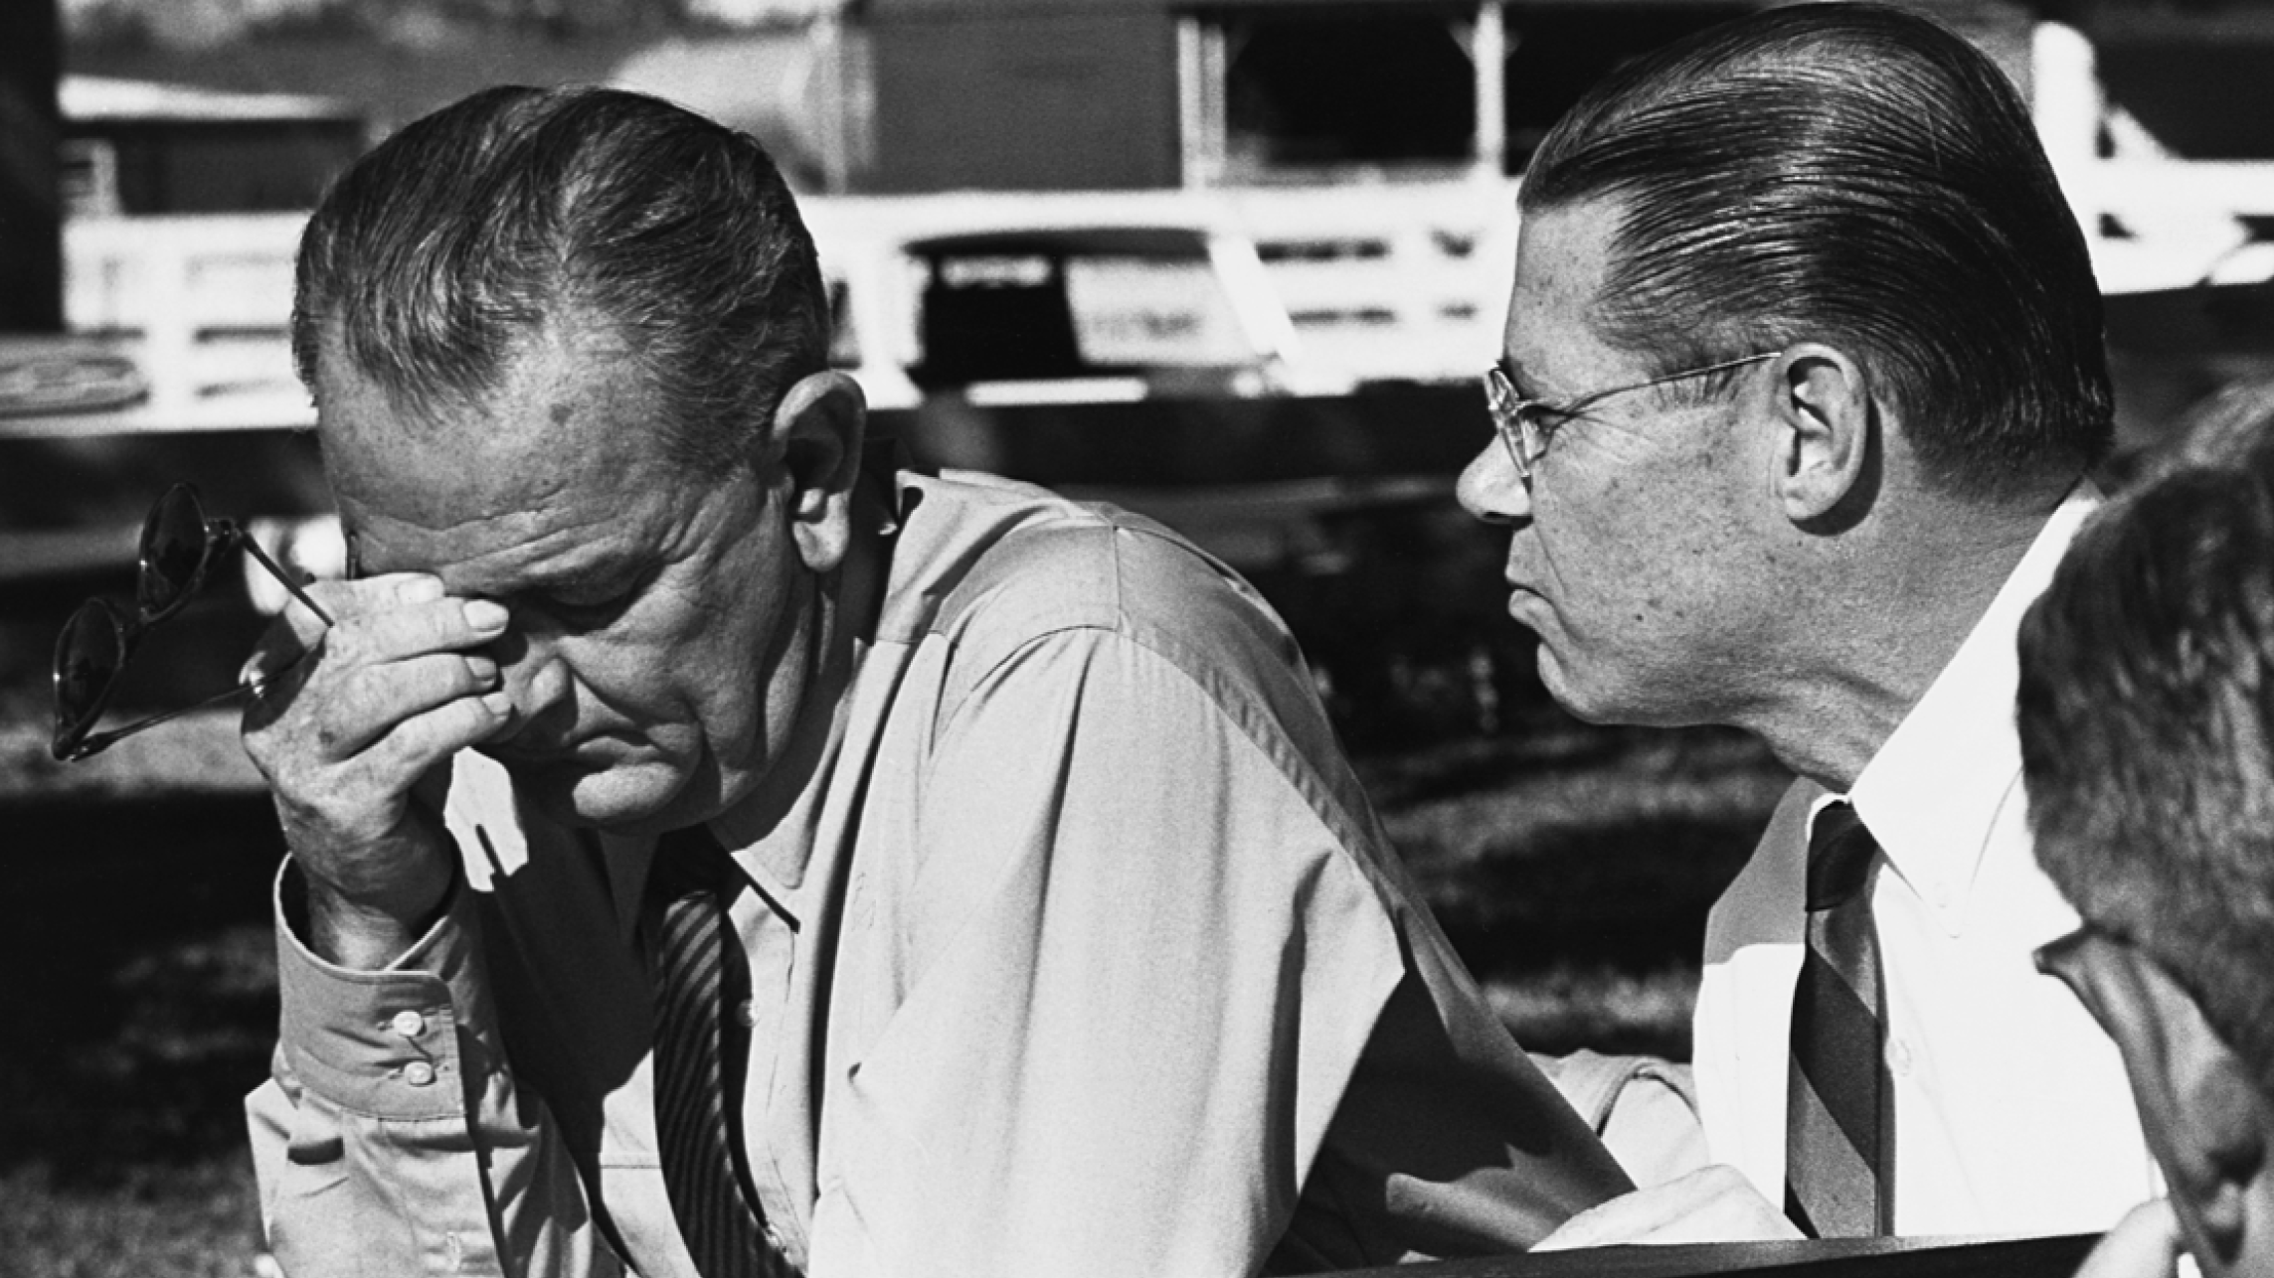
Guided Reading: What guided Johnson’s policy in Vietnam?

Slide 8
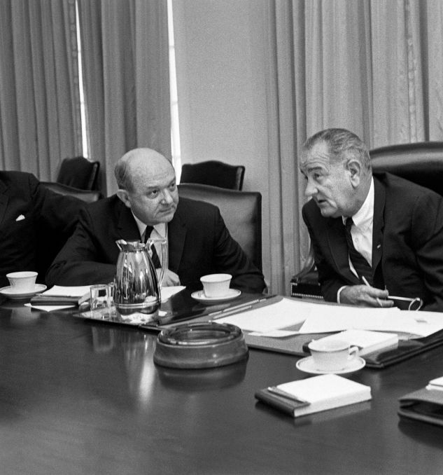
Continued commitment
Johnson remained committed to Kennedy’s policy but did increase US involvement.
Secretary McNamara and CIA director McCone issued pessimistic assessments by the end of 1963 reporting the need for dramatic change in Saigon’s actions.
Senator Mike Mansfield recommended a neutral government in Vietnam but this view was rejected.

Slide 9
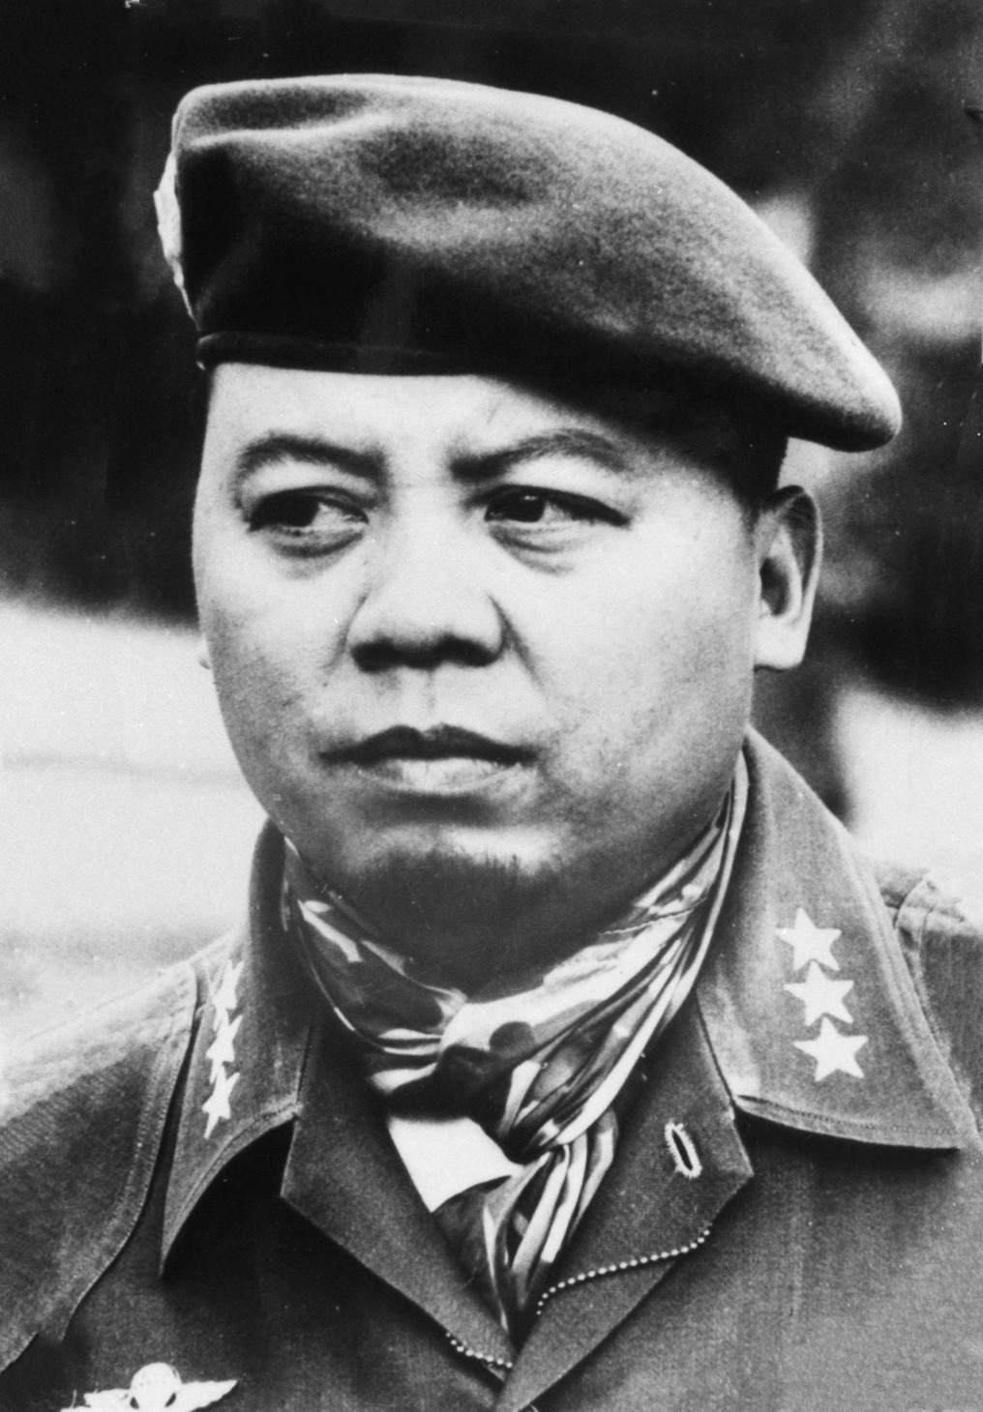
Instability in Saigon
By the end of 1963, the ARVN had 215,000 troops, 83,000 civil guard and more than 200,000 irregular forces.
The CIA estimated PLAF strength below 25,000 (+60-80,000 irregulars).
General Duong Van Minh proved an ineffective Chief of State and was overthrown in a coup by General Nguyen Khanh on 29th January 1964.
Johnson adopted a flexible response while the administration considered a resolution that could give the president authority to use military force in Vietnam.

Slide 10
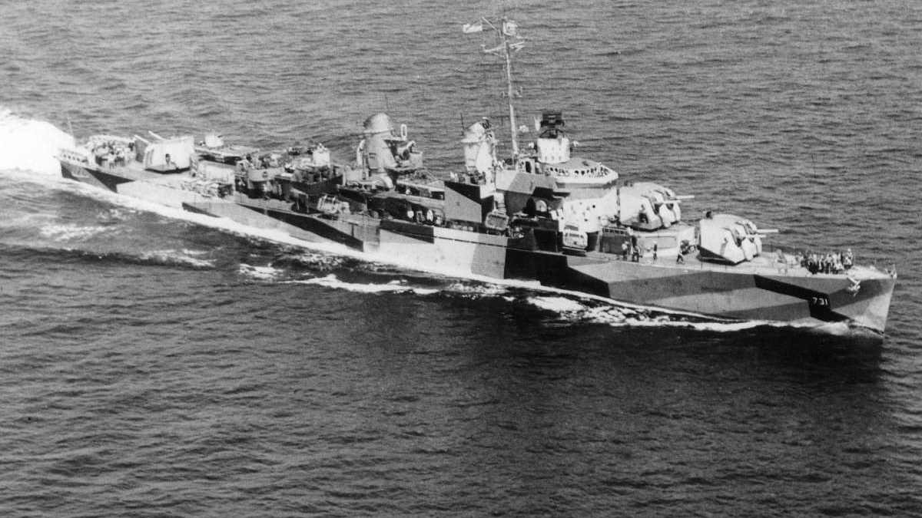
How was Johnson able to escalate the war?

Slide 11
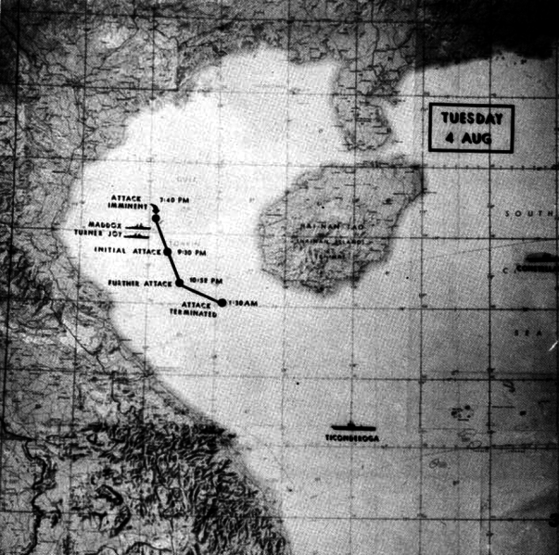
Gulf of Tonkin Incident
30th July 1964 south Vietnamese ships under the direction of the US military, shelled two north Vietnamese islands in the Gulf of Tonkin.
2nd August the destroyer USS Maddox was moving through international waters in the gulf when a north Vietnamese torpedo boat squadron moved to attack (it missed).
US planes damaged two of the north Vietnamese boats and destroyed a third.

Slide 12
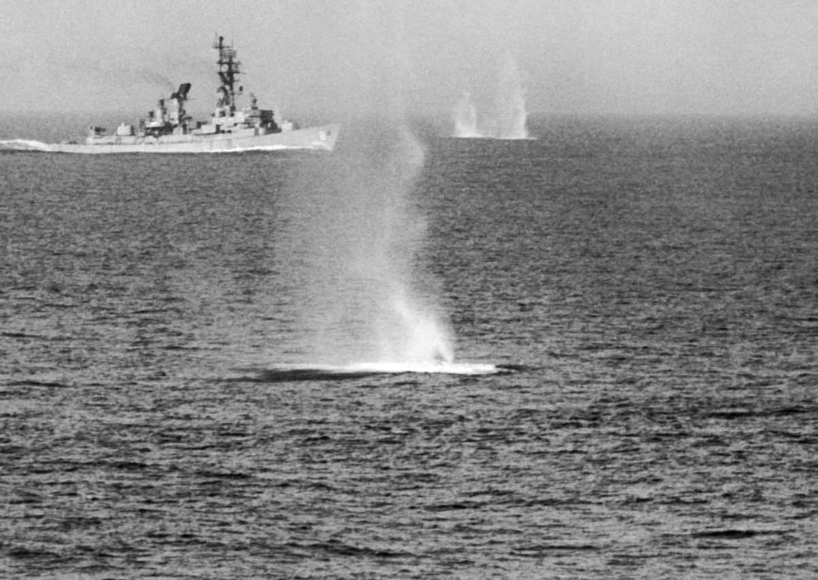
Response
It is not clear who ordered the attack, some point to the First Secretary Le Duan.
In Washington, Johnson rebuffed urges for immediate retaliation and instead issued a warning to north Vietnam.
4th August American radio operators mistranslate north Vietnamese radio traffic and concluded that a new military operation was imminent.

Slide 13
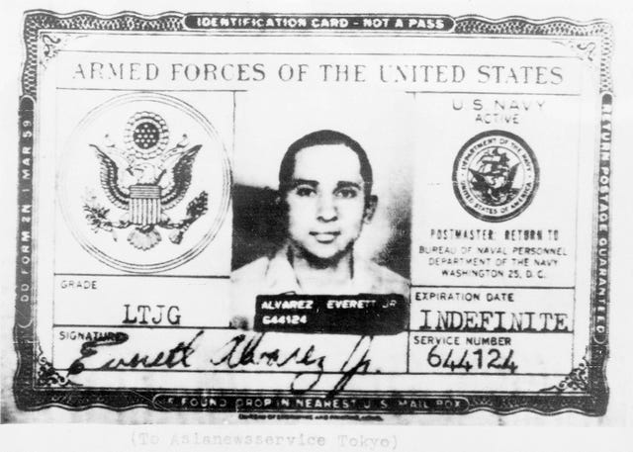
A second attack?
A second attack didn’t come but operators aboard the Maddox and Turner Joy convinced themselves one had.
Johnson announced to the nation (4th August) “We seek no wider war.”
Lieutenant Everett Alvarez was ordered to attack torpedo boat installations and oil facilities. He was the first US pilot to be shot out of the sky over north Vietnam and the first to be imprisoned there.

Slide 14
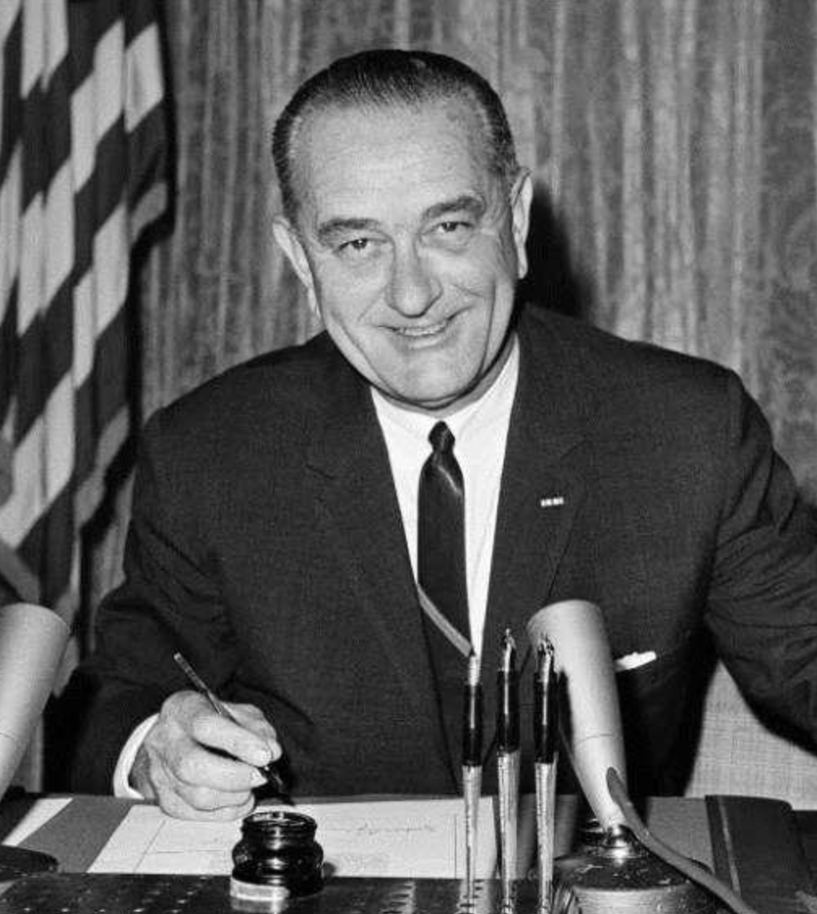
Gulf of Tonkin Resolution
The Tonkin incident have Johnson the opportunity to go to congress and ask for a resolution that would allow him to intervene militarily.
7th of August by vote of 88 to 2, the Senate passed what came to be called the Tonkin Gulf Resolution.
Support for Johnson's handling of the war jumped overnight from 42 to 72%.
The north stepped up their efforts to win the struggle in the South before the United states escalated its presence by sending in combat troops.

Slide 15
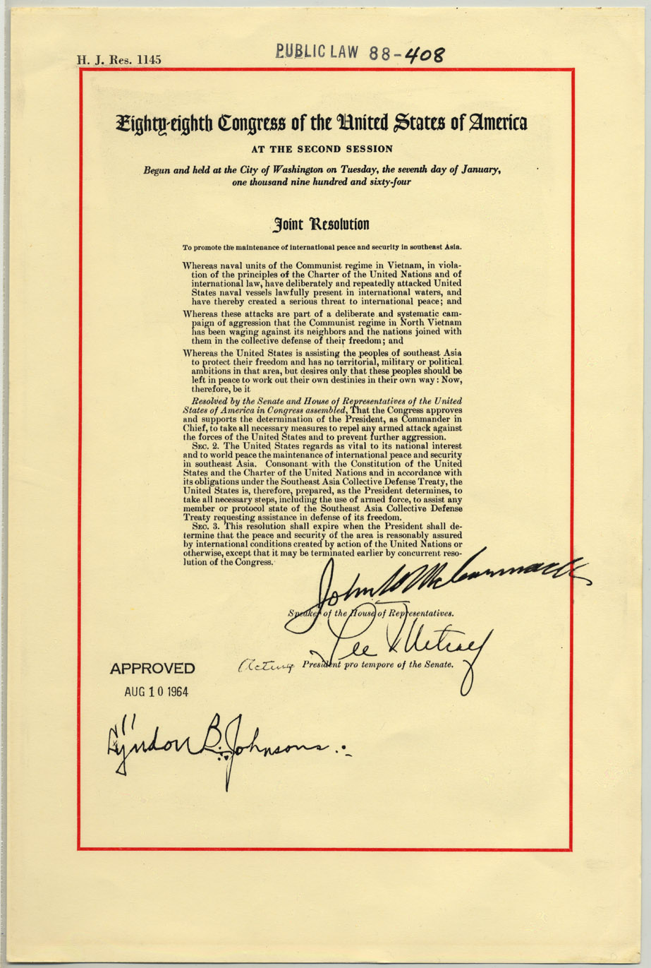
Task: Was the U.S. planning to go to war with North Vietnam before the Gulf of Tonkin incident?

Slide 16
