Slide 1
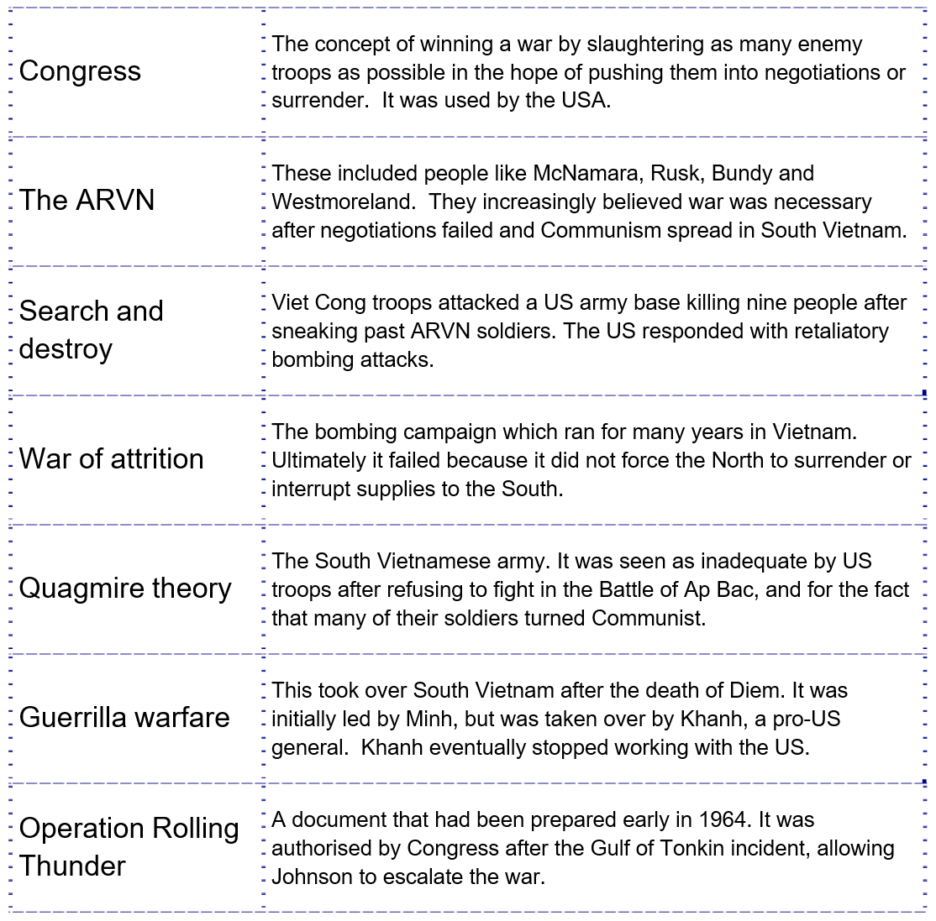
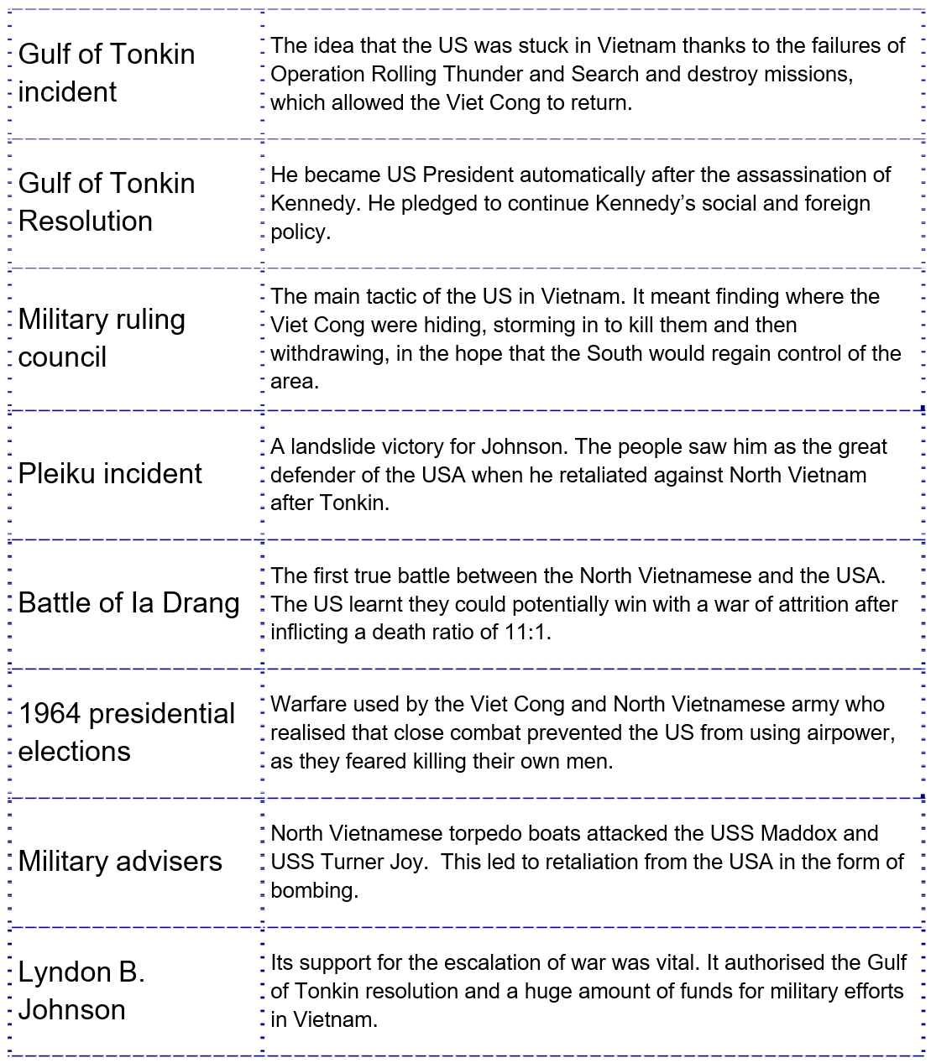
Starter

Slide 2
Johnson’s escalation
Americanization of the Vietnam War, 1965-1968

Slide 3
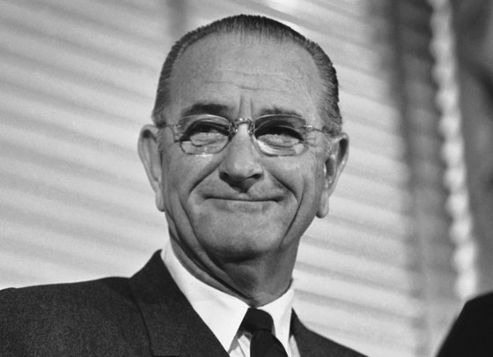
Why escalation?
In 1964 Johnson’s administration was already agreeing on the setback of ‘limited war.’
The Saigon regime was not winning the war and escalation from the VC was evident throughout late 1964 into 1965.
Key dates for South Vietnamese governments
July 1954 to November 1963 | Diem
November 1963 to January 1964 | General Minh
January 1964 to February 1965 | General Khanh
February 1965 to June 1965 | Dr Quat
June 1965 to September 1967 | Air Vice-Marshall Ky
September 1967 to April 1975 | Thieu

Slide 4
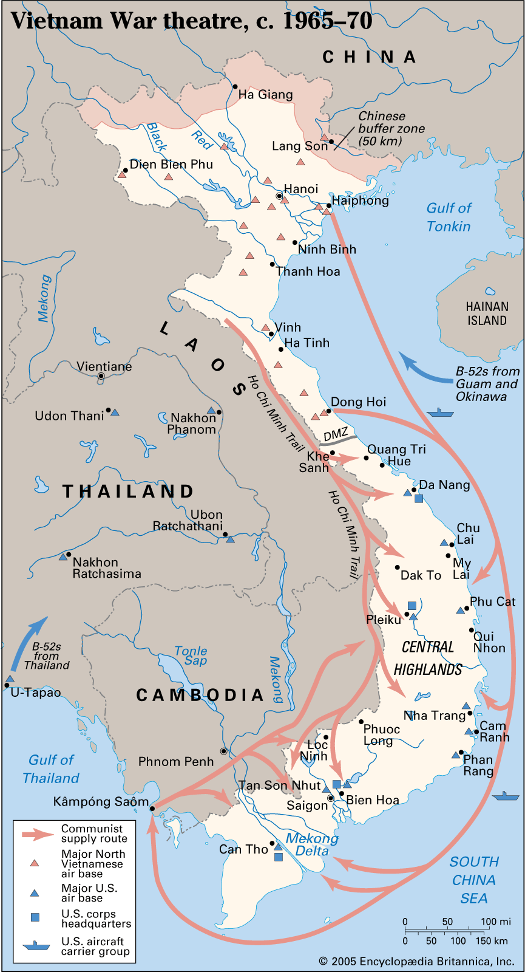
A two-phased escalation
Phase One: armed reconnaissance strikes and retaliatory strikes.
Phase Two: Graduated military pressure (aerial bombing and US ground troops).

Slide 5
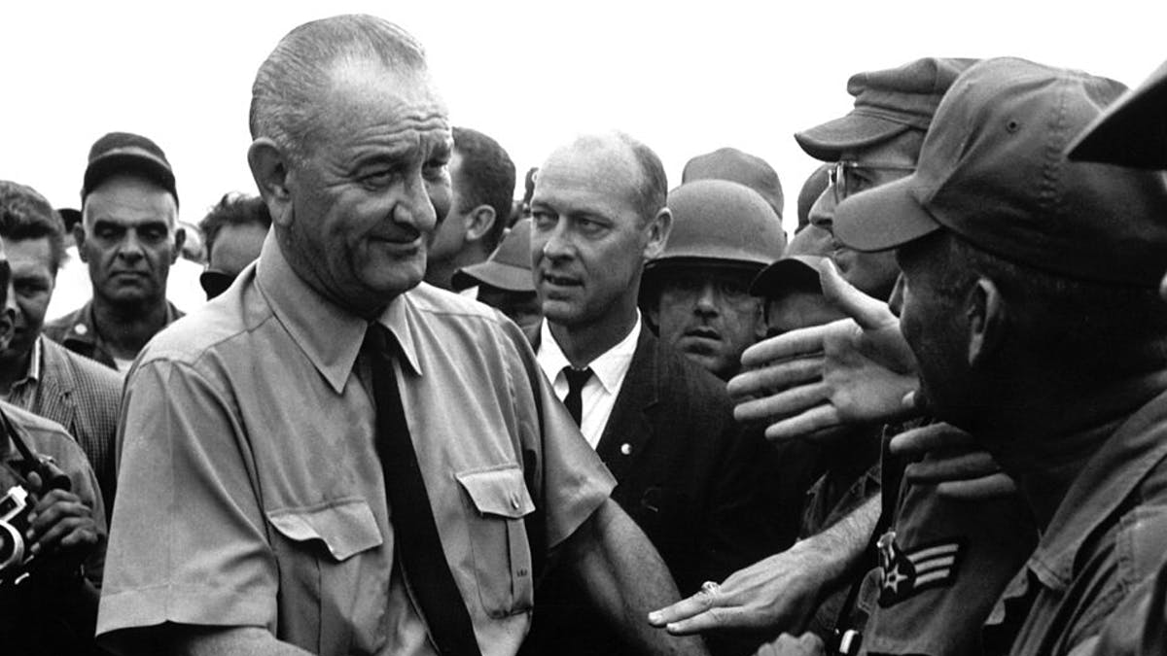
Reading: attempts at settlement

Slide 6
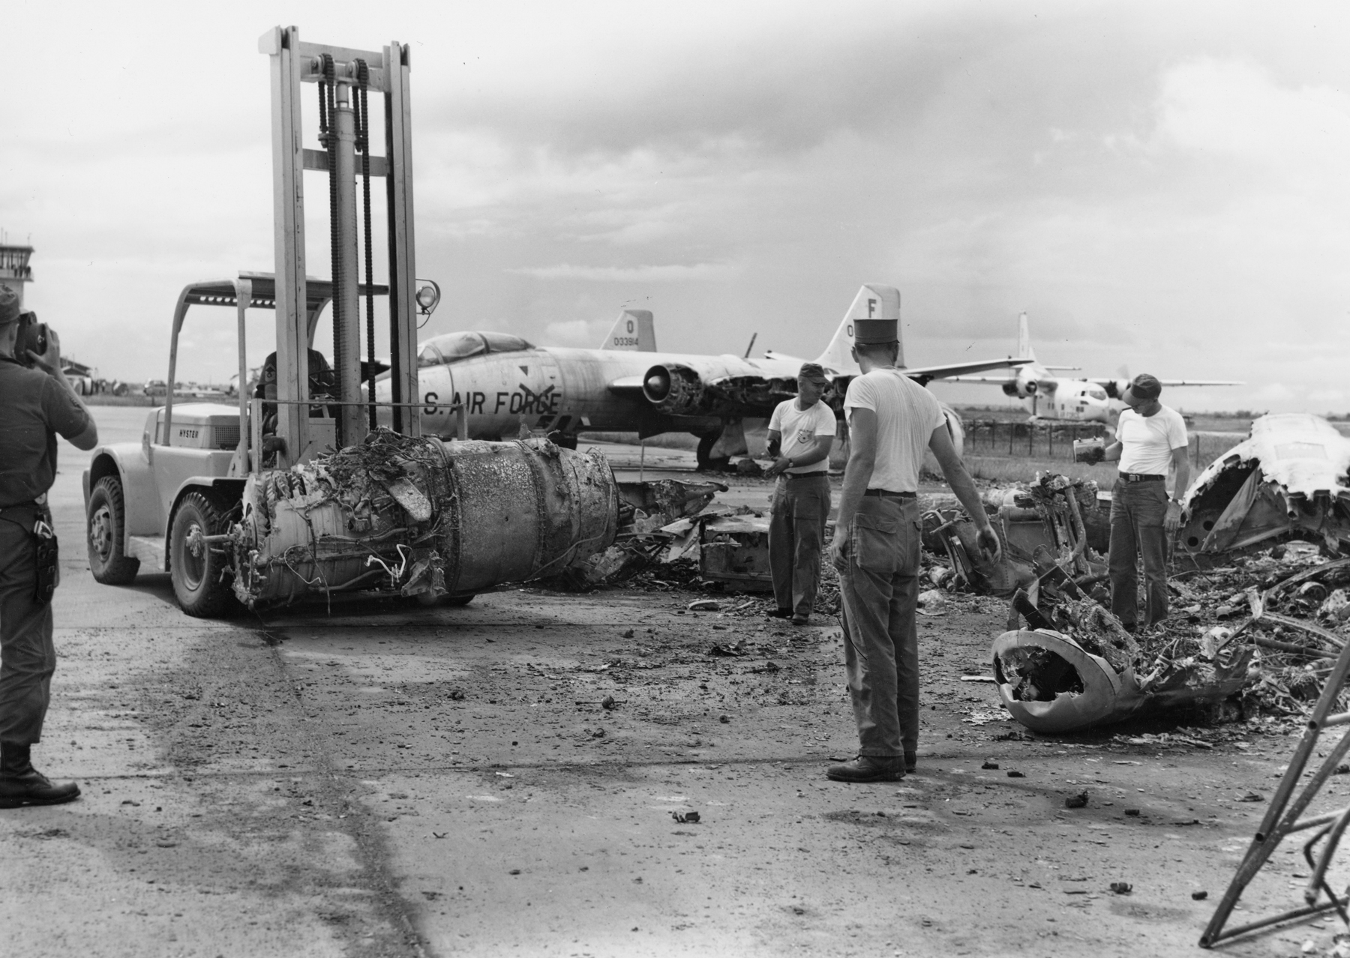
VC aggression
November 1964 attack on US airbase near Saigon.
VC mortar attack at Bien Hoa (left) kills four Americans.
Christmas Eve 1964 VC plant a bomb in a bar frequented by American officers.
February 1965 VC attack a huge American camp near Pleiku.
Johnson authorises Rolling Thunder 13th February 1965.
A Viet Cong mortar attack on Bien Hoa Air Base in November 1964 marked a major escalation in hostilities. Four Americans died and 72 were wounded.

Slide 7
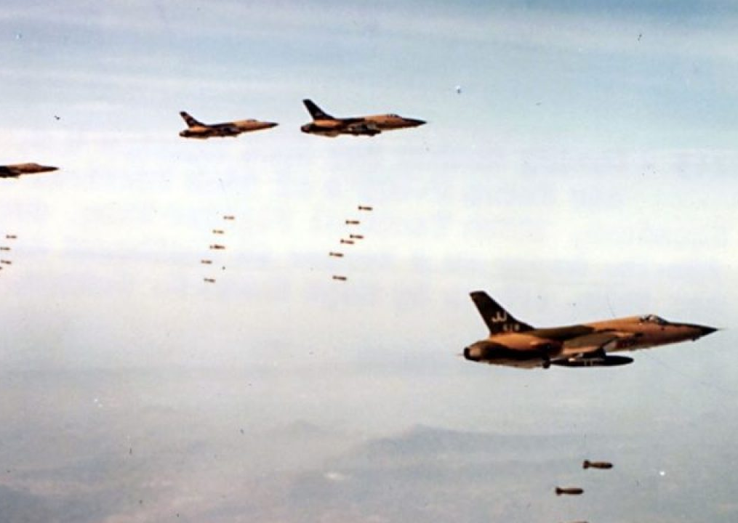
Rolling Thunder (March ’65 – October ’68)
Aim:
Provide Saigon government time to broaden political support and assume command of the war
Intimidate Hanoi into negotiations
Interrupt communication and infiltration into the South

Slide 8
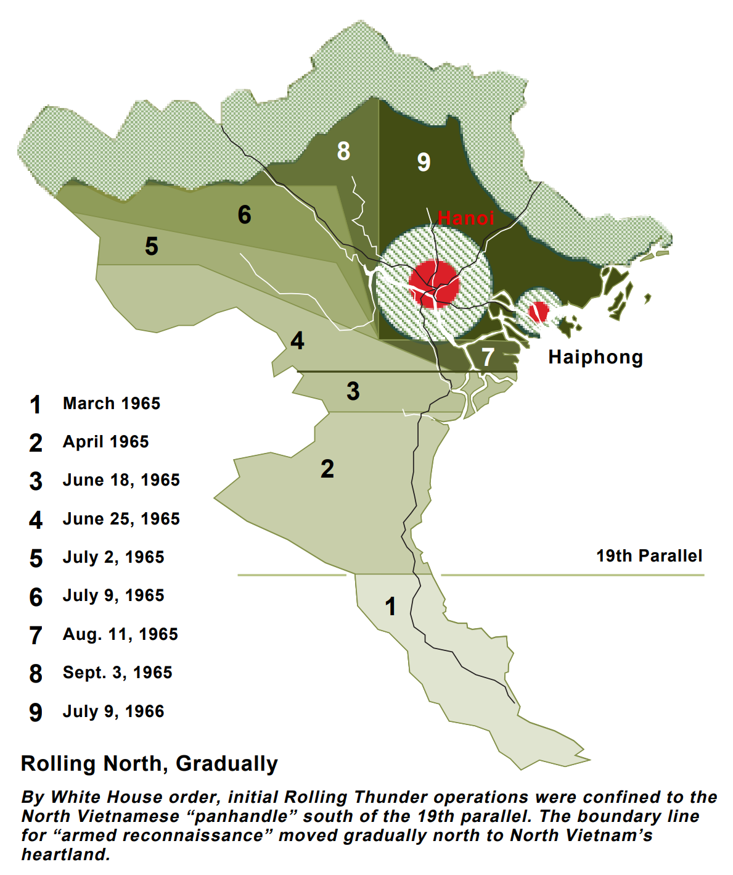
Gradual expansion
Johnson gradually expanded the campaign to include additional targets and more frequent attacks.
The North Vietnamese built air defences over time (SA-2 SAM, MiG fighters and radars of Soviet design supplied by the SU and China).
The first targets around Hanoi and Haiphong were not approved until October and November 1965.

Slide 9
Failures
In 1966 bombing expanded to include North Vietnam’s oil storage facilities (destroyed 70% North’s capacity).
However, the campaign failed to achieve its objectives on account of Vietnam’s agricultural landscape.
Northern infiltration into the south increased from 35,000 in 1965 to 90,000 in 1967

Slide 10
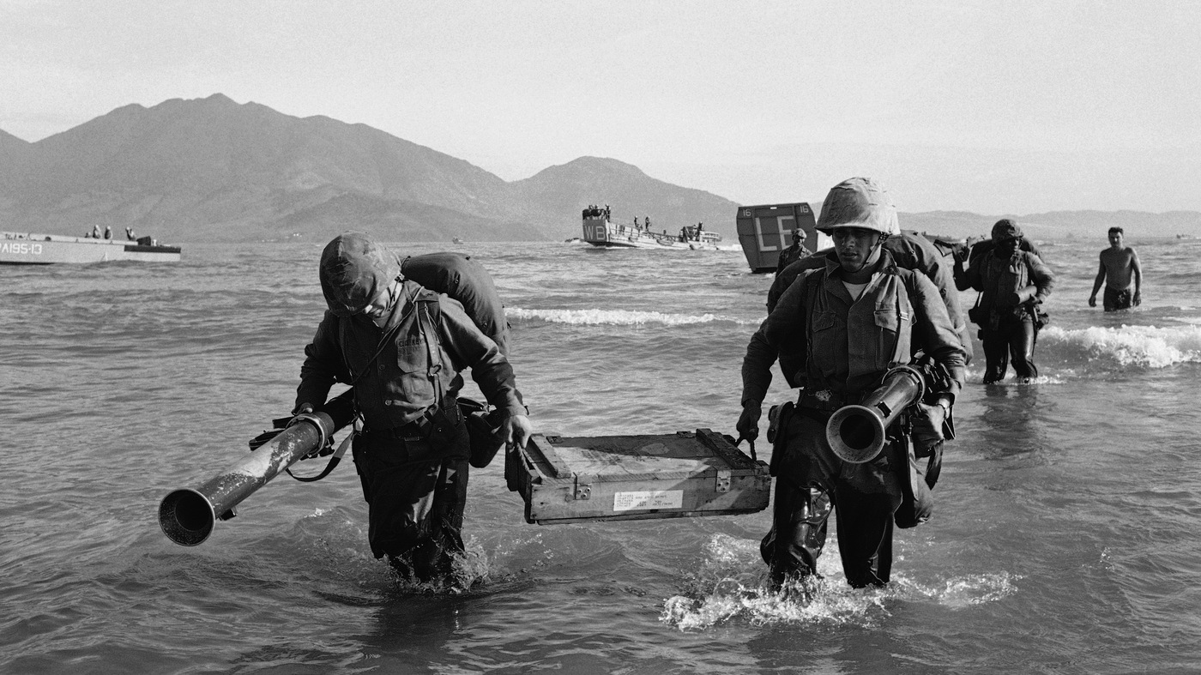
Ground troops
8th March 1965, the first U.S. combat battalions came ashore near Danang.
Late July 1965 Johnson approved the immediate deployment of an additional 50,000 U.S. troops.
Ground troop numbers reaches 180,000 by the end of 1965 and 536,000 in 1968.

Slide 11
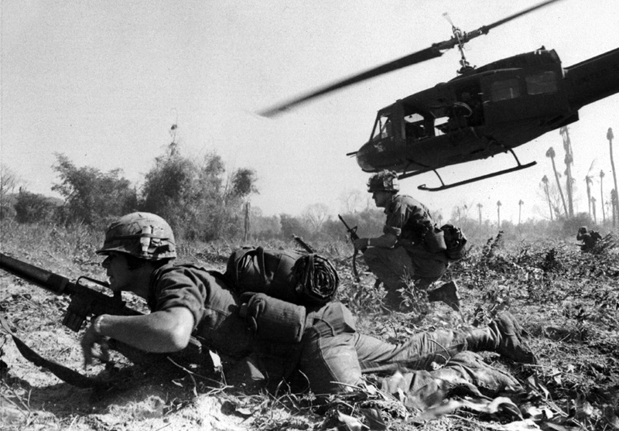
Ia Drang
The 66th regiment of the PAVN travelled south in Autumn 1965.
In November they clashed with the US army in a 34-day battle.
305 Americans and 3561 North Vietnamese died.
It was the first significant contact between US and North Vietnamese forces.
It demonstrated the determination of the northern forces in spite of the high causalities.

Slide 12
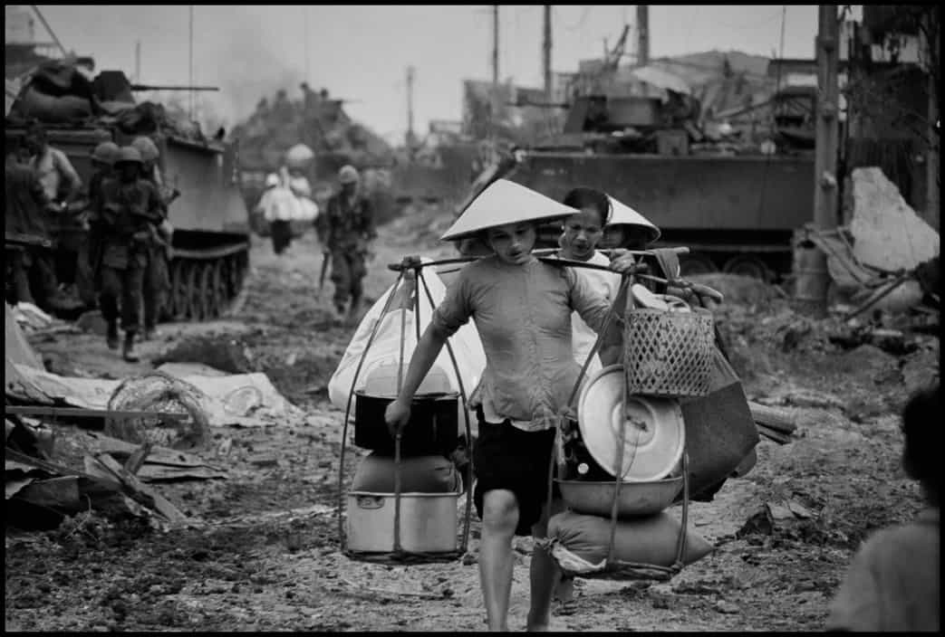
Stalemate
Americanization achieved the immediate aim of staving off South Vietnamese defeat.
What the years 1965-8 demonstrate clearly was that war would not be swiftly won.
General Westmoreland’s belief in a strategy of attribution was sorely mistaken with US reliance on massive military alienating the South Vietnamese and bringing new recruits to the VC.

Slide 13
How valuable is the following source to a historian studying US involvement in Vietnam by 1965?
From a speech by Lyndon Johnson in 1965. The US president explains why the USA continued to be involved in Vietnam.
We have a promise to keep. Since 1954 every American president has offered support to the people of South Vietnam. We have helped to build and defend its independence. To dishonour that promise and abandon this small, brave nation to its enemies, and the terror that must follow, would be an unforgivable wrong. We are also there to strengthen world order. Around the globe are people whose well-being rests partly on believing they can count on us if attacked. To leave Vietnam to its fate would shake these people’s confidence in the value of America’s word. Let no one think for a moment that retreat from Vietnam would bring an end to conflict. The battle would be renewed in one country and then another. The appetite of aggression is never satisfied. In Southeast Asia, as we did in Europe, we must follow the words of the Bible: ‘Hirtherto shalt thou come, but no further.’
Notes:
Next up:
Respective tactics
Tet Offensive
Extension of the war into Cambodia and Laos

