Slide 1
Read the following summary on the escalation of the US involvement in Vietnam and find and correct as many mistakes as you can (8 in total).
JFK was assassinated on 24th November 1963 and replaced by Landan B. Johnson. Johnson continued Kennedy’s policy of helping South Vietnam defend itself, but the situation was getting worse, with 27% of the countryside under communist control, and the leadership of the DMC unpopular. Furthermore, two US ships were attacked in the Gulf of Bahrain in August 1964, leading to a resolution stating that the US would use ‘any necessary measures’ to save South Vietnam. Johnson’s swift response ensured he won a narrow victory in the 1964 presidential election. Attacks on the US continued, and on 6th February 1965 a US base in Pleiku was attacked and nine US service personnel died. This led to a retaliatory bombing campaign known as ‘Flaming Arrow’. Congressional Eagles and presidential advisors like McNamara pushed for further escalation, and the first ground troops were sent to Vietnam in March 1965.

Slide 2
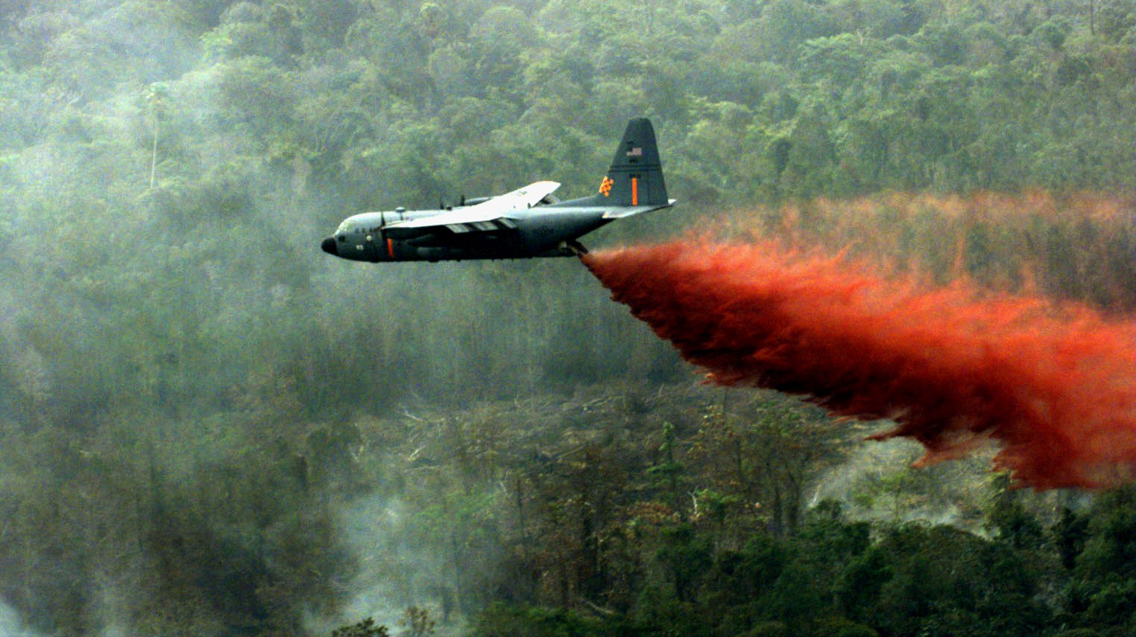
US tactics and the north’s responses
1965-1968
Were US military operations doomed to fail?

Slide 3
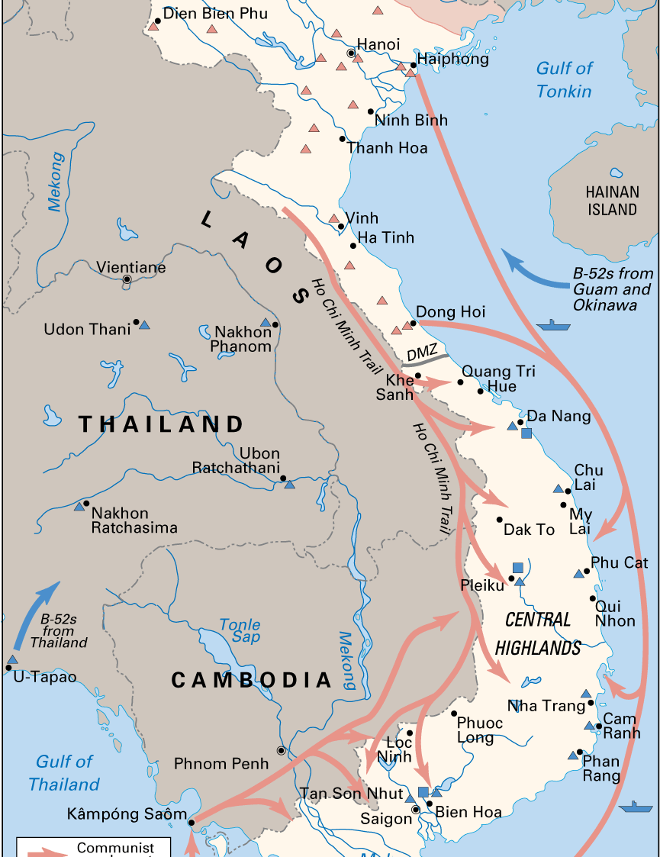
HCMT
The system provided manpower and supplies to the Viet Cong and the North Vietnamese Army (PAVN) – it was never a single route.
Around 50,000 women were employed at any one time to repair the road.
The Soviets and Chinese provided thousands of cheap trucks. While Hanoi lost many trucks, each worth around $6000, the Americans lost many bombers, each worth several million dollars.

Slide 4
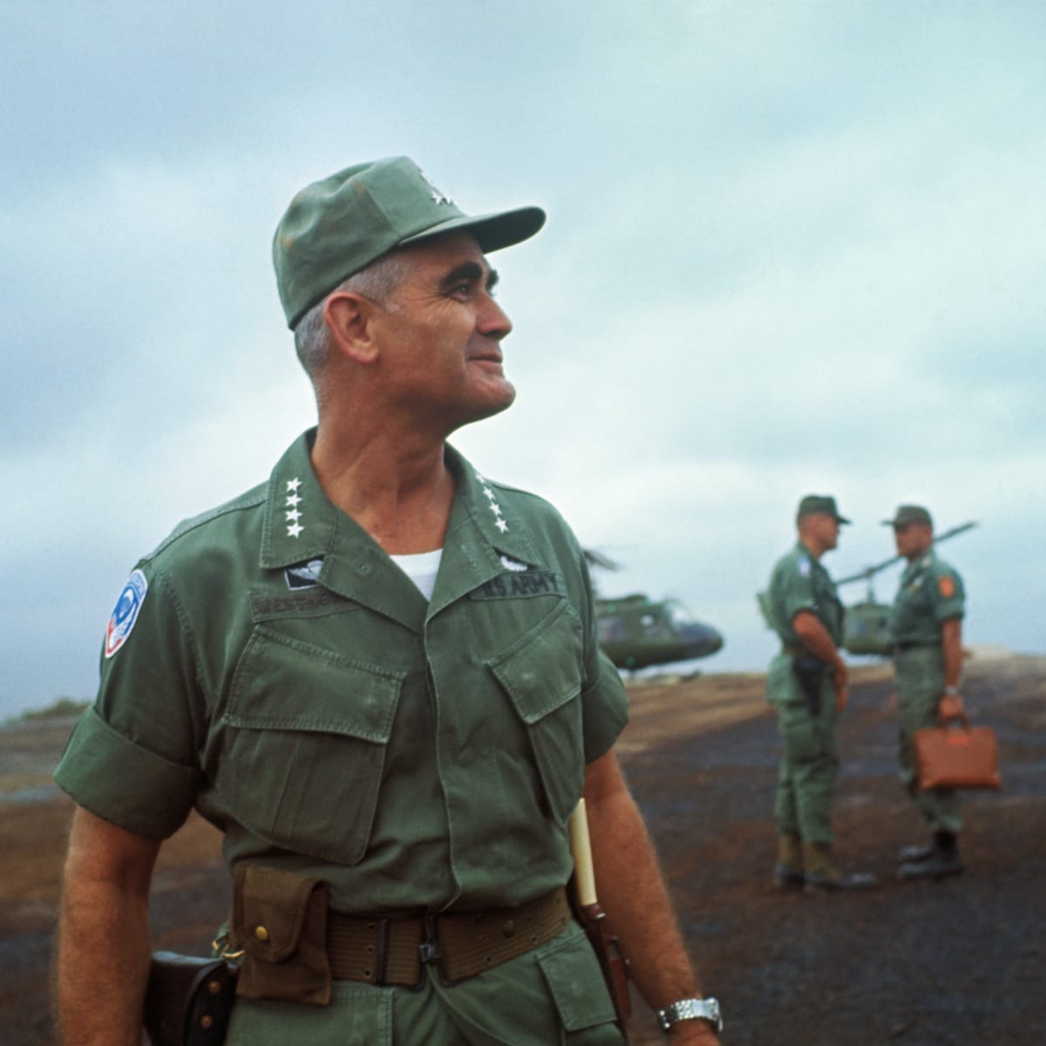
War of attrition
Westmoreland’s attrition strategy played to American strengths in firepower and mobility and minimised US casualties.
Summer 1965, VC offensives were destroying ARVN units at the rate of one battalion (500-1,000 men) per week.
Phase One: US troops would be used to protect developing American logistics systems.
Phase Two: Eliminate the enemy’s base camps and sanctuaries in “search and destroy” missions.
Phase Three (1967): target remaining forces and push them into remove areas.
General William Westmoreland – Commander of the Military Assistance Command Vietnam (COMUSMACV)

Slide 5
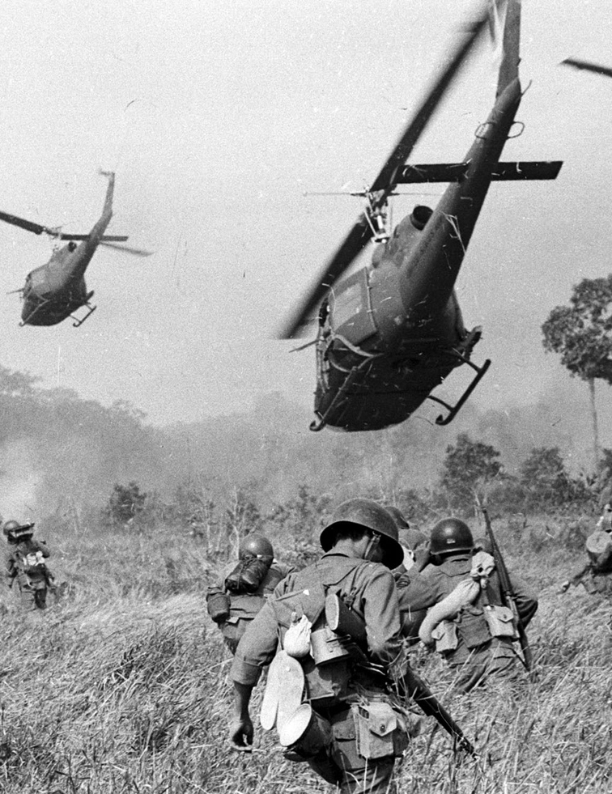
Limitations
Operations were hampered by inadequate logistical support systems.
Manpower shortages delayed Westmoreland’s build-up of combat forces.
Training in the States had not prepared them for the type of warfare they faced.
All South Vietnam was a fluid battlefield.
Westmoreland never had enough combat effectives to occupy an areas after a battle for they had to be withdrawn after a campaign ended.

Slide 6
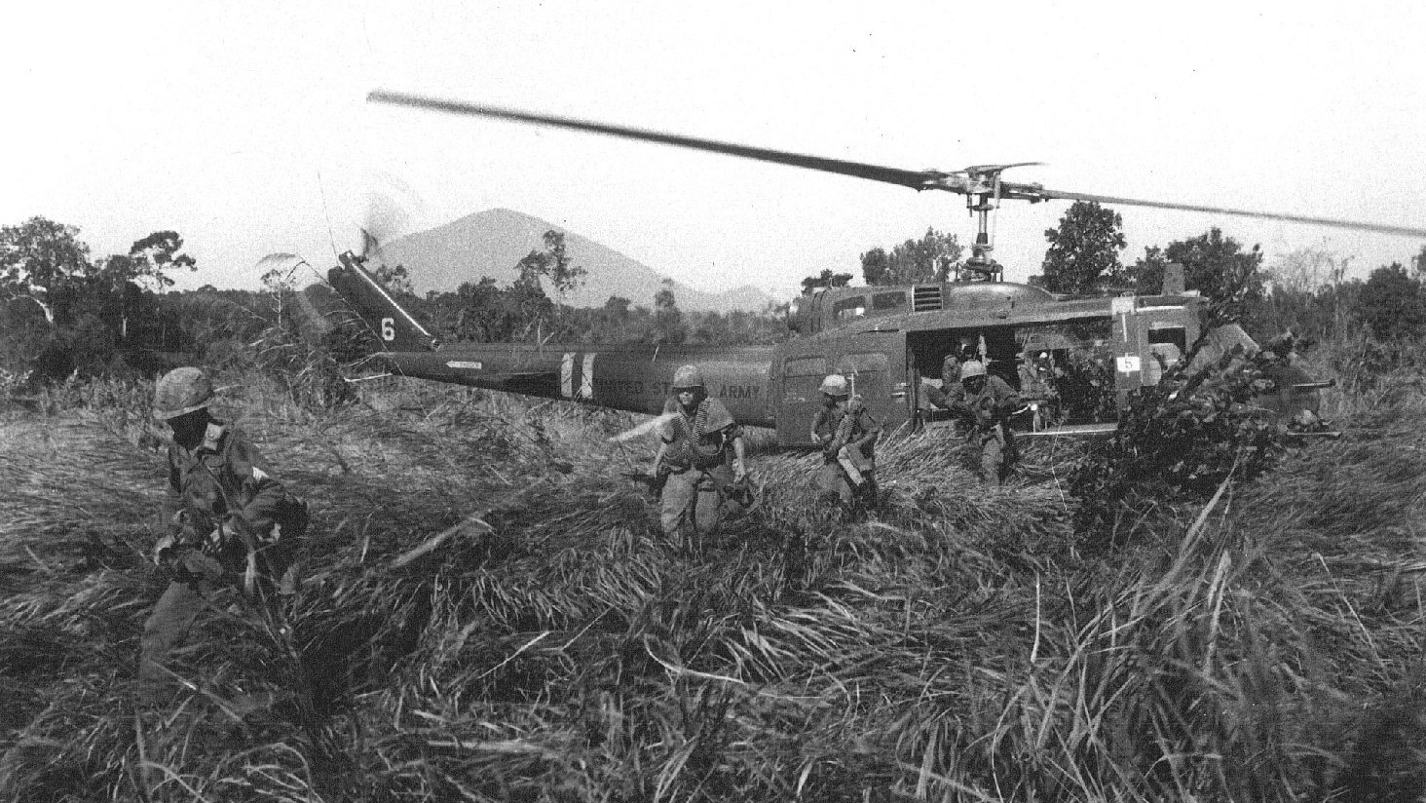
Operation ATTLEBORO
Search and Destroy
A series of battles spread over a month killing over 1,100 enemy.

Slide 7
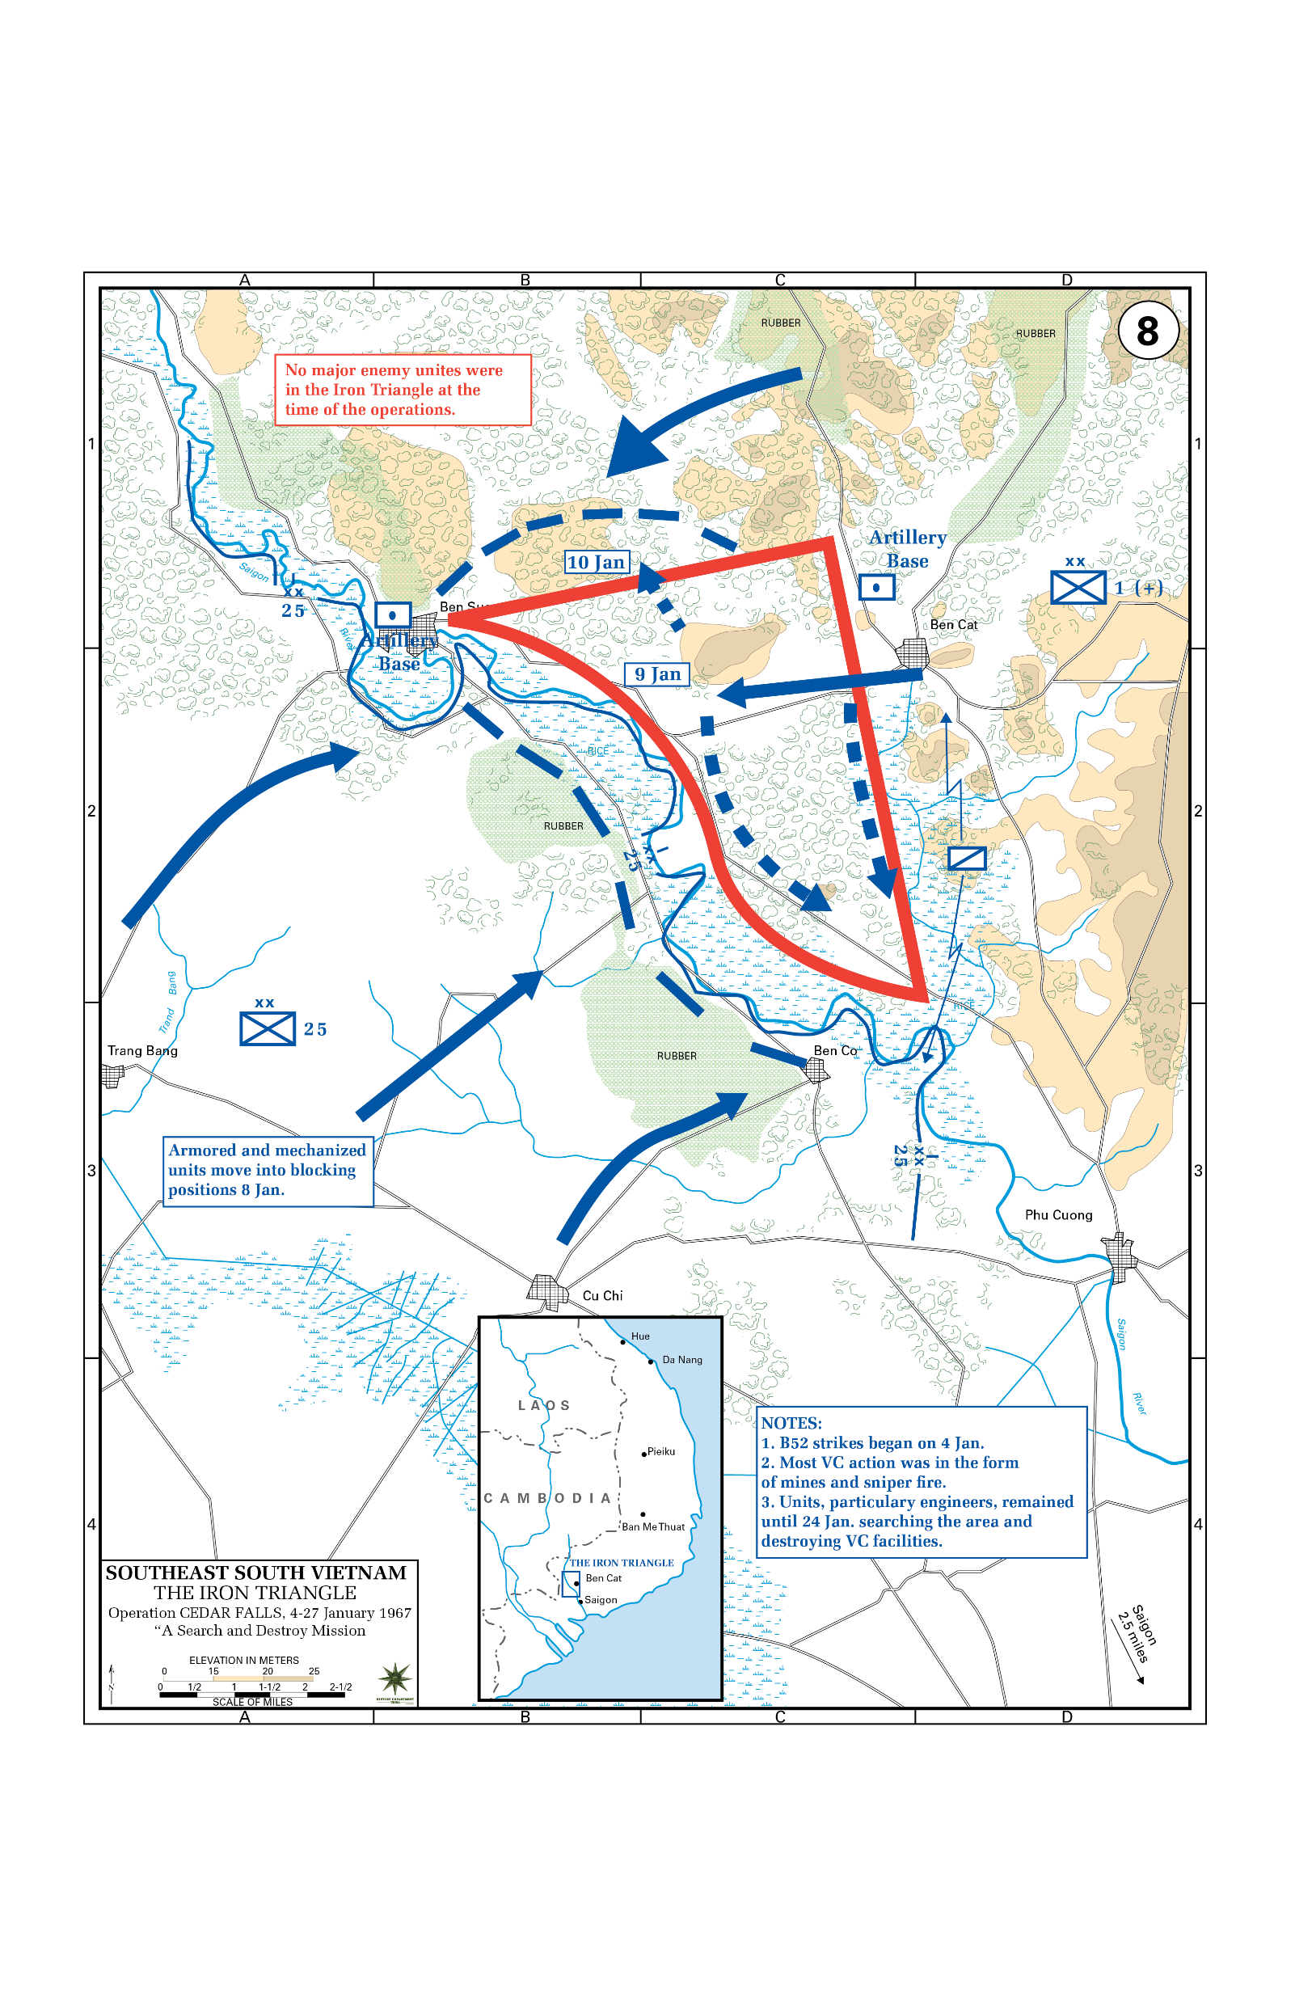
Operation CEDAR FALLS
~700 VC dead and a further 700 captured/turned themselves in.
a chemical unit combed nearly 12 miles of tunnels that were exposed at various locations
The entire region was bombed, shelled, strafed and burned to destroy any remaining structures and tunnels
However, the VC quickly returned to the Iron Triangle, rebuilt and resupplied their base and threatened the region around Saigon.

Slide 8
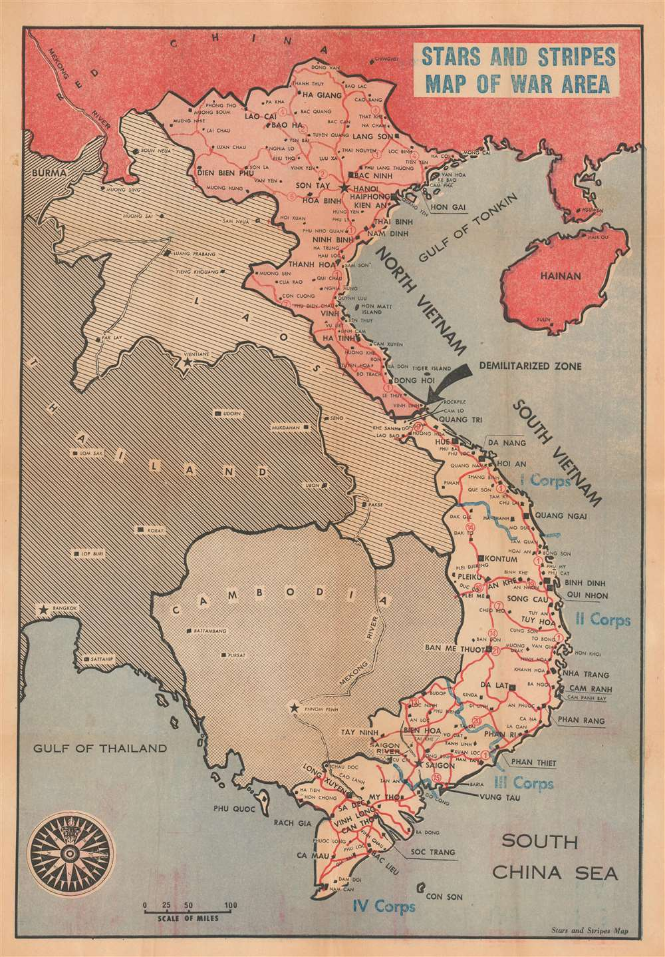

Slide 9
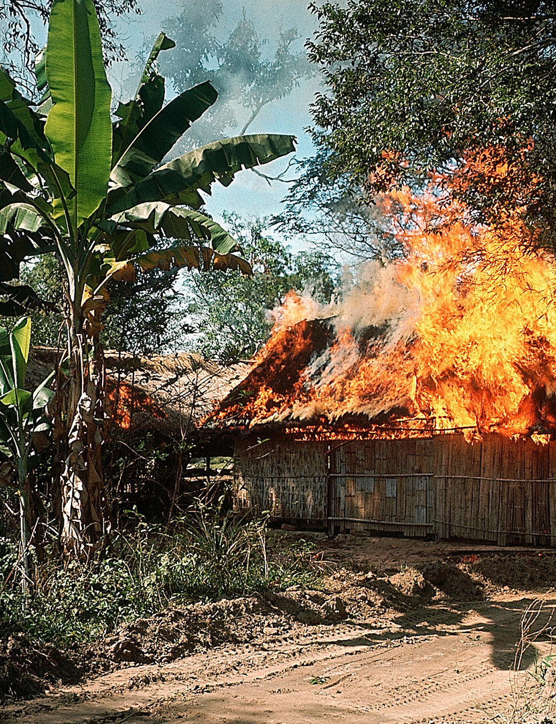
Failings of attrition
The VC and NVA still determined where and when they wanted to fight and for how long.
They could seek refuge across the Cambodian border, took advantage of poor weather or kept close to US troops to prevent air support.
The Communists could absorb huge losses and continue to fight
Bombing and artillery fire disrupted the South Vietnamese rural economy, diminished rice production, inadvertently killed civilians, and generated millions of refugees (25-35% of the South Vietnamese population).

Slide 10
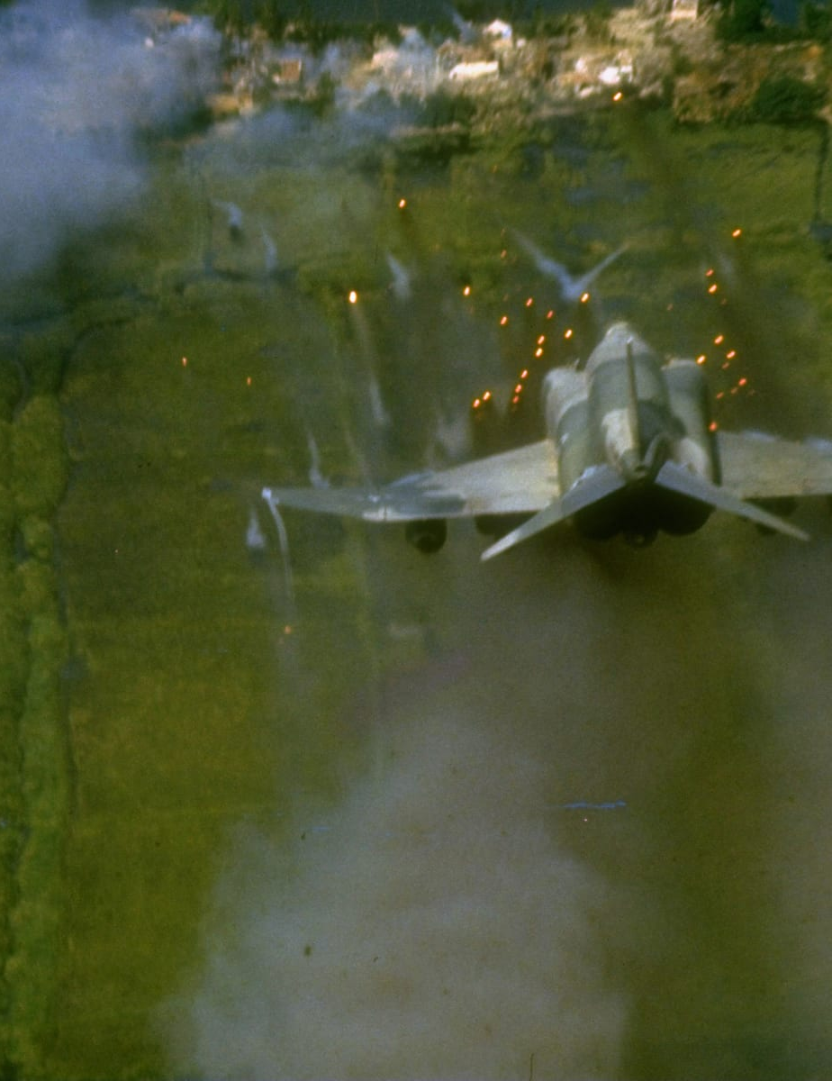
Rolling Thunder
There was a pause 24th December 1965 – 1st February 1966 to get negotiations going; Hanoi also gave no indication that it was ready to negotiate an end to the war on American terms.
After months of discussion, Johnson's military and civilian advisers finally convinced to being raids on petroleum producing facilities (LBJ popularity rating 42% → 54%).
Damage offset by military aid from SU and PRC.
Failed to reduce the north Vietnam’s ability to infiltrate men and supplies into South Vietnam – it did not break Hanoi’s will.

Slide 11
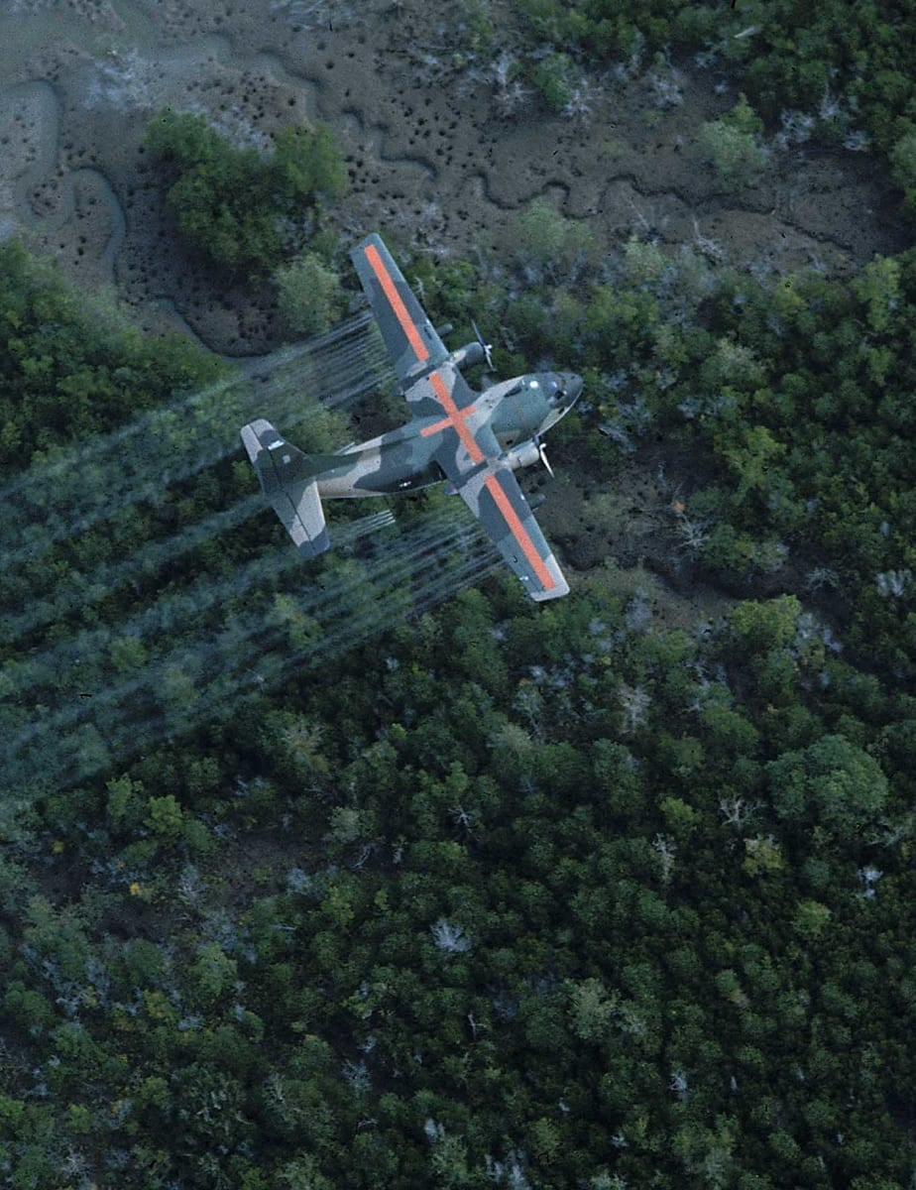
Operation RANCH HAND
An extensive campaign of aerial defoliation intended to deprive the guerrillas of forest cover and to destroy VC good crops (initiated on a small scale in 1962)
Largely delivered by USAF C-123s fitted with 1,000 gallon tanks with bars of spray nozzles on the underside.
Most versatile, effective and widely used was Agent Orange (Dioxin) – one C-123 could dispense 11,000 pounds over 300 acres.
The operation destroyed ½ of South Vietnam’s timberlands – suspended on 15th April 1970.

Slide 12
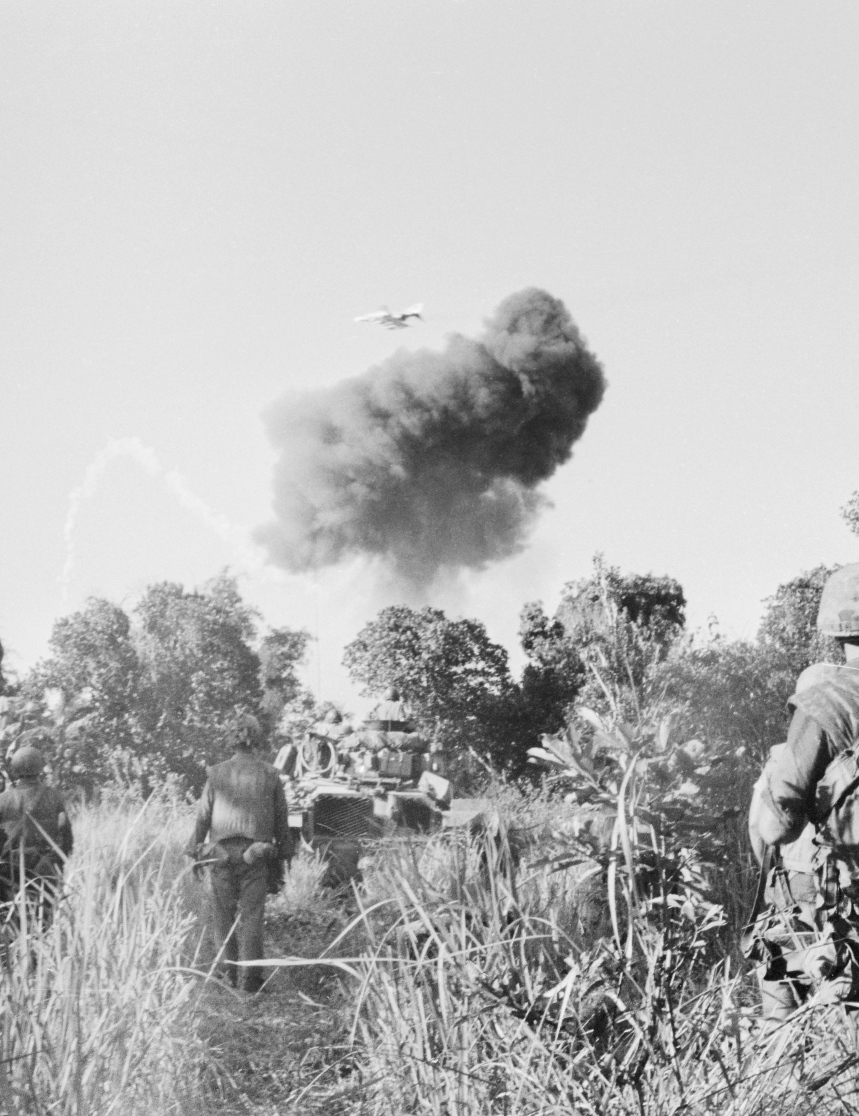
Napalm
Highly flammable sticky jelly used in incendiary bombs.
First authorised by LBJ on 9th March 1965.
Generates temperatures up to 1,200 degrees Celsius, instantly killing those at the epicentre of the attack.

Slide 13
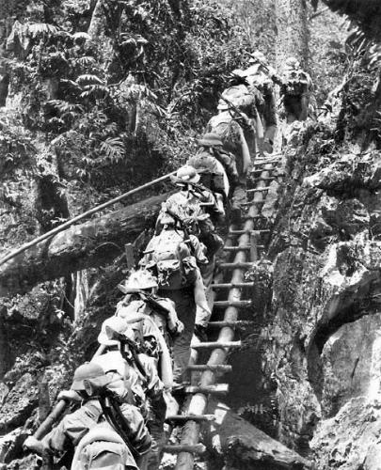

North Vietnamese perseverance
The government claimed to have dug over 30,000 miles of tunnels, and in heavily bombed areas the people spent much of their lives underground.
Around 90,000 North Vietnamese, many women and children, worked full-time keeping transportation routes open.
Losses in military equipment were more than offset by increased aid from the Soviet Union and China.
The bombing created a need for sophisticated military equipment only the Soviet Union could provide.

Slide 14
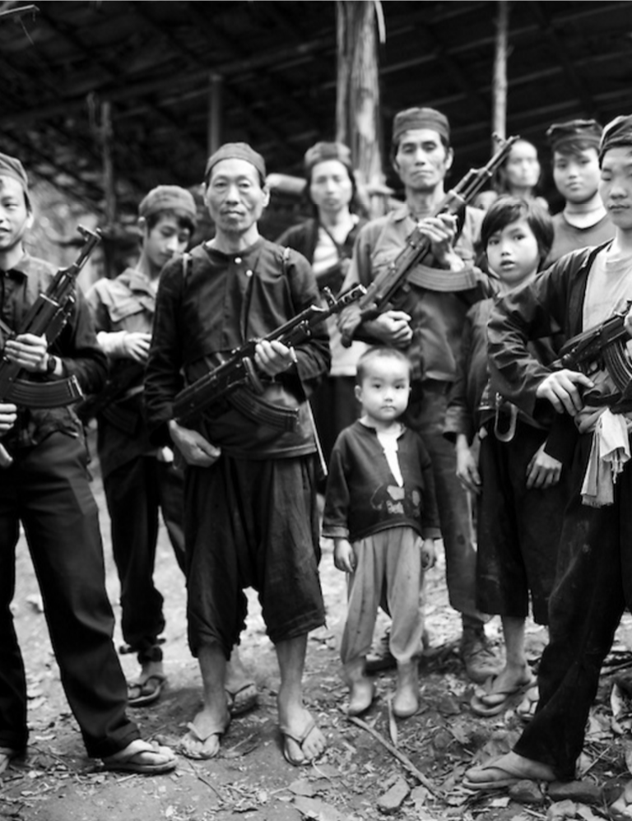
War in Laos
1962 Geneva Accords created a neutral Laos; US provided aid to the royalist government but Communist insurgencies (Pathet Lao) continued war against the government.
The HCMT travels through the mountainous regions of eastern Laos.
Washington use the CIA to train Hmong tribesmen to fight the Pathet Lao.

Slide 15

Air war in Laos
Extensive bombing starts in 1964 and was expanded to ~3,000 sorties a month during 1967.
1964-1967 ~450,000 tons of bombs were dropped in Laos.
Bad weather and terrain hampered the US air operations.
The HCMT was invisible from the air; intercepting the movement of soldiers, weapons and supplies was only marginally successful.

Slide 16


Slide 17
Summary task
 | Tactics | Description | Impact
US
N. Vietnam
Remember to include: Operation Rolling Thunder, Search and Destroy (Cedar Falls), Operation Ranch Hand, Napalm, Booby Traps, Tunnel System, Ho Chi Minh Trail

