Slide 1
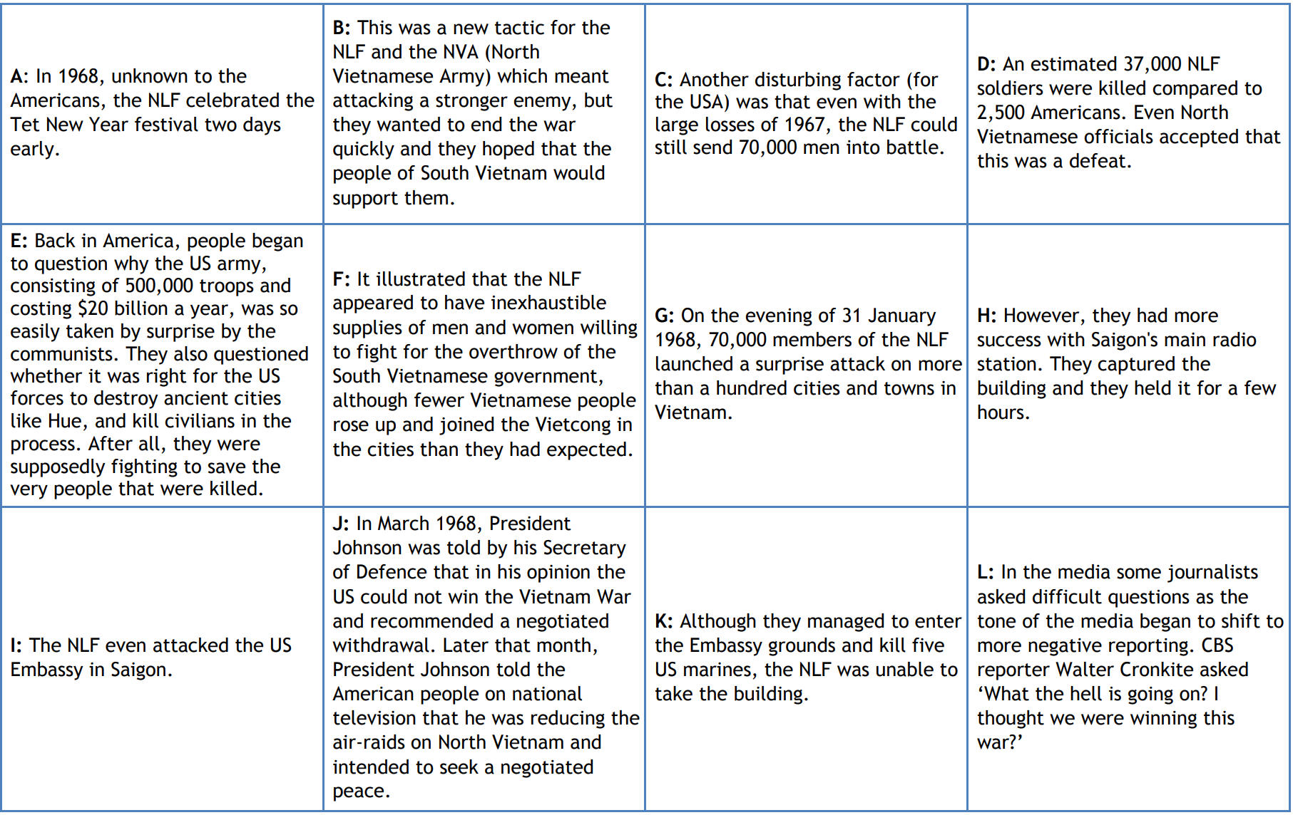

Slide 2
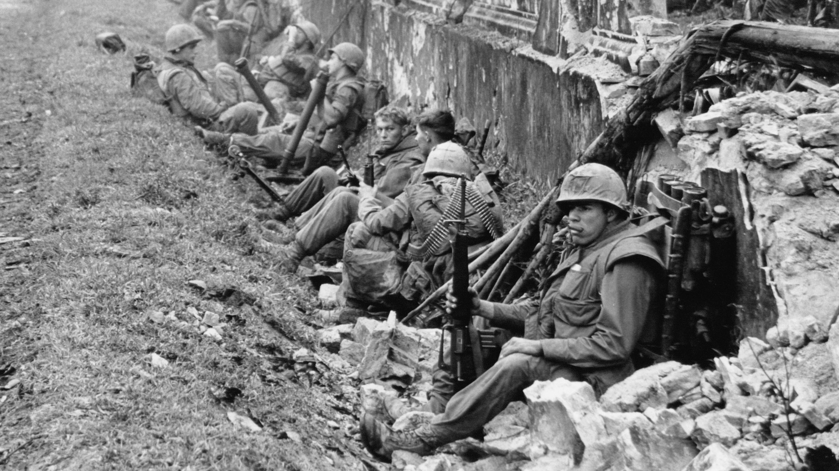
The Tet Offensive 1968
How much of a turning point was this in the Vietnam War?

Slide 3
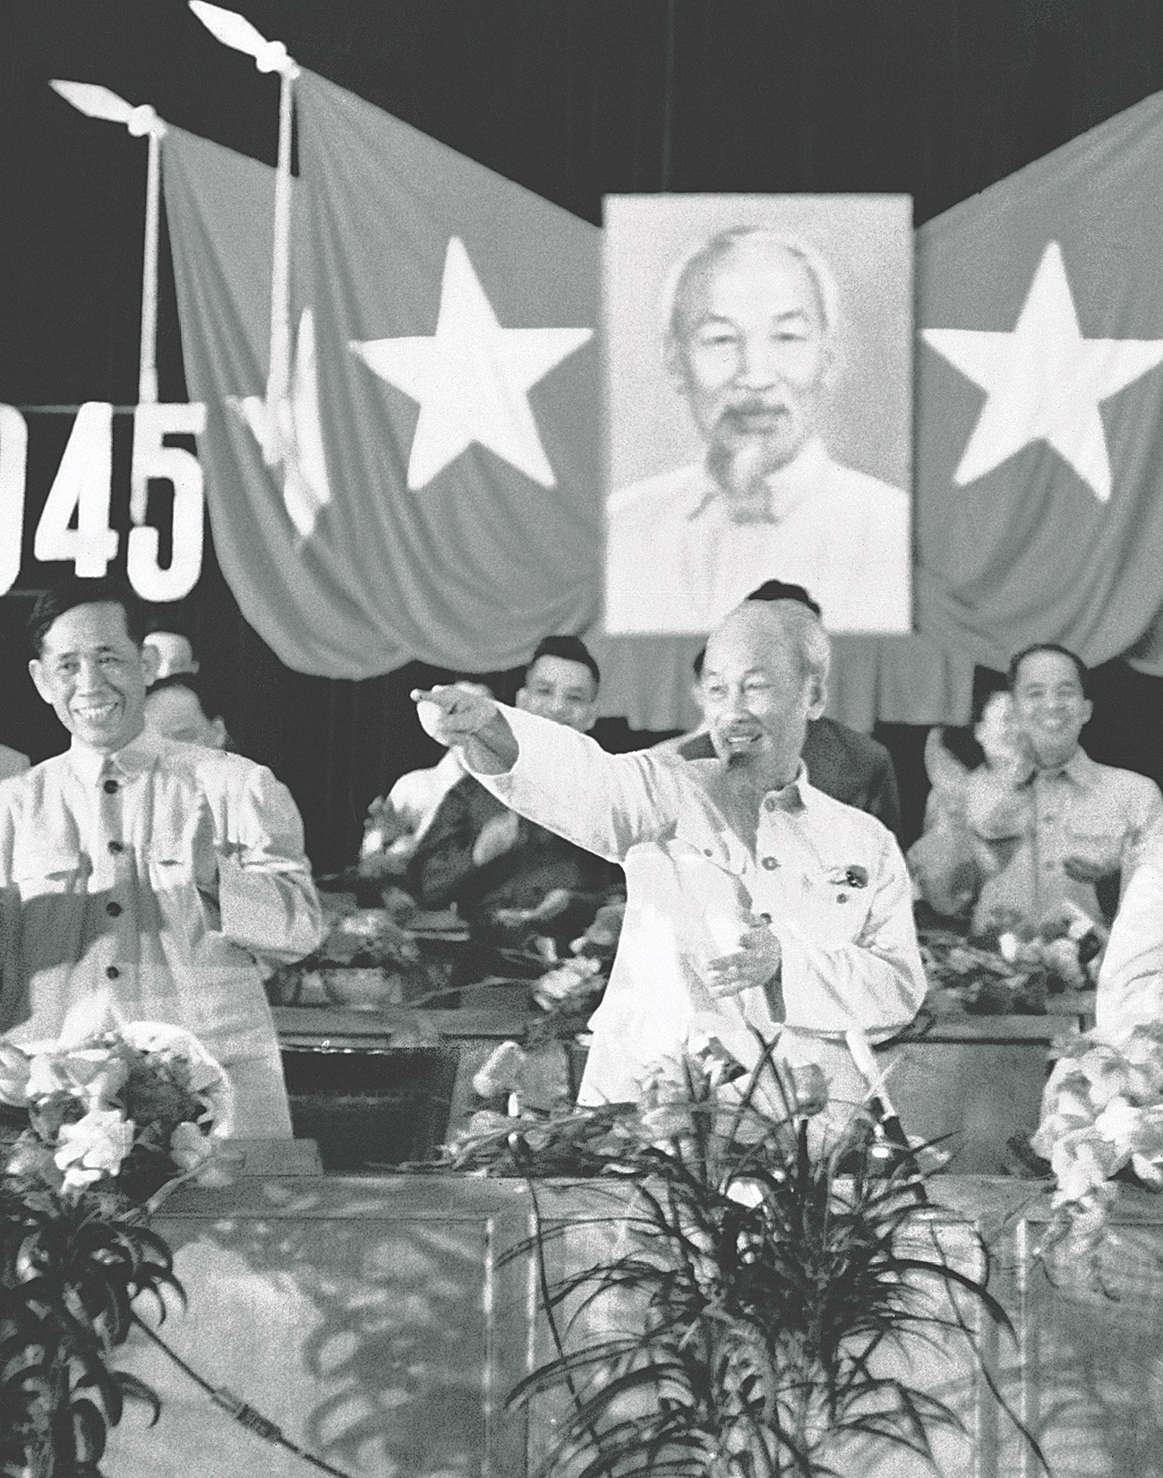
Pre-Tet
In mid-1967, the Communist high command decided the time was ripe for a surprise nation-wide offensive to coincide with the Tet holidays.
In July the Communist High Command met.
Giap proposed a general offensive to trigger a popular uprising in the south.
Planning began 6 months ahead and Tet would provide the perfect cover.

Slide 4
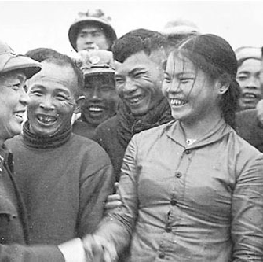
Planning
The Communist party utilised propaganda to encourage fighters.
Some were concerned that urban guerrillas were poorly organised.
1968 was an election year – a successful offensive could convince the American public that the war was unwinnable.
Troops moved into Saigon’s suburban safe houses with weapons conceals by agents, often women and children.

Slide 5
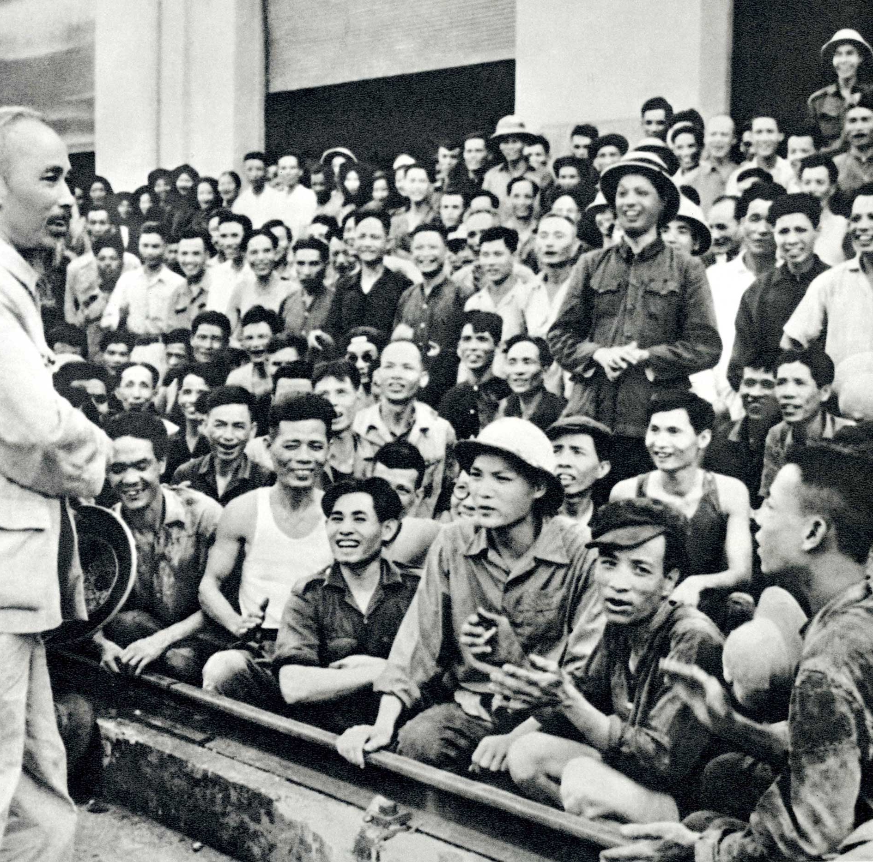
Three-phase military strategy
Resistance
General Offensive
General Uprising
It involved engagement in a conventional sense, with battlefield concentration.
Planning involved seizing heavy weaponry from the ARVN and broadcast Ho Chi Minh’s speech after capturing the national radio station.

Slide 6
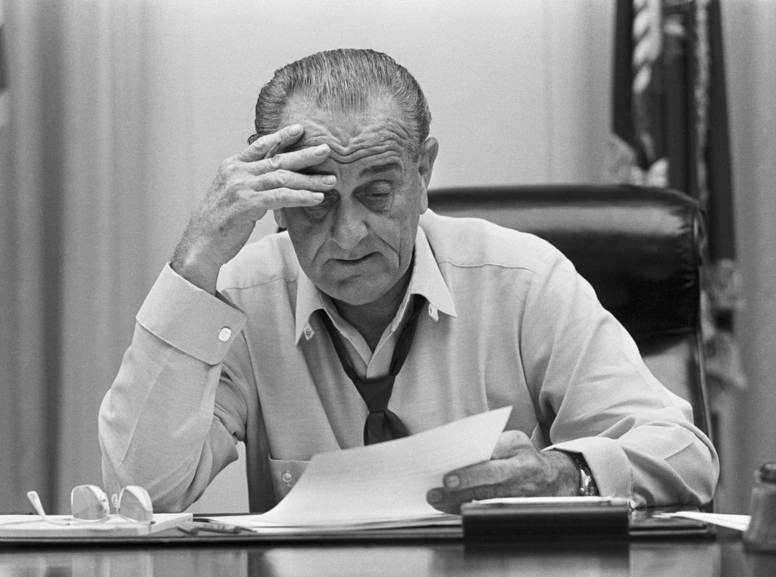
Early warnings
There were indicators what the north were changing tactics; in October 1967 the VC 273rd Regiment tried to hold their position
The US sped up their troop movement
By January 1968 enemy pressure had overstretched American resources.
Thieu agreed to limit the ceasefire over Tet to 36 hours, but the announcement was not made quickly enough.

Slide 7
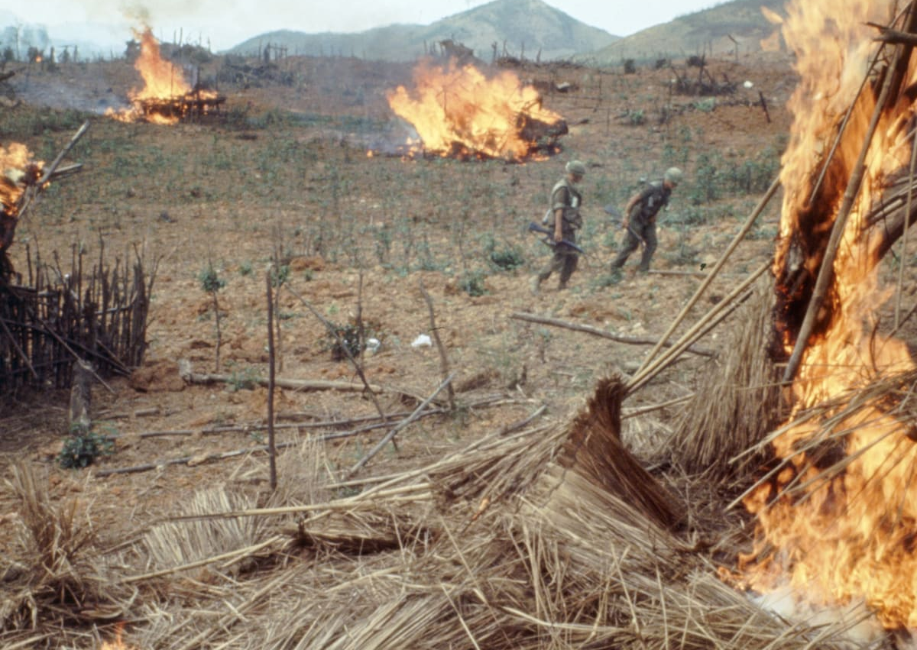
Khe Sanh
The biggest and bloodiest battle of the war so far (10,000 Communists and 500 Americans dead).
It was a diversionary tactic the US fell for – LBJ called for its preservation at all costs.
Westmoreland sent in 6,000 troops and B-52s led aerial assaults pounding the enemy with 100,000 tons of bombs in five square miles.
Meanwhile, NVA and VC regulars were drifting into Saigon…

Slide 8
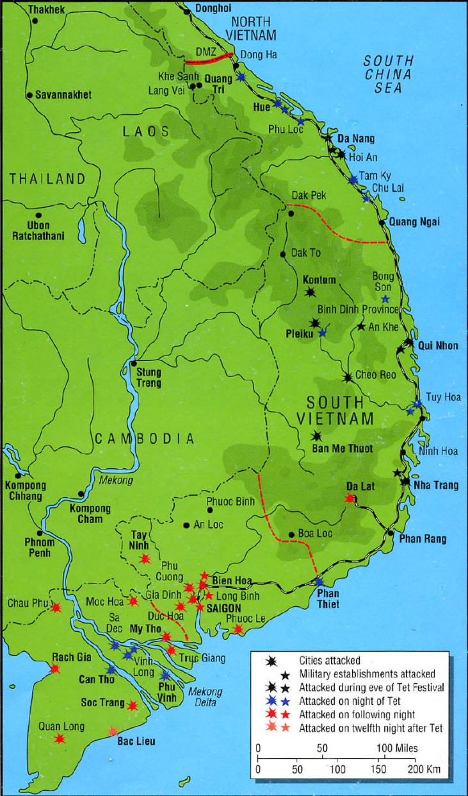
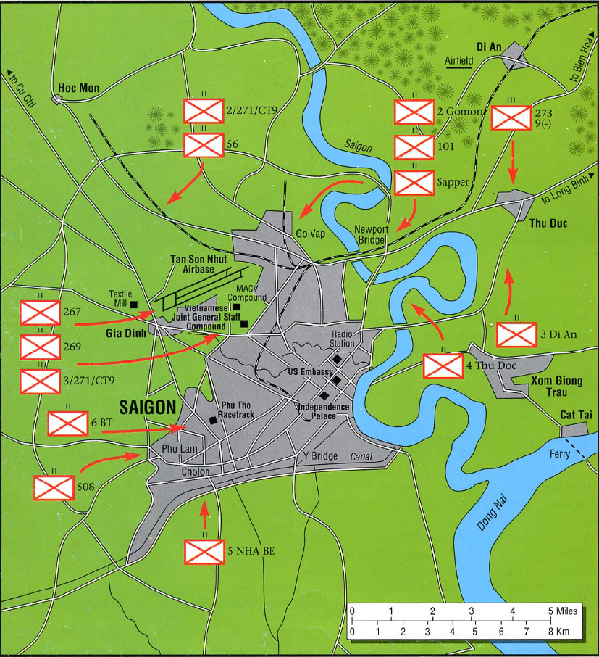

Slide 9
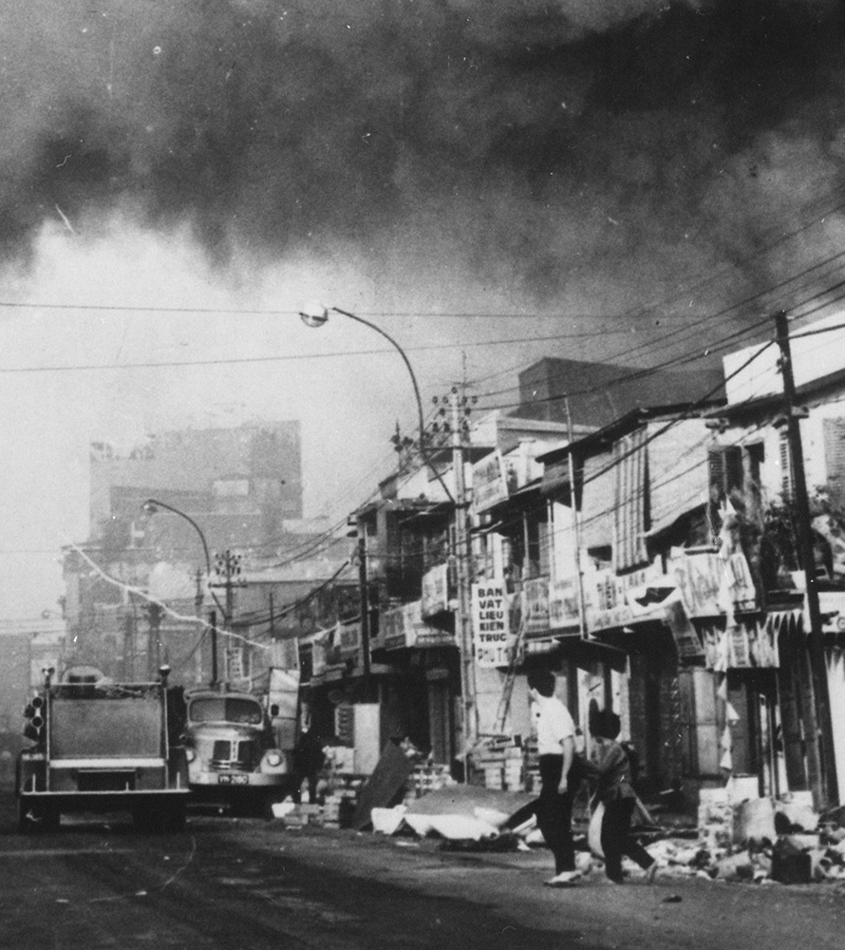
The offensive begins
30 January, 67,000 VC start the first wave
35 battalions sent against 6 primary targets in Saigon including Independent Palace and the American Embassy.
At the radio station, a technician pre-empted VC actions and sent a signal to cut off power.
At Independence Palace the security forces were too strong for the attackers.
At the Navy HQ northern sappers blew a hole in the security wall but reinforcements did not arrive to assist.

Slide 10
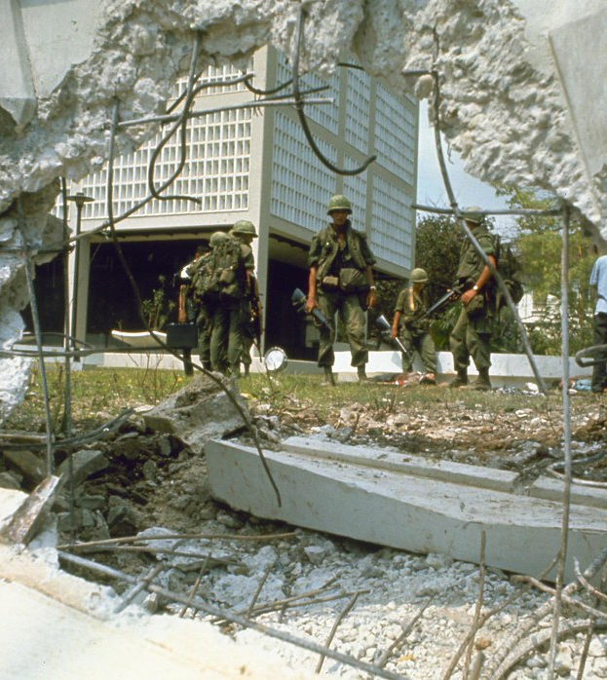
The offensive begins
Attackers attacked the Joint General Staff compound but only seizes one of several command buildings.
South of Saigon, Lon Binh logistical and command complex was attacked, but American firepower successfully repelled the attackers.
At the US Embassy, 19 VC dressed as civilians blasted the outer walls but did not get through the main embassy doors.

Slide 11
Hue
The imperial city was a symbolic target and also served as a major allied supply route.
The Viet Cong had a list of priority groups to be captured, taken out of the city and killed.
Defenders of the city did not receive warning messages on time.

Slide 12
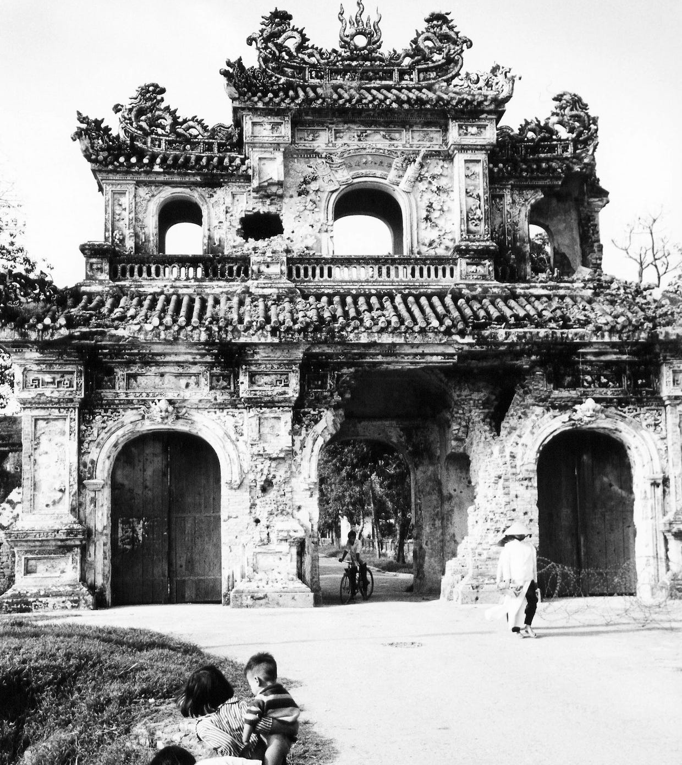
Attack on Hue
Rocket and mortar bombardment covered for VC infiltration
First target was the jail – 500 of the 2500 inmates liberated took up arms
American made weapons were captured from the ARVN armoury
US had to advance with bazooka fire and an air assault targeted the flow of enemy supplies to Hue.
Losses were high – in 26 days of combat ARVN deaths equalled 384, US 216, VC/NVA c.5000. Approximately 5,800 civilians were killed and Hue lay in rubble.

Slide 13
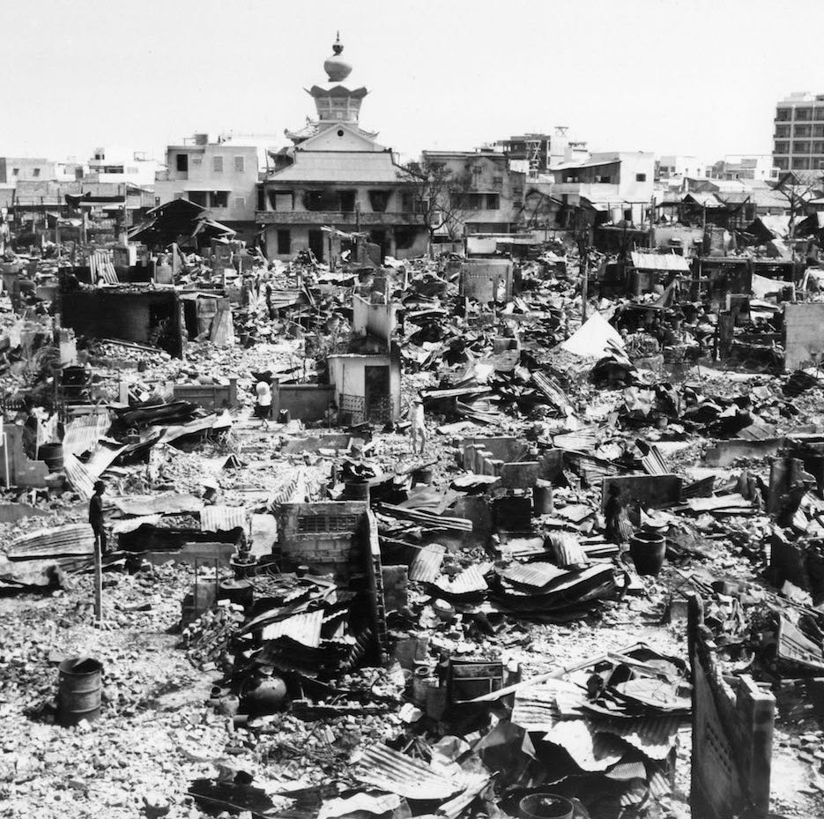
Consequences
By conventional military calculation, Tet was an enormous allied victory.
It highlighted the inadequacy of the South Vietnamese security in Saigon.
The strong anti-war reaction at home was damaging – more felt that sending American troops to Vietnam was a mistake.
Walter Cronkite delivered his televised special report that was despairing of the situation.

Slide 14
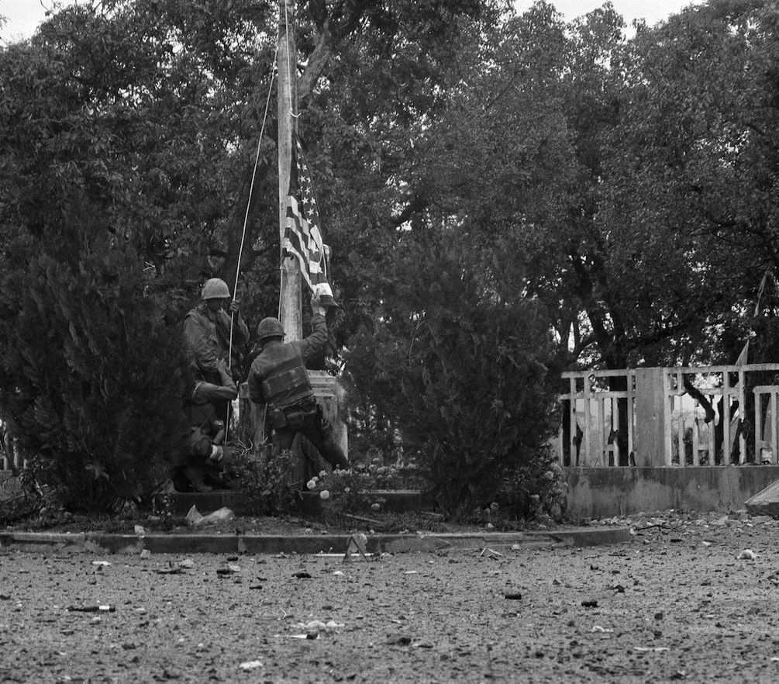
Consequences
LBJ announced (31st March 1968) that he would not run for re-election.
The US and North Vietnamese met in Paris mid-May 1968 to discuss settlement.
The Tet Offensive highlighted the failings of the pacification program.
The South Vietnamese military suffered serious losses and declined – desertion rates increased from 10.5 per thousand at the end of 1967 to 16.5 per thousand in July 1968.
The VC suffered irreplaceable losses.
The offensive turned the tide of conflict; not even the North Vietnamese could comprehend this at the time.

Slide 15
What do Gallup approval polls tell us about Johnson’s policy in Vietnam?
Task: Using the timeline, identify what key events were occurring across the documented approval ratings. Can you explain this trend?
Ideas: VC aggression, withholding information from the public, Rolling Thunder and its expansion, Gulf of Tonkin resolution, agreed ceasefires, Six Day War, failed negotiations, the draft, Tet Offensive, Civil Rights Act, LBJ announces he will not run for re-election, LBJ announces a halt to bombing.

