Slide 1
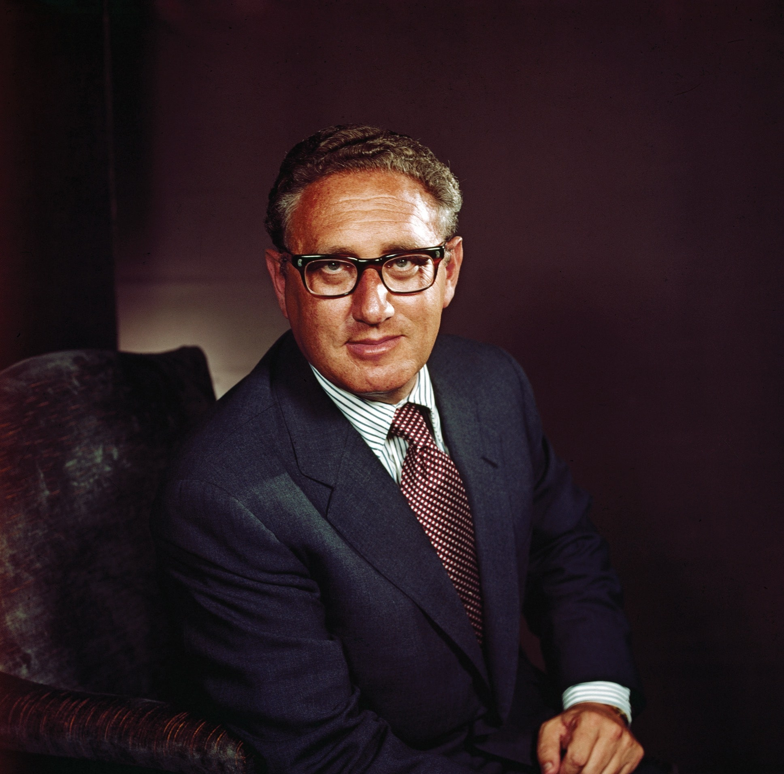
“We will not make the same mistakes; we will make our own.” 1969
Who is this man and what role did he play?
Do you believe him?

Slide 2
Nixon’s policies in Vietnam
Were they a total failure?
1968-1970 focus

Slide 3
‘Nixon’s policies towards Vietnam, in the years 1968 to 1972, were a total failure.’

Slide 4
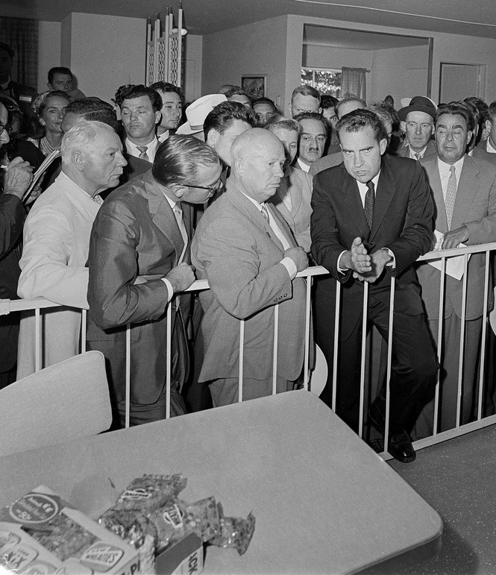
Before the Presidency
Nixon entered the House of Representatives in 1946 and served as Eisenhower’s VP (1953-1961).
He was strongly anti-communist and had firmly defended the American commitment to Vietnam.

Slide 5
Presidential election (1968)
Nixon triumphed in the election because of factions in the Democrat Party and the strength of George Wallace’s campaign in the south-east.
Nixon was reported to have a ‘secret plan’ to end the way. Though he never used the term, he did indicate his leadership would “end the war and win the peace.”

Slide 6
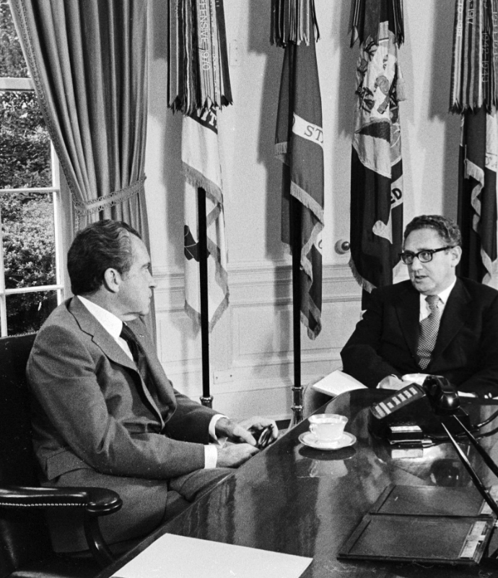
Foreign policy control
Nixon kept foreign policy controls firmly and exclusively in his and Kissinger’s hands, guarding them jealously and rarely replying on (or informing) government.
His policy was hugely contradictory.
He feared domestic upheaval and the international consequences of pulling out.

Slide 7
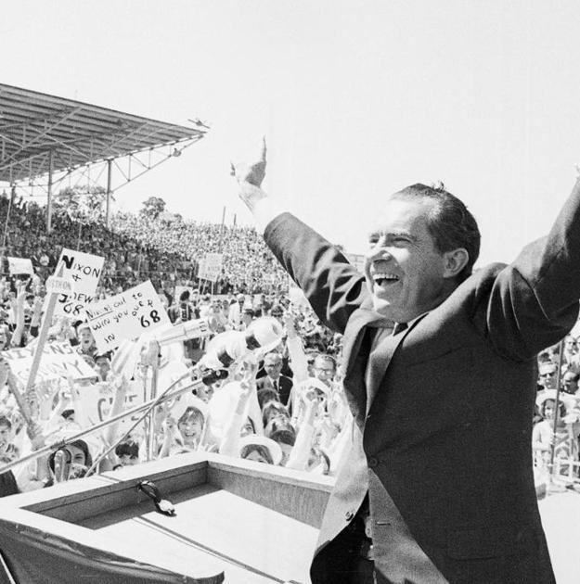
Initial thinking
Nixon did not want to be the first American president to lose the war.
He advocated for “peace with honour.”
When Nixon entered office he seriously considered ramping up the war however …
… domestic and political opposition, alongside a wish for reproachment with the USSR and PRC kept this consideration at bay.

Slide 8
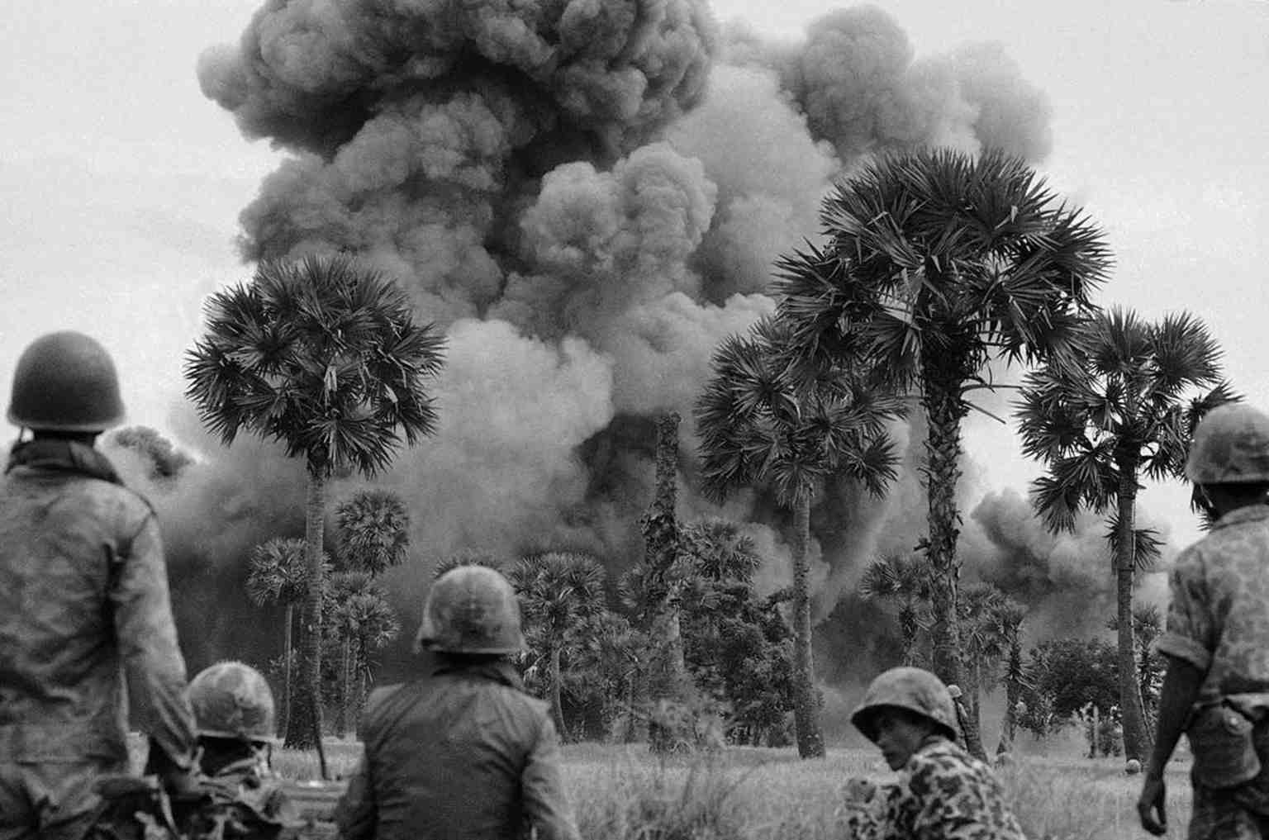
Threat of force
Nixon felt he could compel Hanoi into accepting a settlement by using force (parallel to Massive Retaliation).
The ‘madman theory’ put out that Nixon was hardline and impulsive enough to use nuclear technology against the north.
Operation MENU was ordered, an intensive bombing of Cambodia to limit the north’s capacity to launch an offensive. It was kept secret from the public and ultimately drove northern forces deeper into Cambodia.

Slide 9
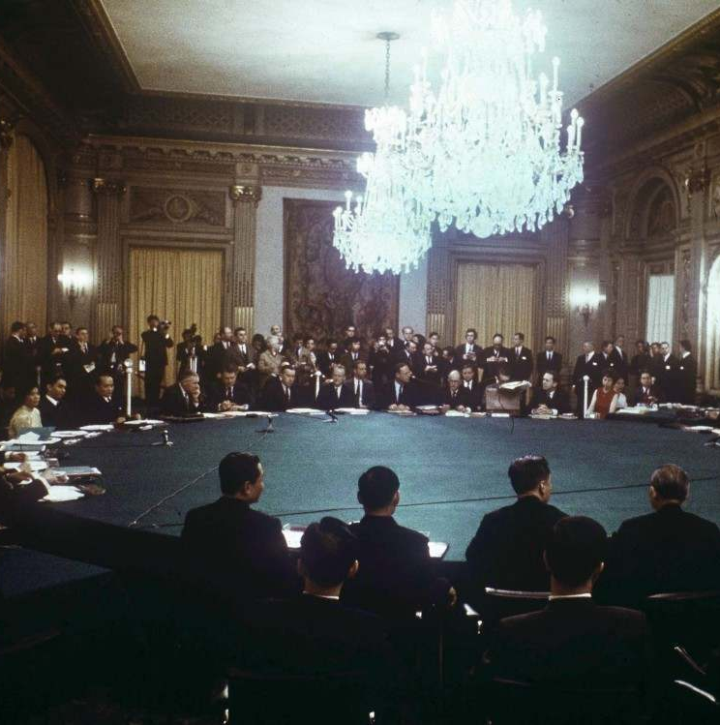
Failing peace initiatives
The north saw no improvement from Johnson’s attempts at settlement – the publicly dismissed Nixon's offer at the Paris Peace Talks (beginning May 1968).
They vowed that, if necessary, they would stay in Paris until the chair rotted.

Slide 10
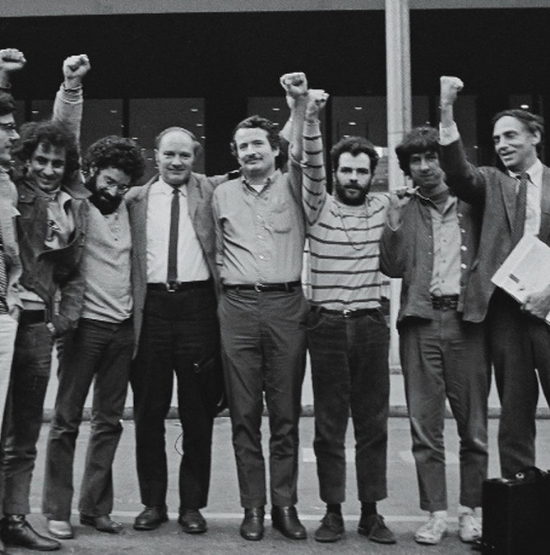
Domestic opposition
Nixon used leading questions and skewed polling to ‘evidence’ popular backing for his policies in Vietnam.
In June 1969, Nixon announced the immediate withdrawal of 25,000 American combat forces.
However, Nixon’s failings in achieving piece prompted domestic opposition; in September 1969 the ‘Chicago 7’ were prosecuted.
The government increased surveillance and the FBI, CIA and military expanded their surveillance activities (tapping phones, ransacking files). Major organisation and leaders were harassed and at times, incited to violent acts.

Slide 11
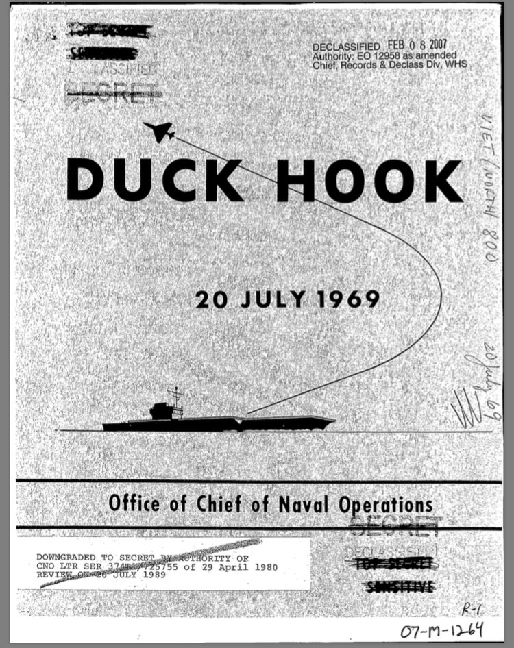
DUCK HOOK
Nixon sent a personal message to Ho Chi Minh that if progress towards a settlement wasn’t made by 1 November (1969) he would resort to force.
A top secret NSC study group drew up plans (DUCK HOOK) that would include massive bombing of major cities, blockades and even ‘tactical nuclear weapons.’
It had no effect. Hanoi stood firm. Nixon abandoned the plan.

Slide 12
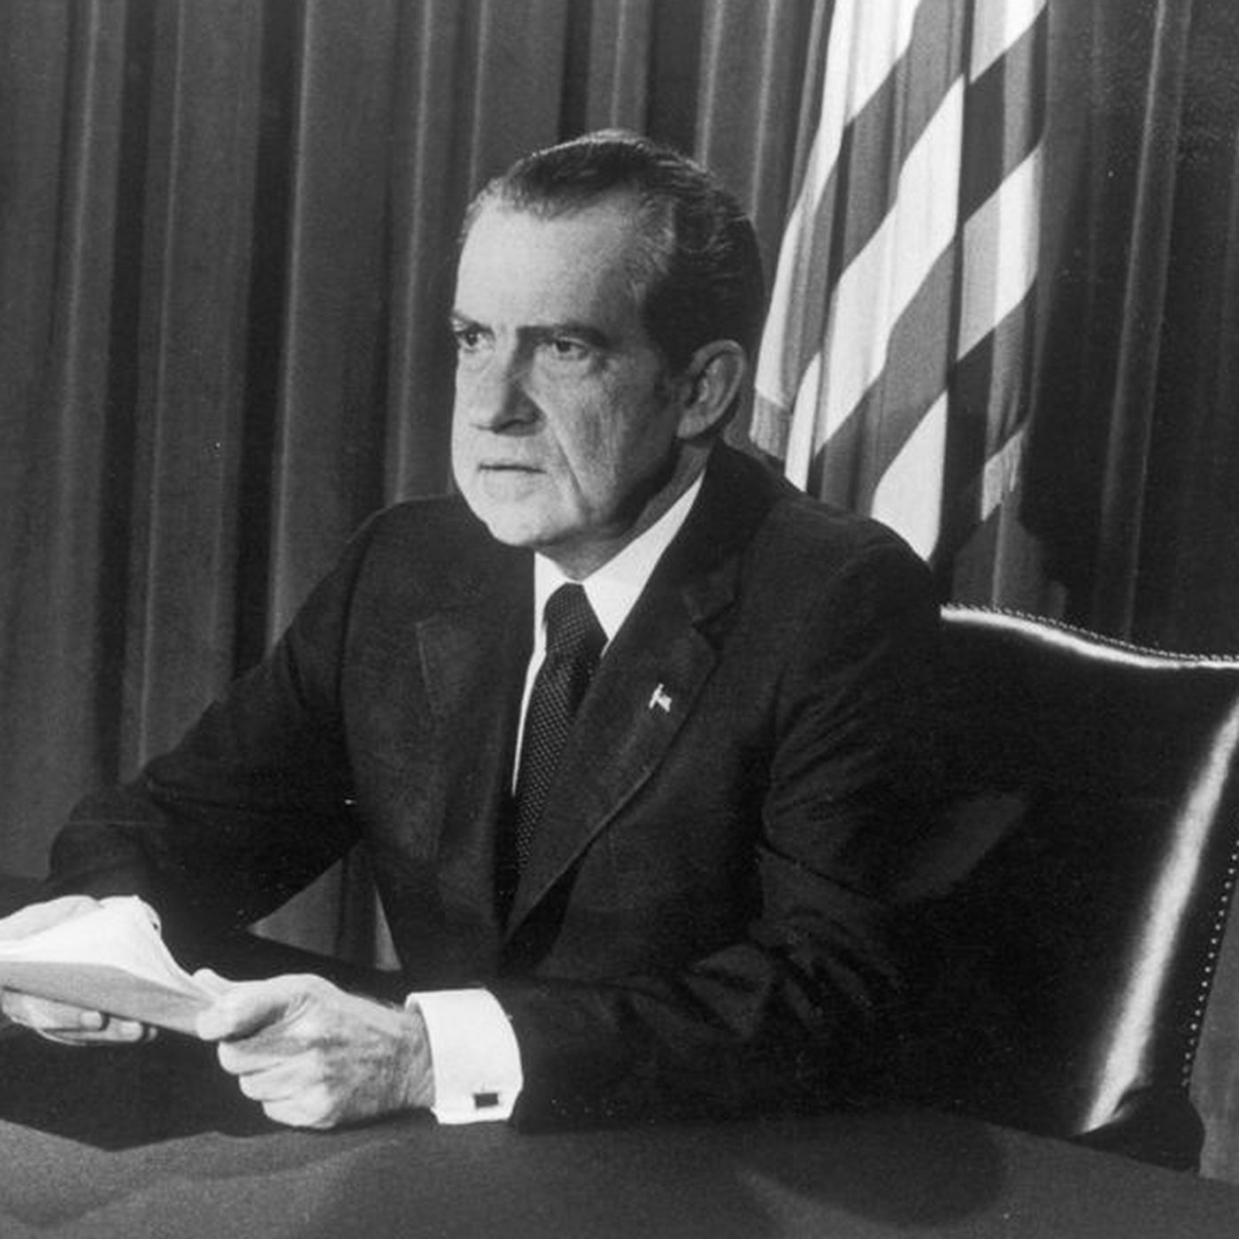
Vietnamization
Nixon ultimately embraced the policy he had inherited from Johnson to extricate the US from the war.
He hoped that an intensive build up of South Vietnam’s military strength the north might conclude that it would be better to negotiate with the US.
His major speech on 3rd November set out to mobilise popular backing for this policy.

Slide 13
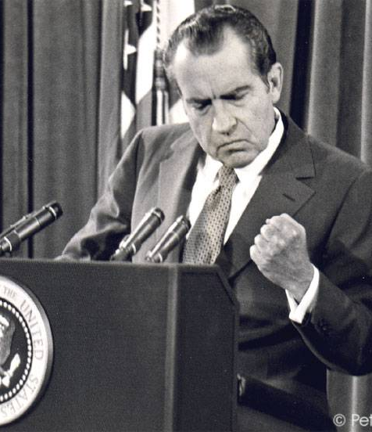
Task: the Nixon Doctrine

Slide 14
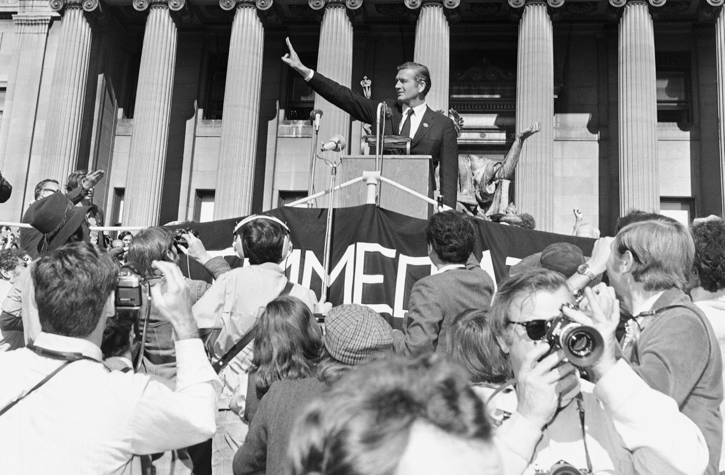
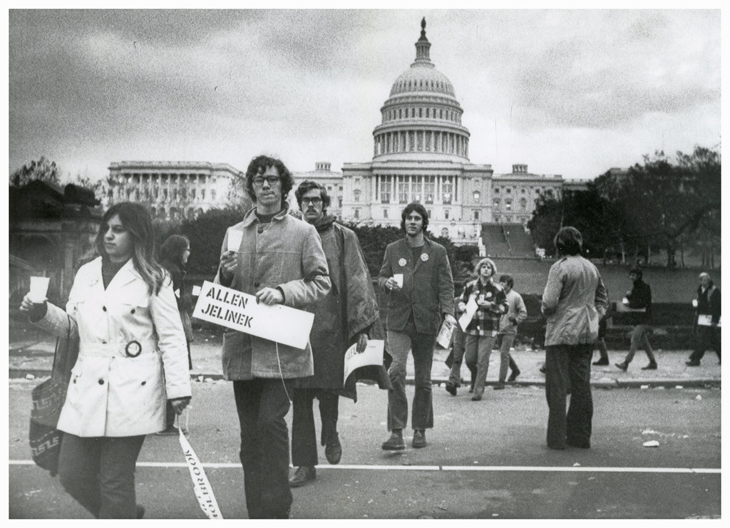
Moratoriums
Definition: It translates roughly to a ‘halt to business as usual. It was a massive demonstration against US involvement in Vietnam.

Slide 15
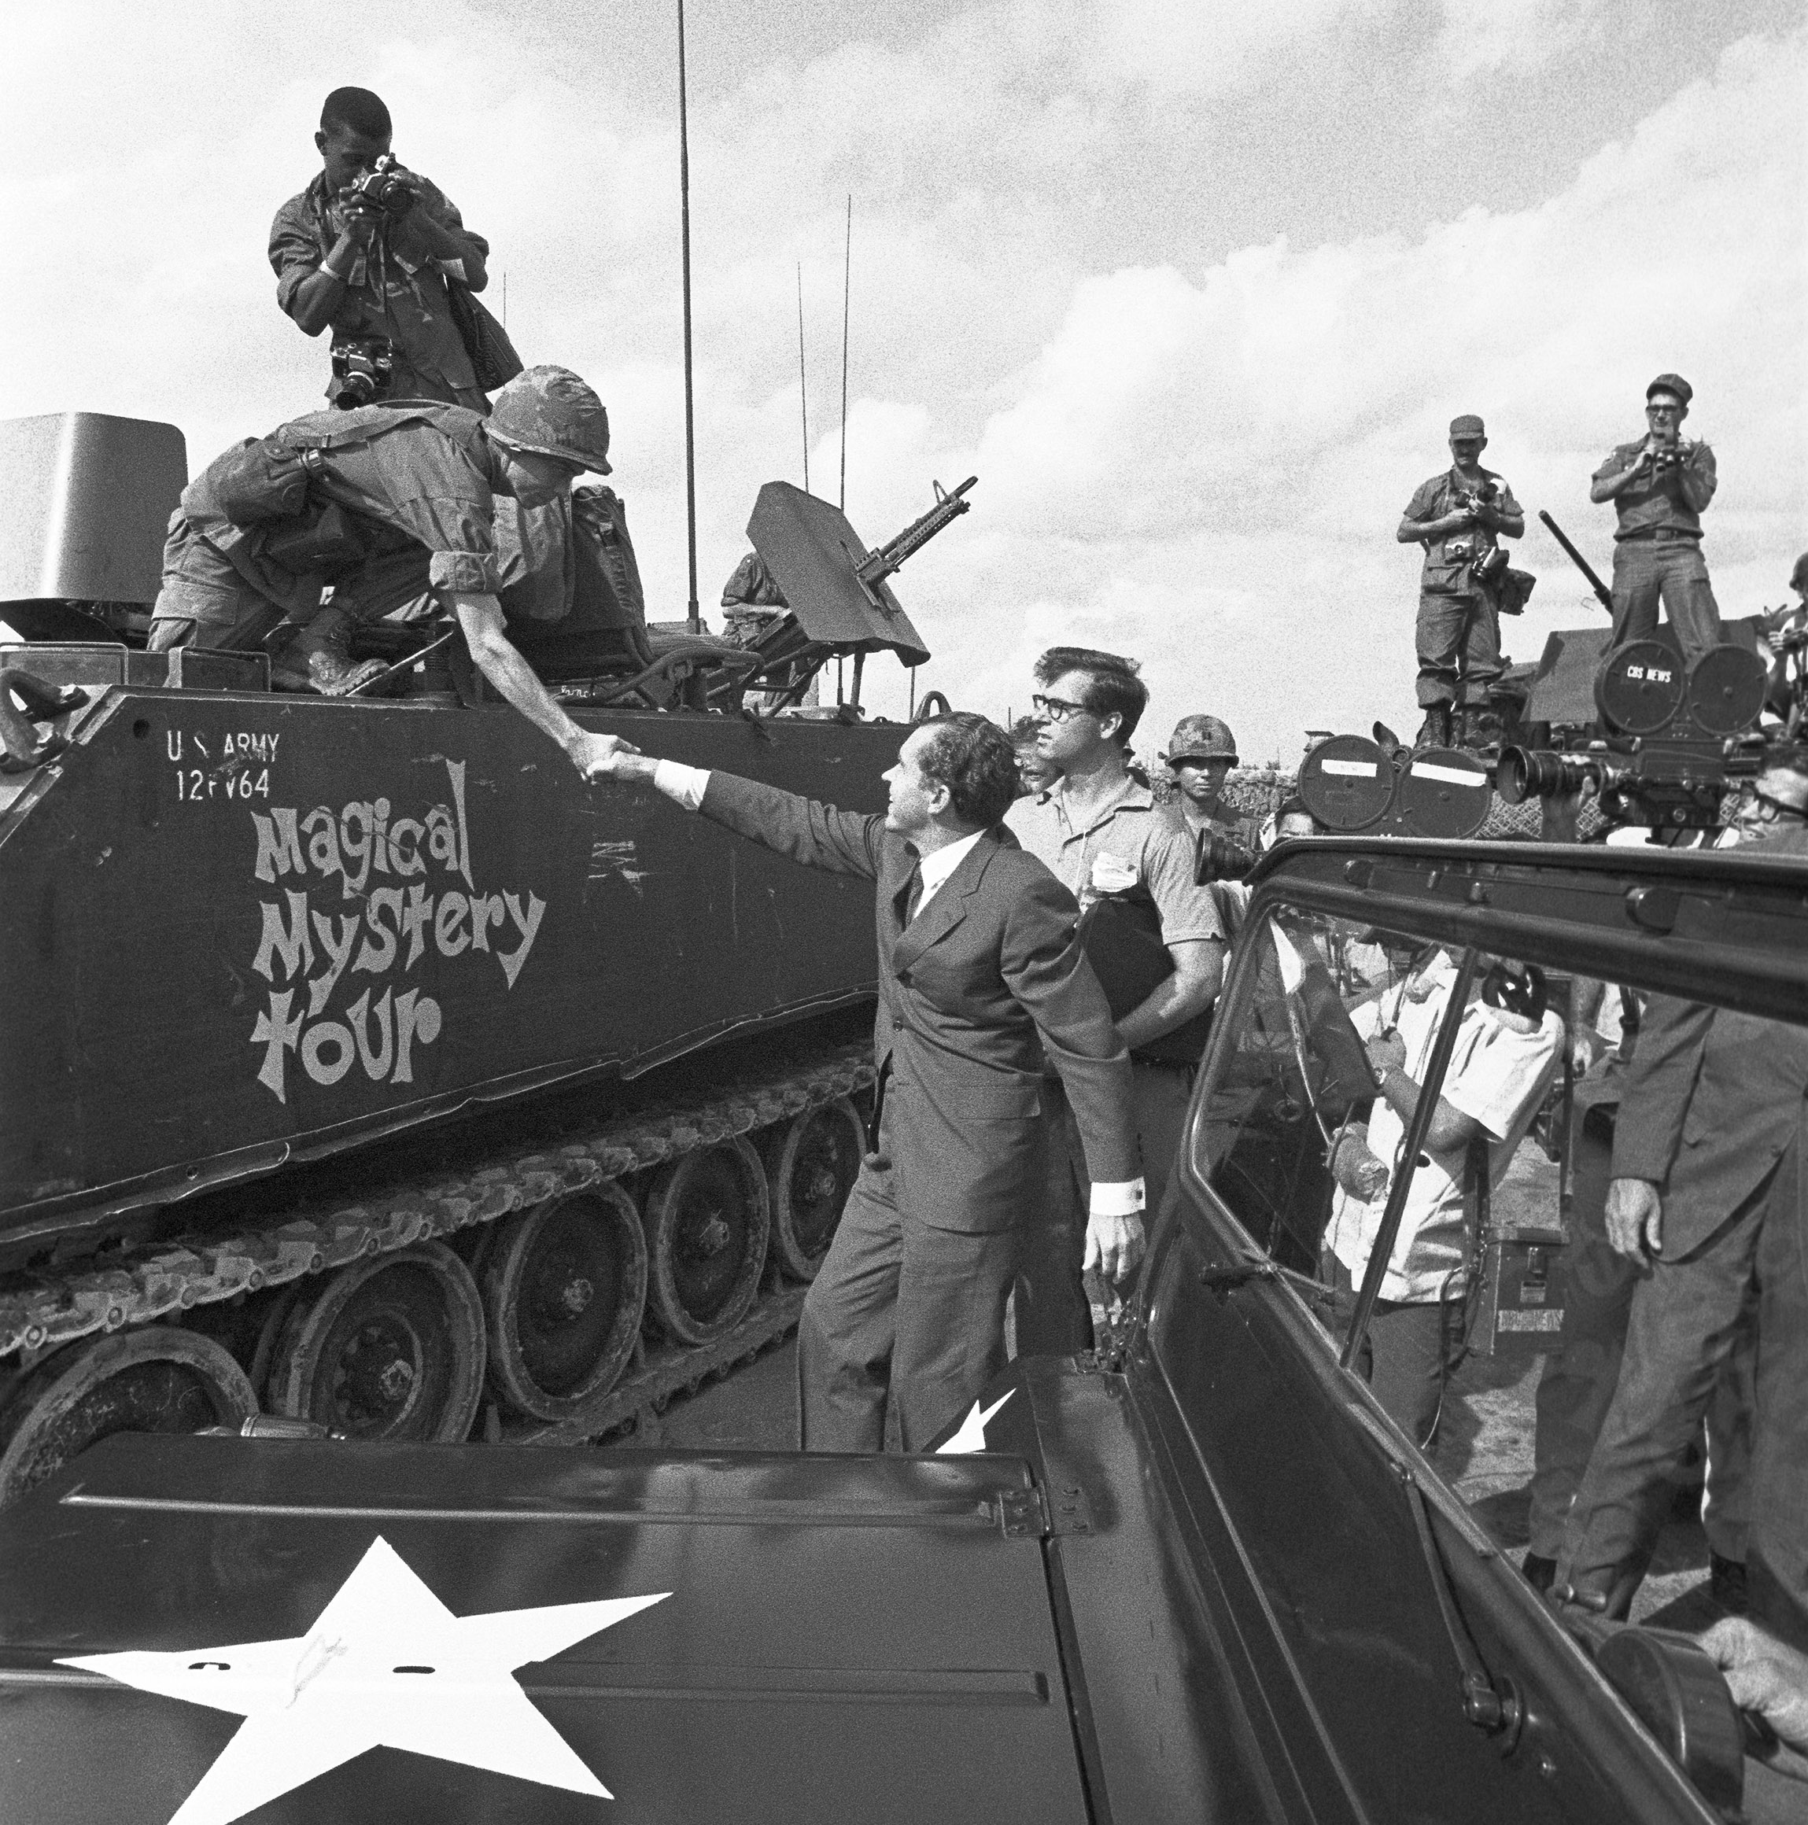
Vietnamization in practice
Military experts and South Vietnamese disliked the policy.
General Abrams shifted to small unit operation to disrupt enemy logistic systems whilst US combat troops continued the relentless attacks on north supply lines and bases.
South Vietnamese force levels were increased to more than 1 million (from 850,000 when Nixon took office). They were given huge quantities of weapons and vehicles.
Military schools were expanded and a concerted effort was made to improve morale (better leave, pay, promotion opportunity, veteran benefits and housing conditions).

Slide 16
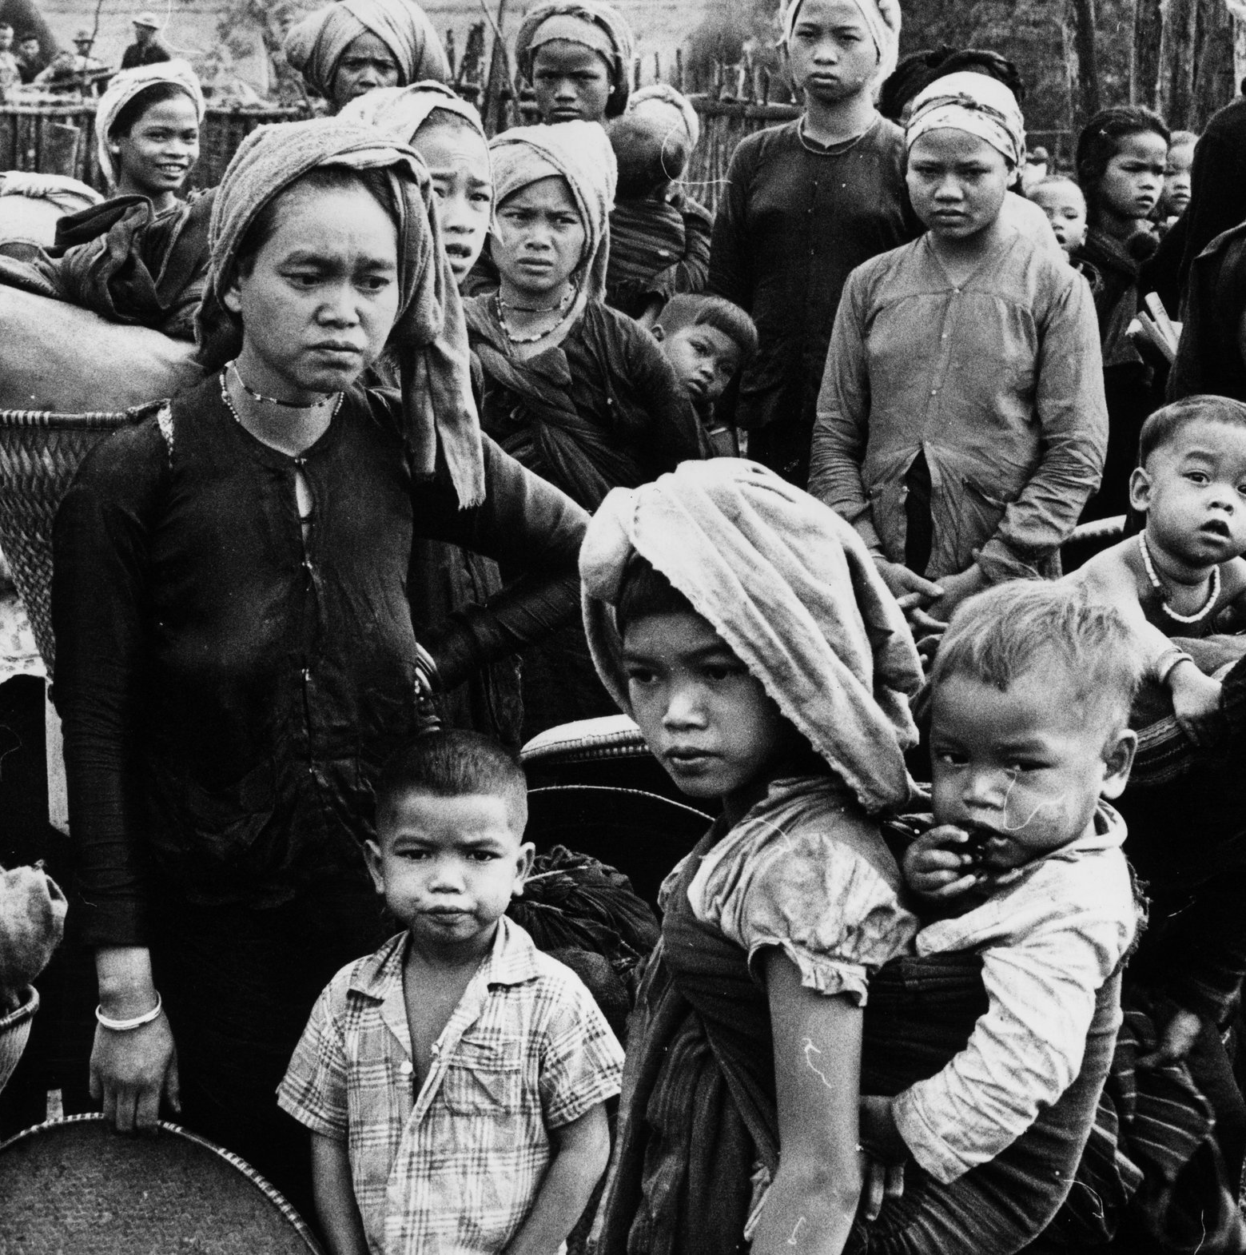
Vietnamization – successes?
Regular forces assigned to pacification were expanded.
Efforts were made to improve village conditions (elections, repairs, land reform).
The South Vietnamese army quickly became one of the best equipped in the land.
On the surface, it appeared that there was greater security in the south, but real progress remained uncertain…

Slide 17
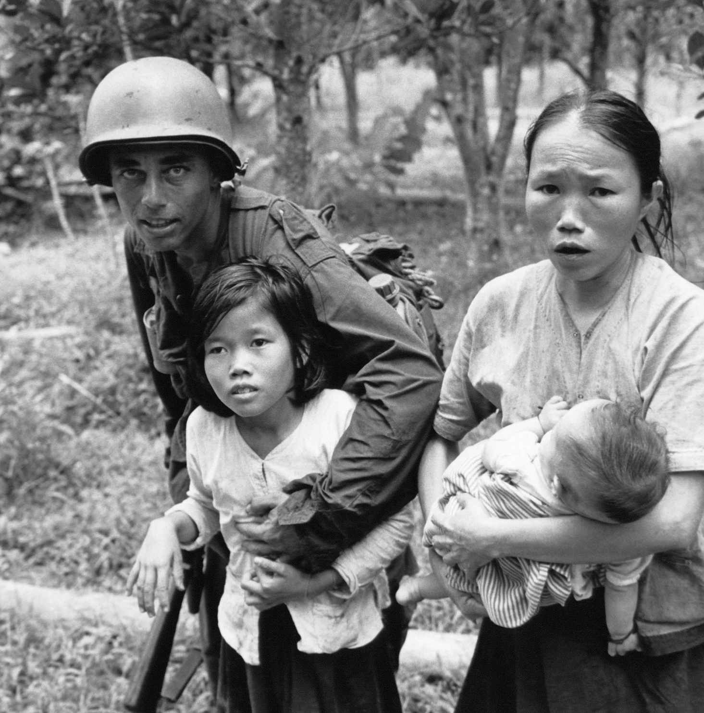
Failure?
The government was entirely dependent on US funds and there wasn’t real enthusiasm for the government in the south.
The ARVN had fundamental weaknesses – ‘ghosting’, desertion rates, inadequate pay and a severe shortage of qualified and competent officers.
Could the ARVN fend for itself following US withdrawal?
In March 1970 Nixon announced the further withdrawal of 150,000 troops – Abrams protested. Still there had been no breakthrough in Paris…

Slide 18
‘Nixon’s policies towards Vietnam, in the years 1968 to 1972, were a total failure.’

