Slide 1
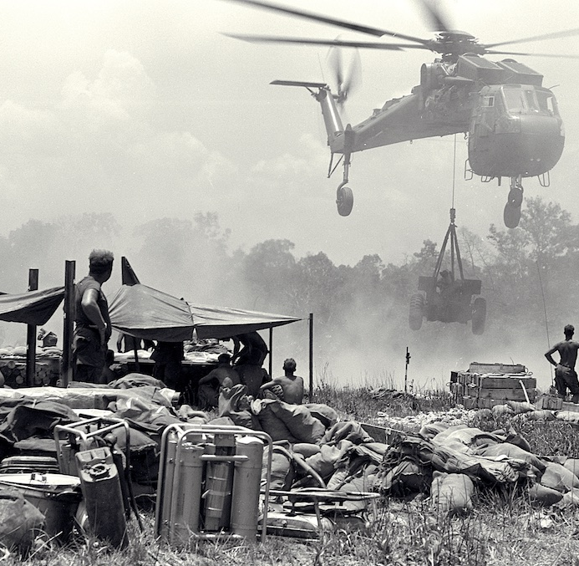
Nixon’s policies in Vietnam
Extending the war into Cambodia and Laos
1970-71

Slide 2
‘Nixon’s policies towards Vietnam, in the years 1968 to 1972, were a total failure.’

Slide 3
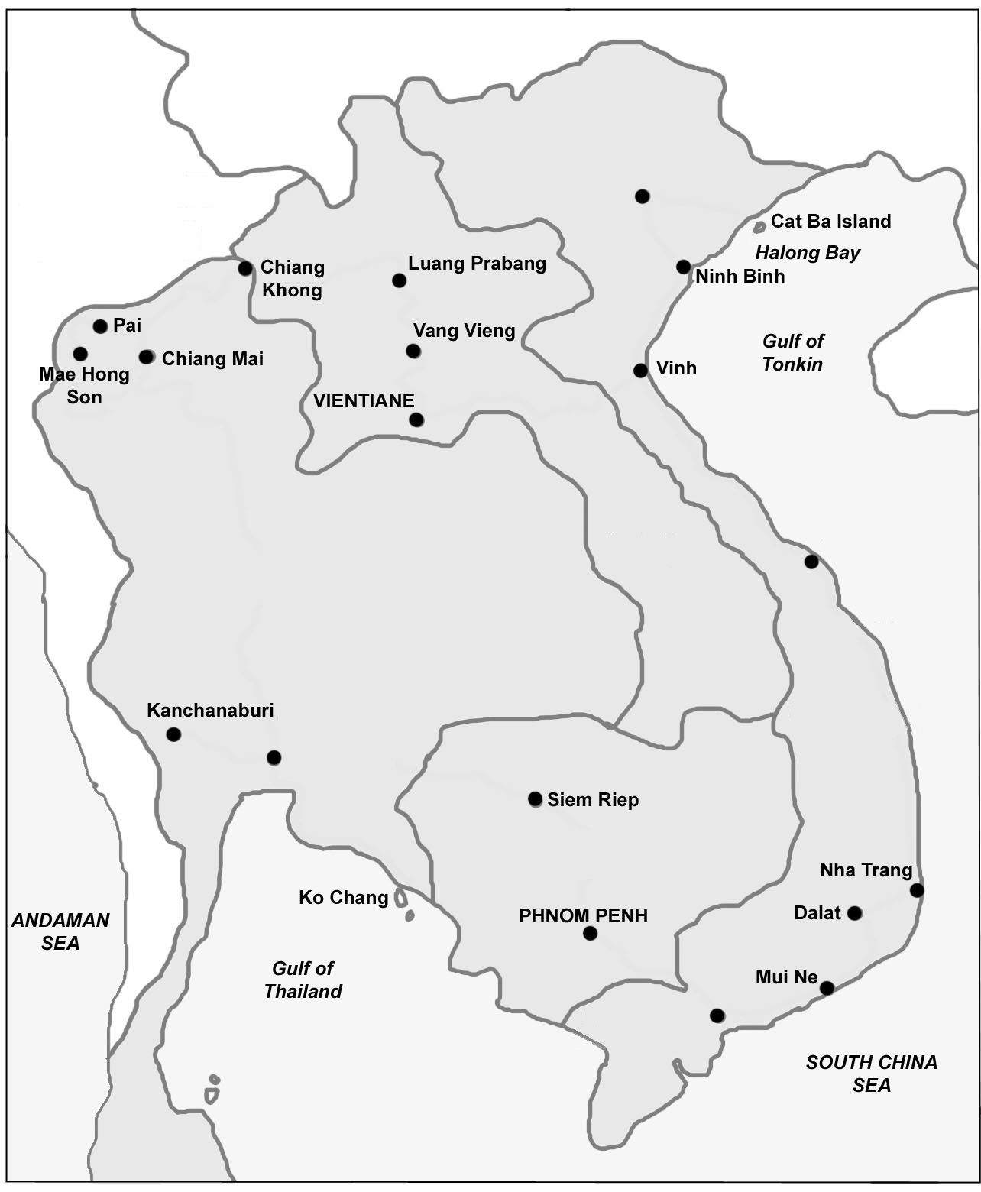

Slide 4
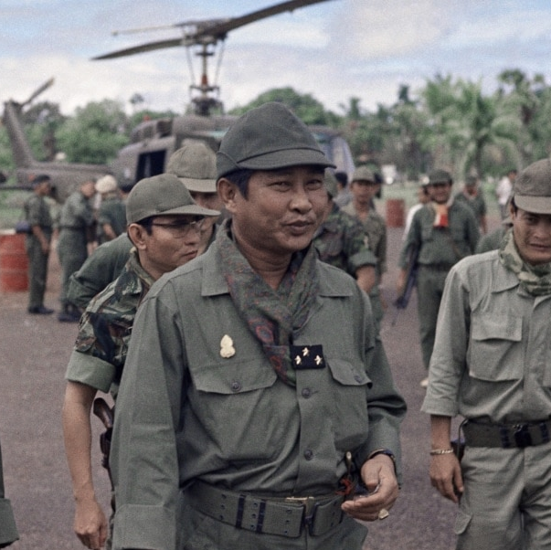
A coup
Cambodia’s neutralist Head of State Price Sihanouk was overthrown in March 1970 and planed by a pro-American clique headed by PM Lon Nol.
Authorisation was given for South Vietnamese units to conduct raid across the border into Cambodia
Justification for attacks on northern sanctuaries was now justified on the grounds of sustaining ‘friendly relations.’

Slide 5
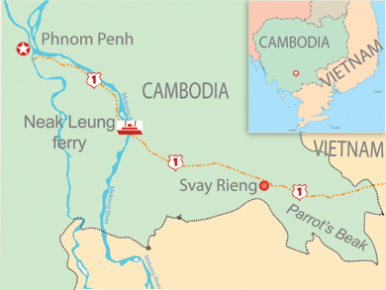
Why Cambodia?
Nixon was motivated to intervene in Cambodia on the basis that:
It would buy time for Vietnamisation
It would help sustain a friendly government in Cambodia
There was a huge domestic backlash but Nixon felt confident he could make peace by threatening Hanoi once more.
Kissinger had his reservations, but supported the President’s decision.
Nixon endorsed a Defence Department proposal that SV units with US air support attack an enemy sanctuary at ‘Parrot’s Beak’, 33 miles from Saigon.

Slide 6
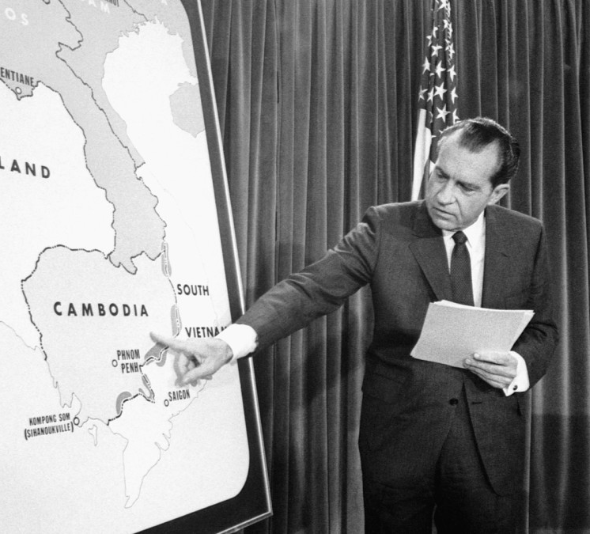
Public announcement
The President explained his decision in a televised speech 30th April 1970.
He explained the target as the Central Office for South Vietnam (COSVN) the ‘nerve centre’ of north Vietnamese military operations.

Slide 7
Success??
However…
Militarily, results were limited – the US command claim 2,000 enemy dead, cleared 1,600 acres of jungle and destroyed 8,000 bunkers.
It uncovered supplies and intelligence and rendered sanctuaries temporarily unusable.
Therefore it did buy time for Vietnamisation.
The South Vietnamese army performed well in most areas.
They did not locate the ‘COSVN’
Gains were short lived
Any advantage gained was offset by the expansion of the war

Slide 8
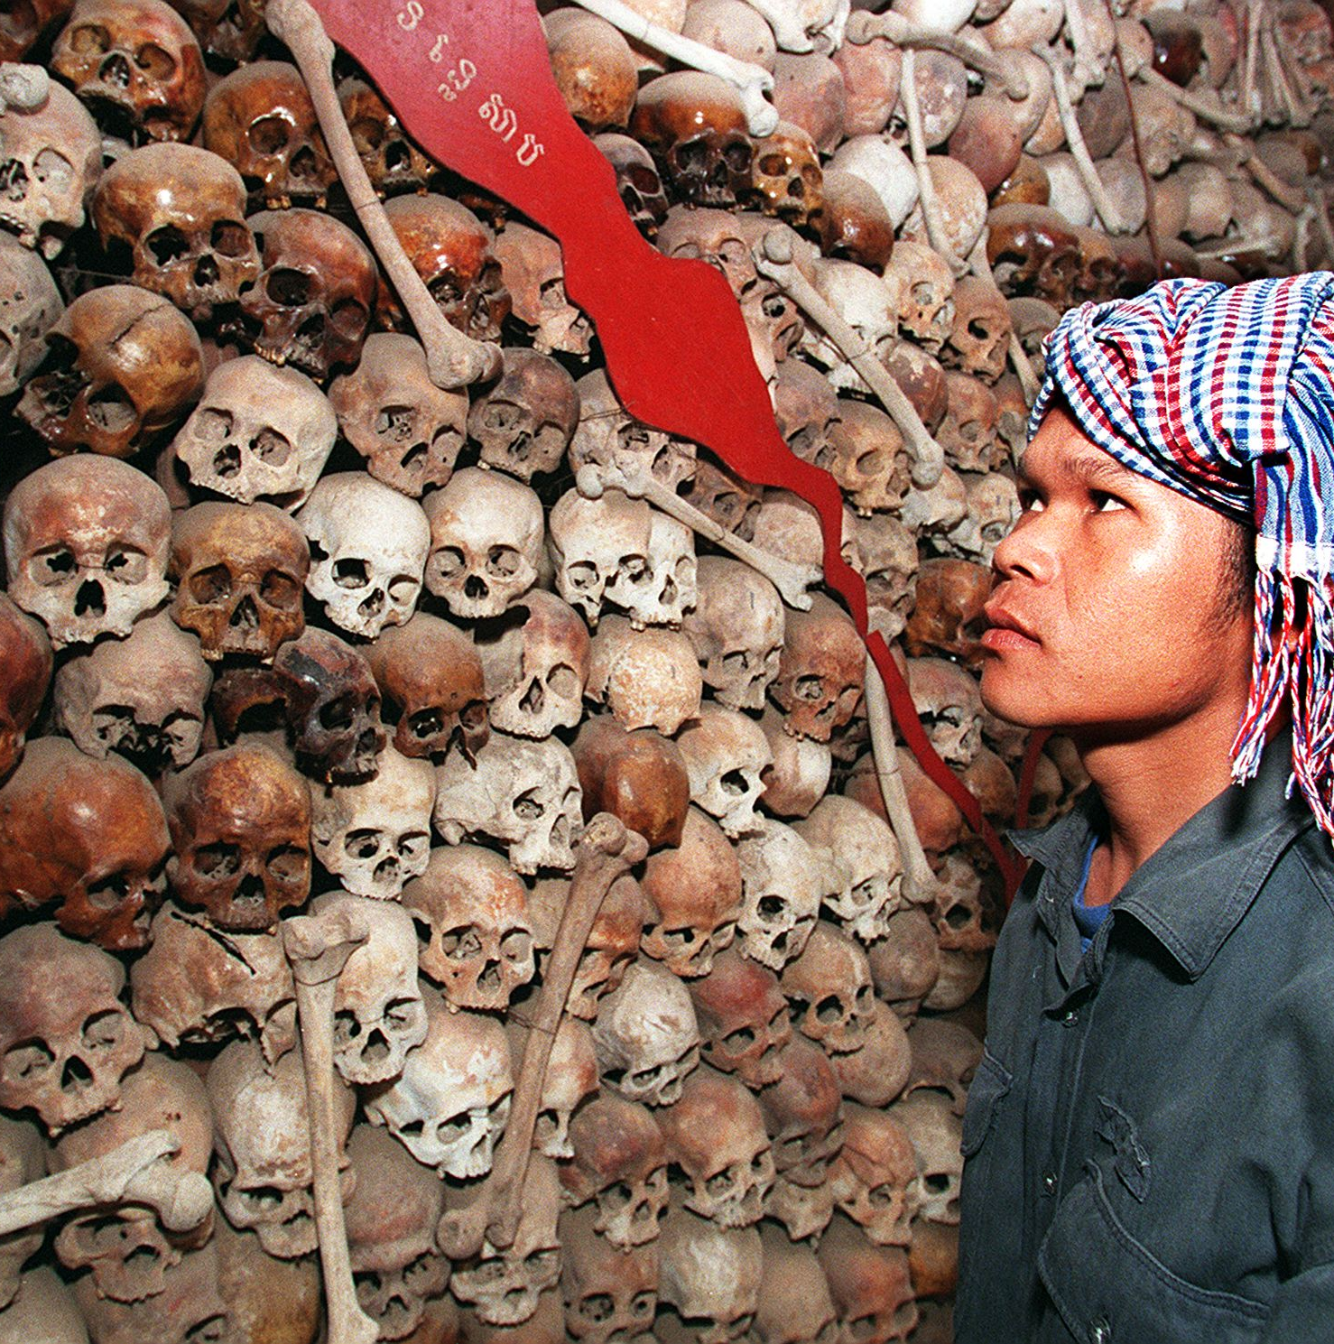
Tragedy
The US encouraged the Lon Nol government to initiate a war it could not win.
It forced the North Vietnamese to move into the heartland of Cambodia.
The north initiated large scale support for the Khmer Rouge and the ensuing civil war was a brutal (approximately 1.5-2 million killed as a result of Khmer Rouge policies in what is recognised as a genocide of the Cambodia people).

Slide 9
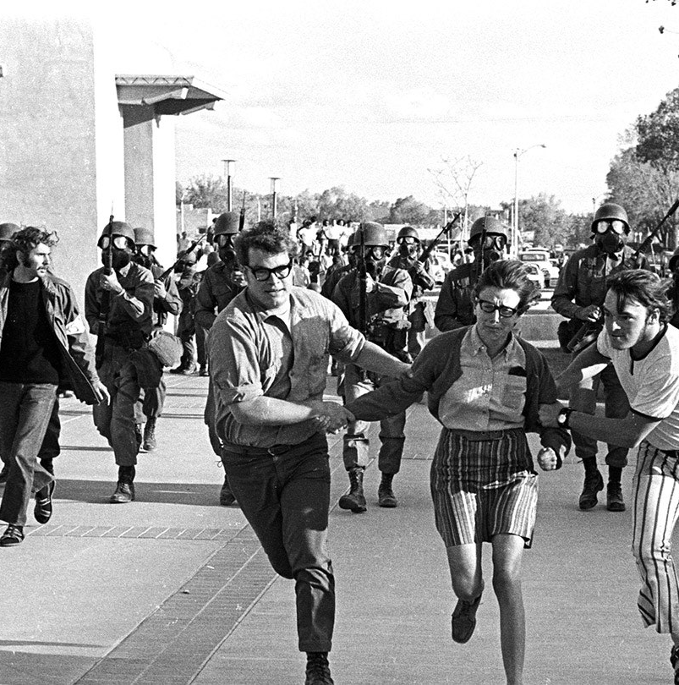
Domestic reaction
Kent State University (Ohio) four students killed; Jackson State College (Mississippi) two students killed (both May 1970).
The Senate voted (88-2) to repeal the Gulf of Tonkin Resolution (signed by Nixon January 1971).
Two amendments were also sponsored (but not passed) in 1970:
Cooper-Church Amendment: proposed to cut off all finds for American military operations in Cambodia after 30th June.
McGovern-Hatfield Amendment: required the Administration to withdraw all US forces from Vietnam by the end of 1971.

Slide 10
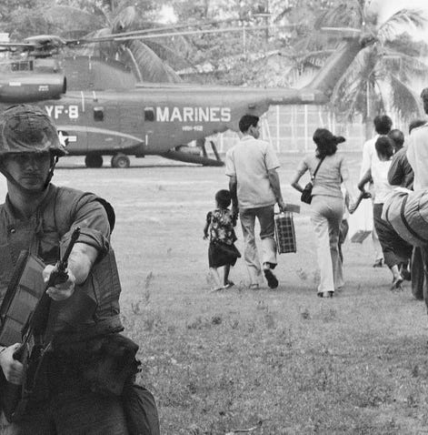
Results
Nixon lashed out at domestic opponents and approved the ‘Huston Plan’ which authorised the intelligence agencies to increase surveillance of Americans (agencies subsequently refused to implement the plan).
Nixon removed troops from Cambodia by the end of June.
The operation may have bought time for Vietnamisation but it also placed limits on the future use of US combat forces and increased pressure for withdrawal.
The North Vietnamese and NLF boycotted the formal Paris talks until troops were withdrawn from Cambodia.

Slide 11
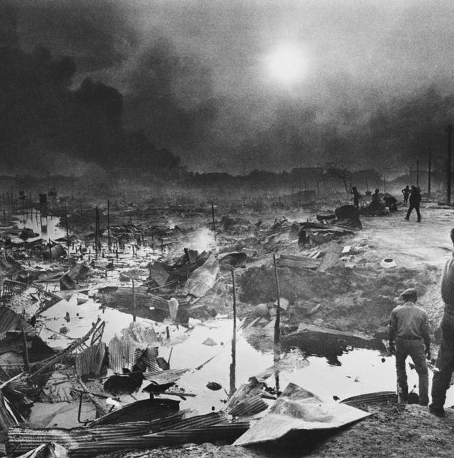
“New Initiative for Peace”
Nixon gave a well phrased speech (7th October 1970) primarily designed for the upcoming congressional elections, calling for a ceasefire. Once again, it offered no concessions and Hanoi rejected it.
Intelligence reports highlighted a sharp increase in the infiltration of troops and supplied into Cambodia, Laos and South Vietnam.
To appease critics at home, Nixon sped up American troop withdrawals (100,000 troops by the end of the year).
Military pressure was stepped up and US aircraft mounted heavy attacks.

Slide 12
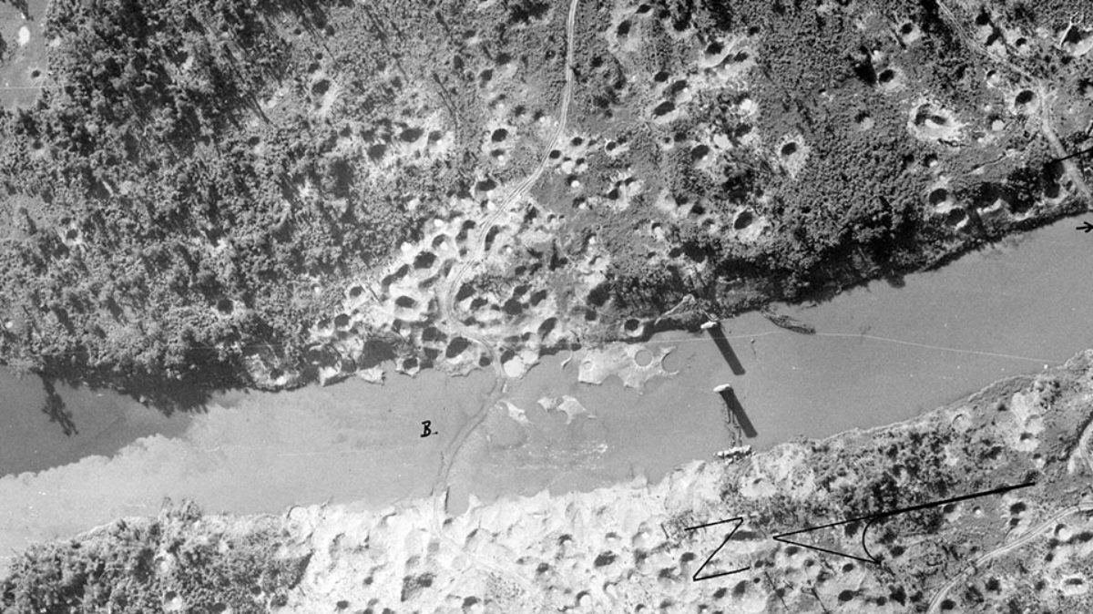
LAM SON 719

Slide 13
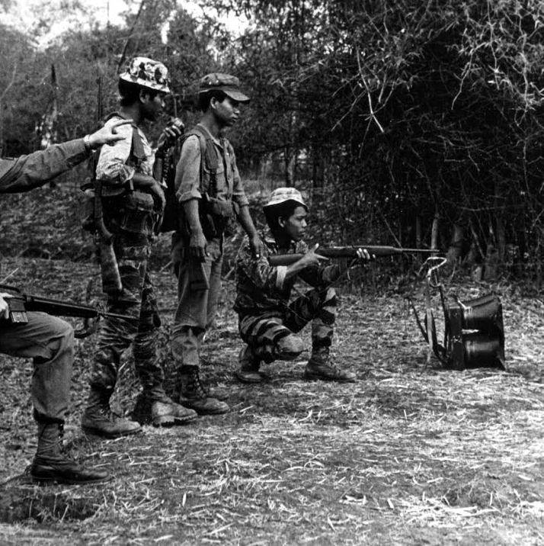
LAM SON 719
Feb. 1971 Nixon approve a major ground operation into Laos.
The objective was, again, to buy time for Vietnamisation by disrupting enemy supply lines.
This time the ARVN was to take on the burden of fighting (with US air support).

Slide 14
Outcomes
Though the ARVN performed well at first, the NVA eventually gained the upper hand.
The battered ARVN retreated.
Officials claimed that the ARVN filled as many as 15,000 enemy troops and destroyed the supply network (delaying a major offensive).
In reality, the ARVN casualty rate was as high as 50% (c.2,000 dead) and would have been far worse without US air support.

Slide 15
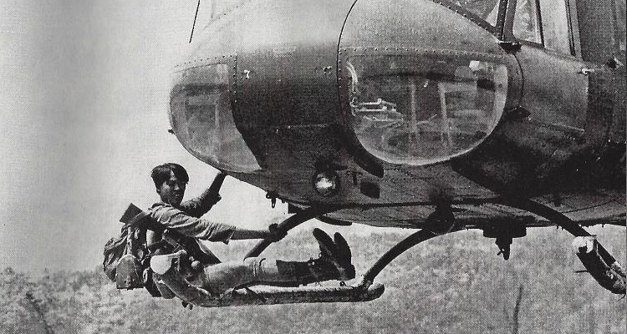
Failings
Retreat was hasty and confused, raising serious concerns about the progress of Vietnamisation.
Abrams concluded that South Vietnam could not “sustain large-scale cross border operations … without external support.”
By summer 1971, 71% agreed that the US had made a mistake by sending troops into Vietnam, 78% regarded the war as immoral and Nixon’s approval rating dropped to 31%.

Slide 16
 | Cambodia Date(s): | Laos Date(s):
Why did the US intervene? What were the public told?
What happened?
Successes?
Failures?

