Slide 1
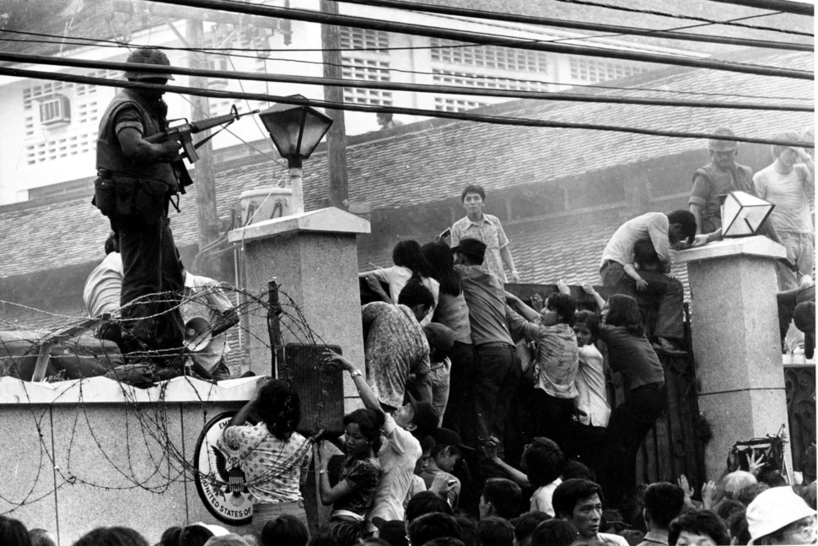

Ending the Vietnam War
The warfare devastatingly resulted in approximately two million Vietnamese deaths. Furthermore, around three million were wounded and about 12 million became refugees. It likewise destroyed Vietnam’s economy and infrastructure that took years to reconstruct.
South Vietnamese scaling the wall of the US Embassy in Saigon, 1975
58,000 Americans were killed during the Vietnam War and 700,000 veterans were affected.
Around 1,000,000 to 4,000,000 Vietnamese were killed. Furthermore, many Vietnamese suffered from exposure to chemicals used by the US. They brought diseases and psychological trauma, which persisted for a long time.
The United States spent around $100,000,000,000 on the Vietnam War.
After the Fall of Saigon, between 200,000 to 300,000 Southern Vietnamese were sent to re-education camps under the communist government.
On 2 July 1976, a new constitution was adopted by Vietnam ratifying the country as the Socialist Republic of Vietnam.
The Presidential Palace was renamed the Independence Palace and 30 April is celebrated in Vietnam as Reunification Day.
IN NUMBERS:
The country became the unified Socialist Republic of Vietnam in 1976, even though conflicts with China and Cambodia continued over the next 15 years.
Vietnam’s economy began improving in 1986 via a free market policy, allowing further oil export revenues and increased foreign capital. In the 1990s, diplomatic and trade affairs between the United States and Vietnam were reestablished.
Due to its 120 billion dollar expenditure on the Vietnam War from 1965 to 1973, the United States suffered widespread inflation, which was aggravated by a worldwide oil crisis in 1973.
Notes:
Image Source:
https://www.telegraph.co.uk/news/picturegalleries/worldnews/7652593/The-Vietnam-War-in-pictures-the-35th-anniversary-of-the-fall-of-Saigon.html

Slide 2
SOURCE ANALYSIS. Read and analyse the given statements delivered by US President Lyndon B. Johnson (1963-1969) and US President Gerald R. Ford (1974-1977) regarding the US involvement in the Vietnam War. How valuable are these sources to a historian examining US involvement in Vietnam
SOURCE A
SOURCE B
“I am not going to lose Vietnam. I am not going to be the president who saw Southeast Asia go the way China went.”
Lyndon B. Johnson, President of the United States 1963-1969, Part of his statement during a meeting at the White House, 24 November 1963.
Today, America can regain the sense of pride that existed before Vietnam. But it cannot be achieved by refighting a war that is finished as far as America is concerned. [...] We, of course, are saddened indeed by the events in Indochina. But these events, tragic as they are, portend neither the end of the world nor of America’s leadership in the world.
Gerald R. Ford, President of the United States 1974-1977. Excerpt from his speech at Tulane University, 23 April 1975.
Source (A) retrieved from: https://millercenter.org/the-presidency/educational-resources/johnson-transition
Source (B) retrieved from: https://history.state.gov/historicaldocuments/frus1969-76v38p1/d57
Notes:
Source (C) retrieved from: https://millercenter.org/the-presidency/educational-resources/johnson-transition
Source (D) retrieved from: https://history.state.gov/historicaldocuments/frus1969-76v38p1/d57

