Slide 1
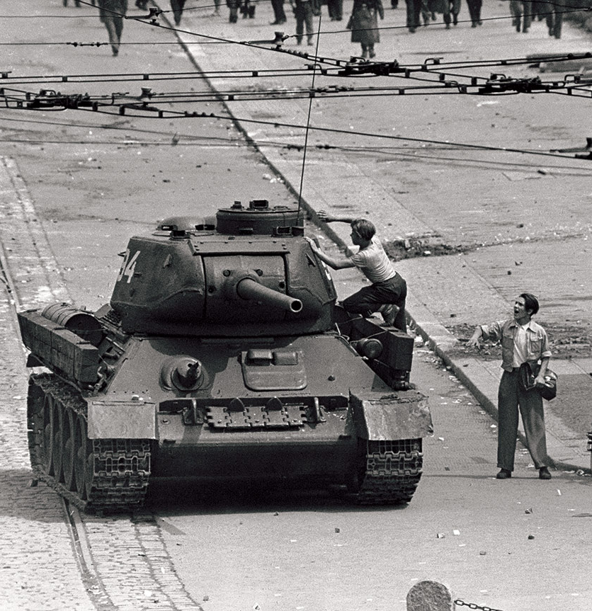
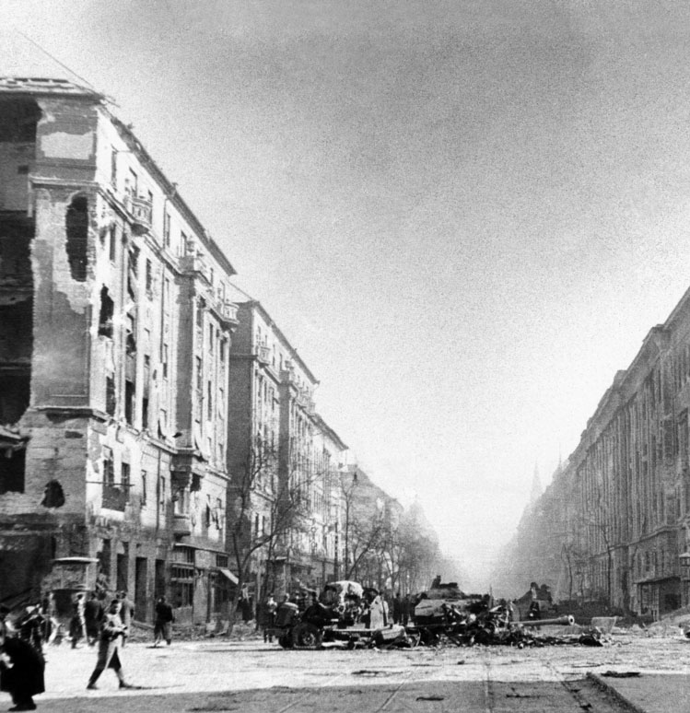
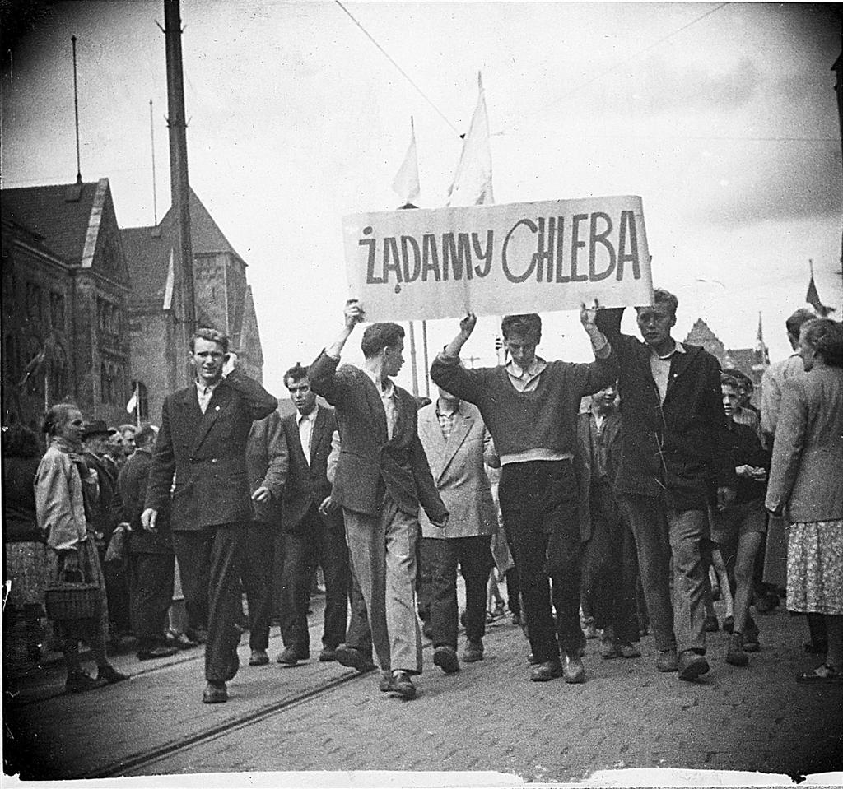
Three key events prior to 1964
(linking to opposition to Soviet rule)

Slide 2
Poland
Hungary
Causes:
The Poles were still harbouring resentment towards the Russians on their historical relationship.
Since 1948, the USSR had taken a heavy-handed approach to aspects of Polish life.
Poles faced continuing economic austerity as the country struggled to recover from the devastating effects of the war. In 1951, rationing was introduced, followed by large price increases in 1953 and a drop in real earnings by 1955.
Intellectuals began to discuss the future form of socialism. Clubs such as the Crooked Circle encouraged open discussion of issues affecting Polish citizens.
Causes:
Hungary was led by a hard-line Communist leader Rákosi.
The people hated the restrictions on their freedoms put on them by their government – in particular the lack of freedom of speech.
They resented the presence of thousands of Soviet troops in their country as they had to pay for Soviet forces to be in Hungary.
Russification permeated Hungary (e.g. Russia street signs, schools and shops).

Slide 3
Poland
Hungary
Outcomes
Khrushchev could not accept Hungary leaving the Warsaw Pact.
November 1956 thousands of Soviet troops and tanks moved into Budapest and two weeks of fighting followed.
2,000 – 4,000 Hungarians are killed.
200,000 Hungarians fled into Austria to escape the Communist forces.
Imre Nagy and his fellow leaders were imprisoned and then executed.
Western powers sent no help as they were involved in their own crisis.
Janos Kadar was made leader of Hungary and he arrested 35,000 anti Communists
Outcomes:
Gomulka gained massive support across Poland. On 24th October 1956, the support was made manifest through a huge street demonstration in Warsaw.
Gomulka’s popularity and political views, particularly with wanting to maintain Poland’s alliance with the Soviet Union, earned him leadership status, which was granted by Soviet leader Nikita Khrushchev.

Slide 4
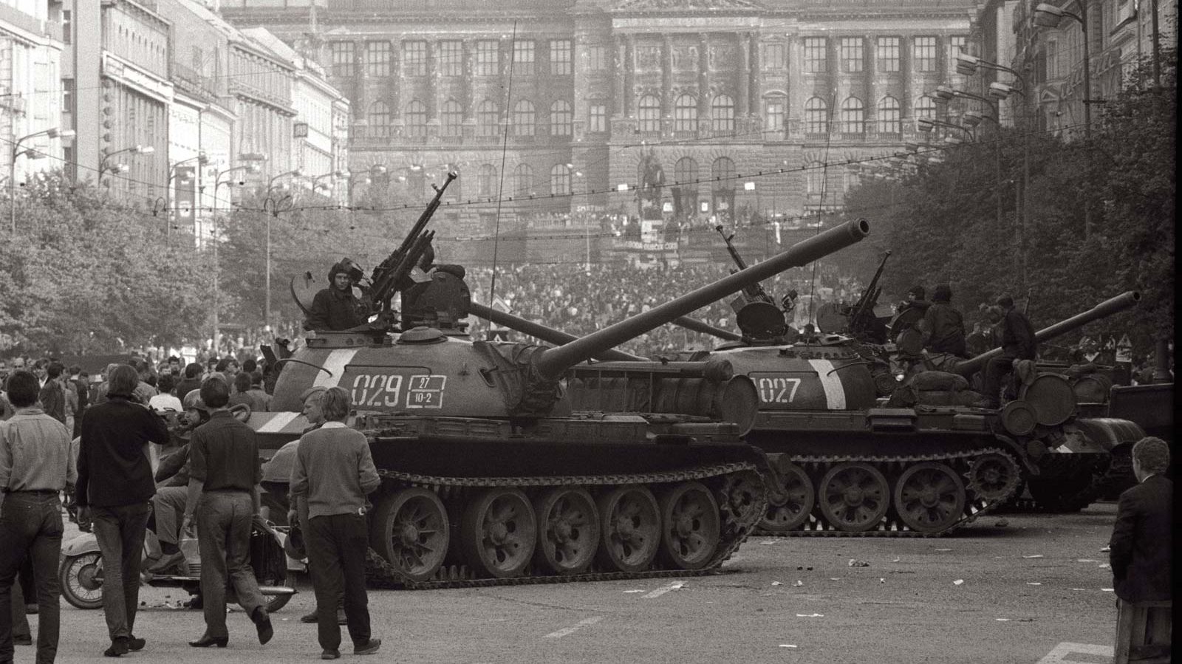
How did the Soviet Union’s actions in Czechoslovakia in 1968 differ from its actions in eastern Europe prior to 1964?

Slide 5
Warsaw Pact
1. When was the Warsaw Pact formed and what was it in response to?
1955, West Germany joined NATO
2. What was the pact? (What was its expected role?)
It was a defensive alliance, controlled by the USSR
3. Who were the original members in the year it was formed?
Albania (until 1968), Bulgaria, Czechoslovakia, East Germany, Hungary, Poland, Romania, USSR.

Slide 6
Changes in superpower leadership
November 1963 Kennedy is assassinated and LBJ assumes power.
His administration was overshadowed by the escalation of conflict in Vietnam.
Khrushchev fell from power in 1964 owing to a combined result of the CMC, Berlin Crisis and failing domestic policies.

Slide 7
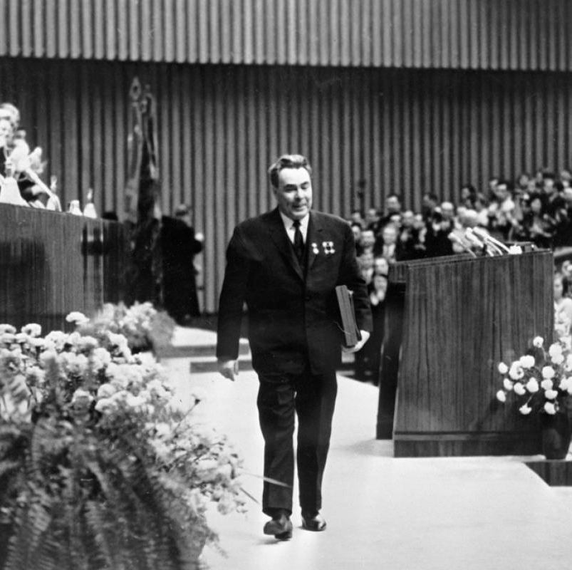
Changes in superpower leadership
Leonid Brezhnev (Secretary of the Central Committee, deputy Party Leader) led a plan to oust Khrushchev.
Following five months absence, he accepted the ouster citing poor health and age as the reason for retirement.
Khrushchev’s policies were reversed and discontent rose in eastern Europe, particularly in Czechoslovakia.

Slide 8
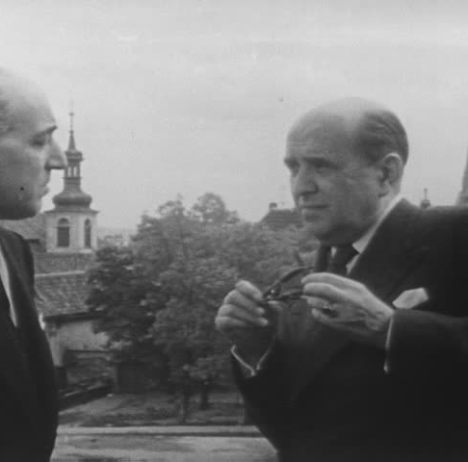
Pre-1968 Czechoslovakia
There was popular support for the Communist Party of Czechoslovakia (KSC).
Stalin’s fears of US ‘economic imperialism’ were confirmed when Czechoslovakia expressed interest in taking up the aid.
As we know, Czechoslovak officials were summoned to Moscow and instructed to reject Marshall Aid.

Slide 9
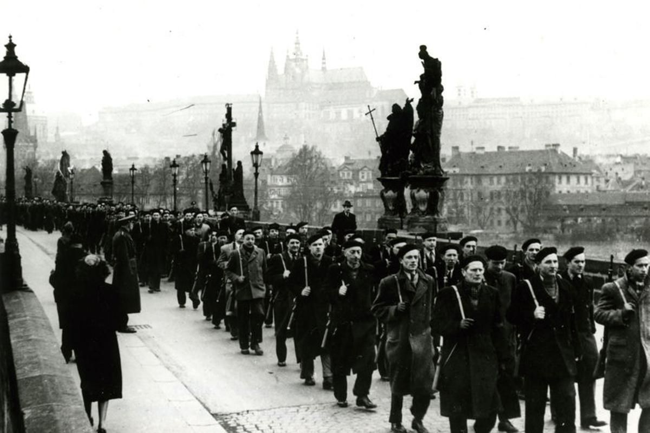
Coup in Czechoslovakia
In February 1948, the Czechoslovakian communists with the backing of the Soviets, overthrew the government.
This stunned western Europe. It led hesitant US politicians to grant aid and implement the Marshall Plan.

Slide 10
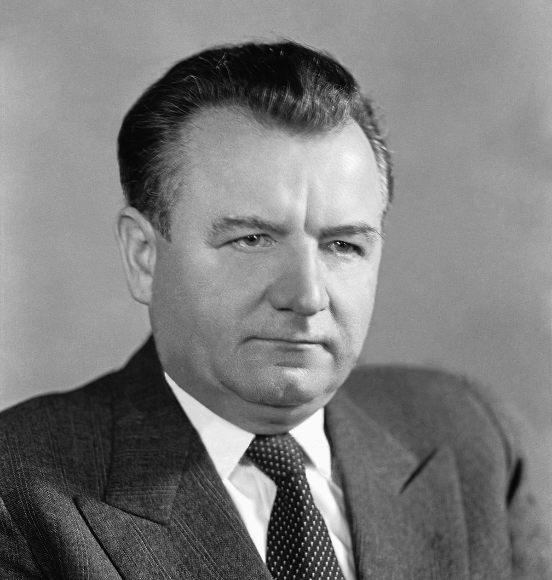
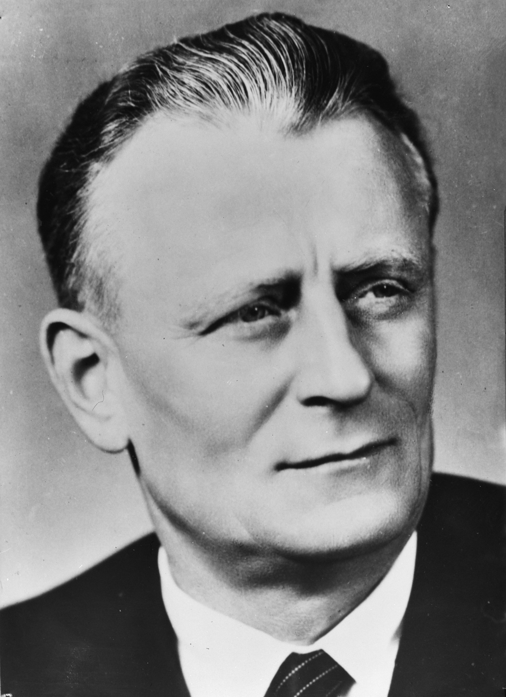
Alexander Dubcek
Clement Gottwald
Antonin Novotny
Key players

Slide 11
Grievances leading to 1968
There was harsh censorship and little freedom of speech; despite Khrushchev's calls for de-Stalinisation Novotny was reluctant to release political prisoners.
The USSR forced Czechoslovakian industry to produce materials (like steel) for the Soviet economy.
Czechoslovakian production was geared towards the Soviet needs, rather than desperately needed consumer goods.
National income fell, living standards were low and many were demanding reform.

Slide 12
Alexander Dubcek
In January 1968 Novotny was replaced by Alexander Dubcek, a long term Slovak Communist. General Ludvik Svoboda was positioned as President (who was supportive of Dubcek’s plans to reform)
He was a charismatic advocate of political reform and advocated for the concept of “socialism with a human face.”
He sought change and during the spring and summer of 1968, he implemented liberalising policies.

Slide 13
“Socialism with a human face”
The shift was announced in a speech commemorating the 20th anniversary of the 1948 communist coup..
In April his intentions were explained through the Action Programme which would allow for:
Freedom of speech, press and movement
Travel to western countries
Freedom of economic enterprise (making decisions based on consumer demand)
Rights of autonomy for the politically repressed and under represented

Slide 14
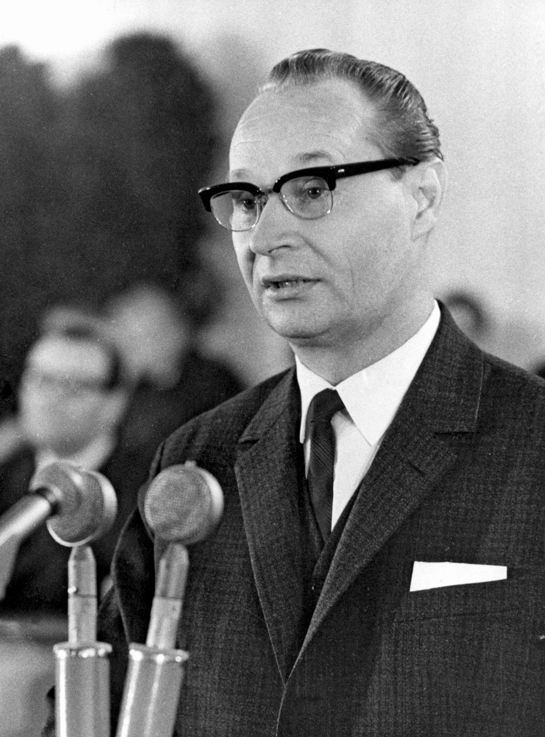
The Prague Spring
The CPCS ended press censorship, planned to open borders with the West, began discussions on trade agreement with West Germany and the possibility of democratic elections.
They asserted they were a loyal member of the socialist order and wished to liberalise in the framework of Marxism Leninism.

Slide 15
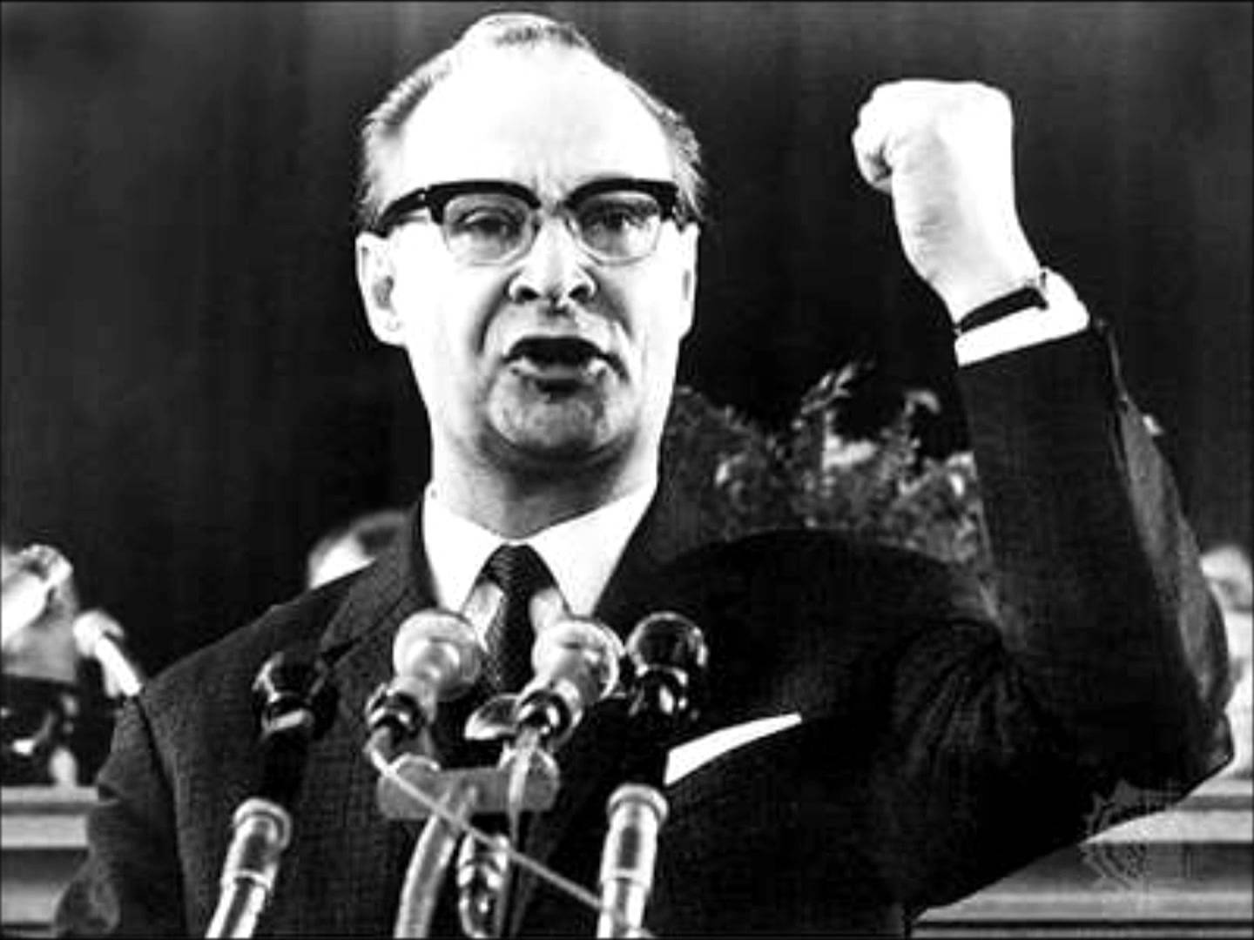
You can crush the flowers, but you can't stop the spring

Slide 16
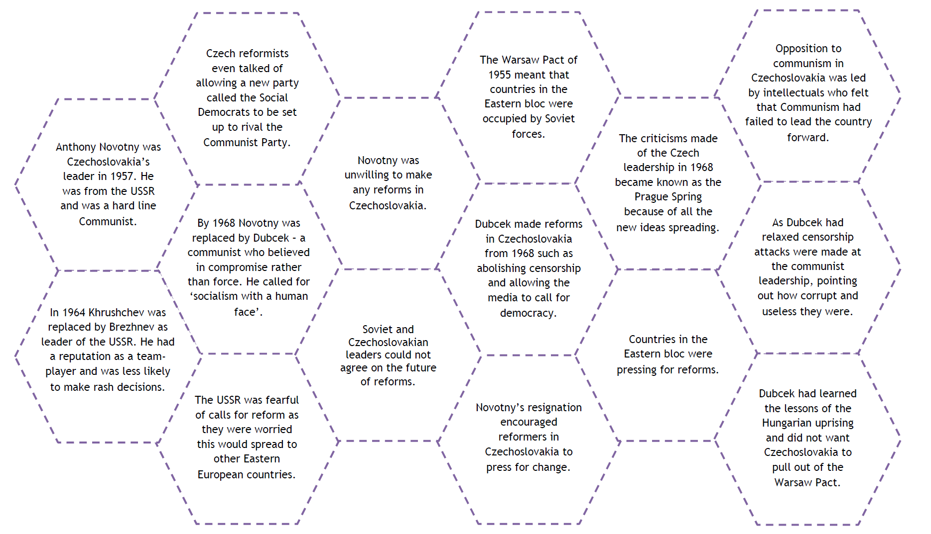

Slide 17
Concerns
WP countries conducted military exercises in Czechoslovakia in late June (nearly 75,000 troops remained close to the border).
A meeting of the leaders of the USSR, Bulgaria, East Germany, Hungary and Poland took place on the 14th/15th July expressed concerns.
The Warsaw Letter (18 July) outlined that a potential split in socialist unity would not be tolerated, calling on Dubcek to reign in “counterrevolutionary” groups.

Slide 18
Task: Warsaw letter

Slide 19
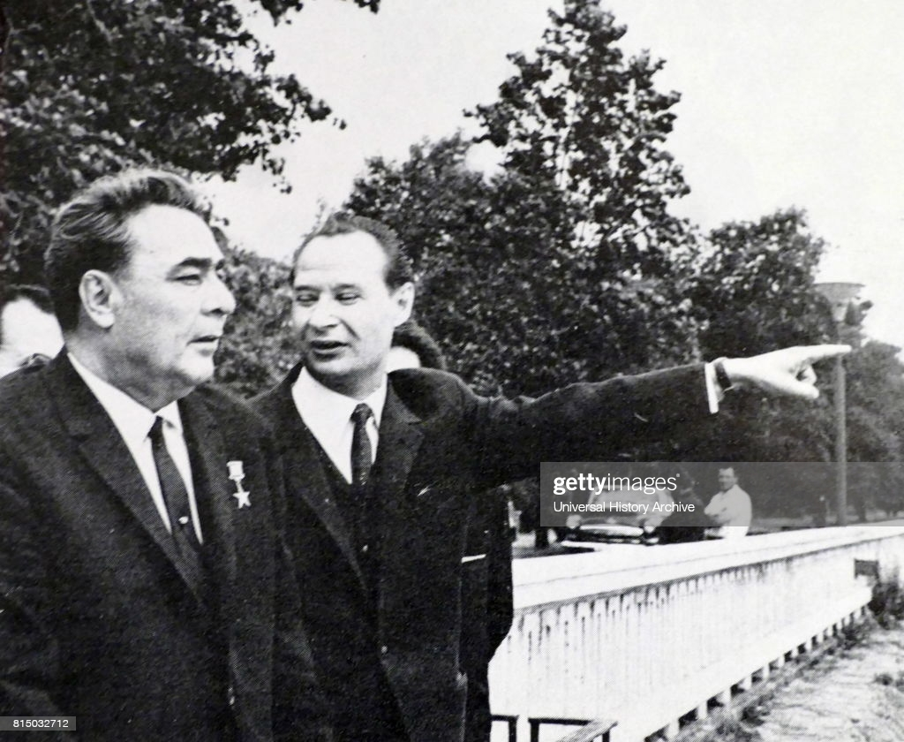
Pressure on Dubcek
Brezhnev and Dubcek met across six meetings at the end of July.
Brezhnev hoped a pro-Soviet group would emerge from the CPCS and ask for military assistance from the WP.
The Soviets fear CZ leaving the WP.
Despite pressure, Dubcek continued on his liberalising path.

Slide 20
Events of the invasion (mixed up!)
Soviet control of Czechoslovakia was re established and Dubcek and the other leaders were arrested and taken to Moscow. Hardline Soviet friendly leaders replaced the reformative leaders of Czechoslovakia.
As the Soviet troops entered the Czech capital Prague, petrol bombs were thrown at Soviet tanks.
As the protest started in Wenceslas Square, anti- Soviet radio broadcasters moved from one place to another to avoid detection. There was, however, no armed resistance from the Czech army to the Soviet invasion.
On the 21st of August 1968, Soviet troops entered Czechoslovakia backed by units from Bulgaria, East Germany, Hungary and Poland.
As well as attacking Soviet troops with petrol bombs, buildings were set on fire and protesters organised in Wenceslas Square. Czech students even climbed onto Soviet tanks and tried to argue with the Soviet soldiers.

Slide 21
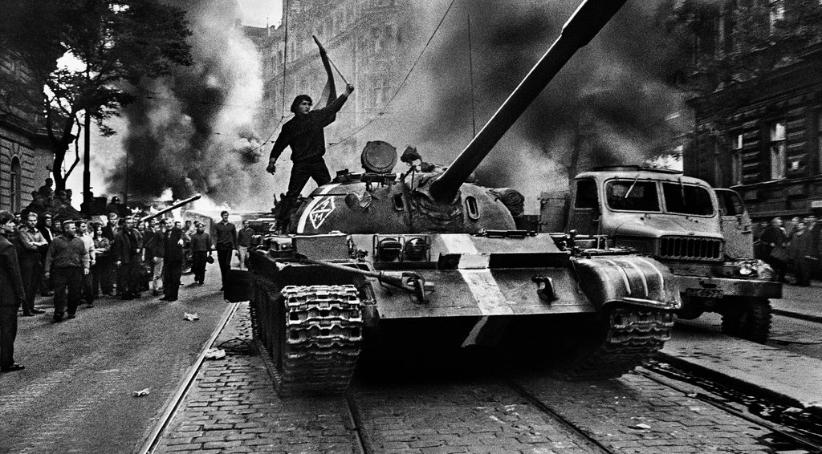

Slide 22
Events of the invasion (in order!)
As the Soviet troops entered the Czech capital Prague, petrol bombs were thrown at Soviet tanks.
On the 21st of August 1968, Soviet troops entered Czechoslovakia backed by units from Bulgaria, East Germany, Hungary and Poland.
Soviet control of Czechoslovakia was re established and Dubcek and the other leaders were arrested and taken to Moscow. Hardline Soviet friendly leaders replaced the reformative leaders of Czechoslovakia.
As well as attacking Soviet troops with petrol bombs, buildings were set on fire and protesters organised in Wenceslas Square. Czech students even climbed onto Soviet tanks and tried to argue with the Soviet soldiers.
As the protest started in Wenceslas Square, anti- Soviet radio broadcasters moved from one place to another to avoid detection. There was, however, no armed resistance from the Czech army to the Soviet invasion.

Slide 23
Invasion
On the night of the 20th August, tanks entered Czechoslovakia and took Prague.
An invasion force of 500,000 troops from WP countries converged on Cz.
Dubcek ordered the army to avoid confrontation though some members of the public fought back.
The radio station alerted the world to their position; Dubcek was arrested and forced to repeal the 1968 reforms.

Slide 24
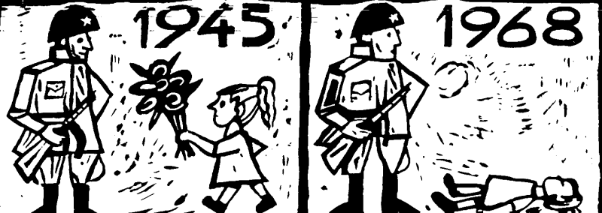
Reaction
The US condemned the invasion and cancelled a planned summit between Johnson and Brezhnev.
The UNSC failed to ass a resolution condemning the act.
There were specific protests against the invasion in China, Romania, Yugoslavia and even a small remonstration in Moscow.
It indicated a level of discontent in the Soviet sphere.

Slide 25
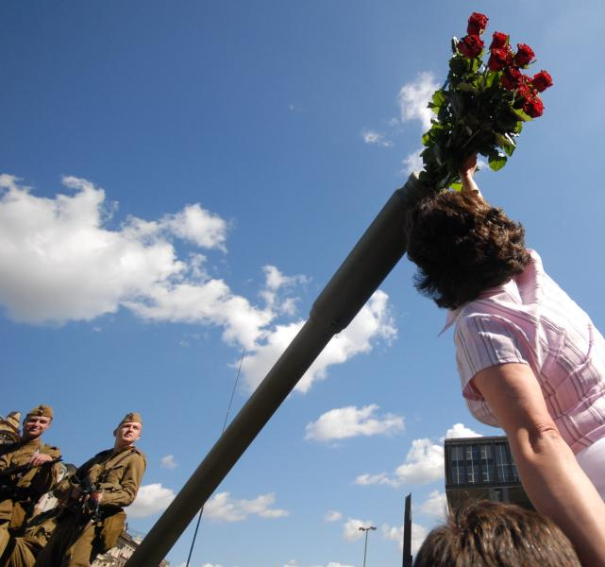
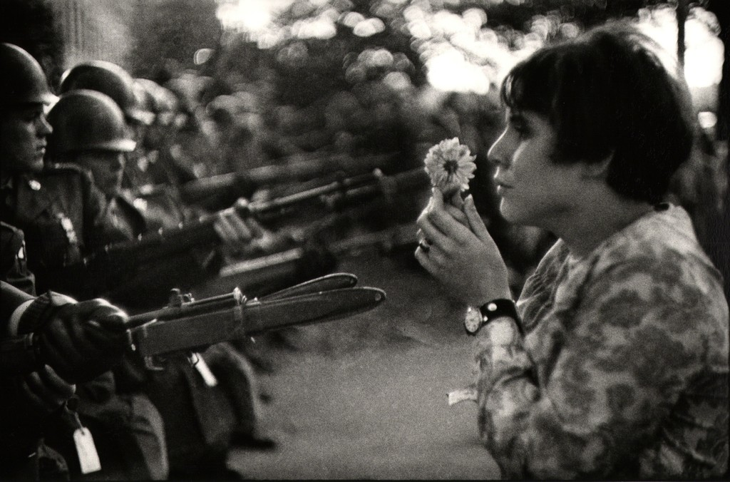
Reaction
As well as revealing supportive governments as stagnant, the Soviets nearly lost control of the Red Army.
Having been told that their presence had been request by the Czechoslovak people, the resistance they faced proved they had been lied to.
Some were hesitant to take action, particularly when responses were peaceful. This soldiers returned to the Soviet Union with their accounts of the invasion.

Slide 26
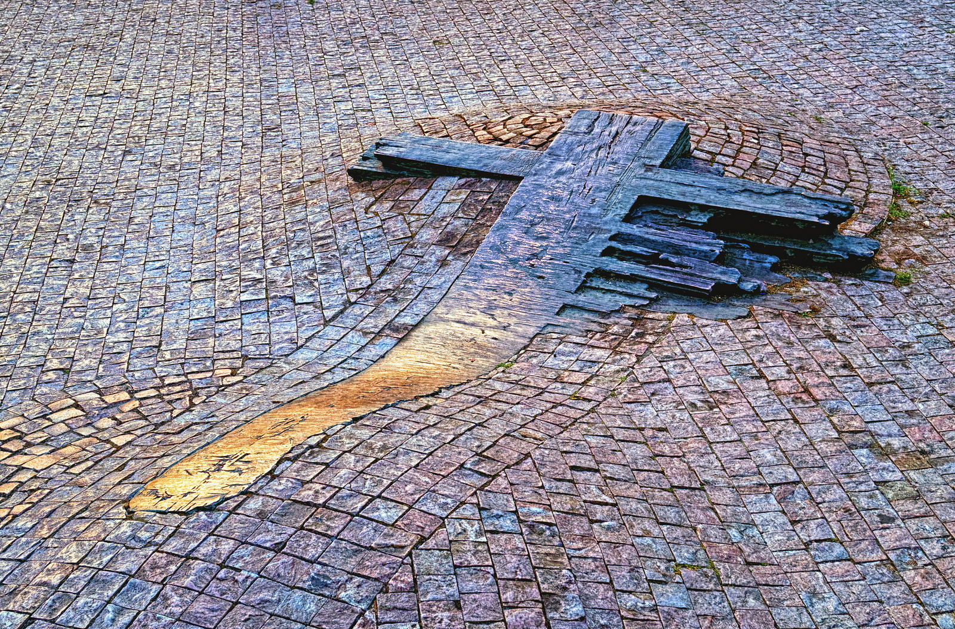
Jan Palach

Slide 27
Gustav Husak
Dubcek remained in power until April 1969, when a new government led by Husak took over (conforming to the Soviet line).
It was dependent on continued Soviet military presence. Brezhnev was willing to pay for this loyalty.
Husak’s policies were enough to prevent a general revolt, though there was a degree of dissidence activity in 1977 (Charter 77).

Slide 28
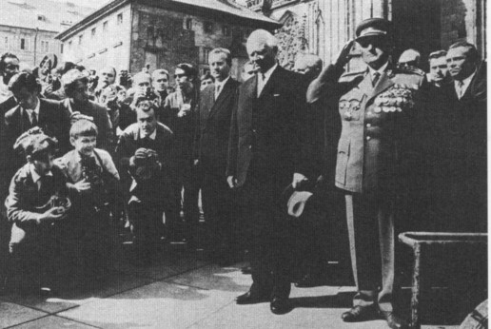
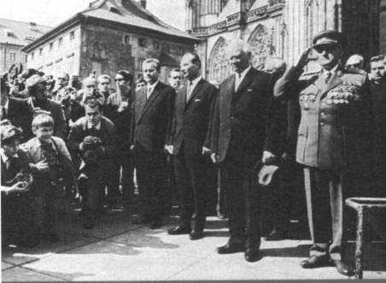
Spot the difference

Slide 29
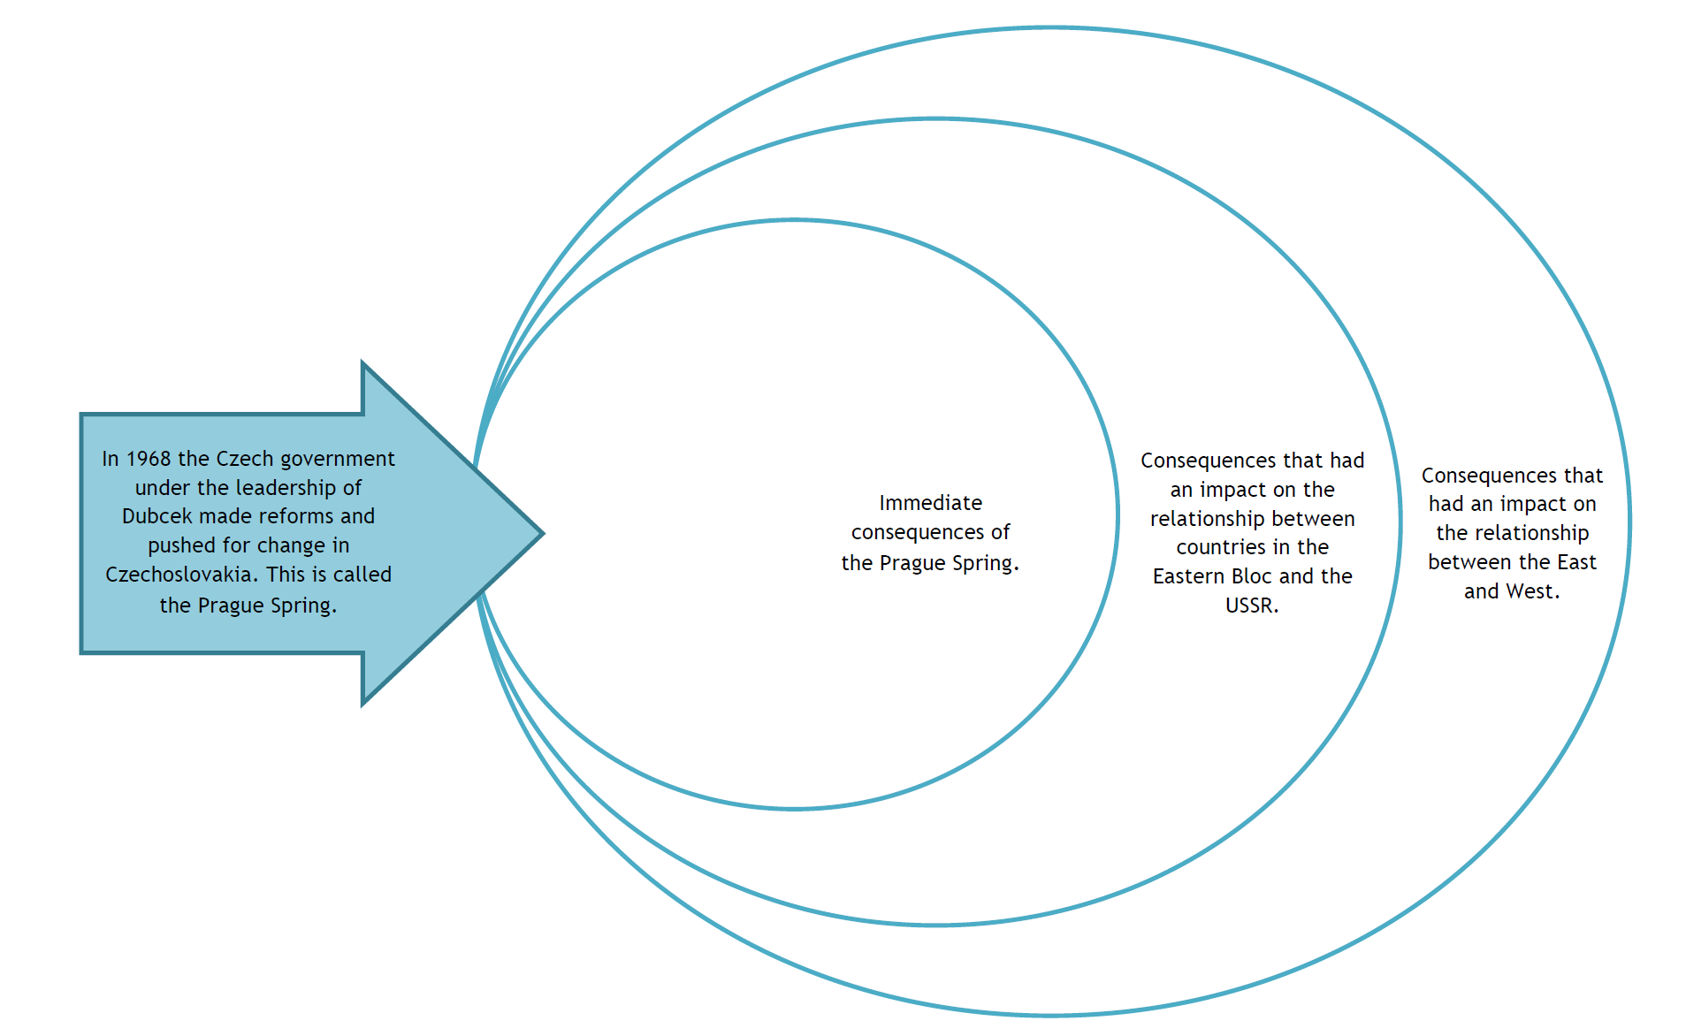

Slide 30
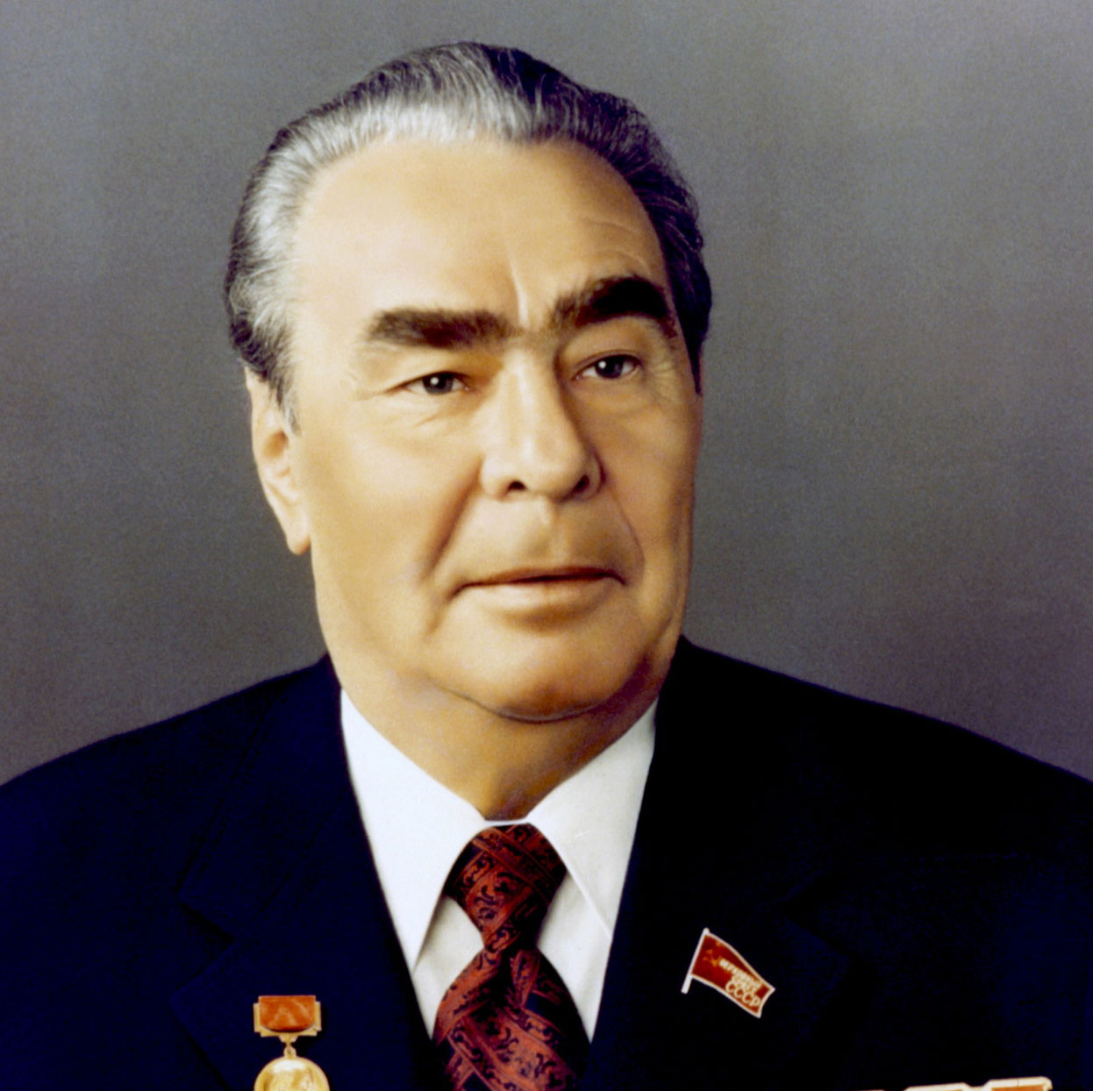
Brezhnev Doctrine
A hugely significant event resultant of the Soviet invasion was the articulation of the Brezhnev Doctrine in November 1968.
This made it clear that the Soviet Union would not allow communist regimes to be overthrown internally or externally.
This, in turn, cemented the Sino Soviet split.

Slide 31
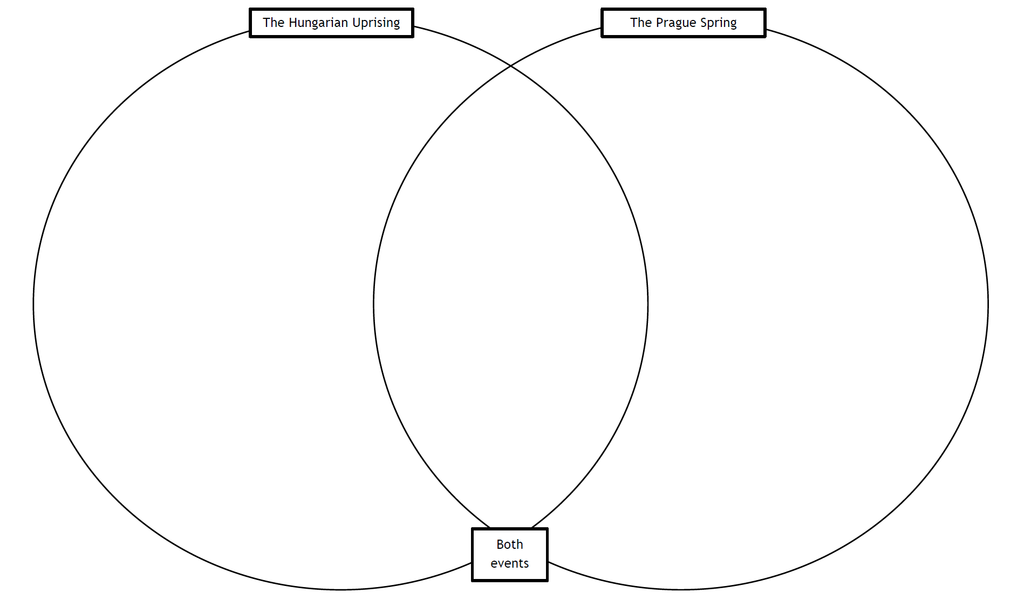
How did these key events differ?

Slide 32
Stretch and challenge
Why do you think the Soviet Union used troops from other communist states in the invasion?
What evidence is there that the Czechs had learnt two lessons from the events in Hungary?
What evidence is there that the Soviet reaction was not as repressive as it was in 1956?
In 1968 Albania left the Warsaw Pact because it claimed that the USSR was ‘not communist enough’ but Brezhnev did nothing. Can you suggest why?

Slide 33
Group source analysis

Slide 34
Assess the value of this source to an historian studying the reasons for Soviet intervention in Czechoslovakia in 1968.
Source A
From a memorandum from the Soviet government to President Johnson. This was handed to Johnson by the Soviet ambassador the evening before the invasion of Czechoslovakia, 20 August 1968.
The government of the Soviet Union considers it necessary to inform President Johnson personally about the following. Because of a conspiracy organised by the external and internal forces of aggression against the existing social order in Czechoslovakia, the Czechoslovak government approached the Soviet Union with a request for military assistance. The events in Czechoslovakia involve the vital interests of the Soviet Union and a number of other states tied together by treaty obligations. These allied states have taken a joint decision to satisfy the request of the Czechoslovak government and to give necessary military assistance. Of course, troops will be withdrawn without delay as soon as the present threat to security is eliminated. We would like President Johnson to know that our steps are dictated fully by the concern to strengthen peace and in no degree do they involve interests of the United States or any other countries. The current events should not harm Soviet-American relations, to the development of which the Soviet government attaches great importance.

Slide 35
Assess the value of this source to an historian studying the reasons for Soviet intervention in Czechoslovakia in 1968.
Source B
From a speech by Marshal Lin Biao, a high ranking Chinese official, at the Ninth Party Congress of the Chinese Communist Party in Beijing, 1 April 1969.
Since Brezhnev came to power, and with Soviet influence becoming less effective and its difficulties at home and abroad growing more and more serious, the Soviet government has been practising dangerous policies. It has stepped up its collaboration with US imperialism and its suppression of the revolutionary struggles of the people of various countries. Its despatch of hundreds of thousands of troops to occupy Czechoslovakia, and its armed provocations against China are two foul performances staged recently by the Soviet government. The Soviets justify their actions of aggression and plunder by talking about the ‘socialist community’. What does all this mean? It means that your power is limited while theirs is unlimited. It means that when any party or any country in their so-called ‘socialist community’ holds a slightly different view, they act ferociously and stop at nothing in suppression, sabotage and subversion, even sending in troops to invade and occupy their so-called ‘brother states’.

Slide 36
Assess the value of this source to an historian studying the reasons for Soviet intervention in Czechoslovakia in 1968.
Source C
From a speech by Leonid Brezhnev to the Communist Party at the Lenin Centenary Celebrations in the Kremlin, 21 April 1970.
The anti-socialist conspiracy in Czechoslovakia was a long-premeditated attempt by the remnants of the former exploiting classes, in alliance with the right-wing opportunists and with the support of world imperialism, to destroy the foundations of the socialist system of Czechoslovakia. This conspiracy aimed to isolate Czechoslovakia from her allies, and thereby to strike a heavy blow against the position of socialism in Europe. But the Marxist-Leninist core of the Czechoslovak Communist Party, and the determined action by those loyal to the principles of socialist internationalism, frustrated the dangerous enemy plans directed against the common interests of socialism and, in the long run, against peace on the continent of Europe. The Soviet Union takes a firm stand in favour of socialist internationalism and the restoration of good relations between socialist countries wherever they have been broken. The Central Committee of the Communist Party of the Soviet Union (CPSU) and the Soviet government will continue to work actively and consistently in this direction.

