Slide 1
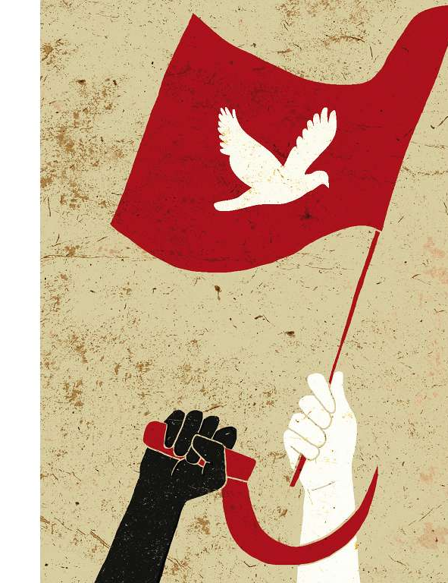
The crushing of Solidarity in Poland
Starter:
What were the similarities and differences in the Hungarian Rising and the Prague Spring?
Why was there so much opposition to Soviet control in Poland?

Slide 2
Poland 1956
In a nutshell…
Events:
On June 28, 1956, industrial workers in the city of Poznan (specifically Poznan Cegielski Factories) went on a notable strike to demand wage increases, fair quotas, and overall better working environments and treatment.
100,000 protesters (workers, students, activists) were reported to have marched through Poznan. What started as a peaceful protest soon turned into violent riots, which resulted in chaos in prisons and the Communist Party Headquarters.
Konstantin Rokossovsky, the Minister of Defence, gave the order to the commanding officer of the local military to contain the acts of resistance happening in Poznan and bring back order as soon as possible.
Rokossovsky’s commands resulted in hundreds of casualties: over 200 people were injured and at least 57 people were killed. In the weeks following the riots, hundreds of people were arrested. The majority of those were workers.
The local uprising caught the attention of the Central Committee of the Polish United Workers’ Party (PZPR). The result of the riots led the party to the realisation that significant policy reforms were needed.
A few months later, the Polish regime enacted wage increases and reforms that signalled the fall of the communist regime in Poland.
On October 21, 1956, the Central Committee elected a new leader: Wladyslaw Gomulka.
Polish October was in October 1956 - the month where a radical shift in the politics of Poland occurred. It is also known as the “Gomulka's Thaw” because this change also marked the beginning of Gomulka's leadership. This transitionary period was caused by several factors: The events following the death of Joseph Stalin in 1953; the Poznan riots; ad the implications of Nikita Khrushchev's speech “On the Personality Cult and its Consequences.”
Causes:
The Poles were still harbouring resentment towards the Russians on their historical relationship.
Since 1948, the USSR had taken a heavy-handed approach to aspects of Polish life. For example, the USSR had imposed a Russian officer, Konstantin Rokossovsky on Poland as its minister of war.
Poles faced continuing economic austerity as the country struggled to recover from the devastating effects of the war. In 1951, rationing was introduced, followed by large price increases in 1953 and a drop in real earnings by 1955.
Intellectuals began to discuss the future form of socialism. Clubs such as the Crooked Circle encouraged open discussion of issues affecting Polish citizens.
Outcomes:
Gomulka gained massive support across Poland. On 24th October 1956, the support was made manifest through a huge street demonstration in Warsaw.
Gomulka’s popularity and political views, particularly with wanting to maintain Poland’s alliance with the Soviet Union, earned him leadership status, which was granted by Soviet leader Nikita Khrushchev.

Slide 3
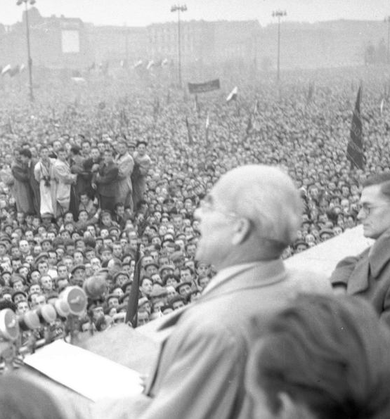
Outcomes from 1956
Had Gomulka’s behaviour displayed weak leadership or approved too strongly of the Hungarian Uprising, the Soviet leaders could easily have decided to send tanks rolling into Poland.
However, Gomulka and his colleagues implemented reforms slowly.
They tried to eliminate oppressive Stalinist features including:
arbitrary arrests
collectivisation
persecution of the Roman Catholic Church.
However, the leadership maintained the command economy and monopoly of the Polish communist party.
Gomulka also insisted on retaining Soviet troops and membership in the Warsaw Pact.

Slide 4

Outcomes from 1956
German revanchism: the idea that West Germany may wish to restore their lost territories and thereby threaten Poland’s security
In 1956, no peace treaty guaranteeing Poland’s territorial integrity had been concluded and fear of west German revanchism was widespread in Poland.
Gomulka convinced the people that “Polish state interests” required the Red Army to guarantee the country’s western borders.
The Polish October showed that a limited campaign of moderate reforms which did not threaten the political system, or the security of the Eastern military bloc, could be implemented even against the will of the Soviet leadership.
More than anything else, this motivated the Czechoslovakian Communist reformers in 1968.

Slide 5

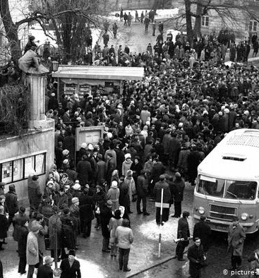
Events in 1968
In January 1968 students protests led to calls for a general strike.
Passive opposition transformed into direct action in March; in Warsaw violent clashes took place between students and the police.
Gomulka’s position as threatened and was lucky to survive the crisis.
Order was restored by force and targeting Jews. The USSR supported Gomulka though the crisis.

Slide 6
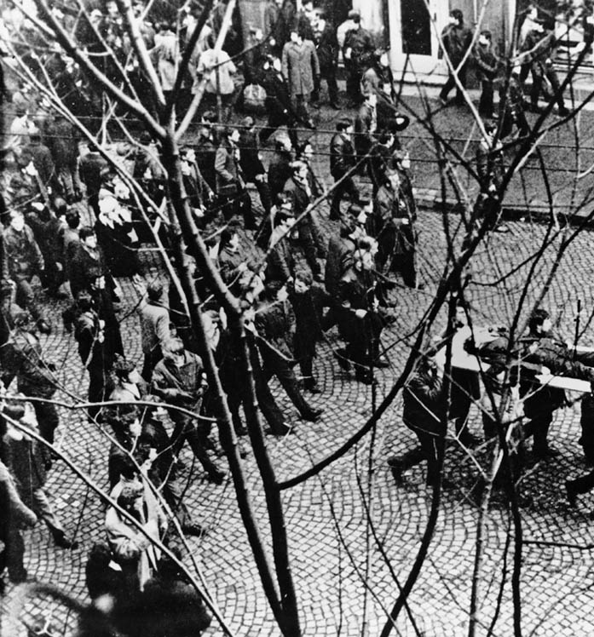
1970: workers’ protest
In December 1970, Gomulka’s politburo announced 40% increases on the price of basic foodstuffs.
Spontaneous workers’ protests took place across the country.
In Gdynia, worker returning to the shipyard were fired on outside the locked shipyards.
Gomulka went into forced retirement, but prices weren’t immediately rescinded.

Slide 7
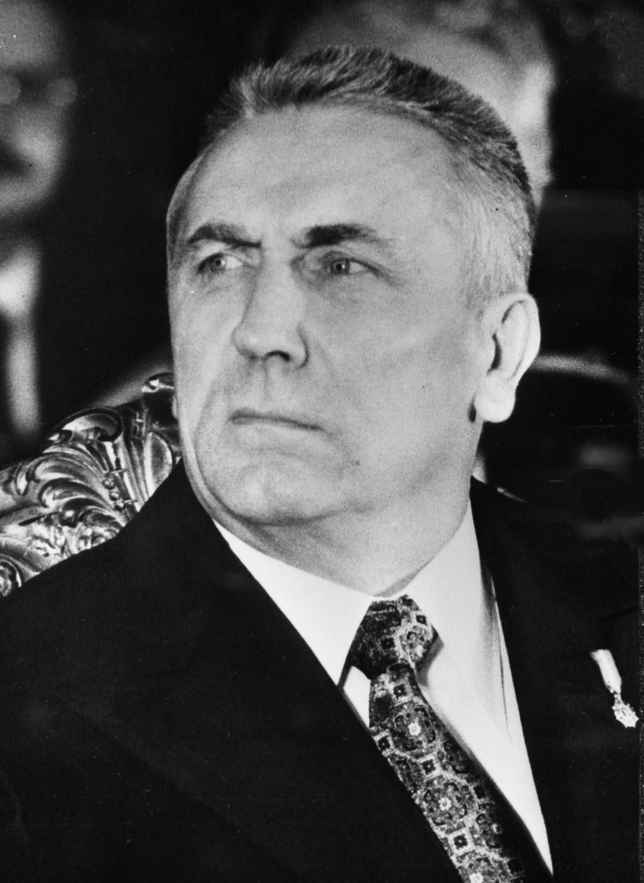
1970: aftermath
Protests resumed in the New Year but the new leadership, under Edward Gierek, took a more reasonable approach.
Edward Gierek travelled to the Szczecin and Gdansk shipyards for discussions with workers’ representatives.
Major protests by textile workers in Lodz eventually forced the new government to withdraw the December price increases.

Slide 8
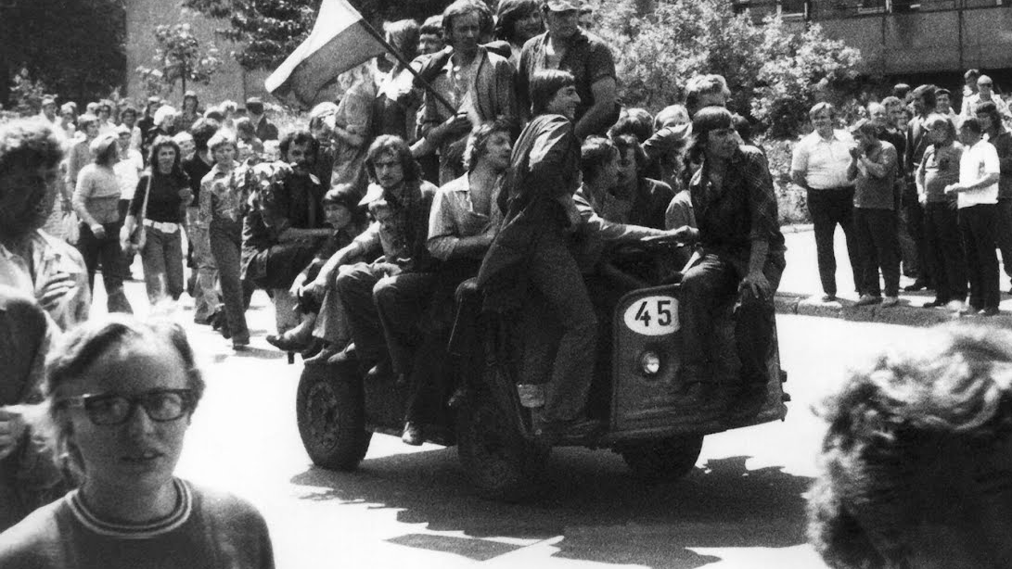
1976: a new stage of opposition
Government increased basic meat prices by 50% and other staples by 30%; this resulted in spontaneous nationwide protests.
The Prime Minister announced the withdrawal of the increases – workers felt emboldened.
The Committee for the Defence of Workers (KOR) was founded to support the persecuted.
They published a large factual bimonthly information bulletin, to record and publicise all cases of government persecution and violence.
They were successful in demanding that those dismissed from the 1976 protests should be released and reinstated.

Slide 9
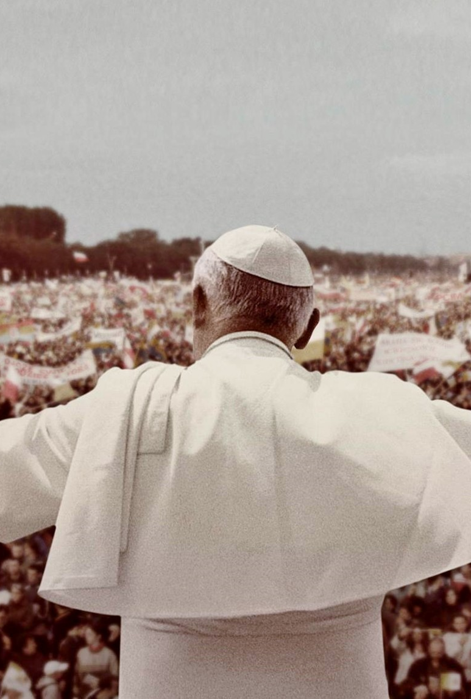
Pope John Paul II
Elected in 1978, he was the first non-Italian Pope for 455 years.
He devoted his in encyclical Redemptor Hominis to the dignity of man and the protection of human rights
The Pope's first pilgrimage to Poland in June 1979 was a massive event; 12 million Poles saw the Pope in person.
The Pope told his congregations that the future of Poland would depend upon how many people were ‘mature enough to become non conformists.’
The event signalled a unique temporary suspension of the communist state.

Slide 10
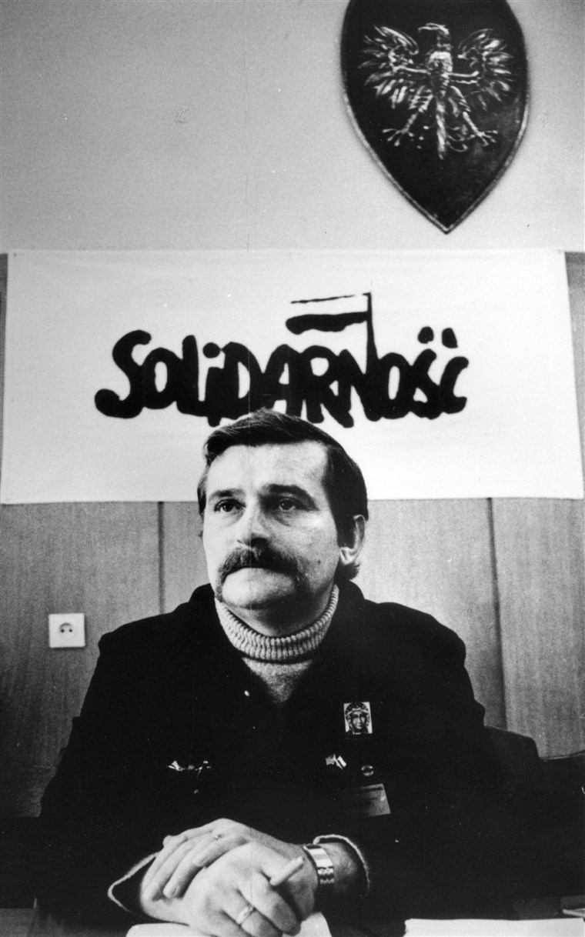

Lech Walesa
Walesa was a Polish pro-democracy activist and union organiser who served as the first democratically elected President of Poland (1990-95).
During 1970, he participated in the work of the Strike Committee.
He led Solidarity (one of the first oppositional social movements in the Soviet bloc).
His organisation’s non-violent struggle resulted in Poland’s transition to a democracy in 1989.
In 1983, he was awarded the Nobel Peace Prize.

Slide 11
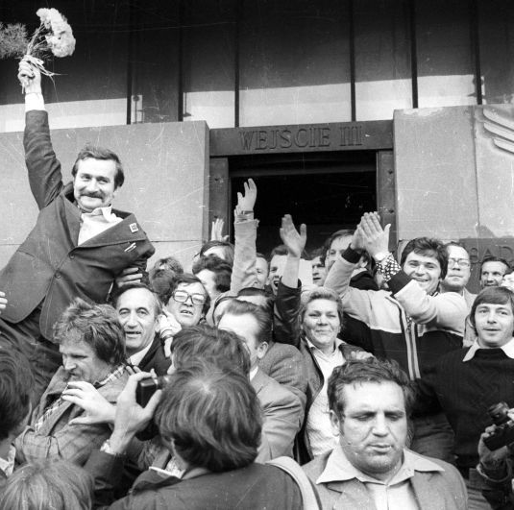
The emergence of Solidarity
In July and August, a wave of strikes swept across Poland after the government announced a food-price increase of close to 100% in some cases.
In Gdansk, Lech Walesa led a strike that shut down the Lenin Shipyards.
31st August, in the Gdansk Agreement, the government officially accepted the first independent trade union in the Communist world: Solidarity.
This guaranteed its right to strike, freedom of speech and access to the media; in return Walesa recognized the leading role of the PUWP.

Slide 12
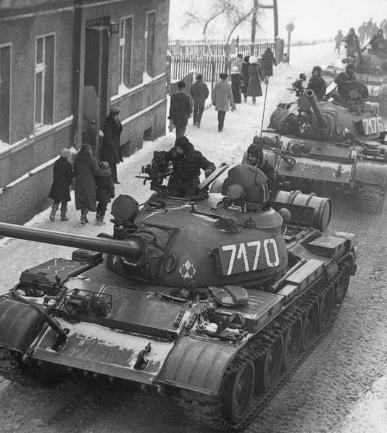
Soviet response
Kremlin analysts regarded the event as an anti-Communist conspiracy.
From August 1980, they conducted military maneuvers and troop movements on Poland’s borders and inside the country to try and intimidate the Union and government.
It became clear that the Soviet leaders were highly reluctant to resort to direct military action.

Slide 13
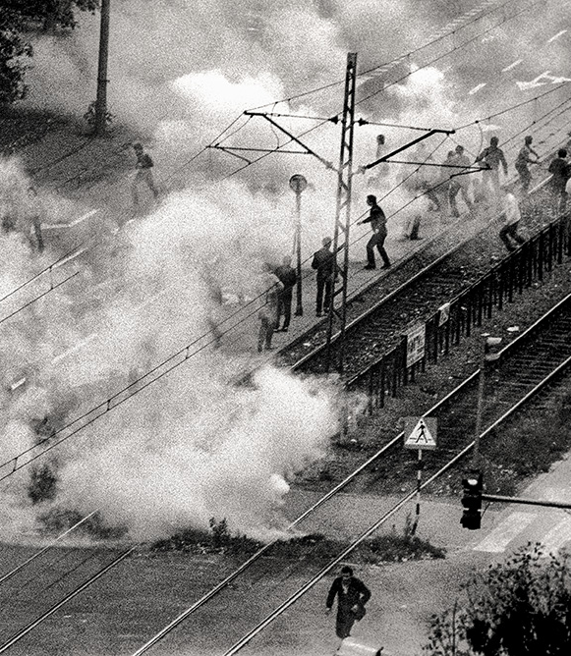
Martial law (December 1981)
Jaruzelski became party leader on 6 September 1981.
He led a military coup of 13 December 1981, arrested Solidarity’s leaders and activists, and avoided a blood bath.
Soviet emergency assistance equally about $5 billion from 1980-81.
The repression was greeted with enormous relief by Moscow and dismay in the west.

Slide 14
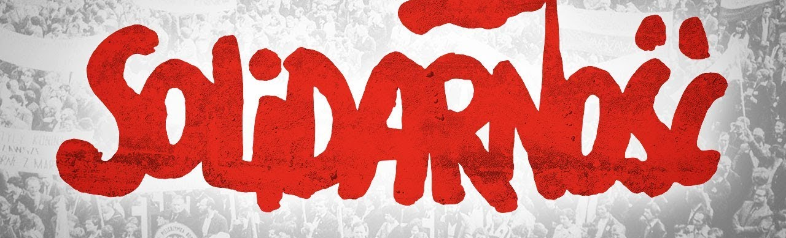
Aftermath
Solidarity’s repression a reminder of Soviet thresholds of tolerance.
Solidarity was outlawed in October 1982, Walesa was released, in November 1982 and martial law was lifted finally in July 1983.
Solidarity showed other communist nations that, if they stood together against oppression, it was very difficult for the authorities to deal with them.

Slide 15
Solidarity chronology (1980-89)
14th Aug. 1980 | Workers at Lenin Shipyard in Gdansk launch sit-in strike, triggering strikes elsewhere | 8th Oct. 1982 | Parliament formally delegalizes Solidarity
31st Aug. 1980 | Government signs Gdansk Accord providing freedom of association | November 1984 | Regime sets up national organisation of official sponsored unions (OPZZ)
24 Sept. 1980 | Solidarity files registration application in Warsaw court | April/May and Aug. 1988 | Two major strike waves cause government to agree to hold ‘round-table talks’ with Solidarity.
24th Oct. 1980 | Court imposes unacceptable condition on registration of Solidarity | 5 April 1989 | Government and Solidarity sign agreement to restore union’s legal status and to hold elections for a new parliament
10th Nov. 1980 | Supreme Court registers Solidarity | 17 April 1989 | Warsaw court restores Solidarity’s legal status
Sep. – Oct. 1981 | Solidarity holds national congress in two sessions between 5th Sep. and 7th Oct. | 4th June 1989 | Solidarity-endorsed state wins all but 1 of 261 parliamentary seats it was allowed to contest.
13th Dec. 1981 | “State of war” (martial law) declared forcing Solidarity underground

Slide 16
Ronald Reagan, "Address to the Nation About Christmas and the Situation in Poland," speech, The White House, Washington, D.C., 23 December, 1981
As I speak to you tonight, the fate of a proud and ancient nation hangs in the balance.... [T]his Christmas brings little joy to the courageous Polish people. They have been betrayed by their own government. The men who rule them and their totalitarian allies fear the very freedom that the Polish people cherish. They have answered the stirrings of liberty with brute force, killings, mass arrests, and the setting up of concentration camps.... The tragic events now occurring in Poland, almost 2 years to the day after the Soviet invasion of Afghanistan, have been precipitated by public and secret pressure from the Soviet Union.... If the Polish Government will honour the commitments it has made to human rights in documents like the Gdansk agreement, we in America will gladly do our share to help the shattered Polish economy, just as we helped the countries of Europe after both World Wars.... I want emphatically to state tonight that if the outrages in Poland do not cease, we cannot and will not conduct "business as usual" with the perpetrators and those who aid and abet them.... The United States is taking immediate action to suspend major elements of our economic relationships with the Polish Government. We have halted the renewal of the Export-Import Bank's line of export credit insurance to the Polish Government. We will suspend Polish civil aviation privileges in the United States. We are suspending the right of Poland's fishing fleet to operate in American waters. And we're proposing to our allies the further restriction of high technology exports to Poland.... I have also sent a letter to President Brezhnev urging him to permit the restoration of basic human rights in Poland provided for in the Helsinki Final Act. In it, I informed him that if this repression continues, the United States will have no choice but to take further concrete political and economic measures affecting our relationship.

Slide 17
Bibliography
Csaba Békés ‘East Central Europe, 1953–1956’ in Melvyn P. Leffler and Odd Arne Westad eds., The Cambridge History of the Cold War: Volume I Origins (Cambridge, 2010) pp. 334-352
Jean Bottaro, Stephen Nutt, History for the IB Diploma: Nationalist and Independence Movements (Cambridge, 2011) pp.188-189
Anthony Kemp-Welch, ‘Eastern Europe: Stalinism to Solidarity’ in Melvyn P. Leffler and Odd Arne Westad eds., The Cambridge History of the Cold War: Volume II Crises and Détente (Cambridge, 2010) pp. 219-237
Jacques Lévesque, ‘The East European revolutions of 1989’ in Melvyn P. Leffler and Odd Arne Westad eds., The Cambridge History of the Cold War: Volume IIII Endings (Cambridge, 2010) pp. 311-332
Robert A. Senser, ‘How Poland’s Solidarity won freedom of association’ Monthly Labour Review, September 1989: https://www.bls.gov/opub/mlr/1989/09/art5full.pdf
Vladislav M. Zubok, ‘Soviet foreign policy from détente to Gorbachev, 1975–1985’, in Melvyn P. Leffler and Odd Arne Westad eds., The Cambridge History of the Cold War: Volume IIII Endings (Cambridge, 2010) pp. 89-111

