Slide 1
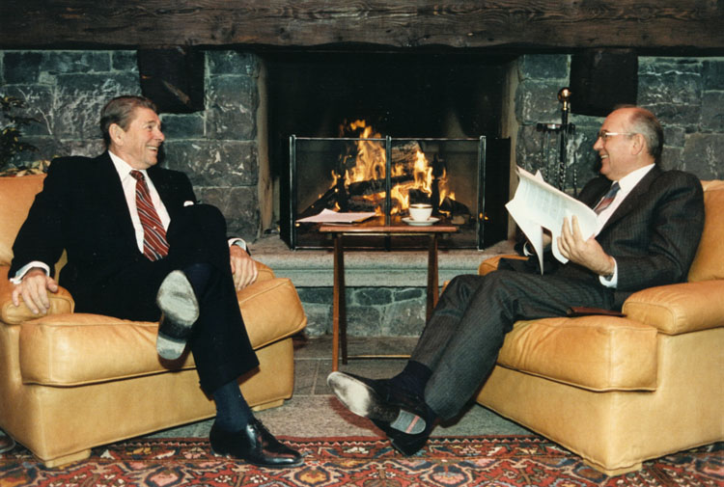
To what extent is it fair to describe President Reagan as a peacemaker, in the years 1985-1989?
We will be considering:
Reagan and the ‘Star Wars’ proposal
Summit meetings between USA and USSR
George H.W. Bush and the US response to 1991

Slide 2
Recap: Upheaval in Latin America
Violent civil war between Marxist guerrillas and government troops supported by armed extremist groups
Reagan administration supported José Napoleón Duarte—a moderate leader who won the 1984 election.
El Salvador
U.S-backed Anastasio Somoza Debayle was ousted by the Sandinistas—a Marxist group.
Reagan cut off aid to Nicaragua saying that the Sandinistas were backed by the USSR.
Reagan then allowed the CIA to equip and train a Sandinista opposition group called the Contras.
Congress cut off funds to the Contras and banned all further direct or indirect U.S. support of them.
Nicaragua

Slide 3
Recap: Trouble Spots Abroad
Lebanon
Muslim and Christian groups waged a civil war.
Israel invaded Lebanon to expel the PLO.
U.S. sent 800 peacekeepers.
Suicide bombers killed 241 marines.
Reagan withdrew the troops.
Grenada
1983 Communist coup stranded 800 U.S. students.
Cuba’s role and students’ safety concerned Reagan.
Reagan sent in soldiers who took the island in two days with a loss of 19 soldiers.
South Africa
Apartheid enforced legalized racial segregation.
Reagan’s policy was one of “constructive engagement” with the white minority government.
Congress overrode his veto and imposed trade limits and other sanctions.

Slide 4
The Iran-Contra Affair
Despite the Congressional ban on U.S. funds for the Contras war, Reagan’s national security staff sought to continue the funding.
In 1985 National Security Advisor Robert McFarlane persuaded Reagan to sell arms to Iran in hopes that Iran would help obtain the release of U.S. hostages in Lebanon.
  This violated a U.S. arms embargo.
Members of the National Security Council staff then secretly diverted the money from the sale of arms to Iran to the Contras in Nicaragua.

Slide 5
The Iran-Contra Affair
Vice Admiral John Poindexter and Lieutenant Colonel Oliver North carried out the plan to divert arms sale money to the Contras.
When the Iran-Contra affair came to light, Congress wanted to know if anyone higher up was involved.
Reagan admitted authorizing the sale of arms to Iran but denied knowing that the money was then diverted to the Contras.
Full details of the affair are not known because the administration engaged in a cover-up of their actions.
  North admitted destroying key documents.
  High-level Reagan staff members lied in testimony to Congress and withheld evidence.
  North was convicted of destroying documents and perjury. His conviction was overturned on technicalities.

Slide 6
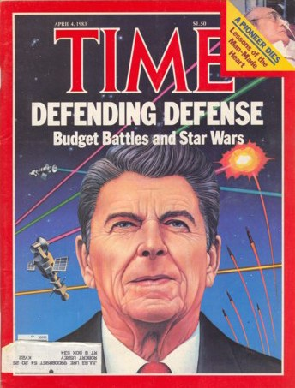
Strategic Defense Initiative (SDI)
In March 1983, Reagan announced the Strategic Defense Initiative (SDI), popularly known as Star Wars.
The plan called for orbiting battle stations in space that could intercept intercontinental missiles
Most scientists considered this an impossible goal, but it fit with Reagan’s arms race strategy with the Soviets

Slide 7
National Security Decision Directive Number 172
Examine the declassified document on the Strategic Defence Initiative to review
The purpose of the programme
Challenges faced by the USA
Soviet reaction
New deterrent options
Perceptions of the programme

Slide 8
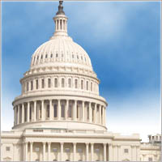
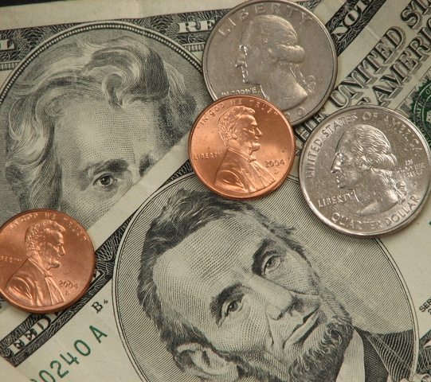
Main Opponents
Congress: potential for public embarrassment, huge bill, need for expanded taxes, upset tax payers
American Public: Fear of it going wrong, Soviet hacking, against raised taxes
Military Contractors: too expensive, too complicated, too out of reach

Slide 9
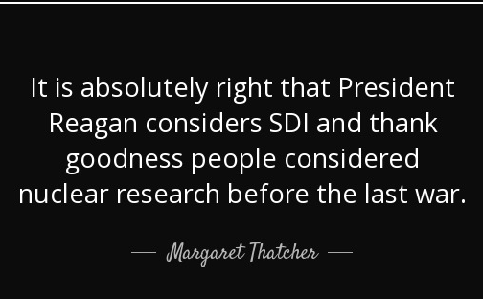
Opinions abroad
USSR: feared it would work, continued to heavily fund their nuclear programmes (instrumental to collapse of SU?)
NATO: Supported the programme, Thatcher and Kohl (West German Chancellor) strongly supported
Britain and France: Sceptical of success – Thatcher ‘pie in the sky’ Mitterrand calls for cooperative approach

Slide 10
Dear Mrs. Thatcher,
I wanted to especially thank you for the opposition to present the technical side of the President’s Strategic Defense Initiative. We feel that very substantial progress is being made, although there is a long way to go.
The key to that progress is the thousands of people in government and in industry who are already working on the project. Our confidence is enhanced because they represent many of our best minds. Over the next year, we hope to create additional opportunities for your people to meet with our experts so they will gain an informed, first-hand impression of the issues and the program.
I have also attached a letter from General Abrahamson expressing his appreciation for the opportunity to meet with you. He provides some additional points in answer to your concern about “automatic response”.
My very best wishes to you. I am looking forward to our next opportunity to discuss the Strategic Defense Initiative further, as well as the many new projects we have underway that are so satisfactorily improving our joint security.
Sincerely,
Caspar Weinberger

Slide 11
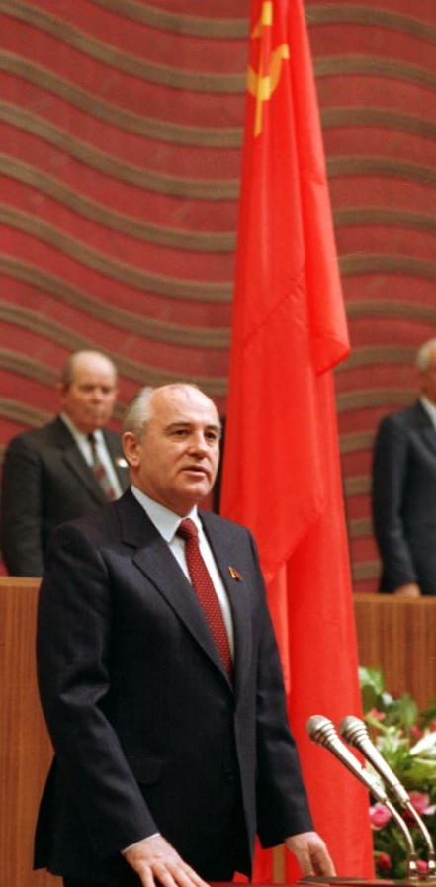
Gorbachev: recap
His approach focused on rethinking Soviet priorities and de-emphasizing the role of ideology
Goal = end the Cold War (not to end the USSR)
He also wanted to negotiate further arms reduction with Reagan – he figured that both the US and the USSR could not afford to keep spending on defense at the rate they were going
Notes:
Gorbachev elected General Secretary in March, 1985
His approach focused on rethinking Soviet priorities and de-emphasizing the role of ideology
Goal = end the Cold War (not to end the USSR)
Main concern when he entered office was to end the stagnation and decline of the Soviet economy
He also wanted to negotiate further arms reduction with Reagan – he figured that both the US and the USSR could not afford to keep spending on defense at the rate they were going

Slide 12
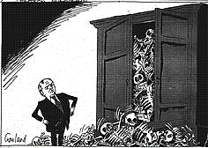
Gorbachev’s ‘New Thinking’
Glasnost = policy of ‘openness’
Perestroika = policy of ‘restructuring’ which focused on reforming and modernizing the Soviet economy and political system
Democratization (demokratizatsiya) = attempts to make the Soviet system more democratic
“New Thinking” (Novoe Myshlenie) = change in political thinking that held that confrontation is counterproductive and that the arms race is pointless.
Notes:
Glasnost = policy of ‘openness’ which allowed people to criticize the government and the communist party, a significant step towards freedom of speech and of the press
Perestroika = policy of ‘restructuring’ which focused on reforming and modernizing the Soviet economy and political system
Democratization (demokratizatsiya) = attempts to make the Soviet system more democratic
“New Thinking” (Novoe Myshlenie) = change in political thinking that held that confrontation is counterproductive and that the arms race is pointless.
New Thinking also suggested that political accommodation was more
important than military power.
Formally endorsed the idea that communist ideology has no place in Soviet diplomacy.

Slide 13
Gorbachev’s ‘New Thinking’
The ‘New Thinking’ policy abandoned the idea of a peaceful, inevitable victory of socialism and focused solely on Soviet security.
Gorbachev announced his desire to reopen arms-control discussions with Reagan, and emphasized ‘reasonable sufficiency.’
April, 1985 - Gorbachev announced that he wanted to withdraw Soviet troops from Afghanistan.
While these ideas increased Gorbachev’s international popularity, they were cause for concern for conservatives within the Soviet Union.
Notes:
The ‘New Thinking’ policy differed from Peaceful Coexistence
and Détente: it abandoned the idea of a peaceful, inevitable victory of socialism and focused solely on Soviet security. Got rid of the idea of peaceful competition.
Gorbachev announced his desire to reopen arms-control discussions with Reagan, and emphasized ‘reasonable sufficiency.’ He was ready to consider Reagan’s ‘Zero Option’ proposal (suggesting the removal of all missiles from Europe), showing a marked change from Brezhnev’s nuclear parity policies.
April, 1985 - Gorbachev announced that he wanted to withdraw Soviet troops from Afghanistan.
While these ideas increased Gorbachev’s international popularity, they were cause for concern for conservatives within the Soviet Union.

Slide 14
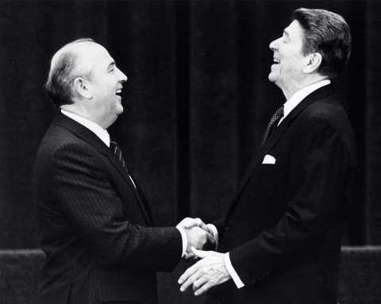
The US Response and Role of Reagan
Reagan also contributed to an improved relationship between the US and USSR, and throughout the latter half of the 1980s we see actual political accommodation taking place.
However, the US was still careful to take advantage of Soviet weakness both within the USSR and in its satellite states.
Notes:
Reagan also contributed to an improved relationship between the US and USSR, and throughout the latter half of the 1980s we see actual political accommodation taking place. Significant change in Reagan’s earlier policies (think “Evil Empire”)
However, the US was still careful to take advantage of Soviet weakness both within the USSR and in its satellite states, by offering concessions to states that tried to diminish their ties to Moscow. From a position of strength, the US began to demand real, fundamental change from the Soviet Union.

Slide 15
First Steps, 1985
In 1985, there’s a new environment or culture of change at work – Gorbachev has stated his desire to end the Second Cold War and reform aspects of the Soviet Union, and Reagan has adopted a more moderate approach.
Gorbachev makes quick work of some of these changes:
  April – stops deployment of missiles
  August – stopped Soviet nuclear testing
  September – suggested that US and USSR both reduce nuclear
weapons stores by half
  October – announced plans to reduce weapons in Eastern Europe.
From 1985-1988, four US-Soviet summits on arms control took place.
Notes:
So in 1985, there’s a new environment or culture of change at work – Gorbachev has stated his desire to end the Second Cold War and reform aspects of the Soviet Union, and Reagan has adopted a more moderate approach.
Gorbachev makes quick work of some of these changes:
April – stops deployment of missiles
August – stopped Soviet nuclear testing
September – suggested that US and USSR both reduce nuclear
weapons stores by half
October – announced plans to reduce weapons in Eastern Europe.
From 1985-1988, four US-Soviet summits on arms control took place.

Slide 16
Let’s Talk About Those Summits
Geneva (November, 1985)
  No significant agreements, but it was the first summit of its kind in six years (remember the “Spirit of Geneva” 1955?). However, they both agree to promise to prevent war between their states and to not seek military superiority.
  After the summit, Gorbachev keeps shaking things up:
 Jan, 1986 – proposed the elimination of ALL nuclear weapons by 2000 and other drastic weapons proposals followed.
 April, 1986 – he proposed talks on limiting the size of conventional forces for the Warsaw Pact and NATO.
 May, 1986 – G. launched “New Thinking.”
Despite these changes, things are still a little frosty in
early 1986 between the US and USSR
Notes:
Geneva (November, 1985)
No significant agreements, but it was the first summit of its kind in six years (remember the “Spirit of Geneva” 1955?). However, they both agree to promise to prevent war between their states and to not seek military superiority.
After the summit, Gorbachev keeps shaking things up:
 Jan, 1986 – proposed the elimination of ALL nuclear weapons by 2000 and other drastic weapons proposals followed.
 April, 1986 – he proposed talks on limiting the size of conventional forces for the Warsaw Pact and NATO.
 May, 1986 – G. launched “New Thinking.”
Despite these changes, things are still a little frosty in
early 1986 between the US and USSR

Slide 17
More Summits
Reykjavik (October, 1986)
  Not as friendly as Geneva…mostly due to the fact that Reagan was still
moving forward with his SDI/Star Wars initiative
  It seemed as though they would be able to agree to withdrawing all nuclear weapons from Europe and reducing nuclear weapons stores by 50%. However, talks broke down when Reagan refused to back down on SDI, and Gorbachev said that further reductions could not happen without assurances on this matter. Now they are deadlocked.
Notes:
Reykjavik (October, 1986)
Not as friendly as Geneva…mostly due to the fact that Reagan was still
moving forward with his SDI/Star Wars initiative
It seemed as though they would be able to agree to withdrawing all nuclear weapons from Europe and reducing nuclear weapons stores by 50%. However, talks broke down when Reagan refused to back down on SDI, and Gorbachev said that further reductions could not happen without assurances on this matter. Now they are deadlocked.
However, in February 1987, Gorbachev offered to accept the NATO zero-zero option, which would mean both sides removing their missiles from Europe. This is a complete REVERSAL from earlier Soviet policies and a huge concession by the Soviet Union. Gorbachev’s critics view this as a dangerous surrender.
November, 1987 – Gorbachev admitted that the Soviet bloc needed to improve human rights and that the ‘Iron Curtain’ should be lifted.

Slide 18
More Summits
However, in February 1987, Gorbachev offered to accept the NATO zero-zero option, which would mean both sides removing their missiles from Europe. This is a complete REVERSAL from earlier Soviet policies and a huge concession by the Soviet Union. Gorbachev’s critics view this as a dangerous surrender.
November, 1987 – Gorbachev admitted that the Soviet bloc needed to improve human rights and that the ‘Iron Curtain’ should be lifted.
Notes:
Reykjavik (October, 1986)
Not as friendly as Geneva…mostly due to the fact that Reagan was still
moving forward with his SDI/Star Wars initiative
It seemed as though they would be able to agree to withdrawing all nuclear weapons from Europe and reducing nuclear weapons stores by 50%. However, talks broke down when Reagan refused to back down on SDI, and Gorbachev said that further reductions could not happen without assurances on this matter. Now they are deadlocked.
However, in February 1987, Gorbachev offered to accept the NATO zero-zero option, which would mean both sides removing their missiles from Europe. This is a complete REVERSAL from earlier Soviet policies and a huge concession by the Soviet Union. Gorbachev’s critics view this as a dangerous surrender.
November, 1987 – Gorbachev admitted that the Soviet bloc needed to improve human rights and that the ‘Iron Curtain’ should be lifted.

Slide 19
Some more Summits
Washington (December, 1987)
  There are real results! Signing of the INF (Intermediate Nuclear Forces) Treaty! This treaty stated that all nuclear missiles would be withdrawn from Europe.
  IMPORTANT, but why? This is the first arms reduction treaty to be signed since 1979 and it was unique in that it completely eliminated an entire category of nuclear weapons.
Notes:
Washington (December, 1987)
There are real results! Signing of the INF (Intermediate Nuclear Forces) Treaty! This treaty stated that all nuclear missiles would be withdrawn from Europe.
IMPORTANT, but why? Because this is the first arms reduction treaty to be signed since 1979, AND, it was unique in that it completely eliminated an entire category of nuclear weapons. Another first was that both sides would accept verification procedures. This means that the arms race isn’t just slowing down – it’s being reversed.

Slide 20
All the Summits!
Moscow (May, 1988)
  Once again, this summit achieved few results, as once again the Star Wars project came up and blocked agreements on reduction of strategic nuclear weapons.
  But by this point, it’s clear that Gorbachev is making sincere efforts to reform and negotiate…and Reagan can’t really keep calling the Soviet Union an “Evil Empire.” The international community looked favorably on Gorbachev and his policies, and Americans started to become frustrated with their politicians.
Notes:
Moscow (May, 1988)
Prior to the summit, Gorbachev had further eased tensions by announcing that the Soviet Union would withdraw its forces from Afghanistan and an agreement was reached to end all foreign involvement in the Afghan civil war (April, 1988).
However, once again, this summit achieved few results, as once again the Star Wars project came up and blocked agreements on reduction of strategic nuclear weapons.
But by this point, it’s clear that Gorbachev is making sincere efforts to reform and negotiate…and Reagan can’t really keep calling the Soviet Union an “Evil Empire.” The international community looked favorably on Gorbachev and his policies, and Americans started to become frustrated with their politicians.

Slide 21
New President
George Bush (Reagan’s vice president) won the election and became
president in 1989.
Bush eased away from improving US-Soviet relations as he felt that Reagan had made too many concessions.
However, in July 1989 Gorbachev and Bush met and their conversation reassured Bush that the USSR did not want to challenge the USA’s dominance, allowing the thaw in relations to progress.
The Soviet Union was in a desperate economic position, and in order to get US financial support, they were willing to sign the START treaty without any major US concessions.
Notes:
George Bush (Reagan’s vice president) won the election and became
president in 1989.
Bush eased away from improving US-Soviet relations as he felt that Reagan had made too many concessions. At the time, the US had a pretty strong global position (SDI project, advanced technology and weaponry, Grenada, Afghanistan, Nicaragua, etc.) and the Soviet Union was obviously weakened. So Bush used these issues as leverage to force Soviet concessions.
However, in July 1989 Gorbie and Bush met and their conversation reassured Bush that the USSR did not want to challenge the USA’s dominance, allowing the thaw in relations to progress.
The Soviet Union was in a desperate economic position, and in order to get US financial support, they were willing to sign the START treaty without any major US concessions. Again, this is both a success for the Soviets (they are desperate after all), and another cause for criticism from hardliners in the USSR.

Slide 22
Gorbachev Doctrine vs. “Diplomacy of Despair”
The Gorbachev Doctrine refers to the policy of disengaging from attachments/involvement in the developing world to avoid confrontation with the US.
‘Diplomacy of Despair’ is a phrase some historians have used to describe the intense economic difficulties that the Soviet Union experienced that forced it to make defense cuts and concede to the US. It indicates the importance of long-term factors in the demise of the Cold War, not just the policies of individuals.
Notes:
Flashback: In 1982, the USSR seemed to be at its height.
Under Brezhnev’s ‘reign’ the USSR had achieved nuclear parity (more or less) and established friendly links with more countries. However, the cost of these policies were high and took a severe toll on the Soviet economy. These economic problems weakened the USSR.
The Gorbachev Doctrine refers to the policy of disengaging from attachments/involvement in the developing world to avoid confrontation with the US.
‘Diplomacy of Despair’ is a phrase some historians have used to describe the intense economic difficulties that the Soviet Union experienced that forced it to make defense cuts and concede to the US. It indicates the importance of long-term factors in the demise of the Cold War, not just the policies of individuals.

Slide 23
The Collapse of Eastern Europe 1988-1989
Late 1970s/early 1980s saw a resurgence of nationalism in many of the
Soviet bloc states.
Gorbachev’s “New Thinking” translated into unwillingness to use military force to maintain Soviet dominance over satellite states.
March, 1985 – Gorbachev publicly abandoned the Brezhnev Doctrine, and said that Soviet troops would not be sent into any Eastern European state.
December, 1988 – Gorbie announced at the UN that he would reduce the number of Soviet troops committed to Warsaw Pact.
Notes:
Late 1970s/early 1980s saw a resurgence of nationalism in many of the
Soviet bloc states.
First nation to show signs of strain and tension was Poland in 1981 with the Solidarity strikes (earlier lecture notes). Though the strikes were forcibly put down, tensions rose again in the late 1980s.
Gorbachev’s “New Thinking” translated into unwillingness to use military force to maintain Soviet dominance over satellite states. Wow, that’s new. More of a focus on shared community and cooperation.
March, 1985 – Gorbachev publicly abandoned the Brezhnev Doctrine, and said that Soviet troops would not be sent into any Eastern European state.
December, 1988 – Gorbie announced at the UN that he would reduce the number of Soviet troops committed to Warsaw Pact. Also announced that ideology should be minimized in foreign affairs.

Slide 24
Collapse of Eastern Europe 1988-1989
Hungary and Poland welcomed the reforms
Some people wanted the reforms to go even further - to restore the power of the church and the capitalist system
Poland: Solidarity legalized in January 1989 and accepted political and economic reforms in April 1989.
Hungary: 1989 – agreed that multi-party elections would be held, also decided to open its border with Austria. This sparked a crisis in East Germany because it allowed East Germans to ‘escape’ to West Germany via Hungary and Austria. This caused another economic crisis similar to the one that preceded the construction of the Berlin Wall.
Notes:
Gorbachev also encouraged the use of his reform policies glasnost, perestroika, and democratization in Eastern Europe (similar to earlier pushes for reform in those nations)
Hungary and Poland welcomed the reforms
Some people wanted the reforms to go even further - to restore the power of the church and the capitalist system (whoa, now. Slow down, crazy.)
Poland: Solidarity legalized in January 1989 and accepted political and economic reforms in April 1989. One of these reforms included open elections, which revealed a clear win for Solidarity in June 1989. In August, parliament elected the first non-communist prime minister to control an Eastern European nation in over 40 years.
Hungary: 1989 – agreed that multi-party elections would be held, also decided to open its border with Austria. This sparked a crisis in East Germany because it allowed East Germans to ‘escape’ to West Germany via Hungary and Austria. This caused another economic crisis similar to the one that preceded the construction of the Berlin Wall.

Slide 25
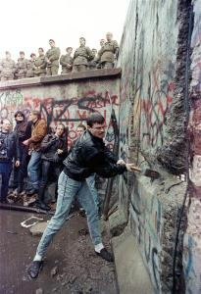
Collapse of Eastern Europe 1988-1989
East Germany: demonstrations in support of democracy began to spread.
October 1989 - leader of the communist party resigned and was replaced by Egon Krenz. Gorbachev told East Germany that it should create closer ties with West Germany, as the USSR could not offer them financial support.
November 1989 – the East German government resigned and Krenz decided to open the Berlin Wall.
People from both sides started to tear down the wall.
Notes:
East Germany: demonstrations in support of democracy began to spread.
October 1989 - leader of the communist party resigned and was replaced by Egon Krenz. Gorbachev told East Germany that it should create closer ties with West Germany, as the USSR could not offer them financial support.
November 1989 – the East German government resigned and Krenz decided to open the Berlin Wall. People from both sides started to tear down the wall.
Czechoslovakia: There was a rebirth of the “Prague Spring” and the communist government resigned and was replaced with a multi-party system (“Velvet Revolution”). Vaclav Havel became president. October 1989 – the Warsaw Pact including the USSR condemned the 1968 invasion.
Romania: remarkable in that it was NOT a peaceful transition. Leader Nicolae Ceausescu (Cheow-shess-ku) tried to put down the demonstrations. Gorbachev refused to intervene, and Ceausescu was captured when he attempted to flee and was later executed.
Big Deal: The Soviet Union is allowing the dissolution of its
cherished security buffer-zone!

Slide 26
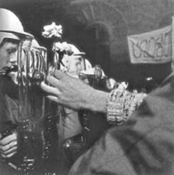
Collapse of Eastern Europe 1988-1989
Czechoslovakia: There was a rebirth of the “Prague Spring” and the communist government resigned and was replaced with a multi-party system (“Velvet Revolution”). Vaclav Havel became president.
October 1989 – the Warsaw Pact including the USSR condemned the 1968 invasion.
Notes:
East Germany: demonstrations in support of democracy began to spread.
October 1989 - leader of the communist party resigned and was replaced by Egon Krenz. Gorbachev told East Germany that it should create closer ties with West Germany, as the USSR could not offer them financial support.
November 1989 – the East German government resigned and Krenz decided to open the Berlin Wall. People from both sides started to tear down the wall.
Czechoslovakia: There was a rebirth of the “Prague Spring” and the communist government resigned and was replaced with a multi-party system (“Velvet Revolution”). Vaclav Havel became president. October 1989 – the Warsaw Pact including the USSR condemned the 1968 invasion.
Romania: remarkable in that it was NOT a peaceful transition. Leader Nicolae Ceausescu (Cheow-shess-ku) tried to put down the demonstrations. Gorbachev refused to intervene, and Ceausescu was captured when he attempted to flee and was later executed.
Big Deal: The Soviet Union is allowing the dissolution of its
cherished security buffer-zone!

Slide 27
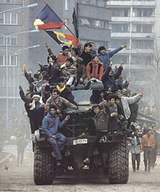
Collapse of Eastern Europe 1988-1989
Romania: remarkable in that it was NOT a peaceful transition.
Leader Nicolae Ceausescu tried to put down the demonstrations.
Gorbachev refused to intervene, and Ceausescu was captured when he attempted to flee and was later executed.
Notes:
East Germany: demonstrations in support of democracy began to spread.
October 1989 - leader of the communist party resigned and was replaced by Egon Krenz. Gorbachev told East Germany that it should create closer ties with West Germany, as the USSR could not offer them financial support.
November 1989 – the East German government resigned and Krenz decided to open the Berlin Wall. People from both sides started to tear down the wall.
Czechoslovakia: There was a rebirth of the “Prague Spring” and the communist government resigned and was replaced with a multi-party system (“Velvet Revolution”). Vaclav Havel became president. October 1989 – the Warsaw Pact including the USSR condemned the 1968 invasion.
Romania: remarkable in that it was NOT a peaceful transition. Leader Nicolae Ceausescu (Cheow-shess-ku) tried to put down the demonstrations. Gorbachev refused to intervene, and Ceausescu was captured when he attempted to flee and was later executed.
Big Deal: The Soviet Union is allowing the dissolution of its
cherished security buffer-zone!

Slide 28
Collapse of the Soviet Bloc
While these developments seemed promising (to the West, at least), there were other problems associated with them:
  Economic problems – most of these nations were in debt to the USSR, which added to the USSR’s economic concerns. Also – applying capitalist policies to ‘backwards’ or under-developed economies would be a difficult transition that would cause hardship for many people.
  Unused to democracy – with the exception of Czechoslovakia, most of these nations prior to Soviet domination were authoritarian regimes and quite intolerant of minority groups…they might struggle with becoming the Western ideal of ‘democratic.’
Notes:
While these developments seemed promising (to the West, at least), there were other problems associated with them:
Economic problems – most of these nations were in debt to the USSR, which added to the USSR’s economic concerns. Also – applying capitalist policies to ‘backwards’ or under-developed economies would be a difficult transition that would cause hardship for many people.
Unused to democracy – with the exception of Czechoslovakia, most of these nations prior to Soviet domination were authoritarian regimes and quite intolerant of minority groups…they might struggle with becoming the Western ideal of ‘democratic.’

Slide 29
Big Changes
The Malta Summit – December, 1989
  Gorbachev and Bush announce an official end to the Cold War. Reach some informal agreements about reducing armed forces in Europe and economic assistance
Germany
  Initially Gorbachev was opposed to a unified Germany (still thought that it would be threatening to Soviet interests/security). However, by February 1990, Gorbachev had decided that this issue should be determined by the German people.
  May 1990 – reunification treaty signed. Agreements made that secured
Notes:
The Malta Summit – December, 1989
Gorbachev and Bush announce an official end to the Cold War. Whoa,
just like that? Amazing.
Reach some informal agreements about reducing armed forces in Europe and economic assistance
Germany
Initially Gorbachev was opposed to a unified Germany (still thought that it would be threatening to Soviet interests/security). However, by February 1990, Gorbachev had decided that this issue should be determined by the German people.
May 1990 – reunification treaty signed. Agreements made that secured
Soviet security and clarified borders, currency, etc.
November 1990 – Conventional Forces in Europe Treaty signed – reduced troop deployments
July 1991 – START Treaty signed at Moscow Summit (10
years after it was first drawn up), talks for a START II began.

Slide 30
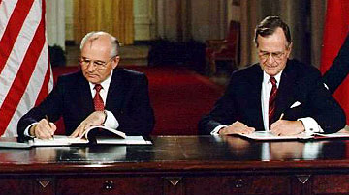
Big Changes
November 1990 – Conventional Forces in Europe Treaty signed – reduced troop deployments
July 1991 – START Treaty signed at Moscow Summit (10 years after it was first drawn up), talks for a START II began.
Notes:
The Malta Summit – December, 1989
Gorbachev and Bush announce an official end to the Cold War. Whoa,
just like that? Amazing.
Reach some informal agreements about reducing armed forces in Europe and economic assistance
Germany
Initially Gorbachev was opposed to a unified Germany (still thought that it would be threatening to Soviet interests/security). However, by February 1990, Gorbachev had decided that this issue should be determined by the German people.
May 1990 – reunification treaty signed. Agreements made that secured
Soviet security and clarified borders, currency, etc.
November 1990 – Conventional Forces in Europe Treaty signed – reduced troop deployments
July 1991 – START Treaty signed at Moscow Summit (10
years after it was first drawn up), talks for a START II began.

Slide 31
Collapse of the Soviet Union
Competing ideas: Gorbachev was endorsing a loose
confederation version of the Soviet Union.
However, Boris Yeltsin advocated a separate Russian republic.
The USA was initially in favor of the Gorbachev plan.
Tensions rose again when the US insisted upon economic changes towards a more capitalist system in return for economic aid.
Gorbachev’s critics: worried about loss of Eastern Europe, nuclear inferiority, dissolution of the Warsaw Pact (in July, 1991), and a lack of significant economic improvement due to Gorbachev’s reforms…
A group of political and military leaders started planning to overthrow Gorbachev
Notes:
Competing ideas: Gorbachev was endorsing a loose
confederation version of the Soviet Union. However, Boris Yeltsin (newly elected president of the Russian republic, aka largest state in the Soviet Union) advocated a separate Russian republic.
The USA was initially in favor of the Gorbachev plan.
Tensions rose again when the US insisted upon economic changes towards a more capitalist system in return for economic aid.
Gorbachev’s critics: worried about loss of Eastern Europe, nuclear inferiority, dissolution of the Warsaw Pact (in July, 1991), and a lack of significant economic improvement due to Gorbachev’s reforms…
A group of political and military leaders started planning to overthrow Gorbachev

Slide 32
Collapse of the Soviet Union
In August, 1991 a coup was attempted.
Gorbachev’s position was precarious and he was constantly undermined by Yeltsin.
In December 1991, Russia, Belorussia, and Ukraine declared the formation of the Commonwealth of Independent States
On December 25th, 1991 Gorbachev announced his resignation as president of the Soviet Union, signaling a formal end to the Soviet Union.
Notes:
In August, 1991 a coup was attempted. However, Bush and Yeltsin sort of get involved, and the coup fails to get popular support form the military.
However, Gorbachev’s position was precarious and he was constantly undermined by Yeltsin.
In December 1991, Russia, Belorussia, and Ukraine declared the formation of the Commonwealth of Independent States (kind of like seceding from the union). On December 25th, 1991 Gorbachev announced his resignation as president of the Soviet Union, signaling a formal end to the Soviet Union.
Three alternative ends to the Cold War (as put forth by historians) are: December 1988 when the ‘ideological’ cold war ended with Gorbachev’s speech at the UN; December 1989 when the ‘economic’ cold war ended at the Malta Summit; and November 1990 when the ‘military’ cold war ended as the CFE Treaty was signed.

Slide 33
Other Gorbachev Policies
Ending tensions in Asia, the Americas, and Africa
  Gorbachev withdrew from Afghanistan.
  Reduced economic support to Cuba and stopped endorsing Cuba’s interventionist policies
  Negotiated agreements with the US regarding the civil war in Angola. In 1991, Cuban troops withdrew and the civil war ended.
  USSR also ended support of Ethiopia, and in turn the US ended its support to Somalia – ending the conflict between those two nations.
Notes:
Ending tensions in Asia, the Americas, and Africa
Gorbachev withdrew from Afghanistan.
Reduced economic support to Cuba and stopped endorsing Cuba’s interventionist policies
Negotiated agreements with the US regarding the civil war in Angola. In 1991, Cuban troops withdrew and the civil war ended.
USSR also ended support of Ethiopia, and in turn the US ended its support to Somalia – ending the conflict between those two nations.

Slide 34
The End of an Era (literally)
So now only one of the superpowers is left, as the Soviet Union dissolved in 1991 – clearly this means that the USA won the Cold War…but what else does this indicate?
Some historians/commentators view this as the end of the “Great Contest” between Marxism/socialism and capitalism. However, other scholars anticipate that a newer, more liberal form of communism might make a comeback in the future…maybe the ‘Great Contest’ isn’t over yet.
So what won the Cold War? US policies? Weaknesses both political and economic within the Soviet Union?
Notes:
So now only one of the superpowers is left, as the Soviet Union dissolved in 1991 – clearly this means that the USA won the Cold War…but what else does this indicate?
Some historians/commentators view this as the end of the “Great Contest” between Marxism/socialism and capitalism. However, other scholars anticipate that a newer, more liberal form of communism might make a comeback in the future…maybe the ‘Great Contest’ isn’t over yet.
So what won the Cold War? US policies? Weaknesses both political and economic within the Soviet Union?

