Slide 1
Revision |  | Date: 11-Feb-18
Outcomes & Success Criteria

Slide 2
Classroom Culture
I bring my full attention and readiness to contribute. I bring my voice, the best of my thoughts and ideas at the right time and in the right way.
I am valuable and this gives me a secure identity. I have no need to prove my worth or impress others.
My thoughts and actions must build up my friends and peers, because we are one.
I listen to my teachers. I will follow their expectations and obey instructions straight away.
I always choose to think, speak and act kindly and lovingly.
In every situation I look to uphold the highest standards and set an example for others to follow.
I will be strong and courageous because I know that I can achieve far more than I believe.

Slide 3
Energy & Transfers
List three forms of energy and show two energy transfers which use them as a starting form and an end form
Heat → Chemical + Sound – boiling pasta
State the equation for efficiency
State the principle of the conservation of energy
A 10kg mass is dropped from a height of 50m and reaches a speed of 10m/s. What is the efficiency of the conversion into kinetic energy?
Explain what has happened what has happened to the rest of the energy

Slide 4
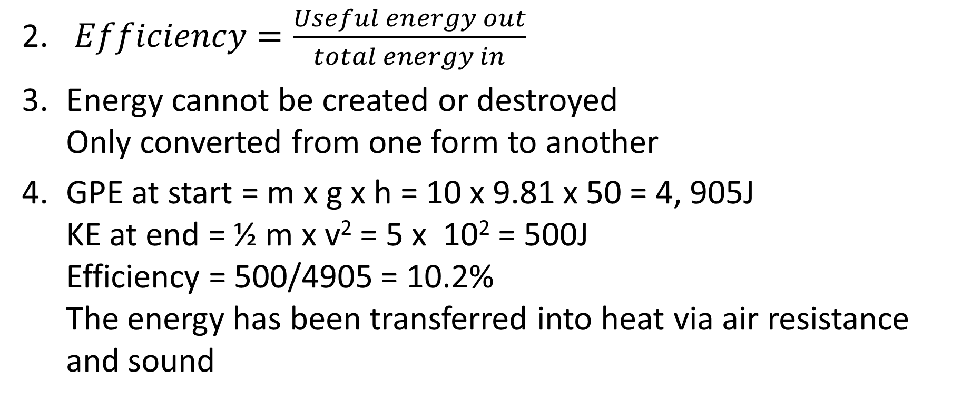
$Efficiency=\frac{Useful energy out}{total energy in}$
Energy cannot be created or destroyed
Only converted from one form to another
GPE at start = m x g x h = 10 x 9.81 x 50 = 4, 905J
KE at end = ½ m x v² = 5 x 10² = 500J
Efficiency = 500/4905 = 10.2%
The energy has been transferred into heat via air resistance and sound

Slide 5
Energy Calculations
A spring is stretched 10cm and stores 100J of energy. What is its spring constant? (E = ½ k x²)
The spring launches a 100g projectile across the room. What is the maximum speed it can reach?
Assuming it is launched straight upwards what height will it reach?

Slide 6
Energy Calculations
100 = 0.5 x k x 0.01 = 0.005k
k = 20,000 N/m (J/m²)
100 = ½ 0.100 x v²
v = 44.7m/s
100 = m x g x h
h = 102m

Slide 7
States of Matter
Describe how the motion of particles changes as they are heated from a solid to a gas
Describe how their energy changes
Explain why a pure substance stays at constant temperature while it is being heated.
Where is the heat energy going?

Slide 8
Particles in a solid vibrate in fixed positions; liquids can flow around one another, but still touching other particles; gases have no interactions between particles and move around the container at high speed
A gas has the highest kinetic energy and the lowest potential energy; solid has least kinetic energy and highest potential
The heat energy added to the substance goes into weakening/breaking the bonds between the particles rather than increasing the temperature
Only once the material has all changed state will the temperature continue to rise again

Slide 9
Kinetic Theory
State Boyle’s Law
Explain what happens to the particles in a gas if they are compressed while at constant temperature
A gas occupies 100cm³ at a pressure of 100kPa. What volume will it take up if the pressure is increased to 350kPa?
Explain how the pressure can be increased without changing the volume of the container

Slide 10
Pressure x Volume = constant; p₁V₁ = p₂V₂
If the volume decreases, the pressure will increase as the particles have less room to move about in, so collide with the container more, increasing the force on the container, increasing the pressure
28.6cm³
If the temperature is increased, the particles will gain energy move around faster, collide with the container more frequently and with more force thus increasing the pressure

Slide 11
Waves
Sketch a longitudinal and transverse wave
Describe the particle motion of each wave, giving two examples of each
State the two equations for wave speed
Describe how the speed of a water wave could be measured using each of these equations
Give uses and potential dangers of the 7 types of wave in the EM spectrum

Slide 12
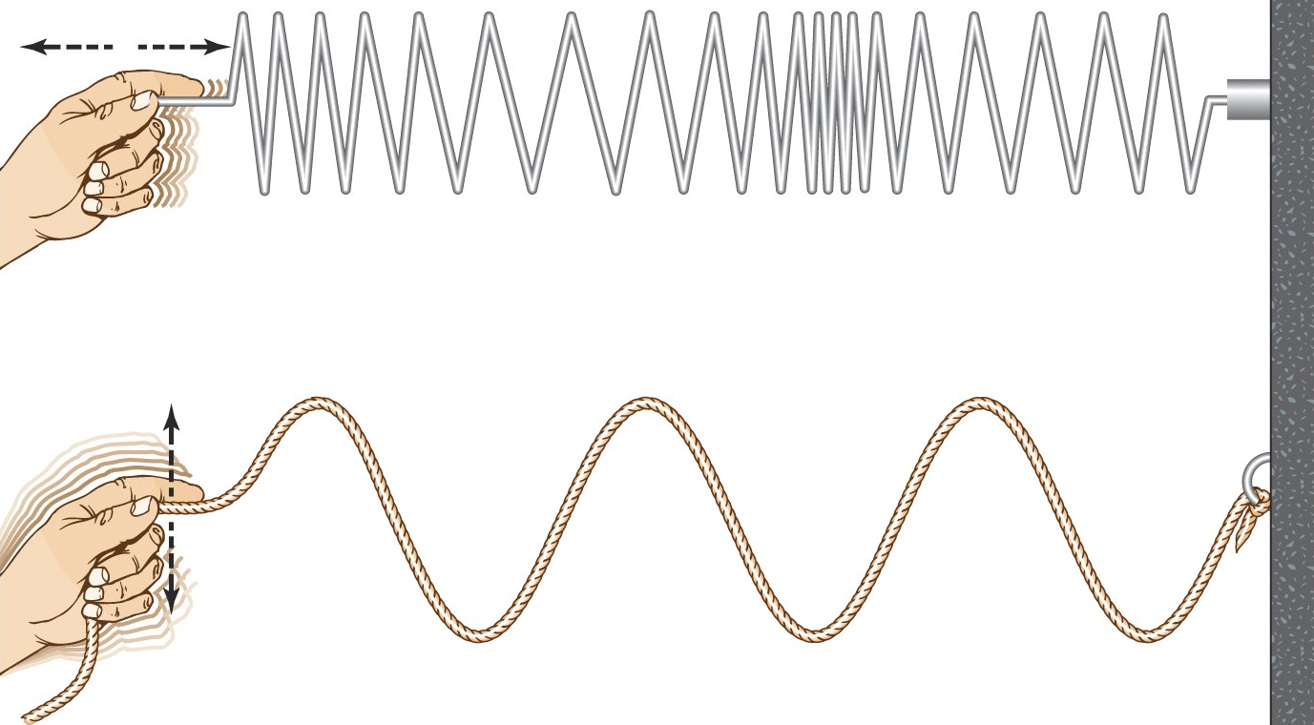
Longitudinal: particles oscillate
parallel to energy transfer
Transvers: particles oscillate
perpendicular to energy transfer
v = f λ – measure the wavelength
(take a photo); measure the
number of waves in 10s to find frequency
v = d/t – time how long it takes a wave to travel a certain distance

Slide 13
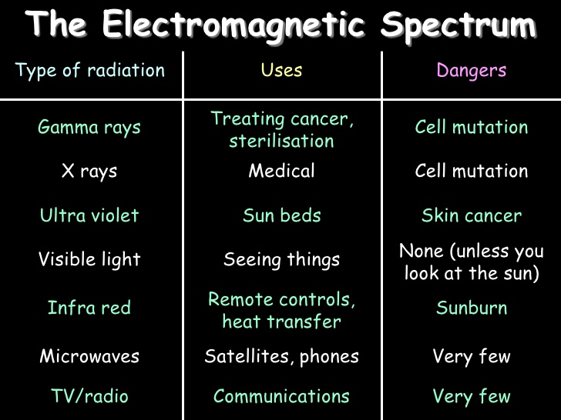

Slide 14
Waves
Describe what happens to the motion of a wave as it refracts
Explain how its frequency and wavelength change
Give a use for a concave and a convex reflector
What three things can happen when a wave hits a boundary between media?

Slide 15
If it enters a denser medium (glass), the ray bends towards the normal
If it enters a less dense medium (air), the ray bends away
Its frequency remains the same, but its wavelength changes. In a denser medium the wave speed slows down, so the wavefronts are closer together, hence a shorter wavelength
Concave: focus light
Convex: curved mirror to see round corners on a road
Reflect – i = r
Transmit/Refract – changes speed; bends towards/away from normal
Absorb – matt black surfaces absorb all visible radiation

Slide 16
Electricity
Define Voltage, Charge, Current & Resistance
Explain how the current and voltage to two identical lamps varies when they are in series and in parallel
Potential Difference (Voltage) =
Energy Transferred =
Power =
Charge =

Slide 17
Voltage – amount of energy per unit charge (per electron)
Charge – number of electrons that have passed a point
Current – amount of charge flowing per second
Resistance – amount of energy given to a component per charge in order to pass it
Current is the same in series (the bread vans only have one route to go) and half in parallel
Voltage is half in series (they give half of their bread to each bulb) and the same in parallel
V = I R
E = Q V
P = I R = I² R
Q = I t

