Slide 1
Romania | A left-wing coalition won the elections in 1945 and led by a non-Communist. In 1946 Communist became the largest party. In 1948, the Communists banned other parties and made the country a one party state.
Bulgaria | Stalin had promised to set up a joint Communist/non-Communist government at Yalta. He invited non communist leaders to Moscow then arrested them. In 1947 the Communists won the election
Poland | In 1945, a Communist was elected Prime Minister within a coalition government. In 1947 the Communists abolished the monarchy.
Hungary | Soviet Communists immediately gained power after the war.
Czechoslovakia | At Yalta and Potsdam conferences agreed to USSR control of the east of the country. Run under the Red Army until the creation of the Democratic Republic in 1949
Yugoslavia | A left-wing coalition won the elections in 1945. However, the Soviet Communist then executed the leaders of the other parties.
East Germany | Marshal Tito led war time resistance to the Nazi’s. He was elected president in 1945. However he was determined to apply his own form of communism (not Soviet led)
Albania | Non-communists won the 1945 election however Rákosi, leader of the communists, took control of the secret police and executed and arrested opponents. By 1948 Rákosi had complete control

Slide 2
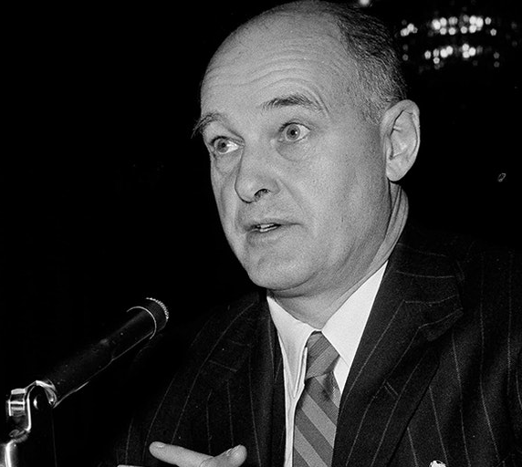
The Cold War in motion?
What role did Kennan’s Long Telegram and Churchill’s Iron Curtain Speech play in the origins of the Cold War?

Slide 3
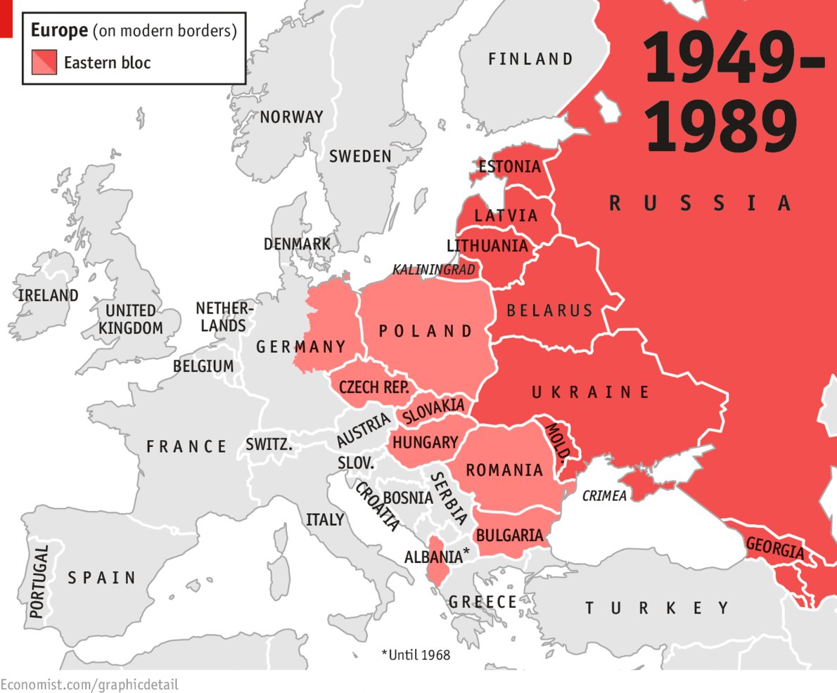
Recap
In 1945/6 Stalin’s expansion was alarming, but there was a strong push for US demobilisation and withdrawal of troops from Europe.

Slide 4
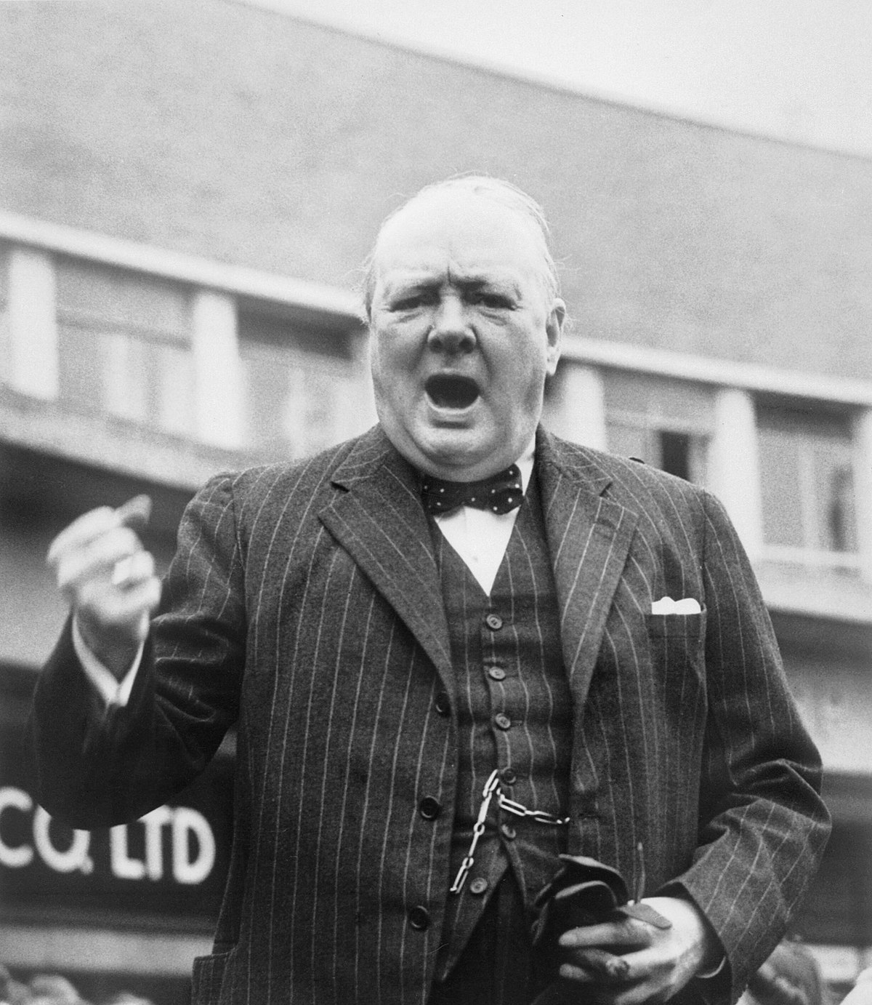
Churchill alarmed
Churchill feared Soviet expansion.
Attlee was sympathetic but more concerned with domestic problems.
Churchill turned to Truman to persuade him to maintain his presence in Europe.

Slide 5
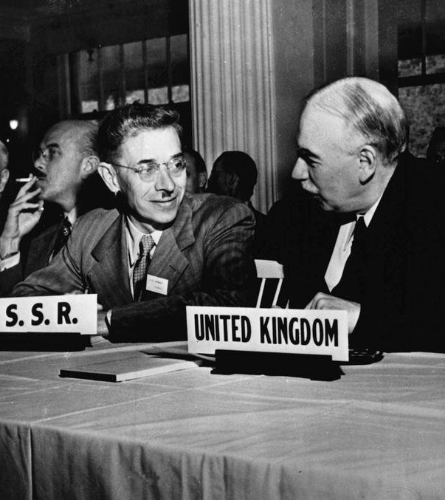
Bretton Woods
The conference was held in July 1944.
It set up the World Bank, International Trade Organisation (ITO) and International Monetary Fund (IMF) → the US $ would take the place of gold in international exchange.
US representatives worked hard to persuade the SU to join the IMF for economic cooperation and post-war prosperity.

Slide 6
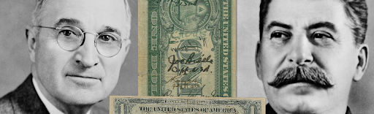
Soviet withdrawal
Stalin eventually refused to ratify the Bretton Woods articles.
This was largely owing to Soviet fears of opening their economy and fund policies being controlled by the West.
Economic incentives to cooperate with the west diminished.

Slide 7
The ‘Long Telegram’
George Kennan was the charge d’affaire to ambassador Averell Harriman in 1946.
He was asked to clarify Soviet motives and possible actions.
His 8,000 word telegram (dated 22nd Feb 1946) suggested the driving forces of Soviet foreign policy were:
The inherent opposition of communist and capitalist systems,
the use of other Marxists against western, capitalist expansion,
Soviet FP was grounded in Russian expansionism, fear of invasion and desires for a security belt.

Slide 8
Task: Reading the Long Telegram

Slide 9
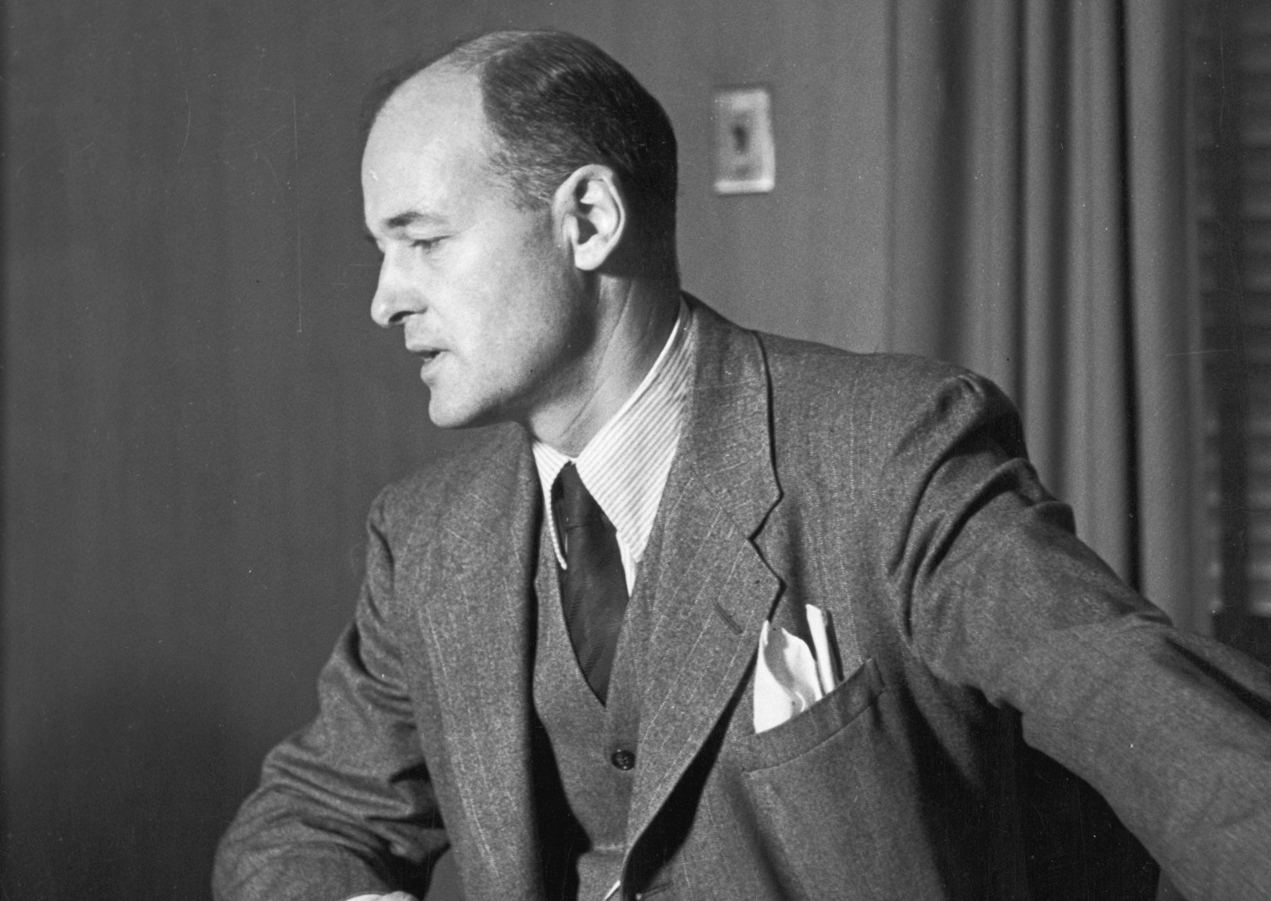
Kennan’s suggestions
The USA should avoid direct military confrontation with the USSR.
The USA should engage in a policy of positive propaganda: make capitalism and democracy attractive to vulnerable countries!

Slide 10
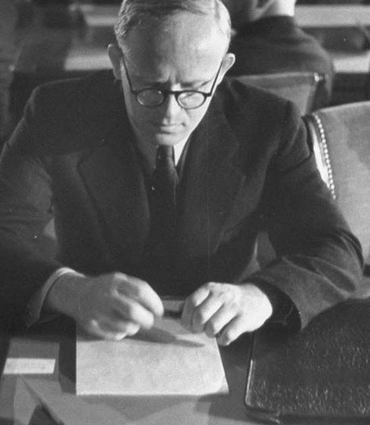
‘Novikov’s Telegram’
Novikov was ambassador of the Soviet Union to the United States.
The telegram was dispatched in September 1946, but not released until the Cold War was ending.
Novikov labelled US FP as “imperialist,” “striving for world supremacy,” and suggested the US were preparing for war against Russia.
The telegram itself seems to be a stronger reflection of Soviet Minister of Foreign Affairs (1939-49) Molotov’s wording.

Slide 11
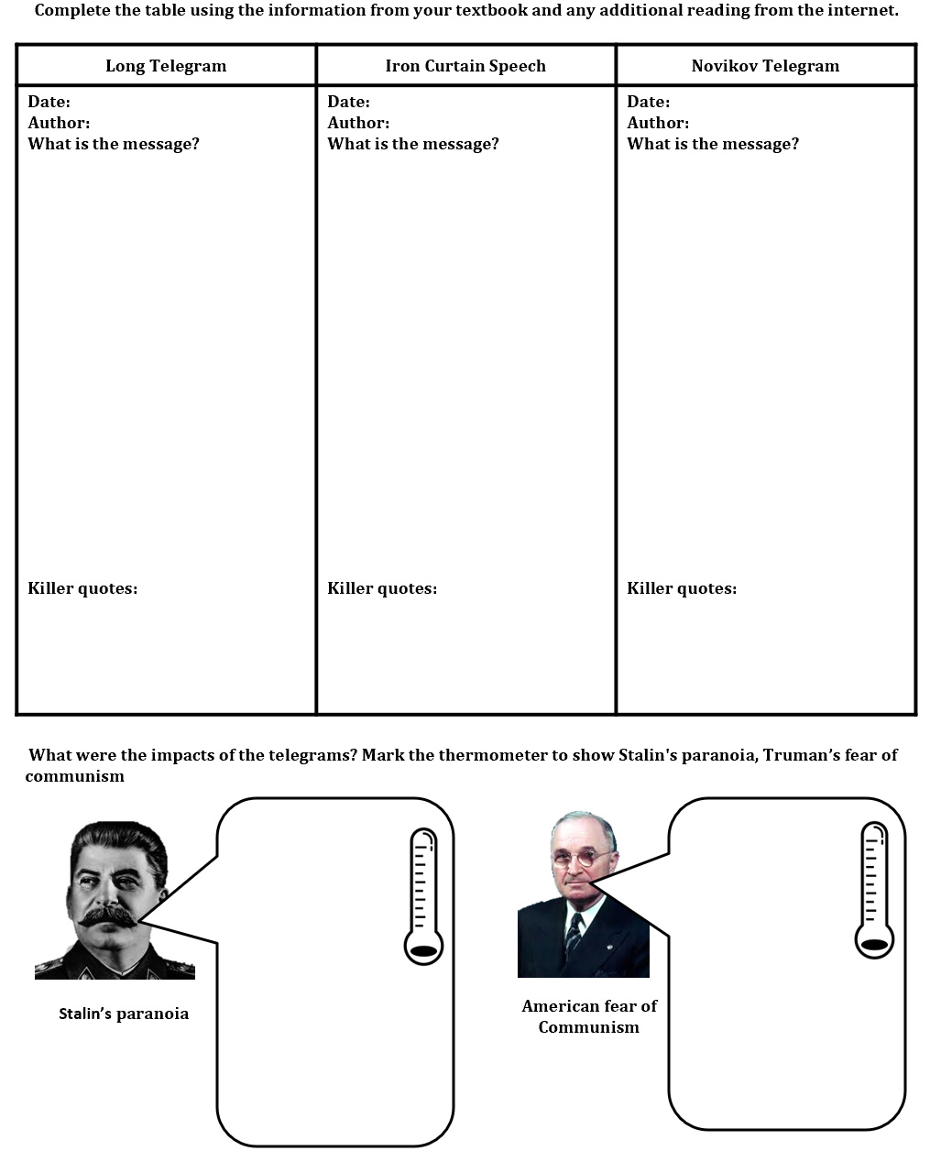
Task

Slide 12
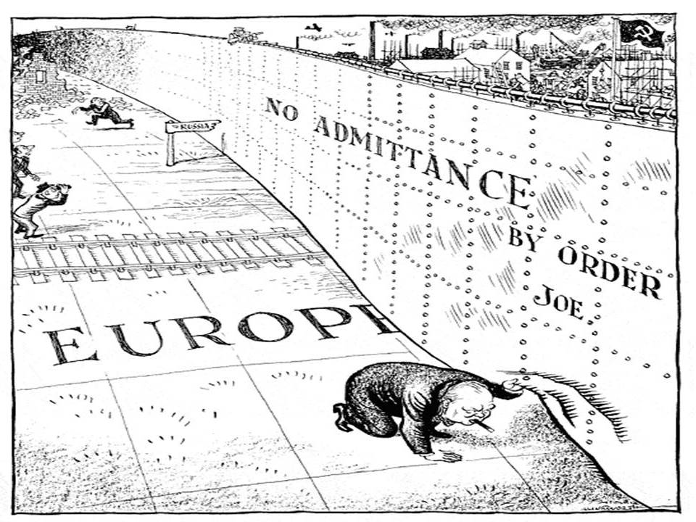

Slide 13
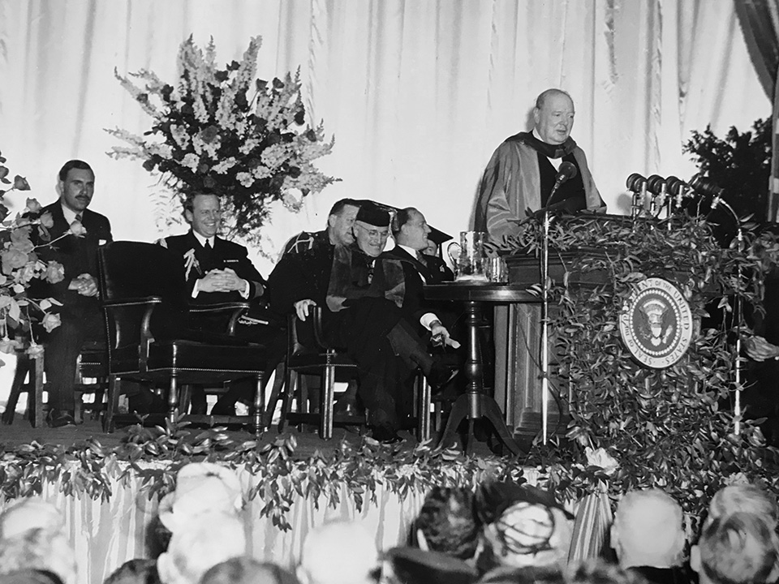
The ‘Iron Curtain Speech’
On 5th March 1946, in Truman’s home state of Missouri, Churchill delivered his ‘Iron Curtain Speech.’
He attacked the Soviet Union’s expansion, suggesting it was the duty of free countries to prevent the further spread of communism.

Slide 14
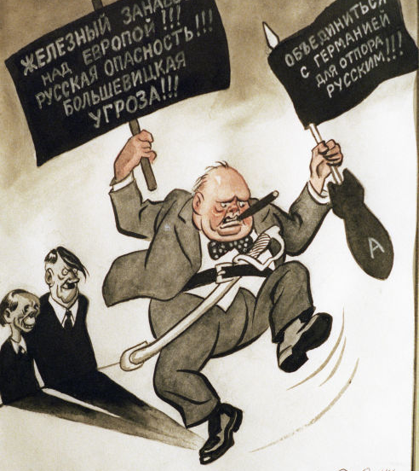
Soviet reaction
In Pravda Stalin accused the British of having desires for world domination.
This alerted the Us government to the potential of further conflict.
Kennan’s assessments and advice was passed to Truman’s advisers who began work on a policy based on the recommendations of the Long Telegram.

Slide 15
Clifford-Elsey report
Given to Truman in September 1946, it was the basis of the policy of containment.
This went beyond Kennan’s recommendations to include a strong military component.
The US felt need to maintain superiority, but resist a land war against the Red Army.
It needed to maintain a force in Europe or establish a network of allies … the problem was that western European allies were in need of significant assistance…

Slide 16
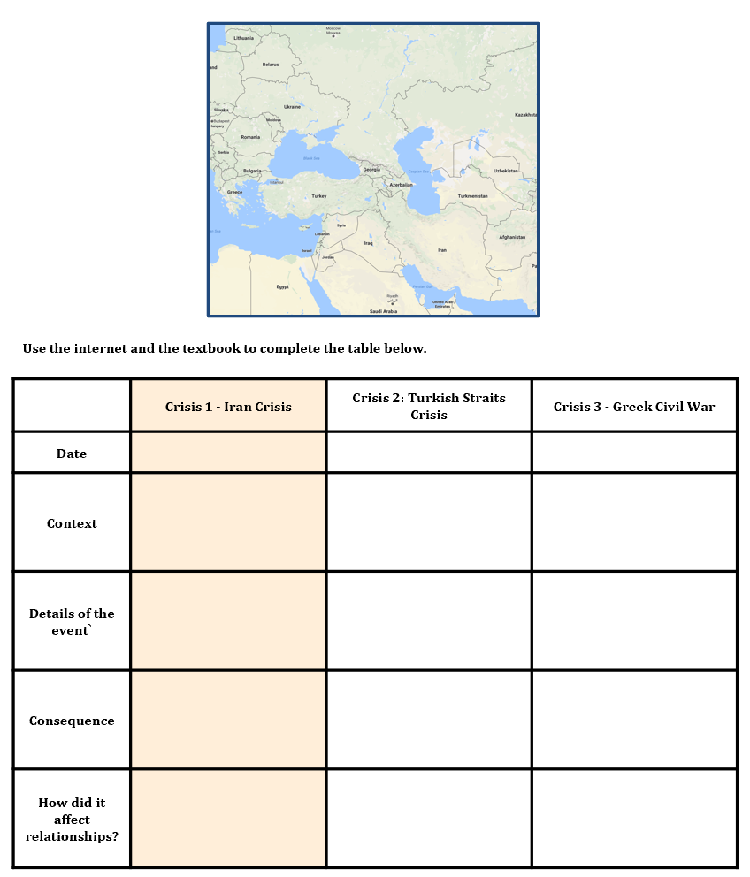
Task

Slide 17
‘The tensions that existed within the Grand Alliance by the end of 1946 were the result of conflicting ideologies.’ Explain why you agree or disagree with this view.

