Slide 1
OCR AM Permutations and Combinations

Slide 2



Product Rule for Counting
Make sure you are familiar with the Product Rule for Counting from GCSE
Remember to think about whether you might have counted the same thing more than once and, if so, divide by the number of things you’ve counted each of those things.
There are five starters and six main course at a restaurant. How many possible meal combinations are there?
$$5×6=30$$
?
There are 30 students in a class. Two are going to be selected to receive a prize. How many different pairs of students can be selected?
?
$$\frac{30×29}{2}=435$$

Slide 3
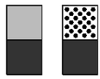
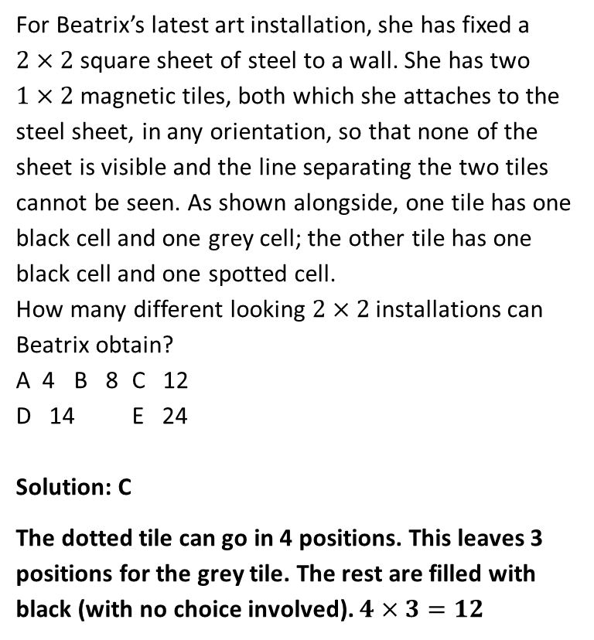
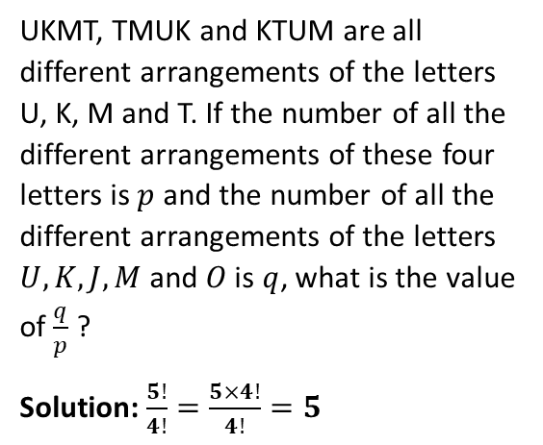
Product Rule Exercises
1
For Beatrix’s latest art installation, she has fixed a $2×2$ square sheet of steel to a wall. She has two $1×2$ magnetic tiles, both which she attaches to the steel sheet, in any orientation, so that none of the sheet is visible and the line separating the two tiles cannot be seen. As shown alongside, one tile has one black cell and one grey cell; the other tile has one black cell and one spotted cell.
How many different looking $2×2$ installations can Beatrix obtain?
A 4 B 8 C 12
D 14 E 24
Solution: C
The dotted tile can go in 4 positions. This leaves 3 positions for the grey tile. The rest are filled with black (with no choice involved). $4×3=12$
2
UKMT, TMUK and KTUM are all different arrangements of the letters U, K, M and T. If the number of all the different arrangements of these four letters is $p$ and the number of all the different arrangements of the letters $U, K, J, M$ and $O$ is $q$, what is the value of $\frac{q}{p}$ ?
Solution: $\frac{5!}{4!}=\frac{5×4!}{4!}=5$
?
?

Slide 4

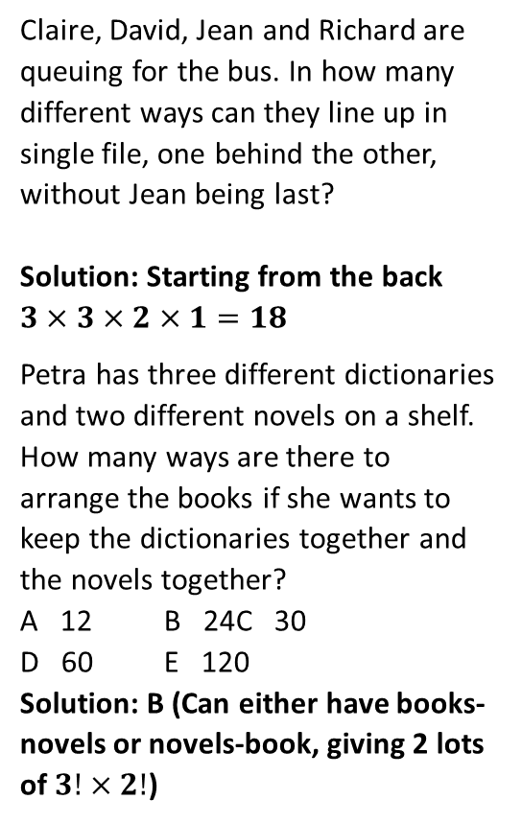
Product Rule Exercises
3
Claire, David, Jean and Richard are queuing for the bus. In how many different ways can they line up in single file, one behind the other, without Jean being last?
Solution: Starting from the back $3×3×2×1=18$
Petra has three different dictionaries and two different novels on a shelf. How many ways are there to arrange the books if she wants to keep the dictionaries together and the novels together?
A 12 B 24 C 30
D 60 E 120
Solution: B (Can either have books-novels or novels-book, giving 2 lots of $3!×2!$)
5
A voucher code is made up of four characters. The first is a letter: V, X or P. The second and third are different digits. The fourth is the units digit of the sum of the second and third digits. How many different voucher codes like this are there?
A 180 B 243 C 270
D 300 E 2700
Solution: C. 3 choices for first character. 10 choices for second character and 9 for third (since a different digit). There is no element of choice for the fourth character as it is determined by the second and third.
$$3×10×9=270$$
?
4
?
?

Slide 5
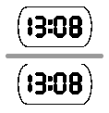


Product Rule Exercises
6
Beatrix has a 24-hour digital clock on a glass table-top next to her desk. When she looked at the clock at 13:08, she noticed that the reflected display also read 13:08, as shown. How many times in a 24-hour period do the display and its reflection give the same time?
A 12 B 36 C 48
D 72 E 96
Solution: E. First note that 0, 1, 3 and 8 reflect.
$2×4×3×4=96$
7
A train consists of five carriages: I, II, III, IV and V. In how many ways can the carriages be arranged so that carriage I is nearer to the locomotive than carriage II is?
A 120 B 60 C 48
D 30 E 10
Solution: B
Long way:
I is in 1st position: $4!=24$ ways of arranging remaining carriages.
I is in 2nd position: $3×3!=18$ ways
I is in 3rd position: $3×2×2=12$ ways
I is in 4th position: $3!=6$ ways
$24+18+12+6=60$ ways
Really Short way: In half of the $5!=120$ ways of arranging the five carriages, I will appear before II. $120÷2=60$
?
?

Slide 6

Product Rule Exercises
N
I choose some numbers between 1 and 20. How many selections are there such that the range of the numbers in my selection is 6?
Suppose the smallest number was 1. Then the largest number would have to be 7. For the five numbers in between (i.e. 2, 3, 4, 5, 6), each number may either be chosen or not chosen (i.e. 2 possibilities). That’s $2^{5}=32$ ways.
There’s 14 possible choices for the smallest number (1 up to 14).
Thus there are $32×14=448$ possibilities.
?

Slide 7
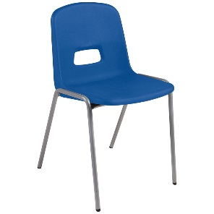


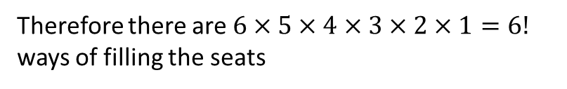
Rearrangements
A rearrangement is a different ordering of a group of objects.
If there are $n$ objects then the number of rearrangements is $n!$
Imagine there are six students and six chairs
The first student has 6 choices
Whichever seat the first student chose, the next student has 5 choices
Whichever seat the first two students chose, the next student has 4 choices
Whichever seat the first 3 students chose, the next student has 3 choices
Whichever seat the first 4 students chose, the next student has 2 choices
Whichever seat the first 5 students chose, the next student has 1 choice
Therefore there are $6×5×4×3×2×1=6!$ ways of filling the seats

Slide 8

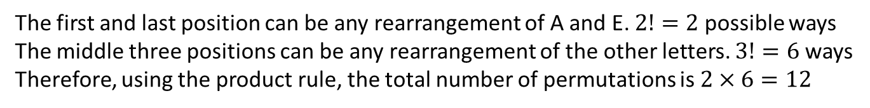
Test Your Understanding
A rearrangement is a different ordering of a group of objects.
If there are $n$ objects then the number of rearrangements is $n!$
How many permutations of the letters A, B, C, D and E
Are there?
Begin with A?
End with E?
Begin with A and end with E?
Begin and end with a vowel?
(a)
$$5!=120$$
?
(b)
The A has to be first and we can rearrange the other four. $4!=24$
?
(c)
The E has to be last and we can rearrange the other four. $4!=24$
?
(d)
The A has to be first and the E has to be last and we can rearrange the other three. $3!=6$
?
(e)
The first and last position can be any rearrangement of A and E. $2!=2$ possible ways
The middle three positions can be any rearrangement of the other letters. $3!=6$ ways
Therefore, using the product rule, the total number of permutations is $2×6=12$
?

Slide 9

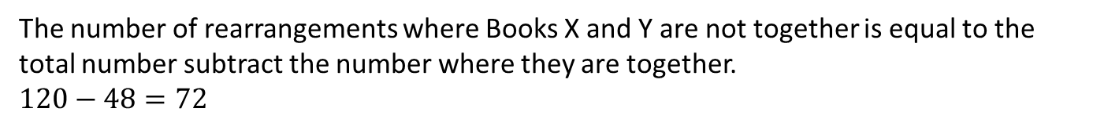
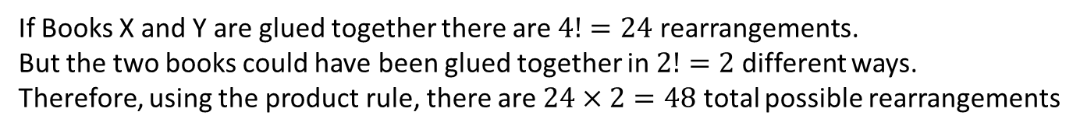
Test Your Understanding
A rearrangement is a different ordering of a group of objects.
If there are $n$ objects then the number of rearrangements is $n!$
In how many ways can five books be arranged on a shelf if
There are no restrictions
Books X and Y must be together
Books X and Y must not be together
(a)
$$5!=120$$
?
Tip: If some objects must be next to each other then imagine them glued together. But remember is more than one way that they could be glued together.
(b)
If Books X and Y are glued together there are $4!=24$ rearrangements.
But the two books could have been glued together in $2!=2$ different ways.
Therefore, using the product rule, there are $24×2=48$ total possible rearrangements
?
Tip: If your looking for the rearrangements where something does not happen, think about the total rearrangements subtract those where it does happen
(c)
The number of rearrangements where Books X and Y are not together is equal to the total number subtract the number where they are together.
$120−48=72$
?

Slide 10

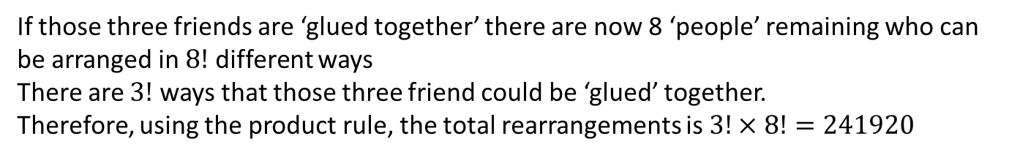
Test Your Understanding
A rearrangement is a different ordering of a group of objects.
If there are $n$ objects then the number of rearrangements is $n!$
Ten friends sit in a row of ten chairs at the cinema. In how many ways can they sit if
There are no restrictions
Three of them insist on sitting next to each other
(a)
$$10!=3628800$$
?
(b)
If those three friends are ‘glued together’ there are now 8 ‘people’ remaining who can be arranged in $8!$ different ways
There are $3!$ ways that those three friend could be ‘glued’ together.
Therefore, using the product rule, the total rearrangements is $3!×8!=241920$
?

Slide 11
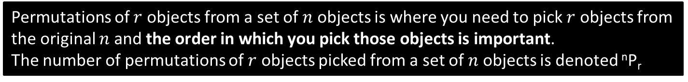
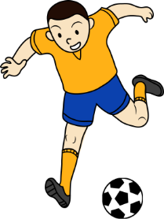
Permutations
Permutations of $r$ objects from a set of $n$ objects is where you need to pick $r$ objects from the original $n$ and the order in which you pick those objects is important.
The number of permutations of $r$ objects picked from a set of $n$ objects is denoted ^{n}P_{r}
1
2
3
4
5
Imagine picking three penalty takers from a team of five players for a shootout.
You also have to specify which order they take the penalties in, so 123 is different from 321.
If you were going to write the numbers of each penalty-taker in boxes you would have to fill in the form below:
For each of the four numbers you put in the second box (which in turn were for each) of the five numbers in the first box) there are three numbers you could put in this box.
You can choose any of the five numbers to go in this box.
For each of the five numbers in the first box there are four numbers that you could write in this box
So the number of permutations is
5
x
4
x
3
=
60
?
?
?
?
So ⁵P₃ = 60
?

Slide 12
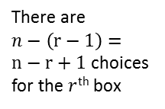
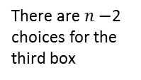
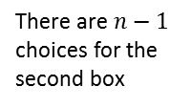
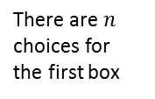
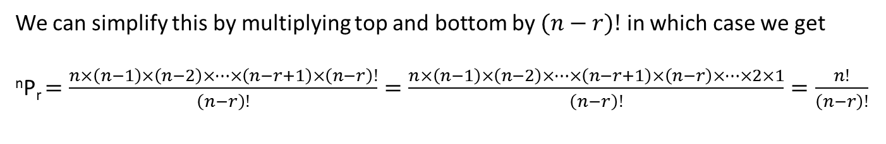

Permutations
We could apply the same principle in the last slide to permutations of any $r$ objects chosen from any $n$ objects
$r$ boxes
…
There are $n$ choices for the first box
There are $n−1$ choices for the second box
There are $n−$2 choices for the third box
…
There are $n−\left(r−1\right)=n−r+1$ choices for the $r$^{th} box
?
?
?
?
Overall the number of choices is ^{n}P_{r} $=n×\left(n−1\right)×\left(n−2\right)×…×(n−r+1)$
?
We can simplify this by multiplying top and bottom by $(n−r)!$ in which case we get
^{n}P_{r} $=\frac{n×\left(n−1\right)×\left(n−2\right)×…×\left(n−r+1\right)×\left(n−r\right)!}{\left(n−r\right)!}=\frac{n×\left(n−1\right)×\left(n−2\right)×…×\left(n−r+1\right)×\left(n−r\right)×…×2×1}{\left(n−r\right)!}=\frac{n!}{\left(n−r\right)!}$
?
?
?
The number of permutations of $r$ objects taken from $n$ objects,
^{n}P_{r} $=\frac{n!}{\left(n−r\right)!}$
This formula is not given to you in OCR AM but there is an ^{n}P_{r} button on your calculator
Note that when $n=r$ then ^{n}P_{r} $=\frac{n!}{\left(n−r\right)!}=\frac{n!}{\left(n−n\right)!}=\frac{n!}{0!}=n!$ which is the rearrangements formula

Slide 13
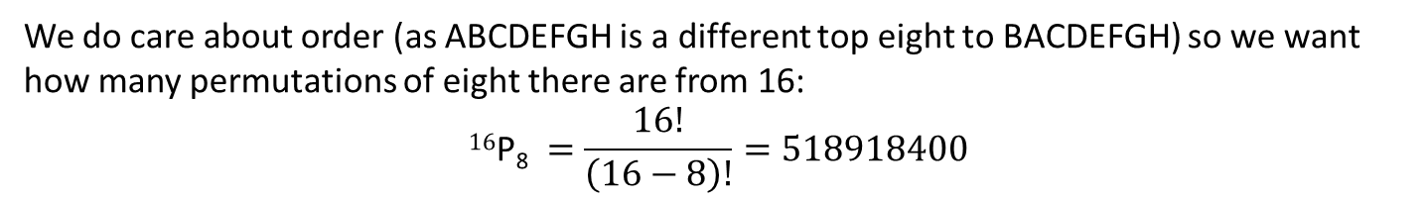
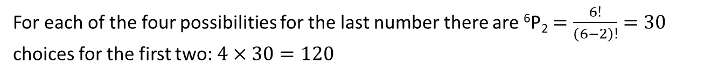
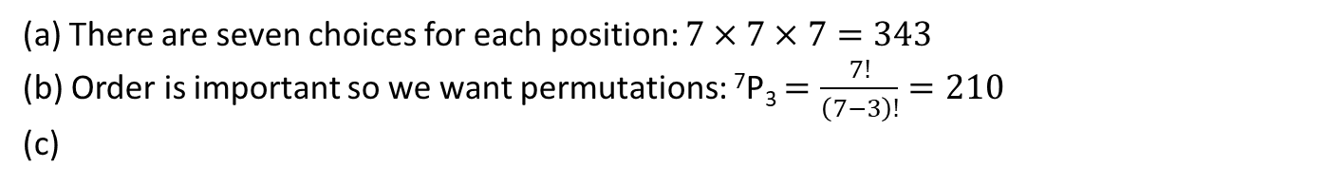
Test Your Understanding
A Chess Association runs a ladder with 16 teams. In how many way could the top eight positions on the ladder be filled?
We do care about order (as ABCDEFGH is a different top eight to BACDEFGH) so we want how many permutations of eight there are from 16:
$$\text{1}\text{6}\text{P}\text{8} =\frac{16!}{\left(16−8\right)!}=518918400$$
?
How many three digit numbers can be constructed from the digits 1, 2, 3, 4, 5, 6 and 7 if each digit may be used:
As often as desired?
Only once?
Once only and the number is odd?
(a) There are seven choices for each position: $7×7×7=343$
(b) Order is important so we want permutations: ⁷P₃ $=\frac{7!}{\left(7−3\right)!}=210$
(c)
?
?
For each of the four possibilities for the last number there are ⁶P₂ $=\frac{6!}{\left(6−2\right)!}=30$ choices for the first two: $4×30=120$
?

Slide 14
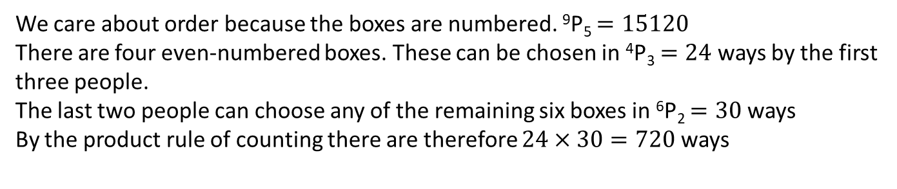


Test Your Understanding
Alice has booked seats at the football for herself and nine friends
If they all attend in how many ways can they sit
Due to a snowstorm only Alice and five friends make it to the game. In how many ways can they sit on the seat that Alice has booked?
(a)
$$10!=3628800$$
?
(b)
¹⁰P₆ $=151200$
?
Nine boxes are labelled with a different whole number from 1 to 9. Five people are allowed to take one box each. In how many ways can this be done if
There are no restrictions?
The first three people decide that they will take even-numbered boxes?
(a)
We care about order because the boxes are numbered. ⁹P₅ $=15120$
There are four even-numbered boxes. These can be chosen in ⁴P₃ $=24$ ways by the first three people.
The last two people can choose any of the remaining six boxes in ⁶P₂ $=30$ ways
By the product rule of counting there are therefore $24×30=720$ ways
?
(b)
?

Slide 15
Combinations
1
2
3
4
5
Now imagine we just had to pick a group of three players to take penalties but they are going to decide the order amongst themselves.
The number of choices we can make is clearly smaller but by how much?
Consider the group of players 1, 3 and 4. When we had to choose an order we could have chosen these three players in the following ways:
1 3 4
1 4 3
3 1 4
3 4 1
4 1 3
4 3 1
The same could be said for any group of three players: each could be made from exactly 6 ordered groups of three that we had before.
These are now all in the group 134
So to get from the number of ordered groups of three players to the number of unordered groups we have to divide by six.
?

Slide 16
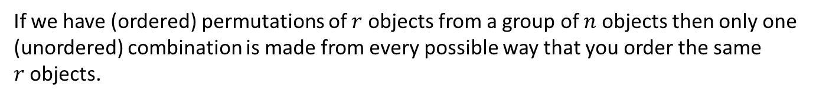
Combinations
If we have (ordered) permutations of $r$ objects from a group of $n$ objects then only one (unordered) combination is made from every possible way that you order the same $r$objects.
The number of ways of ordering $r$ objects is ^{r}P_{r} $=\frac{r!}{\left(r−r\right)!}=\frac{r!}{0!}=r!$
?
Therefore $r!$ permutations give rise to the same combination.
0! is defined to be equal to 1
So to get from the number of permutations to the number of combinations you have to divide by $r!$
?
We know that the number of permutations of $r$ objects from $n$ is $\frac{n!}{\left(n−r\right)!}$ so…
The number of combinations of $r$ objects from $n$ is $\left({n \atop r}\right)$ or ^{n}C_{r} $=\frac{n!}{r!\left(n−r\right)!}$
?
Either notation is fine. You will probably most often see $\left({n \atop r}\right)$

Slide 17

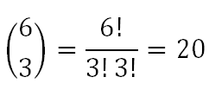

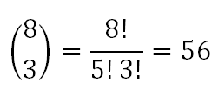


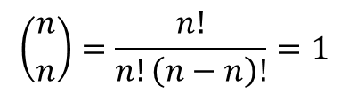
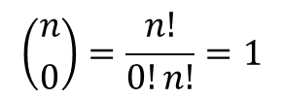
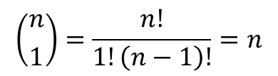
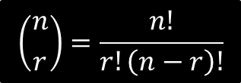
Combinations
$$\left({n \atop r}\right)=\frac{n!}{r!\left(n−r\right)!}$$
Remember that with factorials you often get a lot of cancelling which can save you a lot of work if you don’t have a calculator.
Calculate the following without using a calculator
?
?
?
?
?
?
Simplify the following
?
?
?
$$\left({n \atop 1}\right)=\frac{n!}{1!\left(n−1\right)!}=n$$
$$\left({n \atop 0}\right)=\frac{n!}{0!n!}=1$$
$$\left({n \atop n}\right)=\frac{n!}{n!\left(n−n\right)!}=1$$

Slide 18
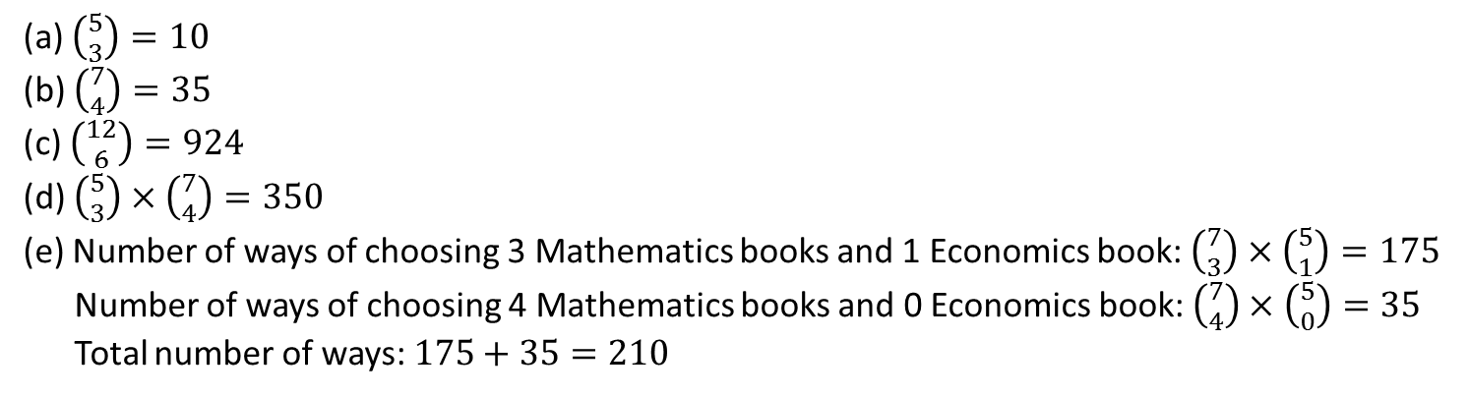
Test Your Understanding
On my desk I have five different Economics books and 7 different Mathematics books.
In how many ways can I select three different Economics books?
In how many ways can I select 4 Mathematics Books?
In how many ways can I select 6 different books?
In how many ways can I select 6 books if I choose an equal number of Economics and Mathematics Books?
In how many ways can I choose 4 books, if I choose more Mathematics books than Economic books?
(a) $\left({5 \atop 3}\right)=10$
(b) $\left({7 \atop 4}\right)=35$
(c) $\left({12 \atop 6}\right)=924$
(d) $\left({5 \atop 3}\right)×\left({7 \atop 4}\right)=350$
(e) Number of ways of choosing 3 Mathematics books and 1 Economics book: $\left({7 \atop 3}\right)×\left({5 \atop 1}\right)=175$
Number of ways of choosing 4 Mathematics books and 0 Economics book: $\left({7 \atop 4}\right)×\left({5 \atop 0}\right)=35$
Total number of ways: $175+35=210$
?

Slide 19
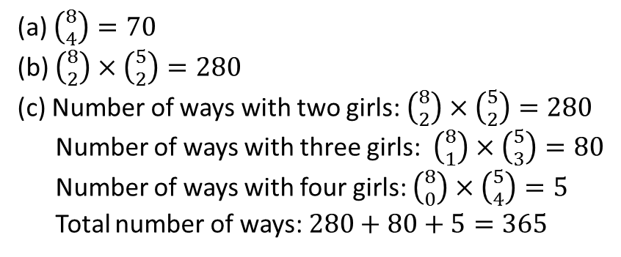
Test Your Understanding
A team of four is needed for a competition. Five girls and eight boys have applied. In how many ways can the team be selected if
They are all boys
There are exactly two girls
There are at least two girls
(a) $\left({8 \atop 4}\right)=70$
(b) $\left({8 \atop 2}\right)×\left({5 \atop 2}\right)=280$
(c) Number of ways with two girls: $\left({8 \atop 2}\right)×\left({5 \atop 2}\right)=280$
Number of ways with three girls: $\left({8 \atop 1}\right)×\left({5 \atop 3}\right)=80$
Number of ways with four girls: $\left({8 \atop 0}\right)×\left({5 \atop 4}\right)=5$
Total number of ways: $280+80+5=365$
?

Slide 20
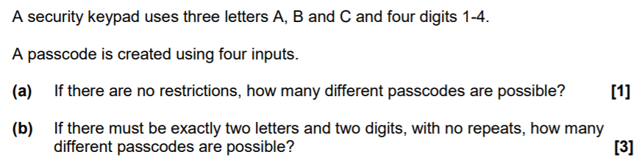
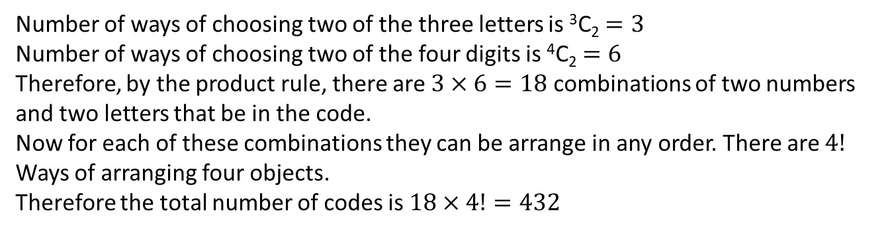

Past Paper Question
(a)
$$7^{4}=2401$$
?
(b)
Number of ways of choosing two of the three letters is ³C₂ $=3$
Number of ways of choosing two of the four digits is ⁴C₂ $=6$
Therefore, by the product rule, there are $3×6=18$ combinations of two numbers and two letters that be in the code.
Now for each of these combinations they can be arrange in any order. There are $4!$ Ways of arranging four objects.
Therefore the total number of codes is $18×4!=432$
?

