Slide 1
Oxbridge Prime Factorisation

Slide 2
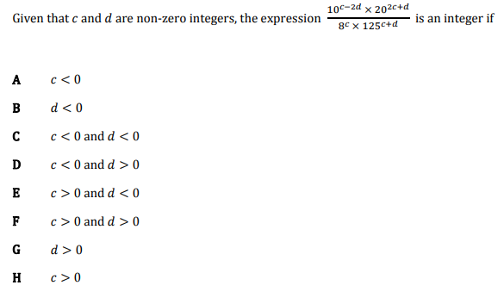
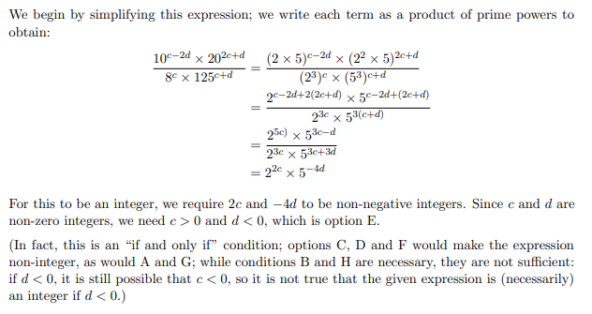
TMUA Question
?

Slide 3

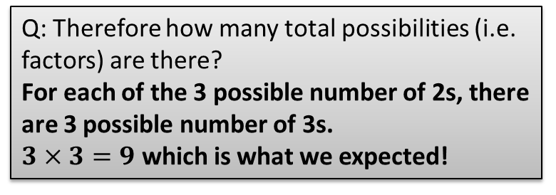
Number of Factors
How many factors does $2^{2}×3^{2}$ have?
We saw on the previous slide that $2^{2}×3^{2}$ has 9 factors. But could we have obtained this number without having to list them all out?
Q: How many possibilities were there for the number of 2s we use for a particular factor?
3 possibilities: We use 2 of them, 1 of them, or none at all.
$$2^{2}×3^{2} \\ 2^{2}×3 \\ 2^{2} \\ 2×3^{2} \\ 2×3 \\ 2 \\ 3^{2} \\ 3 \\ 1$$
?
Q: How many possibilities were there for the number of 3s we use for a particular factor?
Again 3 possibilities
?
Q: Therefore how many total possibilities (i.e. factors) are there?
For each of the 3 possible number of 2s, there are 3 possible number of 3s.
$3×3=9$ which is what we expected!
?

Slide 4
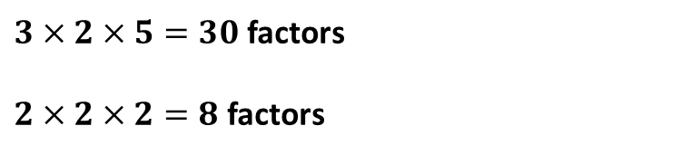
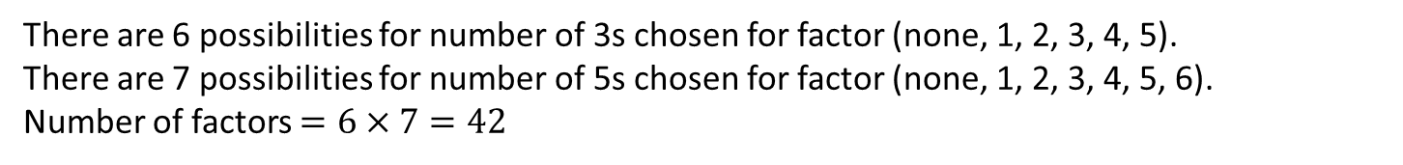


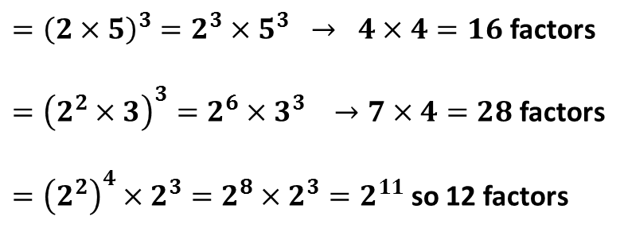

Number of Factors
Without listing them, calculate the number of factors of $3^{5}×5^{6}$
There are 6 possibilities for number of 3s chosen for factor (none, 1, 2, 3, 4, 5).
There are 7 possibilities for number of 5s chosen for factor (none, 1, 2, 3, 4, 5, 6).
Number of factors $=6×7=42$
?
This is much quicker than writing out all 42 factors!
To get the number of factors of a number in prime factorised form, add one to each power and times these numbers together.
How many factors does each of the following have?
$$2^{2}×3^{5}$$
$3^{4}×5$
$2×7^{6}$
$5^{10}$
${11}^{13}$
$3×2×5=30$ factors
$2×2×2=8$ factors
$3×6=18$ factors
$5×2=10$ factors
$2×7=14$ factors
$11$ factors
$14$ factors
$3^{2}×5×7^{4}$
$5×7×11$
${10}^{3}$
${12}^{3}$
$4^{4}×2^{3}$
?
?
?
?
$={\left(2×5\right)}^{3}=2^{3}×5^{3} → 4×4=16$ factors
$={\left(2^{2}×3\right)}^{3}=2^{6}×3^{3} →7×4=28$ factors
$={\left(2^{2}\right)}^{4}×2^{3}=2^{8}×2^{3}=2^{11}$ so 12 factors
?
?
?
?
?
?

Slide 5
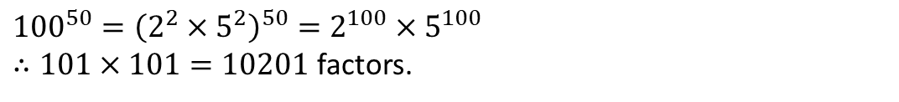
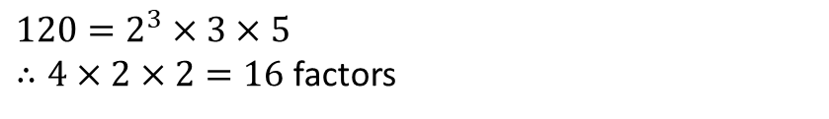
Test Your Understanding
1
How many factors does $5^{3}×7^{4}$ have?
$4×5=20$ factors
?
2
By first finding the prime factorisation, find the number of factors of 120.
?
$$120=2^{3}×3×5$$
$∴4×2×2=16$ factors
3
Is 42 a factor of $2^{2}×5×7^{3}$?
No, as $42=2×3×7$, but $2^{2}×5×7^{3}$ does not have a 3.
?
4
How many factors does ${100}^{50}$ have?
?
${100}^{50}={\left(2^{2}×5^{2}\right)}^{50}=2^{100}×5^{100}$
$∴101×101=10201$ factors.
5
How many numbers between 1 and 50 have exactly four factors?
$2^{3}$, $3^{3}, 2×3, 2×5,2×7, 2×11, 2×13,2×17, 2×19,2×23, 3×5, 3×7, 3×11,$
$3×13, 5×7$. Giving a total of 15.
?

Slide 6
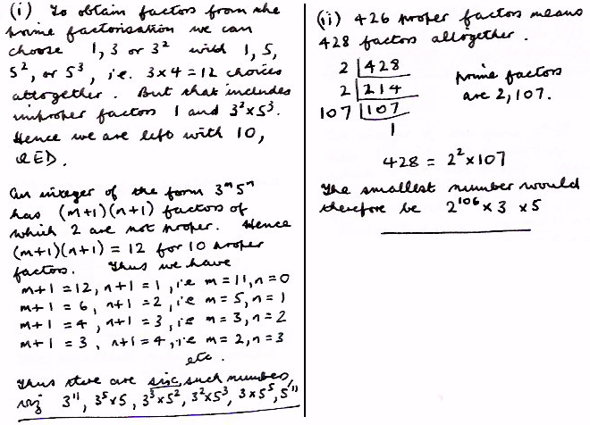
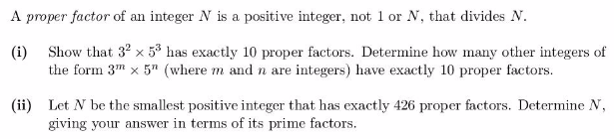
STEP 1 Question
?

Slide 7

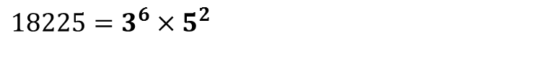
Square Numbers
What do you notice about the prime factorisation of the following square numbers?
$49=7^{2}$
$$324=2^{2}×3^{4}$$
$18225=3^{6}×5^{2}$
Square numbers have even powers in their prime factorisation.
?
Why does this work?
2
The prime factorisation splits into two equal sets.
If you multiply all the numbers in either of these sets you will get the square root
2
3
3
?
3
3

Slide 8

Cube Numbers
What do you notice about the prime factorisation of the following cube numbers?
$8=2^{3}$
$8000=2^{6}×5^{3}$
$19683=3^{9}$
Cube numbers have powers which are multiples of 3.
?
Why does this work?
The prime factorisation splits into three equal sets.
If you multiply together the numbers in any of the sets you will get the cube root
2
2
5
2
?
5
5

Slide 9
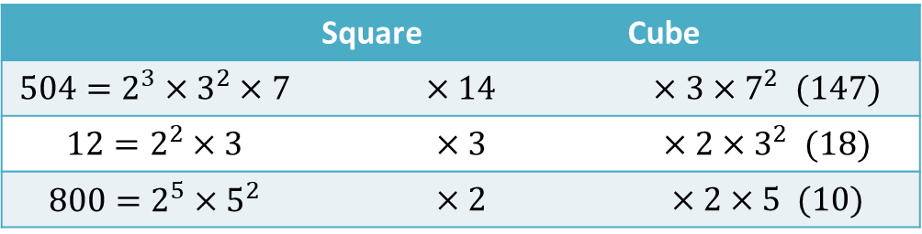
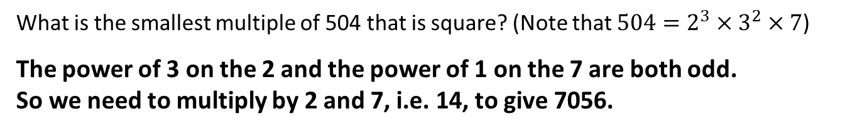

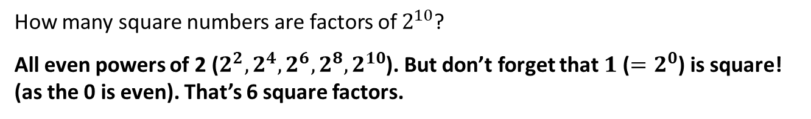
Test Your Understanding
1
What is the smallest multiple of 504 that is square? (Note that $504=2^{3}×3^{2}×7$)
The power of 3 on the 2 and the power of 1 on the 7 are both odd.
So we need to multiply by 2 and 7, i.e. 14, to give 7056.
?
2
What do you need to multiply the following by to make the following square and cube?
 | Square | Cube
$$504=2^{3}×3^{2}×7$$ | $$×14$$ | $$×3×7^{2} (147)$$
$$12=2^{2}×3$$ | $$×3$$ | $$×2×3^{2} (18)$$
$$800=2^{5}×5^{2}$$ | $$×2$$ | $$×2×5 (10)$$
?
?
?
?
?
3
Reminder: Factors of $2^{10}$ will be all powers of 2 with a power up to 10.
How many square numbers are factors of $2^{10}$?
All even powers of 2 ($2^{2}, 2^{4}, 2^{6}, 2^{8}, 2^{10}$). But don’t forget that $1$ ($=2^{0}$) is square! (as the 0 is even). That’s 6 square factors.
?
4
Prove that there are no positive integers $a$ and $b$ for which $a^{2}=2b^{2}$
Since any square number has an even number of twos in its prime factorisation, there will be an even number of twos in the prime factorisation of the left side and an odd number of twos in the prime factorisation of the right side.
?

Slide 10
Numbers of Factors of Square Numbers
List the factors of the (non-square) number 20.How many factors are there?
1, 2, 4, 5, 10, 20 (6 factors)
?
List the factors of the (square) number 49. How many factors are there?
?
1, 7, 49 (3 factors)
The number of factors of a square number will always be odd. Can you explain why this is?
Normally factors come in pairs. e.g. For 20, we have $1×20, 2×10, 4×5$
However, in $49$, the 7 in $7×7$ only counts once, so we’ll have an odd number of factors.
Explanation 1: Factor Pairs?
We have already seen that in the prime factorisation all the powers will be even. The way to work out the number of factors is to add one to each of the powers and multiply together. When you add one to an even number it becomes odd and when you multiply only odd numbers together you get an odd number.
Explanation 2: Prime Factorisation?
Square numbers (and only square numbers) have an odd number of factors.

Slide 11
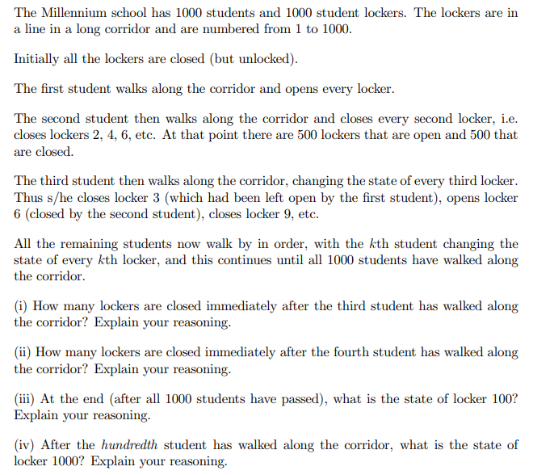
MAT Question
?
501
417
Open as 100 has nine factors
Open as 1000 has 11 factors which are less than or equal to 100
31 as all the square numbers will be open
(v) How many lockers are open after the one thousandth student?

