Slide 1
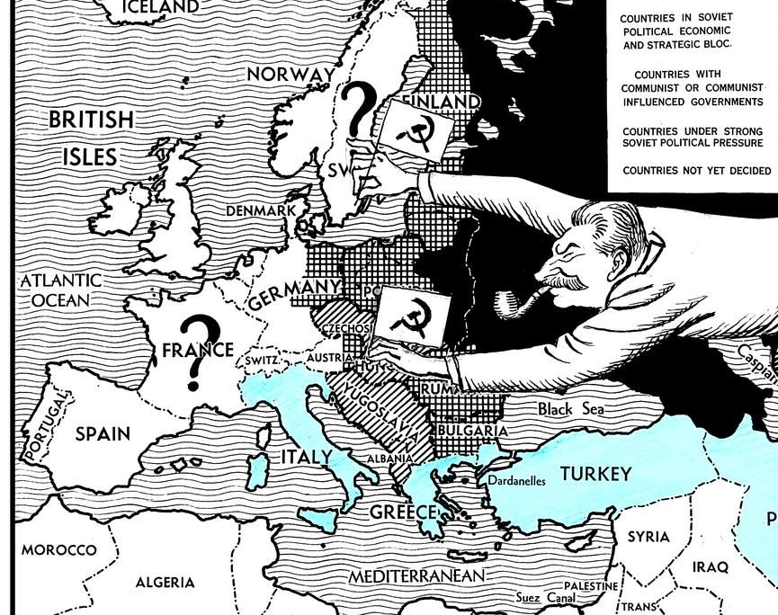
How did Stalin consolidate his control over eastern Europe?
Why were satellite states established and what impact did this have on early Cold War tensions?

Slide 2
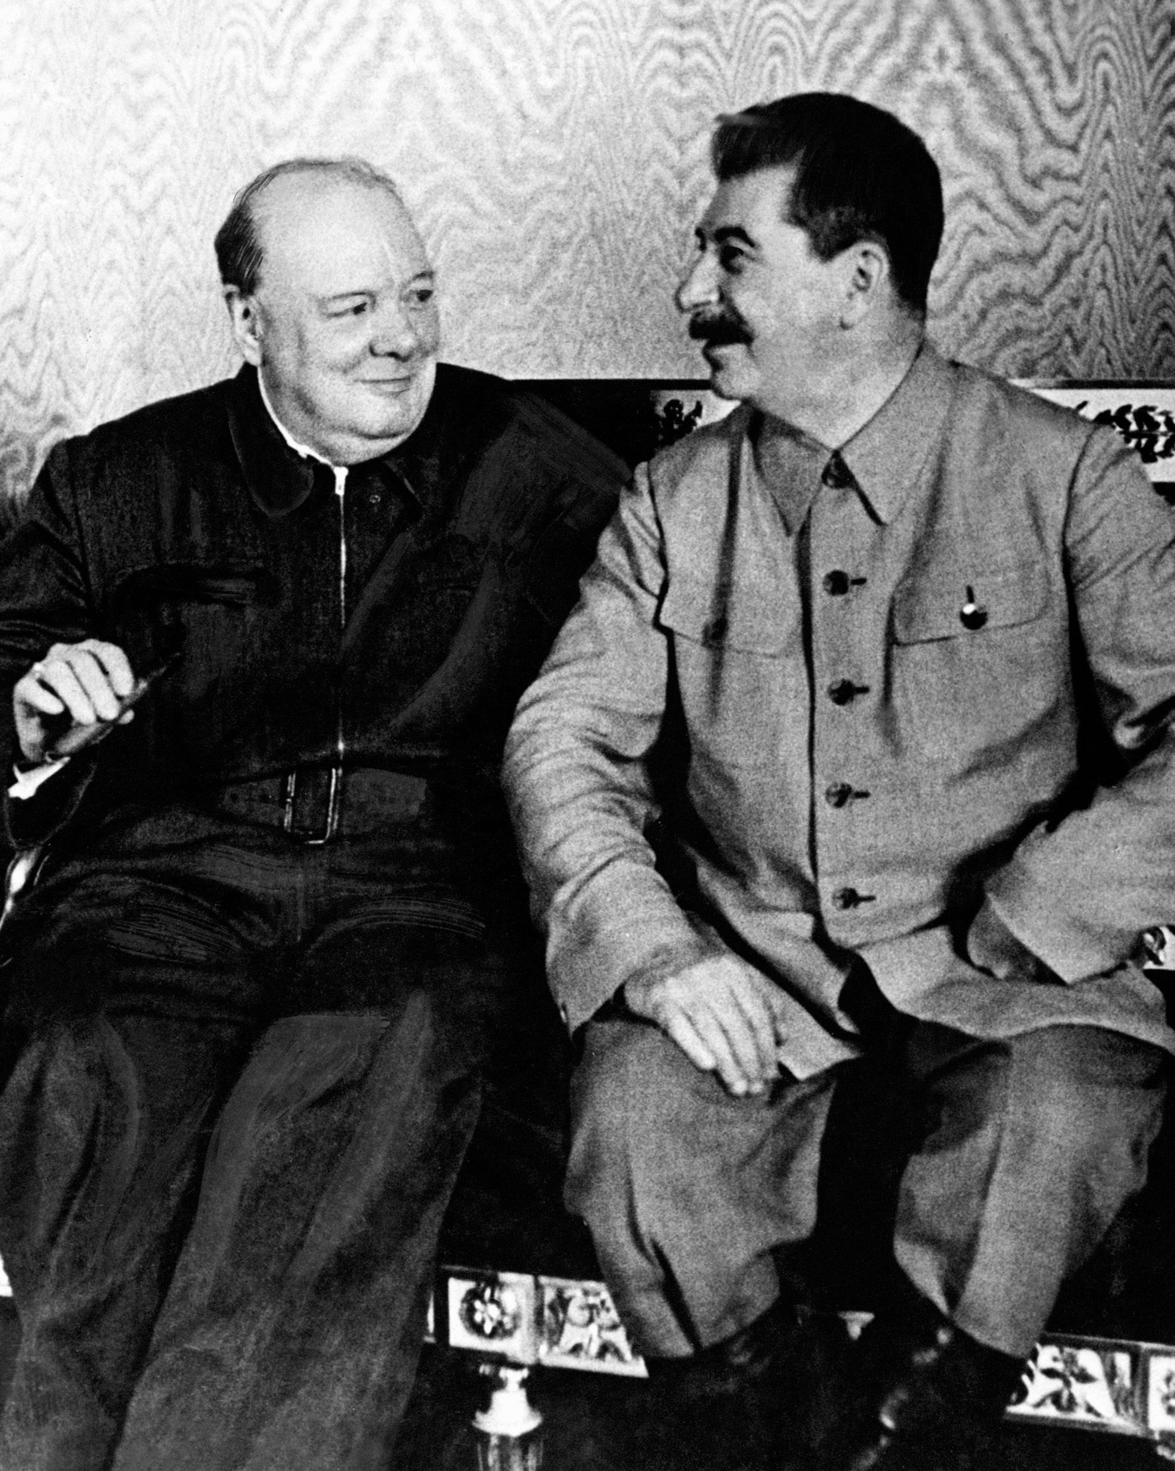
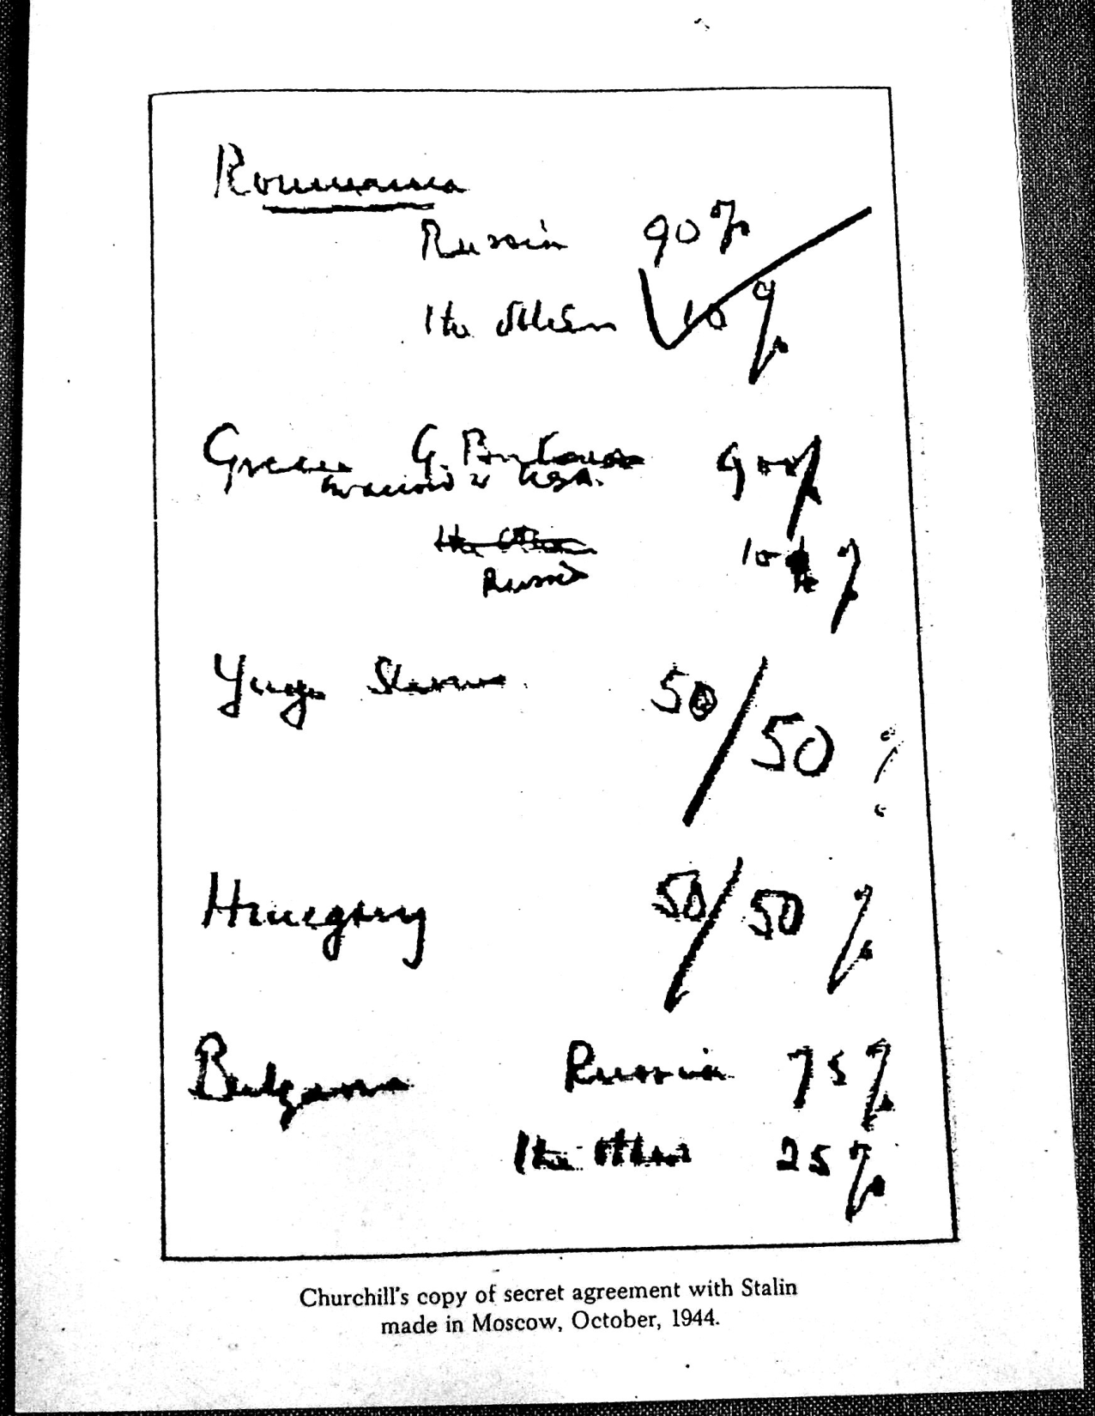

Slide 3
There were three dimensions to the ‘problem’ of communism in Eastern Europe after World War II
1. The widely recognized need for fundamental and progressive social changes
2. Existence of political forces prepared to lead the postwar transformation
3. Role of the USSR
Eastern Europe in 1945
2 groups of countries:
1. Germany and her former allies:
Austria
Romania
Hungary
Bulgaria
Finland
2. Victims of Nazi aggression:
Poland
Czechoslovakia
Yugoslavia
Albania

Slide 4
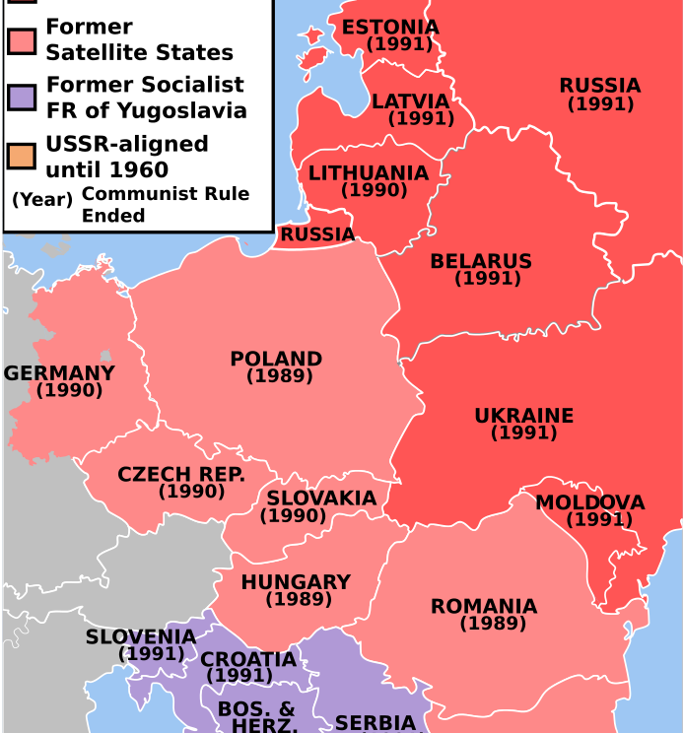
What is a satellite state?
Satellite state: a country that is officially independent but is in reality controlled by another country.
Between 1947-49, the USSR extended its control in Eastern Europe by turning Poland, Hungary, Czechoslovakia, Romania, Bulgaria and Eastern Germany into Satellite States.
Stalin set-up satellite states as a buffer-zone for protection and to prevent the spread of American influence

Slide 5
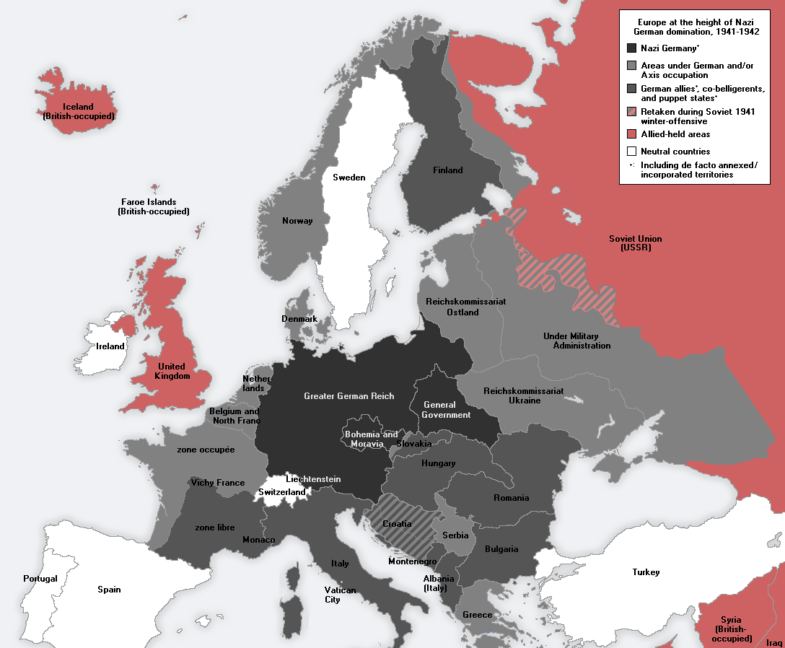
Soviet involvement in the creation of ‘people’s democracies.’
Soviet involvement was central to the development of people’s democracies in:
Poland
Romania
Hungary

Slide 6
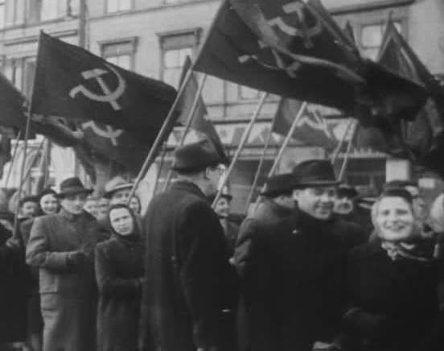
Soviet involvement in the creation of ‘people’s democracies.’
In Bulgaria and Czechoslovakia, the Soviet involvement played a major role but there were internal factors to consider.
Communist parties had collaborated with resistance groups to end Nazi rule.
Soviet troops supported native communist parties.

Slide 7
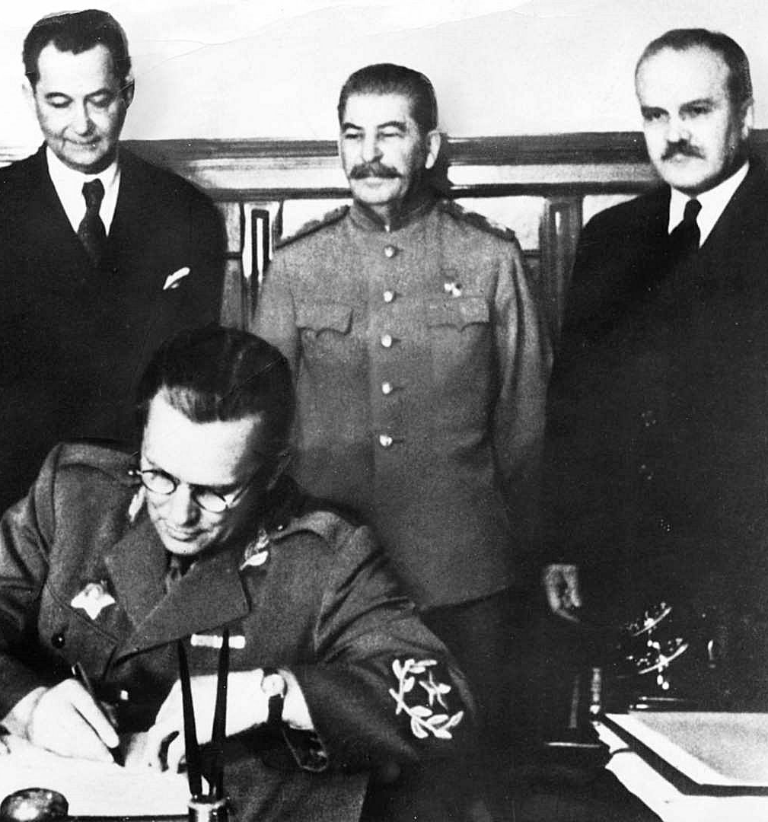
Soviet involvement in the creation of ‘people’s democracies.’
In Yugoslavia and Albania, local communist parties successful resisted Axis occupation,
There already existed a large, popular, left movement.
Soviet foreign aid (particularly military) was essential in the early Cold War years.
Tito, Stalin and Molotov at the signing ceremony of the Yugoslavia und USSR friendship treaty, 1945. ^

Slide 8
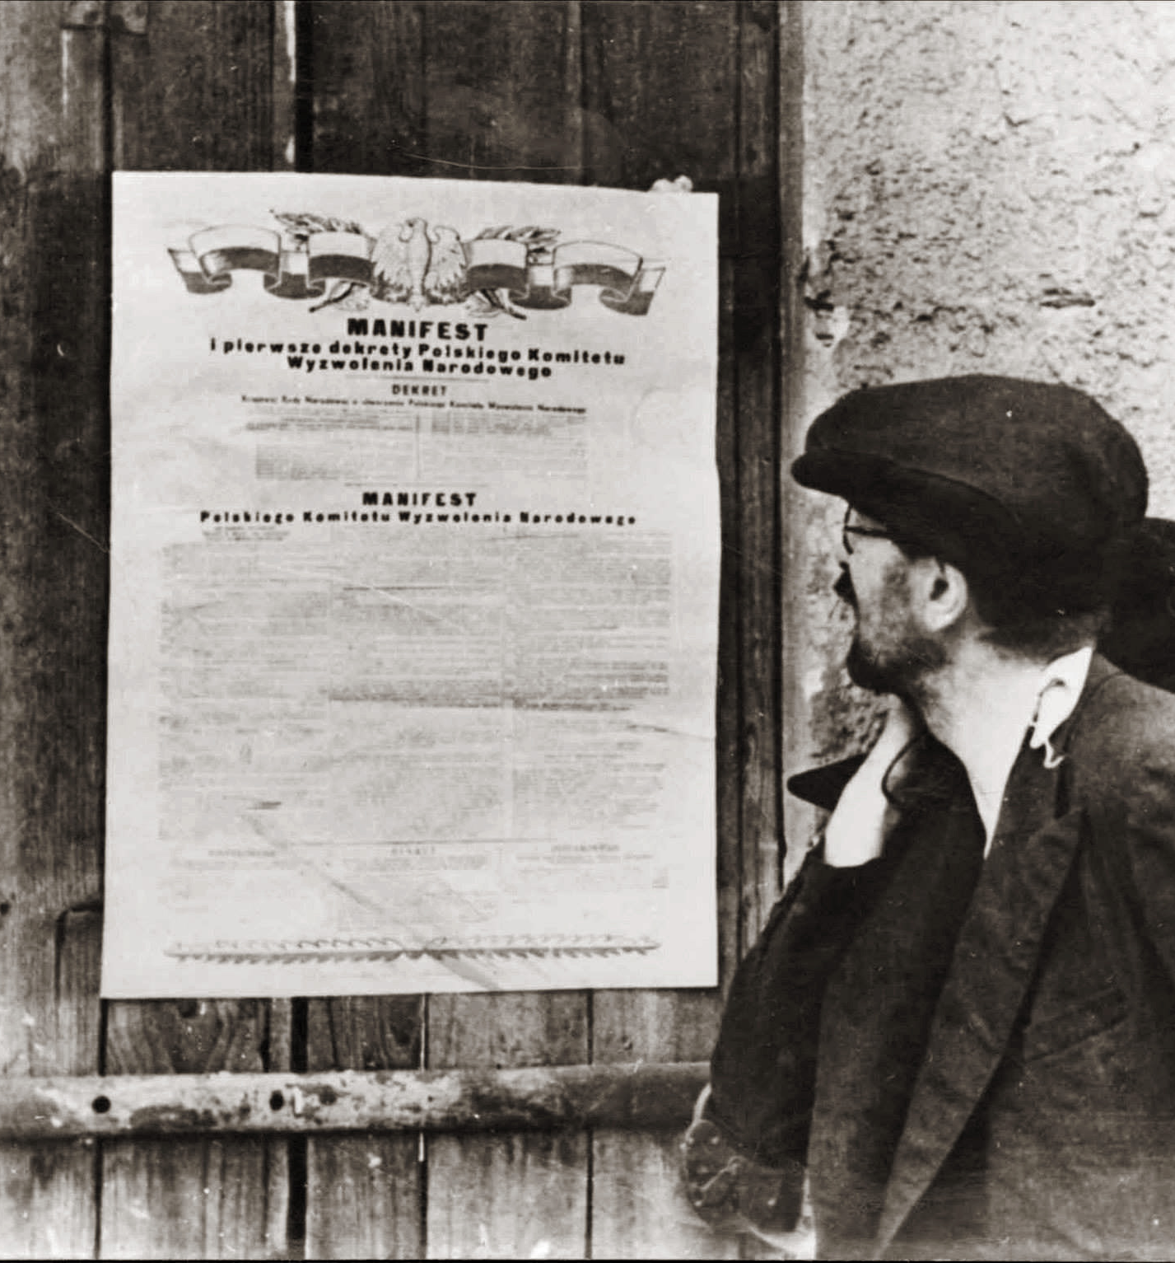
Poland
The Polish National Liberation Committee (PKWN) was secretly formed by Stalin from the ranks of former Polish communists living in Moscow.
The PKWN formed a Polish national government and received formal recognition from Moscow.
A Polish citizen reading the PKWN Manifesto ^

Slide 9
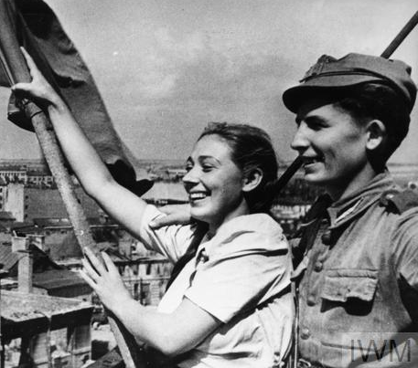
Poland
1944 Stalin oversaw the creation of the Central Bureau of Polish Communists.
After liberation and the formation of the Politburo of the Central Committee of the Polish Workers Part (PPR), the Soviets made sure that the majority of its members had belonged to the Central Bureau.

Slide 10
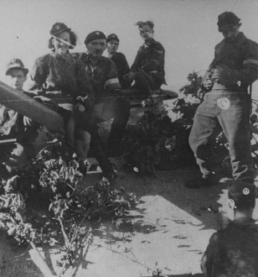
Poland
Soviet forces attacked and eliminated groups attached to the London Polish Government-in-exile
Order from August 1944 indicate that Soviet troops prevented units of the Polish Government-in-exile’s Home Army from reaching Warsaw to aid the Warsaw Uprising.
Stalin preferred that an uprising organised by the government-in-exile be put down by Nazis rather than be an obstacle to Moscow’s authority in Warsaw.

Slide 11
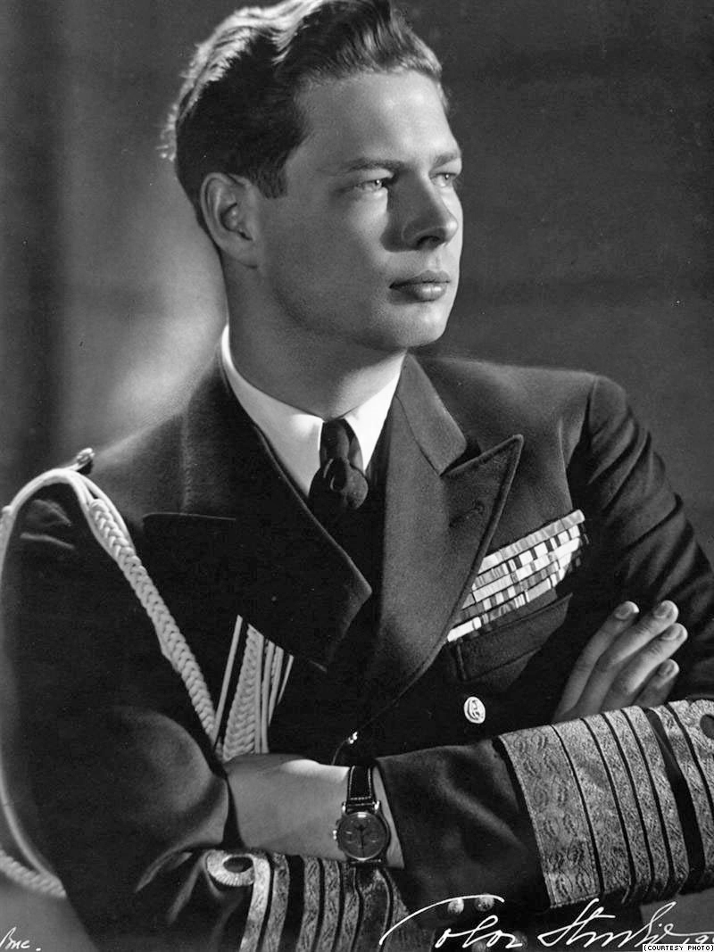
Romania
In Autumn 1944, the communist part – the National Democratic Front (FND) – led a Soviet approved campaign to move the government further left.
The FND demanded the government transfer power to them.
The Soviets pressures the Allied Control Council of Romania and demanded concessions to the “democratic forces” of the country.
A communist initiated coup in Feb-Marsh 1945 led to the king having no choice but to appoint a new government that relied on the FND.

Slide 12
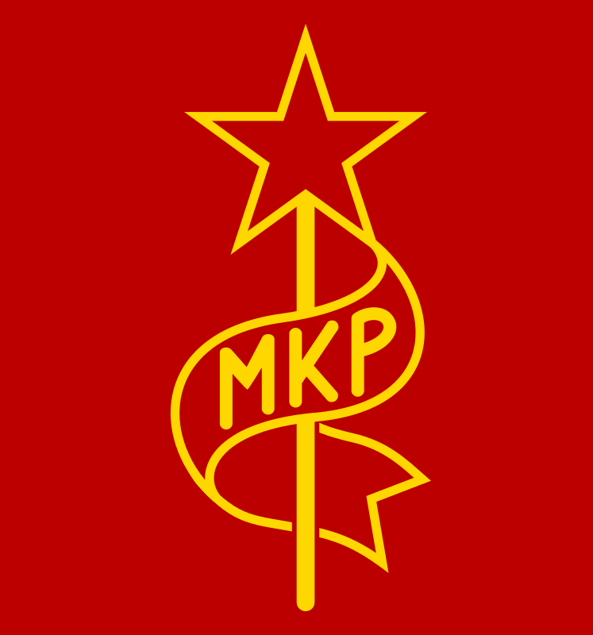
Hungary
Soviet policy was to create a provisional government that would take power.
Stalin was satisfied with placing Hungarian communist party members in prominent positions in the new government.

Slide 13
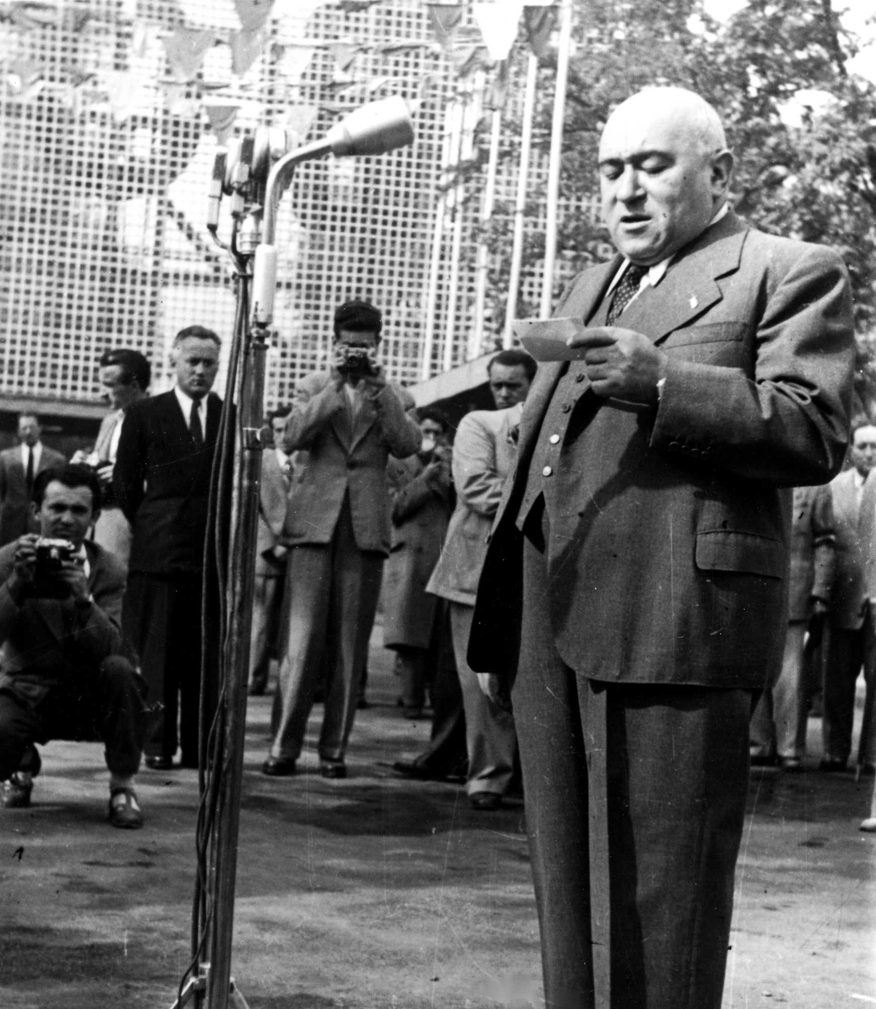
Hungary
1946-47, the Hungarian communist-controlled secret services initiated a campaign against the leaders of the Smallholder Party.
Soviet military authorities in Hungary arrested the party’s General Secretary, Bela Kovacsat, at the end of February 1947.
August 1947 new parliamentary elections were held, where, as a result of pressure and manipulation, the leftist bloc collected 60 percent of the vote.

Slide 14
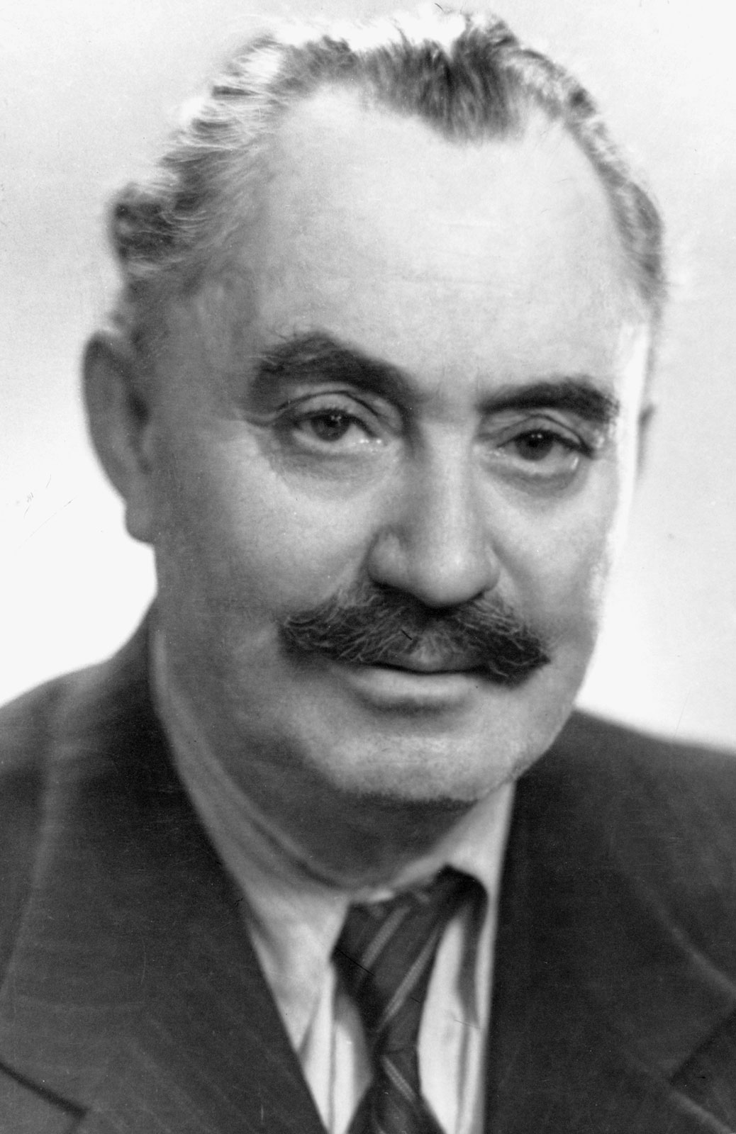
Bulgaria
The Patriotic Front (an alliance of left-wing forces) formed a government in Sofia before the Red Army arrived.
The Soviets dominated the Allied Control Council.
Communists were steadily gaining the ascendancy in the Bulgarian coalition government. The communist ministers were aided covertly by Russian occupation authorities.
A successful communist uprising led to a communist uprising resulting in over 10,000 executions and communist dominance in trade unions and the police.

Slide 15
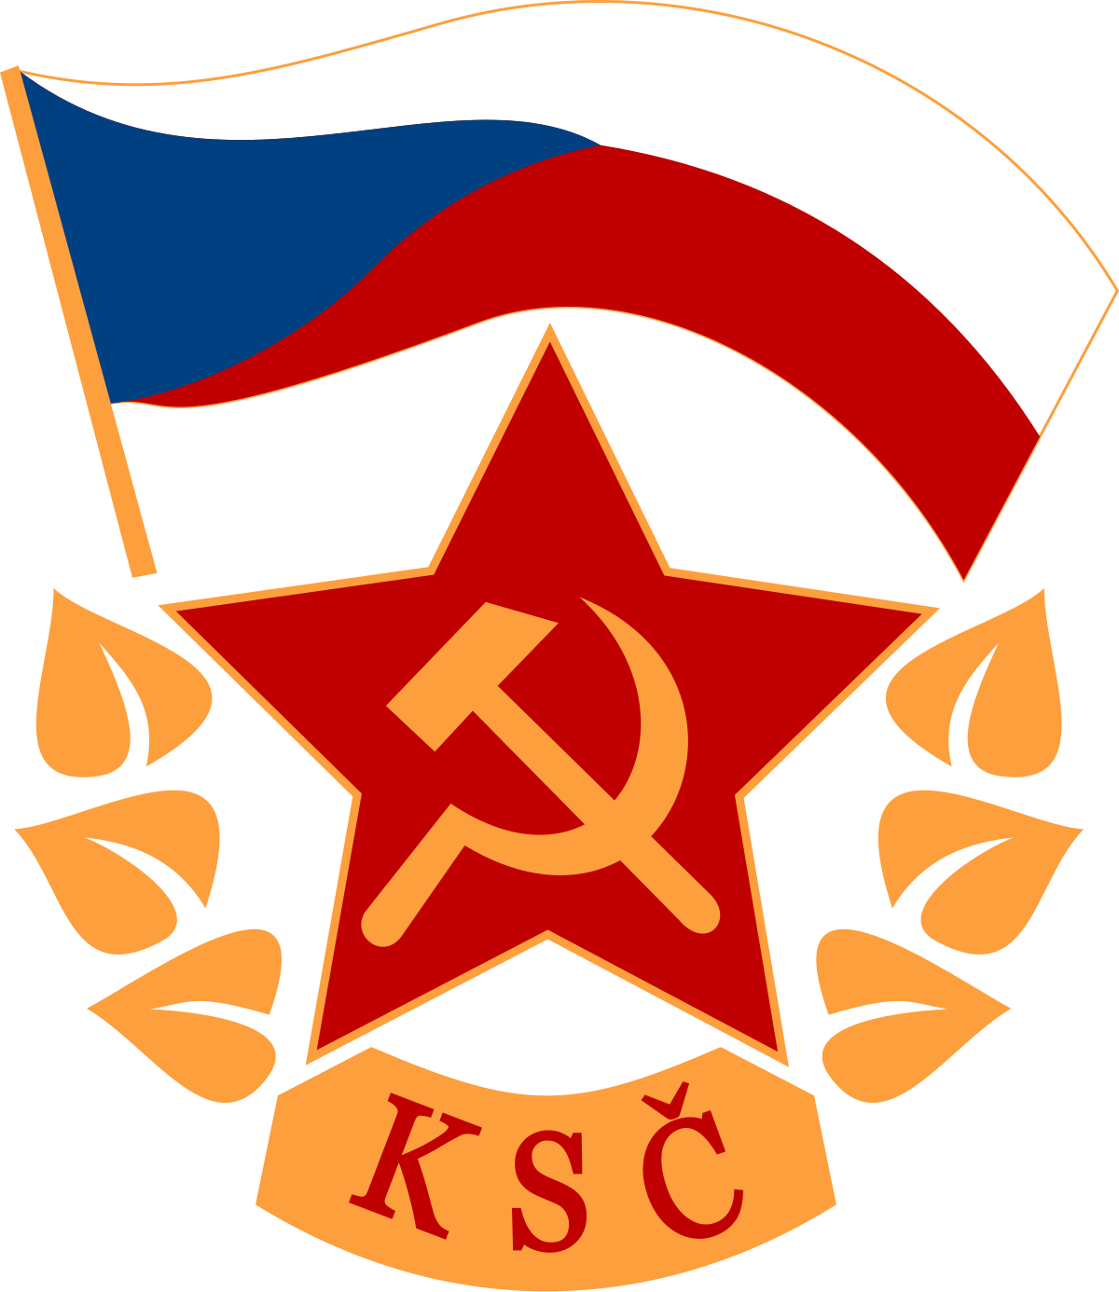
Czechoslovakia
The government was a National Front coalition in which three socialist parties—Communist Party of Czechoslovakia (KSC), Czechoslovak Social Democratic Party, and Czechoslovak National Socialist Party— predominated.
Czechoslovaks, bitterly disappointed by the West at Munich.
May 1945 - May 1946, KSC membership grew from 27,000 to over 1.1 million.
May 1946 election, the KSC won a plurality of 38 percent of the vote.

Slide 16
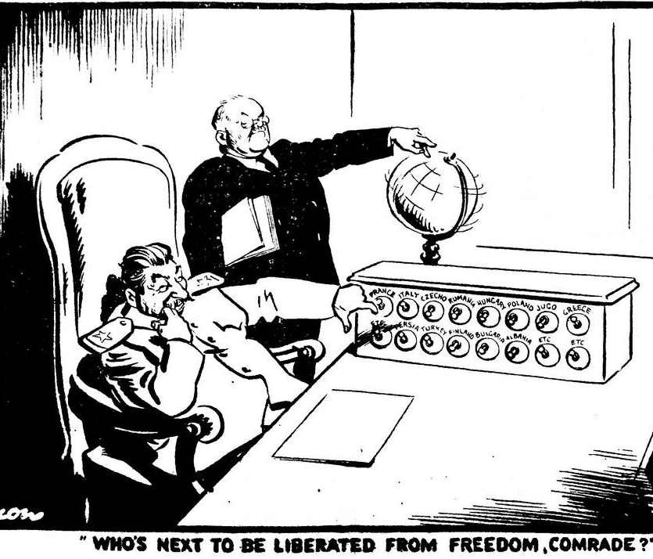
Czechoslovakia
The turning point came when, in July 1948, the Czechoslovak government (with KSC approval) accepted an Anglo-French invitation to attend preliminary discussions of the Marshall Plan.
Stalin summoned the Czech leadership to Moscow; upon their return to Prague, the KSC reversed its decision.
The KSC suggested an impending counterrevolutionary coup as a pretext for intensified activity.

Slide 17
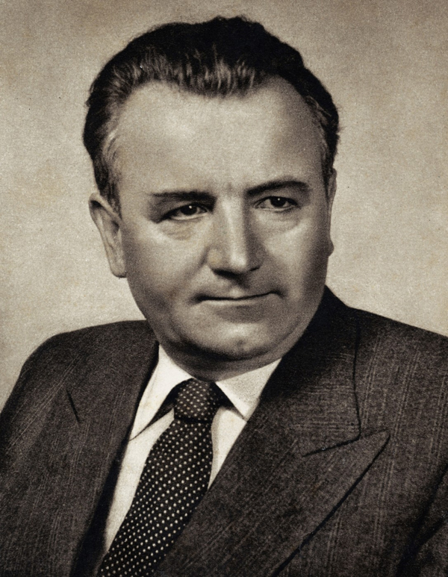
Czechoslovakia
On February 20, 1948, the twelve non-communist ministers resigned, in part, to induce President Benes to call for early elections; Benes refused to accept the cabinet resignations and did not call for elections.
The KSC garnered its forces for the coup d’état of 1948.
On February 25, Benes, perhaps fearing Soviet intervention, capitulated.
In February 1948, when the Communists took power, Czechoslovakia was declared a "people’s democracy"

Slide 18
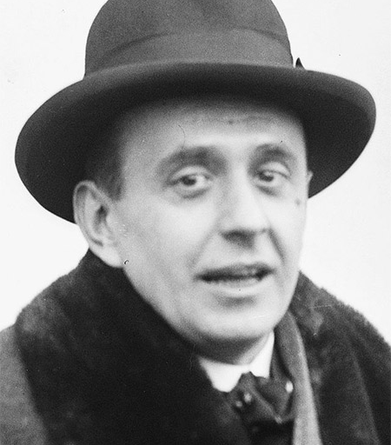
Jan Masaryk

Slide 19
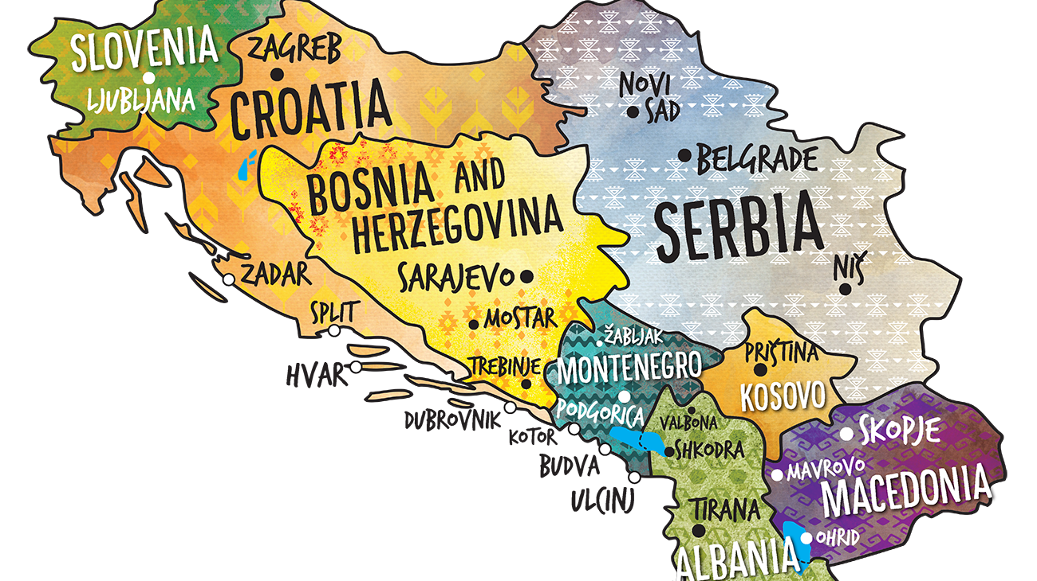

Slide 20
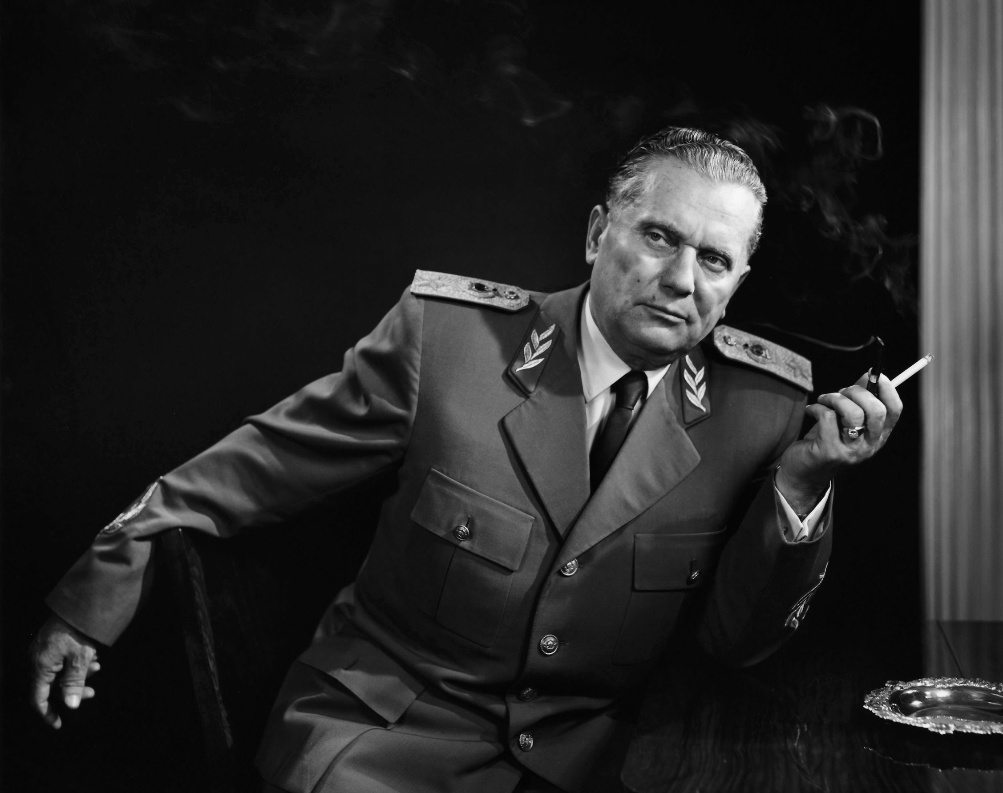
Yugoslavia
On 7 March, 1945, a single provisional Yugoslav government took office with Tito as prime minister.
New election laws barred alleged wartime collaborators from voting and all candidates had to be nominated by the communist-controlled People’s Front
Subasic and other non-communist ministers resigned in protest, while other parties boycotted the election.
People’s Front candidates won 90 percent of the vote.

Slide 21
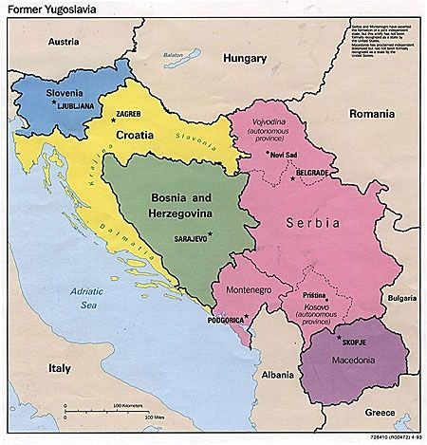
Yugoslavia
Federal People’s Republic of Yugoslavia was established on 29 November 1945.
It adopted a Soviet-style constitution that provided for a federation of six republics under a strong central government.
By 1948 they had nationalized virtually all the country’s wealth except privately held land.

Slide 22
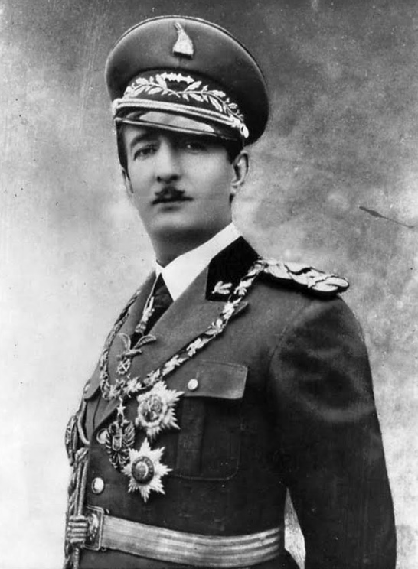
Albania
The Communist Party of Albania (CPA) was established on 8 November, 1941 with he aim of creating a “people’s democratic government.”
24th May 1944: the decision was made to set up the General Committee, which would function as a provisional government (and ignore all Albanian governments in exile as well as prohibiting the King’s return).

Slide 23
Albania
Albania had to organise general elections to obtain the Allies’ support for not only the Communists’ takeover, but also the very existence of the state.
Western Allies understood the provisional government’s pro-Moscow policy, but were faced with the reality that this government was the country’s only organised administration.
The Albanian provisional government had no other choice but to take all the measures necessary to arrange both elections and its victory in them.

Slide 24
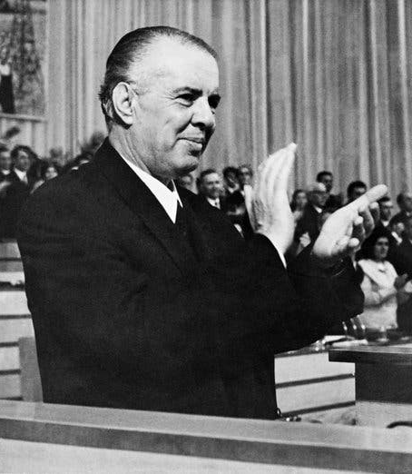
Albania
The Communists used social improvement, propaganda and the removal of political opponents to improve their chances of winning an election.
“War criminal” trials were another method used to eliminate and intimidate political opponents.
89.8% of the voters registered in the voter lists participated, and 93.5% of them voted for the Communists.

Slide 25
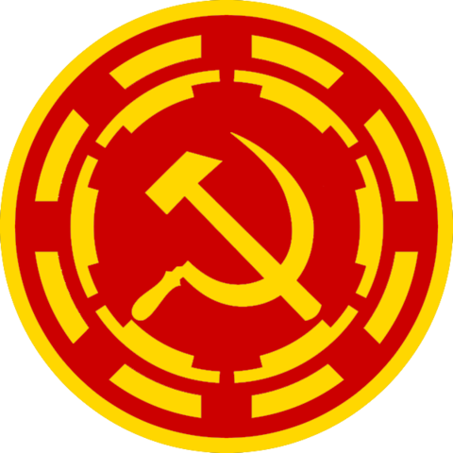
Communist organisations
Cominform 1947-1956
The Communist Information Bureau was an international political organisation that represented Communist Parties across Europe and brought them under the control and direction of the USSR.
Cominform was Stalin’s direct response to the Truman Doctrine. It tried to ‘contain’ American influence, forced other Satellite States to reject Marshall Aid and worked to organise strikes in Western Europe.
In France, 2 million workers went on strike in winter 1947, calling for France to reject Marshall Aid.

Slide 26
Communist organisations
Cominform
Cominform was also used to ensure the loyalty of East European governments.
It investigated and reported on government ministers and removed those not loyal to Stalin and the USSR.
In Hungary, 5% of population was in prison by 1953.
Cominform consolidated the power of the USSR over its Satellite States by stamping out opposition and ensuring the loyalty of governments.

Slide 27
Communist organisations
Comecon 1949-1991
The Council for Mutual Economic Assistance was Stalin’s Communist alternative to the Marshall Plan.
It aimed to encourage economic development in Eastern Europe AND prevent trade with Western Europe and the USA.
COMECON minimised US influence in Eastern Europe by integrated E. European economies with the USSR. In reality, they lost more to the USSR then they gained.

Slide 28
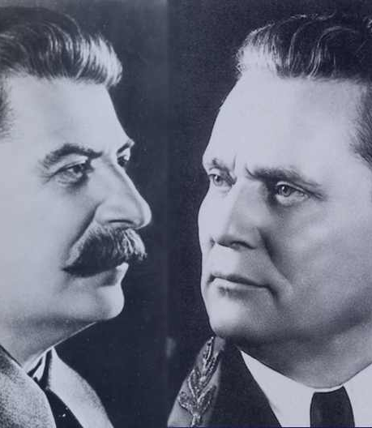
The one that got away…
Stalin ceased advocating "national roads to socialism" in 1947 and ordered creation of a Soviet-dominated socialist bloc.
Cominform’s headquarters were established in Belgrade.
Stalin, however, saw Yugoslavia’s independent Communists as a threat.
The Yugoslavs also resisted establishment of joint companies that would have allowed Moscow to dominate their economy.

Slide 29
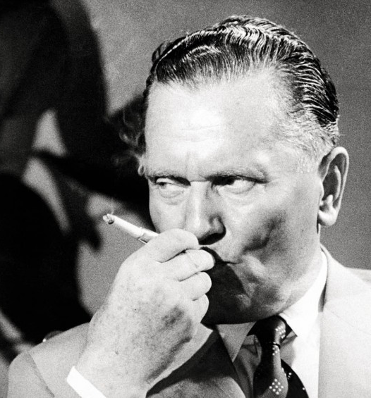
The Yugoslav-Soviet Rift
In early 1948, the Soviets stalled negotiations on a Yugoslav-Soviet trade treaty
In March, Moscow withdrew Soviet military and civilian advisers from Yugoslavia
The Yugoslavs criticised the Soviets for recruiting spies within the Yugoslav party, military, police, and enterprises.
At a special session in Bucharest that the Yugoslavs refused to attend, the Cominform shocked the world by expelling Yugoslavia and calling upon Yugoslav communists to overthrow Tito.

Slide 30
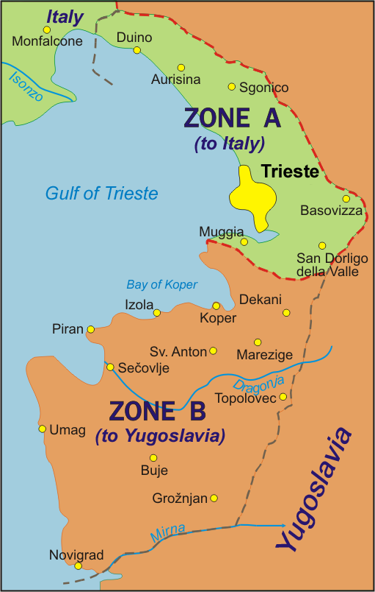
The Yugoslav-Soviet Rift
A few prominent Yugoslav communists did defect.
The Yugoslav regime strove to prove its allegiance to Stalin after 1948.
In 1949 Yugoslavia stood isolated. Relations with the West worsened because of the bitter dispute with Italy over Trieste.
The Soviet-bloc governments launched an economic blockade against Yugoslavia, excluding it from the COMECON.
The West commenced a flow of economic aid in 1949, saved the country from hunger in 1950.

