Slide 1
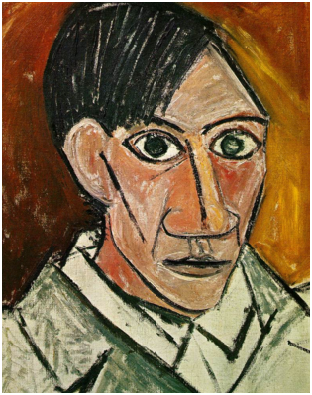
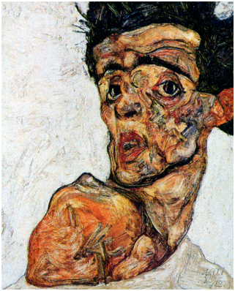
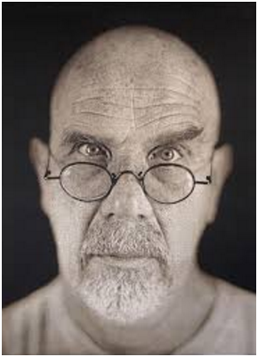
How do these self portraits differ?
Vs
Picasso 1907
Schiele 1912
Monica Lee Chuck Close 2006

Slide 2
Enquiry question: Which is more true – to draw what you look like or to draw how you see yourself?
objective (adjective): based on real facts and not influenced by personal beliefs or feelings.
subjective (adjective): influenced by or based on personal beliefs or feelings, rather than based on facts.

Slide 3
Enquiry question: Which is more true – to draw what you look like or to draw how you see yourself?
Skill Objective: To be able to draw objectively using the grid to produce accurate facial proportions.
Lesson Outcome: An accurate A4 basic line drawing of your face
Keywords: proportion line shape guidelines accuracy
AO3

Slide 4
Step by step
Task: detailed self-portrait study
Tips: use a sharp HB for outlines. Try turning your book upside-down as this stops you making subconscious alterations
On the next available double page stick your self-portrait photo on the left hand page.
Grid your portrait using a ruler (either the width of the ruler or boxes of 4cm by 4cm).
Grid your blank page in exactly the same way so that it is identical! (note: ensure that the lines are really light and have been drawn with a sharp pencil, so that you can easily rub them out).
Drawing the outline of your face (make sure it is all drawn lightly):
Starting with the edge of the face mark on your grid on the blank page where it crosses the grid lines I.e. use the grid to plot exactly where the face is, work carefully from box to box checking as you go. If a bit looks wrong then double check it with a ruler. Every couple of boxes start to join the lines, looking at the shape they form on the photo.
Once you’ve used the grid to help draw your face/head shape, do the same for the neck and shoulders. Then do the same for the hair, but simplify the overall shape (don’t draw each strand at this stage).
Now move onto the outline of all the facial feature. Do not start shading yet. You can always divide your boxes over the features into four to help with proportions.

Slide 5
Shading your portrait
Learning objective – To be able to recognise areas of different tones and texture and understand how to create them using your pencil.
Skill objective –To be able to accurately draw the features of the face using the correct proportions.
To be able to apply shading effectively to show the form.
To use appropriate marks to show texture on a portrait.
Lesson outcome – A portrait with a range of tones added to the face in the direction of the form, showing a smooth texture.
*** AO3 – Recording observations
Notes:
Video if needed https://www.youtube.com/watch?v=fJXN7wzrbwU for shading https://www.youtube.com/watch?v=kttHNbPovFQ for adding texture

Slide 6
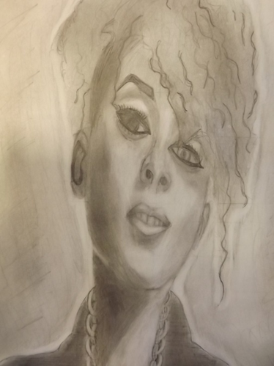
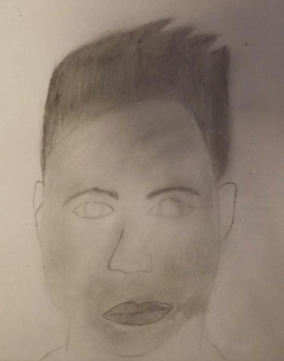
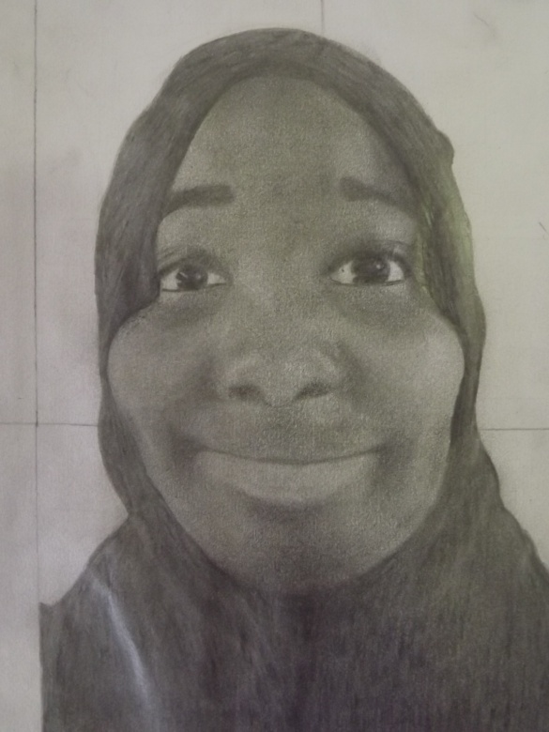
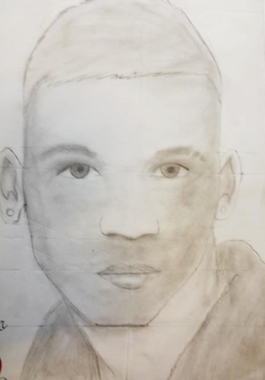
1
2
3
Starter: As a group on your table sort these images into rank order (B1 to A1), and note down two justifications that led you to this conclusion. E.g. Shading has been applied smoothly, but a greater range of tones are needed to show form. Use your mark sheet to help you.
4

Slide 9
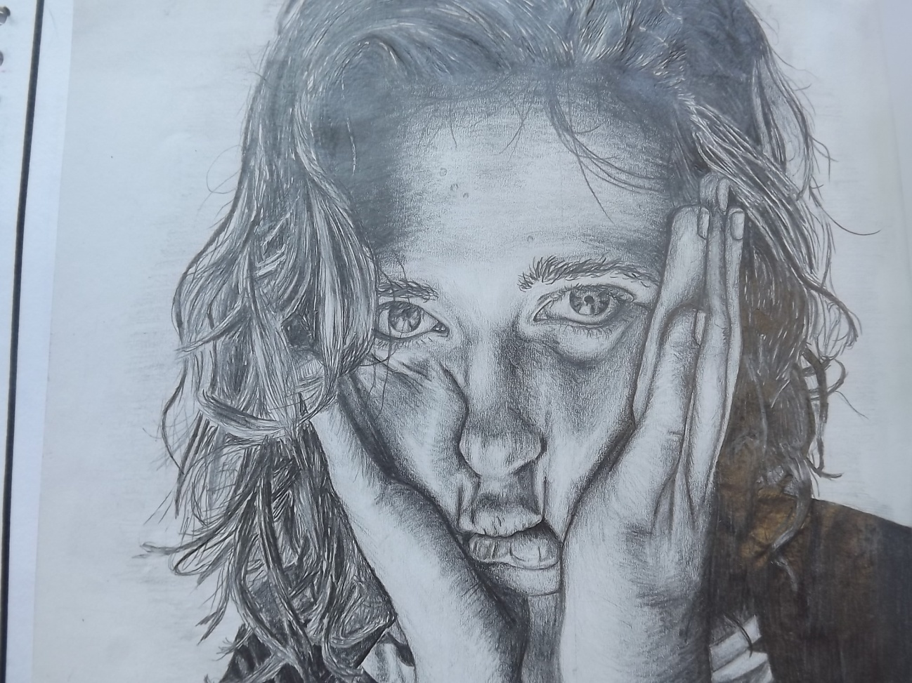
Advanced…

Slide 10
You are going to mark your work. You need to listen carefully to the levels as I read through them and decide which level to give for the portrait.
Write a comment for each piece saying which aspect you got right and which you could improve.

Slide 11
B1
The drawing is fairly accurate.
All shapes are roughly in the correct position.
The shading lacks control/shows only mid-tones.
Some of my outlines are heavily drawn.

Slide 12
A3
The drawing is fairly accurate.
Most of the shapes are in proportion.
The shading is accurate in some areas.

Slide 13
A2
The drawing is accurate.
The shapes are in proportion.
The shading shows a range of tones.
Some attempt has been made to show texture.

Slide 14
A1
The drawing is realistic and accurate.
The shapes are in proportion.
The shading shows a full range of tones, and is applied with understanding of texture and form.
The pencil has been used in different ways to show different textures.

Slide 15
This lesson……improving your portrait studies
Learning objective – To be able to recognise areas of different tones and texture and understand how to create them using your pencil.
Skill objective – To be able to apply shading effectively to show the form and marks to convey texture on a portrait.
Lesson outcome – A complete accurate tonal shaded self portrait.

Slide 16
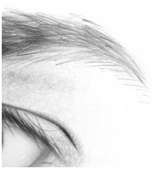
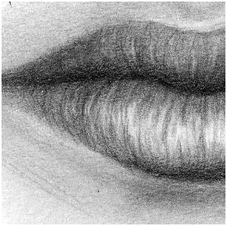
Improving your use of mark making to convey texture:
Eyebrows & eyelashes Lips Hair Hair
TIP: Complete smooth skin shading before adding textural marks. Sharpen your pencil.
Try in the boxes below:

