Slide 1
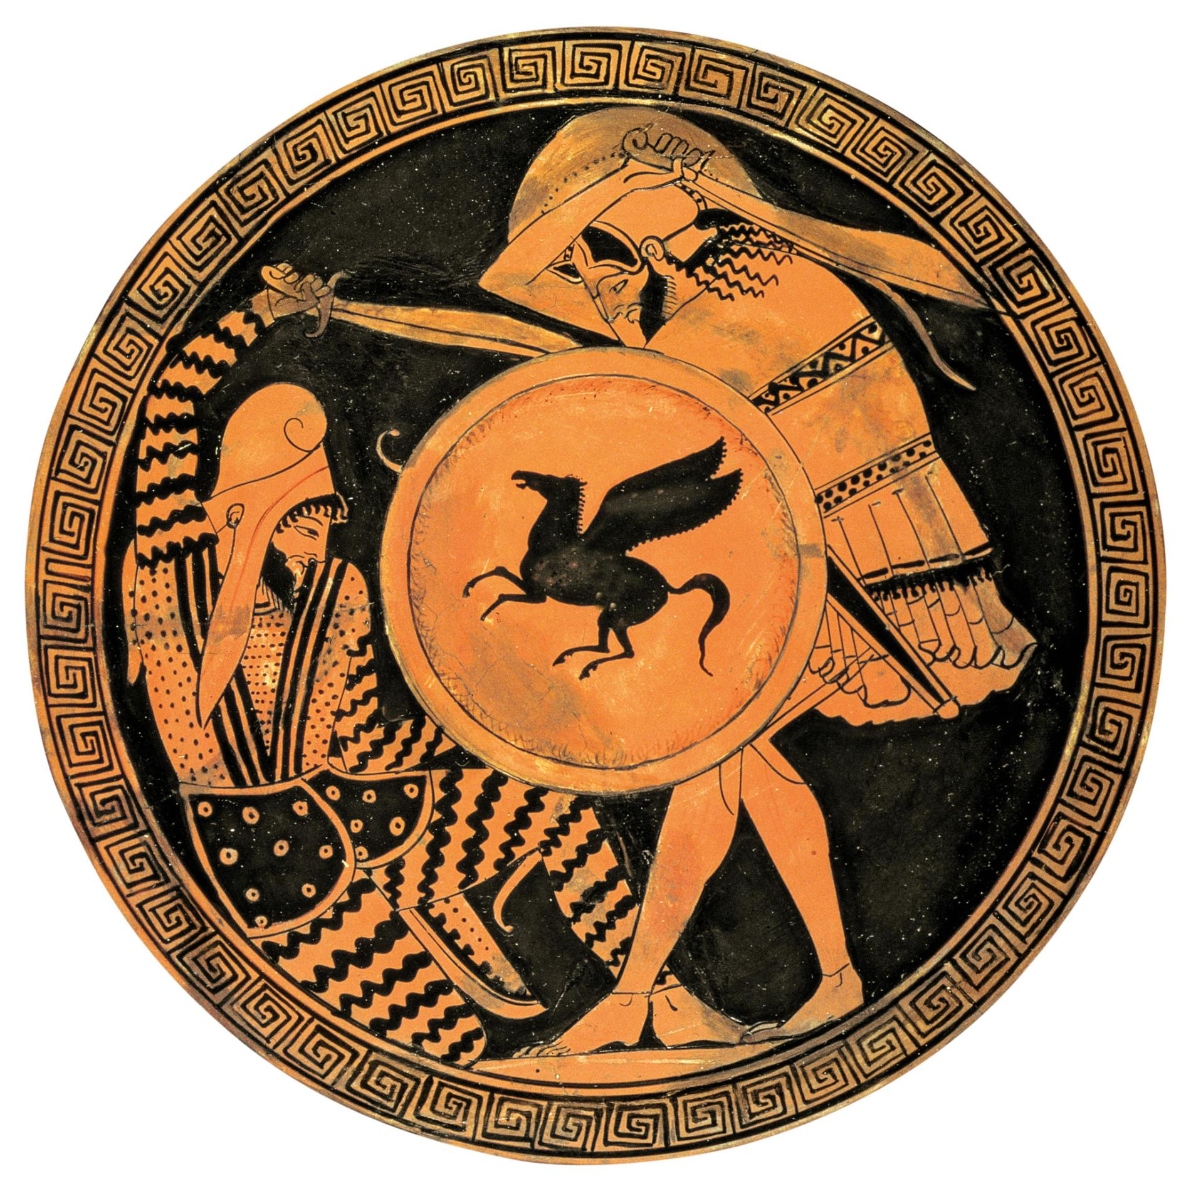
Xerxes’ Invasion of 480

Slide 2
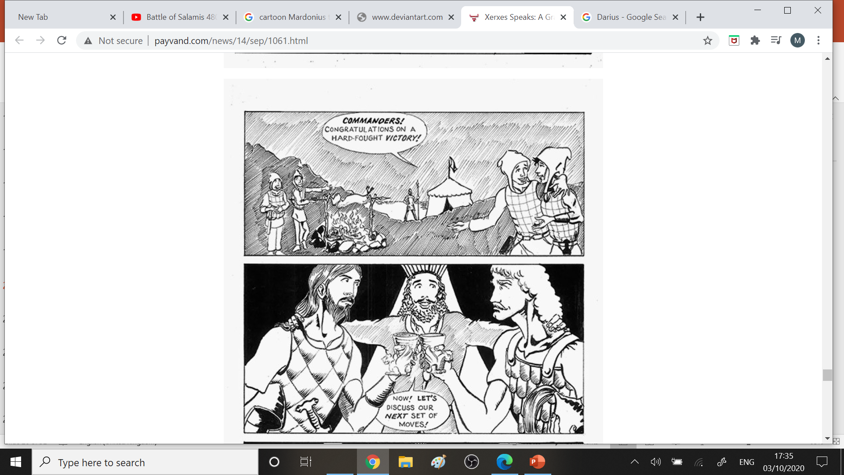
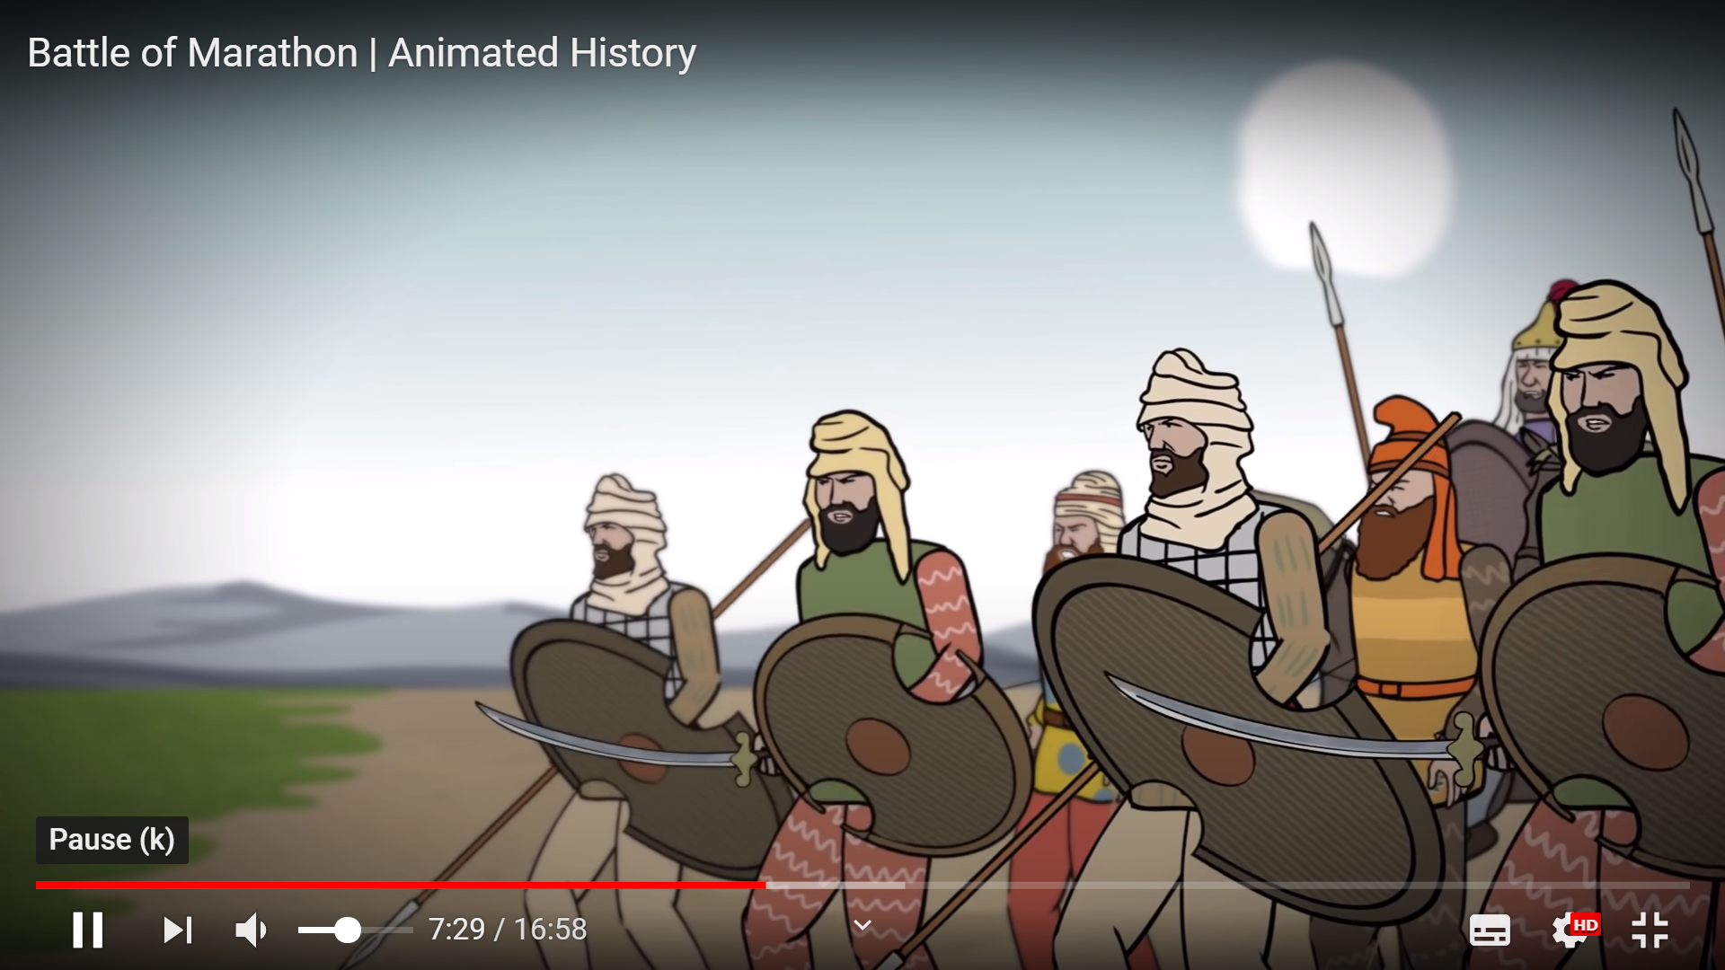

XERXES
Xerxes at first was not at all interested in invading Greece. 7.5
Xerxes is presented by Herodotus as being initially reluctant to embark on an expedition to Greece, in spite of Darius’ three years of preparations before his death in 486BC. The most pressing reason was the revolt of Egypt, which Xerxes swiftly puts down. 7.7.
Mardonius’ motive for urging the campaign were love of mischief, and adventure and the hope of becoming governor of Greece himself.
So what persuades him?
Mardonius develops his arguments (7.9), then there is a silence.
Artabanus 7.10
Xerxes’ cautious uncle is presented as the ‘wise counsellor’, a stock Herodotean device,
‘These Greeks are said to be great fighters’ (remember Marathon?)
The Bridge across the Hellespont invites risk, should Xerxes ‘suffer a reverse’.
(Remember Darius and the Danube?)
Hubris: ‘Often a great army is destroyed by a little one … For God tolerates pride in none but himself.’
Haste is the mother of failure.
Mardonius
is presented as the prime mover. He constantly urges Xerxes to seek:
revenge against the Athenians
glory through conquest
the riches of Europe 7.5 +7.9
After announcing his decision, Xerxes invites ‘debate’ on the subject!
‘Certain other occurrences’ support Mardonius’ bid:
At last I have found a way to win for Persia not glory only, but a country as large and as rich as our own – indeed richer – and at the same time to get satisfaction and revenge. … I will bridge the Hellespont and march an army through Europe into Greece, and punish the Athenians…’ 7.8
The Aleuadae of Thessaly offered ‘zealous assistance’.
The Peisistratids of Athens, resident in Susa offered ‘advice’.
Onomacritus, the disgraced oracle-monger, supported the Peisitratid bid with his dodgy oracles:
His uncle’s words later convince Xerxes to change his mind, but then a terrible dream keeps haunting Xerxes. The King makes Artabanus dress in his pjs and the same terrible dream says….
It is fore-ordained that the Hellespont should be bridged by a Persian… 7.6

Slide 3
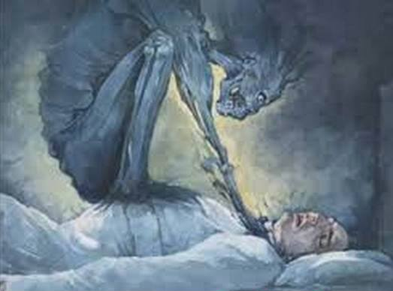
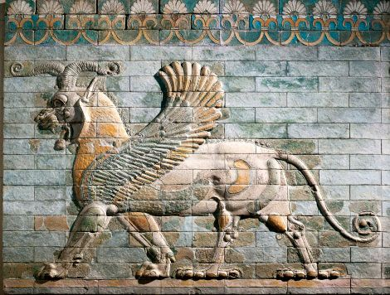
Are you the man who in would-be concern for the king is trying to dissuade him from making war on Greece?
Xerxes has already been told what will happen to him
if he disobeys me.
The phantom after uttering these threats was on the point of burning out Artabanus’ eyes with hot irons,
when he leapt up with a shriek and ran to find Xerxes… 7.17
I have seen in my time powerful kingdoms struck down by weaker ones, and it was for that reason I tried to prevent you. But now I know that god is at work in this matter. 7.18
Dangerous precedents:
Cyrus vs Massagetae
Cambyses vs Ethiopia
Darius vs Scythians
So Xerxes embarks without Artabanus,
but with his blessing.

Slide 4
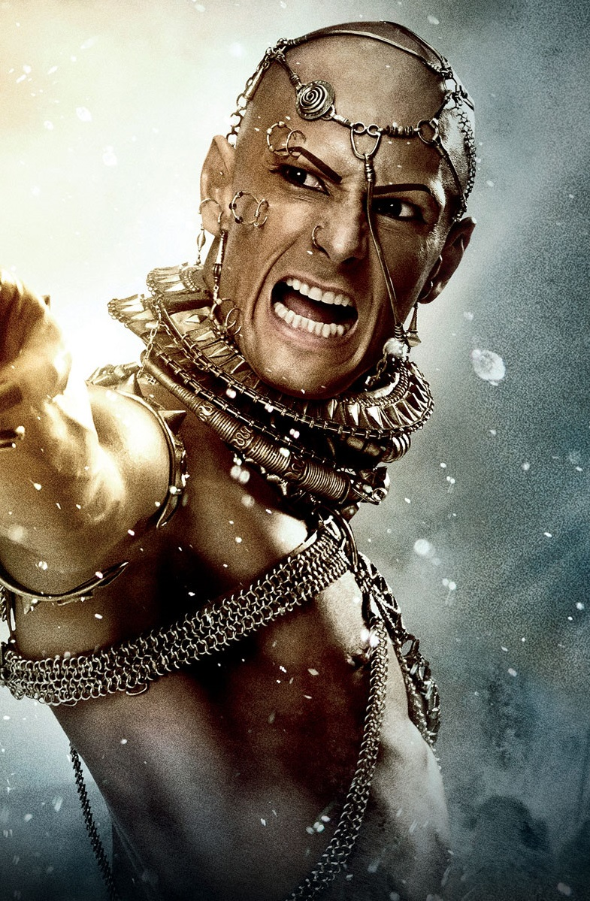
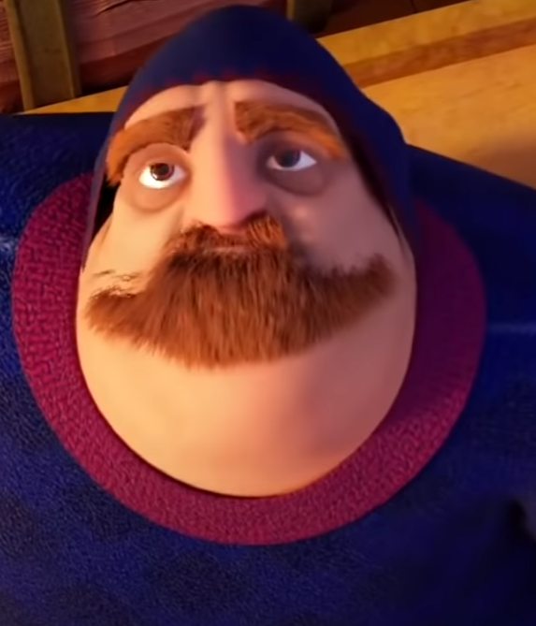
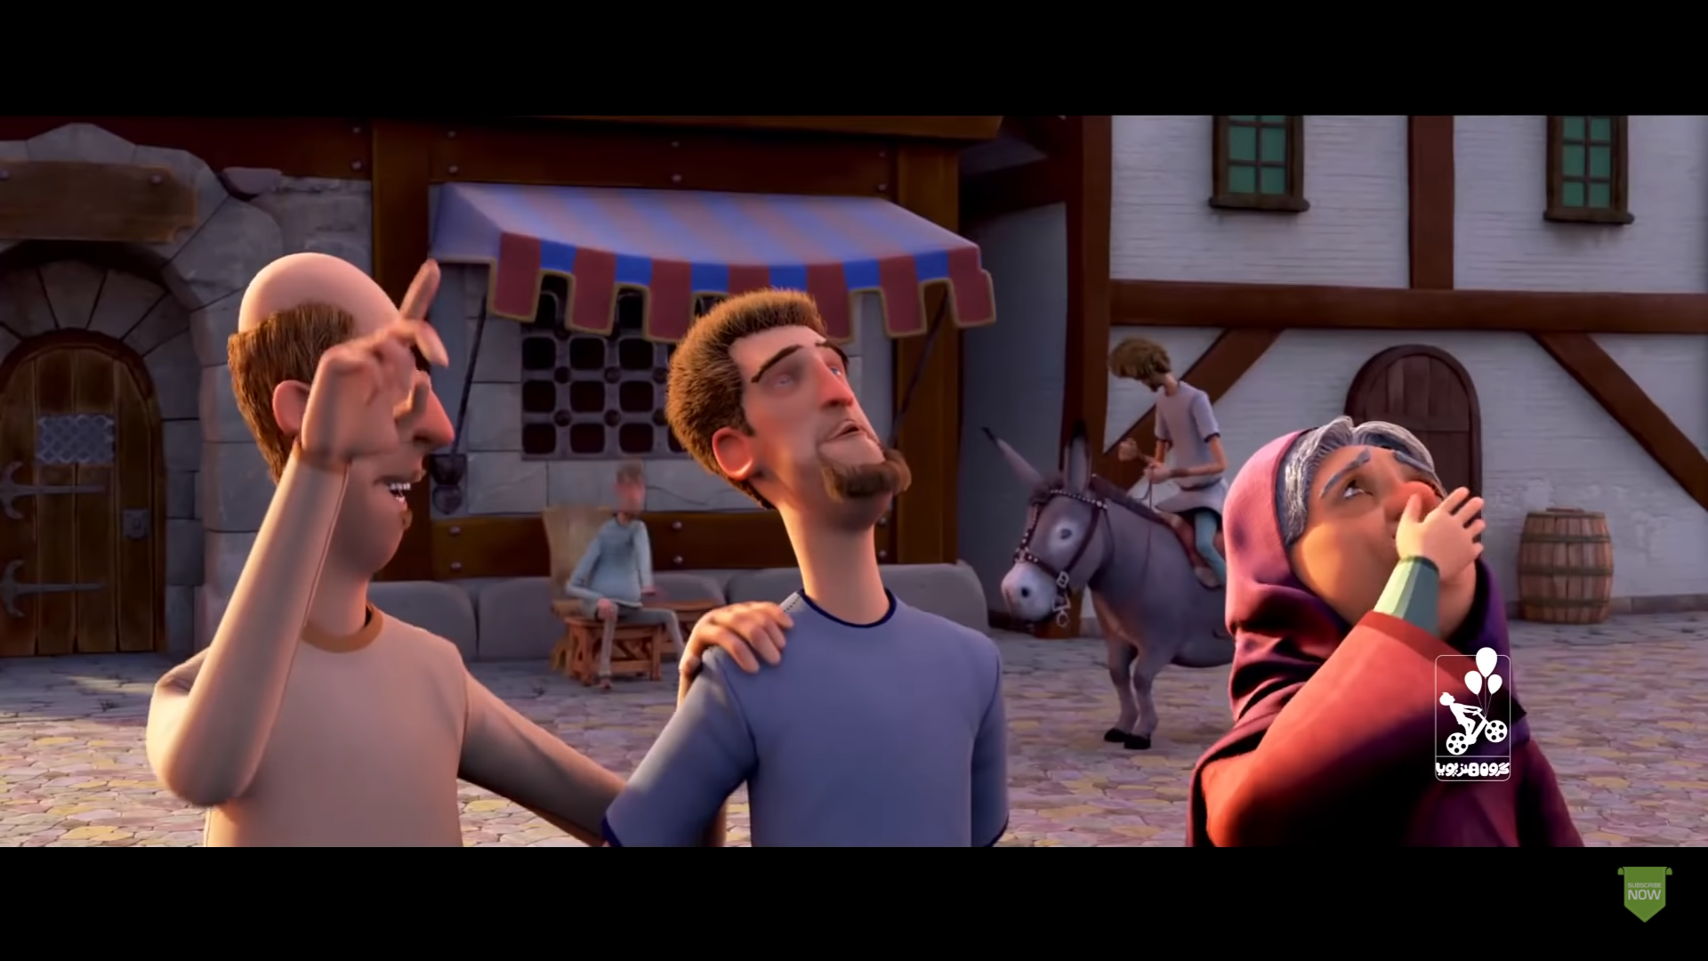
Emboldened by the presents, he came to Xerxes with a request
Pythius
Pythius was a very wealthy man
and a very loyal subject to Xerxes.
He lived in Lydia.
Master, there is a favour I should like you to grant me – it is a small thing.
When I learned that you were on your way to the Aegean coast, my immediate wish was to make a contribution towards the expenses of the war; I went into the matter of my finances and found that I possessed 3,993,000 gold darics. These I propose to give you. 7.29
My lord, I have five sons – every one of them is serving in your army. I am an old man, sir. Release from service one of my sons – the eldest. 7.38
For your impudence you will pay with the life of the fifth, whom you cling to most. 7.39
As a reward for your generosity, I make you my guest friend and I will give you from my own coffers 7,000 gold Darics to make your fortune up to the round sum of 4,000,000. Continue to possess what you have acquired.
Pythius’ eldest son was cut in half.
And now between the two halves of the young man’s body the army marched…

Slide 5
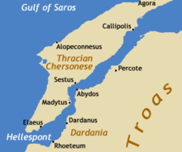
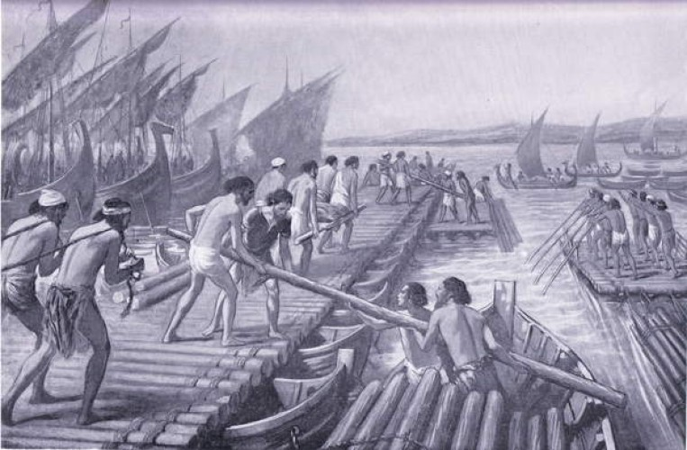
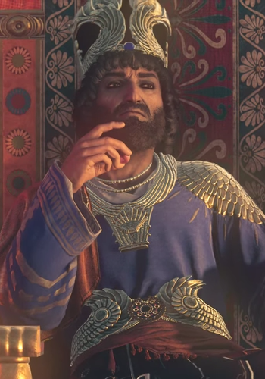
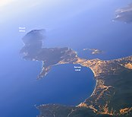
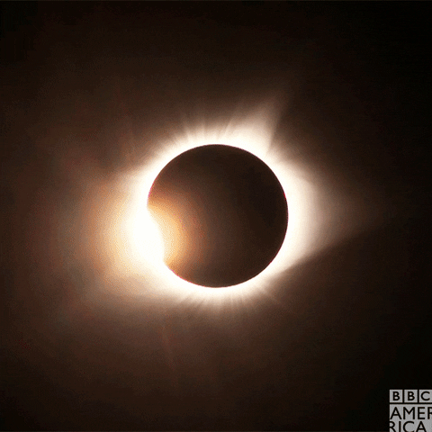
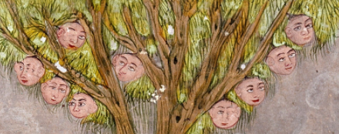
The bridge was constructed between Abydos and a point south of Sestos by Egyptians and Phoenicians using papyrus and flax. It was 7 furlongs (1.4km) in length.
Bridging the Hellespont 7.33-36
‘The work was completed successfully, but a subsequent storm of great violence smashed it up and carried everything away.
‘Xerxes was very angry and gave orders that the Hellespont should receive 300 lashes and have a pair of fetters thrown into it. I have heard before now that he also sent people to brand it with hot irons.
You salt and bitter stream, Xerxes the King will cross you, with or without your permission.
In addition to punishing the Hellespont, Xerxes gave orders that the men responsible for building the bridge should have their heads cut off. 7.35
The second bridge was supported by ships lashed together – 360 on the north side, 314 to the south, packed with earth and protected by a paling to stop the horses being afraid.
The Athos Canal 7.22-24
In view of the previous disaster to the fleet off Mt Athos, preparations had been going on in that area for the past three years. Men of the various nations were put to work cutting a canal under the lash.
Thinking it over, I cannot but conclude that it was mere ostentation that made Xerxes have the canal dug – he wanted to show his power.
No sooner had the troops begun to move than the sun vanished from his place in the sky and it grew dark as night. Xerxes, deeply troubled, asked the Magi to interpret, and was given to understand that God meant to foretell to the Greeks the eclipse of their cities. 7.37

Slide 6
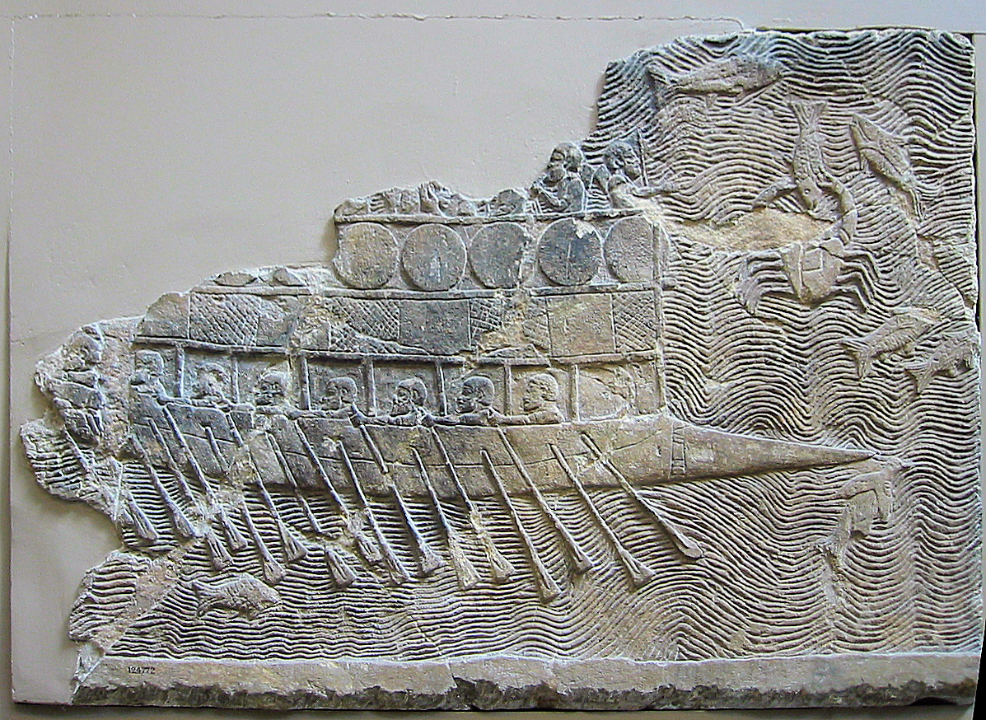
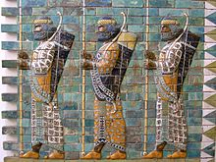
Xerxes’ Expedition: Numbers
As nobody has left a record, I cannot state the precise number of men provided by each separate nation, but the grand total, excluding the naval contingent, turned out to be
1,700,000.
The counting was done by first packing 10,000 men as close together as they could stand and drawing a circle round them on the ground; then they were dismissed, and a fence, about navel-high, was constructed round the circle; finally other troops were marched into the area thus enclosed and dismissed in their turn, until the whole army had been counted. 7.60
The Fleet:
c. 1,207 triremes
3,000
including smaller ships
7.89 + 7.97
In chapters 7.61-100, Herodotus gives a detailed breakdown of the different nations and their equipment.
‘My final estimate is that Xerxes, the son of Darius, reached Thermopylae at the head of an army consisting in all of
5,283,220men
7.186
Provision dumps were formed in advance for the troops ‘lest either men or animals should go hungry on the march to Greece’. e.g. at Doriscus and Eion. 7.25
I am not surprised that with so many people and so many beasts the rivers sometimes failed to provide enough water; what does amaze me is that the food never gave out. 7.187

Slide 7
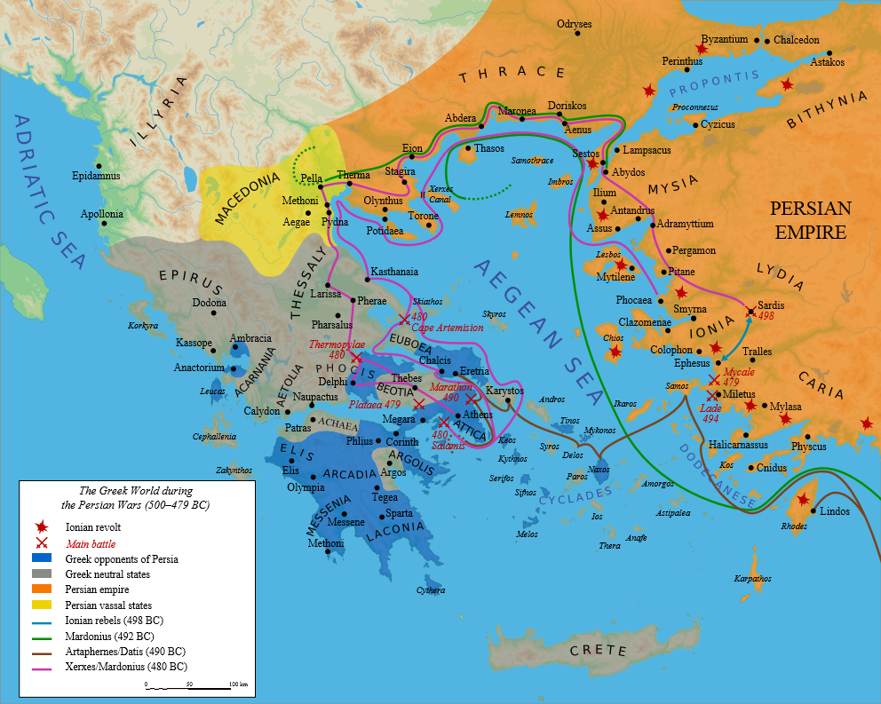
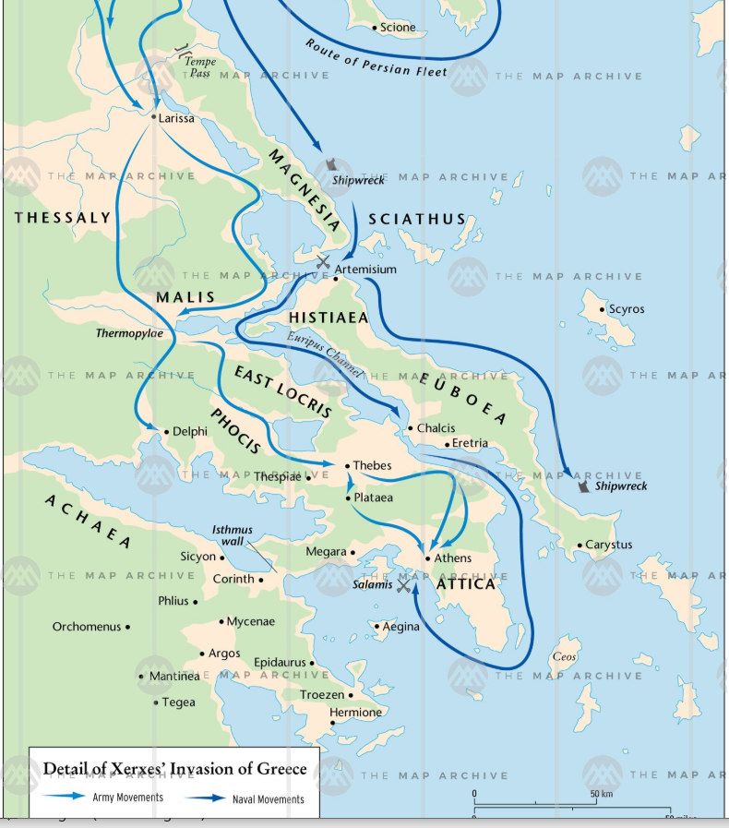
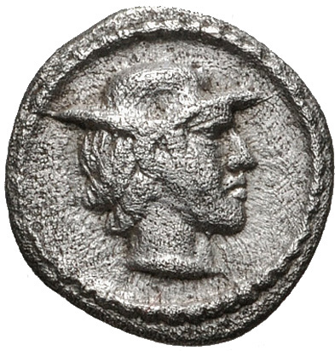
The Thessalians did not submit to Persia until they were compelled. The intrigues of the Aleuadae were not to their liking. No sooner had the news reached them of the imminent crossing of the Persian army into Europe than they sent representatives to the Isthmus. 7.172
Where to make a stand?
The army had not been in Tempe many days when a messenger arrived from Alexander, son of Amyntas, in Macedonia, advising the Greek troops not to stay in the pass to be trampled underfoot. The advice seemed to be sound and was clearly offered in a friendly spirit. 7.173
Option A: Thessaly
Fellow countrymen, in order to save Thessaly and the rest of Greece, it is necessary to defend the passage past Mt Olympus. We are ready to assist you in the defence of this vital pass, and you, for your part, must send a strong force. 7.172
Option B: Thermopylae and Artemisium
I think myself what persuaded them to go was the alarm they felt upon learning that there was another way into Thessaly – near the town of Gonnus – the pass, in fact, by which Xerxes’ army actually did come.’
Option C: The Isthmus
The Greeks sent 10,000 hoplites by sea to Thessaly to defend Tempe, the pass between Mt Olympus and Mt Ossa. The Spartans were commanded by Euanetus, the Athenians by Themistocles.

Slide 8
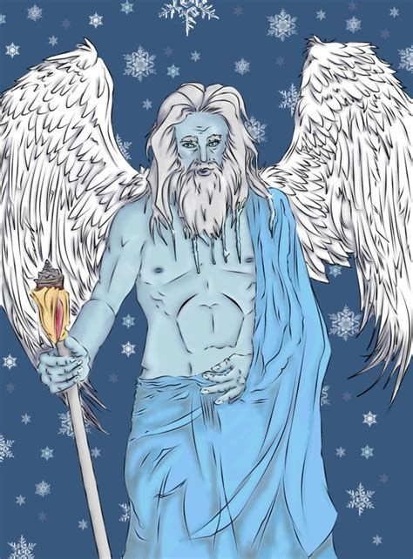
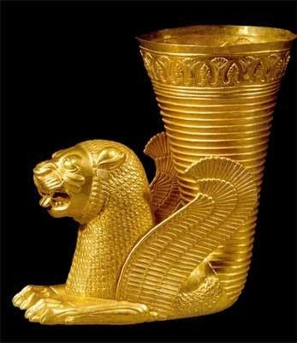
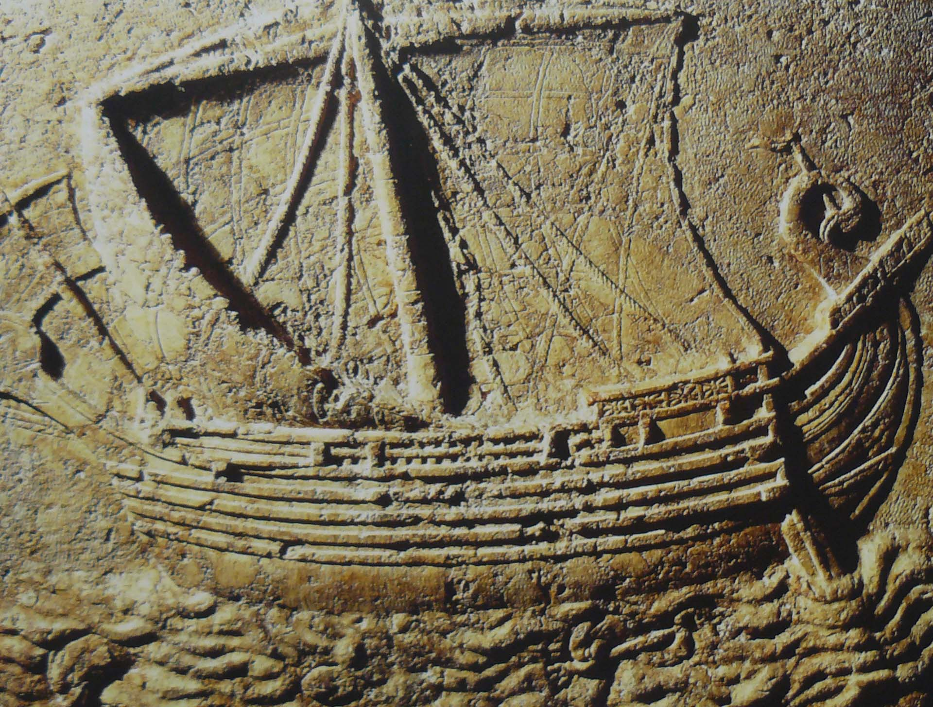
400 Persian ships lost 7.188-189
Boreas, god of the icy north wind
The Persian fleet, as I have mentioned, made the Magnesian coast and on its arrival the leading ships made fast to the land, while the remainder, as there was not much room on the short stretch of beach, came to anchor and lay off-shore in lines, eight deep.
However, it proved a very good thing for a certain Magnesian named Ameinocles,
for he picked up a large number of gold and silver drinking cups, which were washed ashore, and found Persian treasure-chests containing more gold, beyond counting. 7.190
At dawn next day the weather, which was clear and calm, suddenly changed and the fleet was caught in a heavy blow from the East – a ‘Hellespontian’ as the people there call it – which raised a confused sea like a pot on the boil.
There is a story that the Athenians had called upon Boreas to help them, in consequence of another oracle, by which they were advised to
‘ask the assistance of their son-in-law.’
So when they observed from their station at Chalcis in Euboea that a storm was coming, they offered sacrifice to Boreas and Orythuia and begged them to come to their aid and repeat the former disaster at Athos by once again destroying the Persian fleet. On their return home they built him a shrine by the river Ilissus.
400 ships, at the lowest estimate, are said to have been lost in this disaster, and the loss of life and treasure was beyond reckoning.

Slide 9
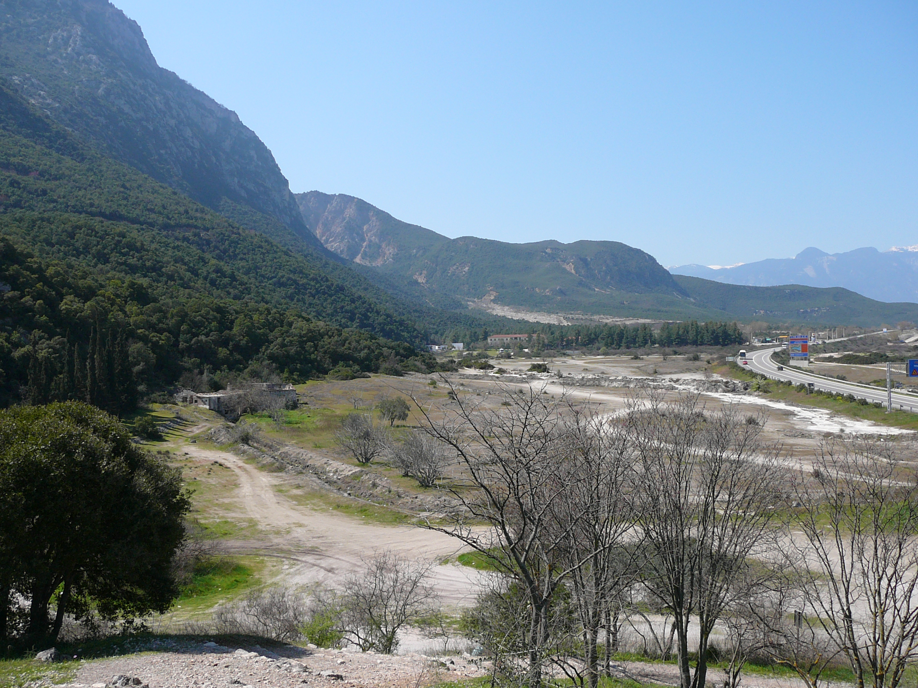
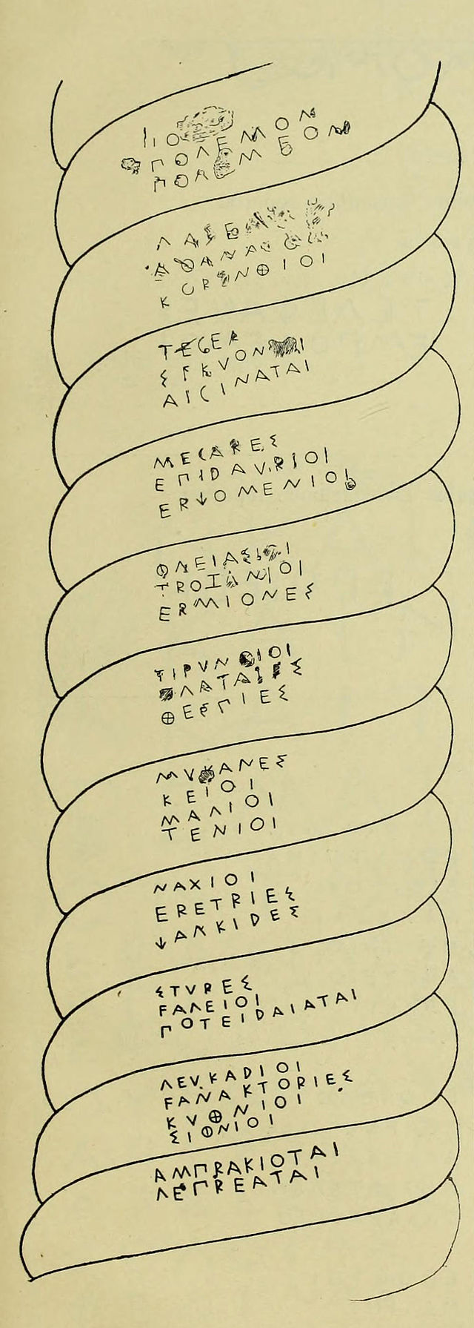
Greek forces at Thermopylae
Four thousand here from Pelops’ Land
Against three million once did stand. 7.228
300 Spartans
all with sons
The other Spartan troops were waiting for the Carneia to end 7. 206.
Demaratus estimates the number of Spartan warriors back home as 8,000 when talking to Xerxes after the battle. 7.234.
I put his name on record as the guilty one. 7.214
500 from Tegea
500 from Mantinea
400 from Corinth
7,000 from Thespiae
All the
Locrians
over 2,000 Boeotians
After Ephialtes betrayed the Greeks, all were dismissed except the Boeotians and Spartans
1,120 from all Arcadia
200 from Phlius
80 from Mycenae
400 from Thebes
1,000 from Phocis
i.e. 3,100 Peloponnesians
The ‘Hellenic League’
7.145 and 7.207
‘At the conference of the Greek states who were loyal to the general cause, guarantees were exchanged, and the decision was reached that the first thing that must be done was to patch up their own quarrels and stop any fighting which happened to be going on amongst members of the confederacy.’ 7.145
When the enemy army was near the pass,
‘The Greeks, suddenly doubting their power to
resist, held a conference to consider the advisability of retreat (to the Isthmus). When the Phocians and Locrians expressed their indignation at this suggestion, Leonidas gave his vote for staying
where they were. 7.207 (See also 8.4)
Especially Athens and Aegina.

Slide 10
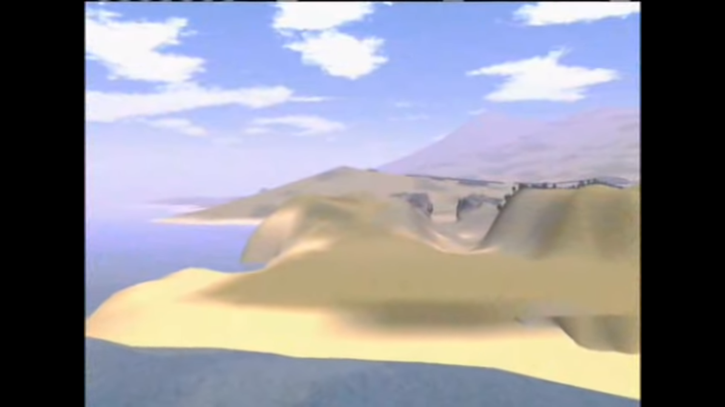
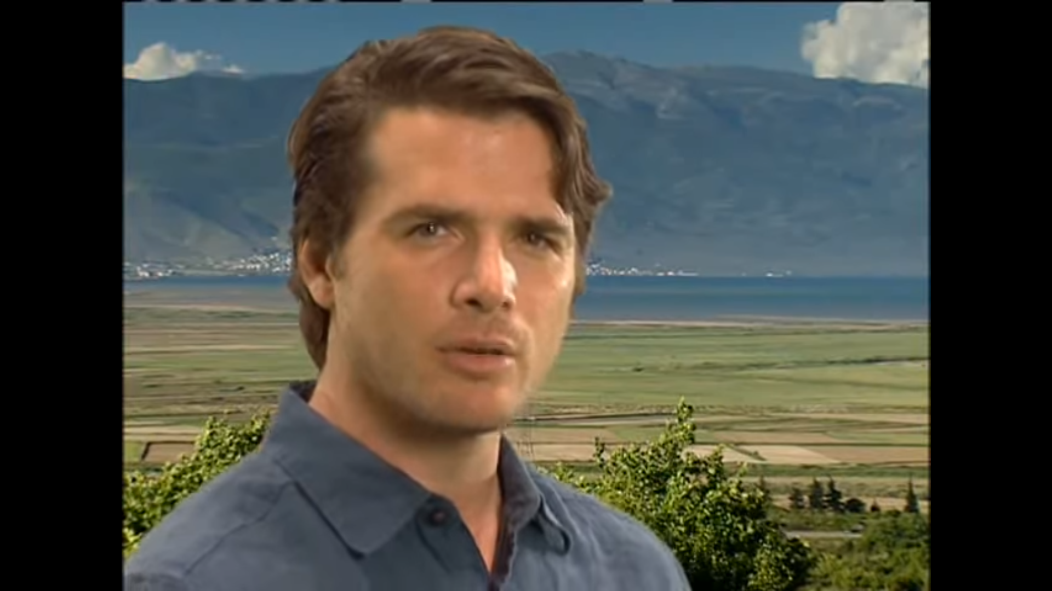
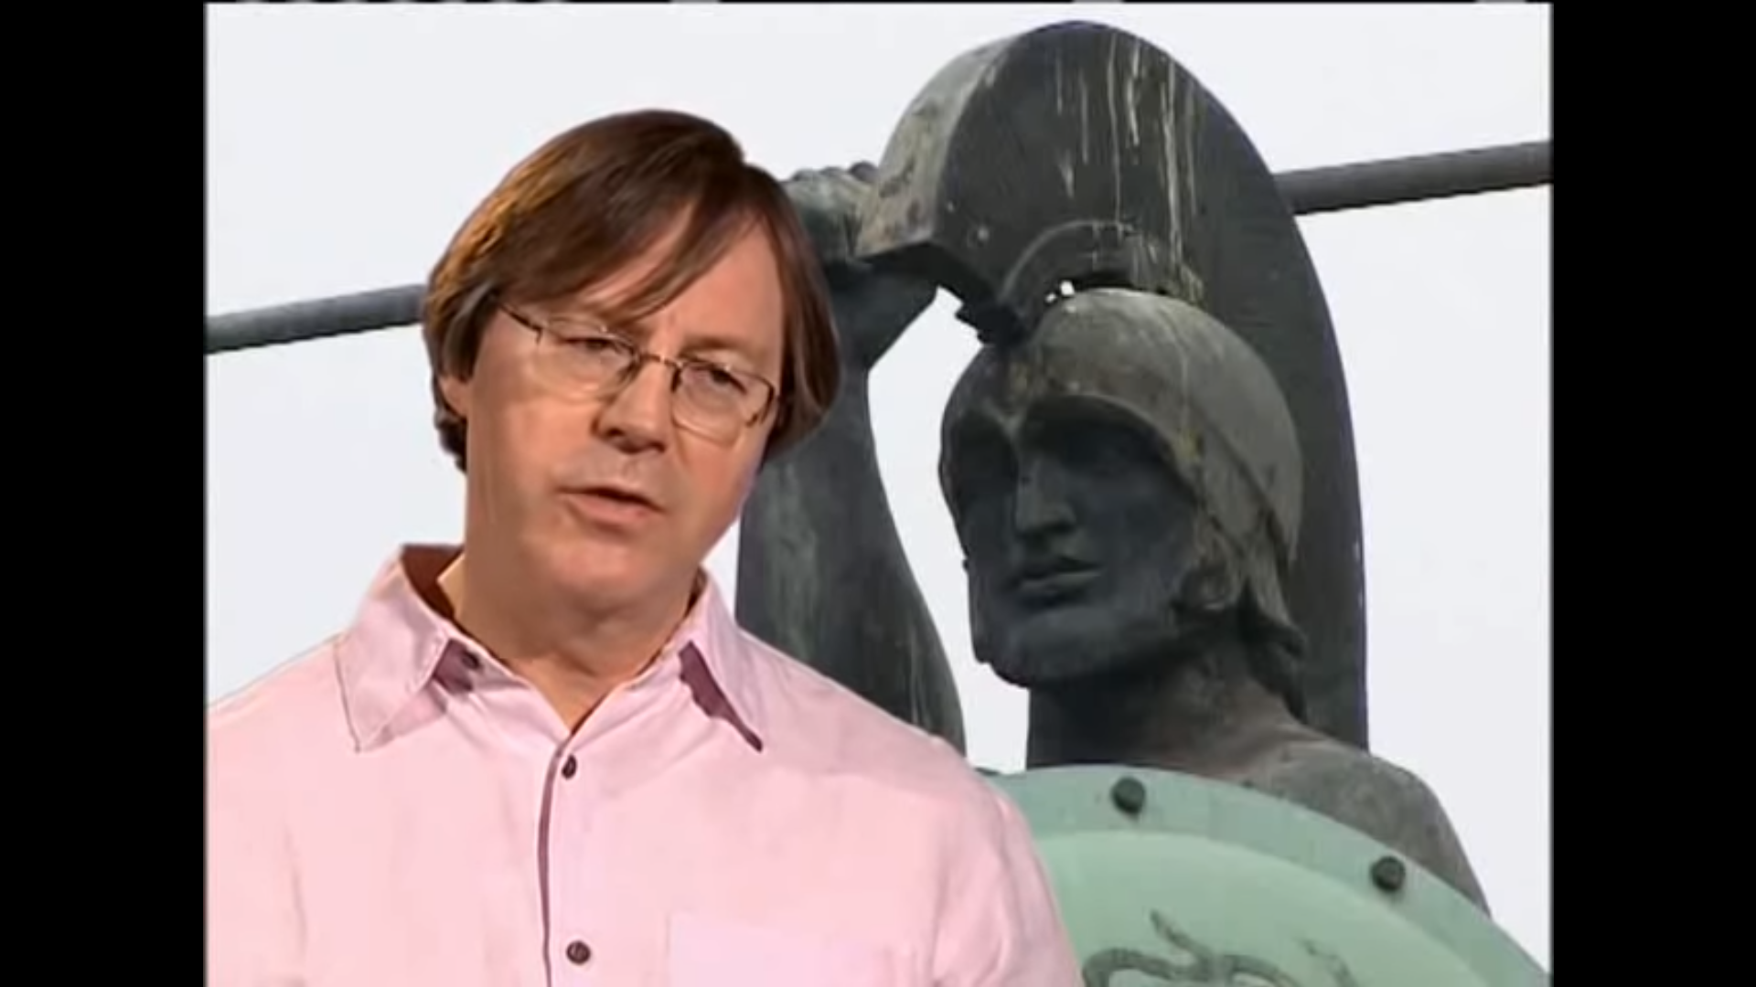
The Battle of Thermopylae 7.207-234
Four thousand here from Pelops’ land
Against three million once did stand.
Go tell the Spartans, you who read,
We took their orders and here lie dead.
Simonides
Here lies Megistias.
He scorned to save
Himself, but shared
The Spartans’ grave.
Decisive Battles, Presented by Matthew Settle (22 minutes)

Slide 11
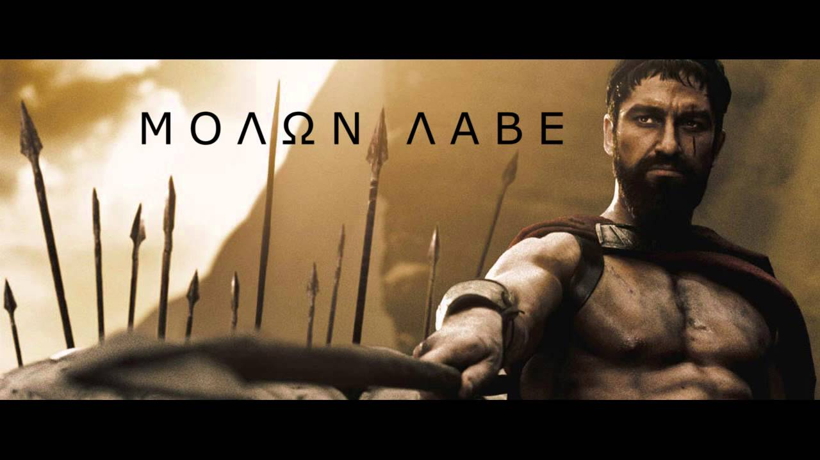
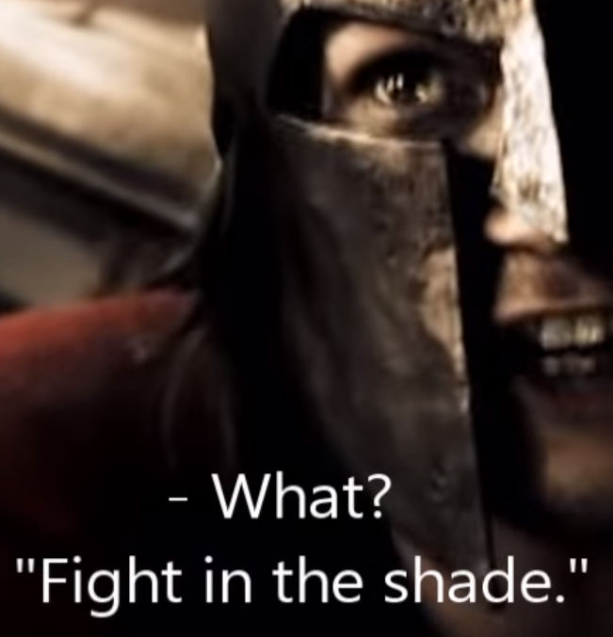
  When Xerxes wrote again, ‘Hand over your arms,’ he wrote in reply, ‘Come and take them.’
Demaratus in his various interviews with Xerxes feeds the Spartan myth, e.g. the combing of their hair before battle. 7.209
Herodotus records Dieneces’ witticism
and award for bravery. 7.226.
  Plutarch records the exchange in a collection of sayings by Leonidas before the Battle of Thermopylae ( 51.2–15).

Slide 12
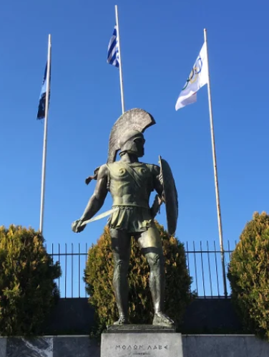

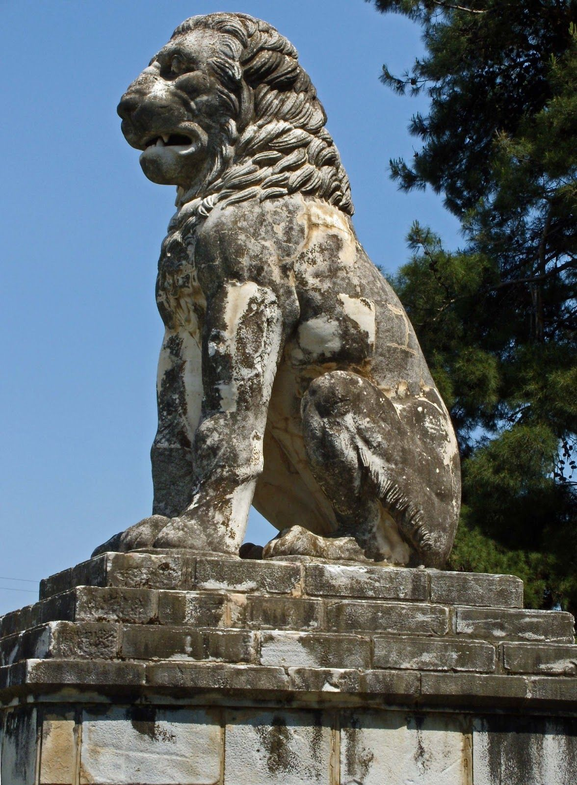
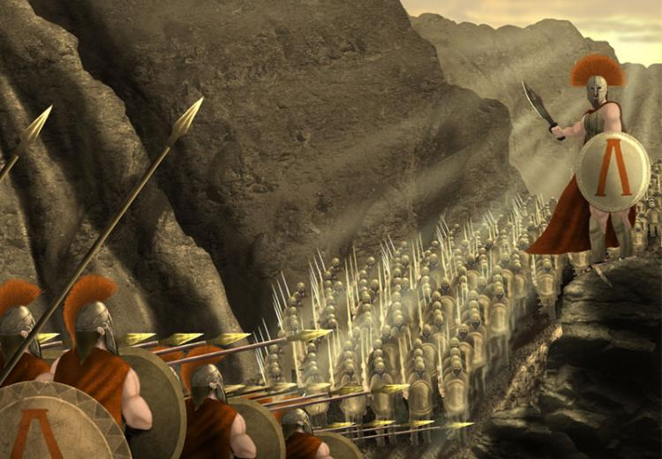

The death of Leonidas was believed to have fulfilled the oracle quoted at 7.220, thereby saving Sparta from being sacked.
LEONIDAS
Xerxes went over the battlefield to see the bodies, and having been told that Leonidas was king of Sparta and commander of the Spartan force, ordered his head to be cut off and fixed on a stake. 7.238
This is my opinion is the strongest evidence – though there is plenty more – that King Xerxes, while Leonidas was alive felt fiercer anger against him than against any other man; had this not been so, he would never have committed this outrage upon his body; for normally the Persians, more than any other nation I know of, honour men who distinguish themselves in war.’ 7.238
Plutarch in On the Malice of Herodotus denounces him as a philobarbaros, a lover of barbarians.
Xerxes’ sense of disgrace is also evident in his attempting to hide the number of the dead: of the 20,000 fallen, all but 1,000 were buried in in trenches. He then invited his forces to see ;how the king fights against the madmen who thought they could beat him’ 7.24
c.f. Pytheas honoured 7.181
The trireme from Aegina gave the Persians some trouble. One of the soldiers on board – Pytheas – distinguished himself that day; for after the ship was taken, he continued to resist until he was cut to pieces. At last he fell, but as there was still breath in his body, the Persians did all they could to save the life of so brave a man, dressed hi wounds with myrrh and bound them up with linen bandages. On returning to their base, they exhibited their prisoner admiringly to everyone there, and treated him with much kindness.’ 7.181
The Spartan system of two kings was hereditary. The Agiad son of Leonidas and Gorgo, Pleistarchus, was too young to rule and Pausanias acted as regent until c.470. Pleistarchus then ruled until 458.
‘Xerxes’ ludicrous attempt to conceal the number of his own dead deceived no-one. For on one side 1,000 corpses lay scattered, and on the other side were the 4,000 all lying together in the same spot.’ 7.25

Slide 13
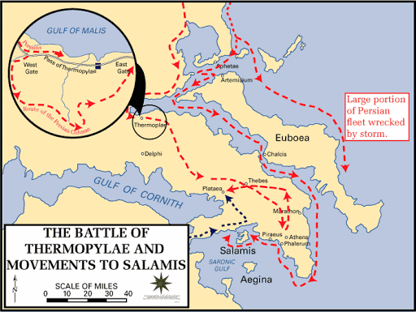
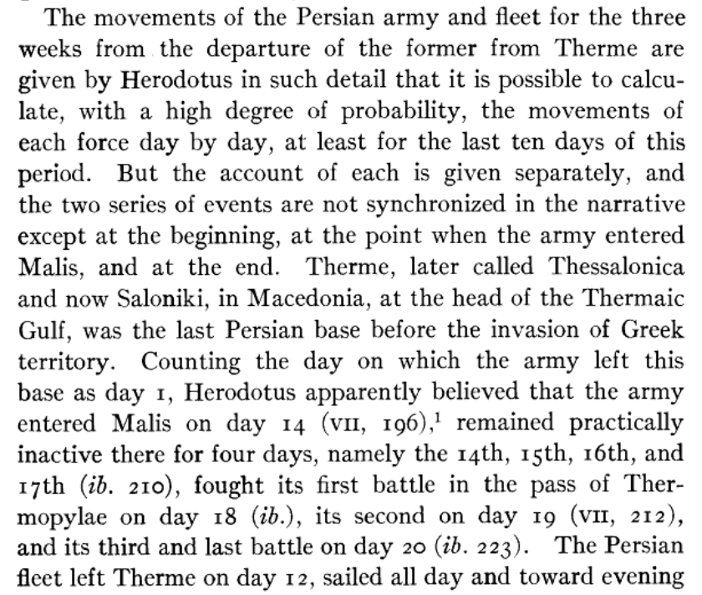
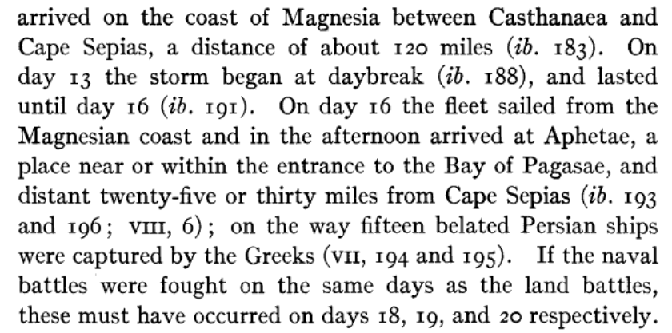
5,283,220 men 7.186
1,207 warships 7.89
William Kelly Prentice
400 lost in the storm of Magnesia 7.188-189
15 captured 7.194-6
Greek fleet: 271 ships 8.1
147 Athenian
c.5,000 men 8.1
200 ships 8.7
20,000 Persian casualties
4,000 Greek casualties
Xerxes’ brother Achaemenes speaks of the loss of 400 ships when he opposes Demaratus’suggestion to send 300 ships and take Cythera. 7.235-6

Slide 14
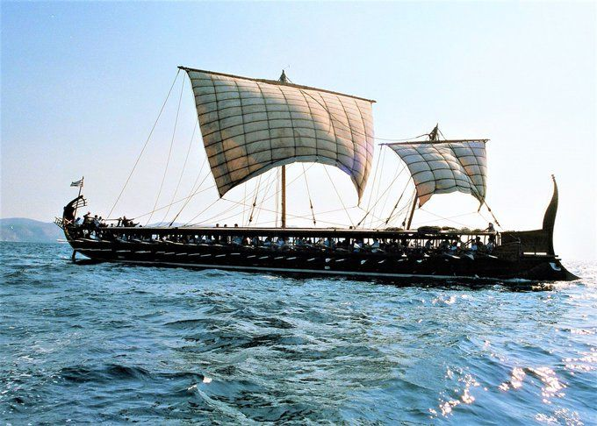
Greek forces at Artemisium
20 ships from Megara
12 ships from Sicyon
8 ships from Epidauros
7 ships* from Locrians
7 ships from Eretria
5 ships from Troezen
4 ships* from Styra
2 ships from Ceos
Total:
271 triremes
(*excluding penteconters)
147 ships from Athens
20 manned by Chalcis
others by Plataeans.
40 ships from Corinth
‘When the Greeks on their arrival at Artemisium found a large Persian fleet lying at Aphetae … they were seized by panic, and began to consider abandoning Artemisium. This greatly alarmed the Euboeans.’ 8.4
18 ships from Aegina
10 ships from Sparta
Note the parallel with indecision at Thermopylae 7.207

Slide 15
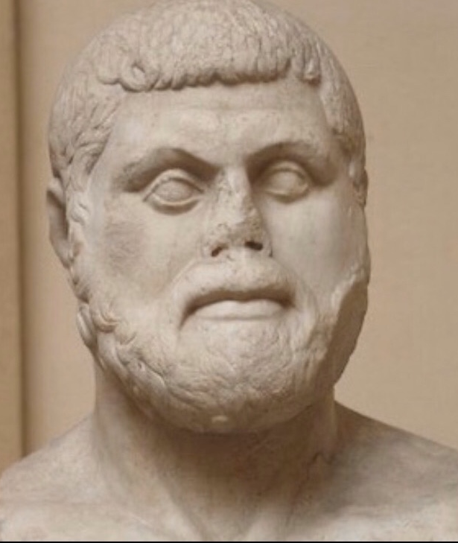
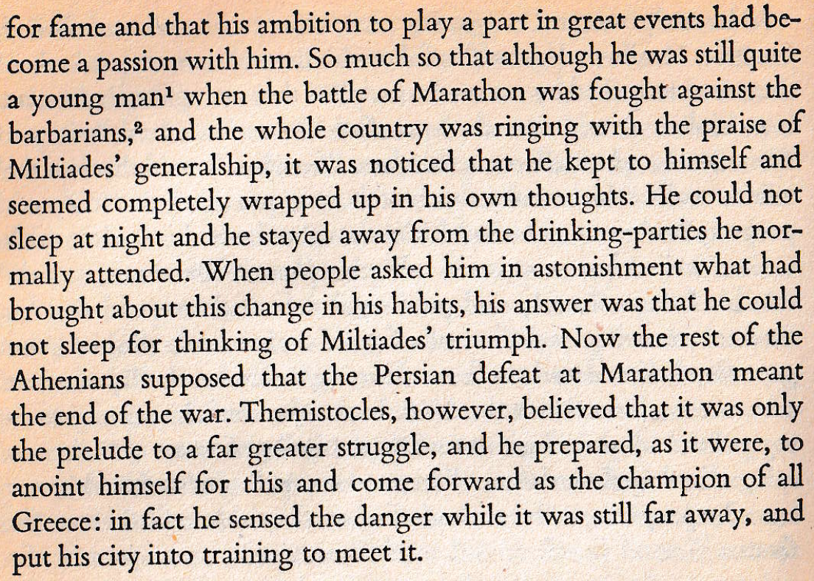
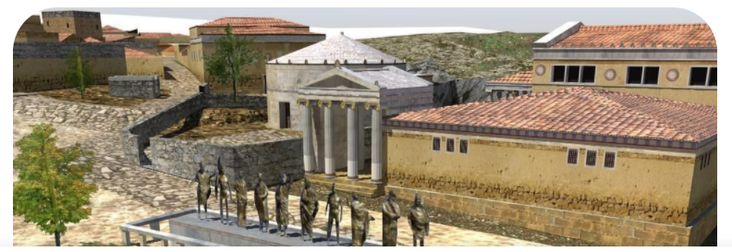
Themistocles
Plutarch’s Life of Themistocles Extracts from Chapters 3-9
A
Praise of Athens: 7.139
Key moments in Herodotus’ account before Salamis:
Wooden Walls and silver from Laurion. 7.143 and 144.
Athenian acceptance of the Spartan Eurybiades as overall commander 8.3.
Euboean bribe (30 talents) used to win over Eurybiades (5 talents) and Adeimantus (3 talents) not to leave Artemisium. 8.4-5.

Slide 16
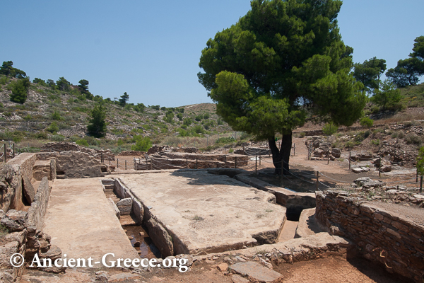
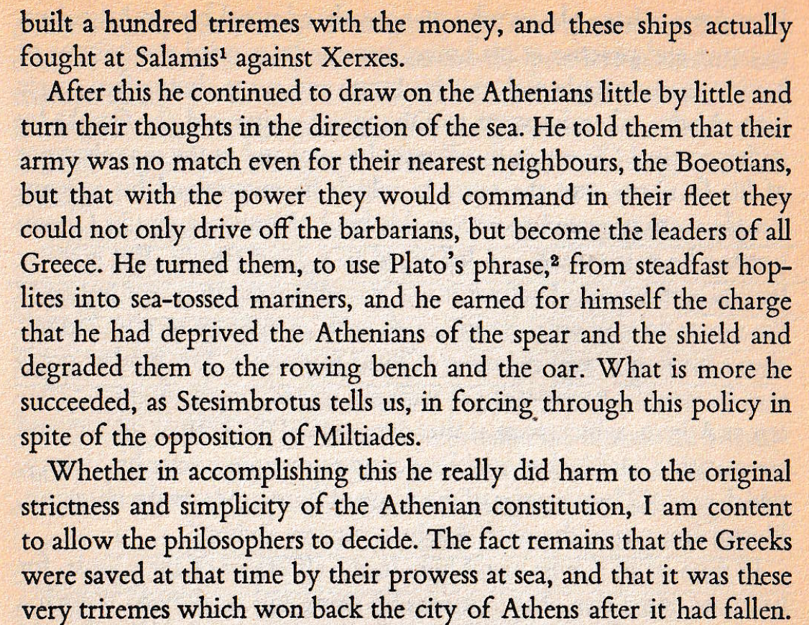
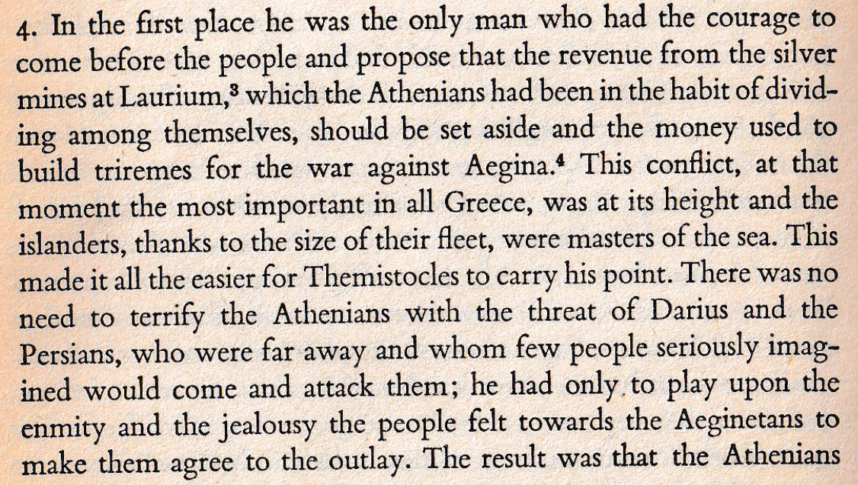
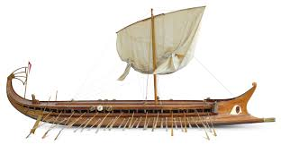

Slide 17
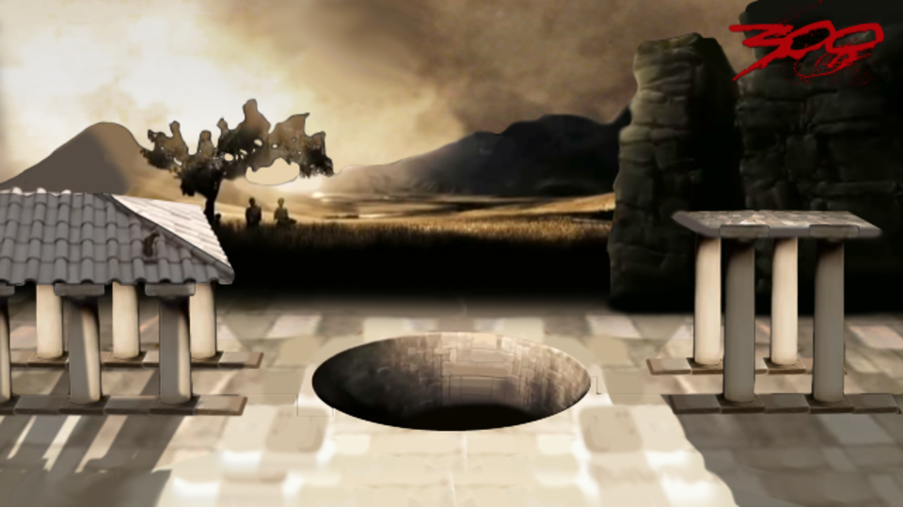
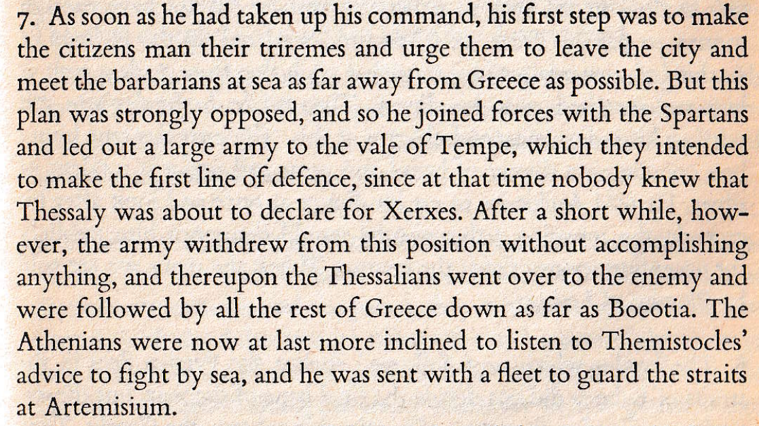
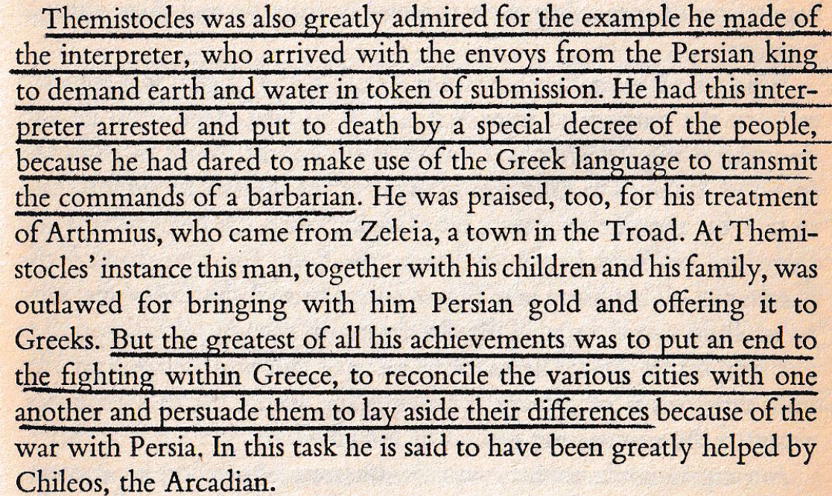
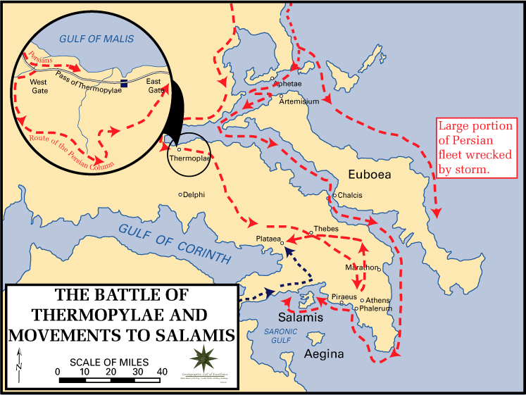
Would you agree that Greek unity was the most important factor in the ultimate defeat of Xerxes’ invasion?

Slide 18
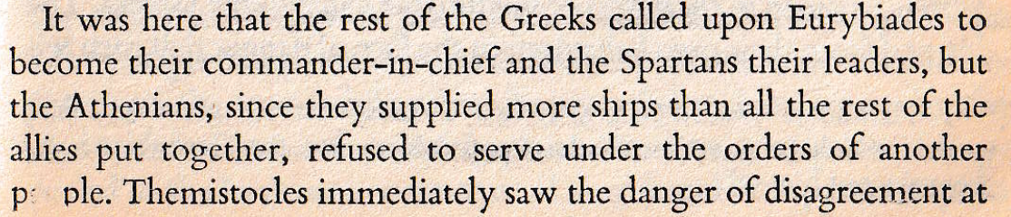
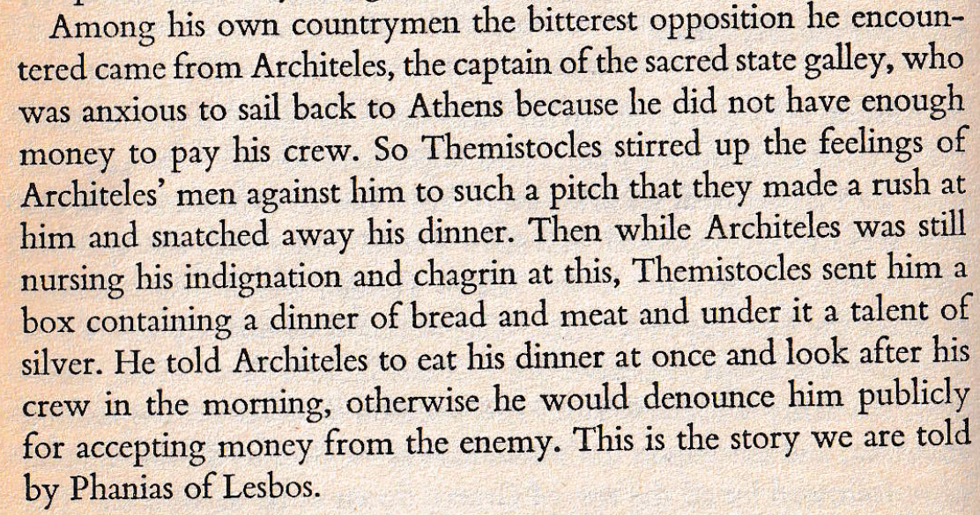
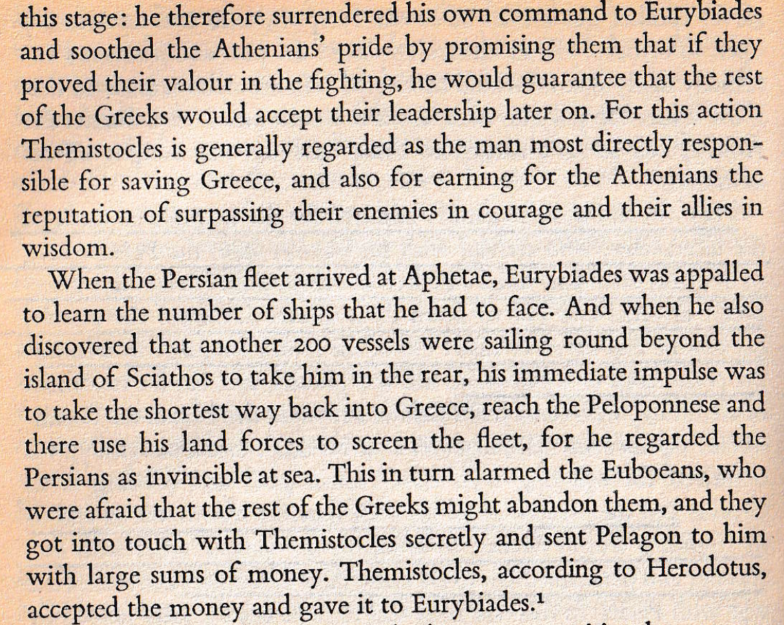


According to Herodotus 8.5, Herodotus gave Eurybiades 5 talents, Adeimantus the Corinthian 3 and kept the other 22! A talent is worth 6,000 drachmas and is enough to pay a trireme crewfor 1 month.
Pindar c.518-438BC

Slide 19



Slide 20

Theban Medizing after Thermopylae
Last stand at the Isthmus?
‘The Thebans were compelled to make some show of resistance to the enemy, but as soon as they saw that things were going in favour of Persia, they took the opportunity of Leonidas’ hurried retreat to the little hill where his last stand was made, to detach themselves from his force; they then approached the enemy with outstretched hands, crying out that in their zeal for the Persian interest they had been amongst the first to give earth and water to the king, and had no share for the injury done him, because they had come to Thermopylae against their will.’ 7.233
(The Thebans’ lives were spared, but they were branded)
Persian advance through Boeotia and Attica
The march of the Persian army from the Hellespon to Attica had taken 3 months – and the crossing of the strait an additional one. 8.51
‘While discussions (about where to make a stand) were taking place, a man arrived from Athens with the news that the Persians had entered Attica and were firing the whole country.
‘This was the work of the division of the army under Xerxes which had taken the route through Boeotia; they had burned Thespia after the inhabitants had escaped to the Peloponnese, and Plataea, too, and then entered Attica, where they were causing wholesale devastation.’
‘The Thebans had told them that Thespia and Plataea had refused to submit to Persian domination: hence their destruction. 8.50

Slide 21


The god is well able to guard his own 8.36-9
The news of the approach of the Persians caused consternation at Delphi; and in their terror the people asked the god’s advice as to whether they should bury the sacred treasures or get them out of the country. The god replied that they were not to be disturbed, for he was well able to guard his own. 8.36
Just as the Persians came into the shrine of Athene Pronaea, thunderbolts fell on them from the sky, and two pinnacles of rock, torn from Parnassus, came crashing and rumbling down amongst them, killing a large number, while at the same time there was a battle cry from inside the shrine. All these things happening together caused panic amongst the Persian troops. They fled. 8.37-8
There is a story, I have learned, amongst those who got away: they saw, so they said, two gigantic hoplites. According to the Delphians they were local heroes… 8.38
The rocks that fell from Parnassus were still there in my time, where they embedded themselves after crashing through the Persians.

Slide 22

Bad prophecies for Athens
Why sit you, doomed ones? Fly to the world’s end! 7.140
The Athenians had sent envoys to Delphi to ask for advice. The first response filled them with fear and dismay.
Zeus all-seeing grants
to Athena’s prayer that
THE WOODEN WALL ONLY SHALL NOT FAIL,
but help you and your children. 7.141
They asked the goddess for something less menacing …
When the oracle was made public, there were two interpretations:
… but others thought that by this expression the god indicated the ships. 7.142
some of the older men supposed that the prophecy meant the Acropolis, fenced in the old days with a thorn hedge.
Themistocles called Neocles’ son now came forward…. He advised his countrymen to prepare at once to meet the invader at sea. 1.143

Slide 23

The Wooden Wall only shall not fail 7.141-3

Slide 24





Plutarch, Life of Themistocles 5
‘When the entire city was thus putting out to sea, the sight provoked pity in some, and in others astonishment at the hardihood of the step; for they were sending off their families in one direction, while they themselves, unmoved by the lamentations and tears and embraces of their loved ones, were crossing over to the island where the enemy was to be fought. Besides, many who were left behind on account of their great age invited pity also, and much affecting fondness was shown by the tame domestic animals, which ran along with yearning cries of distress by the side of their masters as they embarked.
Evacuation to Salamis
Cimon, son of Miltiades
Plutarch, Life of Cimon, 5
‘When the Medes invaded Greece and Themistocles was urging the people to hand over their city, abandon their country, mobilize their forces on board the fleet off Salamis, and
fight out the issue at sea,
the majority shrank from the audacity of his scheme.
Xanthippus’ dog
Plutarch, Life of Themistocles, 6
[6] A story is told of one of these, the dog of Xanthippus the father of Pericles, how he could not endure to be abandoned by his master, and so sprang into the sea, swam across the strait by the side of his master's trireme, and staggered out on Salamis, only to faint and die straightway. They say that the spot which is pointed out to this day as ‘Dog's Mound’ is his tomb.
‘Cimon was the first to set a public example and cheerfully led a procession of his comrades up to the Acropolis. He carried in his hands a horse’s bridle to offer to the goddess in token of the fact that what the city needed at that moment was men to fight at sea.’
‘Cimon was as brave as Miltiades and as intelligent as Themistocles.
His physical presence, according to the poet Ion of Chios (484-424BC)
was imposing, too, for he was tall with a thick and curly head of hair.’

Slide 25


Herodotus 7.139: ‘Greece was saved by the Athenians’
(On the futility of the plan to fortify and defend the Isthmus, see Demaratus’ advice to Xerxes to send a fleet of 300 and capture Cythera.
‘If you take my advice, the Isthmus and the Peloponnesian towns will fall into your hands without a blow.’ 7.235
^{Her.VII} 139 At this point I find myself compelled to express an opinion which I know most people will object to; nevertheless, as I believe it to be true, I will not suppress it. If the Athenians, through fear of the approaching danger, had abandoned their country, or if they had stayed there and submitted to Xerxes, there would have been no attempt to resist the Persians by sea; and, in the absence of a Greek fleet, it is easy to see what would have been the course of events on land.
However many lines of fortification the Spartans had built across the Isthmus, they would have been deserted by their confederates; not that their allies would have willingly deserted them, but they could not have helped doing so, because one by one they would have fallen victims to the Persian naval power. Thus the Spartans would have been left alone – to perform great deeds and to die nobly. Or, on the other hand, it is possible that before things came to the ultimate test, the sight of the rest of Greece submitting to Persia might have driven them to make terms with Xerxes. In either case the Persian conquest of Greece would have been assured; for I cannot myself see what possible use there could have been in fortifying the Isthmus if the Persians had command of the sea.
In view of this, therefore, one is surely right in saying that Greece was saved by the Athenians. It was the Athenians who held the balance: whichever side they joined was sure to prevail. It was the Athenians, too, who, having chosen that Greece should live and preserve her freedom, roused to battle the other Greek states which had not yet submitted. It was the Athenians who – after the gods – drove back the Persian king. Not even the terrifying warnings of the oracle at Delphi could persuade them to abandon Greece; they stood firm and had the courage to meet the invader.
‘We should not overlook, however, the obvious conclusion to be drawn from Herodotus’ remarks: that most people thought that the Spartans had saved Greece in the Persian Wars.’ (Marincola)

Slide 26



The Sack of Athens 8.51-55
The Persians found Athens itself abandoned except for a few people in the temple of Athene Polias. It was partly their poverty which prevented them seeking shelter in Salamis with the rest, and partly their belief that the Wooden Wall, in their minds, was not the ships but the barricade, and that would save them.
The Persians who had got up first made straight for the gates, flung them open and slaughtered those in sanctuary. Having left not one of them alive, they stripped the temple of the treasures and burnt everything on the Acropolis.
Xerxes, now absolute master of Athens, dispatched a rider to Susa with news for Artabanus of his success. 8.54
The olive tree was the sacred gift offered by Athene in the contest between her and Poseidon for patronage of the city.
On the following day he summoned the Athenian exiles who were serving with the Persian forces, and ordered them to go up onto the Acropolis and offer sacrifice according to Athenian usage. When the Athenians went up to that sacred place. they saw that a new shoot 18” long had sprung from the stump. They told the king of this. 8.55

Slide 27



What was the significance of the battles of Thermopylae and Artemisium?
Significance to Xerxes and his expedition?
Significance to the Greek City States?
Immediate
Significance
Did Xerxes achieve his goal of sacking Athens?
Did the Greeks stop Xerxes’ advance?
What happened to Delphi (8.36-39) and Athens?
Did the two battles contribute significantly to the Greeks’ ultimate success in defending their freedom and independence?
Longer Term
Significance
Did Xerxes achieve his longer term ambitions of extending the boundaries of his empire into Europe?
What were the material losses?
What experience was gained?
Did the battles have a significant impact on numbers, supply lines, strategy or morale?
What did the ‘Hellenic League’ achieve?
What was the significance of Leonidas’ personal contribution?
Lasting
Significance
Why is this victory remembered and still considered so significant by some modern thinkers?
https://www.youtube.com/watch?v=2ba2ZinGLl4
https://www.youtube.com/watch?v=2zqy21Z29ps

Slide 28

How simplistic an explanation is this of why the Greeks were ultimately victorious?

Slide 29

2020 Two Euro Coin commemorating
the 2,500th anniversary of the Battle of Thermopylae
The first known photograph of the magnificent statue of Moschophoros, (‘The Calf Bearer’) discovered on the Acropolis in 1864. The statue, dated to c. 560 BC originally measured 1.65 meters (5.4 feet) in height, is now in the Acropolis Museum. To the right is the ‘Critias Boy’, dated to c.

